Slide 1
Step by Step Instruction: How to Plan a Breakfast Menu Professional Standards Learning Code 1100 Length: 1.5 hours
Released March 2016 – Updated July 2022
“How to Plan a Breakfast Menu” is intended for the School Food Authorities in the State of Arizona. All regulations are specific to operating the School Breakfast Program under the direction of the Arizona Department of Education.

Slide 2
Step by Step Instruction: How to Plan a Breakfast Menu
Intended Audience and Content
This How-To-Guide is intended for School Food Authorities (SFAs) operating the School Breakfast Program (SBP) who plan menus and ensure menus meet the SBP meal pattern.
The following slides will only cover how-to instructions for planning a weekly breakfast menu. All crediting statements for grains and meat/meat alternates are fictional for the purposes of illustrating the process of how to plan a breakfast menu.

Slide 3
Step by Step Instruction: How to Plan a Breakfast Menu
Objectives
At the end of this training, attendees should be able to:
read the Meal Pattern Chart;
plan meals that meet the daily requirements;
review the weekly menu to ensure it meets the weekly requirements.

Slide 4
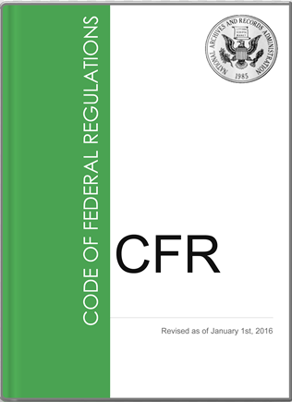
Step by Step Instruction: How to Plan a Breakfast Menu
The instruction within this How-To-Guide is based on guidance from the Code of Federal Regulations (CFR), §220.8 Meal requirements for breakfast.
It is recommended to review the information under the Meal Patter accordion on ADE’s NSLP and SBP Webpage for additional help understanding the guidance in the CFR.

Slide 5
Comprehension Check Questions
Throughout this guide there will be comprehension quiz questions to test your knowledge and help you apply what you've learned.
Be sure to review these quiz questions and the answers, available within the guide.
This icon will indicate a comprehension quiz question, and the background of the slides will be a light pink like you see on this slide.

Slide 6
Step by Step Instruction: How to Plan a Breakfast Menu
The Step-by-Step Instruction will review:
The following slides will only cover the basics of how to plan a breakfast menu and all food items used are examples only. All crediting statements for grains and meat/meat alternates are fictional for the purposes of illustrating the process of how to plan a breakfast menu.
Background and Definitions | Slides 7-10
How to Read the Meal Pattern Chart | Slides 11-22
Planning the Menu to Meet Daily Requirements | Slides 23-74
Check to Make Sure the Menu Meets the Weekly Requirements | Slides 75-83
Dietary Specifications | Slides 84-86
Breakfast Menu Planning Recap | Slides 87-91

Slide 7
Background and Definitions

Slide 8
Background
In 2010, Congress passed the Healthy, Hunger-Free Kids Act (HHFKA), which revised the meal pattern for the National School Lunch Program (NSLP) and the School Breakfast Program (SBP).
All SFAs who participate in the NSLP and SBP are required to serve meals that meet these meal pattern guidelines in order to receive reimbursement funds for the meals served.
This how-to-guide will review how to plan a weekly menu that meets the breakfast meal pattern requirements.

Slide 9
Definitions
Component- is one of five food groups that can comprise a reimbursable meal. These are: fruits, vegetables, grains, meat/meat alternate, and fluid milk.
Nutrient Specification- the minimum (and sometimes maximum) amount of a specific nutrient that is in the meal/food offered.
Grade Group- the range of grades for which the component and nutrient specifications applies to when planning a reimbursable menu.
Reimbursable Menu- A menu made available to all students, that offers the daily minimum and weekly requirements of the SBP meal pattern.
Reimbursable Meal- A meal that a student has at the point of service that will be claimed for reimbursement if it contains the required items from the reimbursable menu.
Serve Only- a meal service option where all participating students receive all planned items in the required amounts.
Offer Versus Serve- a meal service option that allows participating students the option to decline some of the food offered when choosing a reimbursable meal.
Point of Service- The point in a food service operation where a determination can be accurately made that a reimbursable free, reduced-price, or paid meal has been served to an eligible child.

Slide 10
Meet your leader!
Hi! I’m Chef Sonny and I will be leading you through this Menu Planning Guide.
Look for me to provide details about each step of this process! We’ll be going through how to plan a breakfast menu to meet the daily and weekly requirements.

Slide 11
How to Read the
Meal Pattern Charts

Slide 12
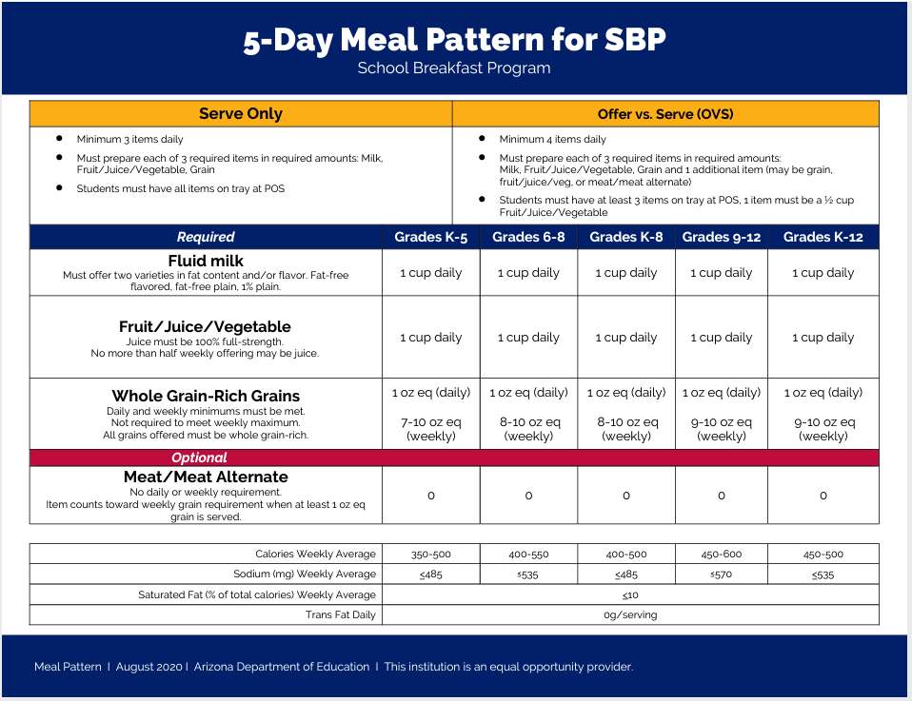
SBP Meal Pattern Overview
The SBP Meal Pattern charts are housed on the NSLP and SBP webpage under the ‘Meal Pattern’ accordion.
All SBP Meal Pattern charts are combined into one packet.
There are 3-day, 4-day, 5-day, 6-day, and 7-day meal pattern charts for SFAs to choose from based on the number of operating days in a week.

Slide 13
SBP Meal Pattern Overview
Now that you’ve printed the chart that meets your menu planning needs, let’s get a bit more specific.
Circle the number of days you’re planning for. As you can see, I will be planning for a
5-Day week throughout this guide.

Slide 14
SBP Meal Pattern Overview
This chart also provides an explanation of the requirements for Serve Only or Offer Versus Serve (OVS). However, these notes apply to what a meal looks like at the point of service, not what must be planned.
The topics of Serve Only and OVS will not be covered in this guide. We will only be reviewing how to plan a menu that meets the meal pattern. You can review the Offer Versus Serve Manual for further details about that meal service option.

Slide 15
SBP Meal Pattern Overview
Next, let’s look at the grade groups. The chart shows the required amounts for the different grade groups in each column. Circle the grade groups you’re planning for. As you can see, I will be planning for grades K-8 throughout this guide.

Slide 16
SBP Meal Pattern Overview
This chart shows you the weekly and daily requirements for each breakfast component. Notice that for breakfast, only fluid milk, fruit/juice/vegetables, and grains/breads are required. Meat/Meat Alternates are optional.

Slide 17
SBP Meal Pattern Overview
Here, I highlighted the requirements for the K-8 Meal Pattern.
For grains, the daily requirement is listed at the top of the box, and the weekly requirement is listed at the bottom of the box. This means I need to plan at least 1 oz eq daily, and at least 8 oz eq weekly.

Slide 18
SBP Meal Pattern Overview
Let’s pause to talk about meat/meat alternates at breakfast. They are not required, which is why the chart shows a 0 for each grade group. They are optional. If you choose to plan and offer a meat/meat alternate, the oz eq can be counted toward the weekly grain requirement.

Slide 19
SBP Meal Pattern Overview
It’s also important to note that if you choose to offer a meat/meat alternate, it can only be offered after you offer at least 1 oz eq of grain. This means you can plan toast (a grain) and yogurt (a meat/meat alternate), but you could not plan eggs (a meat/meat alternate) and yogurt (a meat/meat alternate).

Slide 20
SBP Meal Pattern Overview
This chart also shows the nutrient requirements that must be met. Notice that for calories, sodium and saturated fat, the requirements are based on the weekly average. This means that some days may be higher, and some days may be lower than the numbers listed, but the menu is in compliance as long as the weekly average meets these guidelines.
No trans fat is allowed for items planned for breakfast.

Slide 21
Comprehension Check
Which of the following is true about meat/meat alternates (i.e. eggs, yogurt, cheese, meat) in the breakfast meal pattern?
A meat/meat alternate must be planned every day.
Meat/meat alternates are not allowed to be served at breakfast.
Meat/Meat Alternates are optional and may be served in addition to a grain.
The only meat/meat alternate allowed at breakfast is yogurt.

Slide 22
Comprehension Check ANSWER
Which of the following is true about meat/meat alternates in the breakfast meal pattern?
A meat/meat alternate must be planned every day.
Meat/meat alternates are not allowed to be served at breakfast.
Meat/Meat Alternates are optional and may be served in addition to a grain.
The only meat/meat alternate allowed at breakfast is yogurt.
A grain must be planned every day. However, 1 oz eq of grains per day won’t be enough to meet the weekly minimum of 8 oz eq. Additional grains, or meat/meat alternates can be planned to meet the weekly requirement. Even so, meat/meat alternates cannot be counted as a grain unless at least 1 oz eq of grain is offered.

Slide 23
Planning the Menu to Meet the Daily Requirements

Slide 24
SBP Meal Pattern Overview
The first decision I made as the menu planner was which grade group I’m planning for.
Since my school has students in grades K-8, I am going to plan based on the K-8 grade group requirements. I could have chosen to plan 2 different menus: one for K-5 and one for 6-8. However, it will be easier for me and my staff if I plan using the K-8 requirements.

Slide 25
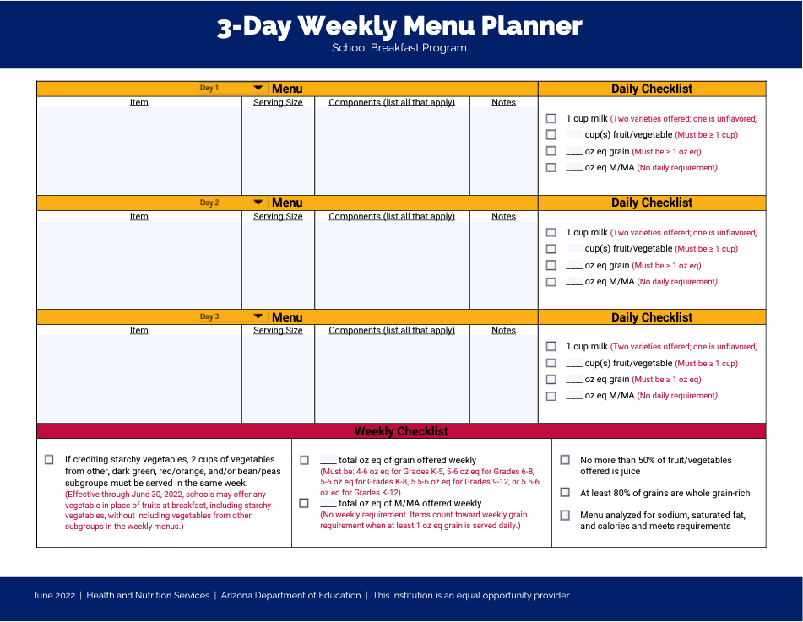
Getting Started
The Breakfast Weekly Menu Planner can be found on the NSLP and SBP – Program Forms and Resources webpage under the ‘Menu Planning’ accordion.

Slide 26
Grains
Let’s look more closely at the grain requirement.
The weekly range of 8-10 oz eq means I will have to offer at least 8 oz eq of grains over the course of the week. If I only serve 1 oz eq every day, I will only offer 5 oz eq throughout the week, and that won’t be enough to meet the weekly minimum requirement. I could plan 1 oz eq on some days, and 2 oz eq on other days to plan the correct number of grains.
The chart also reminds me that there is flexibility for the maximums. That means I could plan more than 10 oz eq grains, but I know that if I stay close to this maximum, I will be more likely to meet my nutrient specifications.
There’s also a reminder that at least 80% of all grains must be whole grain-rich. For an item to be considered whole grain, it must be made from at least 50% whole grain product, and the other 50% must be enriched grains.

Slide 27
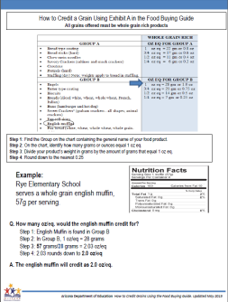
Entrée
MONDAY
Grain 1 slice of Whole Grain-Rich Toast (1 oz eq)
Now… What do I want to plan as my grain for Monday?
Toast is always great in the morning! I am going to plan 1 slice of toast as my grain on Monday.
I will refer to the nutrition facts label and the ingredient list to make sure the item is whole grain rich, and that it credits as 1 oz eq. ADE has great resources on their Meal Pattern webpage to help me with crediting and determining if a product is whole grain-rich. I love the Whole Grain Resource and ADE’s How to Credit Grains worksheet.

Slide 28
Comprehension Check
What resources are available to help you determine if your grain products meet the whole-grain rich requirements, and how they contribute to the meal pattern?
CNP Menu Certification in Common Logon
USDA’s Whole Grain Resource and ADE’s How to Credit Grains worksheet
The USDA Eligibility Manual, and memo HNS 12-2015
The Offer Versus Serve manual and the Meal or No Meal PowerPoint

Slide 29
Comprehension Check
What resources are available to help you determine if your grain products meet the whole-grain rich requirements, and how they contribute to the meal pattern?
CNP Menu Certification in Common Logon
USDA’s Whole Grain Resource and ADE’s How to Credit Grains worksheet
The USDA Eligibility Manual, and memo HNS 12-2015
The Offer Versus Serve manual and the Meal or No Meal Power Point game
While all of these resources are helpful in operating NSLP and SBP, the Whole Grain Resource and How to Credit Grains worksheet will help you know how your grain products contribute to the meal pattern and how to tell if they are whole grain-rich.

Slide 30
Fruit
MONDAY
Grain 1 slice of Whole Grain-Rich Toast 1 oz eq
Fruit: Apple Slices 1 cup
Let’s look at the fruit…. The chart says I need to plan 1 cup daily.
The notes in the chart say I can plan fresh, frozen, canned fruit, or 100% juice. I just have to be sure no more than 50% of the total fruit offerings come from juice. I can also offer vegetables at breakfast and they could count toward my fruit component.
There are lots of options when it comes to planning fruit, but to start out, I am going to keep it simple and plan 1 cup of apple slices.

Slide 31
Fluid Milk
MONDAY
Grain 1 slice of Whole Grain-Rich Toast 1 oz eq
Fruit: Apple Slices 1 cup
Fluid Milk: Fat Free Plain Fat Free Chocolate 1 cup each
When it comes to fluid milk, I have to offer 2 varieties. They can be varieties in fat content or flavor content, and I can choose from:
1% Plain Milk
1% Flavored Milk
Fat Free Plain Milk
Fat Free Flavored Milk
I’m choosing to offer fat free plain and fat free chocolate milk.

Slide 32
Check the Daily Offering with the Meal Pattern Chart

Slide 33
Does the menu meet the Daily Requirements?
MONDAY
Grain 1 slice of Whole Grain-Rich Toast 1 oz eq
Fruit: Apple Slices 1 cup
Fluid Milk: Fat Free Plain Fat Free Chocolate 1 cup each
Here’s our menu for Monday morning. Did we offer enough of each component on this day to meet the K-8 meal pattern?

Slide 34
Does the menu meet the Daily Requirements?
MONDAY
Grain 1 slice of Whole Grain-Rich Toast 1 oz eq
Fruit: Apple Slices 1 cup
Fluid Milk: Fat Free Plain Fat Free Chocolate 1 cup each
We planned 1 oz eq of grains. We can put a check mark on our meal pattern sheet.

Slide 35
Does the menu meet the Daily Requirements?
MONDAY
Grain 1 slice of Whole Grain-Rich Toast 1 oz eq
Fruit: Apple Slices 1 cup
Fluid Milk: Fat Free Plain Fat Free Chocolate 1 cup each
We planned 1 cup of fruit….. Check!

Slide 36
Does the menu meet the Daily Requirements?
MONDAY
Grain 1 slice of Whole Grain-Rich Toast 1 oz eq
Fruit: Apple Slices 1 cup
Fluid Milk: Fat Free Plain Fat Free Chocolate 1 cup each
And finally, we planned 2 varieties of milk, 1 cup each.
Looks like we planned a meal for Monday that meets the daily Breakfast Meal Pattern requirements!

Slide 37
Let’s look at our Menu Planner for Monday.
If we use the Breakfast Menu Planner available on the ADE website to help plan each day, Monday would look like this.
Notice how we list the food name in the box, then fill in the serving size and crediting.

Slide 38
Repeat that Planning Process for Each Day of the Week

Slide 39
Entrée
TUESDAY
Grain Mini Banana Loaf 2 oz eq
Fruit:
Fluid Milk:
Let’s plan for Tuesday!
I know I need to offer more than 1 oz eq of grains on most days to meet the weekly minimums. I also remember that I can plan an extra grain, or I can plan an optional meat/meat alternate.
For this day, I’m going to plan a Mini Banana Loaf made with whole grain-rich flour. When I looked at Exhibit A and the label on the box, I determined that the mini loaf I order credits as 2 oz eq.

Slide 40
Fruit
TUESDAY
Grain Mini Banana Loaf 2 oz eq
Fruit: Fresh Strawberries 1 cup
Fluid Milk:
I also need to plan my fruit. I’m going to plan 1 cup of fresh cut strawberries.

Slide 41
Fluid Milk
TUESDAY
Grain Mini Banana Loaf 2 oz eq
Fruit: Fresh Strawberries 1 cup
Fluid Milk: Fat Free Plain 1% Plain 1 cup each
Finally, I must plan my milk in 2 varieties. Today I’m going to plan fat free plain and 1% plain milk, 1 cup each.

Slide 42
Does the menu meet the Daily Requirements?
TUESDAY
Grain Mini Banana Loaf 2 oz eq
Fruit: Fresh Strawberries 1 cup
Fluid Milk: Fat Free Plain 1% Plain 1 cup each
Here’s our menu for Tuesday morning. Did we offer enough of each component on this day to meet the daily K-8 meal pattern?

Slide 43
Does the menu meet the Daily Requirements?
TUESDAY
Grain Mini Banana Loaf 2 oz eq
Fruit: Fresh Strawberries 1 cup
Fluid Milk: Fat Free Plain 1% Plain 1 cup each
We planned a 2 oz eq mini loaf. That meets the daily requirement and will help meet the weekly requirement too.

Slide 44
Does the menu meet the Daily Requirements?
TUESDAY
Grain Mini Banana Loaf 2 oz eq
Fruit: Fresh Strawberries 1 cup
Fluid Milk: Fat Free Plain 1% Plain 1 cup each
We planned 1 cup of fruit.

Slide 45
Does the menu meet the Daily Requirements?
TUESDAY
Grain Mini Banana Loaf 2 oz eq
Fruit: Fresh Strawberries 1 cup
Fluid Milk: Fat Free Plain 1% Plain 1 cup each
And we planned 2 varieties of milk.
Looks like we planned a menu that meets the meal pattern on Tuesday.

Slide 46
Let’s look at our Menu Planner for Tuesday.
If we use the Breakfast Menu Planner available on the ADE website to help plan each day, Tuesday would look like this.
Again, we list the food name in the box, then fill in the serving size and crediting.

Slide 47
Entrée
Moving on to Wednesday….
I know I need to offer more than 1 oz eq of grains on most days to meet the weekly minimums. I also remember that I can plan an extra grain, or I can plan an optional meat/meat alternate.
I think whole grain-rich mini pancakes and turkey sausage sounds good. When I looked at Exhibit A and the label on the box, I determined that the pancakes credit as 1 oz eq.
I also have a CN Label that says 1 turkey sausage patty contributes
1 oz eq of meat/meat alternate for Child Nutrition Programs. I added a space for my optional meat/meat alternate and filled in my chart for Wednesday.
For more information on the CN Labels or Product Formulation Statements visit the NSLP and SBP – Program Forms and Resources webpage under the ‘Menu Planning’ accordion.
WEDNESDAY
Grain Mini Pancakes 1 oz eq
Meat/Meat Alternate Turkey Sausage 1 oz eq
Fruit:
Fluid Milk:

Slide 48
Fruit
WEDNESDAY
Grain Mini Pancakes 1 oz eq
Meat/Meat Alternate Turkey Sausage 1 oz eq
Fruit: Canned Peaches 1 cup
Fluid Milk:
Peaches sound like they go well with pancakes and turkey sausage. I think I will plan 1 cup of peaches for Wednesday.

Slide 49
Fluid Milk
WEDNESDAY
Grain Mini Pancakes 1 oz eq
Meat/Meat Alternate Turkey Sausage 1 oz eq
Fruit: Canned Peaches 1 cup
Fluid Milk: Fat Free Plain Fat Free Chocolate 1 cup each
And I can’t forget the milk! I will plan fat free chocolate and fat free plain for Wednesday’s meal.

Slide 50
Does the menu meet the Daily Requirements?
WEDNESDAY
Grain Mini Pancakes 1 oz eq
Meat/Meat Alternate Turkey Sausage 1 oz eq
Fruit: Canned Peaches 1 cup
Fluid Milk: Fat Free Plain Fat Free Chocolate 1 cup each
I can’t forget to check and make sure I meet my daily requirements!
I planned 1 oz eq of grain, so I met the daily requirement.

Slide 51
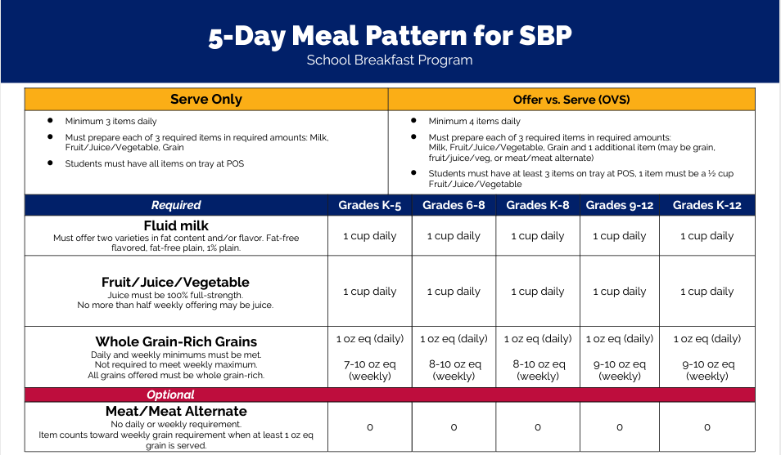
Does the menu meet the Daily Requirements?
WEDNESDAY
Grain Mini Pancakes 1 oz eq
Meat/Meat Alternate Turkey Sausage 1 oz eq
Fruit: Canned Peaches 1 cup
Fluid Milk: Fat Free Plain Fat Free Chocolate 1 cup each
On this day, I also planned an optional meat/meat alternate, so I will check that off too!

Slide 52
Does the menu meet the Daily Requirements?
WEDNESDAY
Grain Mini Pancakes 1 oz eq
Meat/Meat Alternate Turkey Sausage 1 oz eq
Fruit: Canned Peaches 1 cup
Fluid Milk: Fat Free Plain Fat Free Chocolate 1 cup each
I planned 1 cup of fruit, so we can check that off!

Slide 53
Does the menu meet the Daily Requirements?
WEDNESDAY
Grain Mini Pancakes 1 oz eq
Meat/Meat Alternate Turkey Sausage 1 oz eq
Fruit: Canned Peaches 1 cup
Fluid Milk: Fat Free Plain Fat Free Chocolate 1 cup each
And I planned 2 varieties of milk!
Looks like this menu meets the daily requirements for the School Breakfast Meal Pattern.

Slide 54
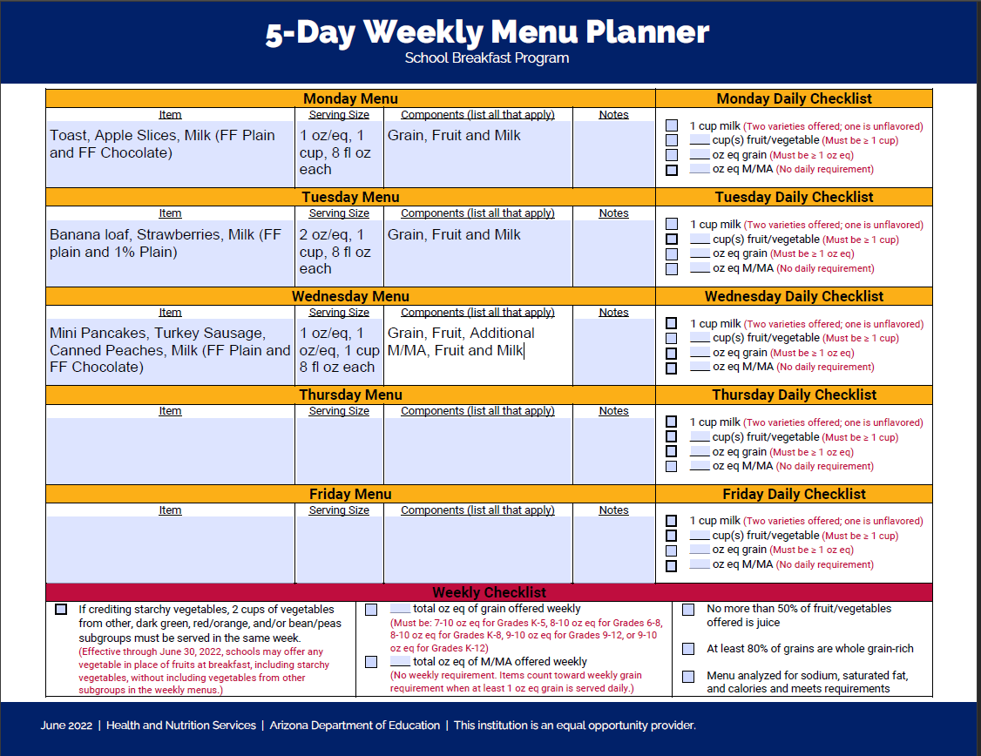
Let’s look at our Menu Planner for Wednesday.
For the last step in planning a weekly breakfast menu, I’m going to fill in my menu planner chart.
The weekly menu is coming together nicely! Let’s move on to Thursday!

Slide 55
Entrée
On Thursday, I’d like to offer
an egg and cheese burrito.
I order this from a manufacturer, and I have a product formulation statement that tells me the burrito has a whole grain-rich tortilla that credits as
1 oz eq, and the eggs and cheese credit as 1 oz eq of meat/meat alternate.
I’ve added those to my daily menu.
I want to offer salsa with the burrito. However, I’m only going to offer ¼ cup to each student. I could count it toward
the fruit requirement, or I could count it as an extra. I like to keep things simple, so I’m counting it as an extra. This means I will need to consider the calories added from the salsa when I calculate the calories, sodium, and saturated fat, but I won’t credit it toward my daily requirements.
THURSDAY
Grain Whole Grain-Rich Tortilla 1 oz eq
Meat/Meat Alternate Eggs and Cheese 1 oz eq
Fruit:
Fluid Milk:

Slide 56
Fruit
THURSDAY
Grain Whole Grain-Rich Tortilla 1 oz eq
Meat/Meat Alternate Eggs and Cheese 1 oz eq
Fruit: Edible pieces Pineapple Chunks ½ cup
Fruit: Juice Grapes ½ cup
Fluid Milk:
I also want to change up the fruit a little bit. So far this week, we’ve planned 1 cup of fruit each day, and it has been the same fruit. We planned 1 cup of apples, 1 cup of strawberries and 1 cup of peaches.
Did you know that you can also choose to plan 1 cup of fruit, but plan it as ½ cup servings of 2 different fruits? Students can choose both options if they would like!
I’m going to take advantage of that option today, and I’m going to plan ½ cup of pineapple chunks, and ½ cup grapes.

Slide 57
Fluid Milk
THURSDAY
Grain Whole Grain-Rich Tortilla 1 oz eq
Meat/Meat Alternate Eggs and Cheese 1 oz eq
Fruit: Edible pieces Pineapple Chunks ½ cup
Fruit: Juice Grapes ½ cup
Fluid Milk: 1% Plain Fat Free Plain 1 cup each
Finally, I will plan my milk. Since I’m offering grapes and pineapples, which can both be very sweet, I think I will plan plain milk in 2 varieties today. I will plan 1 cup each of either 1% plain milk, or fat free plain milk.

Slide 58
Does the menu meet the Daily Requirements?
THURSDAY
Grain Whole Grain-Rich Tortilla 1 oz eq
Meat/Meat Alternate Eggs and Cheese 1 oz eq
Fruit: Edible pieces Pineapple Chunks ½ cup
Fruit: Juice Grapes ½ cup
Fluid Milk: 1% Plain Fat Free Plain 1 cup each
Now… I can’t forget to check and make sure I meet my daily requirements!
I planned 1 oz eq of grain, so I met the daily requirement.

Slide 59
Does the menu meet the Daily Requirements?
THURSDAY
Grain Whole Grain-Rich Tortilla 1 oz eq
Meat/Meat Alternate Eggs and Cheese 1 oz eq
Fruit: Edible pieces Pineapple Chunks ½ cup
Fruit: Juice Grapes ½ cup
Fluid Milk: 1% Plain Fat Free Plain 1 cup each
On this day, I also planned an optional meat/meat alternate, so I will check that off too!

Slide 60
Does the menu meet the Daily Requirements?
THURSDAY
Grain Whole Grain-Rich Tortilla 1 oz eq
Meat/Meat Alternate Eggs and Cheese 1 oz eq
Fruit: Edible pieces Pineapple Chunks ½ cup
Fruit: Juice Grapes ½ cup
Fluid Milk: 1% Plain Fat Free Plain 1 cup each
I planned 1 cup of fruit, so I can check that off! Remember, even though I planned 2 varieties in ½ cup servings each, I still planned 1 cup of fruit total. Students can take both choices if they want.

Slide 61
Does the menu meet the Daily Requirements?
THURSDAY
Grain Whole Grain-Rich Tortilla 1 oz eq
Meat/Meat Alternate Eggs and Cheese 1 oz eq
Fruit: Edible pieces Pineapple Chunks ½ cup
Fruit: Juice Grapes ½ cup
Fluid Milk: 1% Plain Fat Free Plain 1 cup each
And of course, I planned my 2 varieties of milk, so I can check that off.
This menu is a bit more complicated, but I still met the daily requirements!

Slide 62
Let’s look at our Menu Planner for Thursday.
Since I know Thursday meets the daily requirements, I will add it to my menu planner.
One more day to plan for this week…. Let’s plan for Friday!

Slide 63
Entrée
FRIDAY
Grain Whole Grain-Rich Bagel Slice 1 oz eq
Meat/Meat Alternate Eggs, Cheese and Sausage 2 oz eq
Fruit:
Fluid Milk:
On Friday, I want to serve the awesome whole-grain rich breakfast pizza I found. It’s a ½ bagel slice, topped with eggs, cheese and sausage!
When I look at the CN label, it tells me that 1 serving of breakfast pizza provides 1 oz eq of whole grains, and
2 oz eq of meat/meat alternate.
Even though I’m offering more meat/meat alternates than grains, I’m still offering the minimum 1 oz eq of grain, so this is still allowable.

Slide 64
Fruit
I also like the idea of planning 2 types of fruit, so I am going to do that again.
I’m going to plan ½ cup of canned pears and ½ cup orange juice.
It’s important to note that I can plan my menu this way as long as I don’t make more than 50% of my fruit offerings as juice. The meal pattern chart reminds me of that in the fruit section.
FRIDAY
Grain Whole Grain-Rich Bagel Slice 1 oz eq
Meat/Meat Alternate Eggs, Cheese and Sausage 2 oz eq
Fruit: Edible Canned Pears ½ cup
Fruit: Juice Orange Juice ½ cup
Fluid Milk:

Slide 65
Fluid Milk
FRIDAY
Grain Whole Grain-Rich Bagel Slice 1 oz eq
Meat/Meat Alternate Eggs, Cheese and Sausage 2 oz eq
Fruit: Edible Canned Pears ½ cup
Fruit: Juice Orange Juice ½ cup
Fluid Milk: Fat Free Plain Fat Free Chocolate 1 cup each
And finally, like I’ve done every day this week, I will plan 2 varieties of milk. Today I’m going to offer fat free plain and fat free chocolate.

Slide 66
Does the menu meet the Daily Requirements?
FRIDAY
Grain Whole Grain-Rich Bagel Slice 1 oz eq
Meat/Meat Alternate Eggs, Cheese and Sausage 2 oz eq
Fruit: Edible Canned Pears ½ cup
Fruit: Juice Orange Juice ½ cup
Fluid Milk: Fat Free Plain Fat Free Chocolate 1 cup each
It’s the last day of the week, so let’s make sure the planned menu meets the meal pattern daily requirements.
I planned 1 oz eq of grain, so I met the daily requirement.

Slide 67
Does the menu meet the Daily Requirements?
FRIDAY
Grain Whole Grain-Rich Bagel Slice 1 oz eq
Meat/Meat Alternate Eggs, Cheese and Sausage 2 oz eq
Fruit: Edible Canned Pears ½ cup
Fruit: Juice Orange Juice ½ cup
Fluid Milk: Fat Free Plain Fat Free Chocolate 1 cup each
On this day, I also planned 2 oz eq of optional meat/meat alternate, so I will check that off too!

Slide 68
Does the menu meet the Daily Requirements?
FRIDAY
Grain Whole Grain-Rich Bagel Slice 1 oz eq
Meat/Meat Alternate Eggs, Cheese and Sausage 2 oz eq
Fruit: Edible Canned Pears ½ cup
Fruit: Juice Orange Juice ½ cup
Fluid Milk: Fat Free Plain Fat Free Chocolate 1 cup each
I planned 1 cup of fruit, so we can check that off! Remember, even though I planned 2 varieties in ½ cup servings each, I still planned 1 cup of fruit total.

Slide 69
Does the menu meet the Daily Requirements?
FRIDAY
Grain Whole Grain-Rich Bagel Slice 1 oz eq
Meat/Meat Alternate Eggs, Cheese and Sausage 2 oz eq
Fruit: Edible Canned Pears ½ cup
Fruit: Juice Orange Juice ½ cup
Fluid Milk: Fat Free Plain Fat Free Chocolate 1 cup each
And of course, I planned 2 varieties of milk, so I can check that off.
This menu is a bit more complicated, but I still met the daily requirements!

Slide 70
Let’s look at our Menu Planner for Friday.
Since I know Friday meets the daily requirements, I will add it to my menu planner.
Now my weekly menu is complete!

Slide 71
Comprehension Check
Can you plan a menu that includes 2 types of fruit to meet the 1 cup requirement?
No. All fruit planned must be in 1 cup quantities.
Yes. This is only allowed when including juice as a fruit option.
Yes. However, only on days when you also plan 2 oz eq of grains.
Yes. You can plan 2 varieties of fruit in ½ cup servings. This meets the 1 cup daily requirement.

Slide 72
Comprehension Check ANSWER
Can you plan a menu that includes 2 types of fruit to meet the 1 cup requirement?
No. All fruit planned must be in 1 cup quantities.
Yes. but this is only allowed when including juice as a fruit option.
Yes. but only if the fruits are in the same form (all fresh, all dried, all canned, or all frozen)
Yes. You can plan 2 varieties of fruit in ½ cup servings. This meets the 1 cup daily requirement.
You must plan 1 cup of fruit daily, but it can be made up of ½ cup servings of 2 different fruits. The fruits do not need to be in the same form (i.e. fresh, dried, canned, frozen).

Slide 73
Check to Make Sure the Menu Meets the Weekly Meal Pattern Requirements

Slide 74
I’ll have to refer to the meal pattern chart to make sure I planned enough food to meet the weekly requirements. Let’s start with the grains.

Slide 75
The meal pattern chart says I needed to plan 8-10 oz eq of grains for the week to meet the requirements for grades K-8. If I look at just the grains, it looks like I offered 6 oz eq of grains. I might be a little bit short…
1+2+1+1+1 = 6 oz eq

Slide 76
I remember though, that the meal pattern chart also says I can plan meat/meat alternates and count them toward my grain requirements. When I look at this weekly menu, I planned
4 oz eq of meat/meat alternate.
1+1+2
= 4 oz eq

Slide 77
When I combine the grains and meat/meat alternates planned for the week, I can see that a total of
10 oz eq of are available to students. This menu meets the weekly requirement for grains.
1+2+1+1+1 =
6 oz eq
1+1+2= 4 oz eq

Slide 78
Now let’s look at Fruit.
The requirement is 1 cup daily, and the menu meets that requirement.
This menu has 4 ½ cups of edible fruit planned and ½ cup of juice, for a total of 5 cups of fruit offered.
1+1+1+1+1
= 5 cups

Slide 79
The meal pattern chart also says no more than 50% of the fruit offerings for the week can be juice. Since I planned a total of 5 cups, no more than 2 ½ cups of juice can be planned.
This menu has 4 ½ cups of edible fruit planned and ½ cup of juice. That is less than 50%, so the menu is in compliance with the juice requirement!

Slide 80
Finally, I have to plan 1 cup of milk in 2 varieties every day. Looks like the menu does that, and it meets the meal pattern too.

Slide 81
When we look at the Breakfast Menu Planner Template, there’s a daily checklist at the right-hand side of the page. This checklist looks at the same areas we just looked at. You can use this as a tool to ensure all the requirements are met.

Slide 82
Meal Pattern Charts
Dietary Specifications

Slide 83
Now that we know the menu meets the daily and weekly requirements for the components, we need to also make sure the menu meets the dietary specifications.

Slide 84
In order to do that, we will need to look at our nutrition facts labels for all the products to determine the number of calories, grams of saturated fat and milligrams of sodium that are planned every day.

Slide 85
Breakfast Menu Planning Recap

Slide 86
We started by reviewing the meal pattern chart and selecting the grade group we would plan for.

Slide 87
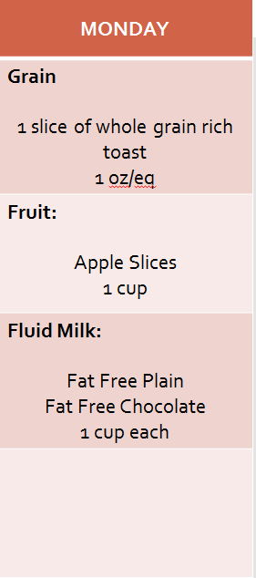
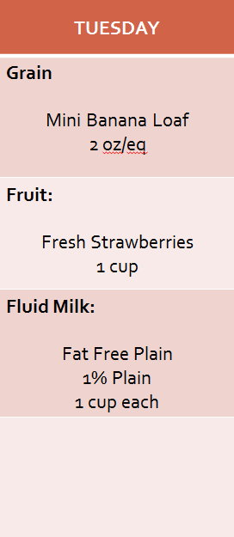
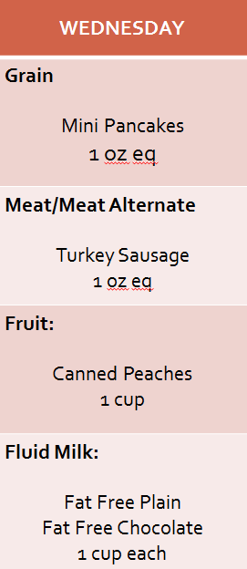
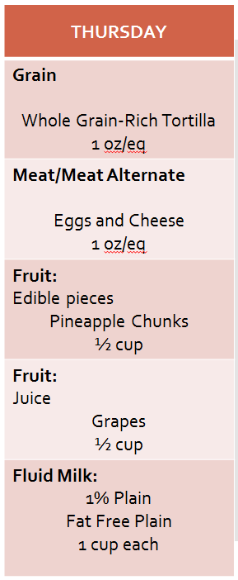
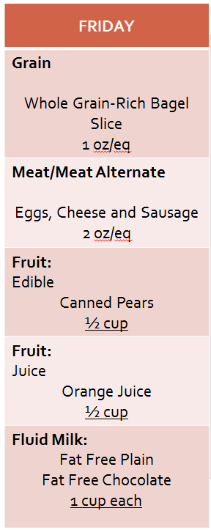
Then, we planned a menu for each day and compared it with the daily requirements on the chart. This helps us know we planned a menu that meets the daily requirements.

Slide 88
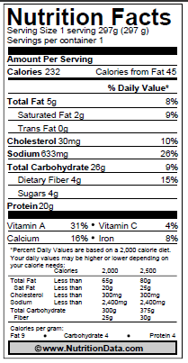
Once we had our daily meals planned and the requirements were met, we compared the menu to the meal pattern chart to make sure our menu also met the weekly meal pattern requirements including the nutrient specifications.

Slide 89
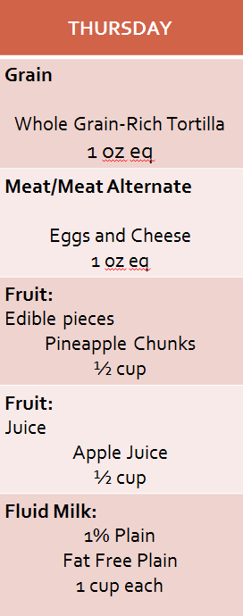
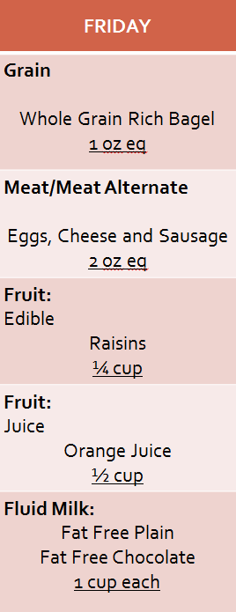
Although we didn’t review it in detail in this presentation, remember that you must also have documentation for all menu items to determine the nutrient content, as well as the crediting information for grains and meat/meat alternates.
CN Labels
Product Formulation Statements
Nutrition Fact Labels

Slide 90
Technical Assistance
For menu planning tools and additional information regarding crediting and meal pattern documentation, access the NSLP and SBP – Progam Forms and Resources webpage under the 'Menu Planning' accordion.
Happy menu planning!

Slide 91
End of Training
Congratulations!
You have completed the Step by Step Instruction: How to Plan a Breakfast Menu.
In order to count this training towards your Professional Standards training hours, the training content must align with your job duties.
Information to include when documenting this training for Professional Standards:
Training Title: Step by Step Instruction: How to Plan a Breakfast Menu
Learning Code: 1100
Key Area: 1000- Nutrition
Length: 1.5 hours
Please note, attendees must document the amount of training hours indicated on the training despite the amount of time it takes to complete it.
Request a Certificate

Slide 92
End of Training
Requesting a Training Certificate
Please click on the link below to complete a brief survey about this training. Once the survey is complete, you will be able to print your certificate of completion from Survey Monkey. *This will not appear in your Event Management System (EMS) Account.
https://www.surveymonkey.com/r/OnlineHowToGuides
The information below is for your reference when completing the survey.
Training Title: Step by Step Instruction: How to Plan a Breakfast Menu
Professional Standards Learning Code: 1100

Slide 93
In accordance with federal civil rights law and U.S. Department of Agriculture (USDA) civil rights regulations and policies, this institution is prohibited from discriminating on the basis of race, color, national origin, sex (including gender identity and sexual orientation), disability, age, or reprisal or retaliation for prior civil rights activity.
Program information may be made available in languages other than English. Persons with disabilities who require alternative means of communication to obtain program information (e.g., Braille, large print, audiotape, American Sign Language), should contact the responsible state or local agency that administers the program or USDA’s TARGET Center at (202) 720-2600 (voice and TTY) or contact USDA through the Federal Relay Service at (800) 877-8339.
To file a program discrimination complaint, a Complainant should complete a Form AD-3027, USDA Program Discrimination Complaint Form which can be obtained online at: https://www.usda.gov/sites/default/files/documents/USDA-OASCR%20P-Complaint-Form-0508-0002-508-11-28-17Fax2Mail.pdf, from any USDA office, by calling (866) 632-9992, or by writing a letter addressed to USDA. The letter must contain the complainant’s name, address, telephone number, and a written description of the alleged discriminatory action in sufficient detail to inform the Assistant Secretary for Civil Rights (ASCR) about the nature and date of an alleged civil rights violation. The completed AD-3027 form or letter must be submitted to USDA by:
1. mail:
U.S. Department of Agriculture Office of the Assistant Secretary for Civil Rights 1400 Independence Avenue, SW Washington, D.C. 20250-9410; or
2.fax:
(833) 256-1665 or (202) 690-7442; or
3. email:
program.intake@usda.gov
This institution is an equal opportunity provider.

