Slide 1
Menu of Assessments 2020-2021 Webinar
Audra Ahumada
Deputy Associate Superintendent of Assessment
Arizona Department of Education

Slide 2
Menu of Assessments 2020 - 2021
This is repeated later today, you do not have to attend both sessions
This webinar will be recorded

Slide 3
Menu of Assessments 2020 - 2021
Overview for today’s webinar
2020-2021 Administration of the Menu of Assessments
Changes from 2019-2020
Important Documents and Information

Slide 4
Menu of Assessments 2020 - 2021
Notification closed July 1, 2020
There are 146 LEAs that have selected to participate in the Menu of Assessments
The State Board of Education has not adopted the 2020-2021 A-F system, but indications are that students’ performance on the Menu of Assessments will be accounted for in CCRI indicator as they have been in the past
Notes:
Mention New Statewide HS assessment has been determined- Grade 9 and Grade 11 ACT

Slide 5
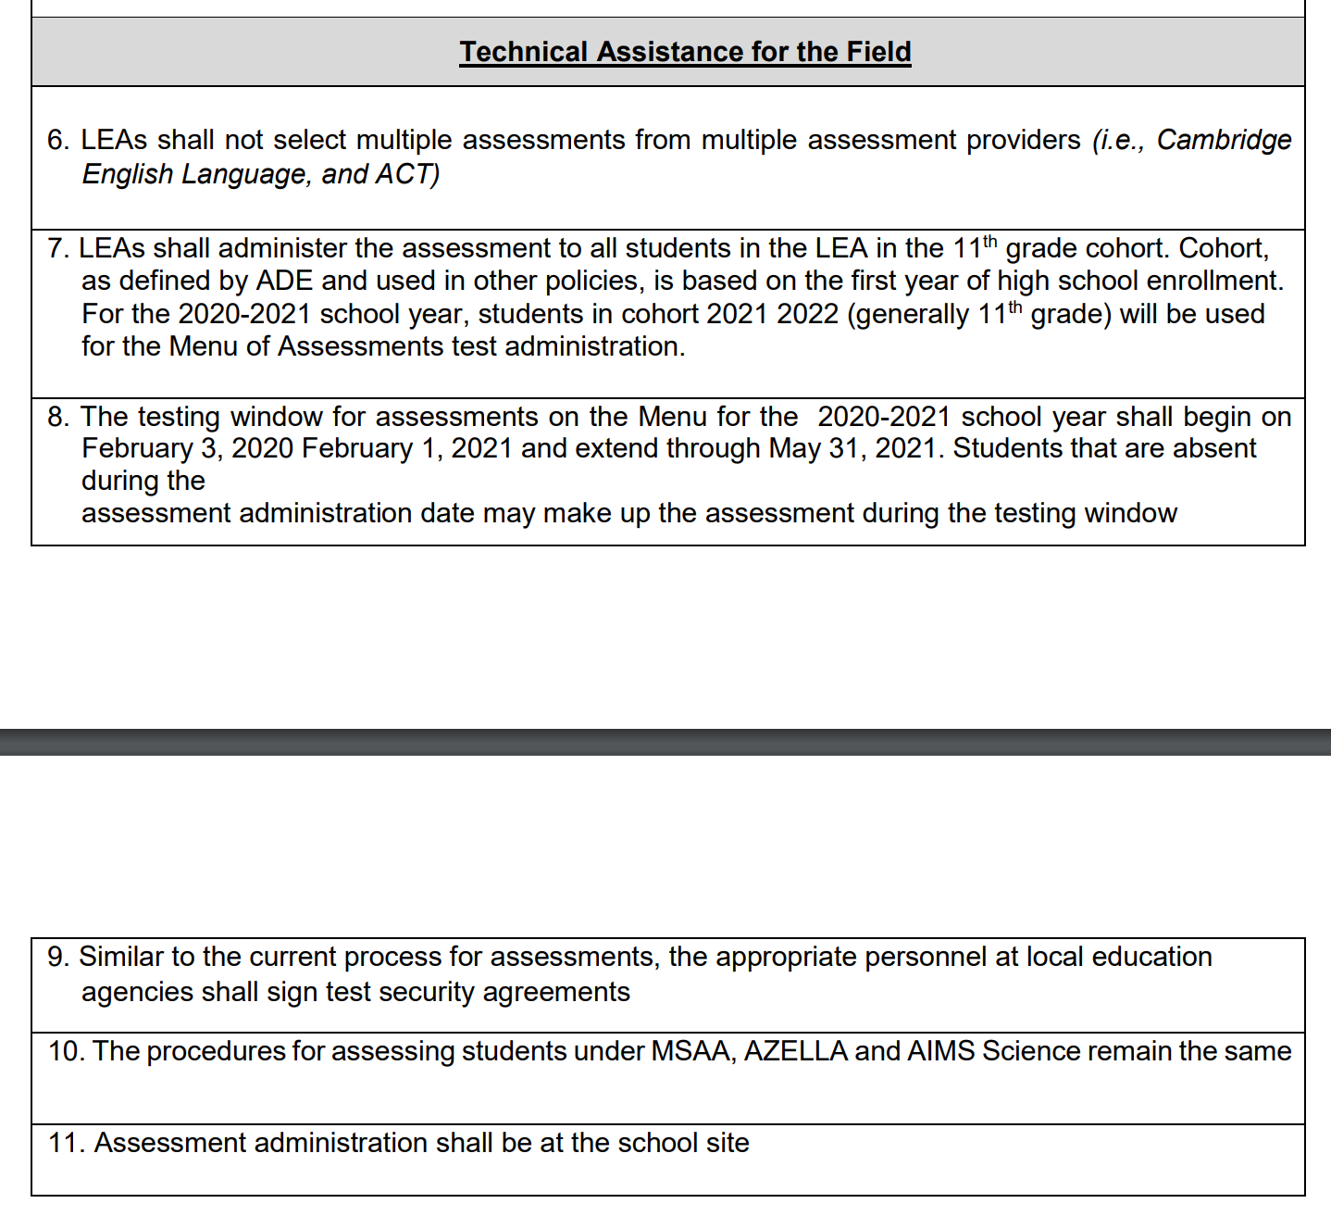
State Board of Education’s Technical Assistance Document (2020 - 2021)
If an LEA selects to participate in the Menu of Assessments, ALL students in the 11th Grade Cohort should be tested. This includes students with disabilities, and students attending alternate campuses

Slide 6
Menu of Assessments - Reimbursement
LEAs will be reimbursed from ADE in the full contracted amount for each Grade 11 (Cohort 2022) student administered the ACT or SAT on their selected test date
Reimbursement will be for the state-contracted price with ACT or SAT
ADE will be sending a reimbursement process step by step document specific to your selected assessment
Notes:
There are specific steps/processes based on the vendor. However, the steps for ADE reimbursement will be the same.

Slide 7
Menu of Assessments – Required Tasks
You will work directly with ACT or SAT to complete all required tasks:
Uploading students
Accommodations requests
Training for staff
Reminder: ADE will not be uploading students from your SIS.

Slide 8
Menu of Assessments - 2020 - 2021
The Menu of Assessments is not in lieu of the Statewide assessments
You will still be required to administer the Statewide ELA and Mathematics (Grade 10 - Cohort 2023) and the AzSCI census field test (Grade 11 – Cohort 2022)
Each LEA will select a date to administer ACT/SAT to all students and all schools in their District/Charter, at their school site(s)
Notes:
FOR 2020-2021 this will be AzM2 and the Census Field Test for AzSCI

Slide 9
Menu of Assessments – State Test Dates
ACT Test Dates
March 2, 2021
April 6, 2021
SAT Test Dates
March 3, 2021
March 24, 2021
Each LEA will select ONE of these test dates to administer your selected Menu of Assessment
Notes:
SAT and ACT may have other test dates that they publish however, these are the dates designated as AZ State Test Dates for Menu of Assessments. These State test options will allow us to receive test results needed to meet state deadlines

Slide 10
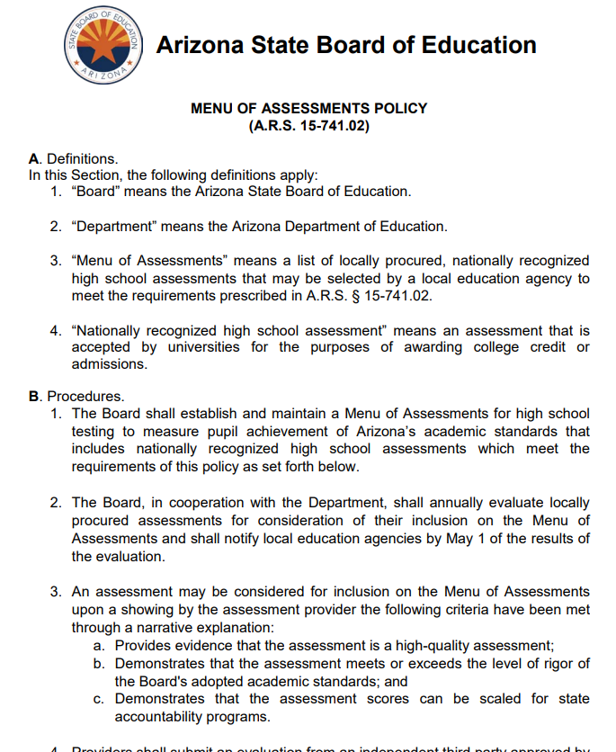
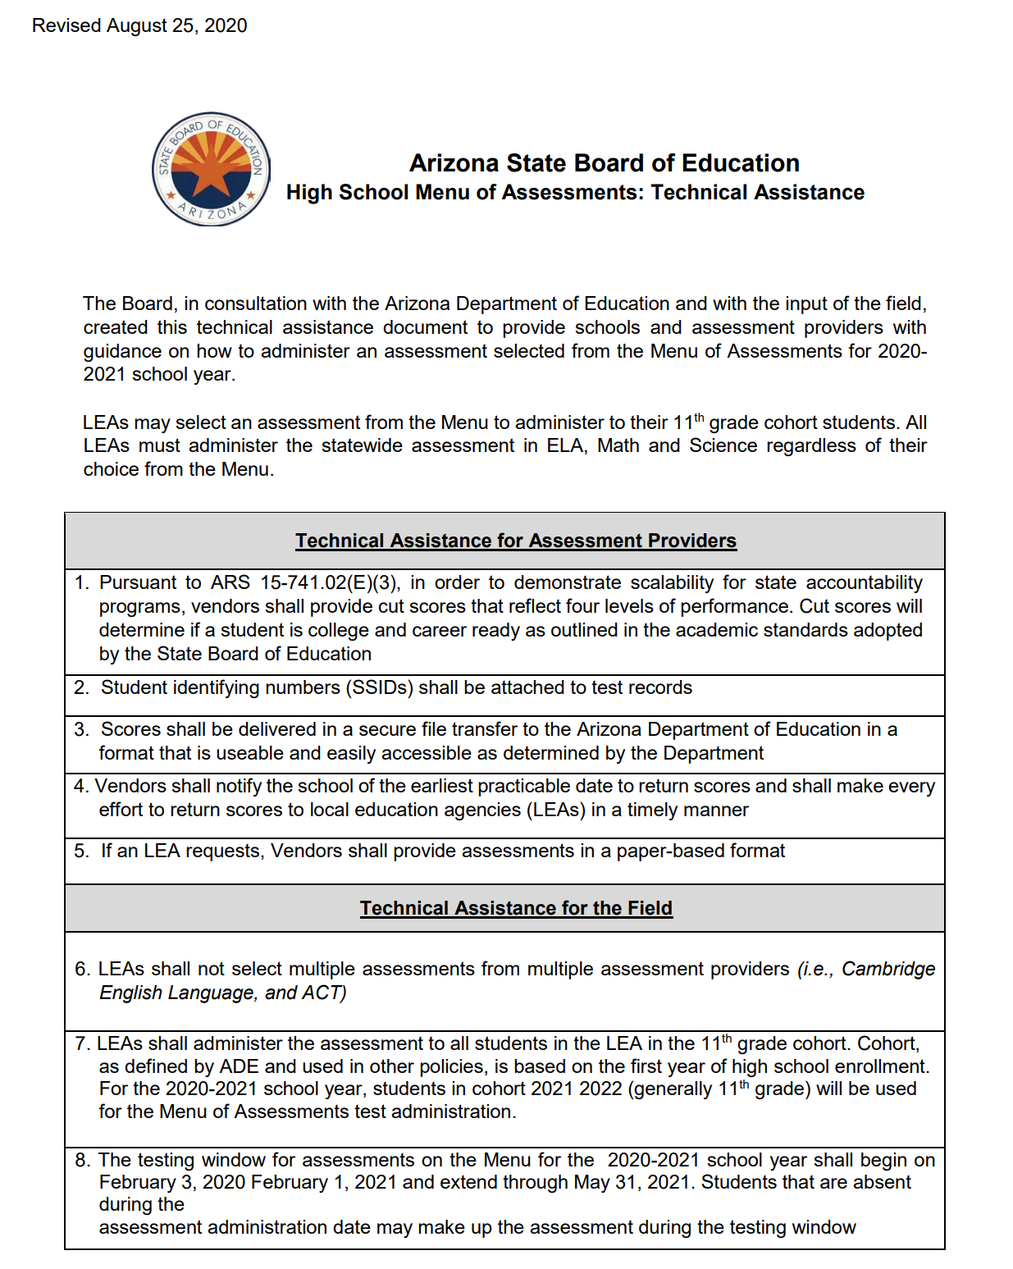
Menu of Assessments – Important Documents
https://azsbe.az.gov/assessments-and-menu-assessments

Slide 11
Menu of Assessments – Important Information
The state statute governing Menu of Assessments: https://www.azleg.gov/viewdocument/?docName=https://www.azleg.gov/ars/15/00741-02.htm
State Board of Education Website: https://azsbe.az.gov/menu-assessments
Arizona Department of Education website: http://www.azed.gov/assessment/menu-of-assessments/

Slide 12
Menu of Assessments - Changes
If your LEA has decided to withdraw their notification to participate in the 2020-2021 Menu of Assessments, send an email with the name of your LEA from your Superintendent/Charter Holder to Testing Inbox <Testing@azed.gov> no later than September 18, 2020.

Slide 13
Menu of Assessments 2020 - 2021
QUESTIONS ?

