Slide 1
Friday Focus: Things You Need to Know as a New DTC
ADE Assessments Team will have 4 more webinar sessions in this series for the 2020-2021 school year.

Slide 2
Welcome to Webinar #2: Things You Need to Know as a New DTC
Please enter your First and Last Name in the Chat for tracking purposes for the live event.
This webinar will be recorded and posted on the ADE Assessments webpage at https://www.azed.gov/assessment.
We will also be capturing the chat questions. If there are questions that were frequently asked or need further clarification, ADE will compile and create an FAQ which will then be distributed to DTCs.

Slide 3
Agenda
General Information Regarding Testing Responsibilities
Welcome from ADE State Test Coordinators
Test Specific Information:
Achievement Assessments
Alternate Assessments
Arizona English Language Learner Assessment
Questions

Slide 4
General Information

Slide 5
Getting Started
Training
District Test Coordinator website
https://www.azed.gov/assessment/dtc
DTC Test Administration Sites
PearsonAccess^{next}, TIDE, MSAA Assessment.org
Student Testing Sites
TIDE, TestNav, MSAA Assessment.org
Assessment Checklists
ADEConnect Role
Achievement Assessment Coordinator, AZELLA District Test Coordinator, Alternate Assessment Test Coordinator

Slide 6
Resources for District Test Coordinators
The Examiner (quarterly newsletter)
https://www.azed.gov/assessment/examiner
Detailed Test Calendar (updated each school year)
https://www.azed.gov/assessment/dtc/
Assessments Overview – 2020 and Beyond (new this year)
https://www.azed.gov/assessment
District Test Coordinator webpage
https://www.azed.gov/assessment/dtc

Slide 7
Welcome from ADE State Test Coordinators

Slide 8
State Test Coordinators
Candis Middlebrook
Achievement State Test Coordinator
AzM2@azed.gov or AzSCI@azed.gov
Brenda Vanderwerp
AZELLA State Test Coordinator
AZELLA@azed.gov
Sarah Han
Alternate Assessment State Test Coordinator
AssessingSWDs@azed.gov

Slide 9
Achievement Assessments
AzM2, AzSCI, Menu of Assessments

Slide 10
Updates and Testing Dates – AzM2/AASA
Statewide Assessment for ELA and Mathematics
2020-2021: AzM2
Who to test:
Grades 3-8 and 10 (cohort 2023)
Computer-Based Test Window: April 5-30, 2021
(Writing must be completed by April 16)
Paper-Based Test Window: April 5-14, 2021
(Writing must be scheduled for April 5 or 6)
2021-2022: AASA
(Arizona’s Academic Standards Assessment)
Who to test: Grades 3-8
Test Windows to be Determined
In 2021-2022, the statewide high school assessment will be ACT and will be administered to 11th graders. ACT Aspire will be administered to 9th graders.
SAT and PSAT may be selected from the Menu of Assessments in lieu of ACT and ACT Aspire.
Watch for AzM2 District Test Coordinator Checklist to be posted soon at https://www.azed.gov/assessment/achievement-dtcs.

Slide 11
Updates and Testing Dates - AzSCI
Statewide Assessment for Science
2020-2021: AzSCI Census Field Test
Who to test:
Grades 5, 8, and 11 (Cohort 2022)
Computer-Based Test Window:
March 22 – April 30, 2021
2021-2022: AzSCI
Who to test:
Grades 5, 8, and 11 (Cohort 2023)
Test Windows to be Determined
AIMS Science will not be administered in the spring of 2021. This decision will enable LEAs to focus on teaching the new 2018 Science Standards.
Watch for AzSCI District Test Coordinator Checklist to be posted soon at https://www.azed.gov/assessment/achievement-dtcs.

Slide 12
Required Training
District Test Coordinator online trainings will be available January 4, 2021 and should be completed by January 29, 2021.
District Test Coordinators are responsible for providing training to Test Administrators in the district or charter who will administer AzM2 and/or AzSCI.
All AzM2 Test Administrators must complete the Test Administrator Certification through the AzM2 portal prior to administering AzM2.

Slide 13
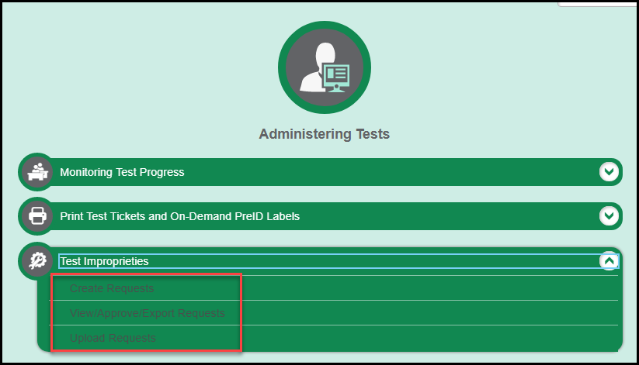
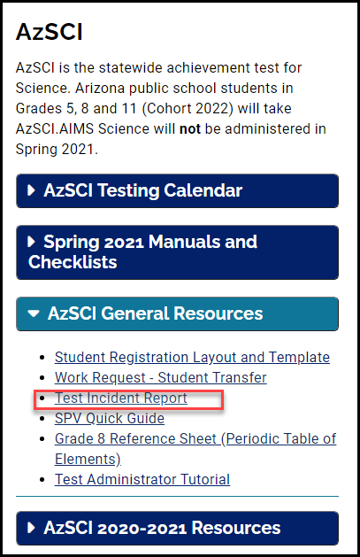
Test Improprieties
Typical Test Improprieties:
TA Error
Test Administrator (TA) opens more than one test (Part 1 and Part 2 or Math and ELA) and approves a student who chooses the incorrect test. The student then logs out instead of continuing to complete the test session he/she is in.
Technical Error
Internet connectivity issues for one or more students.
Student attempts to access another site or uses a shortcut key.
Process: DTC submits a Test Impropriety in TIDE for AzM2; you will receive a response to each Impropriety. AzSCI incidents are reported through email. Any consequences are locally determined.
Notes:
Preventative Strategies:
It is important for TAs to only open the test session that students need. TA should only approve students for the correct session.
Once a student starts a test session, they should continue in that session. They can make up the original session at another time.
Technical Errors:
All responses are saved, so students can resume testing once the tech issue is resolved.
Remind students that they should only use the letter and number keys on their keyboard.

Slide 14
Test Invalidations
Typical Test Invalidations:
Test Administrator (TA) provides resource to student (reference sheet, calculator, graphic organizer, etc.).
Student wasn't eligible to test; should have tested using the alternate assessment.
Student had phone or other electronic device out during test.
Students helping each other during testing.
Process: Please investigate any allegation of student or TA impropriety before requesting the test to be invalidated. You need to use your district/charter procedure for investigations and consequences.
Notes:
A test invalidation means that the student's test opportunity is eliminated and the student has no further opportunities to test in this content area.

Slide 15
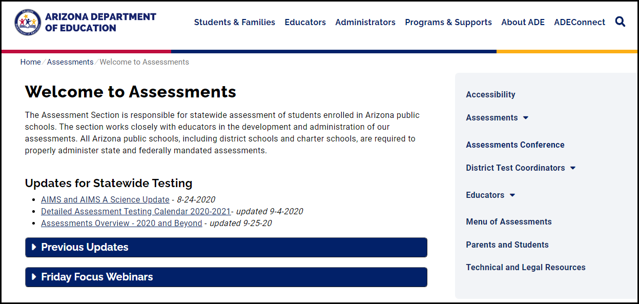
Achievement Assessment Websites
DTC Resources: https://www.azed.gov/assessment/dtc
AzM2 – https://www.azed.gov/assessment/azm2
AzM2 Portal – TIDE, ORS, Test Administrator Certification – for AzM2:
https://azm2portal.org/
AzSCI - https://www.azed.gov/assessment/sci
PearsonAccess^{next} – for AzSCI (same website as for AZELLA):
https://az.pearsonaccessnext.com/customer/index.action
Menu of Assessments Information:
https://www.azed.gov/assessment/menu-of-assessments

Slide 16
Communication
We will send regular emails to District Test Coordinators as we near the testing windows to remind you of important tasks and approaching deadlines. It is the responsibility of the District Test Coordinator to pass important information along to others in your district or charter who need it.
Questions regarding Achievement assessments should be directed to the following inboxes:
Questions about AzM2 – AzM2@azed.gov
Questions about AzSCI – AzSCI@azed.gov
Questions about Menu of Assessments, Test Security Agreements, or other general questions – Testing@azed.gov

Slide 17
Alternate Assessments
MSAA – ELA, Mathematics, and Science

Slide 18
MSAA
The Multi-State Alternate Assessment (MSAA) is a comprehensive assessment system designed to promote increasing higher academic outcomes for students with significant cognitive disabilities in preparation for a broader array of post-secondary outcomes.
The MSAA is designed to assess students with significant cognitive disability and measures academic content that is aligned to and derived from our state content standards.
This test contains many built-in supports that allow students to take the test using materials they are most familiar with and communicate what they know and can do as independently as possible.
The MSAA will be administered in the areas of ELA and Mathematics in grades 3-8 and 11 and Science in Grades 5, 8, and 11.

Slide 19
Eligibility
1. The student has a significant cognitive disability.
2. The student is learning content linked to (derived from) state content standards.
3. The student requires extensive direct individualized instruction and substantial supports to achieve measurable gains in the grade-and-age appropriate curriculum.
The 2020-2021 Eligibility form is now available for IEP teams and will be required moving forward.

Slide 20
Alternate Assessments Checklist
1. Go to the Arizona Department of Education website
2. Click Educators
3. Click Assessment
4. Under State Assessments click MSAA
5. Under Testing Dates and Updates, you will find the Test Coordinator Handbook

Slide 21
Testing Dates
Science Alternate Assessment
Grades 5, 8, and 11
Test Window: March 15 through April 30, 2021
MSAA ELA & Mathematics
Grades 3-8, and 11
Test Window: March 15 through April 30, 2021
MSAA Training Modules Available March 2021

Slide 22
Past Webinar and PowerPoint Presentations
11/18/2019 1% Threshold Action Plans 2019 Presentation-Click for Recorded Webinar
11/12/2019 Arizona’s Learner Characteristics Inventory Presentation-Click for Recorded Webinar
11/08/2019 Alternate Assessment Test Coordinator Responsibilities Presentation-Click for Recorded Webinar
10/31/2019 Determining Eligibility for Alternate Assessments Presentation-Click for Recorded Webinar
Instructional Supports and Resources-PowerPoint -Click for Recorded Webinar

Slide 23
Arizona English Language Learner Assessment
AZELLA
ARS § 15-756. Identification of English language learners
ARS § 15-756.05. Reassessment and reclassification of English language learners
Notes:
AZELLA, the Arizona English Language Learner Assessment, is a state assessment. The AZELLA tests are required by state and federal laws. The AZELLA tests are required for the identification of students with an English language acquisition need and for determining English language acquisition growth over time. The AZELLA test is required for entering and exiting EL program services.

Slide 24
AZELLA Testing 2020-2021
August 2020 | September 2020 | October 2020 | November 2020 | December 2020 | January 2021 | February 2021 | March 2021 | April 2021 | May 2021
AZELLA Placement Test Administration August 17, 2020 – May 14, 2021
 |  |  |  |  |  | Spring 2021 Reassessment Administration February 1 – March 19, 2021 ALL EL Students
 |  |  |  |  |  | 2021 AZELLA Stand Alone Field Test February 1 – April 2, 2021 ALL EL Students
Notes:
There are 3 AZELLA Test administrations for school year 2020-2021. The AZELLA Placement Test runs from August 17, 2020 through May 14, 2021.
The Spring 2021 AZELLA Reassessment Test administration window is February 1 through March 19, 2021.
The 2021 AZELLA Stand Alone Field Test will be administered February 1 through April 2, 2021.
The AZELLA District Test Coordinator must plan accordingly to accommodate the concurrent administration of all 3 AZELLA tests during February and March.

Slide 25
AZELLA Placement Testing
ATMS
AZELLA Training Management System (ATMS) - Complete required training modules for the AZELLA DTC category prior to administering any AZELLA tests.
Understand Scoring
Qualifications: Kindergarten Placement Test (KPT) administrators and Stage II Placement extended Writing Scorer
PAN
Students must be registered in PearsonAccess^{next} (PAN) prior to being administered the AZELLA Placement Test.
Pre-test AZELLA Placement Training and Qualifications Requirements
Testing: All students who are required to be administered the AZELLA Placement Test must be administered the test as soon as practicable. All AZELLA tests must be administered in-person in a secure testing environment at the district office or an official school building.
In-person learning
By appointment (parents may not be in the testing room while student is testing)
Notes:
The pre-testing AZELLA Placement Training and Qualifications Requirements document outlines that all AZELLA District Test Coordinators must complete the required "Annual" and "Placement Test" training modules as listed for the AZELLA DTC category in the AZELLA Training Management System, more commonly referred to as the ATMS.
For districts and school that serve Kindergarten through grade 2 student, there are 2 additional trainings and qualifications that must completed through Pearson's Understand Scoring site. For all who are expected to administer the Kindergarten Placement Test (KPT) and those who will be scoring the Stage II Placement extended Writing responses must have these qualifications before administering the KPT and scoring the Stage II extended Writing responses.
PearsonAccess Next (PAN) is where students must be registered for an AZELLA test prior to a qualified DTC, STC, or Test Administrator testing the student.
AZELLA District Test Coordinators All students who are required to be administered the AZELLA Placement Test must be administered the test as soon as practicable. All AZELLA tests must be administered in-person in a secure testing environment at the district office or an official school building. When students are attending school in-person, they should be assessed as soon as possible. Students who are learning remotely may be administered the AZELLA Placement Test by appointment.

Slide 26
AZELLA in November and December 2020
AZELLA Placement Testing
November 13: ADE is extracting K-3rd grade EL student data to use for Participation Counts
Continuing EL students as shown on your EL73 Report
Students with a new Placement Test showing an EL need as of October 9, 2020
Week of November 30 – AZELLA Stand Alone Field Test Webinar
November 16 – December 18: Mid-Year Placement Test
Qualified High School Students ONLY
December 7 – 18: Participation Counts completed for K-3 ONLY
Notes:
AZELLA Placement testing continues throughout November and December 2020.
On November 13, ADE will be extracting Kindergarten through Grade 3 EL student data as shown on the district and schools EL73 – EL Student Need Report. This data is given to Pearson to upload into PAN so that DTCs and STCs can view and edit these counts during the Participation Counts task in December.
During the week of November 23, specific date is to be determined, will be providing an AZELLA Stand Alone Field Test webinar. Please refer to the November 2020 edition of The Examiner newsletter for additional information, including a registration link, for this very important webinar.
November 16 through December 18 is the Mid-Year AZELLA Placement testing window is strictly for qualified High School students only this school year. The Mid-Year Placement Test is exclusively for Grades 9–12 students whose most recent AZELLA test was administered during school year 2019-2020, has an Overall Proficiency Level of Intermediate, and qualifies for re-administration of the AZELLA Placement Test with the intention of demonstrating proficiency and moving into a mainstream classroom at the start of the next school semester.
AZELLA District Test Coordinators from districts that serve Kindergarten through Grade 3 students must complete the Participation Counts in PAN during a 2-week window from December 7 through December 18, 2020.

Slide 27
AZELLA K-3 Participation Counts – Dec. 7-18
Participation Counts is a head-count of all EL Kindergarten – Grade 3 students at each school within the district.
These head-counts are entered into PAN by Pearson and edited by the DTC for the Spring 2021 Reassessment Test and the 2021 Stand Alone Field Test administrations.
Include all K-3 students who are enrolled in EL program services through the temporary entrance procedures and do not have a current AZELLA test record.
The counts provide needed information to Pearson to print and ship an initial shipment of testing materials in late January 2021 for both test administrations.
DTCs will NOT need to create an initial order for materials if they complete the Participation Counts.
December 7 – 18, 2020 – DTCs edits counts for all schools (even when the count is zero).
Notes:
The Kindergarten through Grade 3 "Participation Counts" is a head count of the EL students for those grade levels in each of your schools. Pearson uses these counts to print and ship the necessary paper test materials for the Spring 2021 Reassessment Test and the 2021 AZELLA Stand Alone Field Test. Pearson will use the data that ADE sends to them and then DTCs must verify that these head counts are correct. DTCs may edit these numbers during December 7 through 18. Do not round the numbers up or down. You will need to mark your calendar to download your EL73 – EL Student Need Report from ADEConnect on November 13, 2020 and then again during the Participation Counts window so that you can compare the numbers.
You will have to add counts for those students administered the Placement Test between October 9 and December 18 and received a less than proficient result. You will also need to add counts for the students who have been placed into EL program services through the temporary entrance procedures and have not been administered the Placement Test yet.
These Participation Counts must be entered for all your Kindergarten through grade 3 students even if the count is zero. Participation Counts must be submitted by the close of business on December 18 to ensure you will receive an initial shipment of Spring Reassessment and Stand Alone Field Test materials.

Slide 28
AZELLA HS Mid-Year Placement Testing
Qualifications:
Grades 9-12 ONLY
Last AZELLA test must be dated during 2019-2020 school year
OPL = Intermediate
TC proficiency level = Intermediate or Proficient
Domain proficiency levels = Intermediate or Proficient
Domain Scale Scores = 247 and higher
November 16 – December 18, 2020
Qualified High School students ONLY
Must submit required documents to ADE no later than November 6
Mid-Year Placement Test Referral Form – available Oct. 20
Mid-Year Placement Student Referral List FY2021 Form – available Oct. 20
Notes:
The AZELLA Mid-Year Placement Test for this school year is strictly for high school students only. Students must meet the qualifications for this special test window.
AZELLA DTCs will enter the student and AZELLA test information from the referral form on the Mid-Year Placement Student Referral List, which is an Excel file. The completed referral forms and the referral list must be submitted to ADE's AZELLA Team no later than November 6, 2020. Referrals submitted after November 6 will be rejected. ADE will review the referral forms and notify the DTC which students have been approved for this special Placement Test. An approved student must be created in PAN, registered and assigned the Stage 5 Placement Test, and then added to a test session created and titled "Mid-Year Placement." The AZELLA DTC will receive notification from ADE as to the students who are approved for this testing.
After ADE has notified AZELLA DTCs of the approved students, they may be registered in PAN for the test. Student may only be administered the test between November 16 and December 18, 2020.

Slide 29
AZELLA in January 2021
7 Jan.
ADE extracts EL student data (your EL73 Report) to be used by Pearson for student pre-registration: Spring 2021 Reassessment Test and the 2021 Stand Alone Field Test
18 Jan.
Reassessment and SAFT Training Modules in ATMS
21 Jan.
1st available day for DTCs PAN account enabled for Spring Reassessment and SAFT administrations (training completions required)
1 Feb.
Spring 2021 Reassessment Test and 2021 SAFT administrations open
25-29 Jan.
Initial shipment of Spring 2021 Reassessment and 2021 SAFT materials arrive at districts
Notes:
Several AZELLA things will be happening in January 2021.
January 7 – ADE will extract all EL student data as shown on your EL73 – EL Student Need Report. Mark your calendar to download your EL73 Reports on January 7. ADE will provide this student level data to Pearson. Pearson uses this data to pre-register EL students for the Spring 2021 AZELLA Reassessment Test and the 2021 AZELLA Stand Alone Field Test (SAFT). They will also use this data to print Pre-ID Labels for Kindergarten through Grade 2 students for the Reassessment Test and Kindergarten through Grade 3 students for the field test.
January 18 – the online training modules for the Reassessment Test and the SAFT will be available for all AZELLA DTCs, STCs, and Test Administrators on January 18 in the ATMS. DTCs must complete only the modules associated with the DTC category. The STCs must complete only the modules associated with the STC category; and, the Test Administrators must complete the modules associated with the Test Administrator category. There is a total of 6 training modules for the Spring Reassessment and the Stand Alone Field Test. There are 3 training modules for each test administration, Reassessment and the SAFT. Districts that do NOT serve Kindergarten through Grade 2 students do not have to complete the K through 2 Reassessment training module. For the SAFT training modules, districts that do NOT serve Kindergarten and Grade 1 students do NOT have to complete the K-1 SAFT training module and those who do not serve Grades 2 through 3 students do NOT have to complete the Grades 2 and 3 SAFT training module.
January 21 is the first available date that AZELLA DTCs PAN accounts will be enabled for the Spring 2021 Reassessment Test administration and the 2021 SAFT administration. PAN accounts will be enabled for both test administrations after the required training modules have been completed and verified by ADE. Once an AZELLA DTC PAN account is enabled, the DTC will be able to move between the test administrations to edit and add additional PAN users, review the pre-registrations, submit Work Requests for students who have transferred into your district since January 7, register students for the test, and add students to test sessions. What an AZELLA DTC or STC does for the Spring 2021 Reassessment Test administration must ALSO be completed for the SAFT administration. Information is not automatically copied between test administrations.
During the week of January 25, districts will received their initial shipment of Stages 1 and 2 Spring Reassessment Test materials, the Grades Kindergarten through Grade 3 2021 Stand Alone Field Test materials, and the 2 different sets of Pre-ID Labels for the materials received. AZELLA DTCs may place an order for additional materials on January 29. Additional Pre-ID Labels will not be available.
February 1 is the opening day for the Spring 2021 AZELLA Reassessment Test and the 2021 AZELLA Stand Alone Field Test.

Slide 30
The AZELLA Team
Contact by email – AZELLA@azed.gov
Brenda Vanderwerp
AZELLA State Test Coordinator
Gabriela Finn
Director of English Language Learner Assessments
Raquel Payton
ELL Assessment Development Coordinator
Notes:
The best and quickest method of communication with the AZELLA Team is through email. Our email address is AZELLA@azed.gov.

Slide 31
Questions
This Photo by Unknown Author is licensed under CC BY-SA

Slide 32
Thank You!
For questions, please contact us at:
Testing@azed.gov
This Photo by Unknown Author is licensed under CC BY-NC-ND

