Slide 1
COMPARISON OF reclassification rates for SEI VS Dual language programs
Notes:
Dr Guzman

Slide 2
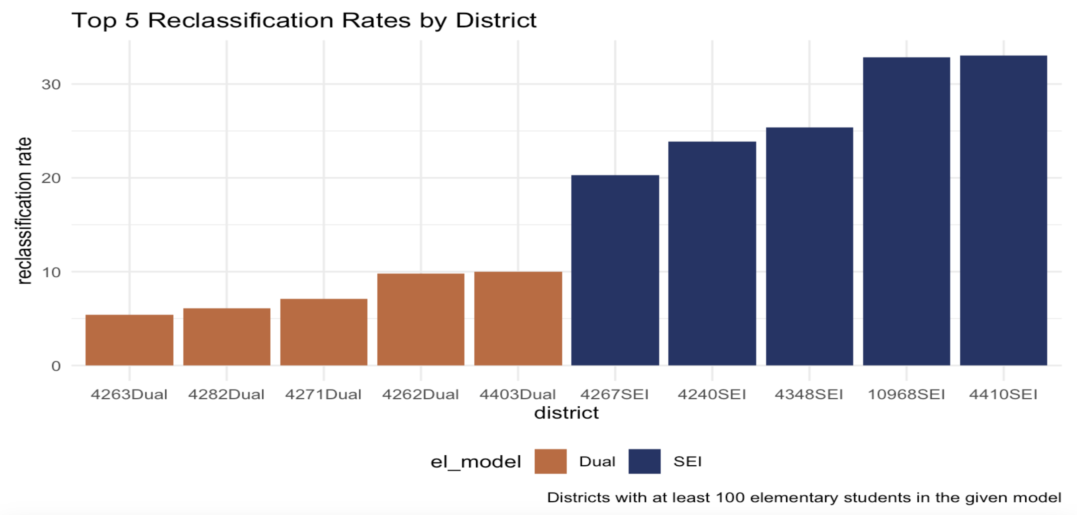
2022
Eligibility for Dual Language: Assured when meeting the AZELLA cut scores, In Accordance With law
12

Slide 3
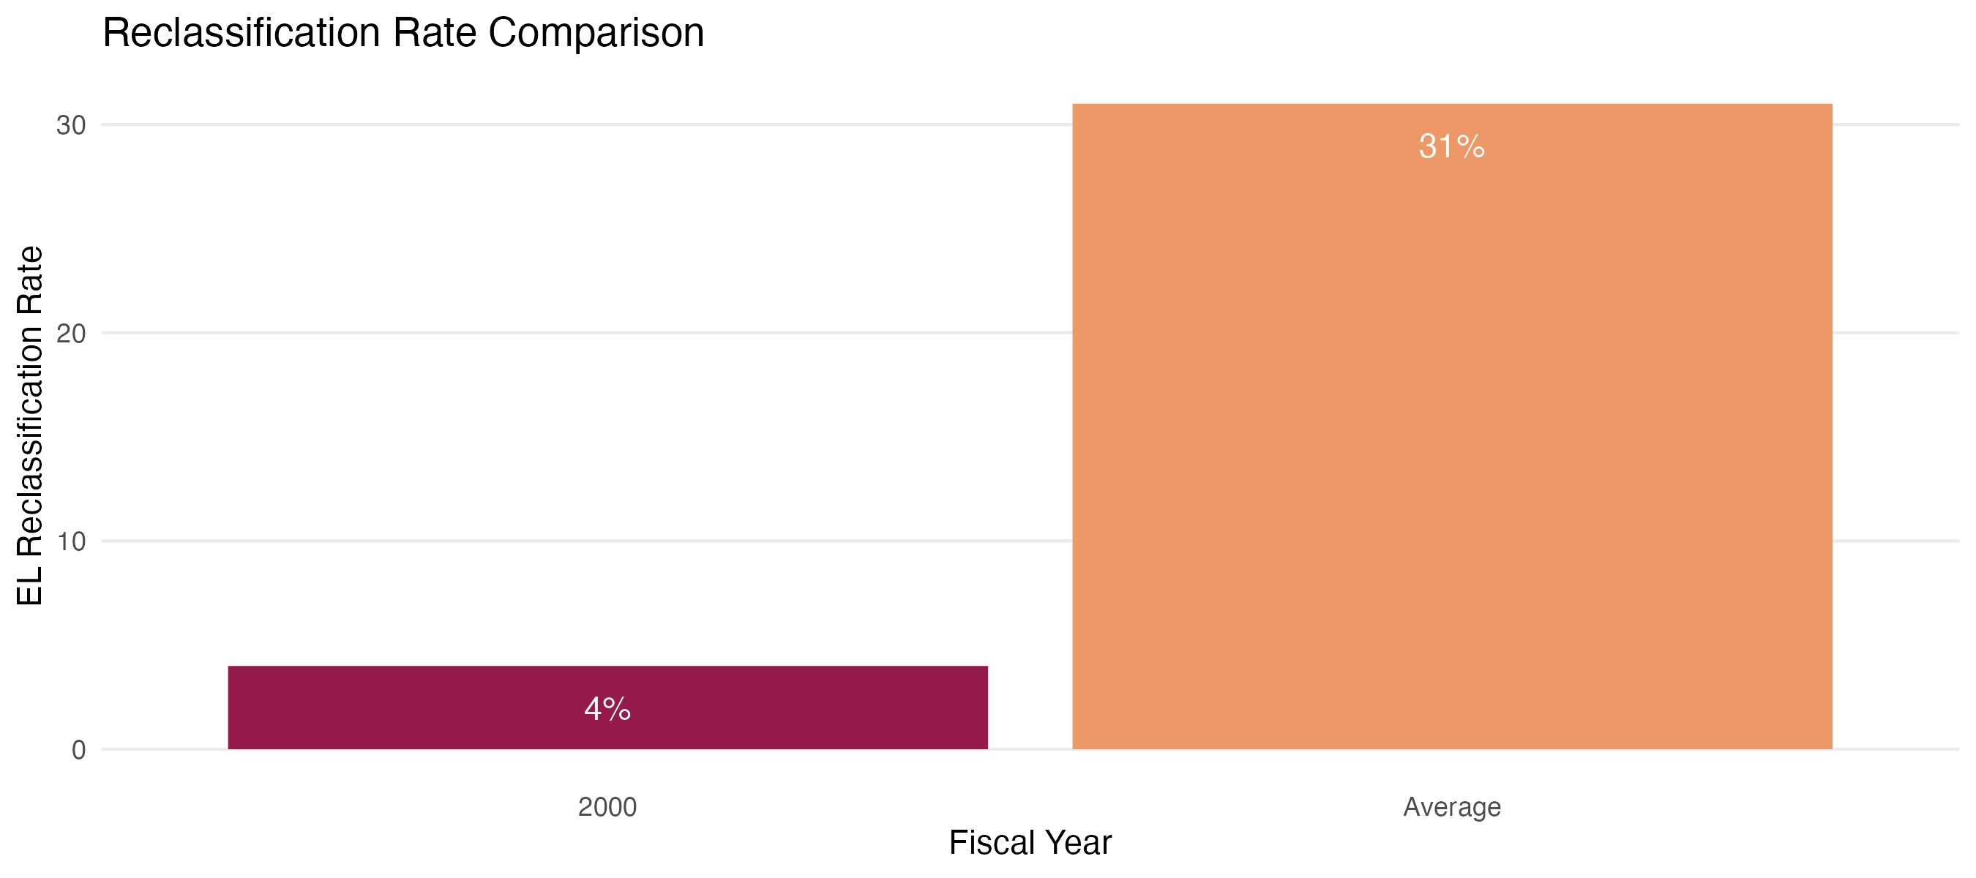
Sei vs dual language
2000
2008-2011
12

