Slide 1




File Submission
School Finance- Budget Team

Slide 2
Please Note:
During the creation of this PowerPoint, the name of the application was changed to “Budget System.” The original name was “Finance System.” “Budget System” and “Finance System” will be used interchangeably in text and in audio throughout this presentation.

Slide 3

Agenda
Submission Dashboard Overview
File Submission Process
File Submission Status
View Log
Data Validation & Acceptance

Slide 4


Submission Dashboard
Budget System
SECTION #1

Slide 5
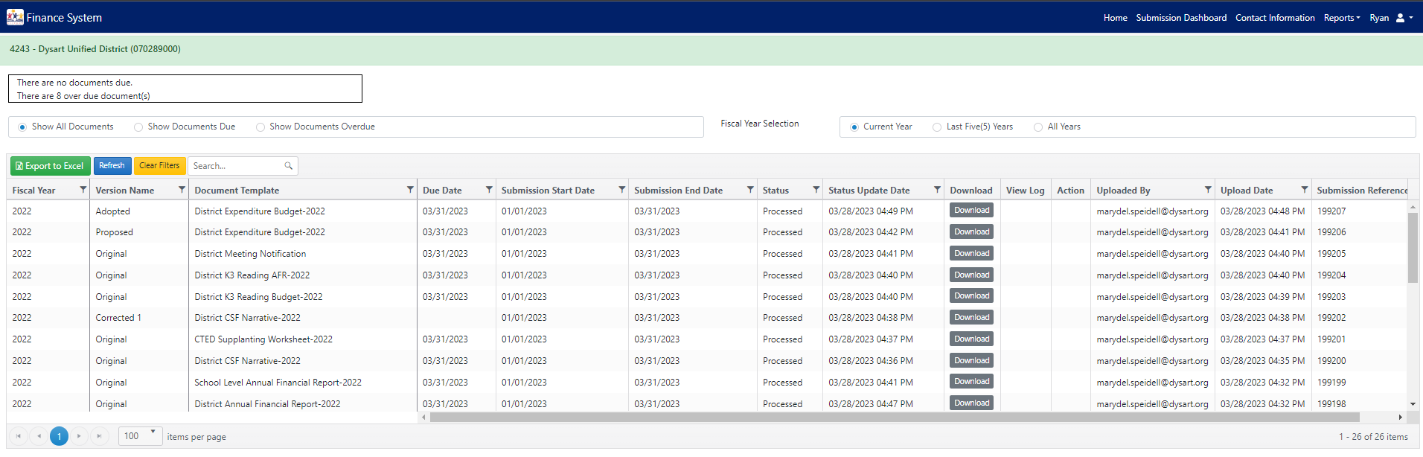
Notes:
Column meaning/purpose:
Fiscal year- this shows you what fiscal year this document is for.
Version name- this shows which version your document is for- such as proposed, adopted, revision #1, etc.
Document template- this shows what document the upload is for- District AFR, Charter AFR, District or Charter Expenditure Budget, etc.
Due date- this will explain when the document is due.
Submission start date- this shows when the upload availability will open.
Submission end date- this shows when the submission end date will open.
Status- we will go into details about the different statuses later, but this will show what status your submission is in.
Status update date- this shows when the most recent status update occurred
Download- you can download the file you uploaded
View log- we will discuss this later as well, but this shows what errors were found within your file
Action- this will give you the upload option
Uploaded by- this shows who uploaded the document- it will display as ADEConnect credentials
Upload date- this shows when the document was initially uploaded
Submission reference- this gives you a reference number for your submission
Normally, you will need to scroll to the right to able to see the “Upload”

Slide 6
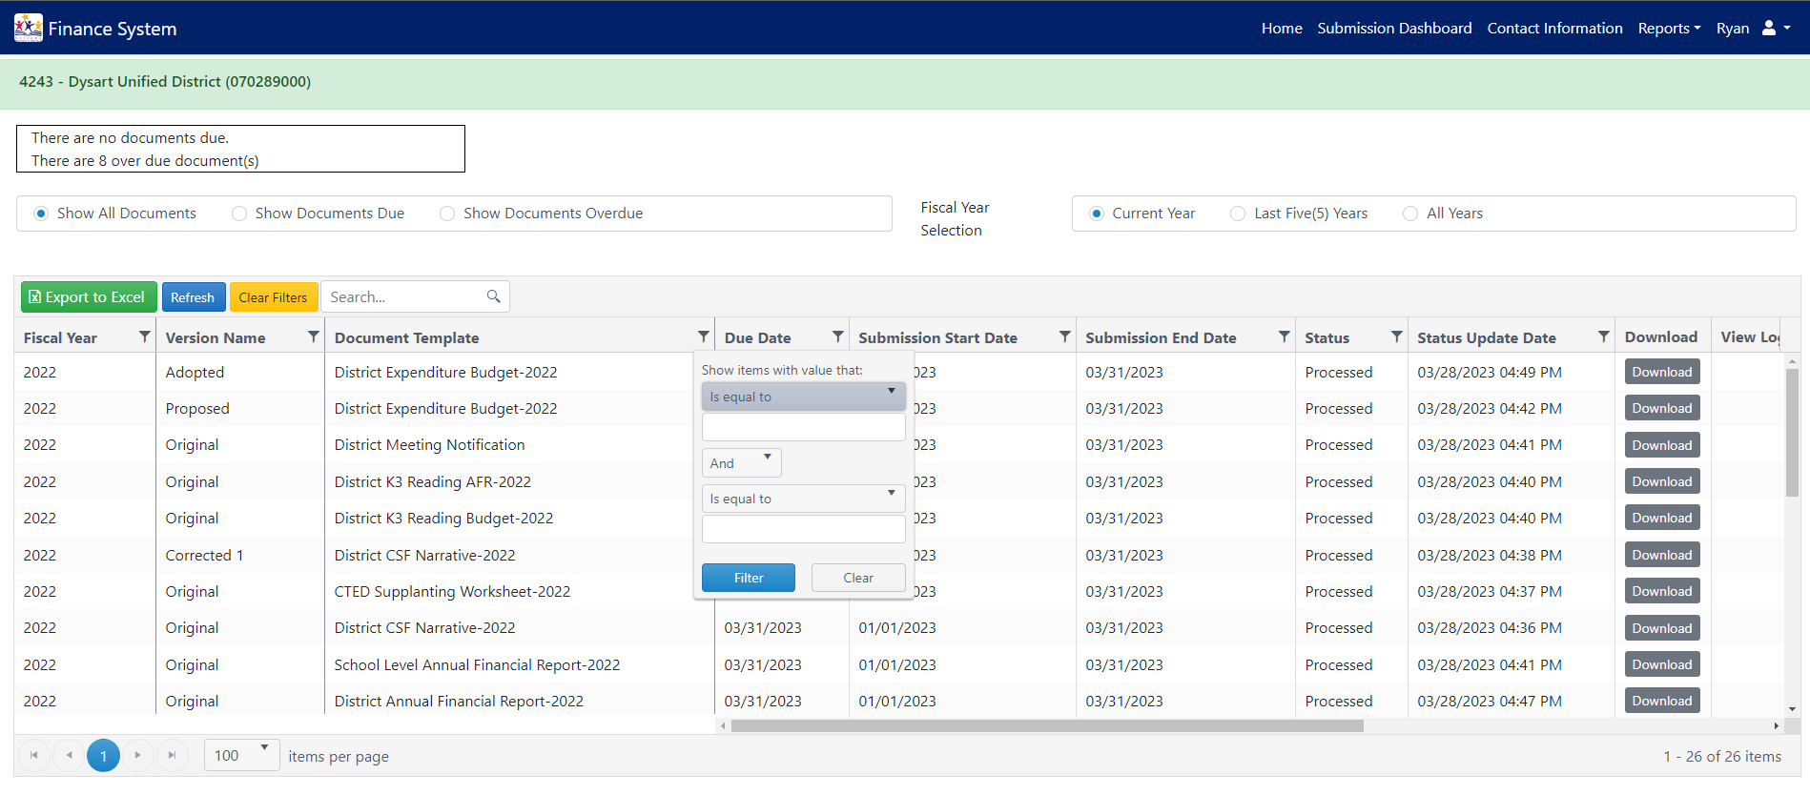
Notes:
We will start from top to bottom on this page:
At the top you will be able to see how many documents are unsubmitted and before their due date
You will also be able to see how many documents are in unsubmitted status and are past their due date
Next there are some preset filters that can be applied
You can view all documents, documents currently due, and documents that were unsubmitted and are past due
You can also show current year documents (which is the default), documents within the last 5 fiscal years, and all documents submitted
Other functions include being able to use the search bar for any information
You can search for a date, a fiscal year, a document, etc.- you can search across all columns.
Other filters you can use are by column
By clicking on the filter icon, you can view the dropdown you see. You can change how you want to filter that column, with contains, equal to, not equal to, begins with, etc.
You can use up to two filters using the and/or option
Clicking on the column title you can sort the data within the column by descending or ascending (click twice); clicking 3 times will default column
Clicking “Export to Excel” will export the data in the submission dashboard to Excel in the same format.
Make sure to clear the filters when you are done using them

Slide 7


Uploading Documents Step-By-Step
Budget System
SECTION #2

Slide 8
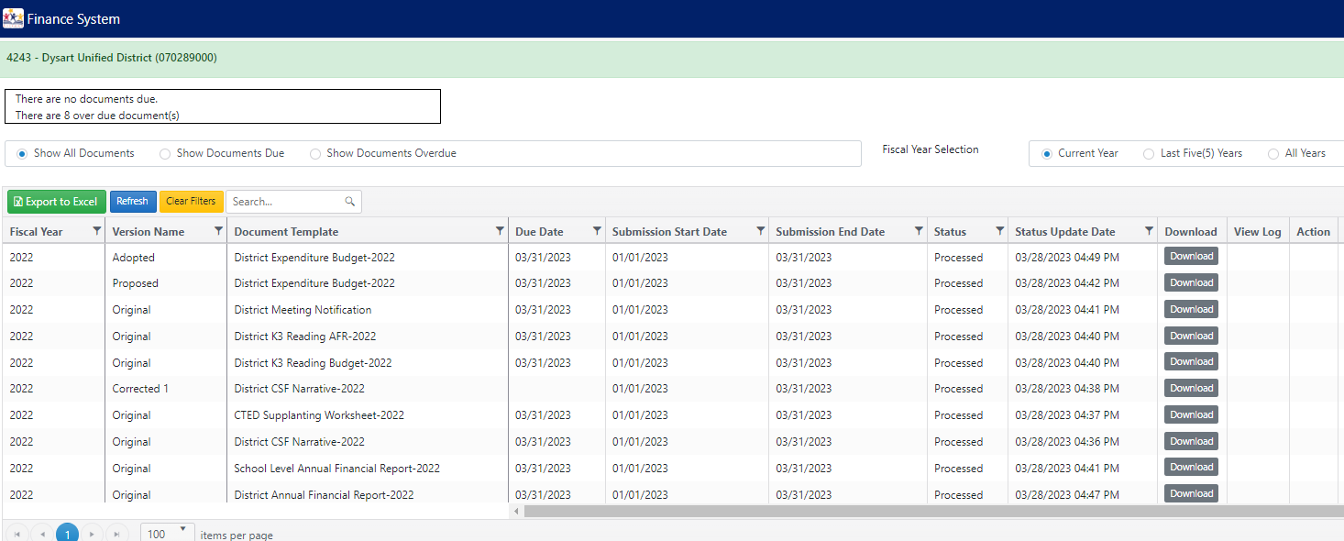
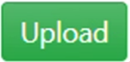
(LEA ID) LEA NAME (CTDS)
05/31/2023
05/31/2023
Unsubmitted
05/31/2023
Unsubmitted
Notes:
Select “Upload” on the template and version that you would like to upload to Budget System.

Slide 9

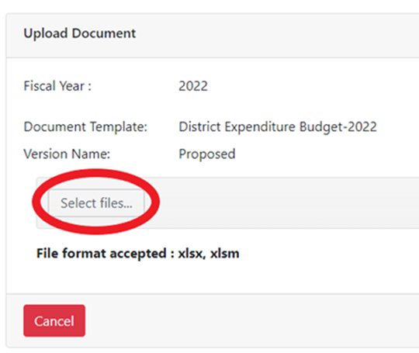
Adopted
Notes:
Notice here that there is no final upload button on the “Upload Document” pop-up that appears at the top of the screen- the system will not allow you to upload without selecting an acceptable file. Please review the three parameters (Fiscal Year, Document Template, and Version Name) before selecting/uploading the file.
Excel file format has changed from .xls to .xlsx or .xlsm

Slide 10
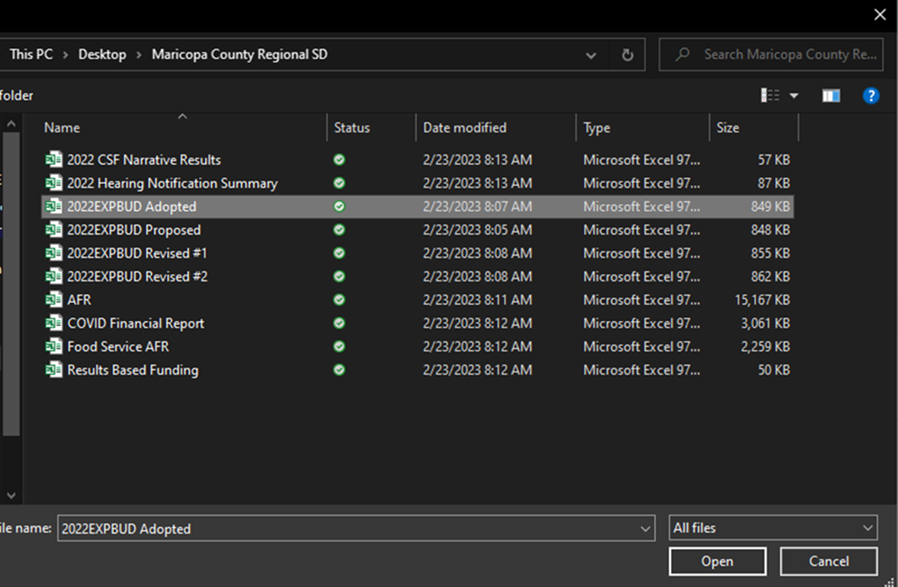
Notes:
Select file and click “Open.”

Slide 11
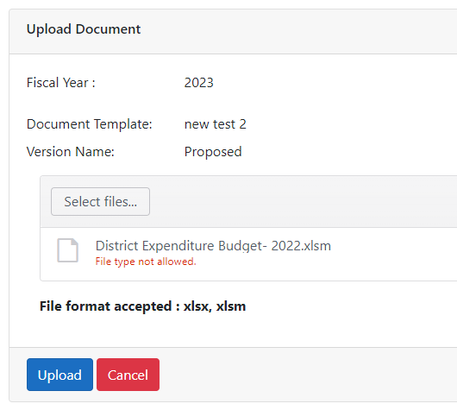
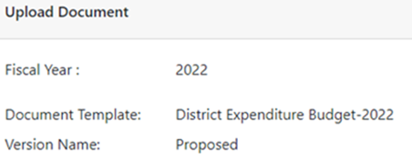
Adopted
Notes:
After selecting the file, hit “Upload” to complete the upload process- after this the file status will change.

Slide 12


File Submission Status
Budget System
SECTION #3

Slide 13
Status
Unsubmitted
Accepted
Processing
Processed
Processed with Warning(s) or Informational
  File has been processed but has failed warning/information tests set up by School Finance
  LEA does not have to resubmit their files
  Can view information in “View Log”
Rejected
  Documents that failed the acceptance tests cannot be processed
  Errors shall be viewable in “View Log”
  Upon “Rejected”, a new row will be added automatically for the same document template with the same version with an “Unsubmitted” status- the “Upload” button will remain available for the LEA to correct errors and resubmit their file in this new row ONLY if the submission window is still open
Notes:
There are many statuses that the file could be in. The following key statuses are :
Unsubmitted: the file has an open submission window and is unsubmitted.
Accepted: the uploaded file has passed initial system validation and is accepted into the system.
Processing: the uploaded file is going through additional validation and acceptance testing.
Processed: a possible final status; the uploaded file has completed all validation and acceptance tests- no further action is needed.
Processed with Warning(s)/Informational: a possible final status; the uploaded file has completed all validation and acceptance test- no further action is needed. Testing set up by School Finance has resulted in warnings or informational warnings that can be viewed in the “View Log” button on the submission dashboard.
Rejected: a possible final status; the uploaded file has failed either system validation testing or acceptance testing- information as to why the upload was rejected can viewed in the “View Log” button on the submission dashboard- LEAs can review their files with this information and adjust as needed for reupload as long as the due date/submission end dates have not passed.

Slide 14
View Log
Budget System
SECTION #4

Slide 15
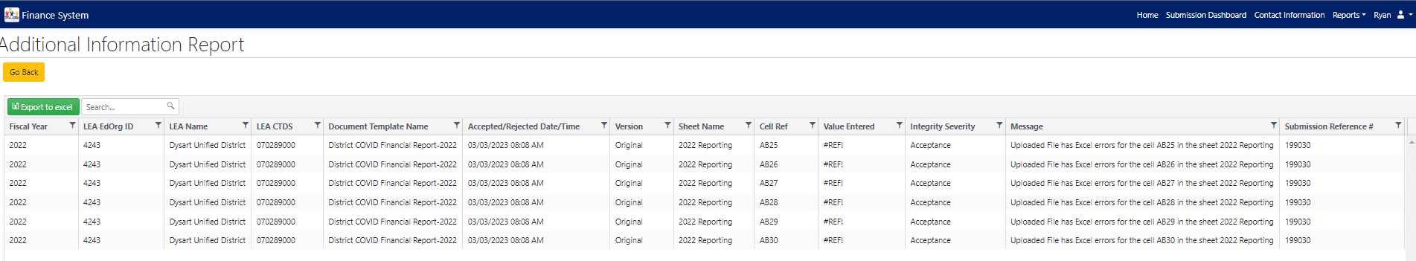
View Log
Notes:
The “View Log” details information of why this file was not processed or what warnings were produced during the validation process.
The “Sheet Name,” “Cell Ref,” “Value Entered,” and “Message” columns are the most important columns in “View Log” as they indicate what information was rejected and why. These columns will allow LEAs to adjust their own files for resubmission.

Slide 16
Data Validation & Acceptance
Budget System
SECTION #5

Slide 17
For File Validation & Acceptance
Document Template
  System confirms correct template is being utilized using GUID
Verify CTDS Permissions
  System verifies site level or district CTDS
Excel Errors
  Disabled formula
  Do NOT add or delete rows/columns
  Deleting linked files
Data Type
  System verifies CTDS, Text, Date, Numerical
Notes:
The GUID is built into the template so this is not something that LEAs will need to worry about. GUID is an ID that matches up a built-in ID in the template and in the uploaded files to make sure the correct file and version is being uploaded by the user. Again, this is nothing to worry about.
While the system is verifying CTDS permissions, it will NOT be verifying other data- the system will prioritize CTDS information. Make sure to input the correct CTDS and to input CTDS values in all locations requiring it.
Excel errors can cause a file to reject so do NOT change formulas, add or delete rows or columns, or delete any linked files in the downloaded Auditor General’s downloaded files.
Data type is, besides CTDS, a new function in this system compared to Common Logon- for example, in some formulas in the AFR if a value does not equal a certain cell it will default to something like “Must equal line 12”- this will cause a reject in the Budget System- so be cautious about the values in your cells. Make sure all cells have the expected type of data before submission or a reject will occur.
Files that pass validation may be rejected for failing an acceptance test set up by School Finance.

Slide 18
Next PowerPoint
The next video will explain the due dates and submission windows of required documents.
  *insert link*

Slide 19
STAY CONNECTED
  (602) 542-5695
  SchoolFinance@azed.gov
  http://www.azed.gov/finance/
School Finance
  SFBudgetTeam@azed.gov
    Expenditure Budgets
    Annual Financial Reports
    BUDG25, BUDG75, BUDGAGD
SF Budget Team
Phone Option 2

Slide 20
Thank You

