Slide 1



File Due Dates & Submission Windows
School Finance- Budget Team

Slide 2
Please Note:
During the creation of this PowerPoint, the name of the application was changed to “Budget System.” The original name was “Budget System.” “Budget System” and “Budget System” will be used interchangeably in text and in audio throughout this presentation.

Slide 3

Agenda
Introduction
Proposed/Adopted/Revision Workflow
Original/Corrected Workflow
Original Workflow
AFR & Budget 915/Revisions

Slide 4


Introduction
Budget System
SECTION #1

Slide 5
Introduction
The Budget System not only has a new process for uploading documents, but also a new understanding of due dates and submission windows
  Statutory due dates will remain the same for required documents, but submission windows and the ability to upload files for certain versions has changed in order to allow more flexibility for LEAs
The Budget System has adopted three workflow types, each of which will be followed by certain documents
  Each workflow has their own process for uploading files

Slide 6


Proposed/Adopted/Revision Workflow
Budget System
SECTION #2

Slide 7
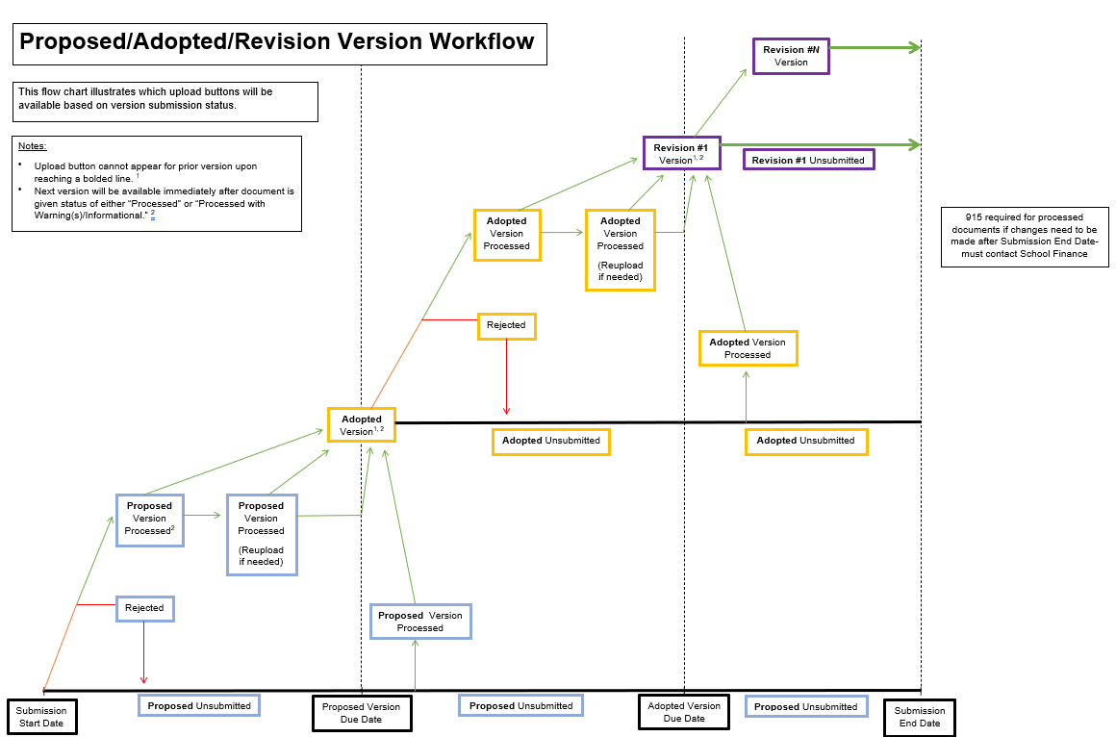
Notes:
The first workflow type we will explain is proposed/adopted/revision. This means that you will first submit the proposed version of the document, followed by the adopted version, then followed by any revisions. The proposed and adopted versions will have their own due dates- you will see these due dates on the submission dashboard. The proposed version can begin to be submitted after the submission window opens. This version will have its own due date. If, for example, you upload your file and it is given the status of “processed” or “processed with warning(s)/information,” then you will have the options to either upload the proposed version again until the due date OR you can upload the adopted version. When the due date passes and you have successfully processed the proposed version, you will only have the option to submit the adopted version. If you have not uploaded the proposed version or it is rejected, you can upload the file after the due date as long as the submission window is still open; if it is successfully processed then you will only have the option to upload the adopted version. The same steps apply to the adopted version; however, after uploading the adopted version and it has been successfully processed, then you will have “Revision 1” available to upload for. Again, as long as the deadline has not passed you can still reupload for the adopted version as well as the Revision 1 version. If the deadline does pass, then you will only have the option for Revision 1. Again, if you do not submit your adopted version by the deadline or it is rejected, but the submission window is still open, you can still upload your adopted version and, if successfully processed, you will only have “Revision 1” available. You can submit up to 10 successfully processed revisions before the submission window closes. Once one revision is successfully processed, you will only have the next revision available. Revisions do not have any due dates. After the submission window closes, if you need to update your Expenditure Budget files via 915, you will need to contact the School Finance Budget Team. Please review the last section for 915s.

Slide 8
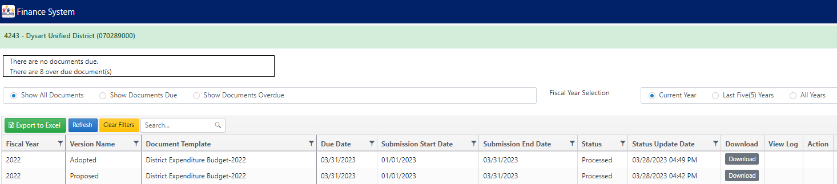
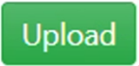
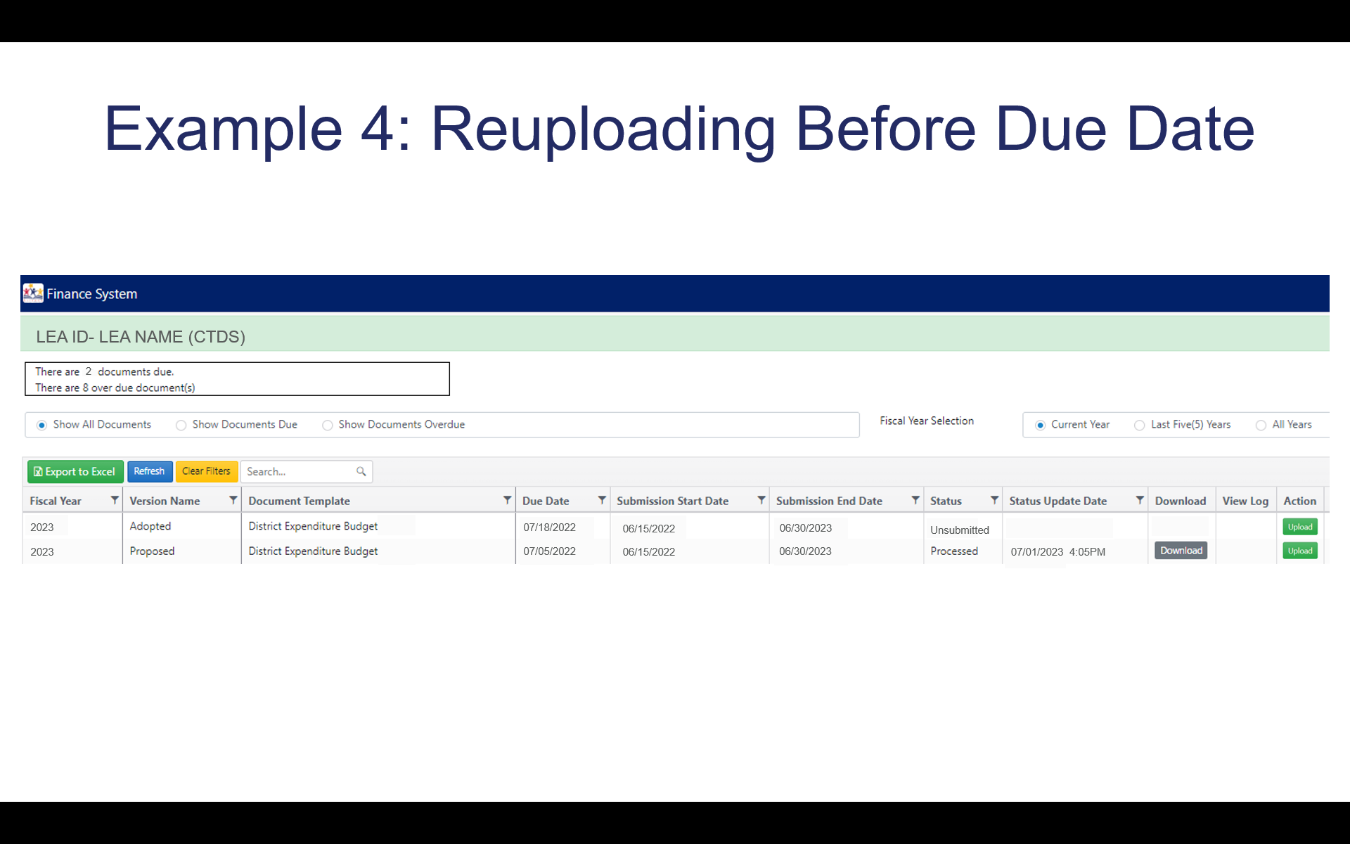
Example 1: Submitted Before Due Date
LEA ID- LEA NAME (CTDS)
2
2023
07/18/2022
06/15/2022
06/30/2023
Unsubmitted
2023
07/05/2022
06/15/2022
06/30/2023
Unsubmitted
07/01/2023 4:05PM
07/01/2022 4:05PM

Slide 9
Example 2: Submitted After Due Date
LEA ID- LEA NAME (CTDS)
2
2023
07/18/2022
06/15/2022
06/30/2023
Unsubmitted
2023
07/05/2022
06/15/2022
06/30/2023
Processed
07/15/2022 7:05PM

Slide 10

Example 3: Rejected File
LEA ID- LEA NAME (CTDS)
2
2023
Proposed
07/05/2022
06/15/2022
06/30/2023
Unsubmitted
2023
Proposed
07/05/2022
06/15/2022
06/30/2023
Rejected
07/10/2022 4:05PM

Slide 11
Example 4: Reuploading Before Due Date
LEA ID- LEA NAME (CTDS)
2
2023
07/18/2022
06/15/2022
06/30/2023
Unsubmitted
2023
07/05/2022
06/15/2022
06/30/2023
Unsubmitted
07/04/2023 10:17PM
Processed
07/03/2022 1:00PM
Processed
07/01/2022 4:05PM

Slide 12


Original/Corrected Workflow
Budget System
SECTION #3

Slide 13
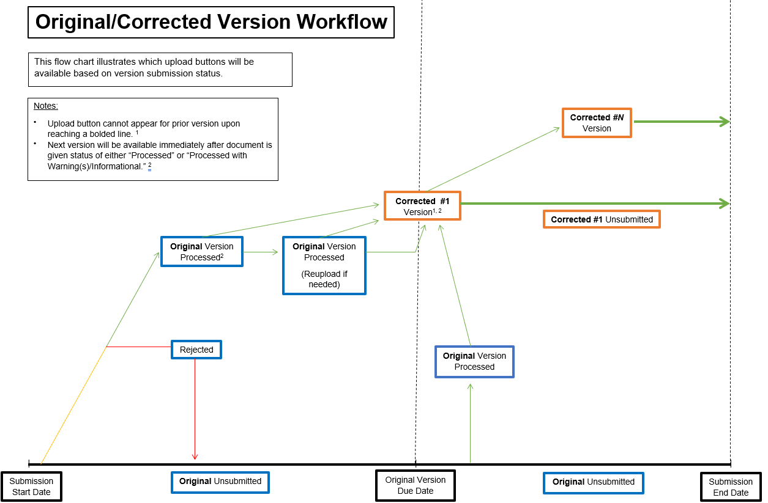
Notes:
The second workflow type we will explain is original/corrected. This workflow is very similar to the proposed/adopted/revision workflow. This original/corrected workflow means that you will upload the original file, then any additional corrections. You will have up to 10 corrections available. The original version can begin to be submitted after the submission window opens. This version will have its own due date. If, for example, you upload your file and it is given the status of “processed” or “processed with warning(s)/information,” then you will have the options to either upload the original version again until the due date OR you can upload “Corrected 1” version. When the due date passes and you have successfully processed the original version, you will only have the option to submit “Corrected 1.” If your upload to “Corrected 1” and it is successfully processed, then you will only be able to upload “Corrected 2.” This pattern will continue up until “Corrected 10” version. This workflow type allows LEAs to submit any corrections until the submission end date without having to contact School Finance. Additionally, if the original version is not uploaded or successfully processed after the due date but before the submission window closes, then the file can still be uploaded and, if processed successfully, then “Corrected 1” will be available. No uploads will be accepted after the submission end date.

Slide 14
Example 1: Submitted Before Due Date
LEA ID- LEA NAME (CTDS)
2
2023
Corrected 1
District K3 Reading AFR
06/15/2022
06/30/2023
Unsubmitted
2023
Original
District K3 Reading AFR
10/01/2022
06/15/2022
06/30/2023
Unsubmitted
07/01/2023 4:05PM
Original
District K3 Reading AFR
10/01/2022
06/15/2022
Processed
07/01/2022 4:05PM

Slide 15
Example 2: Submitted After Due Date
LEA ID- LEA NAME (CTDS)
2
2023
Corrected 1
District K3 Reading AFR
06/15/2022
06/30/2023
Unsubmitted
2023
Original
District K3 Reading AFR
10/01/2022
06/15/2022
06/30/2023
Processed
11/15/2022 7:05PM

Slide 16
Example 3: Rejected File
LEA ID- LEA NAME (CTDS)
2
2023
Original
District K3 Reading AFR
10/01/2022
06/15/2022
06/30/2023
Unsubmitted
2023
Original
District K3 Reading AFR
10/01/2022
06/15/2022
06/30/2023
Rejected
08/10/2022 4:05PM

Slide 17
Example 4: Reuploading Before Due Date
LEA ID- LEA NAME (CTDS)
2
2023
Corrected 1
District K3 Reading AFR
06/15/2022
06/30/2023
Unsubmitted
2023
Original
District K3 Reading AFR
10/01/2022
06/15/2022
06/30/2023
Unsubmitted
07/04/2023 10:17PM
Original
District K3 Reading AFR
10/01/2022
Processed
09/30/2022 1:00PM
Original
District K3 Reading AFR
10/01/2022
Processed
08/01//2022 4:05PM

Slide 18
Original Workflow
Budget System
SECTION #4

Slide 19
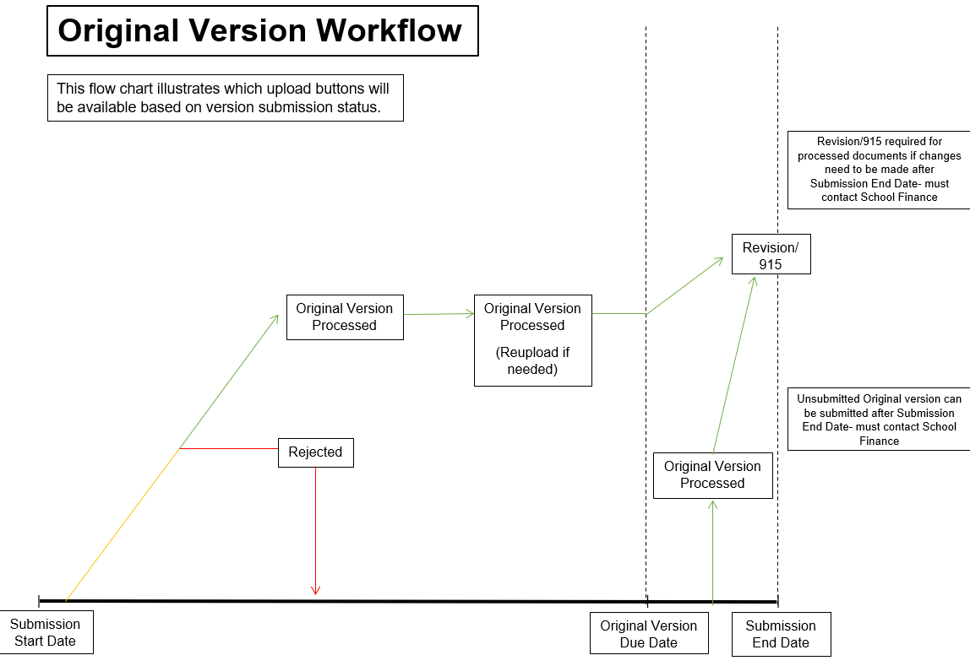
Notes:
The last version workflow is the original workflow. This workflow is unique and is used for Annual Finance Reports, Desegregation Annual Financial Reports, and School Level Annual Financial Reports. This workflow is unique due to the statutory deadlines. In this workflow, you will be able to upload files after the submission window opens. If your files are successfully processed, you are not required to reupload. If you do wish to reupload then you will have the option to up until the due date. If you do not upload your file or if it is after the due date but before the submission window end date, you can still upload your file until the submission window closes. After the submission window closes, you can no longer upload any files. If you need to edit your file for revisions or 915, please contact the School Finance Budget Team. Additionally, please see the next slide for more information about AFR revisions and 915s.

Slide 20
Example 1: Submitted Before Due Date
LEA ID- LEA NAME (CTDS)
2
2023
Original
District Annual Financial Report
10/15/2022
09/15/2022
10/31/2022
Unsubmitted
2023
Original
District Annual Financial Report
10/15/2022
09/15/2022
10/31/2022
Processed
10/05/2022 7:05PM

Slide 21

Example 2: Submitted After Due Date
LEA ID- LEA NAME (CTDS)
2
2023
District Annual Financial Report
10/31/2022
Processed
10/20/2022 7:05PM
Original
10/15/2022
09/15/2022
Unsubmitted
2023
Original
District Annual Financial Report
10/15/2022
09/15/2022
10/31/2023

Slide 22
Example 3: Rejected File
LEA ID- LEA NAME (CTDS)
2
2023
Original
District Annual Financial Report
10/15/2022
09/15/2022
10/31/2022
Unsubmitted
2023
Original
District Annual Financial Report
10/15/2022
09/15/2022
10/31/2022
Rejected
10/05/2022 7:05PM

Slide 23
Example 4: Reuploading Before Due Date
LEA ID- LEA NAME (CTDS)
2
2023
Original
District Annual Financial Report
10/15/2022
09/15/2022
10/31/2022
Unsubmitted
2023
Original
District Annual Financial Report
10/15/2022
09/15/2022
10/31/2022
Processed
10/10/2022 1:15PM
10/31/2022
Processed

Slide 24
AFR 915/Revisions & Budget 915
Budget System
SECTION #5

Slide 25
AFR 915/Revisions & Budget 915
Can request after submission end date
  Same process as before
    Revisions:
      AFR revisions that do not affect expenditures
      Email sf_budgetteam@azed.gov with the following:
        List of manual changes made including cell reference, values, and reason
    915:
      Budget and AFR revisions will require a 15-915 if expenditures are affected
      Email sf_budgetteam@azed.gov with the same information as revisions as well as:
        15-915 letter signed by business manager
      Please visit the following link for more information:
        Correcting AFRs and School-Level Reports | Arizona Department of Education (azed.gov)
    School Finance will review emailed information then upon approval will open a new submission window on Budget System for LEAs to upload their revised files

Slide 26
Next PowerPoint
The next video will review how to retrieve your ADE produced reports.
  *insert link*

Slide 27
STAY CONNECTED
  (602) 542-5695
  SchoolFinance@azed.gov
  http://www.azed.gov/finance/
School Finance
  SFBudgetTeam@azed.gov
    Expenditure Budgets
    Annual Financial Reports
    BUDG25, BUDG75, BUDGAGD
SF Budget Team
Phone Option 2

Slide 28
Thank You

