Slide 1




Contact Information
School Finance- Budget Team

Slide 2
Please Note:
During the creation of this PowerPoint, the name of the application was changed to “Budget System.” The original name was “Finance System.” “Budget System” and “Finance System” will be used interchangeably in text and in audio throughout this presentation.

Slide 3

Agenda
Introduction
Locating Contact Information
Contact Information Homepage
Updating Contact Information

Slide 4


Introduction
Budget System
SECTION #1

Slide 5
Introduction
This contact information page is meant to replace the process of updating and storing LEA contact information
This data is used by School Finance to send out applicable information to the correct LEA personnel

Slide 6


Locating Contact Information
Budget System
SECTION #2

Slide 7
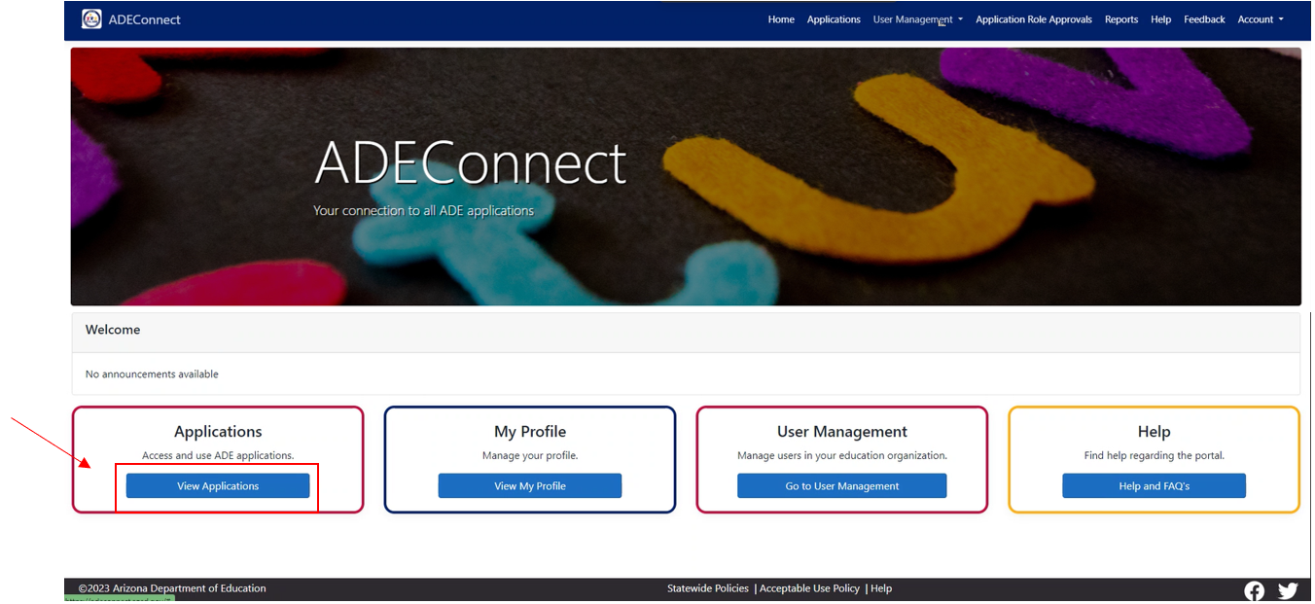
Step 1: Login to ADEConnect and Click “View Applications”

Slide 8
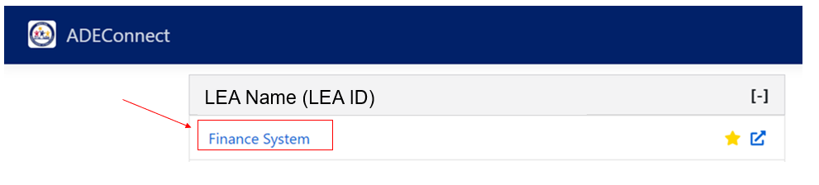
Step 2: Click “Budget System”

Slide 9
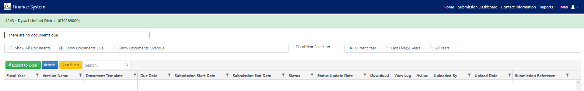
Step 3: Click “Contact Information”
(LEA ID) Lea Name (CTDS)

Slide 10


Contact Information Homepage
Budget System
SECTION #3

Slide 11
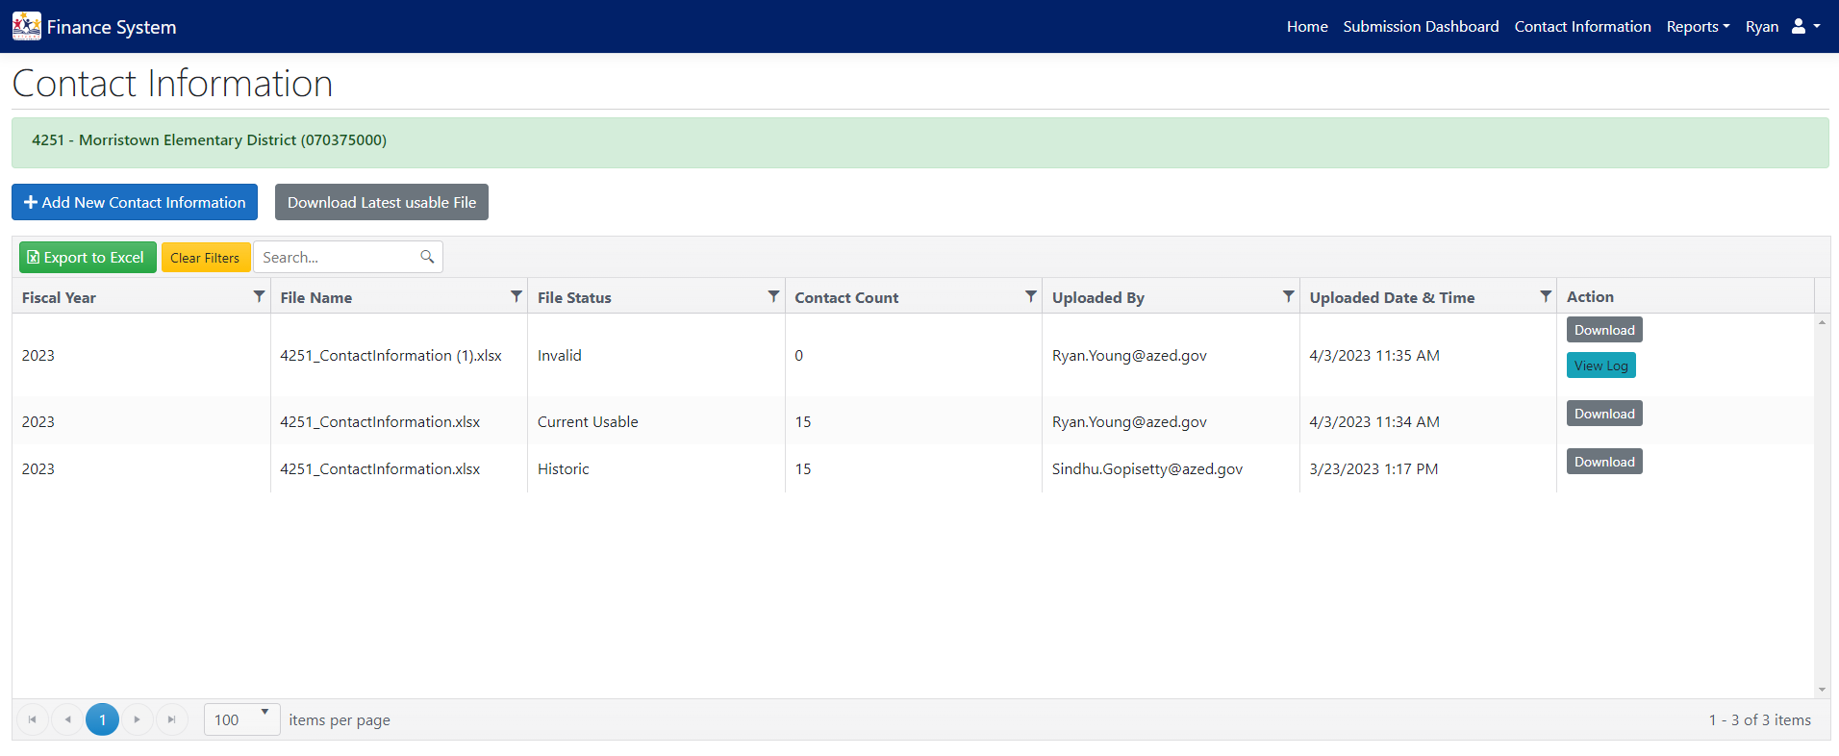
Contact Information Homepage
(LEA ID) LEA NAME (LEA CTDS)
ADEConnect Credentials
ADEConnect Credentials
ADEConnect Credentials
Notes:
See next slide for a breakdown of the information of the Contact Information homepage.

Slide 12
Contact Information Homepage Explanation
Fiscal Year: the fiscal year in which the file was uploaded
File Name: the given name of the uploaded Excel file
File Status: the status of which the uploaded file is in
  Current Usable: this is the processed and in-use file
  Invalid: a rejected file upload due to error
  Historic: a previously processed but out-of-use file
Contact Count: the number of contact positions submitted in the file
Uploaded By: the ADEConnect email of personnel who uploaded the file
Action:
  Download: download existing contact information Excel file
  View Log: explain errors of files with invalid status

Slide 13
Updating Contact Information
Budget System
SECTION #4

Slide 14
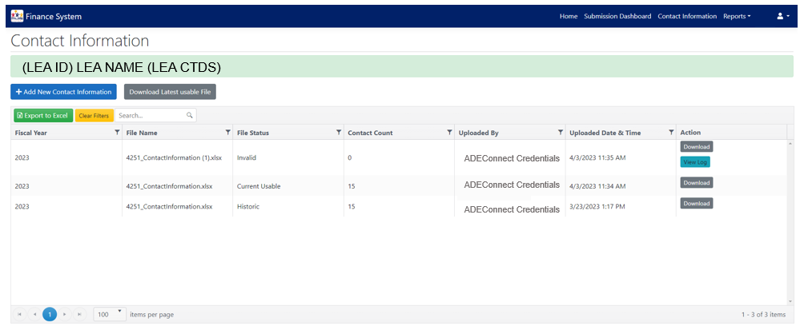
Step 1: Click “Download Latest Usable File”
Notes:
Please download the latest usable file by clicking the indicated button. This will maintain the required template.

Slide 15
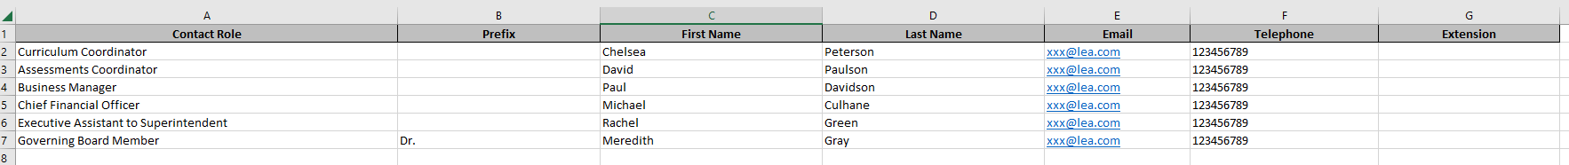
Step 2: Review and Update Downloaded Excel File
Select from drop-down menu
Mandatory Fields
Notes:
Only change information in these fields- do NOT change any other information/format in the Excel file.
A user (First Name + Last Name) can have multiple roles.
A role can have multiple users.

Slide 16
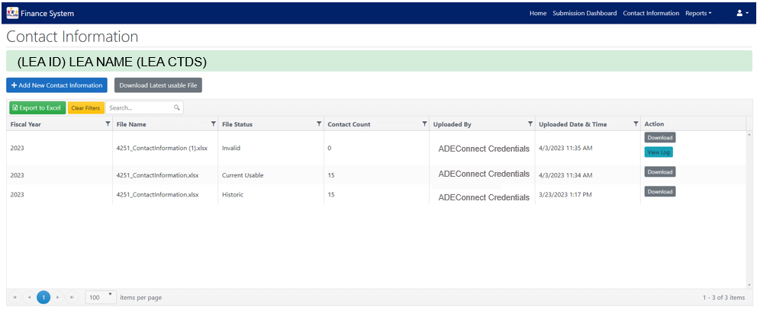
Step 3: Click “+Add New Contact Information” To Update
Notes:
After editing and saving the contact information Excel file, go back to Budget System and click the indicated button.

Slide 17
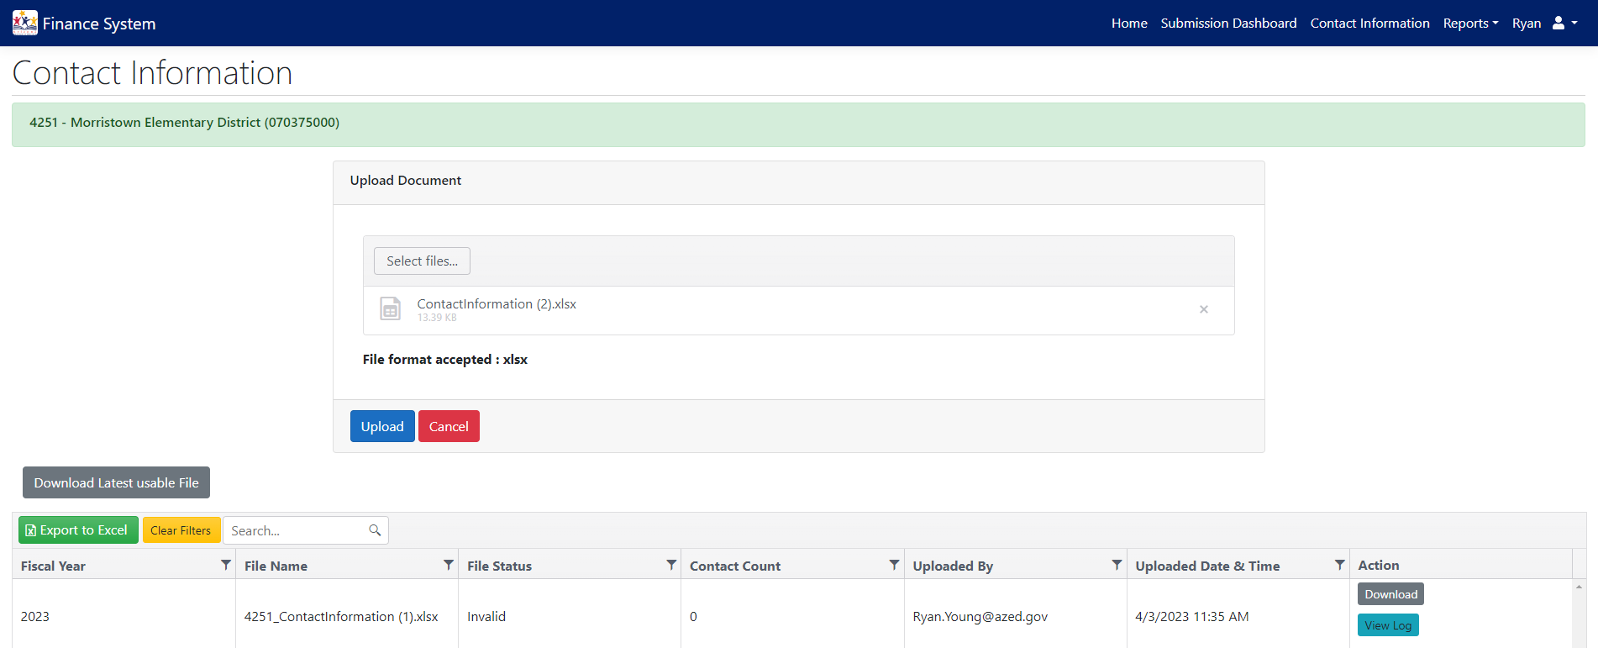
Step 4: Select & Upload Saved Excel File
(LEA ID) LEA NAME (CTDS)
Notes:
Do not change Excel file format.

Slide 18
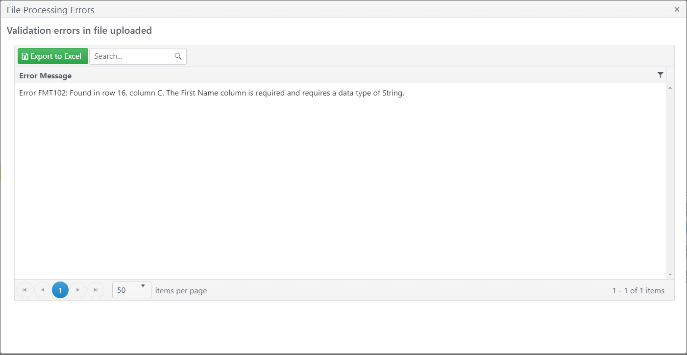
Step 5: If Invalid Upload, Click “View Log” To View Errors
Notes:
This is an example View Log. Correct the errors in saved Excel file then reupload.

Slide 19
Next PowerPoint
The next video will review the submission dashboard and how to submit files.
  *insert link*

Slide 20
STAY CONNECTED
  (602) 542-5695
  SchoolFinance@azed.gov
  http://www.azed.gov/finance/
School Finance
  SFBudgetTeam@azed.gov
    Expenditure Budgets
    Annual Financial Reports
    BUDG25, BUDG75, BUDGAGD
SF Budget Team
Phone Option 2

Slide 21
Thank You

