Slide 1



ADEConnect Budget System Basics
School Finance- Budget Team

Slide 2
Please Note:
During the creation of this PowerPoint, the name of the application was changed to “Budget System.” The original name was “Finance System.” “Budget System” and “Finance System” will be used interchangeably in text and in audio throughout this presentation.

Slide 3

Agenda
Introduction
Purpose of Budget System
Differences Between Common Logon & Budget System
ADEConnect Permissions

Slide 4


Introduction
Budget System
SECTION #1

Slide 5
Introduction
ADEConnect-Budget System is meant to replace Common Logon for all budget purposes starting from fiscal year 2024
  The Budget System is meant to update the existing budget system and to provide a central location for all data
School Finance will be uploading numerous tutorial videos to help ease the transition into this new system

Slide 6


Purpose
Budget System
SECTION #2

Slide 7
Purpose
The Budget System is meant to update the existing budget system and to provide a central location for all data
  On ADEConnect Budget System, you can update contact information, upload your required documents, view submissions, and access reports
  This system will provide feedback on uploaded documents if necessary
  This system provides more flexibility for users and will help everyone by creating a fluid process for all budget related items

Slide 8


Differences Between Common Logon & Budget System
Budget System
SECTION #3

Slide 9
Differences
Budget System provides feedback on uploaded documents so LEAs can make necessary corrections to reupload
School Finance Budget Team cannot upload files on the behalf of LEAs in the new system
Google Chrome is recommended for the system
Excel formatting has changed from .XLS to either .XLSX or .XLSM depending on the file
  This will be done already but do not change back to .XLS

Slide 10
ADEConnect Permissions
Budget System
SECTION #4

Slide 11
Granting Permissions
Must be done before you can access the user interface or submit files
  Please contact your entity administrator to grant access to the Budget System user role
    District entity admin login:
      https://adeconnect.azed.gov/
    How to check who can grant permissions:
      ADEConnect - Find Administrator (azed.gov)
        If there are no entity administrators to grant access, please contact Constituent Services
          602-542-7378
          questions@azed.gov
    Please view these helpful user role videos
      https://adeconnect.azed.gov/Videos

Slide 12
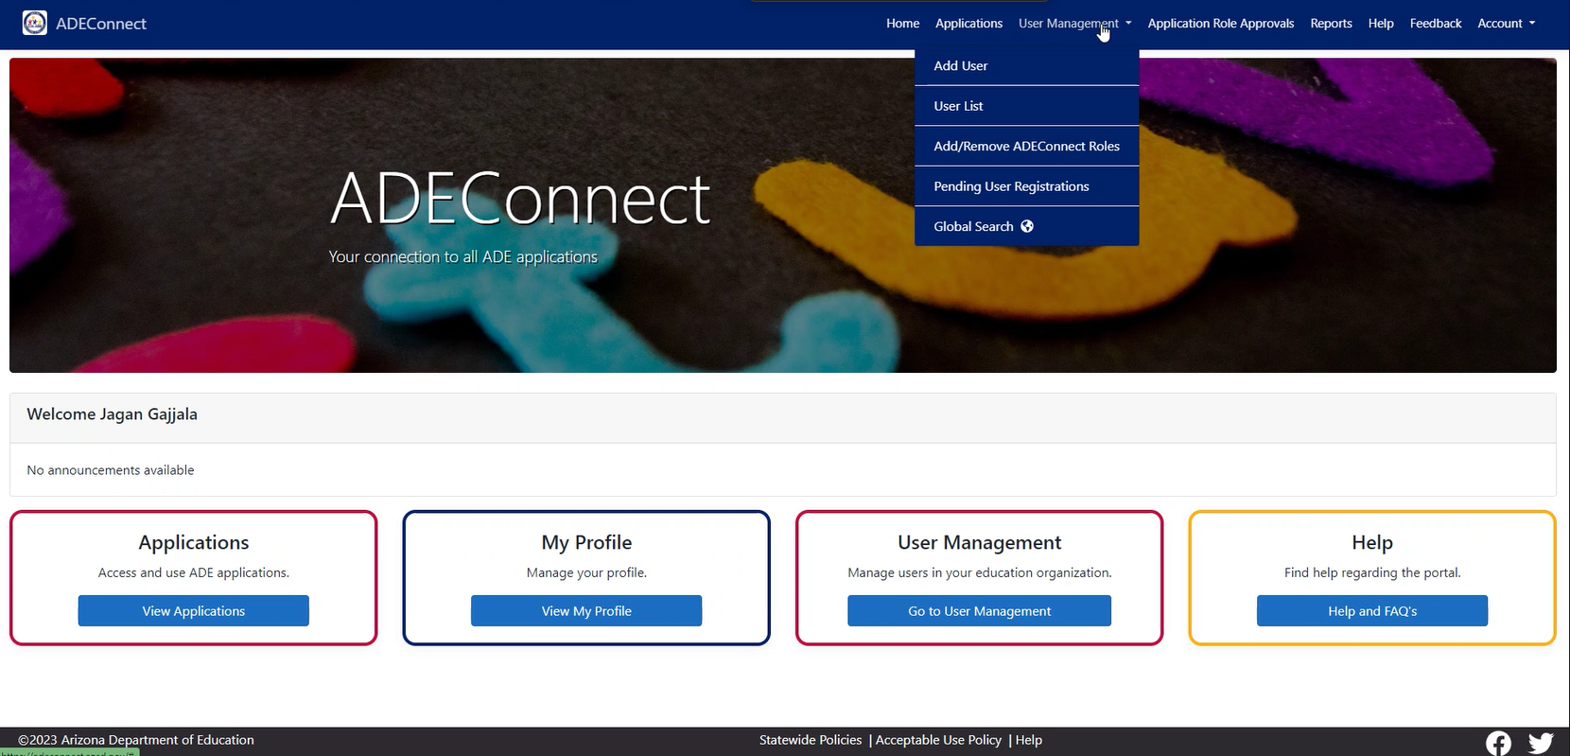
Step 1: Go to ADEConnect & Click “User Management”

Slide 13
Step 2: Click “Add User”
If the user information is already in ADEConnect, skip to step 3

Slide 14
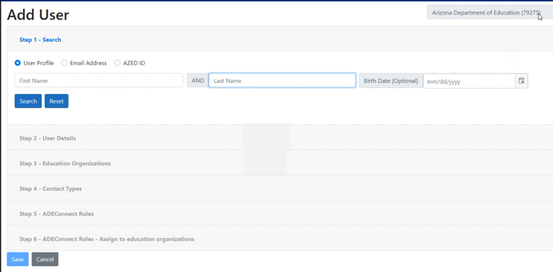
Step 2.a: Add & Save User Information

Slide 15
Step 3: Click “Add/Remove ADEConnect Roles”

Slide 16
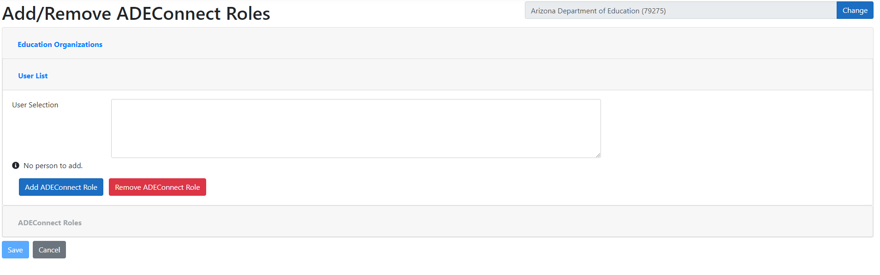
Step 3.a: Selecting User
Search for the user in “User Selection” box
  Click “Add ADEConnect Role”

Slide 17
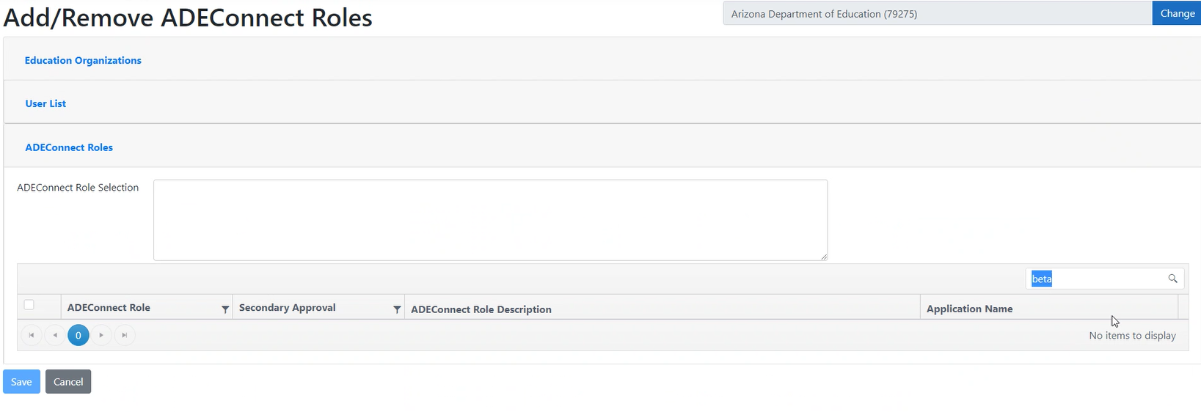
Step 3.b: Adding/Removing ADEConnect Roles
Click or search for “Budget System”
  After selected, click “Save”

Slide 18
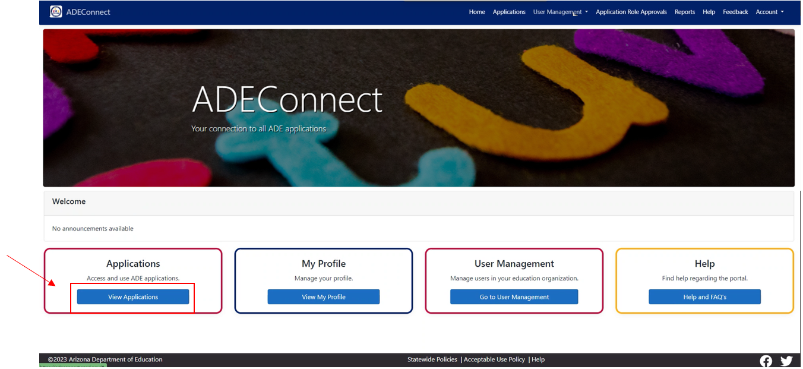
Step 4: Login To Budget System By Clicking “View Applications”

Slide 19
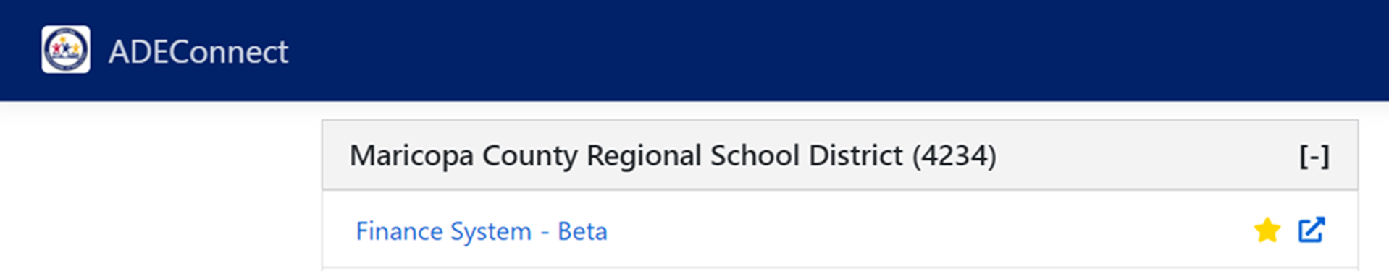
Step 4.a: Click “Budget System”
LEA Name (LEA ID)

Slide 20
Next PowerPoint
The next video will review how to upload and edit your contact information
  *insert link*

Slide 21
STAY CONNECTED
  (602) 542-5695
  SchoolFinance@azed.gov
  http://www.azed.gov/finance/
School Finance
  SFBudgetTeam@azed.gov
    Expenditure Budgets
    Annual Financial Reports
    BUDG25, BUDG75, BUDGAGD
SF Budget Team
Phone Option 2

Slide 22
Thank You

