Slide 1

Notes:
Optional Intro music, approx. 7.5 minutes

Slide 2


ARIZONA PURPLE STAR SCHOOL Professional Development
Developed by Lee E. Fernwault, M.Ed. - K12 Military Community Liaison
C
Notes:
Important note: The STAR w/C (Bottom Right) indicates click/enter to advance or begin a specific animation. Slides with no STAR w/C will automatically advance to improve flow.

Slide 3



Contributors
Mr. Samuel Smith
Mrs. Stacey Holland
Mrs. Candice Brown
MCEC – Military Child Education Coalition
C
Notes:
The Military Child Education Coalition is the primary advocate for the Purple Star School program and offers an extensive library of resources. MCEC (/m/-seck) hosts a yearly Global Summit in Washington, D.C. for all Purple Star Schools in July. POCs, Counselors, Educators, and Student Ambassadors are encouraged to attend.

Slide 4

Professional Development Objective:
Level the Playing Field for
Highly Mobile, Military-Connected Students
C
Notes:
Over 40 states and numerous global schools have utilized the Purple Star School program to enhance student outcomes that are often misunderstood and overlooked.. Understanding the unique needs of some can foster resiliency and leadership for all at our school.

Slide 5

Who are highly mobile,
military-connected students?
A child with at least one parent/caregiver serving in the U.S. Armed Services
(Active, Reserve, National Guard, US Dept. Health, NOAA)
A child with a parent who has recently separated from the military. (Discharged, Veteran)
Highly mobile - A child subject to frequent transitions. (USDOE)
    Foster
    Migrant
    Refugee
C
Notes:
The US Dept of Education's definition of "Highly mobile" should not underscore the importance of Arizona's Purple Star School program or military-connected children. Military-connected students' resiliency, adaptability, maturity, and potential global experiences with diverse cultures are valuable assets that can help any identified student(s) succeed through the implementation of a student-led peer-to-peer program.

Slide 6





Highly mobile*, military-connected students may experience unique situations
Notes:
Slides advance automatically. Slide introduces some situations for highly mobile students through four images, accompanied by a thought-provoking word.

Slide 7
Notes:
Presenter – suggest providing a visual description of each image as they advance to improve accessibility for all attendees. 1. Large moving truck 2. Hurricane 3. Parent leaving 4. A child who has no idea what is next.

Slide 8
A Sudden Move

Slide 9
Natural Disaster

Slide 10
Deployment

Slide 11
Uncertainty

Slide 12
ACTIVITY 1

Slide 13

URGENT!
C
Notes:
Mission assignment open: OPERATION DANDELION. (Distribute activity scenarios.) Scenarios provide situations that highly mobile, military-connected students commonly face during their academic careers. Recommend that groups collaborate to discuss a scenario from one of the four provided options. Click – The FIVE-MINUTE timer will start with the next slide. Probing Question: Have any of you moved recently? How did you feel? Imagine those same feelings when a child has no control over what is happening. Remember, military-connected children serve as well.

Slide 14


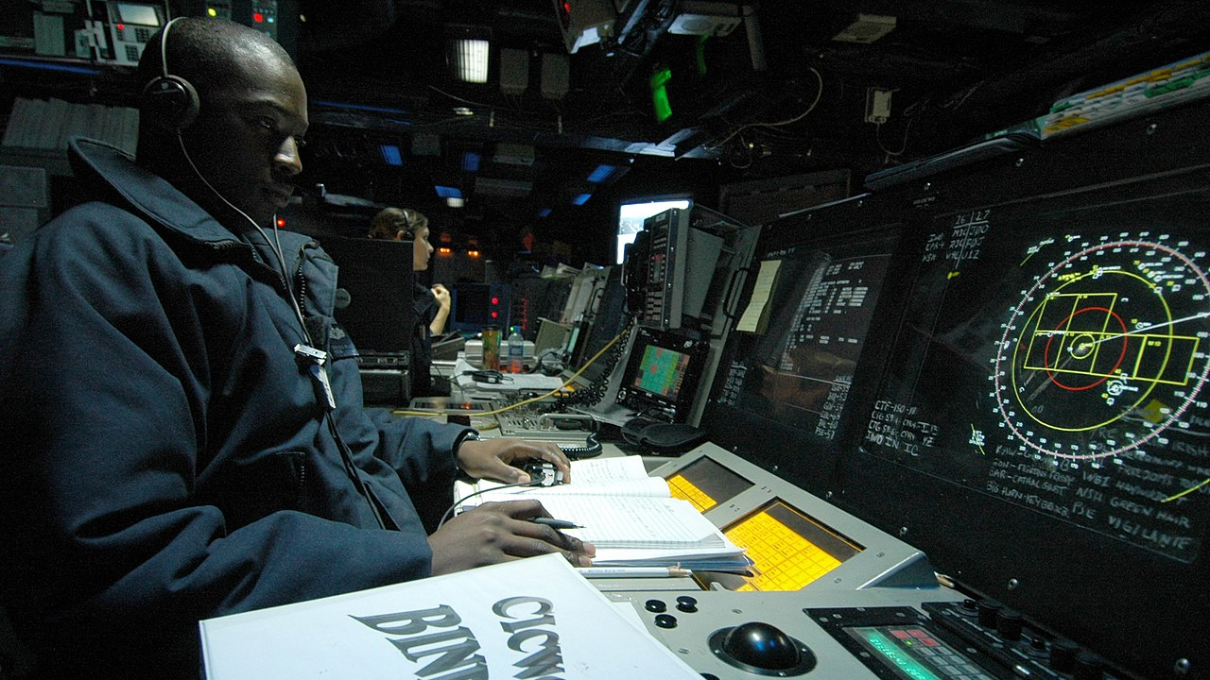
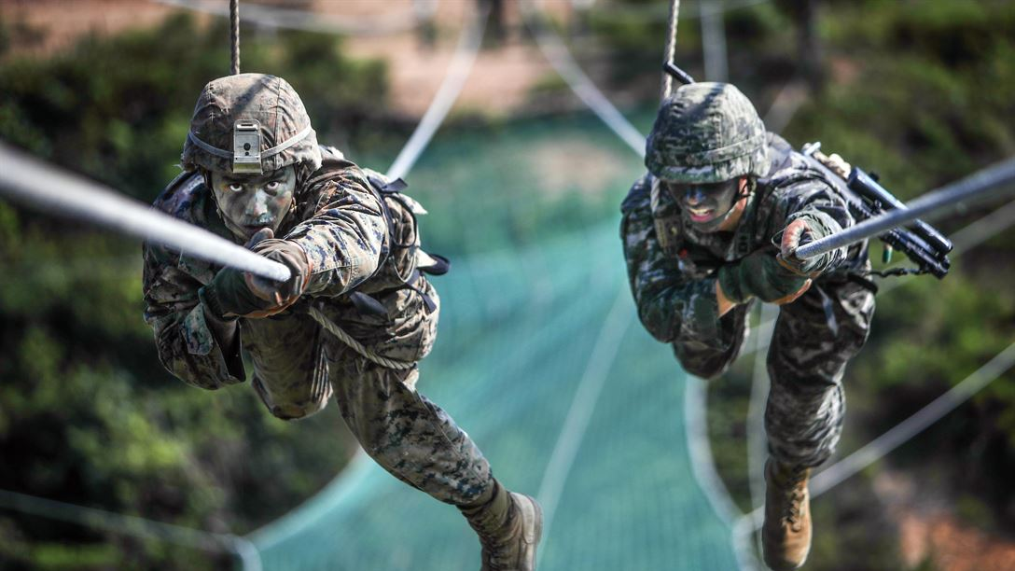

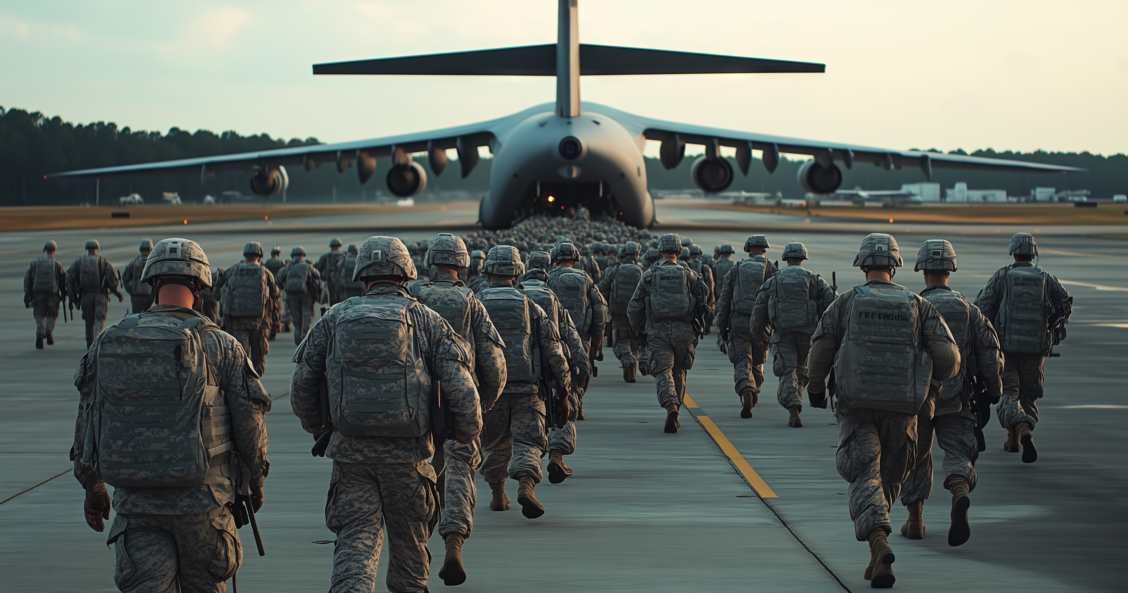

3 min – Ready
2 min – Distance to Contact
Go Time
5 min – Mission Start
4 min – Pre Check
1 min – Mark
C
Notes:
After 5 minutes, the Group Leads share out. (Can be extended to a max of 10 minutes depending on time.)
(Optional) Ask the staff if they have experienced multiple moves and about their experiences with them.

Slide 15

Purple Star Schools implement best practices to address the unique challenges highly mobile, military-connected students undergo:
Transitions
Deployments
Educational Gaps
Curriculum Overlaps
Varying Graduation Requirements
C
Notes:
Provide examples of each – Group call out.
Examples: Transition – moving from one state to another or coming from another country (e.g., Germany, South Korea, Oklahoma to Arizona).
Deployment – Can be of any length of time, and may require short notice; typically, it means being sent somewhere other than their current assignment.
Educational Gaps - states or countries may be ahead or behind in the sequence of courses. May have missed out during the transition period.
Curriculum Overlaps – May have already taken the course and needs a more advanced subject.
Graduation Requirements – Senior came from another state and has not taken AZ History or enough math, etc. (Exemption should be requested)

Slide 16


Highly Mobile Students/Challenges
Transitions
On average, military students move 6 to 9 times during their school years, or about every 2 to 3 years.
Change can lead to tensions at home and school
Frequent unfamiliarity can impact student success
(New school and new environments)
C
Notes:
Common Transition (PCS) Permanent Change of Station, moving from one base to another in or out of the United States.

Slide 17
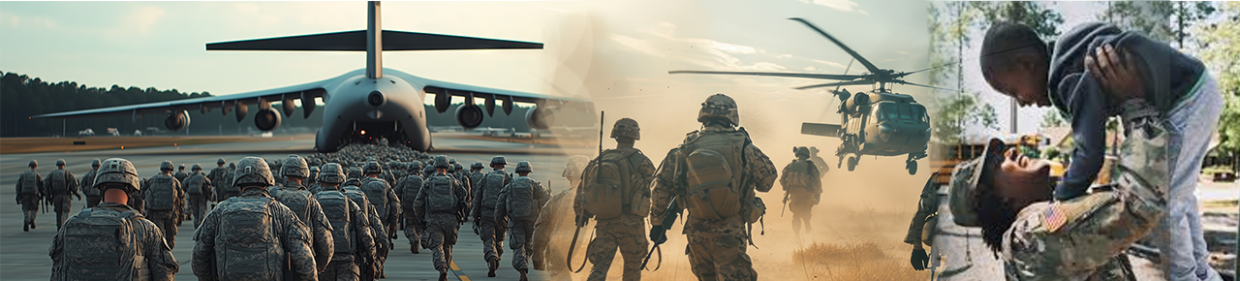
Military-Connected Students/Challenges… (varies by age)
Clinging to people or a favorite toy
Unexplained sadness or crying
Extravert turns into an Introvert
Increased aggression
Increased complaints about health
No longer motivated
Deployments
C
Notes:
A deployment can affect an entire family. Service members may not be able to share detailed information, may not know when they will return, and worry about their spouse and children being ok. The other spouse may have to do even more, including housework, childcare, and activities.
Kids worry about when they may see their family member again, and many other stressors are possible. Kids' behavior varies with age.

Slide 18
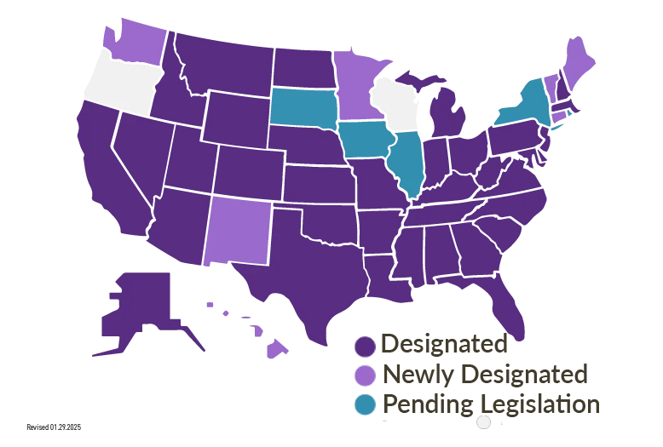
Purple Star School Status
C
Notes:
Arizona joins many other states in supporting our highly mobile, military-connected students. Arizona’s Purple Star School program began in July 2024 after becoming state law.

Slide 19

WHY BECOME A PURPLE STAR SCHOOL
Survey Center for Public Research & Leadership – Columbia Law
77% of Schools reported that being a PSS had a positive to very positive impact overall.
Teachers reported that 53% of PSS-identified students improved academically.
C
Notes:
Schools that implement an effective and purposeful Purple Star School program improve the school culture/climate and academically.

Slide 20
Research shows that Students who feel understood statistically show improvement in their academic performance, reinforcing the PSS focus and program requirements.
Schools should identify students accordingly
***** (Not required to self-report, should be voluntary)*****
Enrollment Forms, Registration, Survey, and Just Ask!
Welcome on the first day, i.e., Front Office
Provide information about the school’s
Peer-to-Peer program
C
Notes:
Enrollment forms typically collect this information; however, it is not shared at the site level. REMEMBER It is ok to ASK; however, families are not required to answer.

Slide 21
Highly mobile*, military-connected students:
Relocate every 2 to 3 years, can be sudden
Can come from anywhere, the US or abroad
May have one or both parents deployed
May be academically advanced or behind
Can be affected by global/military issues
C
Notes:
Previously stated 6 to 9 times during their academic years, averaging a new transition every 2 to 3 years.

Slide 22


It’s time to
PURPLE UP!
GET READY

Slide 23






ARIZONA’S ARMED FORCES

Slide 24
Working together, Each branch’s color combines to make
PURPLE
= UNITY
Notes:
Army - Green, Marine – Scarlet Red, Air Force - Ultra Marine Blue, Navy Blue & Gold, Coast Guard – Blue…

Slide 25
Arizona’s Military Community vs. Abroad
6 Branches of the Armed Forces
Active-duty
Spouses
Active-duty
Reservists
17,479
24,760
8,267
>228K
Military
Abroad

Slide 26
Arizona’s Military Community vs. Abroad
6 Branches of the Armed Forces
>228K
Military
Abroad
Reservists
Active-duty
Active-duty
Spouses
24,760
17,479
8,267
C
Notes:
Arizona has a strong military presence. Besides those shown above at least 3000 to 5000 transition out of the service in Arizona each year. What’s more important, the DoD considers how states support those who serve and their families. Providing programs and resources helps keep base funding and encourages future funding and possible expansion.

Slide 27
APPLICATION
PROCESS
PROFESSIONAL
DEVELOPMENT
PEER SUPPORT
PROGRAM
COMMUNITY
ENGAGEMENT
Schools must complete an application to become a
Purple Star School (PSS), designating a primary point of contact (POC).
Implement a student-led, peer-to-peer program to support highly mobile, military-connected students during transitions.
Each school must have a dedicated webpage and community resources to support military-connected students, honoring the military community annually.
Schools must provide professional development to at least 70% of staff, including administration, once per school year.
SUMMARY OF REQUIREMENTS
&
IMPLEMENTATION
C

Slide 28
APPLICATION
PROCESS
PROFESSIONAL
DEVELOPMENT
COMMUNITY
ENGAGEMENT
PEER SUPPORT
PROGRAM
Schools must complete an application to become a
Purple Star School (PSS), designating a primary point of contact (POC).
Schools must provide professional development to at least 70% of staff, including administration, once per school year.
Each school must have a dedicated webpage and community resources to support military-connected students, honoring the military community annually.
Implement a student-led, peer-to-peer program to support highly mobile, military-connected students during transitions.
C
Notes:
The Student-led Peer-to-Peer program is NOT a part of Student Government (STUGO), and is required for all Purple Star Schools.

Slide 29

Arizona’s Five Military Installations
Luke Air Force Base
Fort Huachuca Army Installation
Arizona Ranks 9th in Defense spending, and
15th for Active and Reserve Service Members.
Davis Monthan Air Force Base
U.S. Army Yuma Proving Ground
Papago Park Military Reservation
C
Notes:
There are over 42,000 military-connected students in Arizona. This does not include the other sub-groups previously mentioned.

Slide 30
Arizona’s
Military Community
Active-Duty
Veterans
Reserves/National Guard
Recently separated military
Families up to 1 year
Active-Duty Spouses & Children
C
Notes:
Who makes up Arizona’s Military Community? See slide… All together, there are nearly 600,000 military-connected individuals in our state, accounting for just under 10 percent of the state’s population.

Slide 31

Generally speaking, each branch of the armed services is akin to a club, fraternity, or sorority, focused on defending the United States and its allies.
Similarly, each branch has unique acronyms just like educators use each day.
C

Slide 32
DOD -
Department of Defense
POC -
Point of Contact
TDY -
Temporary Duty
SLMP -
School Liaison Program Manager
MRE -
Meals Ready to Eat
DOD -
Department of Defense
PCS -
Permanent Change of Station
MCEC -
Military Child Education Coalition
C

Slide 33




Three key components for a
Successful Purple Star School
AZPSS
YOU

Slide 34
Three key components for a
Successful Purple Star School
AZPSS
YOU

Slide 35

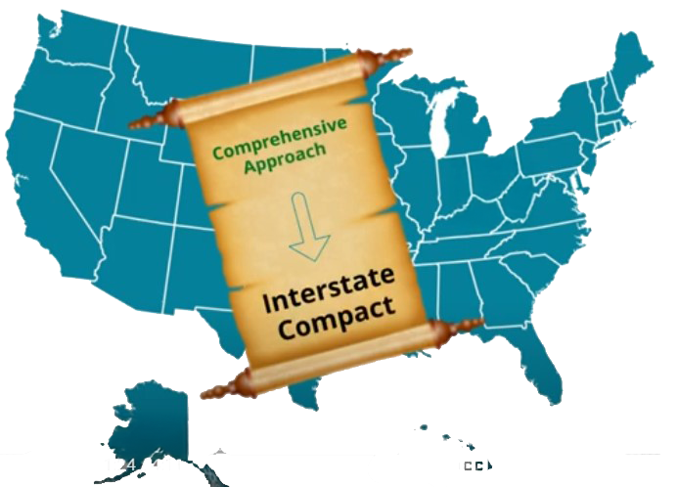
Every state & D.C. is a member
Provides each state a ‘Framework’ for transitioning military students, leveraging the compact to ensure consistency for transitioning military children
• Enrollment • Placement • Attendance • Eligibility • Graduation
(Click map for a short 4 min video)
C
Notes:
Specifically, the compact addresses varying policies between states affecting transitioning military-connected students. (Enrollment, Placement, Attendance, Eligibility – Sports, etc., and Graduation)
The lower portion of the slide is a clickable area to launch the video. (A brief commercial may show and can be skipped after 5 seconds) Please ensure this video is shared.

Slide 36
The Arizona Department of Education provides a consistent driving force.
AZ
Arizona
AZ -
P
urple
P
Application
Policy
Guidance
Resources
S
S
tar
S
chool
S
C

Slide 37

YOU
YOUR SCHOOL
& STUDENTS
BRING IT ALL TOGETHER!
C

Slide 38
RECAP
Level the Playing Field for Highly Mobile Students
Identify…Welcome…Support
Recognize…Honor…Engage
Questions?
C
Notes:
Staff and teachers should be informed about identified students.
Notify appropriate staff of any educational gaps, overlaps, or abrupt changes in behavior.
Global dynamics can affect many.

Slide 39


ADE
MCEC
FREE Resources

