Slide 1
+
How to Use the Certificate Mailing Address Tab for the CTE Technical Skills Assessment
+
Arizona Department of Education, Career and Technical Education

Slide 2
The certificate mailing address tab MUST be filled out and saved at the beginning of every school year in order to access and use the TSA Dashboard. This can only be done by a Level 1 user.
FYI
Arizona Department of Education, Career and Technical Education
Page 2

Slide 3
Certificate Mailing Address Tab
Students who pass the Technical Skills Assessments receive a Congratulatory Letter and Certificate endorsed by Arizona’s business and industry leaders. At the end of testing, these documents are sent to the district’s FedEx address for distribution to students.
Annually when logging into the Technical Skills Assessment as a Level I permission holder, you will be asked to update your FedEx address. Please provide the street address only (no PO Box numbers).
Arizona Department of Education, Career and Technical Education
Page 3

Slide 4
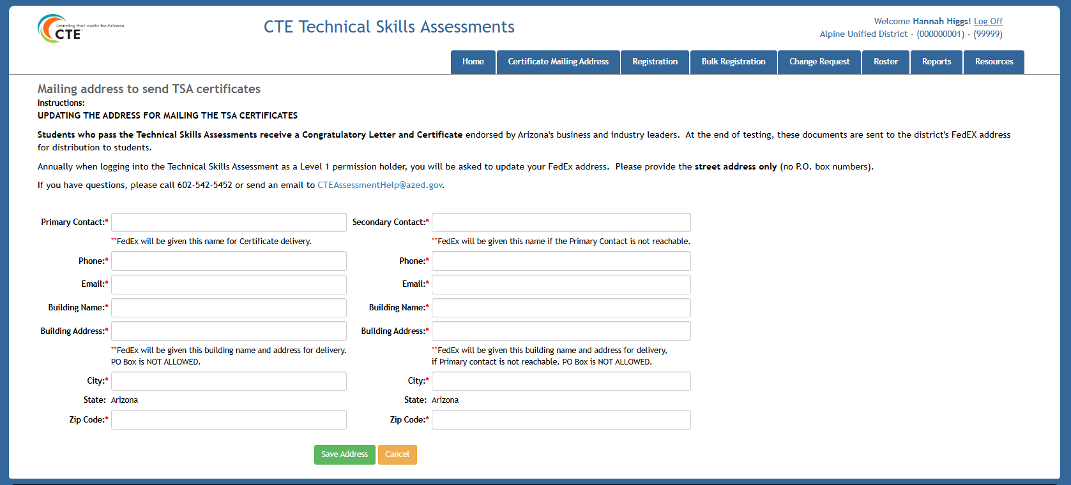
+
Certificate Mailing Address Tab
+
Arizona Department of Education, Career and Technical Education
Page 4

Slide 5
Go to the ADEConnect Portal at https://adeconnect.azed.gov/
How to Use the Certificate Mailing Address Tab
Go
Click on the Applications tab on the top right of the page
Click
Click on the “CTE Technical Skills Assessments” application
Click
Select the Certificate Mailing Address tab
Select
Enter your name, street address (not a PO box), city, state, and zip code, as well as a secondary contact (can be at same address)
Enter
Save Address and contact information
Save
VIDEO: How to Use the Certificate Mailing Address Tab
Arizona Department of Education, Career and Technical Education
Page 5

Slide 6
+
Questions?
CTE Technical Skills Assessments Overview Guide
TSA Troubleshooting Guide
Assessment Helpline: 602-542-5452
Email: CTEAssessmentHelp@azed.gov
+
Arizona Department of Education, Career and Technical Education
Page 6

