Slide 1
+
How to Register Students Using the Bulk Upload Tab for the CTE Technical Skills Assessment
+
Arizona Department of Education, Career and Technical Education

Slide 2
To avoid multiple errors, please go to the TSA Dashboard Registration tab and click on “Download Available Teachers”. Review the file and ensure each of your teachers’ emails have the correct access to the CTE Technical Skills Assessments application in ADEConnect.
First…
The Entity Administrator must grant access to each teacher at a school. Every 15 minutes this information is pulled from ADEConnect into the CTE Assessment System. This allows the teacher emails to automatically appear in the dropdown field during manual registration.
During bulk registration, the user must use the same email used to grant the ADEConnect access to the teacher; otherwise, registrations will be marked as partial.
The user does not have to delete the registration records to change the teacher, but the user can just use the Bulk Changes functionality to update information for all the records.
Once ADEConnect access is granted to a teacher, the bulk registration user must wait 30 minutes for the teacher to display in the dropdown to register a student.
VIDEO: How to Download Available Teachers
Arizona Department of Education, Career and Technical Education
Page 2

Slide 3
Contact your Entity Administrator — the only person who can enter teachers into the system.
When Teacher Email is Not Listed
To find your Entity Administrator, go to https://adeconnect.azed.gov/, click on the Help tab, then “Find an Administrator” to identify the person in your district/school to help you get access to ADEConnect and the CTE Technical Skills Assessments application.
Arizona Department of Education, Career and Technical Education
Page 3

Slide 4
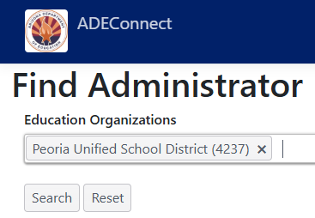
+
Enter the Entity ID, CTDS, or Entity Name
+
Arizona Department of Education, Career and Technical Education
Page 4

Slide 5
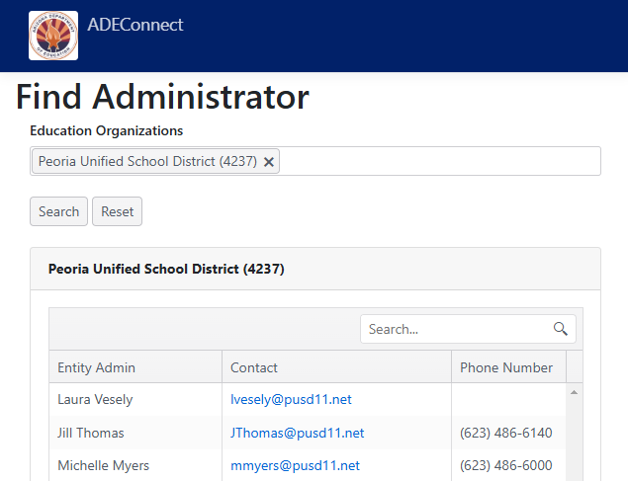
+
Your Entity Administrator(s) will appear
(see example for Peoria Unified School District)
Arizona Department of Education, Career and Technical Education
Page 5

Slide 6
The functionality in the Bulk Registration tab differs slightly from the functionality in the Registration tab, but the outcome will be the same.
FYI
Arizona Department of Education, Career and Technical Education
Page 6

Slide 7
How to Access the Bulk Registration Tab
Go to the ADEConnect Portal at https://adeconnect.azed.gov/
Click on “CTE Technical Skills Assessments” application
Select the Bulk Registration tab
Bulk Registration Tab
VIDEO: How to Access the Bulk Registration Tab
Arizona Department of Education, Career and Technical Education
Page 7

Slide 8
Go to Bulk Registration tab
Bulk Registration Template
Go
Click on Bulk Upload Excel Template (if using the Registration tab, click “Bulk Upload Registration,” then Bulk Upload Excel Template)
Click
Pop-up window will appear; click Open
Open
Delete the line displaying the example
Delete
Enter student information (please use dropdown list when entering program name). Note: Student information, including special populations, syncs with CTE’s Data Portal
Enter
Save template to PC and close file
File
VIDEO: How to Download the Bulk Upload Template
Arizona Department of Education, Career and Technical Education
Page 8

Slide 9
Go to Bulk Registration tab (or Registration tab)
Bulk Upload
Go
Click on the “Browse” button (if using the Registration tab, click “Bulk Upload Registration,” then “Browse”)
Browse
Find and Select your Excel bulk registration that you created and saved on your PC
Find
Click on the green “Upload” button; Pop-up window will appear—click the green “Yes” button
Upload
Student names will appear in a grid on your Registration tab
Display
Check your Bulk Registration tab for any errors; Errors can be corrected individually in the grid on the Registration tab
Check
VIDEO: How to Upload a Bulk Registration
Arizona Department of Education, Career and Technical Education
Page 9

Slide 10
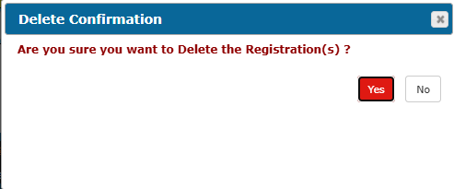
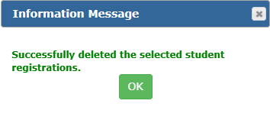
How to Delete Student Registration
On the grid under your Registration tab, find the student row and click the box at beginning of row
Row will highlight in yellow
You can select multiple students
Find
Click the “Delete Selected” link
Delete
Pop-up window will appear; click the red “Yes” button under Delete Confirmation; click the green “OK” under Information Message
Click
On the Registration tab, student(s) will be deleted from the registration
Return/
Check
VIDEO: How to Delete Multiple Students
Arizona Department of Education, Career and Technical Education
Page 10

Slide 11
Once the student(s) have been registered, the next step is adding the student(s) to a roster. Once added to a roster, you will find the student login information for their TSA on the roster.
FYI
Arizona Department of Education, Career and Technical Education
Page 11

Slide 12
+
Questions?
CTE Technical Skills Assessments Overview Guide
TSA Troubleshooting Guide
Assessment Helpline: 602-542-5452
Email: CTEAssessmentHelp@azed.gov
+
Arizona Department of Education, Career and Technical Education
Page 12

