Slide 1
School Safety Program – New Funding Opportunity
FY25 SSP Mini Grant

Slide 2
Agenda
School Safety Program (SSP)
Overview
Requirements
Program Requirements
Training Requirements
School Safety Program – Mini Grant Application
Important Dates & Information
How to Access the Application
Important Sections
How to Submit
Q & A
Notes:
In terms of our agenda today, we will be providing a brief overview of the School Safety Program, the training requirements of the program, and documentation requirements. For those of you familiar with the program, this will not be new information. We want to ensure that those unfamiliar with the program have a baseline understanding of the requirements and opportunities available with these funds. After this program overview, our Grants Management team will explain the specifics of this opportunity. Important dates for the grant, how to access the application, what the application consists of, and instructions on application submission. Finally, we will have time for a Q&A session where you can type questions into the chat and we will answer them and provide clarification on anything necessary.

Slide 3
School Safety Program Overview
2019 - ARS 15-154
Placing School Resource Officers, Juvenile Probation Officers, School Counselors, and School Social Workers on school campuses.
Goals of the SSP
SSP promotes, supports, and enhances safe and effective learning environments for all students on school campuses in Arizona.
Notes:
The School Safety Program has been around since 1994. Originally the program funded school resource officers and juvenile probation officers. The statute was revised in 2019 to include counselors and social workers. Together the School Safety Program positions promote safe and effective learning environments for all students on school campuses in our state.
We encourage you to review the Arizona Revised Statute 15 - 154.
We will also share the link in chat. https://www.azleg.gov/ars/15/00154.htm
We are one program that funds and trains multiple positions to ensure LEAs understand how to promote school connectedness, implement team based approaches, build meaningful relationships, and establish and sustain comprehensive school safety practices.

Slide 4
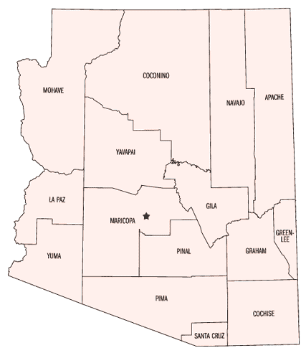
Creating a Community of Safe Schools
796 Awarded Sites
14 out of 15 Counties!
559 School Counselors and Social Workers
231 SROs and JPOs
68 Sites that use ODM
Around 800 SSOs
Notes:
The School Safety Program has grown over the last few years. We are excited to share we currently have:
799 Awarded Sites (256 District/Charters) in 14 out of 15 Counties! 34% of AZ schools
526 School Counselors/School Social Workers
303 SROs/JPOs
We are building connections all across the state and we are so glad to have all of these cities and counties represented!
We know we have a great charge and opportunity to continue to grow, to build communities of safe schools.

Slide 5
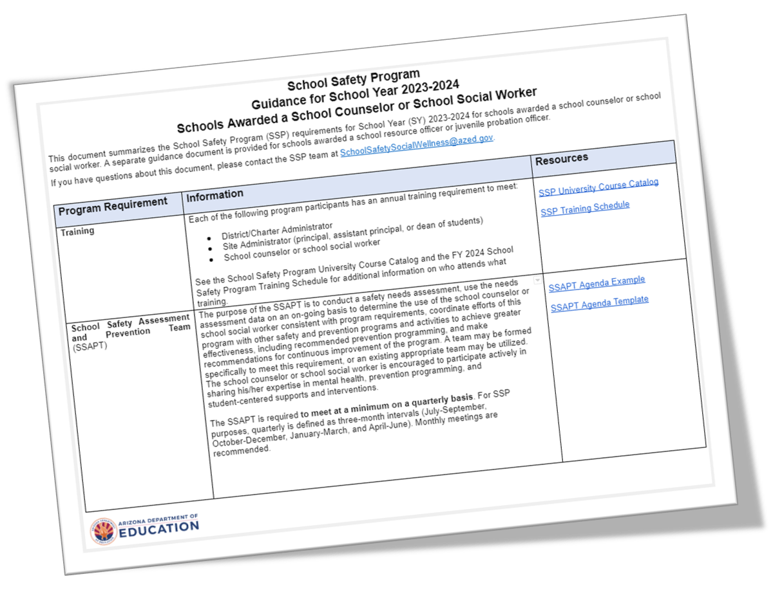
Program Requirements
Notes:
Being part of the School Safety Program brings with it several requirements to ensure a cohesive and effective team. There are requirements for the awarded position, site administrator (principal, vice principal, or equivalent), district administrator (grants manager, charter holder, or for smaller schools same as site administrator), and agency supervisor (SRO/JPO only)
Program Reporting (SSAPT) Activity Logs Program Evaluations
Training
CSW School Guidance Docs: https://docs.google.com/document/d/1iXMEgjIxJoZ9U56xJN4m32HmW4jneWu1/edit
Officer School Guidance Docs: https://docs.google.com/document/d/10blWB5K-jVciqMZ6T66kXNFpArsuYQCk/edit

Slide 6
SSP
Annual Required Training
School Safety Program – REQUIRED TRAINING
Positions | New Positions *1st year on the program | Returning Positions *2nd year or more on the program
- District Administrator - Site/designee Administrator - Agency Supervisor | Leadership 100 | Select (one) SSP Advanced Course
- School Resource Officer (SRO) - Juvenile Probation Officer (JPO) | New Officer Training (4 days) Day 1 - Leadership 100 Days 2, 3, 4 - New Officer Training | Select an Advanced Law Related Education (LRE) Academy
- School Safety Officer (SSO) | SSO Leadership 100 | SSO Annual Training (For Year 2)
- School Counselor & - Social Worker (CSW) | New CSW Training (2 days) Day 1 - Leadership 100 Day 2 - New CSW Training | Select (one) SSP Advanced Course
Notes:
Our SSP Course Catalog is a document that provides training expectations for every member of your SSAPT.
Administrators and Agency Supervisors track is highlighted in yellow
SRO/JPO’s track is highlighted in blue
Counselor and Social Workers track is highlighted in red
Training will be required for next year. Most individuals will require training as new positions. The returning position requirements will only apply to LEAs that are accepted for the next grant cycle.
Training follows the participant/person not the school.
It is important that you understand that you are responsible for attending your training.
We encourage you to sign up for trainings sooner than later.

Slide 7
GME Application
Visit the Grants Management Resource Library located in the Grants Management Enterprise system, gme.azed.gov, for application instructions and updates.
FY25 SSP Mini Grant
Notes:
In this section, our team will go over what this funding opportunity entails, important dates, how to find the application, navigating the application, key sections and submitting the completed application.

Slide 8
School Safety Program Mini Grant – Important Dates
Application Opens: October 21, 2024, at 9am
Application Closes: November 8, 2024, at 11.59 pm
*No TA after 5pm*
If awarded, schools will be notified beginning December 10, 2024.
Project Start Date: January 3, 2025
Project End Date: June 30, 2026
Duration of the Grant: 1.5 year

Slide 9
School Safety Program Mini Grant Opportunity
The FY25 School Safety Program Mini-Grant is a competitive state funded grant.
All Arizona Local Education Agencies are eligible to apply.

Slide 10
SSP Mini Grant Award Process
ADE will prioritize funding to “High-Need LEAs” applying for an SRO or SSO.
ADE has defined “High-Need LEAs” for the grant as public, non-profit LEAs with no school resource officers at one or more of their schools. Additional competitive preference will be given for applications serving small, rural LEAs.

Slide 11
SSP Mini Grant Award Process Cont’d
Funds that are not expended for schools applying for an SRO or SSO will be used to fund schools applying for a school counselor or school social worker.
ADE has defined "High-Need LEAs" for the grant a public, non-profit LEAs with no school counselors or social workers at one or more of their schools. Additional competitive preference will be given for applications serving small, rural LEAs.

Slide 12
School Resource Officers/School Safety Officers
If you are applying for an SRO or SSO, please note:
SROs must be certified police officers hired in full-time roles.
SSOs may be a peace officer or a full-authority reserve police officer who is certified by the Arizona Peace Officer Standards and Training Board. SSOs will perform the same duties as an SRO as required by existing School Safety Program grant protocol.
Schools interested in hiring an SRO are advised to begin conversations immediately with local law enforcement agencies to ascertain whether officer positions will be available.
Notes:
In an effort to ensure that all schools are able to have an officer on campus, if they want one, the Arizona Department of Education has created a new position called the School Safety Officer. This position is an off-duty assignment, meaning that Officers who choose to take these jobs are still completing their regular police work. Rather than have one full-time SRO on campus, this allows a school to have different officers throughout the week who have the same expectations as an SRO and who are still subjected to Arizona Department of Education training. While this may not seem ideal in all scenarios, what led to this was the lack of staffing throughout the state in Law Enforcement Agencies meant that less officers were able to be stationed as an SRO. This solution seeks to remedy that by providing the same services to schools while letting Law Enforcement Agencies have more staff available. To recap, this position allows for schools to have qualified, trained, officers on campus that have the same requirements as a typical SRO but may be more available to schools due to the staffing constraints in Law Enforcement Agencies throughout the state.

Slide 13
School Counselors /School Social Workers
If you are applying for a school counselor or school social worker, please note:
A school counselor means a professional educator who holds a valid school counselor certificate issued by ADE.
A school social worker means a professional educator who holds a valid social worker certificate issued by ADE.

Slide 14
ARS 15-154 Provisions
Per ARS 15-154, applications will include:
• Detailed description of school safety needs.
SRO/JPO applications only
• Law Related Education (LRE) implementation plan
• Plan to use trained SROs/JPOs
Counselor/Social Worker applications only:
• Relationship between position and community resources
• Plan for using position, including policies on confidentiality and parental notification and procedures for referral for services

Slide 15
School Safety Officers?
The School Safety Officer (SSO) position has been added to the SSP grant
SSOs are off-duty officers that can help to fill the role of an SRO in schools who could not find a full-time SRO
SSOs are expected to be indistinguishable from SROs, save their availability may be different
Multiple SSOs can be utilized to ensure a school always has an officer on site
Notes:
In an effort to ensure that all schools are able to have an officer on campus, if they want one, the Arizona Department of Education has created a new position called the School Safety Officer. This position is an off-duty assignment, meaning that Officers who choose to take these jobs are still completing their regular police work. Rather than have one full-time SRO on campus, this allows a school to have different officers throughout the week who have the same expectations as an SRO and who are still subjected to Arizona Department of Education training. While this may not seem ideal in all scenarios, what led to this was the lack of staffing throughout the state in Law Enforcement Agencies meant that less officers were able to be stationed as an SRO. This solution seeks to remedy that by providing the same services to schools while letting Law Enforcement Agencies have more staff available. To recap, this position allows for schools to have qualified, trained, officers on campus that have the same requirements as a typical SRO but may be more available to schools due to the staffing constraints in Law Enforcement Agencies throughout the state.

Slide 16
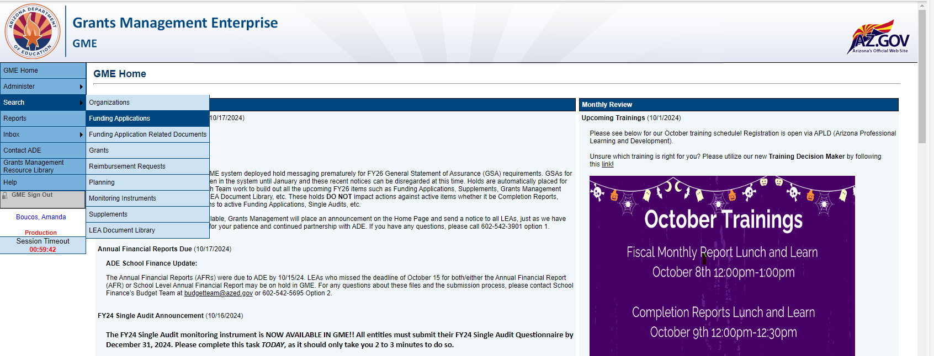
Finding the FY25 School Safety Program – Mini Grant Application
Once you have navigated to Grants Management Enterprise, go to Search > Funding Applications
Notes:
To access the application for this fY25 Mini Grant, first you will need to open Grants Management Enterprise. Hover your mouse over “Search”, then select “Funding Applications”.
Note: If you do not have access to GME you will need to contact your District’s Entity Administrator for ADEConnect and GME access

Slide 17
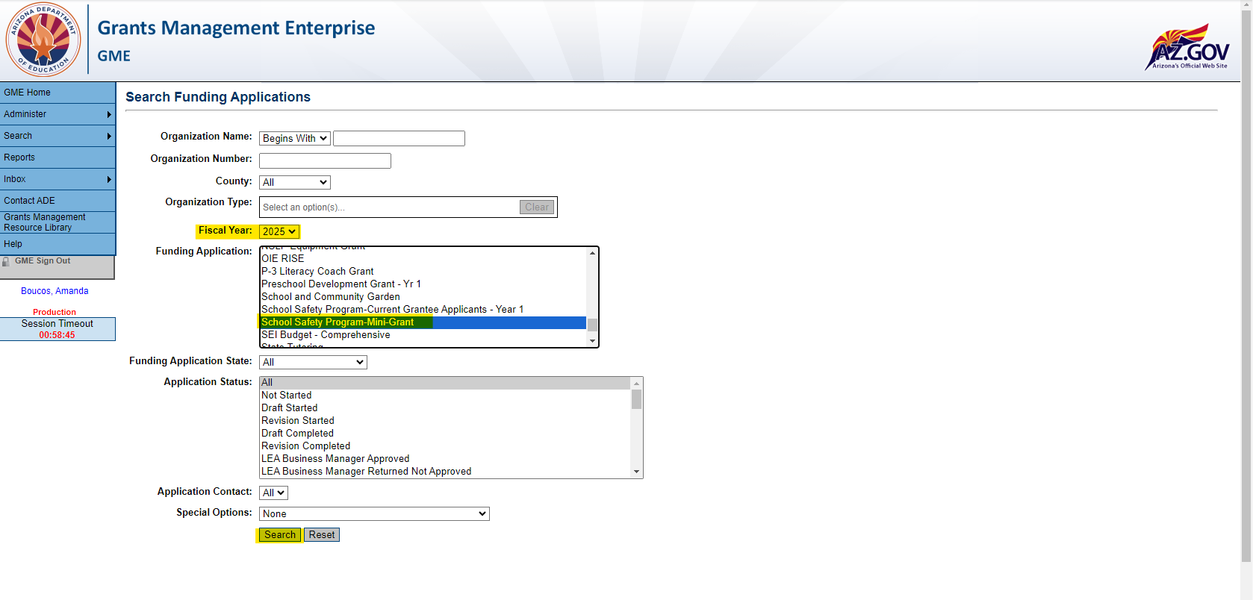
Finding the FY25 School Safety Program – Mini Grant (continued)
Select 2025 in the Fiscal Year drop down menu.
Scroll down to and select "School Safety Program – Mini Grant" in the Funding Application drop down menu.
Then select Search
Select your District/Charter once the search results are populated.
Notes:
Once you are on the Funding Application search page, you will select 2025 from the Fiscal Year drop down menu. Then select School Safety Program – Mini Grant, ensure that “All” is selected in the “Application Status” and click “Search”.
Once the Districts and Charters have loaded, select the District or Charter you are applying for, and this will bring you to the Sections page of your application.

Slide 18
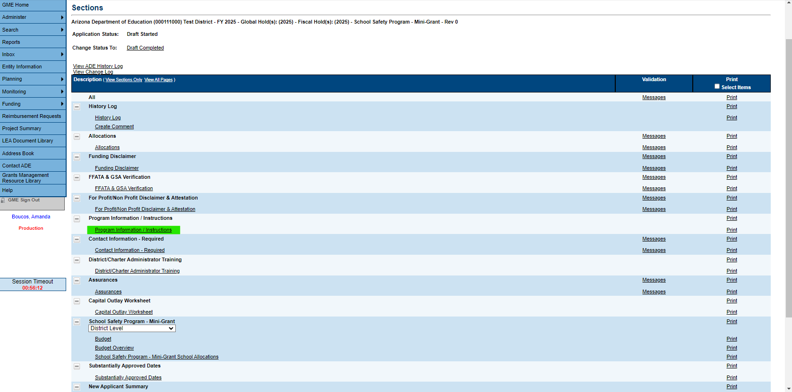
Sections Page
This page will allow you to go directly to any desired page.
Here you will see many sections and the drop-down menu for the Sites within your District/Charter.
**Before getting started, please visit the “Program Information / Instructions page.
Notes:
Links to all application pages are provided on the Sections page. Here you will also find the drop-down menu listing all Sites operated by your District/Charter.
**Please ensure you are not selecting the “District Level” option when making selections in the drop-down menu. Applications submitted for District level programs will not be considered.**
As you navigate through the application, please keep in mind that there is no save button. As you complete each section you will click the blue “Save and Go To” button to return to the Sections page

Slide 19
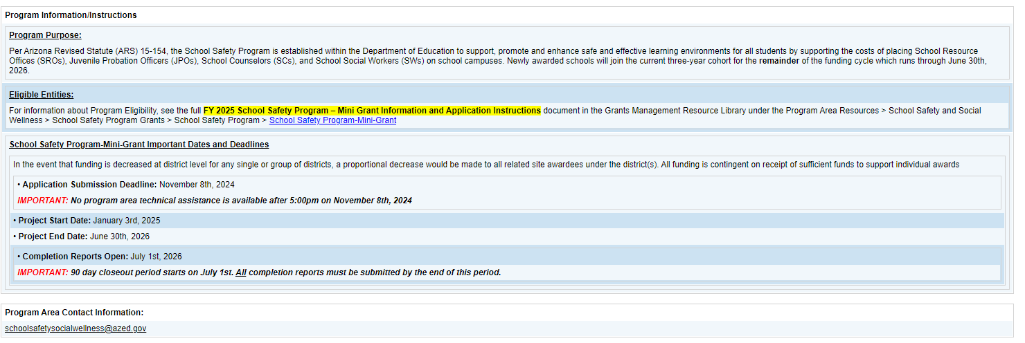
Program Information / Instructions
This section is where you will find important dates and information regarding the application and a link to the School Safety Program (SSP) - Mini Grant Information and Application Instructions PDF.
**PLEASE READ THIS DOCUMENT IN ITS ENTIRETY.
Notes:
The Program Information / Instructions page will include important dates for the application and the Application Instructions PDF. Please read the PDF in it’s entirety. There is important information about the program and section by section notes for completing the application.

Slide 20
Important Sections
Completion of the following sections is REQUIRED. INCOMPLETE APPLICATIONS WILL NOT BE CONSIDERED.
Assurances Section
Contact Information: District Admin, Site Admin(s), Awarded Position (TBD if vacant)
Budget Section (Amounts and Budget Narrative Description) For 1.5 Years!
Site Information
Site Program Narrative Questions
This is a site-based application. Do not select the District Level Program option. Applications completed and submitted with District Level Programs cannot be approved for funding.
Notes:
Budget should be for 1.5 years.
Please note that the following sections SHOULD NOT be filled out:
Capital Outlay Worksheet
Substantially Approved Dates
New Applicant Summary
School Safety Program – Mini Grant Checklist

Slide 21
How to Submit
There is not a ‘Submit’ button in the GME system. Instead, various levels of approval must occur for an application to be submitted and processed by ADE. When the application is ready to be ‘submitted’ to ADE, return to the “Sections” page, and change the status to “Draft Completed” to initiate the LEA levels of approval.
Authorized LEA representatives will need to review the application and change the status to the following:
LEA Business Manager Approved
LEA Authorized Representative Approved (‘submitted’)
Notes:
We recommend having someone else review the application before submitting to ensure it is complete.

Slide 22
School Safety Program Mini Grant
Time for Questions & Answers
Reminders:
This webinar will be repeated on Monday, October 21st, 2024, from 9am-10am.
A recording of the webinar and a copy of the PPT will be posted on the ADE SSP website by the end of next week.

Slide 23
Thank you. School Safety Program schoolsafetysocialwellness@azed.gov.
FY25 SSP Mini Grant

