Slide 1
Required Chrome OS Update
October 2024

Slide 2
Chrome OS version 133 Update
How do I know what version of ChromeOS is on my devices? Visit: https://support.google.com/chrome/a/answer/10025748
In late January 2025, Google will release Chrome OS version 133.
By default, Google will not allow any kiosk applications to run if they use Native Client code.
Before January 2025, District technology staff have two options to continue using the Chrome OS Secure Browser for the 2024-2025 school year:
OPTION 1
Update Chrome OS devices to Chrome OS Long-Term Support (LTS)
OPTION 2
Allow Native Client (NaCl) in the Google Admin Console
Action must be taken before January 2025
What if my Chromebooks are already on Chrome OS Long-Term Support?
No action is required for school year 2024-2025.

Slide 3
OPTION 1: Switch to Chrome OS Long-Term Support (LTS)
Switch Chromebooks to Chrome OS Long-Term Support (LTS).
Chrome OS LTS will ensure devices remain on a stable and supported OS version for the 2024-2025 school year.
For more information on switching to Chrome OS LTS, visit: https://support.google.com/chrome/a/answer/11333726
OPTION 1
Update Chrome OS devices to Chrome OS Long-Term Support (LTS)

Slide 4
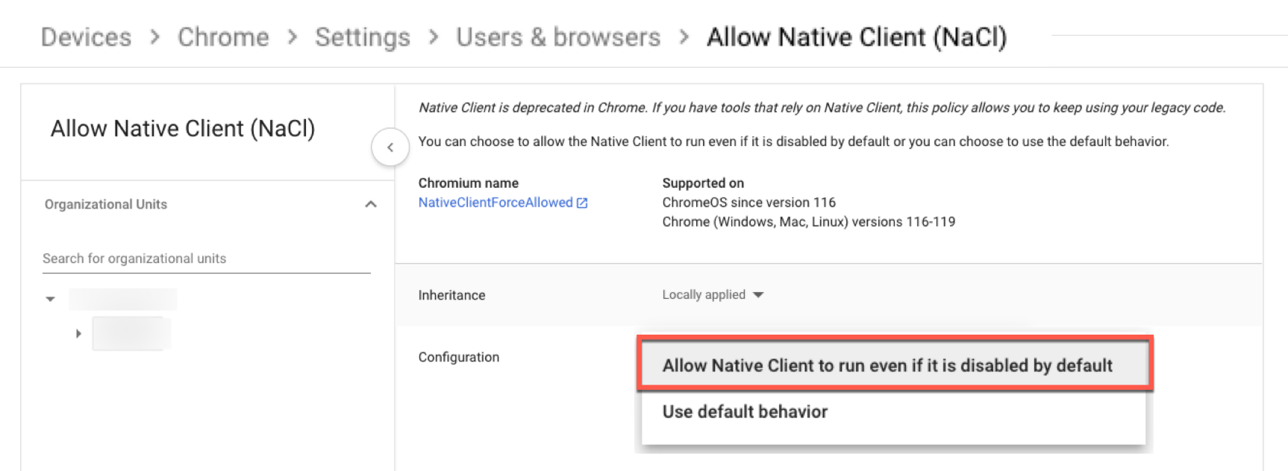
OPTION 2: Allow Native Client (NaCl) Setting
If a district chooses not to switch to Chrome OS LTS, applicable technology staff must update the Native Client (NaCl) setting in the Google Admin Console to ‘Allow Native Client to run even if it is disabled by default’.
For more information on the Native Client (NaCl) setting, visit: https://chromeenterprise.google/policies/#NativeClientForceAllowed
OPTION 2
Allow Native Client (NaCl) in the Google Admin Console

Slide 5
For additional support, contact the ELPA21 helpdesk.
September 2024

