Slide 1
Welcome to Webinar #8: Test irregularities
This webinar will be recorded and posted on the ADE Assessments webpage.​
​
Please enter your First and Last Name in the Chat for tracking purposes for the live event.​
​
We will also be capturing the chat questions. If there are questions that were frequently asked or need further clarification, ADE will compile and create an FAQ which will then be posted on the Assessments webpage under Friday Focus Webinars.

Slide 2

Friday Focus Webinar #8:
Test irregularities
Lisa Oliver
Director of Achievement Assessment
January 19, 2024

Slide 3
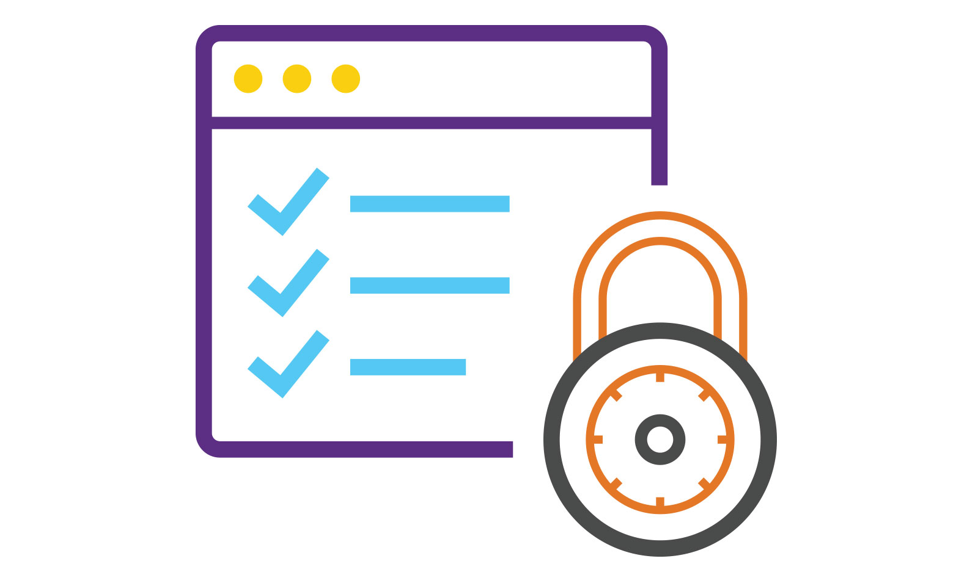
Overview
Standardized Assessments
Test Security
  FERPA
  Security Agreements
    Irregularities and Implications
    Breaches of Security
    Reporting and Codes
Administration Tips

Slide 4
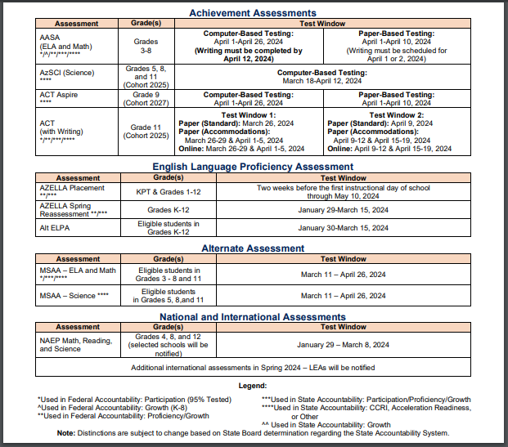
Standardized Assessments
Examples of Standardized Assessments:
NAEP, AASA, MSAA
Standardized training is required for all statewide assessments. This ensures that the test will be administered the same for all students.
Assessment Administrators receive online training and the supporting documents to ensure fidelity of implementation and the validity of the assessment results as well as to help prevent, detect, and respond to irregularities in academic testing and maintain testing integrity practices for the Achievement assessments.
If the test is not administered in the same ways this could result in a test irregularity or even an invalidation of a student test or tests.
Notes:
Large-scale assessments are developed, administered, and scored to meet comprehensive standards of validity, reliability, and fairness for a wide range of learners. In assessment, reliability is the characteristic of an assessment that allows its results to be repeatable. A reliable assessment will produce stable and consistent results. Students of similar ability levels who take the assessment at different times, or in different testing contexts, should show similar results. This is an important characteristic as it allows comparisons to be made fairly and accurately.

Slide 5
valid, fair, and reliable assessment
Meet comprehensive standards of validity, reliability, and fairness
Reliable assessments produce stable and consistent results
Conduct the assessments in a fair and ethical manner
Closely adhere to security policies and test security agreement and practices
Apply principles of test security to assessment material storage and handling, test administration, and electronic tools
Contact the appropriate person regarding test security violations or test irregularities
Notes:
We can ensure these standards are maintained by closely adhering to security policies throughout test administration and conducting assessments in a fair and ethical manner.
The Arizona Department of Education, more commonly known as ADE, is committed to taking every step required to assure the security and confidentiality of all state test materials.

Slide 6
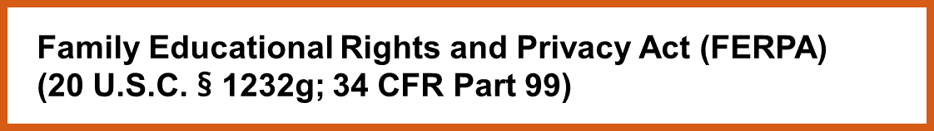
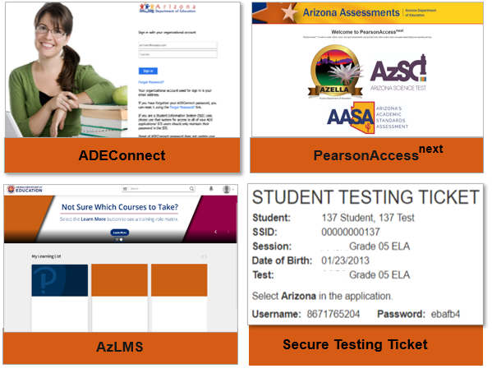
FERPA!
Achievement testing materials may contain Personally Identifiable Information (PII)
The Achievement tests security policy also applies to the digital systems and tools used to administer and score the assessments. It is a direct test security violation to share or exchange account information, such as usernames or passwords, with anyone.
  This applies to all staff for:
  ADE Connect, PearsonAccess Next, and the Arizona Learning Management System. Secure Testing Tickets and Test Booklets
Personally Identifiable Information-Only send ADE SSID numbers
Notes:
Achievement testing materials may contain Personally Identifiable Information, or PII, and sensitive information about a student’s educational background and historical performance. As such, we are all responsible for protecting and securing testing materials to prevent the accidental disclosure of the information they contain.
All Achievement testing staff are responsible, from the DTC to those with only incidental access to testing materials or the testing environment, for protecting the privacy of students and their protected records.
From the moment testing materials are received at the school or district, to the moment scores are shared with parents, we must always keep our security responsibilities in mind. Test security is a district-wide responsibility.

Slide 7
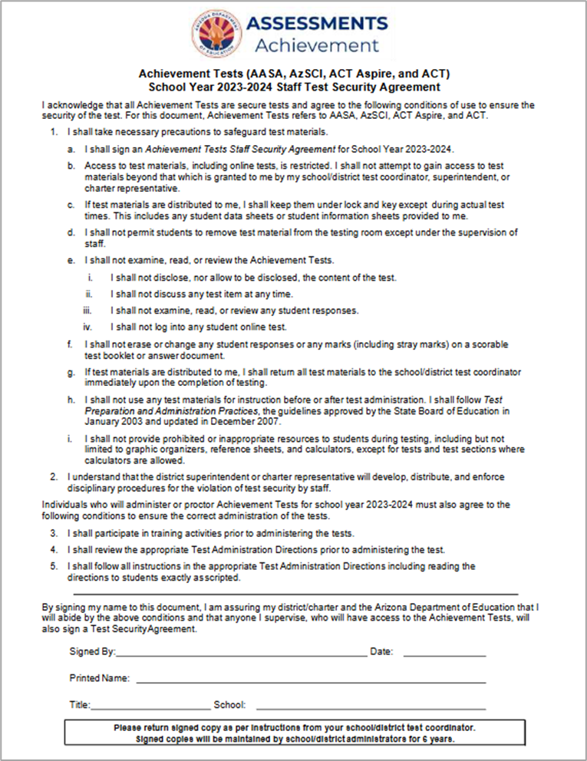

Achievement Tests
Staff Security Agreement
This Achievement Tests Staff Security Agreement must be signed by all employees of the district, charter, and schools who will have contact with Achievement test materials, administer the Achievement tests, monitor students during test administration, assist with testing, and/or enter the testing environment.
Notes:
All Achievement testing staff, whether they are taking inventory, distributing, or administering the tests, or just have incidental access to testing materials or the testing environment, must abide by these security standards and must sign a test security agreement. Failure to do so could negatively impact the validity of test results and could also lead to allegations of test impropriety.

Slide 8
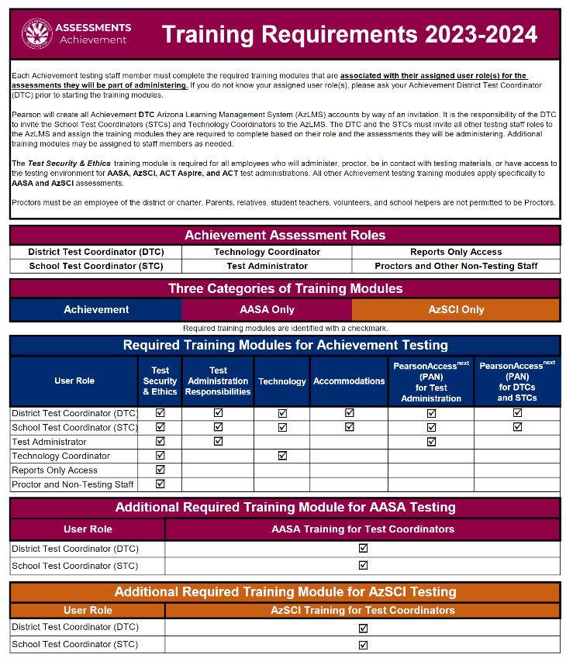
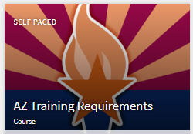
Training requirements
Achievement Assessments Training Requirements
Available in AzLMS
Available on Achievement DTC webpage
Notes:
Coupled with the Test Security Agreement are training requirements- located in our new AzLMS platform.
Trainings are specific to Achievement, AASA, or AzSCI for DTCs, STCs, TCs, TAs, and other staff!

Slide 9

How to avoid test irregularities
Ensure:
  Participation in the Test Security & Ethics module is to be completed by all staff this includes DTC, STC, TA, Tech Coordinators, proctors, and non-testing staff with access to materials or environment (including for ACT and ACT Aspire as well as AASA and AzSCI)
  Participation in The Test Administration Responsibilities module is to be completed by all staff this includes DTC, STC, and TA for AASA and AzSCI.
  Have a plan to monitor during test administration

Slide 10
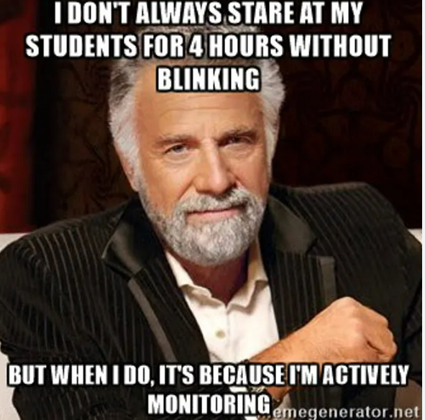
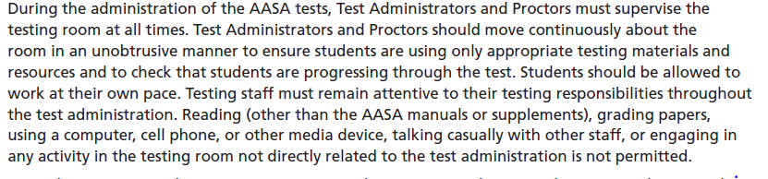
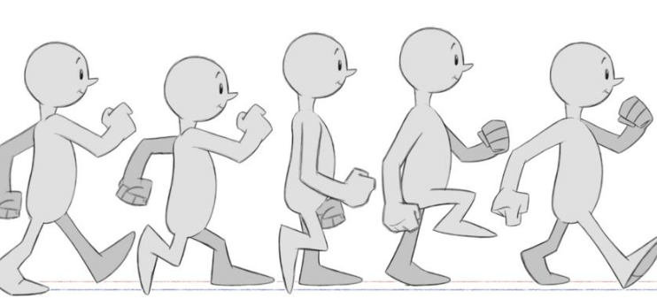
TEST Administration expectations
Notes:
Please ACTIVELY MONITOR

Slide 11

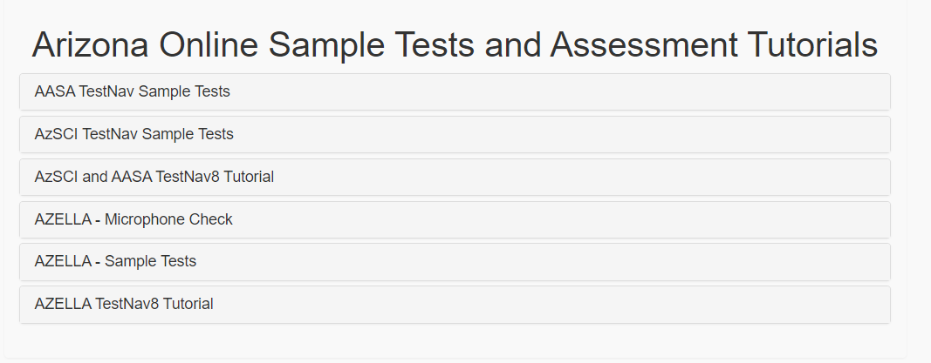
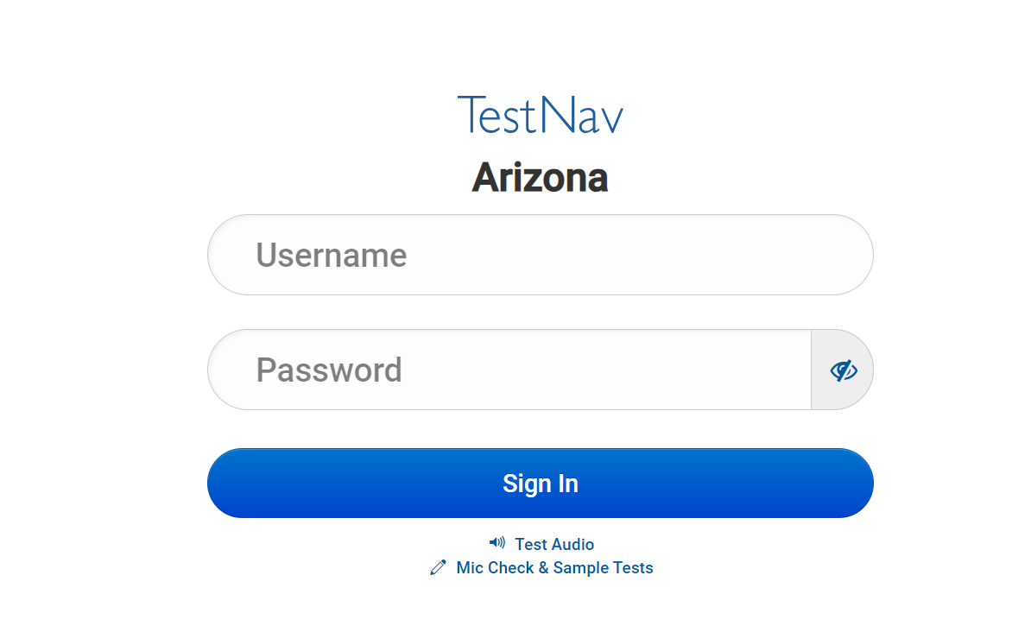
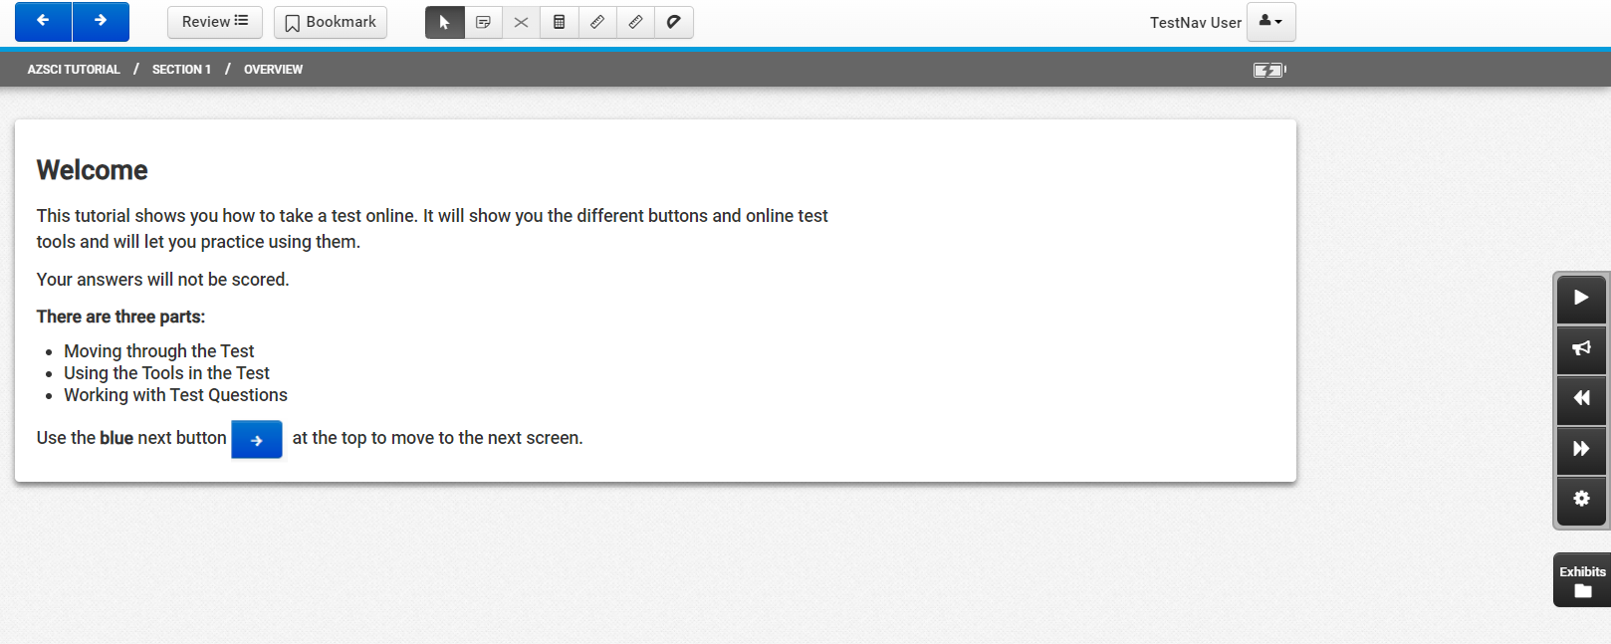
Student Performance? PRACTICE! PRACTICE! PRACTICE!
Notes:
Try mock test administration, have students practice with a fake username and password. UN and PW is not needed to gain access; however, you can practice with the Sample Test. There is a TN8 tutorial for how to use all tools, and soon there will be an animated Student Readiness tool.
DO NOT Practice with the live test.
Do NOT Practice with Real Secure Testing Tickets.

Slide 12
TEST SECURITY

Slide 13

Test Security
  This is why we track Test Irregularities
  Costly Implications
  Student Level (Scored vs. Invalidated)
Item Level (Development/Released Items)
Test Level (Accountability)
Technology is “locked down”
  Disable ALL Applications (external programs) running when TestNav launches
Notes:
Test Security-Important component of Statewide Assessments
Costly Implications
Student Level (Scored vs. Invalidated)
Item Level (Development/Released Items)
Test Level (Accountability)
Let’s take a look.

Slide 14

TA Logs into TestNav as a student
Share their username/password for PearsonAccess Next
Allow students access to test content prior to testing, including the ELA Oral Reading Fluency (ORF) passages
Provide any reference sheets to students during the Math test administration or graphic organizers during the Writing test administration
Allow students to share information, tools, and/or resources during test administration
Influence students’ responses by making any kind of gestures (for example, pointing to questions,
Hold up fingers to signify question numbers or answer options while students are taking the test
Instruct students to go back and reread/redo responses after they have finished their test since this instruction may only be given before the students take the test
Change students’ answer choices
Student Level Implications
It is unethical and shall be viewed as a violation of test security for any person to:
INVALIDATED TEST
Notes:
Student Level Implications
TA Log into TestNav as a student
Share their username/password for PearsonAccess Next- giving test ticket to the incorrect kid
Allow students access to test content prior to testing, including the ELA Oral Reading Fluency (ORF) passages
Provide any reference sheets to students during the Math test administration or graphic organizers during the Writing test administration
Allow students to share information, tools, and/or resources during test administration
Influence students’ responses by making any kind of gestures (for example, pointing to questions,
Hold up fingers to signify question numbers or answer options while students are taking the test
Instruct students to go back and reread/redo responses after they have finished their test since this instruction may only be given before the students take the test
Change students’ answer choices

Slide 15


Item Level Implications
Capture images of any part of the test via any electronic device
Duplicate, in any way, any part of the test
Examine, read, review, disclose, or allow to be disclosed, the content of the test before, during, or after test administration
Read any parts of the test to students, except as indicated in the Test Administration Directions, or as part of an approved accommodation
Translate, reword, or explain any test content
Read or review students’ responses, scratch paper, and other secure materials
Participate in, direct, aid, counsel, assist in, encourage, or fail to report any violations of these test administration security procedures
Instruct students to keep their test unit open
Use remote learning software to view the screen of a student or classroom during testing
It is unethical and shall be viewed as a violation of test security for any person to:
Notes:
Item Level Implications
Capture images of any part of the test via any electronic device
Duplicate, in any way, any part of the test
Examine, read, review, disclose, or allow to be disclosed, the content of the test before, during, or after test administration
Read any parts of the test to students, except as indicated in the Test Administration Directions, or as part of an approved accommodation
Translate, reword, or explain any test content
Read or review students’ responses, scratch paper, and other secure materials
Participate in, direct, aid, counsel, assist in, encourage, or fail to report any violations of these test administration security procedures
Instruct students to keep their test unit open
Use remote learning software to view the screen of a student or classroom during testing

Slide 16


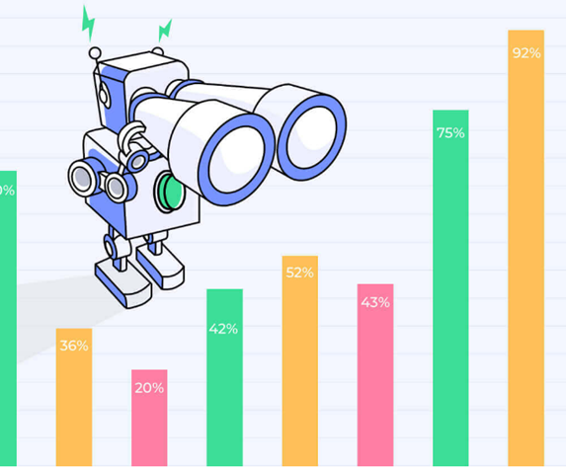


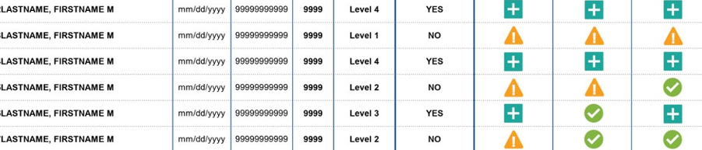
Test Level Implications
Test level implications will impact Accountability Scores and School Data
Notes:
These acts will lead to invalidations impacting Accountability Scores and School Data

Slide 17

Test Irregularities
Notes:
Let’s talk about the elephant in the room.

Slide 18

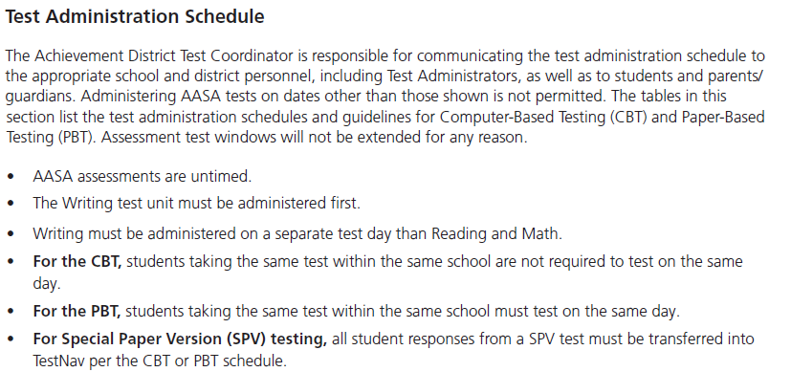
PLAN in place…When and Where
Administered at Arizona schools. Students must be tested in a physical building designated as a testing site by the school.
Administering AASA tests on dates other than those shown without the written permission of the Assessment Unit of the.
TCM, pg. 8
Notes:
Districts , LEAs, including AOIs must communicate with families about when and where testing will happen.

Slide 19
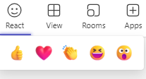
Breaches of Test Security
Please locate your Team’s Reaction button for active participation
Notes:
How many of you have completed the Test security and Ethics training in LMS? Use one of the buttons….

Slide 20
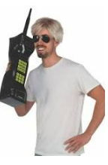
Breaches of Test Security
Use of Unacceptable Resources
If students are observed in possession of and/or use of unacceptable resources, including but not limited to unacceptable reference materials, cell phones, smart watches, or other electronic devices, the unacceptable resource must be removed.
Students are provided all other tools and resources needed for AASA testing within the TestNav application.
Test Administrator:
Use of a cell phone and /or Walkie Talkie is an LEA decision. Please use with caution and silence the device. Communication should not interfere or impede student performance.
Notes:
How many of you have a telephone land line in your home?
How many of you have a cell phone? Likely, all of your students regardless of age also, have them. How do you handle devices during assessment? Example from Glendale Union- cell phone in baggies with testing ticket/identifier
Use of Unacceptable Resources
If students are observed in possession of and/or use of unacceptable resources, including but not limited to unacceptable reference materials, cell phones, smart watches, or other electronic devices, the unacceptable resource must be removed
Test Administrator:
Use of a cell phone and /or Walkie Talkie is an LEA decision. Please use with caution and silence the device. Communication should not interfere or impede student performance.

Slide 21
Breaches of Test Security
Use of Accommodations
Accommodations are provisions made in how a student accesses the test and/or demonstrates learning that do not alter the validity of the test, score interpretation, reliability, or security of the test.
Modifications that alter the test construct being measured are prohibited, including changing the number of answer options, providing Text-to-Speech or a human reader during the ELA Reading test units, or providing a calculator during Math test units where a calculator is prohibited.
OR-
Inappropriate test administration for students not eligible for testing
(eligible for Alternate Assessment)
Notes:
Use of Accommodations
You may do it in instruction but not in assessment!
Modifications that alter the test construct being measured are prohibited, including changing the number of answer options, providing Text-to-Speech or a human reader during the ELA Reading test units, or providing a calculator during Math test units where a calculator is prohibited.
Inappropriate test administration for students not eligible for testing (eligible for Alternate Assessment)

Slide 22
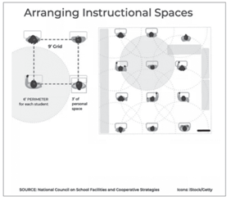
Breaches of Test Security
Testing Environment
All visual aids displayed in the testing room that could assist students while testing must be removed or covered completely prior to any test session.
Any motivational signs, apparel, or activities are not permitted in the testing environment.
Arrange student seating so that students cannot easily see each other’s test materials.
Parents, relatives, student teachers, volunteers and school helpers are not permitted to be in the testing room.
District or school staff who have relatives being administered the test are not permitted to be in the testing room while their relative is testing.
Test Administrators, Proctors, and any adult who will have access to the assessment must be employees of the school/district/charter.
Notes:
Who enjoys spirit week?
Who has redesigned station and location specific to content areas? For example, circular tables, wobble chairs?
Who has a great PTA/PTO?
Testing Environment
All visual aids displayed in the testing room that could assist students while testing must be removed or covered completely prior to any test session.
Any motivational signs, apparel, or activities are not permitted in the testing environment. -This can happen the week before testing, if you desire.
Arrange student seating so that students cannot easily see each other’s test materials. - Please arrange seating according to TAD for testing during statewide testing
Parents, relatives, student teachers, volunteers and school helpers are not permitted to be in the testing room.
District or school staff who have relatives being administered the test are not permitted to be in the testing room while their relative is testing.
Test Administrators, Proctors, and any adult who will have access to the assessment must be employees of the school/district/charter. - You can still use your parents, in the hallways as bathroom monitors or food runners or for the cell phone station.
Questions: Can so and so proctor? ADE: are they under contract with your LEA? Yes? Yes. No. No.

Slide 23
Breaches of Test Security
Entering and Exiting the Testing Environment
Students who are working productively and require additional time must be allowed to complete the test. Once student has submitted their test, students may remain in the environment; however, they must remain silent, and they may not access content material, computer, or have access to their electronic devices.
Students may not leave the testing environment to attend lunch. Group or class stretch breaks are not allowed. Students cannot be stopped from testing by the Test Administrator for a stretch break.
Students who disrupt testing, refuse to participate, receive help from others, or otherwise engage in behavior not consistent with acceptable classroom behavior should be removed from the testing room as soon as possible to allow other students to continue to test undisturbed.
Notes:
Entering and Exiting the Testing Environment
Students who are working productively and require additional time must be allowed to complete the test. Once student has submitted their test, students may remain in the environment; however, they must remain silent, and they may not access content material, computer, or have access to their electronic devices.
Students may not leave the testing environment to attend lunch. Group or class stretch breaks are not allowed. Students cannot be stopped from testing by the Test Administrator for a stretch break.
Students who disrupt testing, refuse to participate, receive help from others, or otherwise engage in behavior not consistent with acceptable classroom behavior should be removed from the testing room as soon as possible to allow other students to continue to test undisturbed.- This is not an invalidation unless cheating

Slide 24

Breaches of Test Security
Food in Testing Environment
Students may not leave the testing environment to attend lunch.
Group or class stretch breaks are not allowed. Students cannot be stopped from testing by the Test Administrator for a snack break.
ACT prohibits the consumption of snacks and beverages within the testing environment.
For AASA and AzSCI, please limit consumption of snacks and beverages within the testing environment. (LEA Choice)
Notes:
Any foodies?
ACT prohibits the consumption of snacks and beverages within the testing environment.
For AASA and AzSCI, please limit consumption of snacks and beverages within the testing environment. (LEA Choice)

Slide 25
Kinds of Test Irregularities
Will most likely not be invalidated:
Started test but technology prohibited reentering test to complete during same day
Technology disruptions (Enter a Test Irregularity)
Disruptive students (Do Not Enter a Test Irregularity)
Will be invalidated:
Students being administered the test without a qualified test administrator
Cheating by adults or students
Teachers instructing students to practice with operational test questions
Providing any reference sheets to students during testing
Students using or in possession of cell phones
Providing a non-allowable accommodation
Reading the Reading Test
Taking photo or tik-toks during test administration
Motivational posters up in classroom
Students accessing content or web content during test session
All need to be documented but some will result in an invalidation of a test or tests
We appreciate the seriousness our District Test Coordinators take in reporting and investigating
We get reports from DTCs and parents (whose children went home and shared what happened)
We investigate all reports to ADE- including anonymous reports
Notes:
All need to be documented but some will result in an invalidation of a test or tests
We appreciate the seriousness our District Test Coordinators take in reporting and investigating
We get reports from DTCs and parents (whose children went home and shared what happened)
We investigate all reports to ADE- including anonymous reports

Slide 26
Glitch in the matrix
Technology concerns

Slide 27
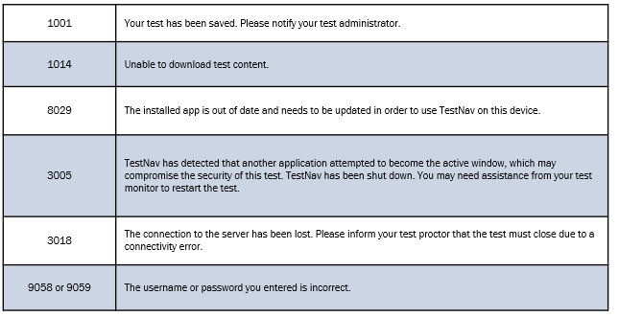
common issues that arise during the test and how to resolve the issue…
Student unable to log in – Student must type their username and password exactly as listed on the student’s secure testing ticket. Verify that the student’s test session is in Ready status and student is unlocked in PearsonAccess^{next}.
• Student in “Exited” status – Student has signed out of TestNav. If appropriate, the Test Administrator should “Resume” the student’s test session in PearsonAccess^{next}.
• Student in “Completed” status – Student has completed and submitted the test unit. The test unit will not be eligible to be reopened.
• Student in "Marked Complete" status – Student's test was launched but not submitted properly. At the end of each day, any test that was not submitted properly is placed in a Marked Complete status.
3005: TestNav has detected that another application attempted to become the active window, which may compromise the test security.
Should this test be resumed?
PLEASE ASK QUESTIONS!
Notes:
familiarize themselves with the common error codes that may appear in the TestNav application. This will assist in troubleshooting technical issues during testing.
For technical issues encountered during testing that require a call to Pearson Support, note the error code number and provide this information to the agent. Technical issues may take additional time to resolve, depending on the nature of the problem.
Largest reported technology issue is Lag time between items. This could be to many students accessing the same internet drop. Check with your technology coordinator, there is a limit to how many active test can access a single drop.
3005: TestNav has detected that another application attempted to become the active window, which may compromise the test security.

Slide 28
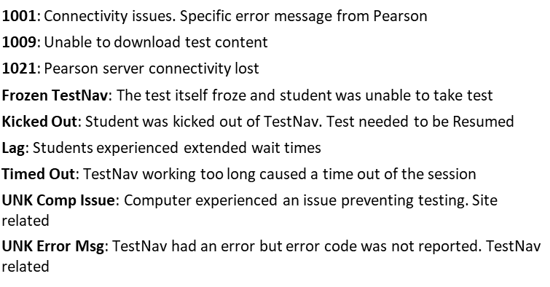
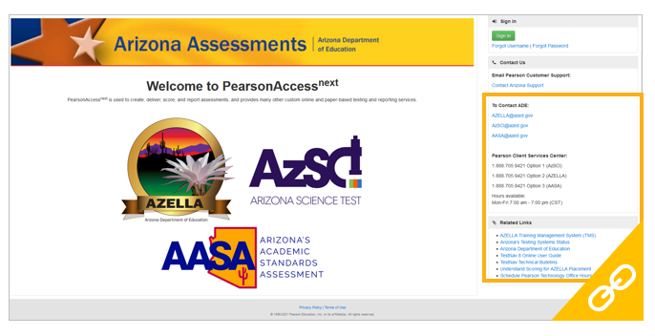
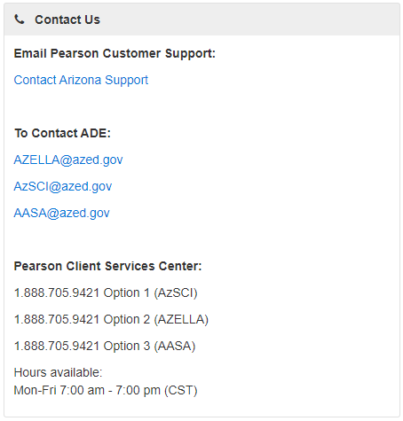
Technical Support
Immediate Level 2 Technical Support Available by Phone or Email
Pearson Customer Support
1-888-705-9421 opt #
(ask to speak with Level 2)

Slide 29
Reporting irregularities
PearsonAccess next

Slide 30
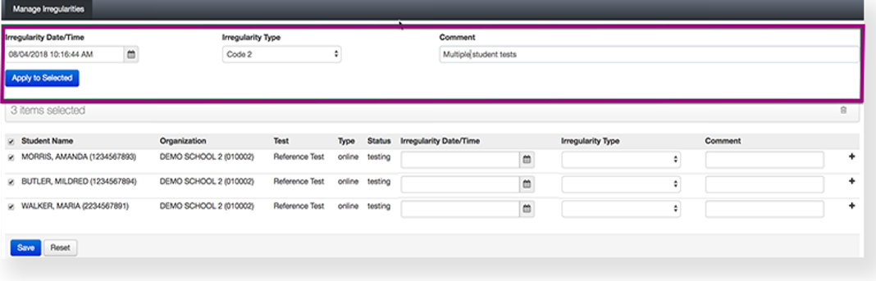
Reporting Test Irregularities
Submit in Test Irregularity into PAN
  For AASA , AZSCI , ACT Aspire. ADE will follow up with next steps, if required.
Submit in PAN for ACT for online testing and paper irregularity report form for paper testing
Any breach of test security, loss of materials, failure to account for materials, exposed test questions, or any other deviation from acceptable security procedures shall be reported immediately by submitting a test irregularity report in PearsonAccess Next. The discipline of staff members who violate test security is the responsibility of the district or charter. Disciplinary action may include, but is not limited to, a letter of reprimand, suspension with pay, suspension without pay, dismissal, or report of violation to the Investigations Unit of the Arizona State Board of Education.
See Test Coordinator Manual
Notes:
Submit in Test Irregularity into PAN
For AASA , AZSCI , ACT Aspire. ADE will follow up with next steps, if required.
Steps are in the next issue of the PAN User Guide.

Slide 31
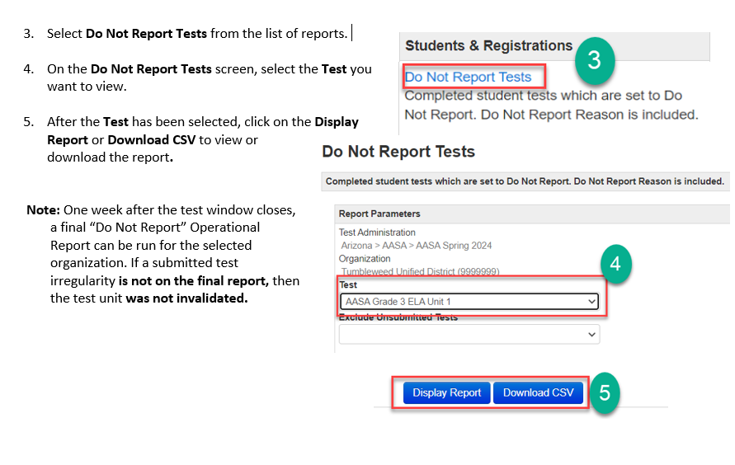
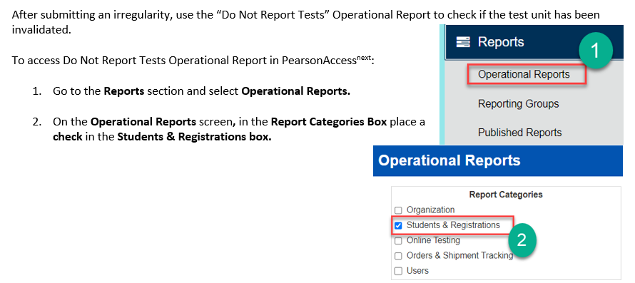

Test Irregularity Report 2024

Slide 32

TIPS:

Slide 33
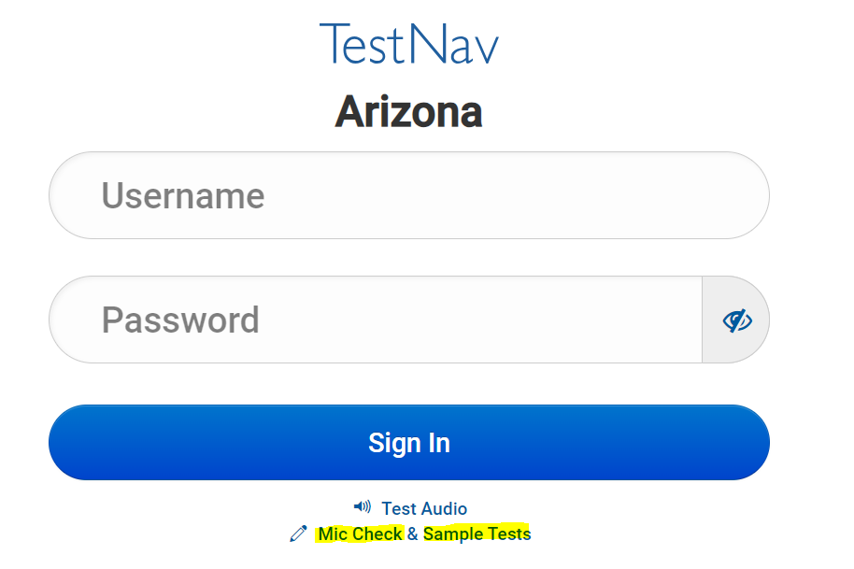
AASA and AzSCI Sample Test
The AASA and AzSCI Sample Test helps students, teachers, and parents become familiar with the content, question types, and the tools in the AASA and AzSCI assessments.
The sample tests are available in the computer-based format, including American Sign Language (ASL), for ELA Writing, Reading, Oral Reading Fluency (ORF), and Math test units.
Students will access the test as a guest, so no personal information needs to be provided. Students should take the Sample Test prior to taking the Spring 2024 test.
To access the AASA and AzSCI Sample Tests, the educator will go to the TestNav Arizona Sign In screen (https://home.testnav.com/). A username and password are not required. The Test Audio link and the Mic Check & Sample Tests links are at the bottom of the screen. Click on Sample Tests
Notes:
PRACTICE set up mock test sessions.

Slide 34
Submit Final Answers
Once the student clicks the green “Submit Final Answers” button, the screen “Test Submit Warning” will display to confirm that the student is about to leave this unit. Once the student selects the “Yes, Submit Final Answers” button on this warning screen, the test opportunity will end, and the student will not be able to continue to test.
This unit of the test cannot be reopened once the student clicks “Yes, Submit Final Answers.”

Slide 35

Questions?

Slide 36
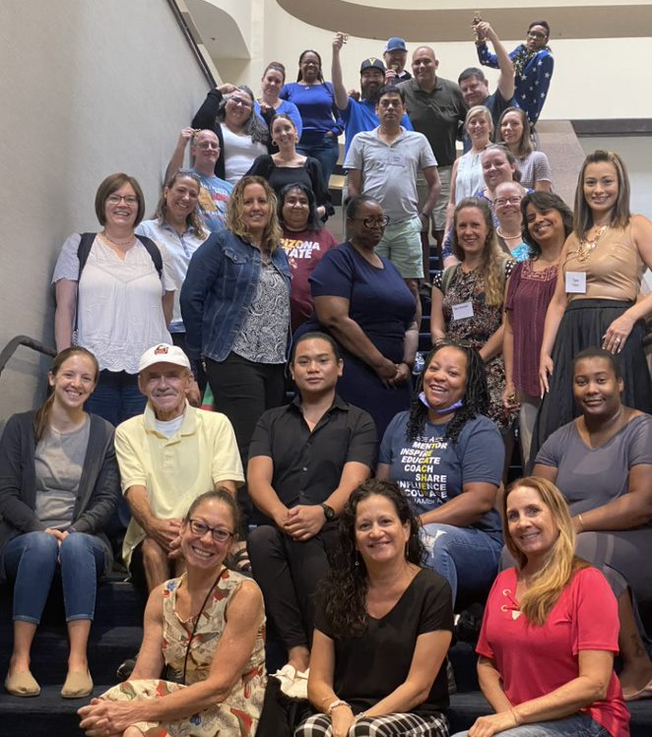
Assessment Committee
We are inviting content area teachers, teachers of students with disabilities, teachers of EL students, and instructional coaches/administrators to provide their perspective on the items and standards set on Arizona's statewide assessments. If you are interested in serving on an Assessment Educator Committee, please complete our Committee Application found at:
https://www.azed.gov/assessment/assessment-educator-committee-application

Slide 37
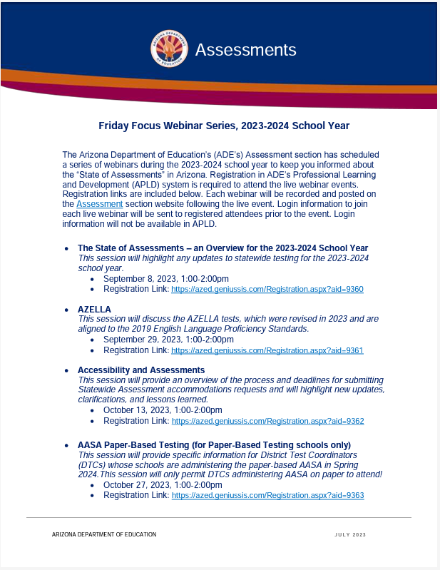
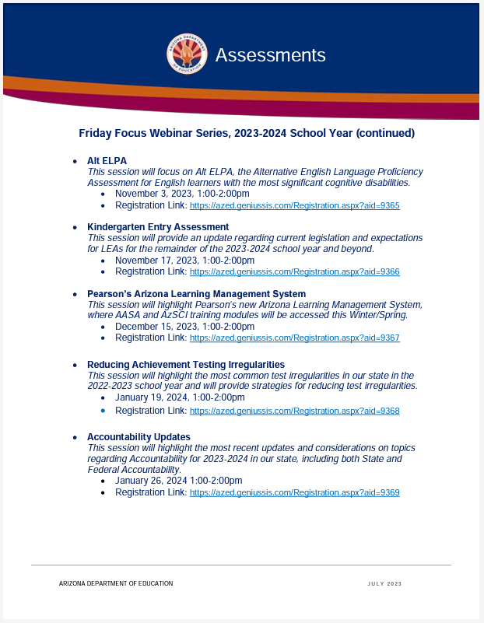
Assessment Webinar Series - POSTED
The flyer is posted on the Assessment Main page:
https://www.azed.gov/sites/default/files/2023/07/2023-2024%20Friday%20Focus%20Webinar%20Schedule.pdf
Reminder: participants must register in ADE’s Professional Learning and Development (APLD) system
Log in information to join the session will be sent to registered participants prior to the event. Login information will not be available in APLD.

Slide 38
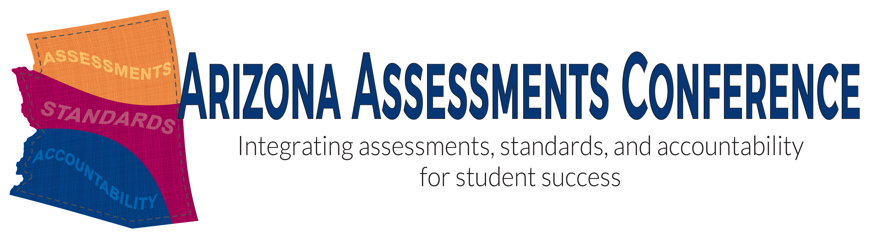
Save the DATE
Arizona Assessments Conference – September 17-19, 2024
https://www.azed.gov/assessment/conference

Slide 39

THANK YOU!
For questions, please contact us at: ​
Testing@azed.gov​

