Slide 1
Welcome to Webinar #9: Accountability Updates
This webinar will be recorded and posted on the ADE Assessments webpage.​
​
Please enter your First and Last Name in the Chat for tracking purposes for the live event.​
​
We will also be capturing the chat questions. If there are questions that were frequently asked or need further clarification, ADE will compile and create an FAQ which will then be posted on the Assessments webpage under Friday Focus Webinars.

Slide 2
Friday Focus Webinar #9: Accountability Updates
SEAN SMITH
Chief Accountability Officer
January 26, 2024

Slide 3
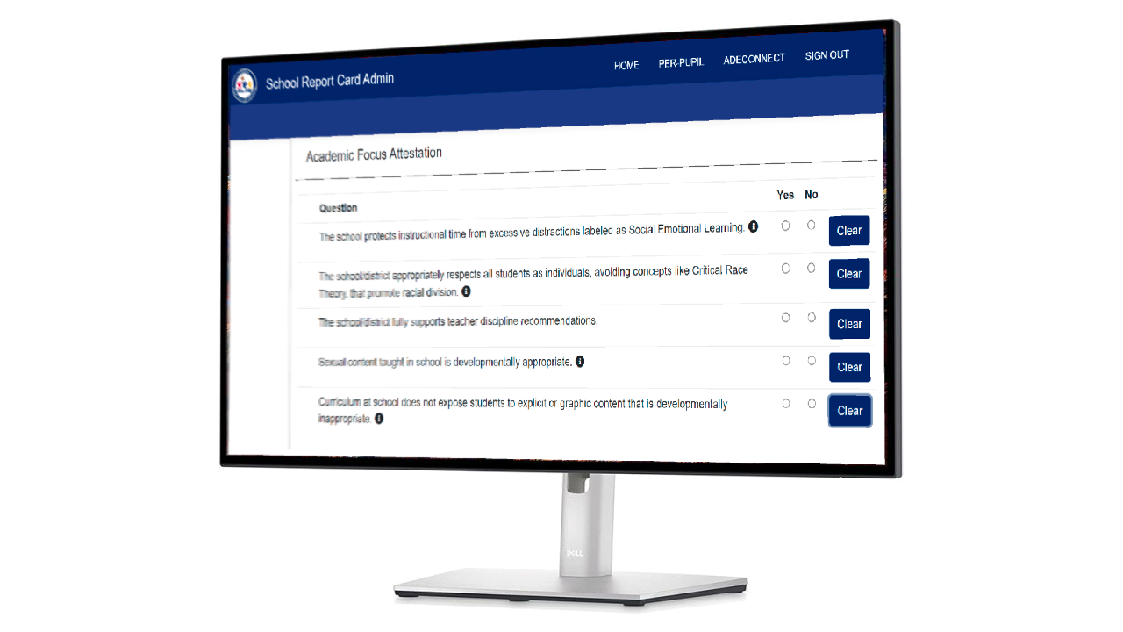
School Report cards - updates
New sections
Academic Focus Attestation
School Goals
Timeline
Responses needed by 2/11
Launch 2/13

Slide 4
District Accountability Coordinator Form
Form link
Training coming in February

Slide 5
2023-2024 A-F Models and Business rules
Planned Timeline
Present at February 26 Board Meeting
Recent Technical Advisory Committee (TAC) discussions
23-24 Business Rules
SGT
Next meeting: 2/5
Redline Version of 2023-2024 Business Rules
Link to draft

Slide 6
GRADER
January Grader available
Includes important timelines for 23-24 Accountability

Slide 7
Public reports
2023 Public Reports Currently Available:
Achievement Assessments
Science Assessments
English Learner Assessments
Graduation Rate
Dropout Rate
2023-2024 Enrollment
Link: https://www.azed.gov/accountability-research/data

Slide 8
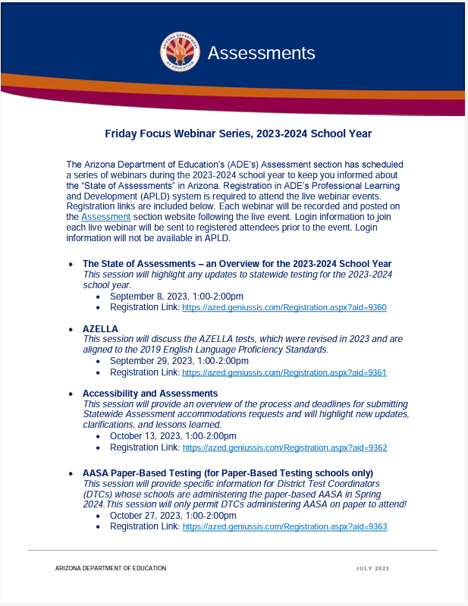
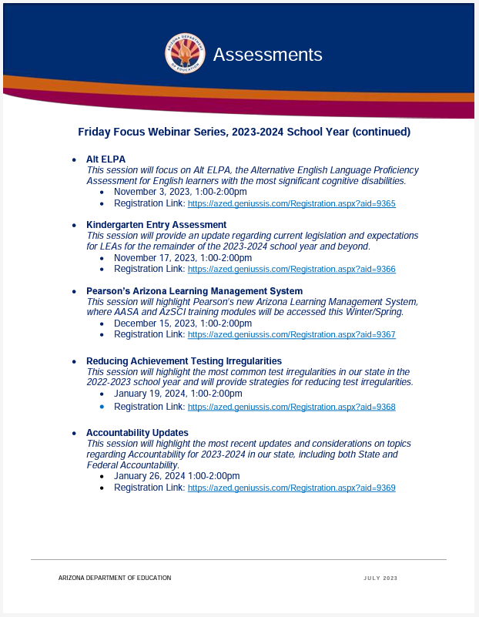
Assessment Webinar Series - POSTED
The flyer is posted on the Assessment Main page:
https://www.azed.gov/sites/default/files/2023/07/2023-2024%20Friday%20Focus%20Webinar%20Schedule.pdf
Reminder: participants must register in ADE’s Professional Learning and Development (APLD) system
Log in information to join the session will be sent to registered participants prior to the event. Login information will not be available in APLD.

Slide 9
Save the DATE
Arizona Assessments Conference – September 17-19, 2024
https://www.azed.gov/assessment/conference

Slide 10
Questions?

Slide 11
THANK YOU!
For questions, please contact us at: ​
Achieve@azed.gov

