Slide 1


AzEDS
Arizona Education Data Standards
Vendor Support Meeting - February 14, 2023
Notes:
This is a title page – please do not use for bulleted content

Slide 2

Agenda
Firearms Data Collection (New)
  Program Evaluation Model (New)
  CTED Status Update (FY2023)
  Review from November Vendor Meeting.

Slide 3

Firearms Data Collection
Purpose and Impact
Firearms Data Collection (FDC) has moved from a legacy system to AzEDS
  FDC is part of the annual EDFacts data collection.
  AZ Dept of Education’s EDFacts team will be responsible for aggregating FDC from AzEDS at the Local Education Agency and State Education Agency levels for EDFacts reporting.
  FDC is a subset of discipline data which is also required for SPED students and 21st CCLC schools in FY2024. FY2023 has been a pilot year for SPED student Discipline Data.

Slide 4
Firearms Data Collection
Discipline Data Overview
Discipline Data has three elements. The Primary element is a Discipline Incident. Tied to Discipline Incident are the Discipline Behavior and Discipline Action
  Discipline Data is also required for SPED students and schools participating in 21st CCLC programs beginning FY2024.
  FDC is defined as any Discipline Data with one of these four Discipline Behaviors (new for FY2024):
    Handguns
    Rifles/shotguns
    Multiple Firearms
    Other Firearms (other than handguns, rifles or shotguns)

Slide 5
Firearms Data Collection
Discipline Actions
CodeValue | Description
Expulsion | Expulsion
In School Suspension | In School Suspension
Out of School Suspension | Out of School Suspension
No action for incident | No action for incident
Removal by Hearing Officer | Removal by Hearing Officer for Likely Injury to Self or Others
Unilateral Removal | Unilateral removal to an Interim Alternative Educational Setting
Reassignment to alt education prog in school | Pupil reassignment to an alternative education program in school
Reassignment to alt education prog out of school | Pupil reassignment to alt education program out of school
Reassignment to alt suspension prog in school | Pupil reassignment to alternative to suspension program in school
Reassignment to alt suspension prog out of school | Pupil reassignment to alternative to suspension program out of school
*Modified Expulsion | Modified Expulsion – Less Than One Year
*Other Removal | Removal due to Death/Withdrawal/Incarceration
*Potential actions to be added to existing UseCase

Slide 6
Program Evaluation Model
Purpose and Impact
Each student that participates in a 21st Century Community Learning Center program has a survey completed by a teacher to assess their growth.
  The survey contains three prompts as follows.
  While this student was in your regular school day class, assess their change in Class Participation?
  While this student was in your regular school day class, assess their change in Positive Classroom Behavior?
  While this student was in your regular school day class, assess their change in Positive Peer Relationships?
  A teacher will provide a response for each prompt to determine if the student experienced an increase, decrease, remained the same or if they did not need to improve.

Slide 7
Program Evaluation Model
Model Development
AzEDS and Ed-Fi began collaborating in the Fall of 2022 to develop a model that can be used to collect program evaluation data initially for the purpose of collecting the 21st CCLC Teacher Survey data.
  The model has been expanded to match other evaluation schema to provide a general approach which may suit other evaluation needs.
  AzEDS in collaboration with Ed-Fi is adding the following tables: ProgramEvaluation, ProgramEvaluationObjective, ProgramEvaluationElement.

Slide 8

Program Evaluation
Data Model as of 2/1/2023

Slide 9
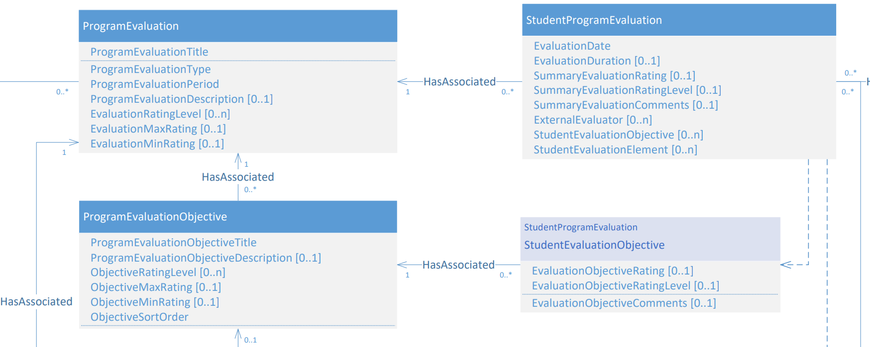
Program Evaluation
Data Model as of 2/1/2023

Slide 10
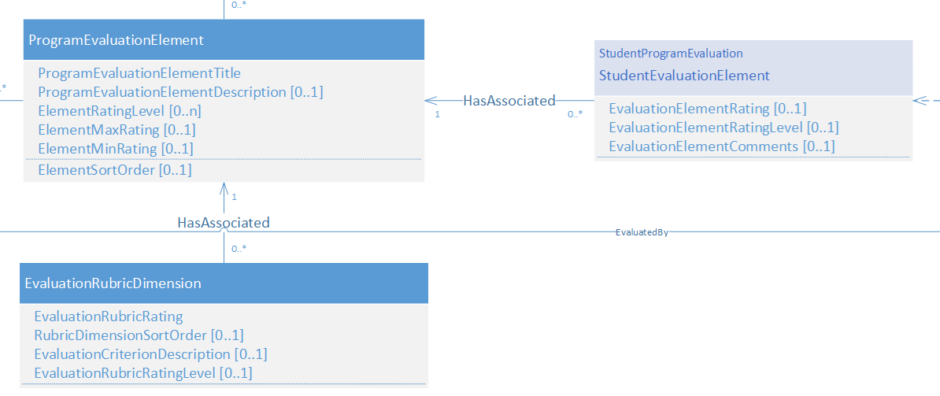
Program Evaluation
Data Model as of 2/1/2023

Slide 11
Program Evaluation
StudentProgramEvaluation – AzEDS UseCase Table: az.StudentProgramEvaluation
Column Name | Data Type | Codes | Descriptions
StudentUniqueID (R) | nvarchar(32) |  | Student ID for the program participant evaluated
EvaluationDate (R) | date |  | Date that the evaluation is completed
ProgramEvaluationEducationOrganizationId (R) | int |  | Entity with the program submitting the evaluation
ProgramEvaluationPeriodDescriptorId (R) | int |  | Period for which the evaluation is being submitted (e.g. Yearly)
ProgramEvaluationProgramName (R) | nvarchar(60) |  | Program name associated with evaluation
ProgramEvaluationProgramTypeDescriptorId (R) | int |  | Descriptor of program type (e.g. Support Program)
EvaluationElementProgramEvaluationEducationOrganizationId (R) | int |  | Entity with the program submitting the evaluation
EvaluationElementProgramEvluationPeriodDescriptorId (R) | int |  | Period for which the evaluation is being submitted (e.g. Yearly)
EvaluationElementProgramEvaluationProgramName (R) | nvarchar(60) |  | Program name associated with evaluation
EvaluationElementProgramEvaluationProgramTypeDescriptorId (R) | int |  | Descriptor of program type (e.g. Support Program)
EvaluationElementProgramEvaluationTitle (R) | nvarchar(50) |  | Title of program evaluation
EvaluationElementProgramEvaluationTypeDescriptorId (R) | int |  | Descriptor of evaluation program type (e.g. Teacher Survey)
EvaluationElementRating (R) | decimal(9,3) | Table 58 | The rating or response provided to an objective
StaffID | nvarchar(32) |  | Staff ID for the person completing the evaluation.

Slide 12
Program Evaluation
StudentProgramEvaluation – AzEDS UseCase ‘Code Values’ Tab
Table 58: Evaluation Rubric Dimensions - 21st CCLC Teacher Survey
Evaluation Rubric Rating | Evaluation Criterion Description
1 | Decreased
2 | Remained the same
3 | Improved
4 | Did not need to improve
JSON will include an EvaluationRubricRating for each ProgramEvaluationElement included in the Teacher Survey.

Slide 13
Program Evaluation Model
Model Development
21st CCLC Annual Performance Report Teacher Survey- Teacher Reported Student Engagement Student Name: ___________________ Please complete this survey for the student listed above in your school day classroom, reflecting on the entire time the student was in your class this year. For each question, consider if the student did not need to improve in this engagement area (i.e., already satisfactory level of engagement for this question), showed improved engagement over time, remained at the same level of engagement throughout, or decreased in their engagement over time. This survey is required to maintain federal grant funding for the 21st CCLC grant. Thanks for your efforts. While this student was in your regular school day class, assess their change in Class Participation. Did not need to improve Improved Remained the same Decreased While this student was in your regular school day class, assess their change in Positive Classroom Behavior. Did not need to improve Improved Remained the same Decreased While this student was in your regular school day class, assess their change in Positive Peer Relationships. Did not need to improve Improved Remained the same Decreased

Slide 14
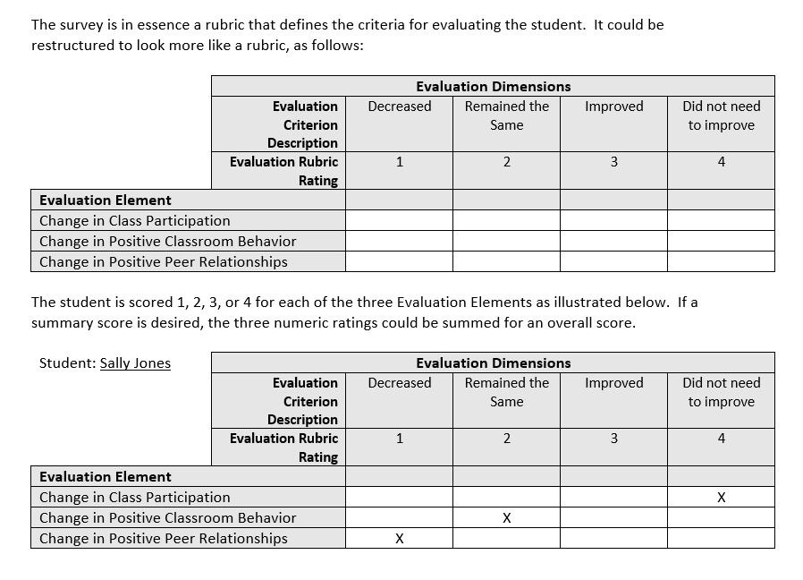
Program Evaluation Model
Model Development

Slide 15
Program Evaluation
Sample JSON
studentProgramEvaluations
[
{
"id": "211cb9c95b694ff79bdee1a31f760ef1",
"programEvaluationReference": {
"programEvaluationEducationOrganizationId": 4235,
"programEvaluationPeriodDescriptor": "uri://azed.gov/ProgramEvaluationPeriodDescriptor#Yearly",
"programEvaluationProgramName": "21st CCLC",
"programEvaluationProgramTypeDescriptor": "uri://azed.gov/ProgramTypeDescriptor#Support Program",
"programEvaluationTitle": "21st CCLC Annual Performance Report Teacher Survey",
"programEvaluationTypeDescriptor": "uri://azed.gov/ProgramEvaluationTypesDescriptor#Teacher Survey",
"link": {
"rel": "ProgramEvaluation",
"href": "/AZ/programEvaluations/53a38707ff05467f81d3441c258c6ca2"
}
},

Slide 16
Program Evaluation
Sample JSON
studentProgramEvaluations
"studentReference": {
"studentUniqueId": "28631598",
"link": {
"rel": "Student",
"href": "/ed-fi/students/87955b31eb2e4ca2bacb3f6511d81c72"
}
},
"evaluationDate": "2023-01-25",
"externalEvalutors": [
{
"externalEvalutor": "Test1"
}
],

Slide 17
Program Evaluation
Sample JSON
studentProgramEvaluations
"staffEvaluatorStaffs": [
{
"staffEvaluatorStaffReference": {
"staffUniqueId": "34279966",
"link": {
"rel": "Staff",
"href": "/ed-fi/staffs/0607722f65944ecf89b43084b4a069d5"
}
}
}
],

Slide 18
Program Evaluation
Sample JSON
continued
"studentEvaluationElements": [
{
"programEvaluationElementReference": {
"evaluationElementProgramEvaluationEducationOrganizationId": 4235,
"evaluationElementProgramEvaluationPeriodDescriptor": "uri://azed.gov/ProgramEvaluationPeriodDescriptor#Yearly",
"evaluationElementProgramEvaluationProgramName": "21st CCLC",
"evaluationElementProgramEvaluationProgramTypeDescriptor": "uri://azed.gov/ProgramTypeDescriptor#Support Program",
"evaluationElementProgramEvaluationTitle": "21st CCLC Annual Performance Report Teacher Survey",
"evaluationElementProgramEvaluationTypeDescriptor": "uri://azed.gov/ProgramEvaluationTypesDescriptor#Teacher Survey",
"programEvaluationElementTitle": "Change in Classroom Participation",
"link": {
"rel": "ProgramEvaluationElement",
"href": "/AZ/programEvaluationElements/9ae179d1c2c84438809db12d294bb675"
}
},
"evaluationElementRating": 1
},

Slide 19
Program Evaluation
Sample JSON
continued
{
"programEvaluationElementReference": {
"evaluationElementProgramEvaluationEducationOrganizationId": 4235,
"evaluationElementProgramEvaluationPeriodDescriptor": "uri://azed.gov/ProgramEvaluationPeriodDescriptor#Yearly",
"evaluationElementProgramEvaluationProgramName": "21st CCLC",
"evaluationElementProgramEvaluationProgramTypeDescriptor": "uri://azed.gov/ProgramTypeDescriptor#Support Program",
"evaluationElementProgramEvaluationTitle": "21st CCLC Annual Performance Report Teacher Survey",
"evaluationElementProgramEvaluationTypeDescriptor": "uri://azed.gov/ProgramEvaluationTypesDescriptor#Teacher Survey",
"programEvaluationElementTitle": "Change in Positive Classroom Behavior",
"link": {
"rel": "ProgramEvaluationElement",
"href": "/AZ/programEvaluationElements/716f876956c149499ce819fd76802167"
}
},
"evaluationElementRating": 2
}
],
...
"studentEvaluationObjectives": [],
"_etag": "5249802721335628048", "_lastModifiedDate": "2023-02-10T23:58:10.8240144Z" } ]

Slide 20

CTED FY2023 Update
Vendors shared that they expected to be able to have the CTED Planned Instructional Minutes or Community College Credit Hours submitted until February.
  School Finance is expecting all CTED data to be updated within the first week of March.
  Any CTED Central (Owned or Leased), Community College or Satellite student memberships will stop generating ADM once School Finance uses the Planned Instructional Minutes / CC Credit Hours

Slide 21

Exceptional Student Services (ESS)
StudentParentAssociation added IsIDEAParent for all students with StudentSpecialEducationProgramAssociation across all dates of the SSEPA. (Integrity will flag as warnings for FY2024, errors for FY2025)
  IsAncillary added to StudentNeeds
  Least Restrictive Environment (SPED Program Association) “L” used for students with an IsAncillary Need but not on an IEP.
  IsProgressMade added to Preschool Assessment Outcomes (StudentSpecialEducationProgramAssociationAssessmentOutcome)

Slide 22
Exceptional Student Services (ESS)
  Discipline Actions reduced with new flags added for “ServicesProvided” and “ParentDeclinedServices”
  “ServicesProvided” is for any Discipline Action that removed the student from their Educational Setting. Default True
  “ParentDeclinedServices” is for any student where services were offered, but the [IsIDEAParent] refused.

Slide 23
21st Century Community Learning Center
Teacher Survey (Program Evaluation Model)
Schools with 21st CCLC acceptance will be required to submit their student Discipline Data beginning in FY2024
Summer Participation Guidance updated November 2022. Vendors are asked to retain the 21st CCLC Program and Program Attendance for the Summer Months when a student has a Summer Withdrawal.

Slide 24
21st CCLC Guidance
FY23 Activities guidance.pdf (azed.gov)
ActivityTypeDescriptor
Context: Starting in FY23 and moving forward, an ActivityTypeDescriptor is required for 21st CCLC student attendance. This is part of the federally required data collection for the Annual Performance Report (APR). This Activity data will be used by ADE’s 21st CCLC team to calculate dosage of each activity offered throughout the program year for the APR.
The below chart includes the AzEDS Activity Type Descriptor Code Value, definition, and possible examples. To determine which code should be selected for a class/activity, consult with the 21st CCLC program coordinator/director to ensure the activity selected aligns to each school’s program goals and requirements. For additional information about the APR requirements see the 21st CCLC APR Reporting Guide on the 21st CCLC Annual Performance Report page of the 21st CCLC website.

Slide 25
21st CCLC Guidance
 | Activity Descriptor Type Value for AzEDS Reporting | Definition | Possible Examples
Student Activity Categories
Literacy Education | Activity001 | Those activities that contributed to the development of reading and language arts skills and to the enjoyment of reading. | Reading tutoring, breakfast reading clubs, writing club, reader’s theatre, Project LIT
Science, Technology, Engineering, and Mathematics, including Computer Science | Activity002 | Any classes that contributed to the development of science, technology, engineering, or mathematics skills, including any combined STEM classes. This includes all mathematics classes. In addition to traditional STEM classes, add the math classes you offered that align to the site’s approved math objective(s). | Math tutoring, coding classes, STEM club, robotics, Girls Who Code, 3D printing, Young Builders Club, gardening club
Academic Enrichment | Activity003 | Classes or activities that provided academic enrichment, including academic classes not categorized under Literacy Education or STEM. | Mentoring, non reading/math tutoring, homework help, community service, Power Hour, Student Skills, Art History
Healthy and Active Lifestyle | Activity004 | Those activities that engage students in a physical activity and/or cultivate the appreciation of a healthy and active lifestyle. | Martial arts, fitness class, cooking class, mountain bike club, yoga club, discing for kids, sports clubs, dance class, folklorico, gardening club
Cultural Programs | Activity005 | Activities or classes that contributed to enhanced understanding of culture. | Cooking around the world, folklorico, foreign language, music, girls teaching girls, art history

Slide 26
21st CCLC Guidance
 | Activity Descriptor Type Value for AzEDS Reporting | Definition | Possible Examples
Student Activity Categories
Telecommunications and Technology Education | Activity006 | Classes that contributed to the development of telecommunication and related technology skills. | Esports, Multimedia Club, Podcast/Movie Making,
Expanded Library Service Hours** | Activity007 | Activities that contributed to expanded access to library resources including time and personnel. | Expanded Library Time
Assistance to Students who have been Truant, Suspended, or Expelled | Activity008 | Those activities/classes that target students with content related to truancy, suspension, expulsion. | Check- Club, Leadership Club, Truancy Prevention Camp
Drug and Violence Prevention and Counseling | Activity009 | Those activities that promoted peaceful conflict resolution, that provided information about the dangers of drug use, or that provided socio-emotional counseling services. | MATforce, Horse therapy, grief group
Career Competencies and Career Readiness | Activity010 | Those activities that prepare students to enroll and succeed in a credit bearing course at a postsecondary institution or a high-quality certificate program with a career pathway to future advancement. Include also classes that provide introduction to potential careers for all grade levels, career training or job prep. | FAFSA prep, AP course prep, CTE classes (see ADE CTE K-12 standards), Mechanic certification program

Slide 27
21st CCLC Guidance
 | Activity Descriptor Type Value for AzEDS Reporting | Definition | Possible Examples
Student Activity Categories
Well-rounded Education Activities, including credit recovery or attainment | Activity011 | Courses, activities, and programming in subjects such as foreign languages, civics and government, economics, arts, history, geography, music, and any other subject with the purpose of providing all students access to an enriched curriculum and educational experience. | Credit recovery or attainment, volunteerism, community service, accelerated learning, Civics, economics geography, American history, Government, community involvement, Student Council, Arts and crafts, music, entrepreneurship
Services for Individuals with Disabilities | Activity012 | Those activities designed to directly support students identified as individuals with disabilities, including students who have an IEP or 504. | Discuss with the Evaluation Specialist classes you think may fit here.
Activities for English Learners | Activity013 | Those activities designed to directly support students classified as English learners. | Discuss with the Evaluation Specialist classes you think may fit here.

Slide 28
21st CCLC Guidance
ActivityCode (New FY2024)
Context: Starting in FY24 and moving forward, an ActivityCode is required in addition to the Activity Type Descriptor for 21st CCLC student attendance. This is part of the federally required data collection for the Annual Performance Report (APR).
The ActivityCode is meant to solve the problem of distinguishing between two different classes with the same ActivityTypeDescriptor that took place at the same time.
For example, four STEM classes from 2:30-3:30 on the same day will have the same activity type descriptor and will therefore look like they are all the same activity- it will look like 1 hour of that activity even if 4 STEM classes took place in that hour. We are not able to distinguish between them on any other variable. We’re essentially including an additional variable that will allow us to count activity hours on the roster level per federal guidance.

Slide 29
21st CCLC Guidance
ActivityCode, continued
21st CCLC has left the requirement of what this code looks like up to individual vendors with the above needs in mind- that ultimately 21st CCLC will be able to count the hours that activities took place accounting for more than one class having the same activity type at any given time.
One vendor shared that their plan:
Setting this structure for the district so the district doesn’t have to make the choice of how to code their classes.
Based on this vendor’s structure, they will submit: SchoolId-ActivityType-Course#-SectionId

Slide 30
Office of Indian Education
Multiple Tribal Affiliations may be submitted per student (this may improve grant availability)
Added IsEnrolled flag to Tribal Affiliations (only one Tribal Affiliation may be marked as ‘IsEnrolled’)

Slide 31
Q & A
AzEDS IT
Business Areas:
            Exceptional Student Services
        Firearms Data Collection
        Office of Indian Education
        21st CCLC

Slide 32
Thank You !

