Slide 1
Welcome to Webinar #7: AZ Learning Management System (AZ LMS)
This webinar will be recorded and posted on the ADE Assessments webpage.​
​
Please enter your First and Last Name in the Chat for tracking purposes for the live event.​
​
We will also be capturing the chat questions. If there are questions that were frequently asked or need further clarification, ADE will compile and create an FAQ which will then be posted on the Assessments webpage under Friday Focus Webinars.

Slide 2
Friday Focus Webinar #7: Arizona Learning Management System (az LMS)
Audra Ahumada
Deputy Associate Superintendent of Assessment
December 15, 2023

Slide 3
Welcome and Overview
Transition to new Learning Management System (for required training)
Who, What, When, Where, Why,
….and How
Demonstrations from Pearson LMS Partners
Resources and Supports
Question and Answer Session

Slide 4
AASA and AzSCI Required training For Administration
Standardized training is required for all statewide assessments. This ensures that the test will be administered the same for all students.
Assessment Administrators receive both the online training and the supporting documents to ensure fidelity of implementation and the validity of the assessment results as well as to help prevent, detect, and respond to irregularities in academic testing and maintain testing integrity practices for the Achievement assessments.
If the test is not administered in the same ways, this could result in a test irregularity or even an invalidation of a student test or tests.

Slide 5
WHO? You.
District Test Coordinator (DTC)

Slide 6
Arizona’s Learning Management System
DTCs will be added to the system by Pearson and will receive a Welcome Email with information to access AzLMS.
If a DTC already has access to AzLMS for AZELLA, they will not receive a Welcome Email but will receive access to the training modules.
The DTC Welcome Email will come from admin@adobelearningmanager.com with the subject “Welcome to Arizona’s Learning Management System: Verification Required“. Check your junk or spam folder.
The Welcome Email will contain links that DTCs should send to testing staff so they can access trainings in AzLMS according to their user roles.
If a DTC received an AZELLA Welcome Email, the links included for testing staff are the same links that will be used for Achievement.

Slide 7
Arizona’s Learning Management System
DTCs will have two roles in their AzLMS account – Learner and Manager
Use the Manager role to access AzLMS reports to track and confirm completion of training for users (test administrators and other testing staff)
DTCs must complete training under the Learner role using the District Test Coordinator tag

Slide 8
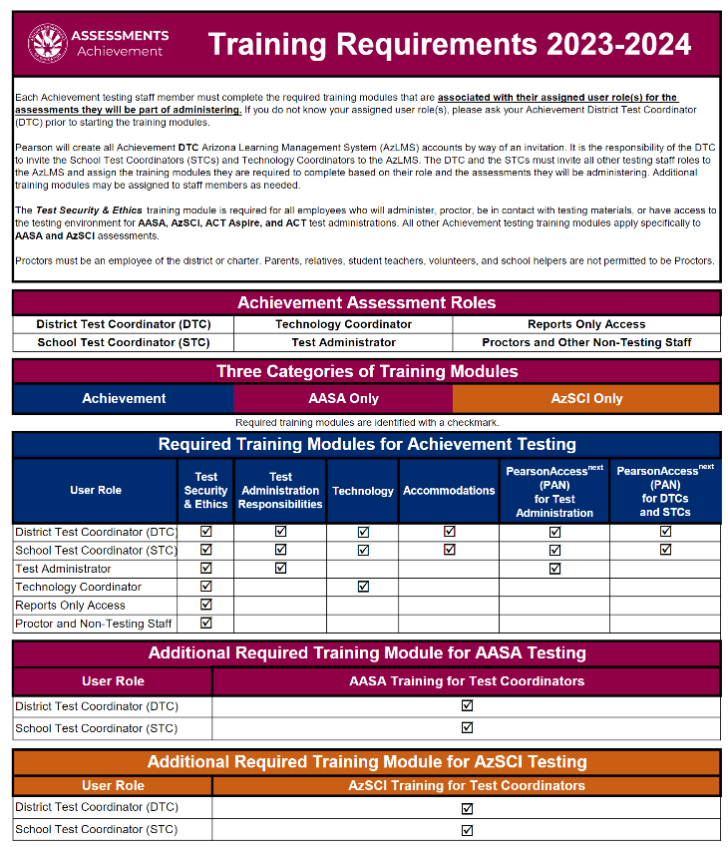
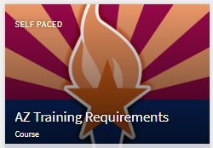
Training requirements by user role
Achievement Assessments Training Requirements
Available in AzLMS
Available on Achievement DTC webpage

Slide 9
WHAT?
What is AZLMS?

Slide 10
Transition to Arizona's Learning Management System (AZLMS)
AZELLA was the first program to transition to the new Arizona Learning Management System
AASA and AzSCI required training modules will be completed in AzLMS
Training modules for District Test Coordinators will be tracked in the system.
DTCs are required to ensure all test administrators and anyone who will proctor or be in contact with the test materials or the test environment be trained according to their role.
Users must self-register in AzLMS using links provided to them by the DTC to complete modules in the system
DTCs may conduct a group training independently of the AzLMS and track users’ training completion in the system

Slide 11
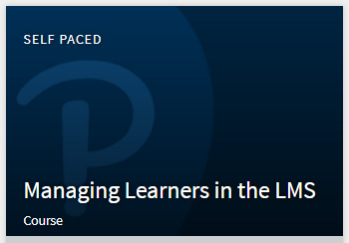
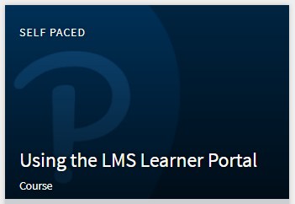
Arizona’s Learning Management System
DTCs must first complete LMS Training
Managing Learners in the LMS
Using the LMS Learner Portal

Slide 12
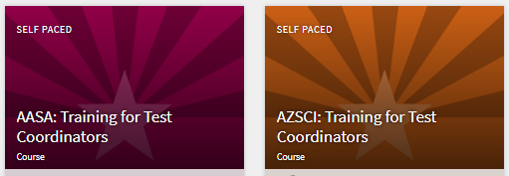
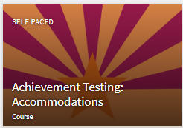
Arizona’s Learning Management System
Achievement trainings can be identified by color. The AASA Training for Test Coordinators training is red, and the AzSCI Training for Test Coordinators is copper.
All other Achievement training modules, which apply to both AASA and AzSCI, are a combination of the two colors.

Slide 13
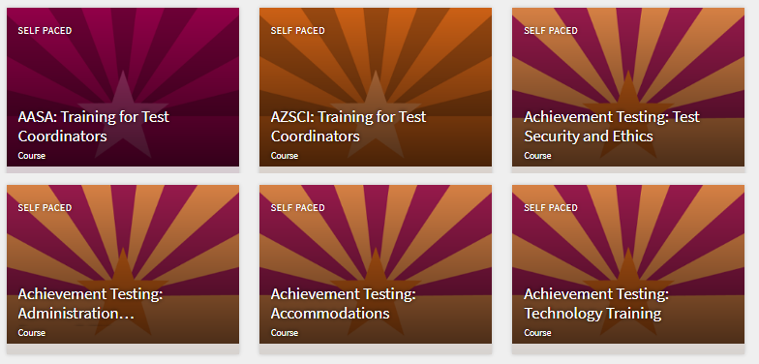
AASA and AzSCI Required training For Administration

Slide 14
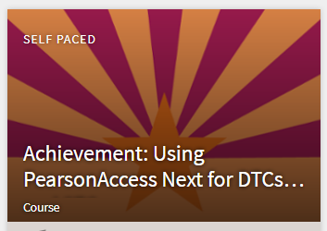
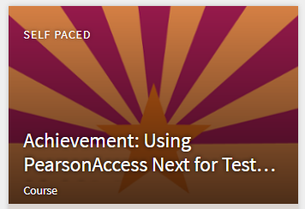
AASA and AzSCI Required training For Administration
PearsonAccess^{next} Training for DTCs and STCs
PearsonAccess^{next} Training for Test Administrators

Slide 15
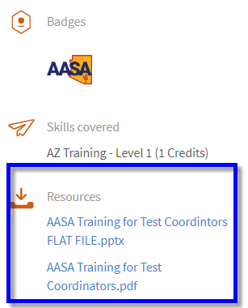
Resources for each training module
PowerPoint flat file
Transcript PDF
After completing each module, these resources may be utilized to reference content material without having to rewatch the entire training

Slide 16
WHEN?
When will training be available?

Slide 17
AZLMS Training Window
Training modules will be available through the testing Windows
DTCs should complete training no later than February 23, 2024

Slide 18
WHEre?
Where to access AzLMS?

Slide 19
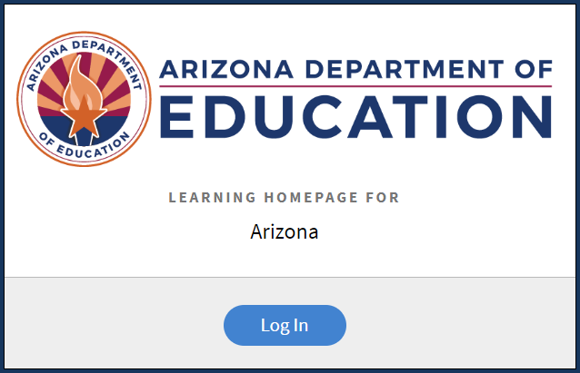
AzLMS
https://learningmanager.adobe.com/pearson-lms-az

Slide 20
WHY?
Why LMS vs. TMS?

Slide 21
ADE is committed to Improving Tools
Our Learning Management System integration services give you the integration, support, and training you need.
LMS integration provides single sign-on, grade sync, and assignment linking capabilities to improve how DTCs can interact with Courseware within the state’s LMS.
What is the difference between TMS and LMS?
Training Management System vs Learning Management System
The main difference between a TMS and an LMS is that the TMS manages instructor-led and virtual instructor-led training operations and is built for the training back-office, whereas the LMS manages eLearning and is built for the learner!

Slide 22
How to…
Learner Self Registration
LMS Overview - Learner Role
LMS Overview - Manager Role

Slide 23
Learner Self-Registration
DTC Welcome Email
Links must be sent to users in school/district
Users must self-register
Existing Adobe ID
Create New Adobe ID

Slide 24
Questions?

Slide 25
LMS Overview - Learner Role
Training Requirements Documents
LMS Menu - Home, My Learning, Catalog, Badges
Mention the LMS trainings
Using the LMS Learner Portal
Managing Learners in the LMS
Catalogs/Tags Filter Options
Course Enrollment/Unenrollment
Show Course Example with Content Player
Course Badges and Certificates
Learner Transcript

Slide 26
Questions?

Slide 27
LMS Overview - Manager Role
Manual Enrollment of Courses
Dashboard Views
Report Options

Slide 28
Questions?

Slide 29
Resources

Slide 30
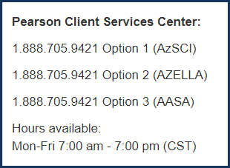
resources
Reminder: Check the Job Aids posted in the AzLMS for detailed guidance.
Pearson Help Desk

Slide 31
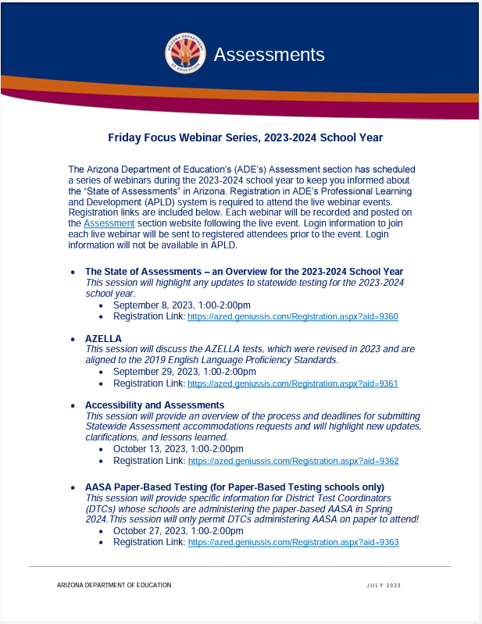
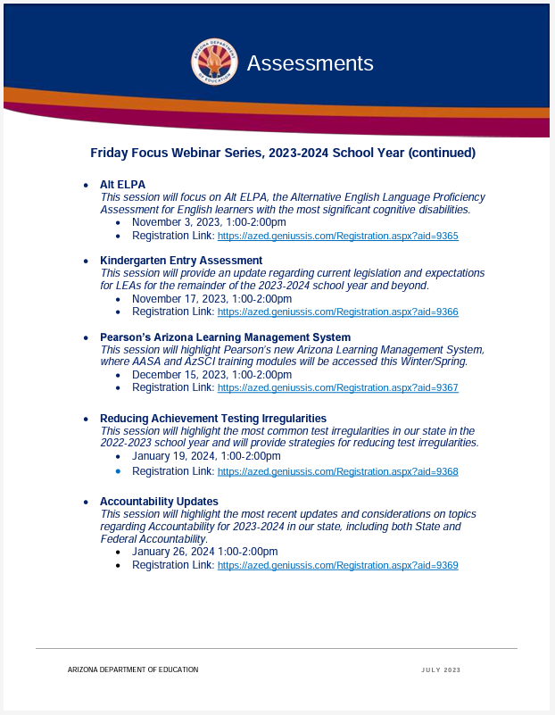
Assessment Webinar Series - POSTED
The flyer is posted on the Assessment Main page:
https://www.azed.gov/sites/default/files/2023/07/2023-2024%20Friday%20Focus%20Webinar%20Schedule.pdf
Reminder: participants must register in ADE’s Professional Learning and Development (APLD) system
Log in information to join the session will be sent to registered participants prior to the event. Login information will not be available in APLD.

Slide 32
Save the DATE
Arizona Assessments Conference – September 17-19, 2024
https://www.azed.gov/assessment/conference

Slide 33
Questions?

Slide 34
THANK YOU!
For questions, please contact us at: ​
Testing@azed.gov​

