Slide 1
Welcome to Webinar #6: Kindergarten Entry Assessment (KEA)
This webinar will be recorded and posted on the ADE Assessments webpage.​
​
Please enter your First and Last Name in the Chat for tracking purposes for the live event.​
​
We will also be capturing the chat questions. If there are questions that were frequently asked or need further clarification, ADE will compile and create an FAQ which will then be posted on the Assessments webpage under Friday Focus Webinars.

Slide 2
Friday Focus Webinar #6: Kindergarten Entry Assessment (KEA)
Audra Ahumada
Deputy Associate Superintendent of Assessment
November 17, 2023

Slide 3
Welcome and Overview
KEA Legislative Updates
KEA Results and Data
KEA Resources and Supports

Slide 4
Kindergarten Entry Assessment (KEA)
https://www.azed.gov/ece/kindergarten
LEA’s must assess students with KEA (board approved or LEA selected) first 45 days of school or within 45 days from time of enrollment
LEA should ensure that the kindergarten entry assessment selected by a LEA is accessible to all students including all students with disabilities
The Board’s approved KEA is accessible, observation-based and requires the teacher to provide a rating on the student’s current skills
Currently there are about 50,000 studnets entered into the Teaching Strategies GOLD Platform

Slide 5
KEA Guidance

Slide 6
KEA Results and Data

Slide 7
Current Status

Slide 8
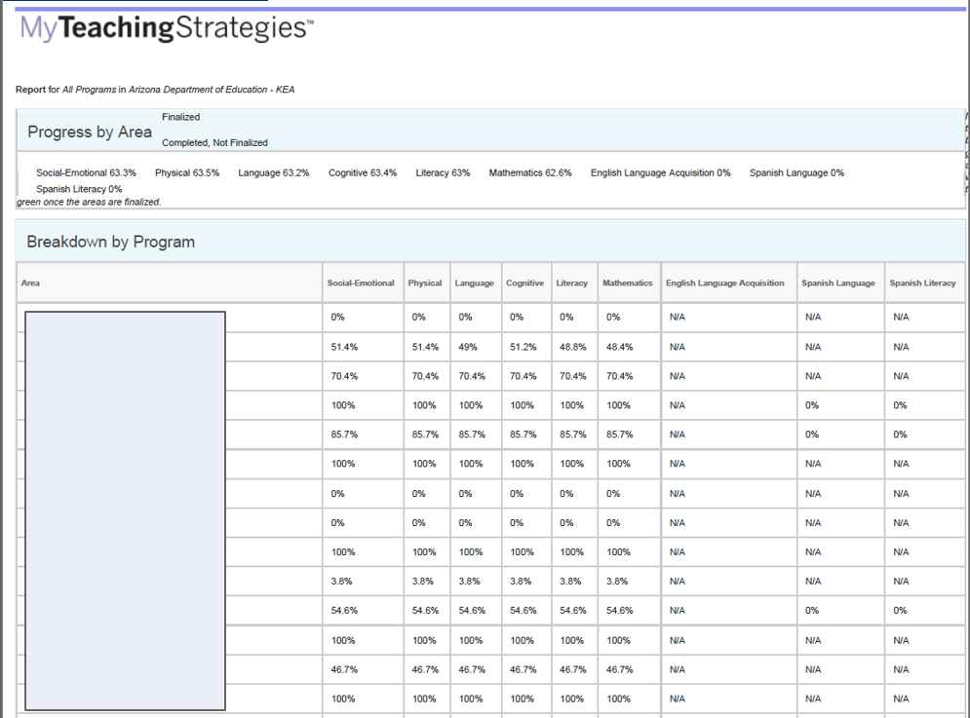
KEA Reports

Slide 9
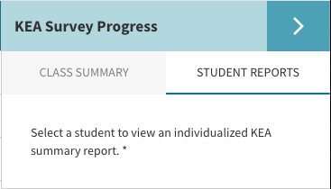
KEA REPORTS

Slide 10
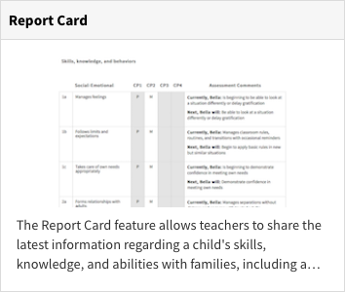
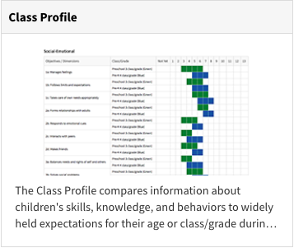
Next Steps for teachers

Slide 11
Resources

Slide 12
Resources - Infographic
https://www.azed.gov/sites/default/files/2023/07/KEA%20Infographic%2023-24%20Final%20v3.pdf

Slide 13
TSG Resources
https://www.azed.gov/ece/kindergarten Under My Teaching Strategies GOLD Resources Tab

Slide 14
KEA Webinars
KEA Information Session
KEA for Administrators Session
https://www.azed.gov/ece/kindergarten Under the Recorded Webinars Tab

Slide 15
KEA Trainings
KEA Trainings Live trainings are required for KEA District Test Coordinators (DTCs)
Teachers/Test Administrators will complete either the asynchronous trainings or live training
https://www.azed.gov/ece/kindergarten Under the KEA Trainings Tab

Slide 16
Questions?

Slide 17
THANK YOU!
For questions, please contact us at: ​
Testing@azed.gov​

