Slide 1
Alt ELPA-Alternate English Language Proficiency assessment
Bethany Spangenberg
Director of Alternate Assessment
Friday Focus Webinar
November 3, 2023
Notes:
Welcome to the Friday focus webinar. Today we will be exploring Alt ELPA, our Alternate English Language Proficiency Assessment.

Slide 2
Welcome to Webinar #5: Alt ELPA
This webinar will be recorded and posted on the ADE Assessments webpage.​
​
Please enter your First and Last Name in the Chat for tracking purposes for the live event.​
​
We will also be capturing the chat questions. If there are questions that were frequently asked or need further clarification, ADE will compile and create an FAQ which will then be posted on the Assessments webpage under Friday Focus Webinars.

Slide 3
Welcome to Webinar #5: Alt ELPA
ADE Assessments Team will have 4 more webinar sessions in this series for the 2023 - 2024 school year​
These webinars will be recorded and posted on the Assessments Webpage​
This session will spotlight Alt ELPA, our Alternate English Language Proficiency Assessment for English learners with the most significant cognitive disabilities.

Slide 4
Agenda
Introduction to Alt ELPA
Standards
2023 Operational Field Test
Cut score approval
Reporting
Upcoming activities
Notes:
Today I will give a brief overview of the background, previous activities, students, and accessibility of the Alt ELPA. Then we will look at the standards. I will review the 2023 operational field test, provide information on cut score approval, and describe reporting and proficiency. We will close with some upcoming activities to prepare for the 2024 administration.

Slide 5
Background of Alt ELPA
Notes:
Let’s start with an introduction for those who many not be familiar with this assessment.

Slide 6
Background
Federal grant to develop an alternate English language proficiency assessment over 4 years
Collaborative with 10 states and the National Center for Research on Evaluation, Standards and Student Testing (CRESST) at UCLA
Priority to focus on the unique student population
Iterative approach that involved national experts, state stakeholders, LEA administrators, and teachers
Aligned with CCSSO Alternate ELP standards, approved to be used in AZ by the State Board of Education in January 2022
Notes:
Alt ELPA was developed under the CAAELP project (Collaborative for the Alternate Assessment of English Language Proficiency), which was funded through a four-year grant. This collaborative involved work across 10 states and the National Center for Research on Evaluation, Standards, and Student Testing (CRESST) at UCLA. Throughout the development, the focus was on the unique needs of this student population. The assessment design was an iterative process involving various stakeholders from national organizations, state education agencies, and LEAs. The assessment is aligned with the CCSSO Alternate ELP standards, which were approved for use in Arizona in 2022. These Alternate ELPA standards align very closely with Arizona’s general ELP standards.

Slide 7
Additional work
Community of Practice started to engage educators and gather feedback
Pilot Alt ELPA test February – March 2022
Suite of training modules to share information and prepare for test administration
Notes:
In addition to assessment design, the Arizona Department of Education began a community of practice to engage educators throughout the process. A pilot was conducted in 2022, which included cognitive labs to better understand student engagement. A suite of training modules were developed to share more information on the assessment and to prepare educators for test administration. These modules are still available in the LMS.

Slide 8
The Students
Who takes alternate assessments?
Meet eligibility criteria as determined by the IEP Team:
Have a significant cognitive disability characterized by a disability or multiple disabilities that impact intellectual functioning and adaptive behavior
Is learning content linked to state content standards
Requires extensive direct individualized instruction and substantial supports to achieve measurable gains
Who takes Alt ELPA?
Meet eligibility criteria above
Has an EL status based on AZELLA Placement test
Previous ELP test history
Notes:
There is one alternate assessment eligibility determination. Determination is not made for each assessment. Eligibility criteria include a significant cognitive disability characterized by a disability or multiple disabilities that impact intellectual functioning and adaptive behavior, learning linked to state content standards, and a need for extensive direct individualized instruction and substantial supports to achieve measurable gains. Students who meet these criteria and also have been determined to be an English learner through the AZELLA placement test may participate in Alt ELPA. The student must also have a recent test history, just like students who take AZELLA. We do not yet have an alternate placement test, but we are in the process of having one available very soon.

Slide 9
Accessibility
What about students with alternate modes of communication or a sensory impairment?
Optimal Testing Conditions
Universal Features*
Accommodations
Embedded
Non-embedded
*Universal features and accommodations are determined by domain. Refer to the Accessibility Manual for details.
Notes:
As I mentioned, student needs were a priority for the development of the Alt ELPA. These next few slides list the many accessibility supports included in the assessment design. Please refer to the Accessibility Manual for additional details.

Slide 10
Universal Features
Domain Dependent: Some universal features may also be accommodations
Amplification
Color adjustment
Disable universal features
Keyboard navigation
Online tools: highlighter, mark items, masking, strikethrough
Replay audio
Re-record
Text-to-speech
Writing tools
Zoom
Notes:
Many universal features are built into the test. These are available to all students and can be accessed by the test administrator during testing. Some of these features may also be accommodations depending on grade and domain. The Accommodations Manual distinguishes these options by domain. All accommodations must be documented in the IEP, but these features should also be described as helpful supports as needed by the student.

Slide 11
Optimal Testing Conditions
For all students and all domains
Assistive Technology (AT) device
Breaks and flexible scheduling
Directions adjusted
Focusing prompts and materials
Lighting
Magnification
Medical device
Navigation assistance by test administrator
Noise buffer
Object representations
Positioning
Preferred communication mode
Scratch paper and other note-taking devices
Scribe
Tactile graphics
Verbal encouragement
Notes:
Optimal testing conditions are best practices for providing a comfortable and supportive testing environment. These conditions are for all students and all domains.

Slide 12
Accommodations
Domain Dependent
Print on demand (paper test)
Text-to-speech
Word prediction
Read aloud
Sign language presentation
Verbal description of graphics
Remember: all accommodations must be documented in the IEP!
Notes:
The list of accommodations is much smaller! Again, these accommodations depend on the domain so please refer to the Accommodations Manual. Accommodations are activated by the test administrator when approving the student to the test session in TIDE. Remember, all accommodations must be documented in the IEP.

Slide 13
Standards
Notes:
Let’s take a look at the standards. This will be a short overview. More information is available on the website.

Slide 14
Standards Development
Were developed to
Meet federal requirements
Support instruction
Reflect an understanding of the learner
Notes:
The CCSSO Alternate ELP standards were developed to meet federal requirements, support instruction, and reflect an understanding of the learner.

Slide 15
Organization
6 grade levels/grade bands
Kindergarten; grade 1; and grade bands 2–3, 4–5, 6–8, and 9–12
10 standards
common across the grade levels/grade bands
3 proficiency levels
low, mid, and high
reflecting end targets
reflecting a progression K–12
Notes:
The standards are organized into 6 grade levels/grade bands. There are 10 standards that are common across the grade levels/grade bands. These standards include three proficiency levels that reflect end targets and progress throughout the grades.

Slide 16
ELP Standards for ELSCD
Standards 1 through 7 involve the language necessary for ELSCDs to engage in the central content specific practices associated with ELA and literacy, mathematics, and science. They begin with a focus on extracting meaning and then progress to engagement in these practices.
Standards 8 through 10 focus on some micro-level linguistic features and serve the other seven standards.
Notes:
These are the standards. Standards 1 through 7 involve the language necessary for ELSCDs to engage in the central content specific practices associated with ELA and literacy, mathematics, and science. They begin with a focus on extracting meaning and then progress to engagement in these practices. Standards 8 through 10 focus on some micro-level linguistic features and serve the other seven standards. These standards are the same as the Arizona ELP standards except for one phrase in standard 6.

Slide 17
Domain Definitions
Speaking: the action of conveying information or expressing thoughts and feelings, or a response in a conversation.
Writing: process of using symbols to communicate thoughts and ideas or to convey or record information in a readable form to a particular audience and for a particular purpose.
Listening: receiving of language with thoughtful attention and processing sounds to understand their meaning or intent.
Reading: process of recognizing and understanding or making meaning from symbols, letters, or words.
Notes:
Although the standards are the same, the approaches to instruction and assessment is different. These domain definitions allow for flexibility in communication that is needed for students with the most significant cognitive disabilities. Speaking is the action of sharing information or thoughts. This could be done through any mode of communication. The same is true for writing, listening, and reading. Students do not have to physically write or read to access the domains, and students are listening when they receive information in any accessible format.

Slide 18
Domains and Modalities
Modalities | Domains | Standards
Receptive | Listening and Reading | 1, 8
Productive | Speaking and Writing | 3, 4, 7
Interactive | Listening, Speaking, Reading, and Writing | 2, 5, 6
The Alt ELPA reports out by modalities.
Notes:
This table shows the alignment between modality, domains, and standards. Alt ELPA reports out by modalities because many students may access the domains differently. More information on reporting will be shared a little later in this presentation.

Slide 19
Proficiency Descriptors
The ten standards are common across every grade level/grade band.
Additional details about language are provided in the proficiency descriptors (low, mid, high) for each standard and grade level/grade band.
The proficiency descriptors articulate the English language proficiency knowledge, skills, and abilities expected of students at each level (low, mid, high) for a given standard and grade/grade band.
Notes:
One helpful feature of the standards is that proficiency descriptors were developed to help educators identify and work toward increasing English language proficiency for students with the most significant cognitive disabilities. As I mentioned, the standards are the same across the grades. However, additional details about language are provided in the proficiency descriptors for each standard and grade level. The proficiency descriptors articulate the English language proficiency knowledge, skills, and abilities expected of students at each level (low, mid, high) for a given standard and grade/grade band.

Slide 20
Example
ELP Level | Proficiency Descriptors An English learner with significant cognitive disabilities can: | Example(s)
Low | analyze and critique the arguments of others orally and in writing | A student may Identify the main idea of a presentation.
Mid | with prompting and support Identify a reason an author or a speaker gives to support the main point of a familiar topic. | A student may Respond to questions such as, “Show me how you know this?” Point to a frequently occurring word/phrase that supports the main idea. Determine why the speaker/author likes or dislikes their main point.
High | with prompting and support: Tell how one or two reasons support the specific points an author or a speaker makes on a familiar topic. | A student may Respond to simple wh- questions (e.g., What does the speaker/author want to happen? Why does the speaker/author want …?) Respond to questions such as, Why was Joe sad? Why are fire drills important? Why does the policeman say to stop at a red light?
Standard 6 for Grade Band 2–3
An English learner with significant cognitive disabilities can analyze and critique the arguments of others orally and in writing
Notes:
This slide shows an excerpt from the Standards document.
Below the dark blue row, from left to right, are the EL level for the standard (low, mid, high); the proficiency descriptor for each ELP level; and examples of observable student behaviors related to each ELP level and corresponding proficiency. The proficiency descriptors and examples change from grade to grade.

Slide 21
Sample Items

Slide 22
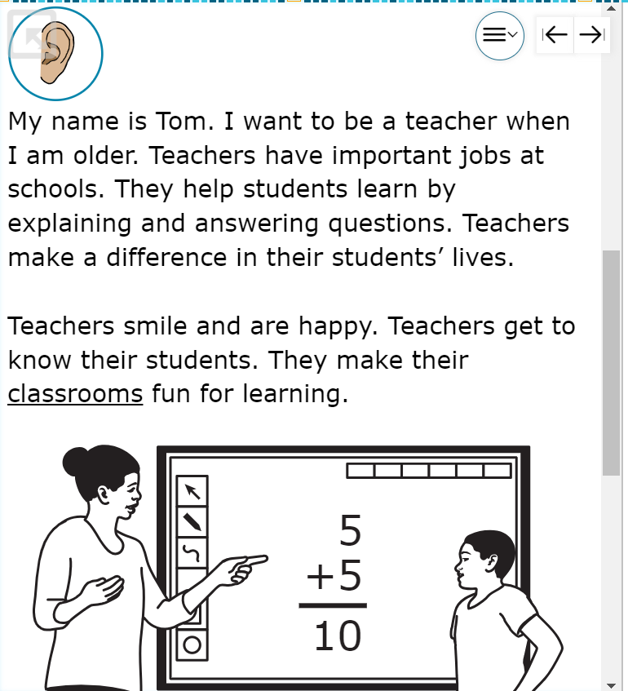
Sample Test Items Grade 4 Listening
https://login3.cambiumtds.com/student_core/V27/Pages/LoginShell.aspx?c=Arizona_PT&a=Student
Notes:
Sample items are available in the Cambium portal under practice tests. This option will give test administrators and students familiarity with the assessment.

Slide 23
2023 Operational field test
Notes:
Let’s review the 2023 operational field test.

Slide 24
Operational field test
Over 900 students participated in Arizona’s first alternate ELP assessment
Embedded standard setting
Reporting opened on October 23
Sending hard copies of Individual Student Reports
Notes:
Over 900 students participated in Arizona’s first alternate ELP assessment. We are excited to have an ELP assessment that was designed for these students. Operational field tests allow the test developers to gather item level information for a new assessment and still have reports that can be used for accountability. Because we conducted a pilot with cognitive labs before the first administration, we had enough information to administer the operational field test with confidence that the results were valid. Alt ELPA also had an embedded standard setting with confirmation through an educator workshop that was held in August. Alt ELPA reporting opened on October 23 and is still open. We are currently getting the student reports printed and mailed out to LEAs. More information on reporting will shared in a few more slides.

Slide 25
Cut Score Approval
After any standard setting, the cut scores need to be approved.
Cut scores for Alt ELPA were approved by Superintendent Horne on September 15.
Future reports will be available much sooner so that LEAs can plan for instructional models and notify parents.
Notes:
Before moving on to reporting, let me explain why reporting was so late this year. After a new assessment, a standard setting is required to determine cut scores. And after cut scores are proposed, they need to be approved in each state. The Alt ELPA cut scores were approved by Superintendent Horne on September 15. Starting next year, reports will be available much sooner so that you can plan for instruction and notify parents. We appreciate your patience in your decision-making processes and waiting for the ADEConnect reports to update.

Slide 26
Reporting
Notes:
Now let’s look at reporting!

Slide 27
Alt ELPA reporting
Reporting portal is in the Cambium portal (where you log into TIDE)
District test coordinators have access to district, school, and student reports.
Quick Guide to Understanding Reports
Three overall proficiency levels: Emerging, Progressing, Proficient
Four modality and domain proficiency levels: Beginning, Intermediate, Early Advanced, Advanced
Notes:
Alt ELPA reports are available in the Cambium portal, the same place you log into TIDE. District test coordinators have access to district, school, and student reports. The reporting portal offers dynamic reporting options with many ways to view and analyze the results. The reporting user guide available in the portal explains the many features of this site. The quick guide to understanding reports is a short overview of how to understand the student report and proficiency determination. We will look at this topic next. Alt ELPA has three overall proficiency levels: Emerging, Progressing, Proficient and four modality and domain proficiency levels: Beginning, Intermediate, Early Advanced, Advanced.

Slide 28
Student report
Overall score, comprehension score, and proficiency determination at the top followed by descriptions of proficiency determination
Notes:
The student report will have the overall score, comprehension score, and proficiency determination at the top followed by descriptions of proficiency determination. This gives the reader a quick look at the student’s proficiency.

Slide 29
Proficiency Determination
Proficiency Determination | Definition | Profiles
Emerging | Students show a level of English language proficiency reflected in alternate ELPA standards that significantly limits participation in the grade-appropriate classroom activities… | Level 1 in both modalities
Progressing | Students show a level of English language proficiency reflected in alternate ELPA standards that moderately limits participation in the grade-appropriate classroom activities… | Above level 1 and below level 3 in at least one modality
Proficient | Students show a level of English language proficiency reflected in alternate ELPA standards that enables full participation or only slightly limits participation in the grade-appropriate classroom activities… | Level 3 or higher in both modalities
Notes:
Proficiency is determined by modality. A student whose proficiency is described as emerging will have significant limitations to participation in grade-level classroom activities compared to students with significant cognitive disabilities who are not English learners. These students have a level 1 (beginning) in both modalities. A student whose proficiency is described as progressing will have moderate limitations to participation in grade-level classroom activities compared to students with significant cognitive disabilities who are not English learners. These students have above level 1 and below level 3 in at least one modality. A student whose proficiency is described as proficient will not have limitations or may have slight limitations to participate in grade-level classroom activities compared to students with significant cognitive disabilities who are not English learners. These students have a level 3 or 4 (early advanced or advanced) in both modalities.

Slide 30
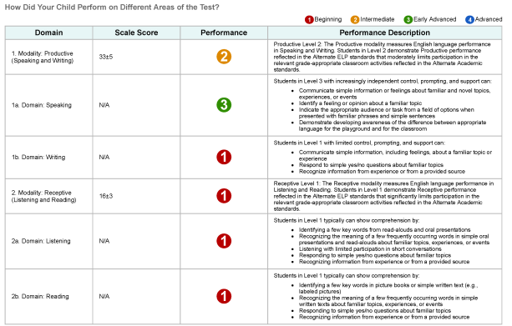
Modality and Domain
Student reports also have proficiency levels in each modality and domain. Performance descriptions are included.
Notes:
The student reports also have proficiency levels in each modality and domain. Performance descriptions are included. Performance descriptions are general statements about students in this proficiency level and may not reflect all areas of mastery or need for individual students.

Slide 31
Resources
Notes:
We also have many resources available for Alt ELPA.

Slide 32
Forms
Parent Notification and Consent Form – Alt ELPA – Do not modify
Notification of Reclassification – Can modify as needed
Two-year monitoring form – Can modify as needed
Follow the same processes you do for students who take AZELLA!
Notes:
The parent notification and consent form was added to the OELAS website. Do not modify this form. The notification of reclassification letter and the two-year monitoring form can be modified to use for students who took Alt ELPA. You will use the same processes for assessment, reclassification, and monitoring of students who take Alt ELPA as you do for students who take AZELLA.

Slide 33
Websites
ADE Alt ELPA
https://www.azed.gov/assessment/altelpa
Cambium Portal
https://az.portal.cambiumast.com/resources
Notes:
There are many more resources available for educators and parents. Please visit the ADE Alt ELPA website and the Cambium portal to view these resources. Some resources of interest are the Alt ELPA Test Administration Manual, quick guide to understanding reports, parent guide to student reports, standards, and glossary.

Slide 34
Upcoming
Notes:
We are already starting for the upcoming Alt ELPA administration.

Slide 35
Logistics
Registration in the Student Selector Application through November 30.
Communication goes to the Alternate Assessment Test Coordinator.
Alternate Assessment Test Coordinator Handbook
Test administrator and test coordinator training available end of November or early December
No accommodations requests
One-on-one administration with an observer required for scoring items on the speaking test
Test administration window January 30 – March 15, 2024
Notes:
Registration in the Student Selector Application through November 30. Alt ELPA communication goes to the Alternate Assessment Test Coordinator. The Alternate Assessment Test Coordinator Handbook is available and has due dates and instructions for Alt ELPA activities. Test administrator and test coordinator training available end of November or early December. A notification will be sent to Alternate Assessment Test Coordinators. Alt ELPA does not have accommodation requests. Test administrators add the needed accommodations directly in TIDE. Remember that Alt ELPA is a one-on-one administration with an observer required for scoring items on the speaking test. The test administration window is January 30 – March 15, 2024.

Slide 36
Registration Communication
AZELLA platform is set up to upload all students.
Students who are eligible for alternate assessments will usually be uploaded to AZELLA (PAN).
Alternate Assessment Test Coordinators and AZELLA Test Coordinators must communicate student lists with each other.
Do not administer AZELLA to students who are eligible for Alt ELPA!
Notes:
LEA staff must also communicate so that students take the correct test. The AZELLA platform is set up to upload all students, including students who are eligible for alternate assessments. Students taking Alt ELPA will usually be uploaded to AZELLA (PAN). Alternate Assessment Test Coordinators and AZELLA Test Coordinators must communicate student lists with each other. Do not administer AZELLA to students who are eligible for Alt ELPA!

Slide 37
Questions?
Notes:
Thank you for joining me today. Are there any additional questions?

Slide 38
THANK YOU!
For questions, please contact us at:
AlternateAssessment@azed.gov

