Slide 1
CTE Technical Skills Assessments
How to Take the Assessments
Arizona Department of Education, Career and Technical Education, Technical Skills Assessments

Slide 2
WELCOME to your Technical Skills Assessment
Today you will answer 100 multiple-choice questions about what you have learned in your CTE program. The test is not timed so you will have all the time you need to select the correct answers.

Slide 3
When you finish, you will be able to view your results and send them to your school or personal email address.
DO NOT CLOSE THE BROWSER UNTIL YOUR TEST IS SUBMITTED.
Paper, pencils, and User ID cards will be turned in at the conclusion of the test. Now let’s talk about the assessment you will be taking.

Slide 4
Sample Question
Question 1 of 100
What are the three colors of the American flag?
Red, white, and green
Red, white, and blue
Yellow, white, and black
Yellow, white, and purple

Slide 5
1. No Answer (Skip this Question) – this is the default answer.
There are three ways to answer
assessment questions.
2. Save Answer and Mark for Review -- both will bookmark the question.
3. Correct Answer
Click the Save Answer button to advance the test to the next question.

Slide 6
Click the Resume Test button to return to where the test
was paused.
Use the Pause Test button to interrupt (stop) the test.

Slide 7
The Summary screen displays when the last question is answered.
The Review Assessment screen gives you a Final Chance to answer all skipped or marked for review questions.
Summary
1 skipped
1 marked for review

Slide 8
Look at the three columns below:
Question = This is the original question. Answer = (Skipped) in red is the answer.
Review = Yes in red is the mark for review answer.
Click the green Review button to return to the original test question. Change or Keep your answer. Click the Save Assessment button to save a new answer and to return to the Review Assessment screen.
Review Assessment
You have 1 question(s) you did not answer. You have 1 question(s) marked for review.
Question
Answer
Review
Question 1
(Skipped)
No
Question 2
Clean
Yes

Slide 9
Look at the three columns below:
Question = This is the original question.
Answer = (Skipped) is the answer you selected.
Review = Yes is the mark for review answer you selected.
Change or Keep your answer for this question by clicking the Save Assessment button.
Review Assessment
You have 1 question(s) you did not answer. You have 1 question(s) marked for review.
Click the green
Review button
to return to the test question.
Question
Answer
Review
Question 1
(Skipped)
No
Question 2
Clean
Yes

Slide 10
When all skipped and mark for review questions have been answered the top two lines will display zeros.
Review Assessment
You have 0 question(s) you did not answered. You have 0 question(s) marked for review.
Click the blue Return to Summary button.
Question
Answer
Review
Question 1
mop
No
Question 2
Clean
No

Slide 11
The Summary screen now displays zeros for skipped and marked for review questions.
Summary
0 skipped
0 marked for review

Slide 12
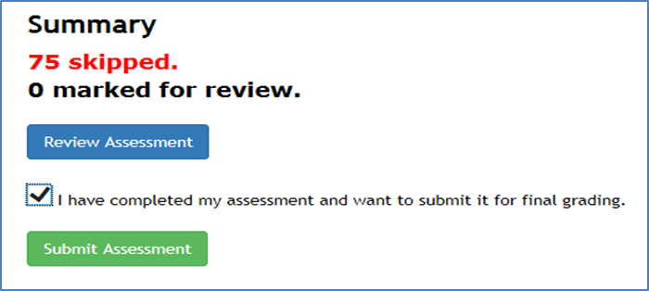
0 skipped
Click in the box to show you have completed the test.
Click the green Submit Assessment button to submit your test.

Slide 13
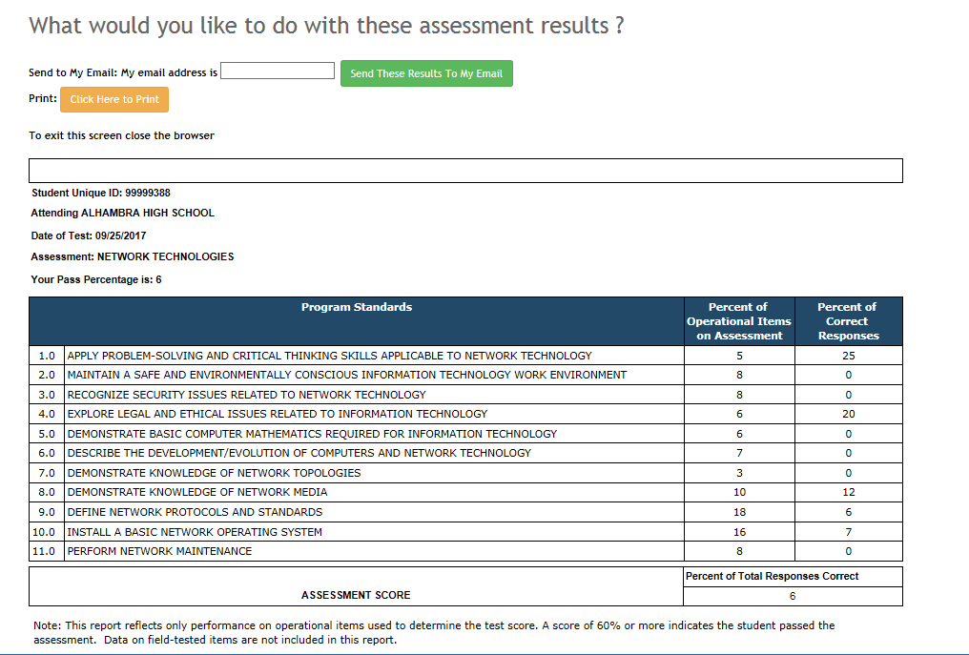
You will receive your Test Results when you mark your test completed.
Your Assessment Score will be displayed at the bottom of your Test Results.
You can enter one email address at a time and click the Send These Results To My Email green button.
Once you are finished, log off the browser by clicking the red X at the upper right corner of the monitor.

Slide 14
You are now ready to start the test.
Log onto this website to take the test.
https://ctetechnicalskillsassessments.azed.gov/student

Slide 15
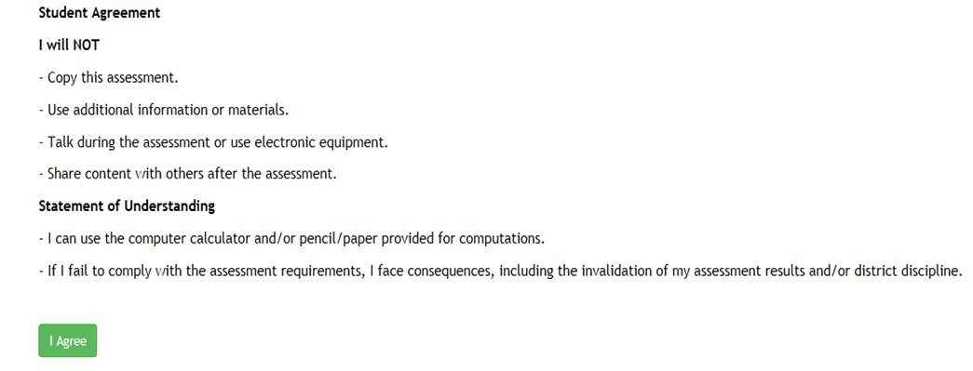
Read the Student Security Agreement screen which states the rules for taking the assessment. You must click the green I Agree button to move on.

Slide 16
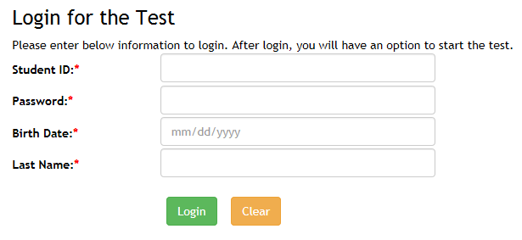
Enter your Student ID, Password, Birth Date, and last name.
Click the green Login
button.

Slide 17
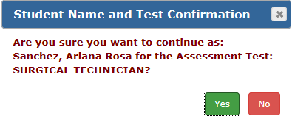
Please verify this is your name and assessment. If it is correct, click the green Yes button. If this is not your information, raise your hand. Once you click the Yes button the first question will display and the test time starts.

