Slide 1


ITEM DEVELOPMENT
Technical Skills Assessments

Slide 2


Overview
The Technical Skills Assessments are computer- based, criterion-referenced, summative (end-of- program) tests. Each test is 100 multiple-choice items aligned with the program standards and measurement criteria. Items range in cognitive difficulty from knowledge and comprehension to application, analysis, and evaluation.

Slide 3



Criterion-Referenced Assessments
Criterion-referenced assessments measure individual student performance on a body of knowledge of skills.
Items are based on measurement criteria that link to program
standards.
Items measure student learning against industry-recognized knowledge and skills.
Assessment results provide administrators, educators, parents, and students with information needed to improve curriculum and instruction.

Slide 4


Why Multiple-Choice Items?
They can assess any content at a variety of Bloom’s levels.
The probability of guessing the correct answer is lower than with true/false items.
They are quickly and reliably scored.
They are suited to statistical item analysis that leads to improved test quality.

Slide 5


The Role of Teachers
in the Assessment Process
Working in committees, teachers—
serve as content experts in their program area
develop multiple-choice items aligned to standards and measurement criteria
review and edit items for revision or replacement.

Slide 6







The mechanics of a multiple-choice item
Writing Multiple-Choice Items
Each item consists of a stem phrased as a question followed by four options consisting of one correct response and three distractors.
Students may be asked a question about a graphic or an image. Also, graphics and images may appear as options from which to select the correct response.

Slide 7


Item Stem
Writing Multiple-Choice Items
Always use a question format.
Keep questions focused, simple, and free of unnecessary words and jargon.
Capitalize MOST, LEAST, and EXCEPT. Avoid clues such as ALWAYS and NEVER. Do not use textbook, verbatim phrasing.

Slide 8




Options (distractors)
Writing Multiple-Choice Items
Each question is followed by four options.
There should be only one correct answer. Options should be parallel in length and structure. Incorrect options should be plausible.
Avoid humorous or nonsensical options.
Avoid using all of the above and none of the above.

Slide 9

General Rules
Writing Multiple-Choice Items
Keep the reading level below grade level to test mastery of content not reading comprehension.
Items are based on important content, not trivial matter. Items should not trick or mislead students.
Avoid double negatives in the questions and options. Always use correct grammar, punctuation, and spelling.

Slide 10

Writing and formatting items
(Don’t repeat “oven” in options.)
What kind of oven uses forced circulating air?
Convection
Conventional
Revolving
Deck
(Capitalize words such as “first” and “best”.)
What is the FIRST step when preparing to key a hand-written document?
Review the document to determine format.
Read the document thoroughly for content.
Key a rough draft for the document.
Proofread the document for errors.
(Each option is a complete sentence followed by a period.)
What is the BEST method for determining seasonal sales promotion strategies?
Collect data on buying trends of the target market.
Place certain items on sale and calculate total revenue.
Review newspaper ads for local competition.
Circulate product coupons and track their redemption.

Slide 11
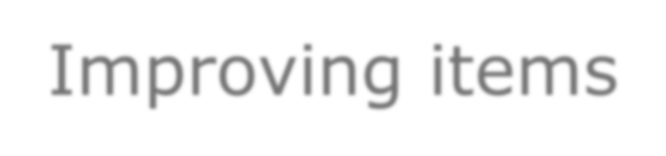
Improving items
Problem: The stem leads the reader to the correct answer.
What type of search engine crawls the internet looking for recently created pages and updates?
Spider-based
RSS
Directory
Pay per click
Modified: The stem is adjusted to eliminate the “animated”
language.
What type of search engine looks for recently created pages and updates?
Spider-based
RSS
Directory
Pay per click

Slide 12

Improving items continued…
Problem: Passive “would be” is used when active “is” is more
direct.
What would be the PRIMARY purpose of DHCP?
It assigns IP addresses.
It assigns protocol instruction to a server.
It assigns domain names automatically.
It assigns a new user name.
Modified: Stem is in active voice. Options are shortened by
using gerunds.
What is the PRIMARY purpose of DHCP?
Assigning IP addresses
Assigning protocol instructions to a server
Assigning domain names automatically
Assigning user name

Slide 13
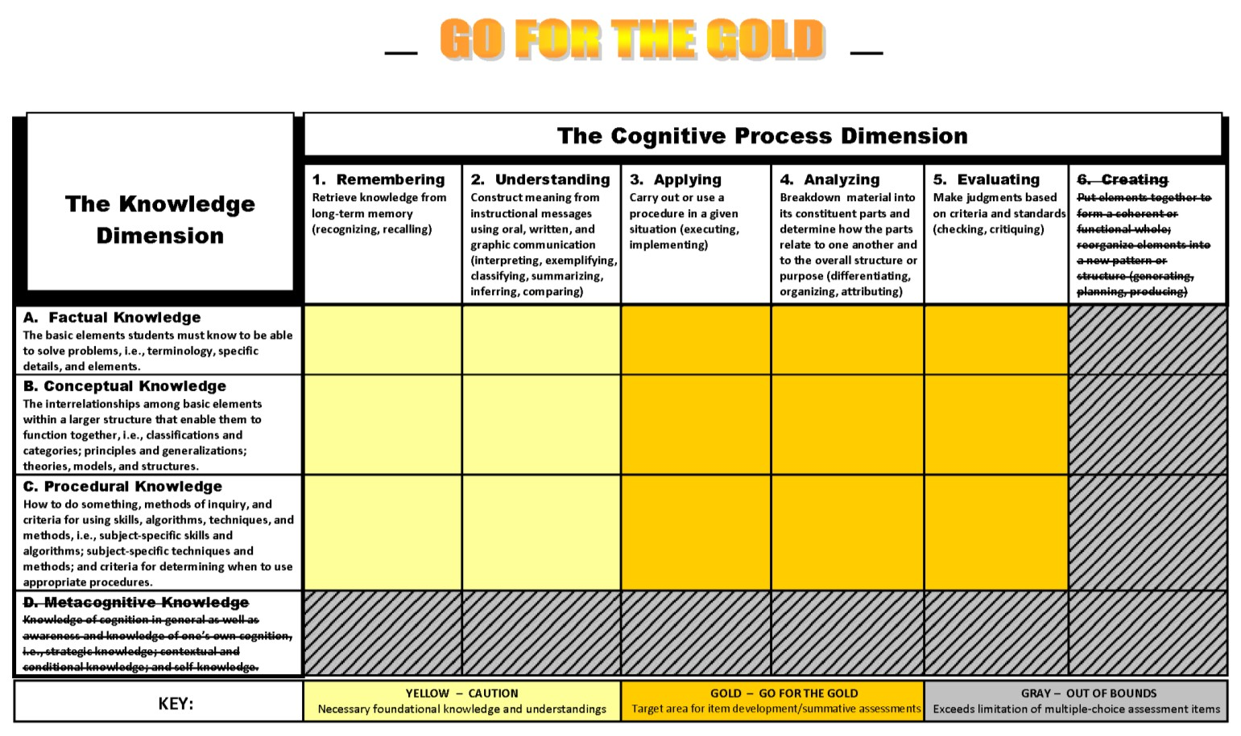
Bloom’s Classification
This two-dimensional framework is used to classify multiple-choice items in cognitive difficulty from knowledge and comprehension to application, analysis, and evaluation.

Slide 14

Examples of Bloom’s Classification
OSHA requires healthcare workers to treat all patient specimens as potentially infectious. What is this safety requirement called?
Standard precautions
Risk management
Right-to-know law
Quality control
Blooms ID: A1
Magnetic lines of force will pass through what material most readily?
Iron
Magnesium
Aluminum
Copper
Blooms ID: B1

Slide 15

Bloom’s classification continued…
When starting to move an aircraft when taxiing, what should be done FIRST?
Test the brakes.
Monitor the instruments.
Notify the control tower.
Remove gear safety pins. Blooms ID: C3
A crane lifts two 500-pound loads of roofing materials to the top of a building (one 500-pound load in 60 seconds and a second 500-pound load in 90 seconds). Which statement BEST compares the work and power expended by the crane?
The crane does the same work for each lift, but expends more power for the first lift. The crane does less work and expends more power for the second lift.
The crane does more work and expends less power for the first lift.
The crane does equal work and expends equal power for both lifts.
Blooms ID: B5

Slide 16
The expertise of teachers
and their engagement in making connections between curriculum, instruction, and assessment has contributed greatly to the advance of student achievement.

