Slide 1
Welcome to Webinar #4: AASA paper-based testing
This webinar will be recorded and posted on the ADE Assessments webpage.​
​
Please enter your First and Last Name in the Chat for tracking purposes for the live event.​
​
We will also be capturing the chat questions. If there are questions that were frequently asked or need further clarification, ADE will compile and create an FAQ which will then be posted on the Assessments webpage under Friday Focus Webinars.

Slide 2
Friday Focus Webinar #4: AASA Paper-Based Testing
Achievement Assessment
October 27, 2023

Slide 3
Administration overview
Director of achievement assessment:
Lisa Oliver
Achievement State Coordinators:
Candis Middlebrook and Sheri Davenport

Slide 4
AASA PAPER-BASED Testing
All students in grades 3-8
(ELA and Mathematics)
PAPER-BASED TESTING WINDOW
APRIL 1-10, 2024
Writing must be scheduled for April 1 or 2, 2024

Slide 5
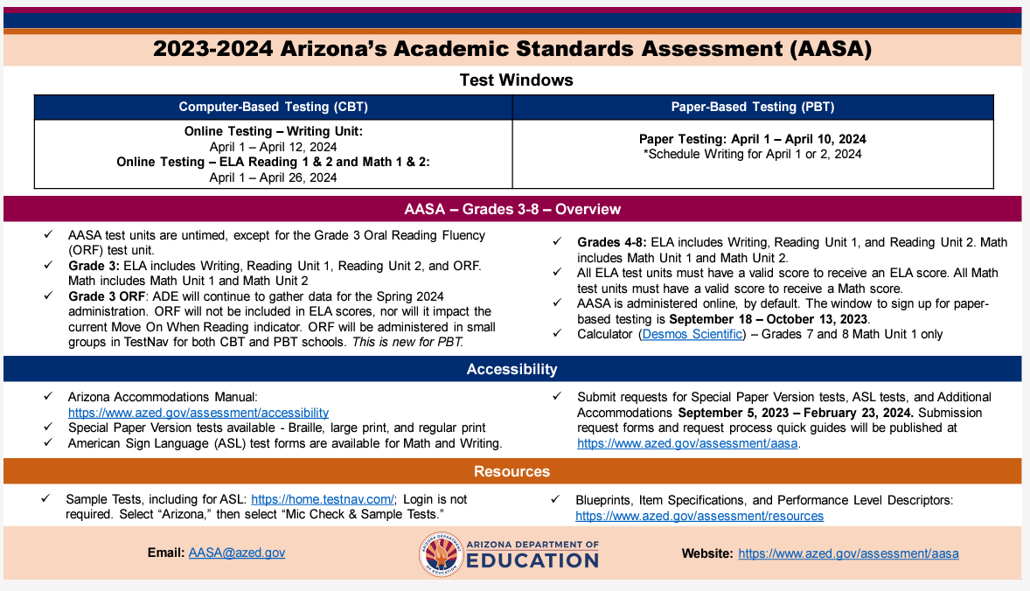
Resources - INfographics
https://www.azed.gov/assessment Under the Statewide Assessments Infographics

Slide 6
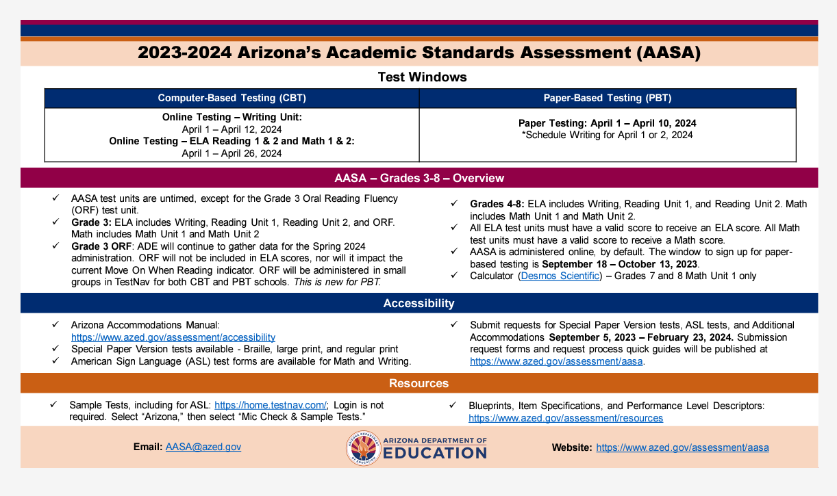
AASA
https://www.azed.gov/assessment Under the Statewide Assessments Infographics

Slide 7
PAPER-BASED ADMINISTRATION
Test Administration Resources:
Test Coordinator’s Manuals (TCM)
Test Administration Directions (TAD)
Test Booklets
Pre-ID Labels
Return shipment materials
Participation Count and Materials Due-in-District Window
Receive and Inventory Test Materials Shipments
Verify Contact and Shipping Information
Pre-ID Labels
Returning AASA Materials
Details will be provided in Arizona Learning Management System (AzLMS)Training

Slide 8
PAPER-BASED ADMINISTRATION

Slide 9
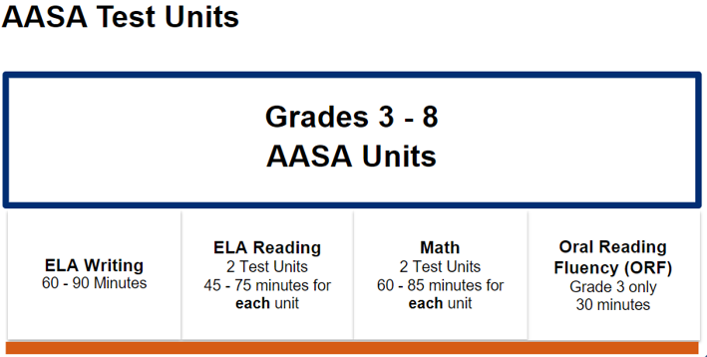
AASA PAPER-BASED Test

Slide 10
Oral Reading Fluency

Slide 11
Oral Reading Fluency
Important Resources:
AASA Test Coordinator’s Manual and the AASA Test Administration Directions Manual

Slide 12
Test Irregularities Examples
Inappropriate reference materials
Calculators
Graphic organizers
Math formula sheet
Student using or in possession of prohibited devices or resources
Cell phones
Smart Watch
Air pods / Earbuds
Unapproved adults in testing environment
Student Cheating
Group Breaks
Test Administrator approving a test for a student who is not eligible

Slide 13
Educator Resources
https://www.azed.gov/assessment/aasa

Slide 14
Questions?

Slide 15
Content tips
ELA Resources and Item Types

Slide 16
ELA Resources
AASA Content Developer: Katie DiTullio

Slide 17
ELA Blueprint online vs Paper

Slide 18
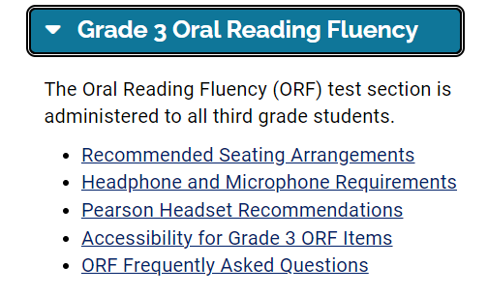
Oral Reading Fluency (ORF)

Slide 19
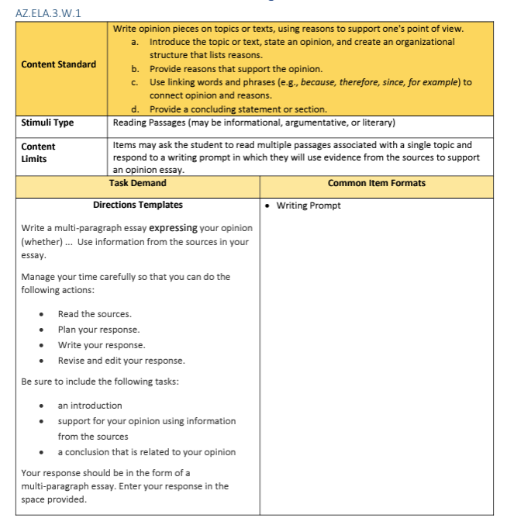
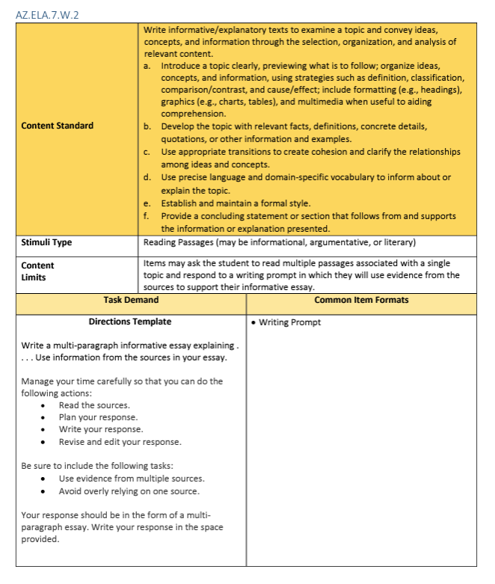
Writing Resources

Slide 20
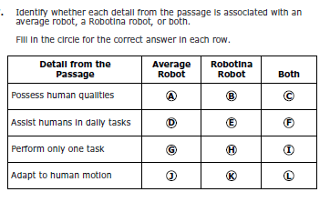
Match Table Grid
Grade 8, #7
Grade 6, #7

Slide 21
Inline Choice
GRADE 4, #13

Slide 22
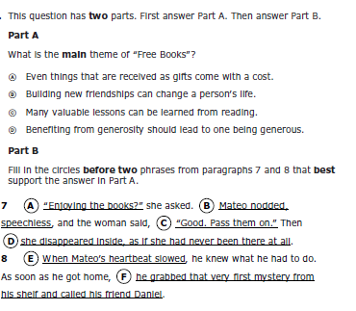
Hot Text
Grade 5, #5
Grade 8, #13

Slide 23
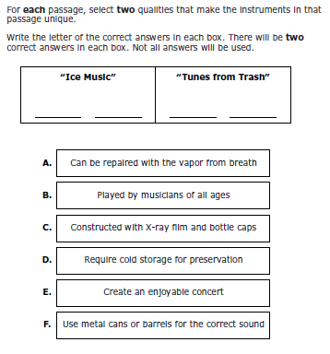
Drag and Drop
Grade 3, #5
Grade 7, #15

Slide 24
Questions?

Slide 25
Math Resources
AASA Content Developer: Melanie Hill

Slide 26
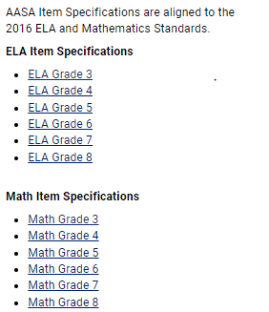
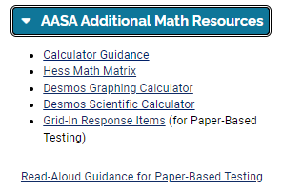
MATH TOOLS

Slide 27
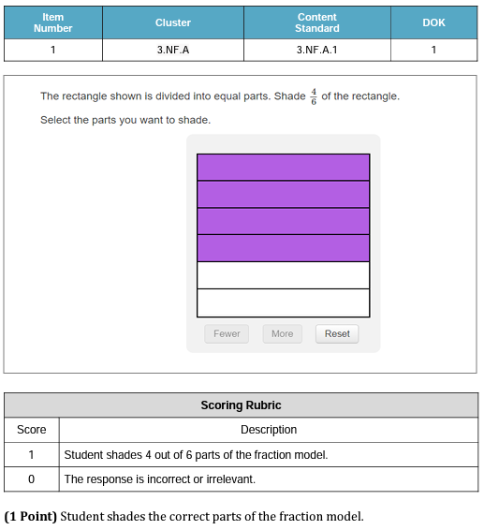
ITEM SPECIFICATIONS

Slide 28
Online Option

Slide 29
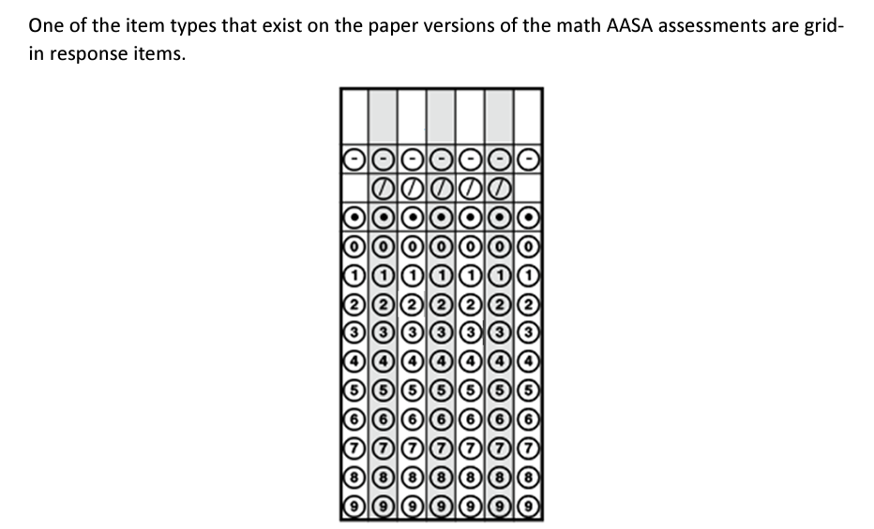
The Bubble or the blanks?
Notes:
On these response grids, blanks are generally ignored. This means that students can left or right justify their response or place it somewhere in the middle. • The purpose of the boxes above the grid are an aid to bubbling but are not scored. • Only one bubble per column is permitted; any response with more than one bubble in a column is marked as incorrect.

Slide 30
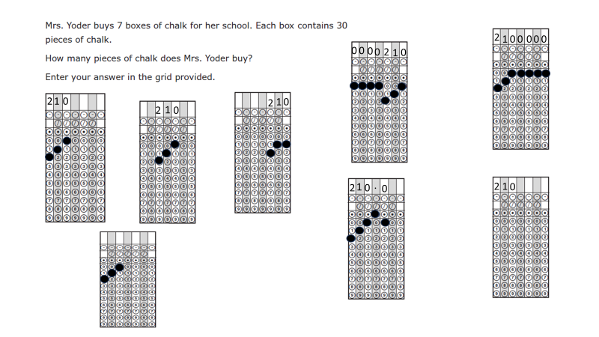
Grid-in response

Slide 31
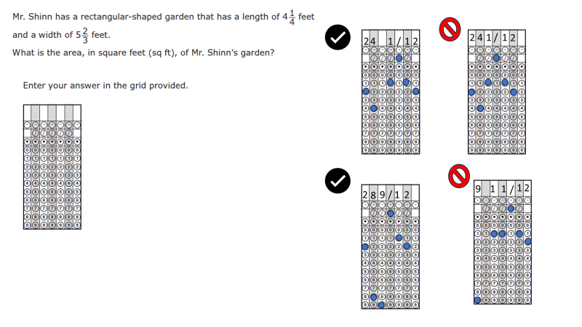
Grid-in mixed number response
Notes:
Note that in the second example (that of the mixed number) the space between the whole number and fraction is important. Without this space, the response would be scored as twenty-one-halves. Again, in any of these shown responses, it does not matter which column the student chooses to begin their response.

Slide 32
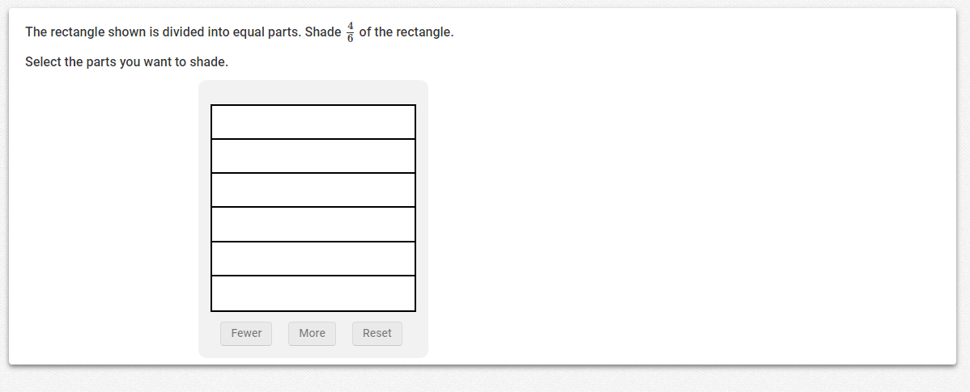
Math sample – Fraction model

Slide 33
Online option – fraction model

Slide 34
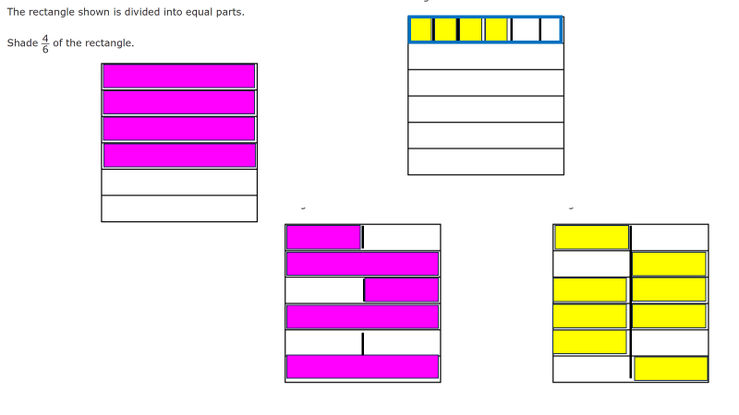
Math sample
Notes:
Credit is awarded to the correct response.
Student shades 4 out of 6 parts of the fraction model or any equivalent value.

Slide 35
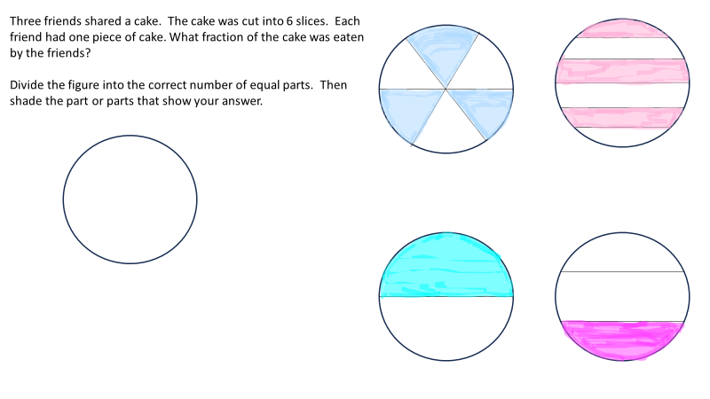
EXAMPLE WITH A PIE GRAPH

Slide 36
Online option

Slide 37
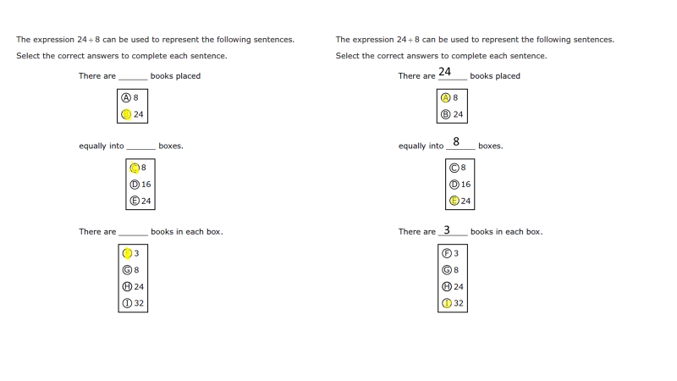
PAPER-BASED SAMPLE

Slide 38
Online Option – Bar Graph

Slide 39
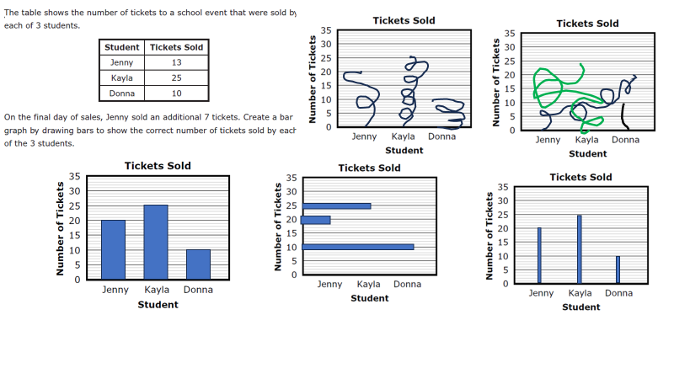
PAPER -BASED BAR GRAPH SAMPLE

Slide 40
Online Option

Slide 41
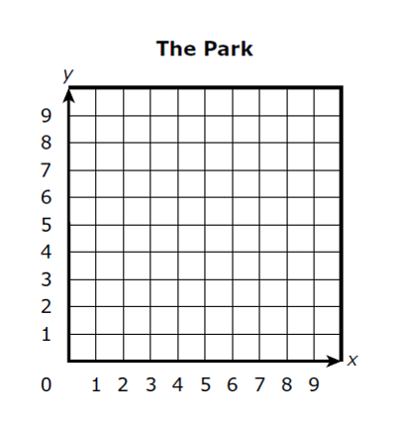
PAPER-BASED COORDINATE GRID SAMPLE

Slide 42
Questions?

Slide 43
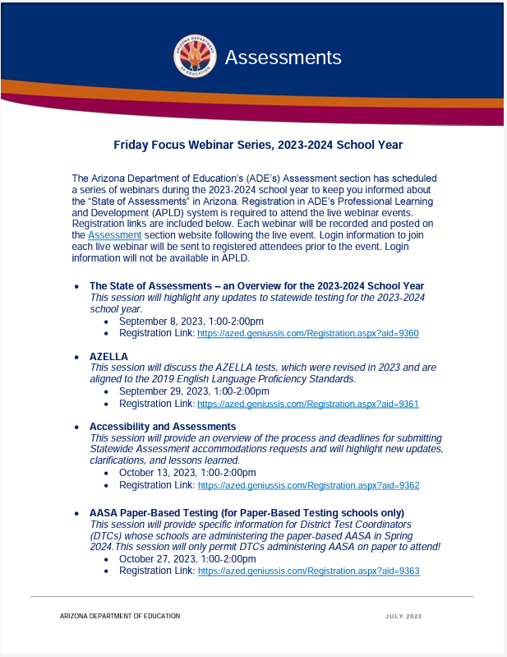
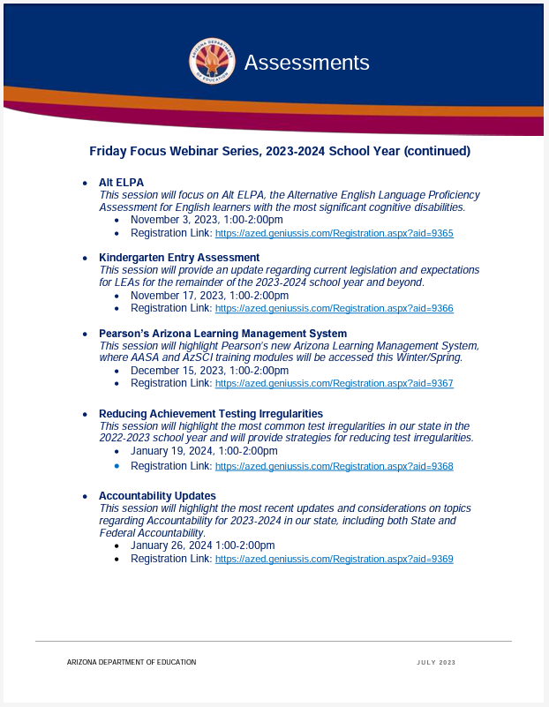
Assessment Webinar Series - POSTED
The flyer is posted on the Assessment Main page:
https://www.azed.gov/sites/default/files/2023/07/2023-2024%20Friday%20Focus%20Webinar%20Schedule.pdf
Reminder: participants must register in ADE’s Professional Learning and Development (APLD) system
Log in information to join the session will be sent to registered participants prior to the event. Login information will not be available in APLD.

Slide 44
Save the DATE
Arizona Assessments Conference – September 17-19, 2024
https://www.azed.gov/assessment/conference

Slide 45
We are inviting content area teachers, teachers of students with disabilities, teachers of EL students, and instructional coaches/administrators to provide their perspective on the items and standards set on Arizona's statewide assessments. If you are interested in serving on an Assessment Educator Committee, please complete our Committee Application found at: https://www.azed.gov/assessment/aasa
Assessment Committee

Slide 46
Questions?

Slide 47
THANK YOU!
For questions, please contact us at: ​
Testing@azed.gov​

