Slide 1
CTE Administrators Meeting
November 2, 2023
Career and Technical Education

Slide 2
Updates for the Technical Standards and Technical Skills Assessments
Career and Technical Education

Slide 3
New or Updated Technical Standards for 2024
Automotive Collision
Culinary Arts
Diesel Engine
Early Childhood Education
Energy Systems
Fashion Design and Merchandising
Heating, Ventilation, and Air Conditioning
Heavy Industrial Maintenance
Music and Audio Production
Network Security
Plumbing
Software and App Design

Slide 4
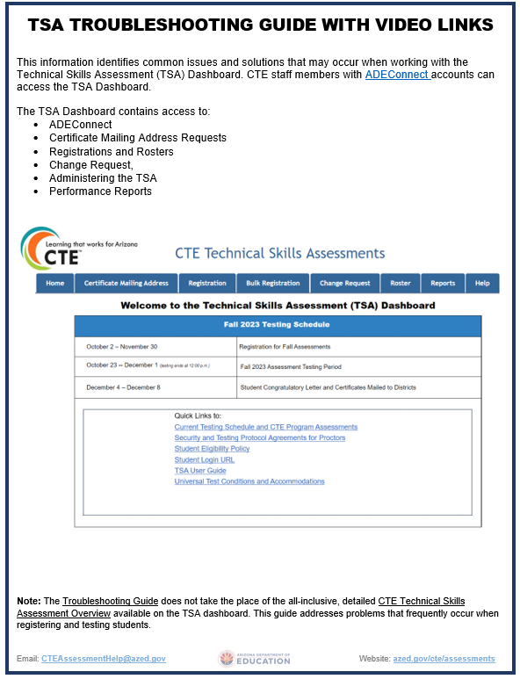
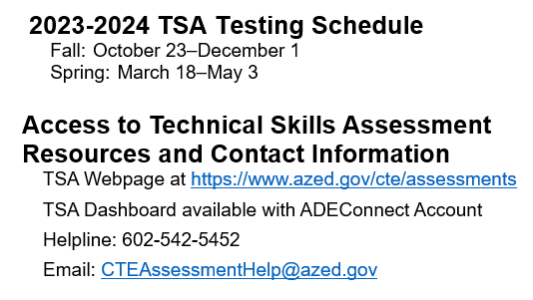
Update on Technical Skills Assessments (TSA)

Slide 5
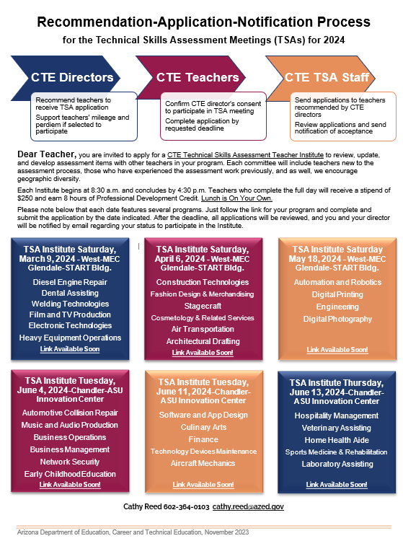
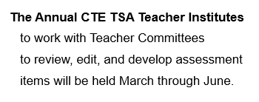
2024 CTE TSA Teacher Institutes

Slide 6
Career and Technical Student Organization (CTSO) Updates
Career and Technical Education

Slide 7
(We)
“How Can I Help?”

Slide 8
CTE Program Services Updates
Career and Technical Education

Slide 9
Program Services Webpages
https://www.azed.gov/cte/programs
Program List
Standards
Embedded Academics
Local Occupational Programs (LOP)
Application open until November 30th
Quality and Compliance Monitoring
Resources
https://www.azed.gov/cte/cte-industry-credentials
Credentials lists
Update credentials process
Credential application
https://www.azed.gov/cte/work-based-learning
Work-based Learning Guide
Resources

Slide 10
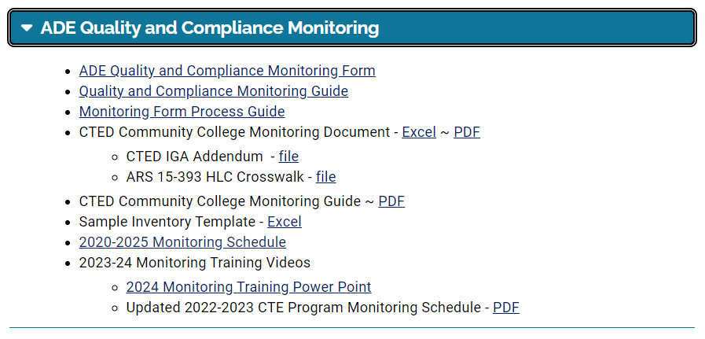
CTE Programs and Standards Page
Monitoring Resources

Slide 11
Monitoring News – Year 5 of 5
Districts being monitored in SY24-25
CTD and member districts
GIFT and member districts
Pima JTED and member districts
Mandatory Monitoring Training
Prescott Resort Granite Room
January 31, 2024
Check-in: 12:30pm
Starts at 1:00pm

Slide 12
Important Email Addresses
For all CTE program monitoring questions:
CTELocalPrograms@azed.gov
CTE Program Services
Cindy.Gutierrez@azed.gov
Technical Assistance – monitoring electronic applications
Janai.Nesby@azed.gov
Agriculture & Welding
Bruce.Watkins@azed.gov
Business & Marketing Education, Communication Media Tech
Elena.Sobampo@azed.gov
Construction Science Technologies
Joe.Grieco@azed.gov
Engineering Sciences, Information Tech
Tracy.Rexroat@azed.gov
Family & Consumer Sciences, Education & Training
Kylie.Chamblee@azed.gov
Health Science Technologies
Wesley.Wood@azed.gov
Public Service Careers, Transportation Technologies
Jason.Wojcik@azed.gov

Slide 13
Important Dates
New Local Occupational Program Applications
Opened October 1st
Closes November 30th
Online application at www.azed.gov/cte/programs

Slide 14
Important Dates
New 2023-2024 Credentials List
Six new credentials approved by School Board of Education (SBE)
List available online at www.azed.gov/cte/cte-industry-credentials.
Credentials Updates/Changes/Corrections
Online form for input/justification – open continuously
www.azed.gov/cte/cte-industry-credentials
New Credentials Applications
Online form – opens March 1st and closes April 30th
www.azed.gov/cte/cte-industry-credentials

Slide 15
CTE Program Services
Cindy Gutierrez
Director, CTE Program Services
602-542-4365
Cindy.Gutierrez@azed.gov

Slide 16
Perkins V: Performance Measure and State Determined Performance Levels Revisions
CTE Administrators Meeting
November 2, 2023
Career and Technical Education

Slide 17
Today's Anticipated Outcomes
Understand how we got here.
Understand Perkins – A General Overview and Added Value
Understand the Timeline – The start of a conversation
Participation in Activity
Understand the data today are PROPOSALS
Collect Feedback
AGREEMENT
Appreciate your professionalism.
Be mindful of your participation.
Designated time for feedback

Slide 18
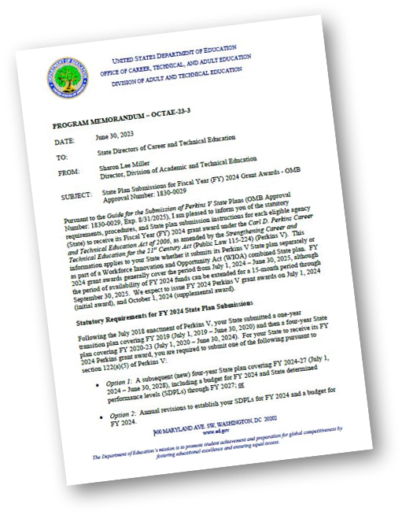
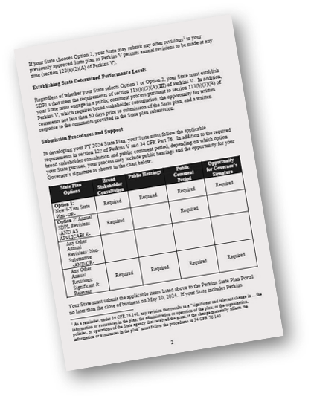
Perkins V Revision
HOW DID WE GET HERE?
Pursuant to the Guide for the Submission of Perkins V State Plans …I am pleased to inform you of the statutory requirements, procedures, and State plan submission instructions ….
A subsequent (new) four-year State plan covering FY 2024-27 (July 1, 2024 – June 30, 2028), including a budget for FY 2024 and State determined performance levels (SDPLs) through FY 2027.

Slide 19
Perkins V - General Overview
The 21st Century Act (Perkins V) requires that each state establish a performance accountability system. ​
Eight Perkins V performance measures (State Determined Performance Levels - SDPL).​
Continuous improvement on an annual basis. ​
Performance for: LEA-level, individual school-level, and individual program-level reports. ​ ​
Districts must meet 90% of the Annual SDPLs. ​
May be placed on an Improvement Plan​.
Directed Improvement Plan for missing 90% for three years.
CONTINOUS IMPROVEMENT
8 Performance Indicators
SDPLs
CALCULTED ANNUALLY
SDPLs Increase each Year
MEET EACH YEAR (@90%)
Program Level
School/District Level

Slide 20
Perkins V - Added Value
Plan will address the Findings in the 2017 Auditor General’s Report.
Enhance Data for TSA
Enhance Data for Placement
Include Granular Data for Credentials

Slide 21
Timeline
March 1st, 2024 – DRAFT POSTED
(providing the opportunity for written comments not less than 60 days prior to submission)
May 10, 2024 – FINAL PLAN DUE

Slide 22
Requirements for Setting SDPL
Requirements are established in §113(b)(3)(a)(i)(III) of Perkins V:
(aa) | be expressed in a percentage or numerical form, so as to be objective, quantifiable, and measurable;
(bb) | require the state to continually make meaningful progress toward improving the performance of all CTE students…;
(cc) | have been subject to the public comment process…and [ADE] has provided a written response;
(dd) | take into account how the levels of performance compare with the SDPLs for other States…;
(ee) | be higher than the average actual levels of performance of the 2 most recently completed program years, except in the case of unanticipated circumstances that require revisions…;
(ff) | take into account the extent to which the SDPLs advance [ADE’s] goals…

Slide 23
Requirements for Setting SDLP
Requirements are established in §113(b)(3)(a)(i)(III) of Perkins V:
(aa) | be expressed in a percentage or numerical form, so as to be objective, quantifiable, and measurable;
(bb) | require the state to continually make meaningful progress toward improving the performance of all CTE students…;
(cc) | have been subject to the public comment process…and [ADE] has provided a written response;
(dd) | take into account how the levels of performance compare with the SDPLs for other States…;
(ee) | be higher than the average actual levels of performance of the 2 most recently completed program years, except in the case of unanticipated circumstances that require revisions…;
(ff) | take into account the extent to which the SDPLs advance [ADE’s] goals…
This is the “performance floor”, the minimum target for FY 2024 and the baseline on which the next four years of performance targets are based

Slide 24
Requirements for Setting SDLP
Requirements are established in §113(b)(3)(a)(i)(III) of Perkins V:
Arizona can revise the SDPL if unanticipated circumstances arise or changes occur related to improvements in data or measurement approaches, such as:
New academic assessments
Improved approach to collecting data that increases validity
Poor or incomplete data from one or both of the 2 most recently completed program years
(aa) | be expressed in a percentage or numerical form, so as to be objective, quantifiable, and measurable;
(bb) | require the state to continually make meaningful progress toward improving the performance of all CTE students…;
(cc) | have been subject to the public comment process…and [ADE] has provided a written response;
(dd) | take into account how the levels of performance compare with the SDPLs for other States…;
(ee) | be higher than the average actual levels of performance of the 2 most recently completed program years, except in the case of unanticipated circumstances that require revisions…;
(ff) | take into account the extent to which the SDPLs advance [ADE’s] goals…

Slide 25
1S1 Graduation Rate
Based on the four-year adjusted cohort graduation rate defined in Every Student Succeeds Act (ESSA)
No changes to Perkins definition or calculation
Numerator: Number of CTE concentrators who graduate with their cohort in the reporting year.
Denominator: Number of CTE concentrators in the cohort in the reporting year.

Slide 26
1S1 Graduation Rate
2020-2021 Actual | 2021-2022 Actual | 2022-2023 Actual | Proposed 2023-2024 | Proposed 2024-2025 | Proposed 2025-2026 | Proposed 2026-2027
95.05% | 94.44% | 96.03% | 96.06% | 96.09% | 96.11% | 96.14%
 |  |  | 90%: 86.45% | 90%: 86.48% | 90%: 86.5% | 90%: 86.53%
Performance floor is 95.24%
Proposed targets place CTE target 10% greater than ESSA targets over 4 years.

Slide 27
2S1 Reading/ELA Proficiency
Removal of cohort year in calculation
Existing Definition/Calculation
Numerator: Number of CTE concentrators in the reporting year cohort who met or exceeded all the reading standards measured on a State Reading Assessment test and left secondary education in the reporting year.
Denominator: Number of CTE concentrators in the reporting year cohort who took a State Reading Assessment test and left secondary education in the reporting year.
Existing Definition/Calculation
Numerator: Number of CTE concentrators who met or exceeded all the reading standards measured on a State Reading Assessment and left secondary education in the reporting year.
Denominator: Number of CTE concentrators who took a State Reading Assessment and left secondary education in the reporting year.

Slide 28
2S1 Reading/ELA Proficiency
2020-2021 Actual | 2021-2022 Actual | 2022-2023 Actual | Proposed 2023-2024 | Proposed 2024-2025 | Proposed 2025-2026 | Proposed 2026-2027
49.21% | 35.73% | 44.17% | 47.71% | 51.25% | 54.79% | 58.33%
 |  |  | 90%: 42.94% | 90%: 46.13% | 90%: 49.31% | 90%: 52.50%
Performance floor is 39.95%
Proposed targets place CTE target on par with ESSA targets over 4 years.
Actual performance for CTE concentrators is roughly aligned to statewide performance in 2021 and 2022
Based on those two years’ available data, state performance is 5% less than ESSA target, CTE is 10% below ESSA target

Slide 29
2S2 Mathematics Proficiency
Removal of cohort year in calculation
Existing Definition/Calculation
Numerator: Number of CTE concentrators in the reporting year cohort who met or exceeded all the mathematics standards measured on a State Mathematics Assessment test and left secondary education in the reporting year.
Denominator: Number of CTE concentrators in the reporting year cohort who took a State Mathematics Assessment test and left secondary education in the reporting year.
Existing Definition/Calculation
Numerator: Number of CTE concentrators who met or exceeded all the Mathematics standards measured on a State Mathematics Assessment and left secondary education in the reporting year.
Denominator: Number of CTE concentrators who took a State Mathematics Assessment and left secondary education in the reporting year.

Slide 30
2S2 Mathematics Proficiency
2020-2021 Actual | 2021-2022 Actual | 2022-2023 Actual | Proposed 2023-2024 | Proposed 2024-2025 | Proposed 2025-2026 | Proposed 2026-2027
53.17% | 47.09% | 38.54% | 43.32% | 48.10% | 52.89% | 57.67%
 |  |  | 90%: 38.99% | 90%: 43.29% | 90%: 47.60% | 90%: 51.90%
Performance floor is 42.82%
Proposed targets place CTE target on par with ESSA targets over 4 years.
Actual performance for CTE concentrators is roughly aligned to statewide performance in 2021 and 2022
Based on those two years’ available data, state performance is 35% less than ESSA target, CTE is 8% above ESSA target (but 1% below ESSA if including 2023)

Slide 31
2S3 Science Proficiency
Removal of cohort year from calculation
Extenuating circumstances allow us to bypass the performance floor requirement (substantially new science assessment)
Numerator: Number of CTE concentrators in the reporting year cohort who met or exceeded all the science standards measured on a State Science Assessment and left secondary education in the reporting year.
Denominator: Number of CTE concentrators who took a State Science Assessment and left secondary education in the reporting year.

Slide 32
2S3 Science Proficiency
AzSCI data introduced
2020-2021 Actual | 2021-2022 Actual | 2022-2023 Actual | Proposed 2023-2024 | Proposed 2024-2025 | Proposed 2025-2026 | Proposed 2026-2027
42.20% | 47.82% | 22.11% | 24.08% | 26.06% | 28.03% | 30.00%
 |  |  | 90%: 21.67% | 90%: 23.45% | 90%: 25.22% | 90%: 27%
Performance floor is 34.97%, but this may be bypassed due to new science assessment (AzSCI)
Proposed targets are set by establishing a goal and working towards goal.
Only one year of data available for AzSCI – actual state performance in 2022 is 20%.

Slide 33
3S1 Placement
No changes to Perkins definition or calculation
Numerator: Number of CTE concentrators who, in the second quarter after exiting from secondary education, were placed in postsecondary education or advanced training, in military service, in a service program that receives assistance through the National & Community Service Act of 1990, in the Peace Corps, or employed.
Denominator: Number of CTE concentrators who left secondary education in the reporting year.

Slide 34
3S1 Placement
2020-2021 Actual | 2021-2022 Actual | 2022-2023 Actual | Proposed 2023-2024 | Proposed 2024-2025 | Proposed 2025-2026 | Proposed 2026-2027
69.79% | 69.58% | 70.62% | 71.72% | 72.81% | 73.91% | 75.00%
 |  |  | 90%: 64.54% | 90%: 65.53% | 90%: 66.51% | 90%: 67.5%
Performance floor is 70.1%.
Proposed targets are set by establishing a goal and working towards goal. Proposed targets are set assuming a goal of 75%, which maintains linear progression along current trend.

Slide 35
4S1 Nontraditional
No changes to Perkins definition or calculation
Numerator: Number of nontraditional CTE concentrators in a nontraditional program in the reporting year.
Denominator: Number of CTE concentrators in a nontraditional program in the reporting year.

Slide 36
4S1 Nontraditional
2020-2021 Actual | 2021-2022 Actual | 2022-2023 Actual | Proposed 2023-2024 | Proposed 2024-2025 | Proposed 2025-2026 | Proposed 2026-2027
31.34% | 31.11% | 32.73% | 32.80% | 32.87% | 32.93% | 33.00%
 |  |  | 90%: 29.52% | 90%: 29.58% | 90%: 29.64% | 90%: 29.7%
Performance floor is 31.92%.
33% target is minimum performance to maintain performance floor in the baseline year and increase year over year.
Proposed targets are set by establishing a goal and working towards goal. Proposed targets are set assuming a goal of 33%, which is an aggressive, yet realistic goal based on prior years’ actual performance.

Slide 37
Discussion & Feedback on 1S1, 2S1, 2S2, 2S3, 3S1, & 4S1
Warm
What resonates with us is ….
The essential qualities are ...
The best bit was ...
Cool
Did you think of …?
It would better if …
The implications to my work are..
Discuss at your table; each table has a note-taker.

Slide 38
5S1 Industry Recognized Credentials
Existing Definition/Calculation
Numerator: Number of CTE concentrators who graduated from high school during the reporting year and earned a recognized postsecondary credential for their program.
Denominator: Number of CTE concentrators who graduated from high school during the reporting year and attempted to earn a recognized credential for their program.
New Definition/Calculation
Numerator: Number of CTE concentrators that graduated from high school during the reporting year having earned a recognized industry credential for their program.
Denominator: Number of CTE concentrators that graduated from high school during the reporting year.

Slide 39
5S1 Industry Recognized Credentials
The Why
Perkins V program quality indicator language:
“The percentage of CTE concentrators graduating from high school having attained a recognized postsecondary credential”
New indicator definition will more accurately reflect the Perkins program quality indicator language.
New indicator aligns with 18 out of 19 other states that use the 5S1 Program Quality indicator.

Slide 40
Concerns
Concern
Potential Solution
Credentials cost money, but credential incentive was discontinued.
Testing Center / Location
Perkins, State Priority, and CTED funds can be used to purchase credentials.
ADE/CTE is investigating potential new funding sources

Slide 41
5S1 Industry Recognized Credentials
New indicator is based on concentrators graduating in the reporting year and is not a cohort-based metric.
Historical data for each district shows a weighted average of 33.96% in FY 2023, 29.15% in FY 2022, and 19.4% in FY 2021.
Among other states that use this indicator, the weighted average performance is 37.72%. The weighted average performance target is 24.11%.
Since the definition is changing, we can bypass the performance floor/minimum SDLP requirement (which would have been 87.41%.)

Slide 42
5S1 Industry Recognized Credentials
2020-2021 Actual | 2021-2022 Actual | 2022-2023 Actual | Proposed 2023-2024 | Proposed 2024-2025 | Proposed 2025-2026 | Proposed 2026-2027
19.42% | 29.13% | 33.92% | 35.44% | 36.96% | 38.48% | 40.00%
4648 / 23931 | 7383 / 25345 | 8975 / 26458 | 90%: 31.9% | 90%: 33.26% | 90%: 34.63% | 90%: 36%
Performance floor based on historical performance using new definition is 31.53%.
Proposed targets are set by establishing a goal and working towards goal. Proposed targets are set assuming a goal of 40%, which is an aggressive, yet realistic goal based on prior years’ actual performance.
Warm & Cold Feedback

Slide 43
5S4 Technical Skills Assessment (TSA)
Existing Definition/Calculation
Numerator: Number of CTE concentrators who graduated from high school during the reporting year and passed the technical skills assessment for their program.
Denominator: Number of CTE concentrators who graduated from high school during the reporting year who took the technical skills assessment for their program.
New Definition/Calculation
Numerator: Number of CTE concentrators that graduated from high school during the reporting year having passed the technical skills assessment for their program.
Denominator: Number of CTE concentrators that graduated from high school during the reporting year.

Slide 44
5S4 Technical Skills Assessment (TSA)
The Why
Data is more reliable.
Success on the TSA among all graduating concentrators is a truer picture of program quality than the TSA pass rate among select students.

Slide 45
Concerns
Three-year programs
Students become a concentrator after passing two courses – performance indicator measures concentrators, not completers.
Students are eligible to take TSA in second year or third year for three-year programs and are not counted until they graduate.

Slide 46
5S4 Technical Skills Assessment (TSA)
New indicator is based on concentrators graduating in the reporting year and is not a cohort-based metric.
Historical data for each district shows a weighted average of 61.39% in FY 2023, 50.22% in FY 2022, and 40.26% in FY 2021. COVID-19 had a significant impact on TSA participation.
ADE will still report TSA pass rates by program for in-district use.
Since the definition is changing, we can bypass the performance floor/minimum SDLP requirement (which would have been 75.76%.)

Slide 47
5S4 Technical Skills Assessment (TSA)
2020-2021 Actual | 2021-2022 Actual | 2022-2023 Actual | Proposed 2023-2024 | Proposed 2024-2025 | Proposed 2025-2026 | Proposed 2026-2027
40.29% | 54.53% | 61.49% | 64.87% | 68.25% | 71.62% | 75.00%
9641 / 23931 | 12729 / 23345 | 16270 / 26458 | 90%: 58.38% | 90%: 61.42% | 90%: 64.46% | 90%: 67.5%
Performance floor based on historical performance using new definition is 58.02%.
Proposed targets are set by establishing a goal and working towards goal. Proposed targets are set assuming a goal of 75%, which is an aggressive, yet realistic goal based on prior years’ actual performance.
Warm & Cold Feedback

Slide 48
Start of a conversation...
Public Comment & Perkins V Plan Convenings
Perkins V Plan Stakeholder Convenings to collect more input – Dates TBD
Perkins State Plan will be posted for public comment at least 60 days prior to submission in May.
ADE/CTE will announce this and provide a link to submit a comment. All comments will receive a written response.

Slide 49
Resources

