Slide 1
Friday Focus Webinar #2: New AZELLA Item specifications
Gabriela Finn
Director of English language Assessments
September 29, 2023

Slide 2
Welcome to Webinar #2: New AZELLA Item specifications
This webinar will be recorded and posted on the ADE Assessments webpage.​
​
Please enter your First and Last Name in the Chat for tracking purposes for the live event.​
​
We will also be capturing the chat questions. If there are questions that were frequently asked or need further clarification, ADE will compile and create an FAQ which will then be posted on the Assessments webpage under Friday Focus Webinars.

Slide 3
Welcome to Webinar #2: New AZELLA Item specifications
ADE Assessments Team will have 7 more webinar sessions in this series for the 2023 - 2024 school year​
These webinars will be recorded and posted on the Assessments Webpage​
This session will spotlight provide a brief guide to navigate the new AZELLA Test Specification Documents and potential applications in the SEI classroom. Updates on the EL70 Report and the K – 1 Speaking test will be provided.

Slide 4
Navigating the AZElla item specification documents

Slide 5
definition
The AZELLA Items Specifications document:
is a resource that defines the content and format of the test and the test items,
indicates the alignment of items with the 2019 Arizona ELPS,
provides information about the scope and function of assessment items,
can also serve to assist educators in understanding how assessment items are developed in alignment with the standards,
intended to provide information regarding standards, item formats, and response types typically used on the AZELLA, and
is not intended to be used for the purposes of instruction or the basis for curricula.

Slide 6
Contents
Item Specifications
Grades 4–5 Item Specifications
EL.4–5.RFS.1 Phonological Awareness
EL.4–5.RFS.2 Print Concepts
EL.4–5.RFS.3 Phonics and Word Recognition (Decoding)
EL.4–5.RFS.4 Fluency
EL.4–5.S1
EL.4–5.S2
EL.4–5.S3
EL.4–5.S4
EL.4–5.S5
EL.4–5.S6
EL.4–5.S7
EL.4–5.S8
EL.4–5.S9
EL.4–5.S10
Introduction
AZELLA Test Units and Domains Assessed
Item Development Process
Test Construction Guidelines
AZELLA Blueprint
Item Formats and Item Types
Stimulus Guidelines
AZELLA Reading Passages Word Count and Lexile Ranges
AZELLA Listening Passages Word Count
ELP Standards

Slide 7
Item Types and descriptions
Item Type | Description
Multiple Choice (MC) | KG & G1 -3 options Grades 2-12 -4 options
Inline Choice (IC) | Drop-down menu contains options
Gap Match (GM) | Drag-and-drop
Short Answer (SA) | KG & G1 -student writes missing word, capitalizes words, or adds end punctuation.
Constructed Response (CR) | Student creates written response to a prompt (one sentence for Kindergarten, two to three sentences for Grade 1 and Grades 2-3)
Extended Response (ER) | The student uses the keyboard to enter a response into a text field (Grades 4–12). These items can usually be answered in one paragraph

Slide 8
Item Development Process
Passage Development
ADE and WestEd generate potential passages for review.
Educator Review
Committees of Arizona educators review passages for content and bias. Approved passages are moved forward.
Item Development
WestEd and ADE generate potential items for review.
Educator Review
Committees of Arizona educators review items for content and bias. All approved items are moved forward.
Field Test
Items are field tested to see how they operate.
Data Review (includes educator review)
Field Test items are reviewed for statistical performance to ensure they are valid.
Operational
Field Test items that have made it through all stages are now eligible for inclusion in the AZELLA tests.

Slide 9
AZELLA listening and Reading Passages Word Count and Lexile Ranges
Reading Passages
Listening Passages
Word Count and Lexile Ranges by Grade Level
Grade | Word Count Range | Lexile Range
K | 40–60 | NA
1 | 75–85 | NA
2–3 | 100–125 | 350-750L
4–5 | 175–225 | 720-850L
6–8 | 200–275 | 860-1010L
9­–12 | 250–300 | 1000-1200L
Word Count Ranges by Grade Level
Grade Level | Words
K | 30-50
1 | 40-100
2–3 | 60-135
4–5 | 60-250
6–8 | 60-300
9­–12 | 60-300

Slide 10
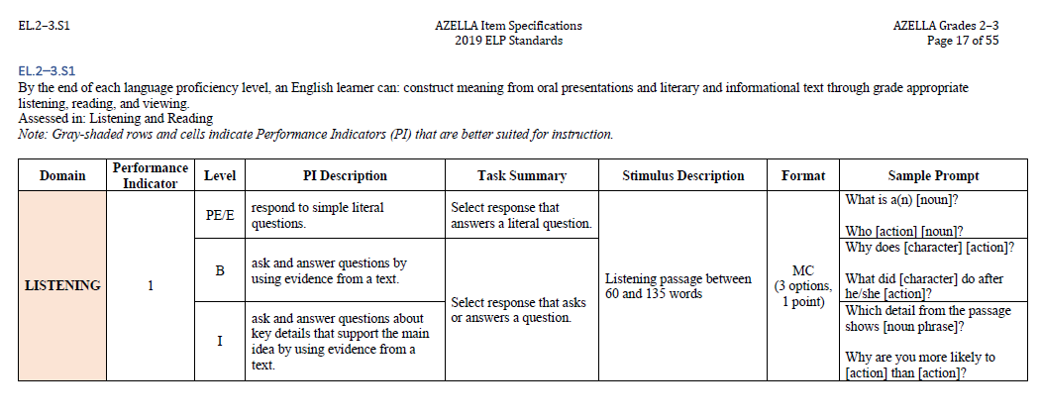

Slide 11
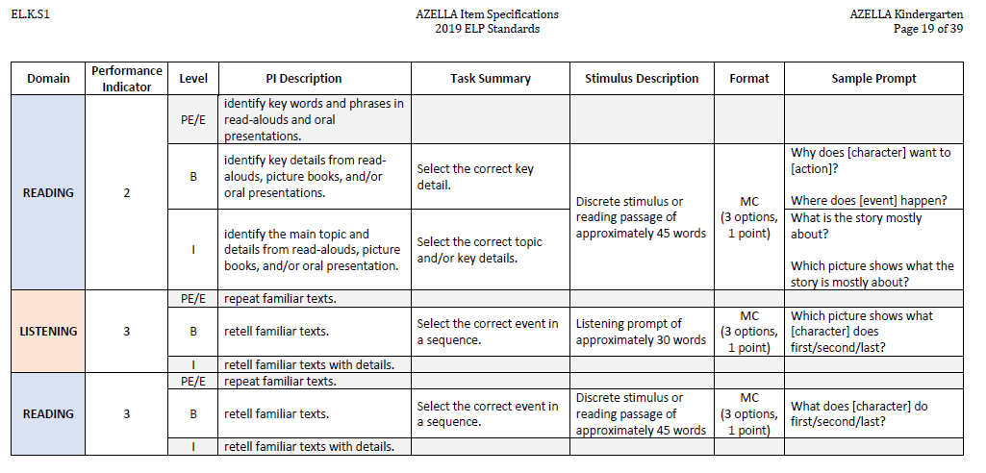

Slide 12
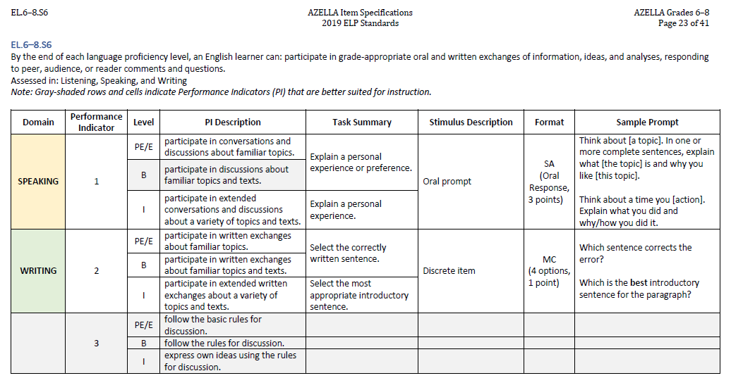

Slide 13
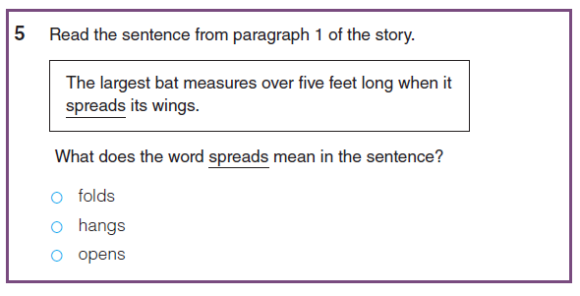
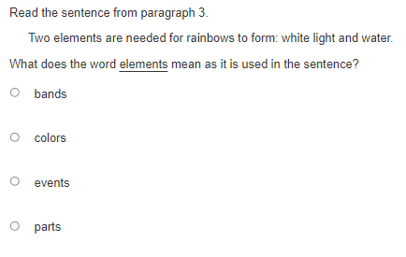
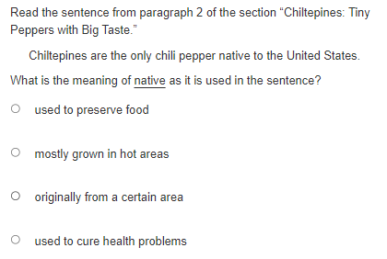
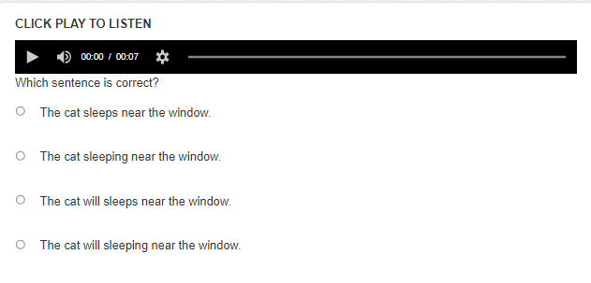
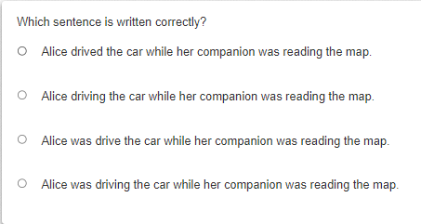
Terms used and supports across grades
Grade 1 S02(RC).B-1
Grades 4 – 5 S02(RC).B-1 and B-3
Grades 2 – 3 S10(LA).B-6
Grades 9 – 12 S10(LA).I-5

Slide 14
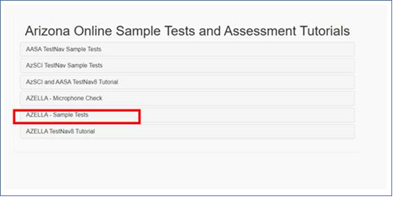
AZELLA Sample Tests
Online Sample Test are accessible through https://az.testnav.com/client/index.html or the dedicated TestNav application
Digital Kits and Teacher’s Editions available at https://www.azed.gov/assessment/azella under AZELLA Sample Test Information
Grades 2 – 3: Units 1, 2, 3, and 5
Grades 4 – 12: All five test units
Digital Kits for KG and Grade 1: Student Test Book, audio files, and Teacher’s Edition. Grades 2 – 3 Extended Writing STB and audio file. Grades 4 – 12 Teacher’s Editions.

Slide 15
Potential applications of the azella item specifications

Slide 16
Applications and Resources
Create items aligned to the ELP Standards similar to those that students will encounter in AZELLA for the purpose of:
Classroom quizzes and tests
Formative assessments
Additional practice for the Spring Reassessment
Educators can contribute to the development of a school or district item bank
Resources available:
AZELLA Item Specifications (KG, Grade 1, Grades 2-3, Grades 4-5, Grades 6-8, and Grades 9-12)
Considerations to Create an English Language Test handout
Ideas and templates to develop items by grade/grade band handouts (6 in total)

Slide 17
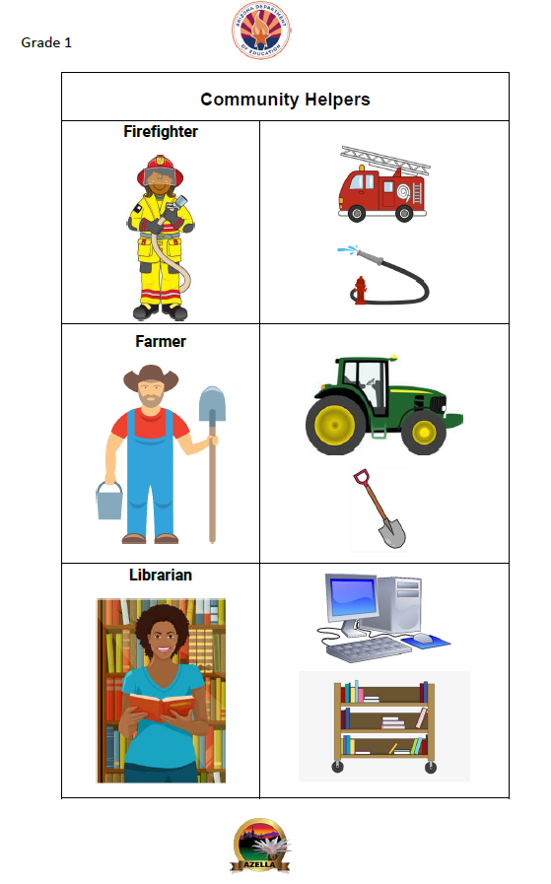
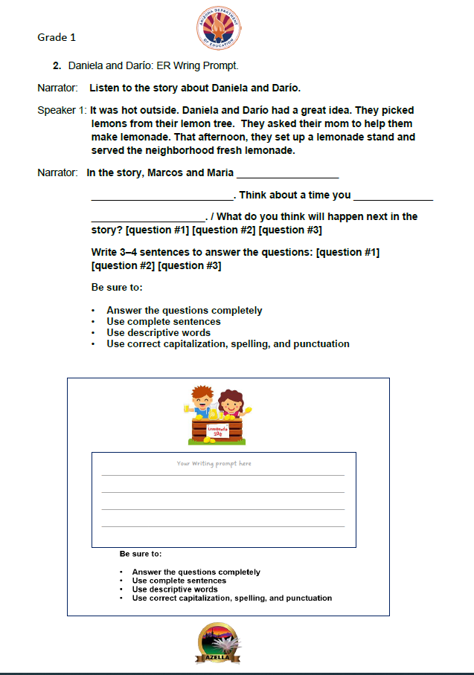
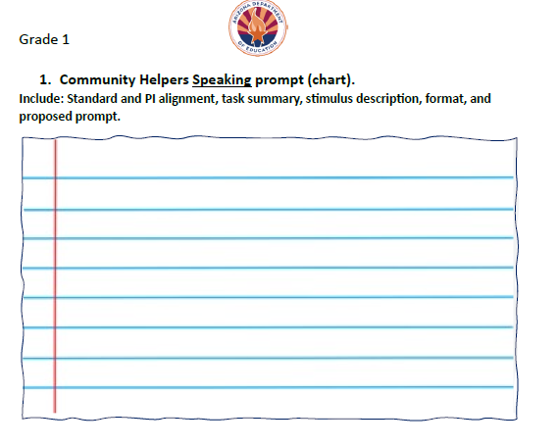
Ideas and Templates to Develop Items –Grade 1

Slide 18
Considerations to Create an English Language Test
PELL Meeting
September 6, 2023
Arizona EL Student Art

Slide 19
Questions and considerations to create an English language classroom test
Suggested literature: Brown & Abeywickrama (2010) Language Assessments Principles and Classroom Practices

Slide 20
Spring 2024 Reassessment -Kindergarten and Grade 1 Speaking Test (Unit 5)
TestNav will replace the phone administration.
Student experience will be virtually the same when compared to the phone administration. In a one-on-one administration:
Students will use their Student Test Book.
Only the Test Administrator will interact with the testing device.
Test Administrator will sign into TestNav with the Testing Ticket, play the question or prompt for the student, and record their answer.
The KG and Grade 1 Unit 5 Sample Test will be available in TestNav for Test Administrators and students to practice before the administration of the Reassessment test.
A new Speaking Demonstration Video will be available in PAN and embedded in the Reassessment K – 1 training module.
Scripted directions in TAD will include, “Turn the page. Look at number X.”
There should not be a considerable pause between the question/prompt and recording the student response. ADE will be monitoring.

Slide 21
Questions?

Slide 22
THANK YOU!
For questions, please contact us at:
AZELLA@azed.gov

