Slide 1
Friday Focus Webinar #1: Overview for the 2023-2024 School Year
Audra Ahumada
Deputy Associate Superintendent of Assessment
September 8, 2023

Slide 2
Welcome to Webinar #1: Overview for the 2023-2024 School Year
This webinar will be recorded and posted on the ADE Assessments webpage.​
​
Please enter your First and Last Name in the Chat for tracking purposes for the live event.​
​
We will also be capturing the chat questions. If there are questions that were frequently asked or need further clarification, ADE will compile and create an FAQ which will then be posted on the Assessments webpage under Friday Focus Webinars.

Slide 3
Welcome and Overview
ADE Assessments Team will have 8 more webinar sessions in this series for the 2023 - 2024 school year​
​
These webinars will be recorded and posted on the Assessments Webpage​
This session will spotlight what has transpired over the last year and a plan for moving forward with test administration and accountability

Slide 4
Test Administration 2023-2024
Test Windows, resources, and General Assessment and Reporting Updates

Slide 5
New Cut Scores
This past summer ADE and Arizona educators were busy participating in several standard settings.
AZELLA – new proficiency levels (approved by Supt. Horne)
MSAA Science – new proficiency levels (approved by State Board of Education)
Results available in the MSAA Testing Platform – beginning October 16, 2023
Alt ELPA – new proficiency levels (will be approved by Supt. Horne)
Results will be available in the Alt ELPA Testing Platform October 23 at the latest

Slide 6
Test Windows
https://www.azed.gov/assessment

Slide 7
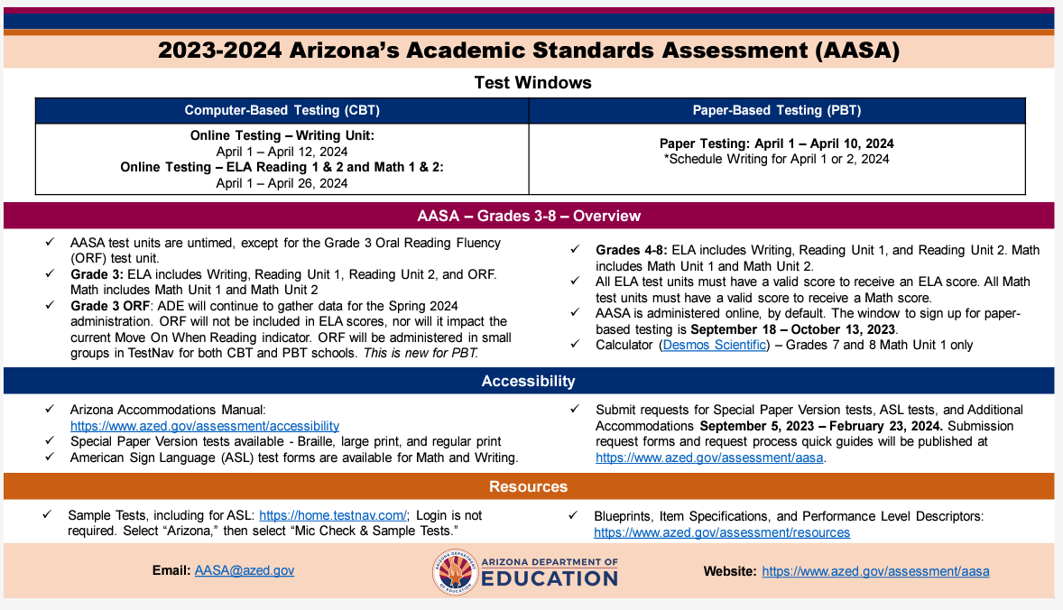
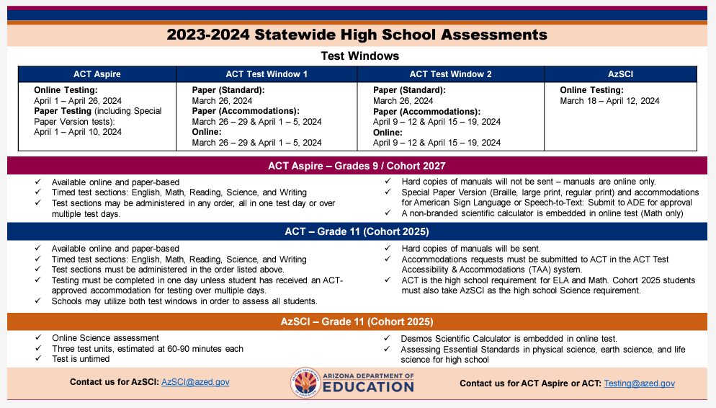
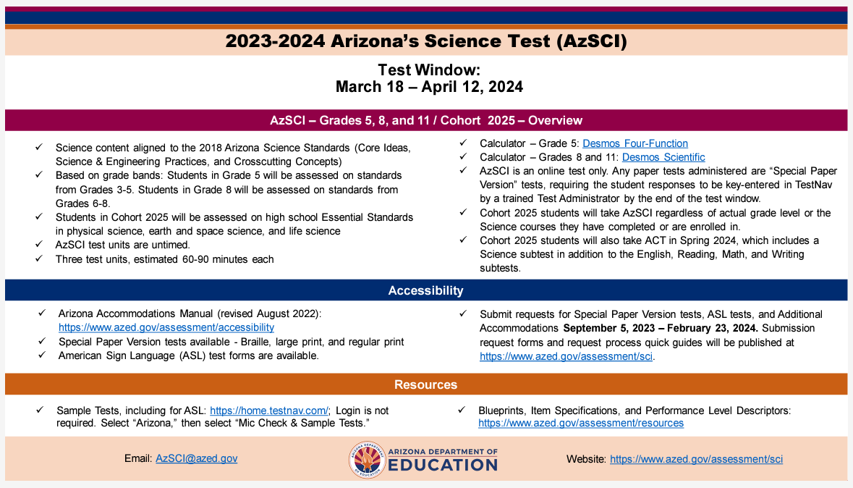
Resources - INfographics
https://www.azed.gov/assessment Under the Statewide Assessments Infographics

Slide 8
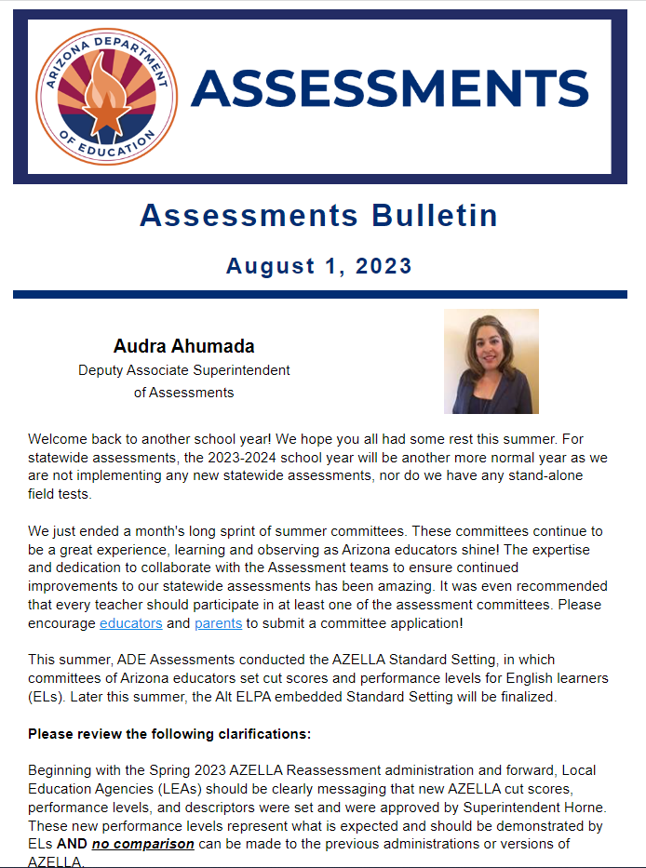
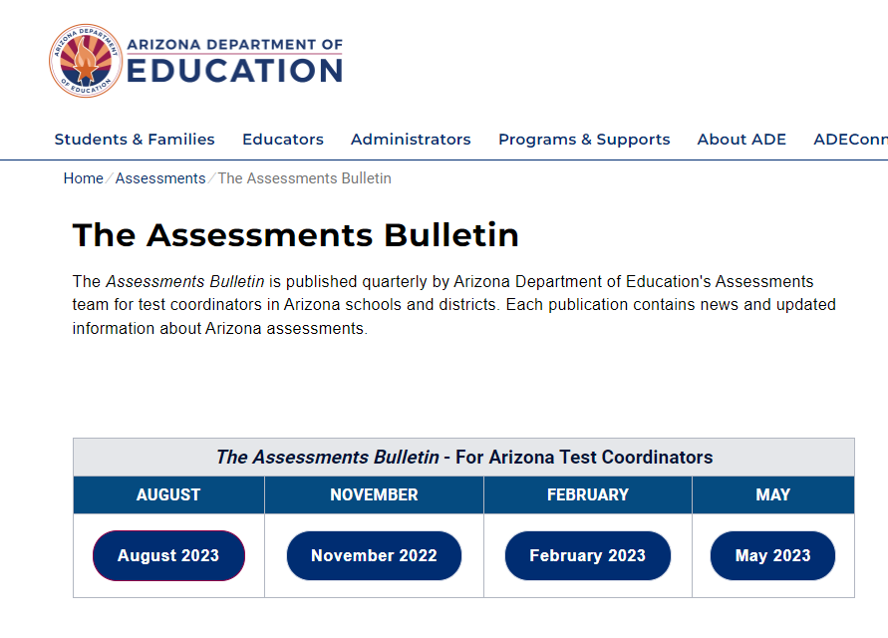
Resources – Assessments Bulletin
https://www.azed.gov/assessment/bulletin

Slide 9
AASA Grade 3: Oral Reading Fluency (ORF)
For the 2023-2024 school year, ADE will continue to collect data. This information will be shared with the State Board of Education.
ORF will NOT be a part of the students’ ELA score or Move on When Reading for 2023-2024.
New this year – paper-based schools will administer the ORF session via TestNav. Telephones are no longer an option. Utilizing TestNav will allow up to 6 students appropriately spaced to be administered the test simultaneously. The option to administer individually remains available as well, dependent on the number of devices the LEA has.

Slide 10
New Learning Management System
For the 2023-2024 school year, training modules for DTCs, STCs, proctors, technology specialists, TAs, and any other required staff will be accessed through the new Arizona Learning Management System (AZ LMS)
Achievement DTCs will receive a “Welcome Email” in December- more information to come
The Arizona LMS is a separate platform- you cannot access it from PAN

Slide 11
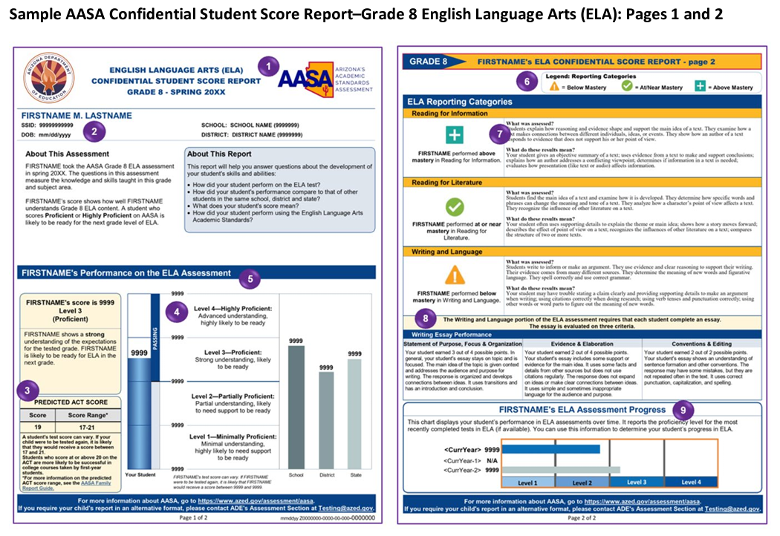
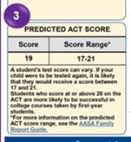
Grade 8 Predictive Score
Test scores are linked to ACT scales to obtain the ACT predicted score range

Slide 12
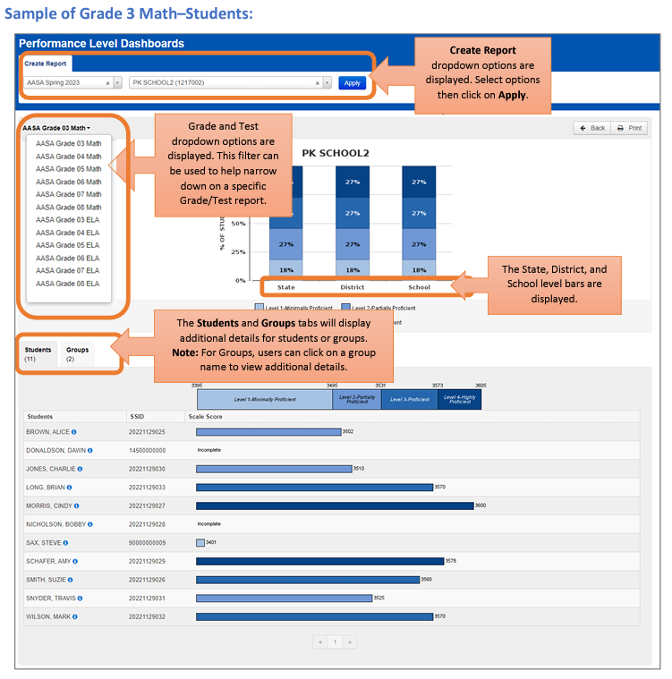
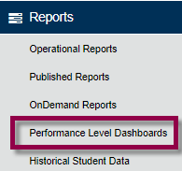
AASA Reports – Performance Level Dashboards
Accessible via PAN Reporting portal
On demand
Permissions/Access is through Historical Report Viewer role which is given to DTCs, and then DTCs can give access to other users in their LEA.
https://www.azed.gov/sites/default/files/2023/06/AASA%20Reporting%20Quick%20Guide%20-%20Performance%20Level%20Dashboards%20and%20Historical%20Student%20Data.pdf

Slide 13
Save the DATE
Arizona Assessments Conference – September 17-19, 2024
https://www.azed.gov/assessment/conference

Slide 14
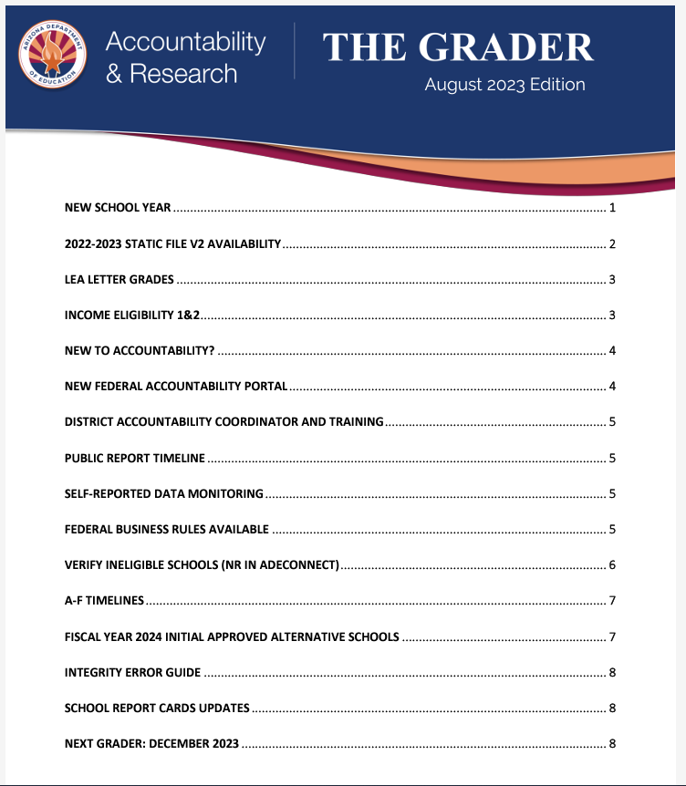
State and federal Accountability
State, District, and School Letter Grades are mandated by State Law and must be Board approved. These must be made available to LEAs no later than November 1st of each school year
Grader Newsletter email: Achieve@azed.gov

Slide 15
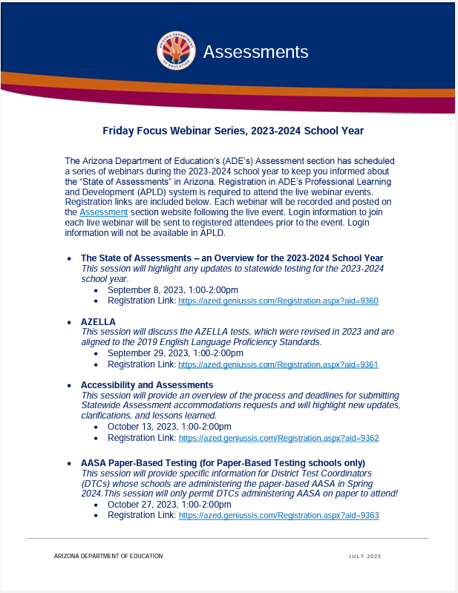
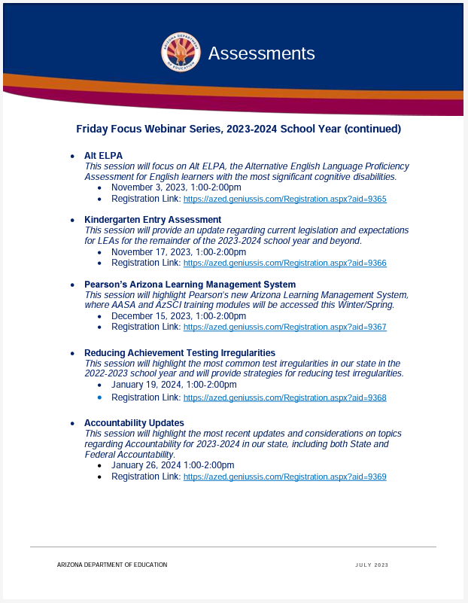
Assessment Webinar Series - POSTED
The flyer is posted on the Assessment Main page:
https://www.azed.gov/sites/default/files/2023/07/2023-2024%20Friday%20Focus%20Webinar%20Schedule.pdf
Reminder: participants must register in ADE’s Professional Learning and Development (APLD) system
Log in information to join the session will be sent to registered participants prior to the event. Login information will not be available in APLD.

Slide 16
Questions?

Slide 17
THANK YOU!
For questions, please contact us at: ​
Testing@azed.gov​

