Slide 1
ARIZONA DEPARTMENT OF EDUCATION
CAREER AND TECHNICAL EDUCATION
CTE Administrators Meeting
September 2023

Slide 3
Video Link: https://www.youtube.com/watch?v=6u8_ZA7f3ck

Slide 5
ACOVA
Professional Organization for
CTE Administrators
www.acova.org
We need your contact information

Slide 6
ACOVA Fall Conference
November 2-3, 2023
Prescott Resort
Call For Presentations
Mini Camp M & M
ACOVA.org

Slide 7
AUCTION ITEMS NEEDED
Scholarship Fund for YOUR Students
Auction is Thursday evening at the Networking event
We need help with items donated…student made items a plus

Slide 8
CTE Administrators Meeting
September 2023

Slide 9
Thank You!

Slide 10
Midwinter 2024
Jan. 31 – Feb. 2, 2024 at Prescott Resort
Call for Presentations will open before the holidays

Slide 11
Updates to Come
Check your e-blasts and ACTEAZ.org for updates on the following:
Premier Series updates
CTE Month 2024 video contest
Awards and Scholarship submissions
2024 Summer Conference (July 12 – 17, 2024)

Slide 12
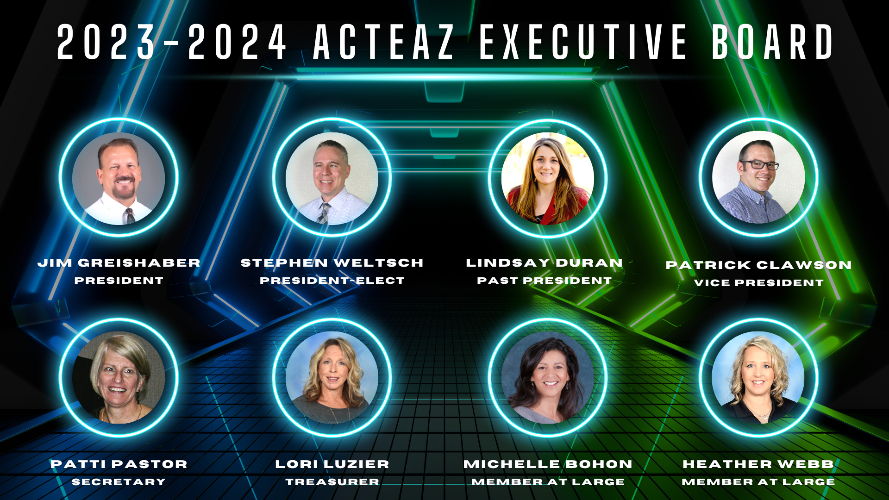
ACTEAZ Board of Directors

Slide 13
ACTEAZ Exec Board

Slide 14
Want More Information?
Jim Grieshaber, ACTEAZ President
jamesgrieshaber@acteaz.org
Pam Ferguson, ACTEAZ Exec. Director
pamferguson@acteaz.org
Shelly York, ACTEAZ Asst. Exec. Director
shellyyork@acteaz.org
(623) 826-6399
Shelby Freytag, Premier Series Coordinator
premierseries@acteaz.org

Slide 15
PREMIER SERIES

Slide 16
ACTEAZ Premier Series Coordinator
Shelby Freytag
Hello Everyone!
I am Shelby Freytag, the ACTEAZ Premier Series Coordinator.
I live in my hometown, Yuma, AZ with my husband, son and soon to be daughter.
I am a graduate of the University of Arizona: College of Agriculture and Life Sciences, with a Bachelors Degree in Agricultural Technology Management and Education with a Teaching Emphasis.
I was an Agriculture Educator for 5 years in the Yuma Area.
I have a love for Career and Technical Education, I am beyond excited and happy to be a part of the ACTEAZ Team, and the Arizona CTE Family.
Premier Series

Slide 17
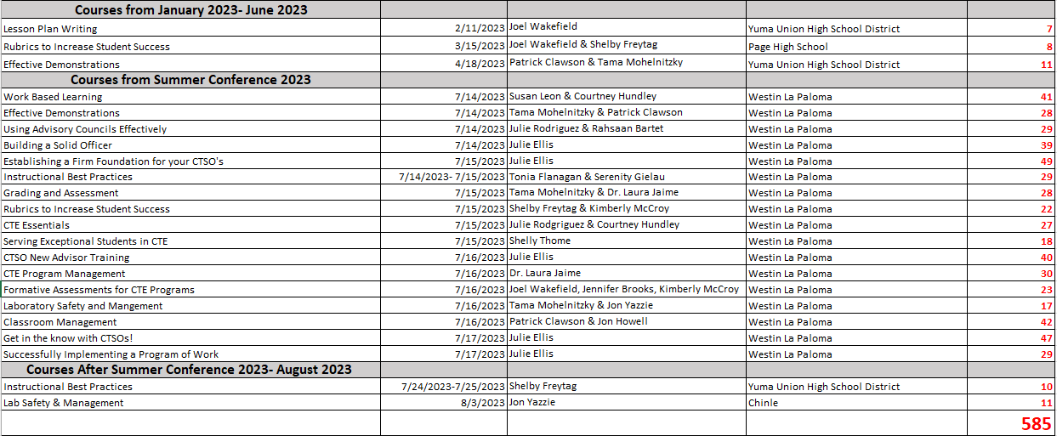
Premier Series Courses Delivered
Premier Series
FY 2022-2023 as of
September 13, 2023

Slide 18
Scheduled/ Upcoming Premier
Series Courses
Premier Series
FY 2022-2023 as of September 13, 2023

Slide 19
Cancelled/ Rescheduled
Premier Series Courses
Premier Series
FY 2022-2023 as of September 13, 2023

Slide 20
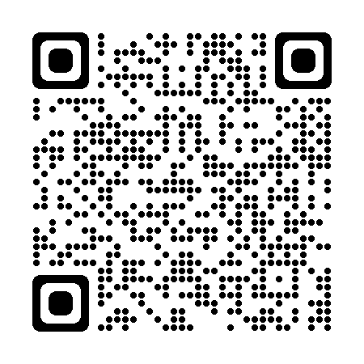
What is new for ACTEAZ Premier Series?
ACTEAZ is in the process of implementing Premier Series courses through an online virtual learning platform!
To best serve all districts ACTEAZ serves we would like to ask for your participation in the Premier Series Technology Survey.
Premier Series

Slide 21
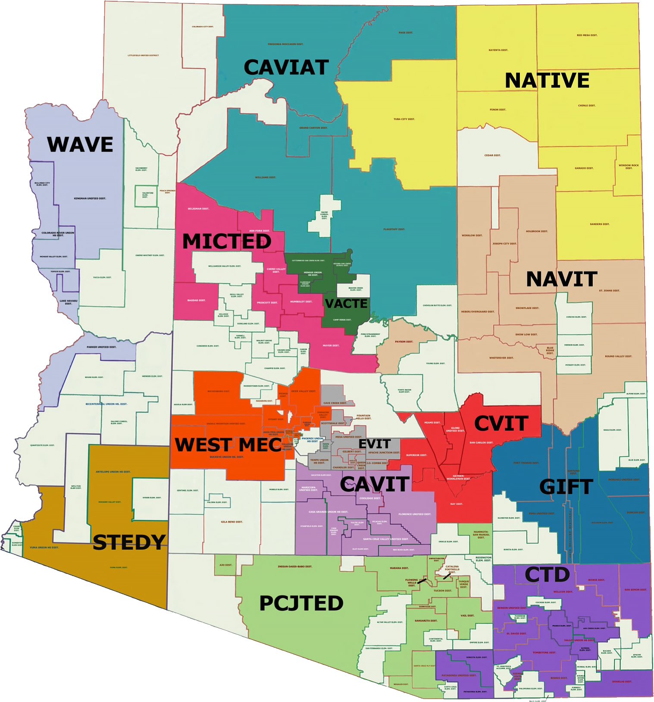
Statewide Partnerships
The Premier Series is offered throughout Arizona by:
- ACTEAZ
- Pima JTED
- West-MEC
With a handful of courses available through:
- CTD
- NAVIT
- EVIT
- WAVE
Premier Series
FY 2022-2023 as of February 2nd, 2023

Slide 22
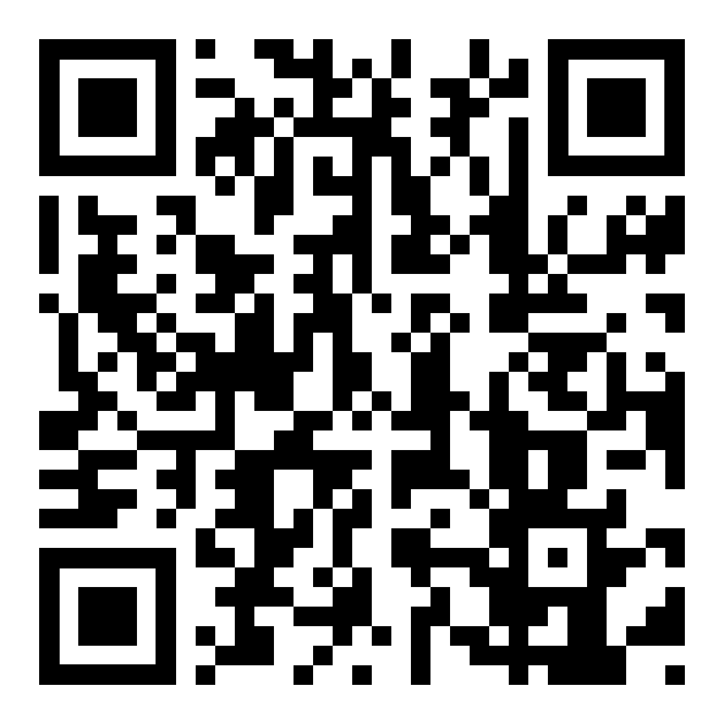
Course Offerings/ Calendar
For more information on ACTEAZ Courses & Course Calendar please visit the ACTEAZ Website.
https://www.acteaz.org/cte-leads-2/about-the-teacher-series/
Premier Series

Slide 23
How Can I Help?
For more information about the Premier Series or to schedule Premier Series classes for your instructors, please contact:
Shelby Freytag
Email: Premierseries@acteaz.org
Phone: (928) 941-0204
Premier Series

Slide 24
AZ CTE Curriculum Connection

Slide 25
CTE Curriculum Connection Site Enhancements
Completed:
Updated branding and color pallette
Refreshed home page with reduced navigation options
Industry Cluster Collections created
All CTE Program Groups adjusted from Private to Open
New CTE Program Groups (3) added
Reorganized CTSO information
Link to Affiliate websites in each program group
In progress:
Updated graphics and icons
Reorganized Supplemental Collections
Still to come:
Updated training videos
Consolidate Teacher Submitted materials into Program resources
Updated Instructional Resource videos
Updated Subject Area Taxonomy

Slide 26
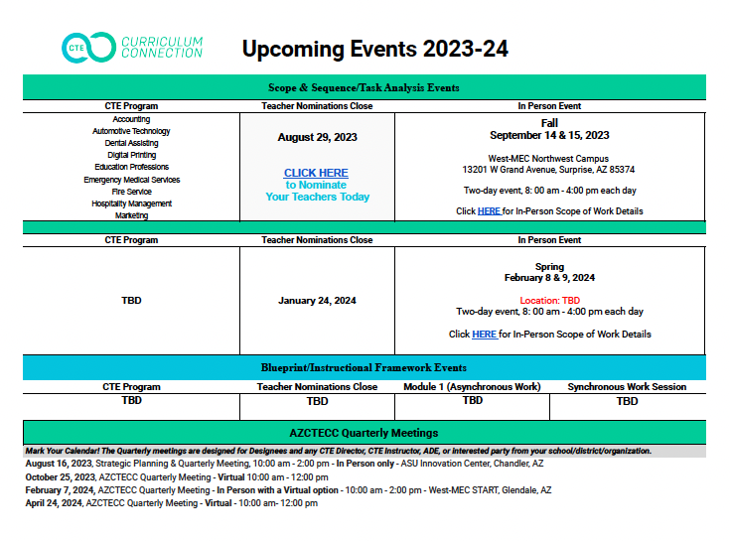
CTE Administrators Group/Upcoming Events
Consortium Opportunities
Grant Related Opportunities
Nomination Process

Slide 27
Reach Us
Notes:
Stephen, turn meeting over to Tammy & Jen

Slide 28
CTED Update

Slide 29
Arizona Occupational Administrator’s Council (AOAC)

Slide 30
$35M Advanced Manufacturing Building opens at Pima College

Slide 31
Established in partnership with Mohave Community College, the Kingman accelerator will support the region’s growing manufacturing, transportation, and mining industries. The accelerator will comprise of a more than 30,000 square-foot facility at Kingman Airport and Industrial Park, with industry partners to include NUCOR Steel, Kingman And Mohave Manufacturing Association (KAMMA), Progressive Pipe, Arizona Sommers Cooling and Heating and more.

Slide 32
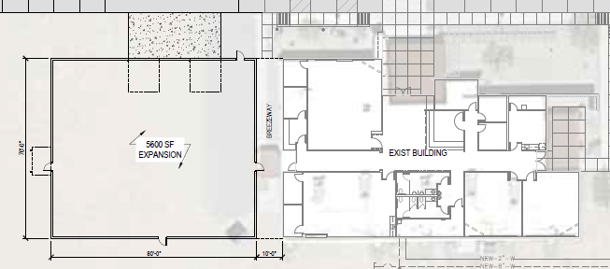
Building for the Future
Wellton Manufacturing Center
State48 Workforce Accelerator
Arizona Commerce Authority - $3.8M grant for AWC
5600 sq. ft. expansion of Wellton Advanced Manufacturing Center
$1M funding from Senator Kelly for equipment
Summer 2024

Slide 33
New Programs
AWC received $15M to support CTE
Establishing Dental Assistant & Dental Hygienist Programs
Establishing Cybersecurity Program

Slide 34
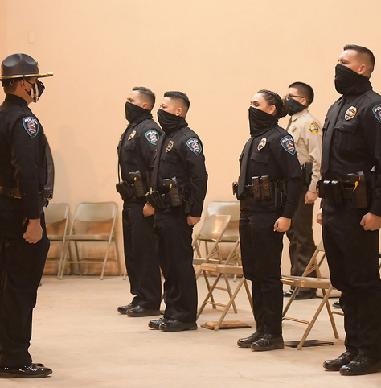
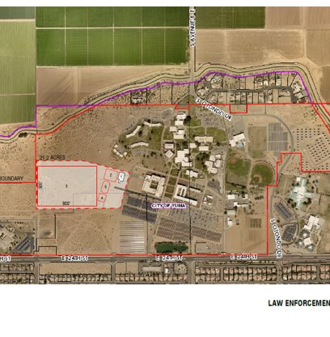
Building for the Future
Law Enforcement Training Academy (LETA)
Groundbreaking this Fall 2023!
$7.5M from Governor Ducey
Approximately $3 Million - $3.5 Million from AWC
Collaborative planning with Yuma County Sheriff and Yuma Police Department

Slide 35
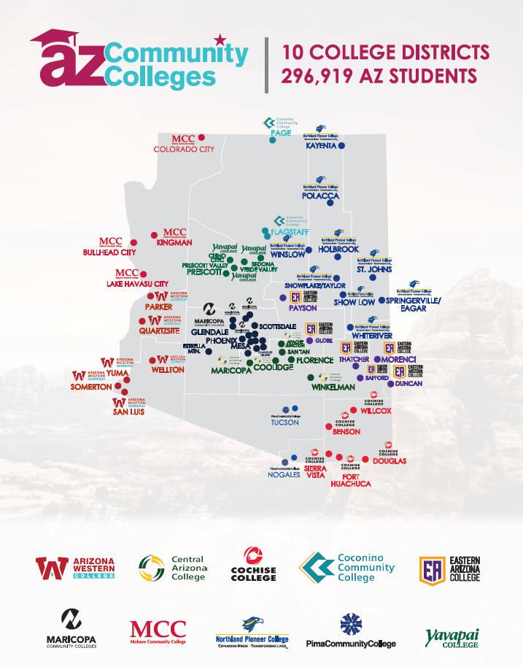
University Transfers
The Data tells the story
2021-2022 9,217
2022-2023 7,926
2021-2022 430
2022-2023 441

Slide 36
Creating a College-Going Culture
Dual Enrollment
102 Students graduated with their Associates (AA) degree before their high school graduation*
95,321 credits earned by high school students since 2017 (at $25/credit hour)
Record Numbers:
transfer students (From AWC 2021-22): 430
university graduates (From AWC 2020-22): 727
AWC saw a five-year % change increase of about 24% of the total number of
Baccalaureate degree recipients who entered as New Transfers.
Bottom Line – It is making a Difference
*2021-22: 47, 2022-23: 55

Slide 37
ARIZONA DEPARTMENT OF EDUCATION
CAREER AND TECHNICAL EDUCATION
CTE Administrators Meeting
September 2023

Slide 38
Scan the QR code to submit feedback about today’s meeting.
https://forms.office.com/r/zJxXvQ7bfC

