Slide 1
CTE Administrators Meeting
ACTEAZ Summer Conference
July 2023

Slide 2
CTE Administrators Meeting
Please send any changes to your district’s CTE teachers, administrators, and programs to:
Jet.WilsonDight@azed.gov
Over 230 new teachers and administrators this year!
Notes:
Postcards are also on the table – please take one!

Slide 3
CTE Administrators Meeting
Welcome and Introduction
Mission: We are a service organization
Why
What today’s meeting will look like

Slide 4
Notes:
Use the arrow keys to play the video and then to advance to the next slide.

Slide 5
Check for understanding
What is the mission of ADE CTE?
What will happen during the meeting today?
POSTSECONDARY
CAR III and IV will open in October and will be due in December. There are no technical updates. Please keep any eye out for an announcement this Fall.
Notes:
What is the mission of ADE CTE?
We are a service organization – when you are successful, we are successful.
What will happen during today’s meeting?
Information will be presented and then there will be to minutes between presentations to check for understanding.

Slide 6
CTE Fiscal Resources
ACTEAZ Summer
Conference
July 2023

Slide 7
FY 2023 Remaining Funds
CTE Data & Accountability
Secondary Perkins | $10,324,338.91 |  | 44%
Postsecondary Perkins | $2,584,683,57 |  | 50%
Innovative | $614,632.95 |  | 91%
Statewide Leadership | $100,673.83 |  | 37%
State Priority | $774,614.60 |  | 9%
ACTEAZ Summer
Conference
July 2023

Slide 8
FY 2024 Perkins
CTE Data & Accountability
Arizona | $34,271,864.00
Secondary | $24,363,433.27
Postsecondary | $5,348,070.72
State Institutions | $110,000.00
Nontraditional | $80,000.00
Competitive | $928.377.51
State Admin | $1,800,000.00
Basic Admin | $1,606,982.50
ACTEAZ Summer
Conference
July 2023

Slide 9
FY 2024 State Priority
CTE Data & Accountability
Arizona | $11,576,300.00
Secondary | $9,000,942.00
Admin | $2,575,358.00
ACTEAZ Summer
Conference
July 2023

Slide 10
POSTSECONDARY
CAR III and IV will open in October and will be due in December. There are no technical updates. Please keep any eye out for an announcement this Fall.
Bobby Neves CTE Fiscal Director
602-542-5137
Bobby.Neves@azed.gov
Discussion:
What hurdles are you running into that prevent your entity from reimbursing funds regularly?
www.azed.gov/cte/grants
Notes:
Table discussion

Slide 11
CTE Data & Accountability
ACTEAZ Summer
Conference
July 2023

Slide 12
CTE Data & Accountability
AUGUST 4, 2023
Enrollment
Placement Survey
Funding Exemption Requests
Use Reports to review your data
Courses Ineligible for Funding
Funding Summary
Performance Measures Results
Participant/Concentrator Verification Report
CTED/School Articulated Enrollment Discrepancy Report
ACTEAZ Summer
Conference
July 2023
Notes:
The CTE Data Portal will close for good in early August for FY 2023 for everything except the industry credentials. Credentials for last year’s students may be reported through the end of fiscal year 2024. If you need to submit an exemption request, please do so ASAP to ensure that it can be reviewed and approved no later than August 4 and the course can be included in the funding calculations.

Slide 13
Use Reports to review your data
Courses Ineligible for Funding
Funding Summary
Performance Measures Results
Participant/Concentrator Verification Report
CTED/School Articulated Enrollment Discrepancy Report
Funding Exemption Requests
Due BEFORE August 4, 2023
Submit early to give time for approval process
Submit for articulated courses too!
Use the Improper Teacher Certification Report
Notes:
Use the reports in the CTE Data Portal to ensure that your data is accurate and matches your LEAs records.
Use the CTED/School Articulated Enrollment Discrepancy Report to ensure that your articulated enrollment matches your CTED’s and vice versa (if applicable).
Check your participants/concentrators list and make sure that everyone you expected to see there is there.
Remember – only concentrators with the GR or LS Enrollment Status code will appear on your Placement Survey.

Slide 14
Placement Surveys
Only concentrators with the GR or LS Enrollment Status Code will appear on the Placement Survey
Placements are “related” if technical skills align to placement, not professional skills
Funding Exemption Requests
Due BEFORE August 4, 2023
Submit early to give time for approval process
Submit for articulated courses too!
Use the Improper Teacher Certification Report
Use Reports to review your data
Courses Ineligible for Funding
Funding Summary
Performance Measures Results
Participant/Concentrator Verification Report
CTED/School Articulated Enrollment Discrepancy Report

Slide 15
Data Integrity
Funding Exemption Requests
Due BEFORE August 4, 2023
Submit early to give time for approval process
Submit for articulated courses too!
Use the Improper Teacher Certification Report
Placement Surveys
Only concentrators with the GR or LS Enrollment Status Code will appear on the Placement Survey
Placements are “related” if technical skills align to placement, not professional skills

Slide 16
Data Integrity
LEAs must implement robust systems and processes for collecting, verifying, and maintaining accurate student data for their CTE courses.
LEAs must implement measures to ensure that the data they submit to ADE is accurate, including data audits and validation processes.
Adequate documentation and evidence shall be maintained and must be provided to ADE upon request.

Slide 17
Technical Updates
Performance Measures 3-Year Comparison
Continuation of Services/13th Year Students
CTE Opportunity Gap Analysis

Slide 18
What is ADE IT Working on?
Completer Flag
Participant/Concentrator Adjustments
System Upgrade Requirements
Bug/Glitch Fixes

Slide 19
ENROLLMENT
STATISTICS
156,232
Students Enrolled
138
312
Districts
Schools
~2400
School-level Programs
Notes:
“School-level programs” is an instance of a program taught at a school (non-articulated), so if 10 schools teach Program A, that means there are 10 “school-level programs” of that program A. Excludes articulated, only counts if the school teaches the program on-campus.

Slide 20
2023 CREDENTIALS STATISTICS (so far)
10,152
Students earned a credential this year
12,347
Credentials earned this year
77.6%
Pass Rate
Notes:
12,347 passed out of 15,916 attempts = 77.6% pass rate over these two years.
This is about 60% of the number of students that earned credentials in 2022 (16,446), it is very important that you report credentials earned!
Credentials earned is greater than students as many students earn more than one credential.

Slide 21
COMING UP NEXT
FY 2023 funding and performance measures
CTED Achievement Profiles
FY 2024 CTE Data Portal expected to open in Mid-October 2023

Slide 22
POSTSECONDARY
CAR III and IV will open in October and will be due in December. There are no technical updates. Please keep any eye out for an announcement this Fall.
Fall term data collection “snapshot” is October 15, 2023
Fall term enrollment due January 15, 2023

Slide 23
POSTSECONDARY
CAR III and IV will open in October and will be due in December. There are no technical updates. Please keep any eye out for an announcement this Fall.
Fall term data collection “snapshot” is October 15, 2023
Fall term enrollment due January 15, 2023
Contact
CTE Accountability Specialists
www.azed.gov/cte/data

Slide 24
POSTSECONDARY
CAR III and IV will open in October and will be due in December. There are no technical updates. Please keep any eye out for an announcement this Fall.
Tammie Chavez
602-542-3839
Tammie.Chavez@azed.gov
Samuel Irvin
602-364-1946
Samuel.Irvin@azed.gov
Charles Jarvis
602-542-3823
Charles.Jarvis@azed.gov
Donna Kerwin
602-542-7881
Donna.Kerwin@azed.gov
www.azed.gov/cte/data
Notes:
1. When is everything due? August 4, 2023
2. When will FY 2024 reporting open? Mid-October 2023
3. When is the fall term “snapshot” date for enrollment? October 15, 2023, no change from prior year

Slide 25
Check for understanding
When is everything due? (Enrollment, placement survey)
When is the Fall term “snapshot” date for enrollment?
POSTSECONDARY
CAR III and IV will open in October and will be due in December. There are no technical updates. Please keep any eye out for an announcement this Fall.
Notes:
1. When is everything due? August 4, 2023
3. When is the fall term “snapshot” date for enrollment? October 15, 2023, no change from prior year

Slide 26
CTE Grants
Managing your Federal Perkins and State Priority Grants
ACTEAZ Summer
Conference
July 2023

Slide 27
CTE Grants Program Specialists
Vacant (Grant Specialist)
Audrey Dieken
Daniel Rick Schmidt
Mark McManus
John Jones (OCR)
Vacant (Supervisor)

Slide 28
Important Dates FY 2023
March 31, 2023
Perkins Performance Measure Action Plan Mid-Year Narratives
September 15, 2023
Perkins Measurable Objectives Final Narratives
September 28, 2023
State Priority Completion Reports
December 29, 2023
Perkins Completion Report
Important Dates FY 2024
May 1, 2023
Perkins and Priority Grants Submissions Due
July 1, 2023 – September 30, 2024
Funding Year for Perkins
July 1, 2023 – June 30, 2024
Funding Year for Priority
July 1, 2023 – September 30, 2024 Funding Year for Statewide and Innovative

Slide 29
Important Dates FY 2023
March 31, 2023
Perkins Performance Measure Action Plan Mid-Year Narratives
September 15, 2023
Perkins Measurable Objectives Final Narratives
State Priority Completion Reports: September 28, 2023
Perkins Completion Report: December 29, 2023
Important Dates FY 2024
May 1, 2023
Perkins and Priority Grants Submissions Due
July 1, 2023 – September 30, 2024
Funding Year for Perkins
July 1, 2023 – June 30, 2024
Funding Year for Priority
July 1, 2023 – September 30, 2024 Funding Year for Statewide and Innovative
Statewide Leadership and CTE Innovative Grants
September 30, 2023
Project End Date
September 15, 2023
Final narratives due
December 19, 2023
Completion Reports due

Slide 30
Important Dates FY 2024
May 1, 2023
Perkins and Priority Grants Submissions Due
July 1, 2023 – September 30, 2024
Funding Year for Perkins
July 1, 2023 – June 30, 2024
Funding Year for Priority
July 1, 2023 – September 30, 2024 Funding Year for Statewide and Innovative
Statewide Leadership and CTE Innovative Grants
September 30, 2023
Project End Date
September 15, 2023
Final narratives due
December 19, 2023
Completion Reports due

Slide 31
Reimbursement Requests
Statewide Leadership
63%
as of 7/1/23
State Priority
91%
as of 7/1/23
CTE Innovative
10%
as of 7/1/23
Perkins
59%
Postsecondary 51% as of7/1/23

Slide 32
FY 2024 Perkins Grant and CLNA

Slide 33
Incorporated Year 1 and Year 2 CLNA Requirements
Condensed CLNA criteria requirements
Incorporated Gap Analysis
Aligned FY 2024 Perkins grant application with new template
FY 2024 Perkins Grant and CLNA

Slide 34
FY 2024 Perkins Performance Measure Improvement Plans
Plans due January 15, 2024
Final Narratives due September 15, 2024
Grant Final Narratives due September 15, 2024
Federal Perkins
Statewide Leadership
CTE Innovative
FY 2024 Completion Reports
State Priority CR due September 28, 2024
Perkins, Statewide Leadership, and CTE Innovative CRs due December 31, 2024
REMINDERS
Incorporated Year 1 and Year 2 CLNA Requirements
Condensed CLNA criteria requirements
Incorporated Gap Analysis
Aligned FY 2024 Perkins grant application with new template
CLNA goals and objectives must align to the Perkins V grant application
Completed CLNA must be uploaded to the Related Documents section
Coherent sequence for CTE programs must be in place

Slide 35
FY 2024 Perkins Performance Measure Improvement Plans
Plans due January 15, 2024
Final Narratives due September 15, 2024
Grant Final Narratives due September 15, 2024
Federal Perkins
Statewide Leadership
CTE Innovative
FY 2024 Completion Reports
State Priority CR due September 28, 2024
Perkins, Statewide Leadership, and CTE Innovative CRs due December 31, 2024
REMINDERS
CLNA goals and objectives must align to the Perkins V grant application
Completed CLNA must be uploaded to the Related Documents section
Coherent sequence for CTE programs must be in place

Slide 36
FY 2024 Perkins Performance Measure Improvement Plans
Plans due January 15, 2024
Final Narratives due September 15, 2024
Grant Final Narratives due September 15, 2024
Federal Perkins
Statewide Leadership
CTE Innovative
FY 2024 Completion Reports
State Priority CR due September 28, 2024
Perkins, Statewide Leadership, and CTE Innovative CRs due December 31, 2024
GEPA Requirement
Must be completed with first revision (FY24).
Be sure to answer all four questions.
Reach out to your grant specialist with any questions!

Slide 37
REMINDERS
FY 2024 Perkins
68% approved
FY 2024 Grant Status
CLNA goals and objectives must align to the Perkins V grant application
Completed CLNA must be uploaded to the Related Documents section
Coherent sequence for CTE programs must be in place
FY 2024 State Priority
97% approved
79%
Approved
Not Started 4
In Progress 40
Waiting on ADE 2
Program Specialist Approved 3
Director Approved 189

Slide 38
REMINDERS
Managing your grants
FY 2024 Grant Status
Ensure user access
Purchase capital and supplies at the beginning of the year
Work with your business manager often on reimbursements
Read the history log
Focus on FY 2024 CLNA and measurable objectives
Provide narrative details when submitting revisions
Avoid acronyms or abbreviations in budgets
Adhere to grant deadlines
SPEND YOUR ALLOCATED FUNDS!

Slide 39
REMINDERS
Managing your grants
Ensure user access
Purchase capital and supplies at the beginning of the year
Work with your business manager often on reimbursements
Read the history log
Focus on FY 2024 CLNA and measurable objectives
Provide narrative details when submitting revisions
Avoid acronyms or abbreviations in budgets
Adhere to grant deadlines
SPEND YOUR ALLOCATED FUNDS!

Slide 40
REMINDERS
Things that may affect your grants
Ensure user access
Purchase capital and supplies at the beginning of the year
Work with your business manager often on reimbursements
Read the history log
Focus on FY 2024 CLNA and measurable objectives
Ordering equipment/supplies not in the grant or not on the approved equipment lists
Procrastination in purchasing = irregularity in reimbursements
Limited/vague information in budget and/or revisions

Slide 41
Things that may affect your grants
Ordering equipment/supplies not in the grant or not on the approved equipment lists
Global holds prevent your grant from being approved. Resolve holds with GME as soon as possible!
Procrastination in purchasing = irregularity in reimbursements
Contact your Grant Program Specialist for review prior to submission if you are unsure about any revisions.
Limited/vague information in budget and/or revisions

Slide 42
Resources
Updated CLNA template
Chart of Accounts
CTE Quick Reference Guide
Allowable/Unallowable Expenditures Sheet
CTE Dates/Deadlines Chart

Slide 43
Audrey Dieken
602-350-5064
Audrey.Dieken@azed.gov
Mark McManus
602-542-8744
Mark.McManus@azed.gov
John Jones OCR Special Populations Specialist
970-216-6740
John.Jones@azed.gov
Daniel Rick Schmidt
602-364-2167
Rick.Schmidt@azed.gov
www.azed.gov/cte/grants

Slide 44
Check for understanding
When are the Measurable Objectives Final Narratives due for the FY 2023 Perkins, State Leadership, and CTE Innovative Grants?
What are some things that may affect the approval of your grant?
POSTSECONDARY
CAR III and IV will open in October and will be due in December. There are no technical updates. Please keep any eye out for an announcement this Fall.
Notes:
When are the Measurable Objectives Final Narratives for the FY2023 Perkins, State Leadership, and CTE Innovative grants due? September 15, 2023
What are some things that may affect the approval of your grant applications?
Global Holds
Limited / vague information in the budget narrative
Coding errors

Slide 45
Technical Standards
and
Technical Skills Assessment

Slide 46
CTE Program Standards and the Technical Skills Assessment are FUNDAMENTAL to the CTE process.
Program standards (S/MCs) emphasize learning goals focused on key knowledge and skills.
Technical Skills Assessment (TSA) provide a numerical description of what students have learned and how well programs perform.

Slide 47
New Updated Standards
CTE Program Standards and the Technical Skills Assessment are FUNDAMENTAL to the CTE process.
Program standards (S/MCs) emphasize learning goals focused on key knowledge and skills.
Technical Skills Assessment (TSA) provide a numerical description of what students have learned and how well programs perform.

Slide 48
New Updated Standards
Program standards (S/MCs) emphasize learning goals focused on key knowledge and skills.
Technical Skills Assessment (TSA) provide a numerical description of what students have learned and how well programs perform.
Marketing
Emergency Medical Services
Education Professions
Hospitality Management
Laboratory Assisting
Fire Service

Slide 49
New Updated Standards
32,989
Students
24,745
Passed (75%)
54
Programs

Slide 50
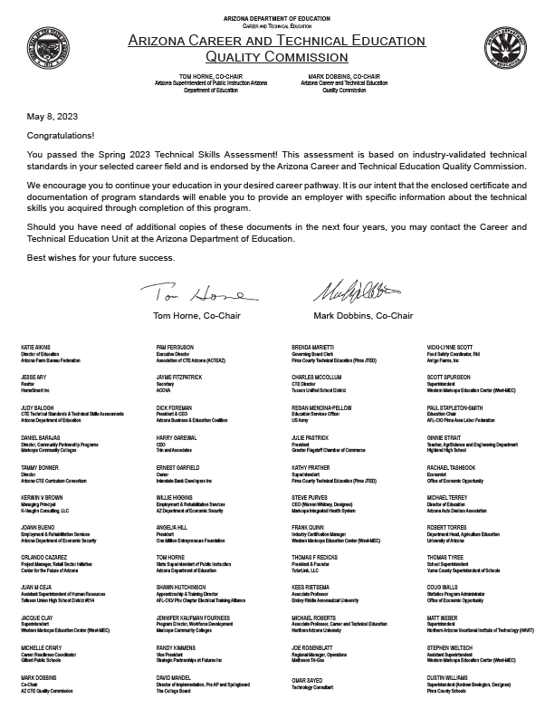
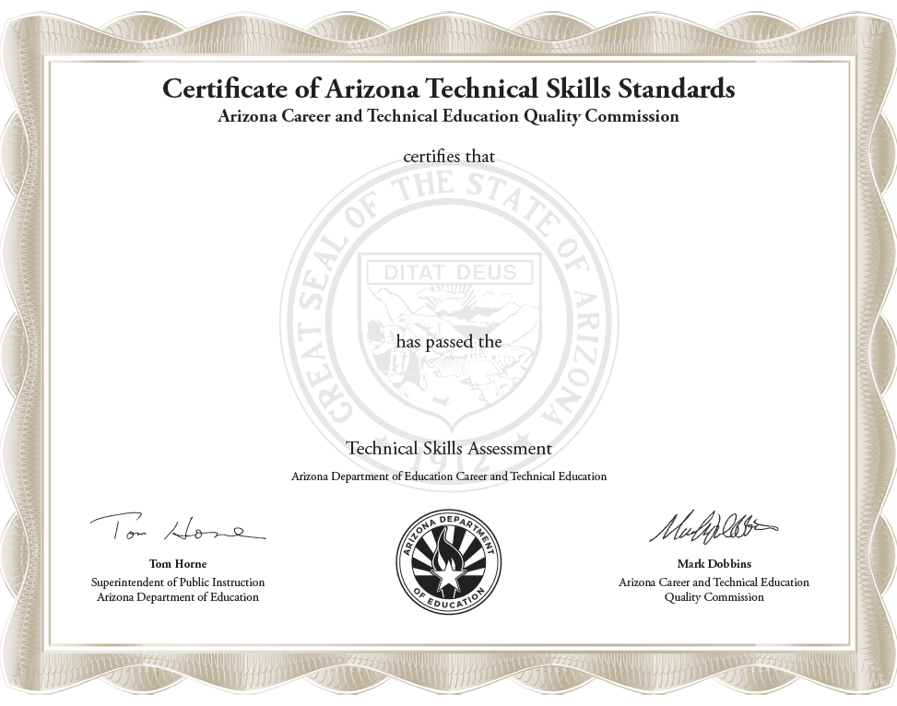
Top 10 High Performing Programs
Veterinary Assisting 98%
Education Professions 95%
Nursing Services 95%
Early Childhood Education 91%
Home Health Aide 91%
Laboratory Assisting 91%
Mental and Social Health Technician 91%
Cosmetology & Related Services 90%
Medical Assisting 89%
Film & TV Production 88%
Emergency Medical Services 86%
Engineering 85%
Finance 85%
Therapeutic Massage 85%
Law & Public Safety 84%
Sports Medicine and Rehabilitation 83%

Slide 51
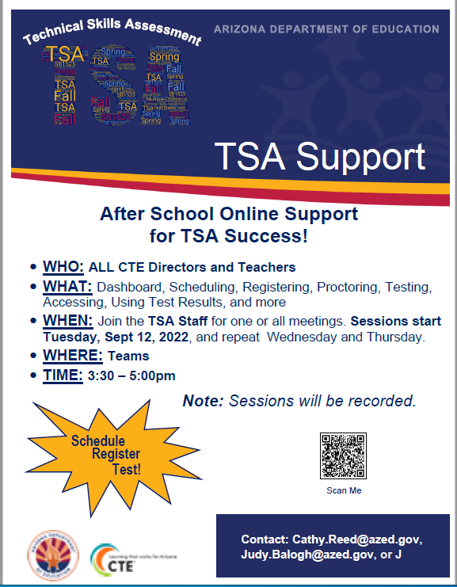
Resources for Directors and Teachers
CTE Technical Skills Assessment Webpage
www.azed.gov/cte/assessents
TSA Dashboard (ADEConnect)
Email
CTEAssessmentHelp@azed.gov
Helpline
602-542-5452

Slide 52
Cathy Reed
602-364-0103
Cathy.Reed@azed.gov
Jet Wilson Dight
602-542-2968
Jet.WilsonDight@azed.gov
Susan Faretta
602-542-5540
Susan.Faretta@azed.gov
Judy Balogh
Team Lead, CTE Assessments, Technical Standards, and PD
602-542-4511
Judy.Balogh@azed.gov
www.azed.gov/cte/assessments

Slide 53
Check for understanding
How often are program standards reviewed?
When can a student retake the TSA?
POSTSECONDARY
CAR III and IV will open in October and will be due in December. There are no technical updates. Please keep any eye out for an announcement this Fall.
Notes:
How often are CTE program standards reviewed? Standards are reviewed at reasonable intervals at the request of business-industry advisors, sometimes teachers, and most importantly because of recent innovations and advancements in the occupational area.
When can a student retake the TSA? If a student fails the test and retakes the course or takes an additional course in a single CTE program, the student can retake the test in the next school year prior to graduation through special arrangement with ADE/CTE.
If an IEP or 504 plan states that the student can take the test more than one time, the student can retake the test in the current or next school year prior to graduation through special arrangement with ADE/CTE.

Slide 54
CTE Program Services
ACTEAZ Summer
Conference
July 2023

Slide 55
CTE Program Services Website
www.azed.gov/cte/programs
CTE Program Information
Quality and Compliance Monitoring Information
Resources
Contacts for program specialists

Slide 56
Quality and Compliance Monitoring
Began 4th year of rotation SY 2023 – 2024
Monitoring session on Monday July 17, 8 am at Westin for anyone
Year 5 districts official notification will be given in September 2023
All things Program Monitoring – contact CTELocalPrograms@azed.gov
Notes:
ADE CTE is in year 4 of monitoring, each year we work to improve the process, increase communications to districts and CTEDs and improve our reliability in accepting evidence as compliant. The Program Services team appreciates input that will help the next group of districts with the process.
The entire process for monitoring begins with a new group at the mid winter conference, then small meeting in April with each district getting their link to begin submitting documentation. On the ADE CTE Side as a program submission is receive the program specialist gets an email and begins reviewing the evidence. To ensure the high level of reliability in reviewing, the PS team holds weekly monitoring meetings to review some programs together and discuss their findings. Once a district has submitted all programs hopefully by the deadline and the PS have reviewed, a preliminary report is sent to the district and a virtual meetings is set with the district. That meeting is to answer questions and give direction on the next steps to full compliance.

Slide 57
Monitoring Statistics
Programs processed: 604
Programs Compliant: 425
67 onsite visits, 36,000 miles, 4 out of 4 corners
Notes:
Some highlights on monitoring For The past year,
Total Number Of Monitors Processed = 604 Total Number of Compliant Monitors = 425
On average that means a PS has viewed one submission at least twice, reviewing/reading up to 47 uploaded documents with multiple pages for each monitor submission. That’s a lot of pages folks 604 times!!
The team also conducted 67 on site visits this year traveling over 36,000 miles to 3 of the 4 corners of Arizona, plus 3 additional onsite monitoring assistance visits and one district requested in person training in Nogales to prepare for SY24-25. Just to expand on the Nogales training, The CTE director, Mily Fontes, contact our team asking if we would come to Nogales to train her teachers on the requirements of CTE program monitoring. Nogales will not be monitored until SY 24-25 the last round, but they wanted to be prepared and to begin working on their documentation. While in Nogales, the Program specialists were able to explain the monitoring indicators, answer question the teachers had and to assist some teachers with certification questions. The entire PS team is willing to provide technical assistance, trainings and support for you and your teachers, just ask. We all enjoy getting out of the office and seeing the great CTE programs across Arizona.

Slide 58
Industry Credentials Webpage
Update current credentials (anytime)
Submit new credentials (March 1 – April 30)
Potential new credentials (FY 2024) to be submitted for approval to the CTE Quality Commission:
NOCTI – JROTC Leadership and Employability Skills
BACKstage High School Assessment
NC3 – Snap-on Tire Pressure Monitoring Systems
NC3 – Snap-on Batter, Starting, and Charging
NC3 – Snap-on Advanced Driver Assistance Systems
RECF – Pre-Engineering and Robotics Certification
Notes:
Potential New credentials (SY23-24) to be submitted to CTE Quality Commission for approval today – those are ????
Explain the update credential process and who, why to use that button.
Explain- A district/program may offer any credential to their students who want that credential and can use that credential. A program may go above and beyond to offer their students more than the minimum to meet performance measures. ADE CTE does not dictate to a district what credentials may be offered.

Slide 59
Industry Credentials Reminder
CTE Quality Commission approved policy
Credentials with no attempts (no data) for past four years will be removed
BE SURE TO REPORT ALL ATTEMPTS!

Slide 60
Local Occupational Programs (LOP)
Submit button on website (www.azed.gov/cte/programs)
Notes:
A LOP is a local program that has been determine as a need in a community supported by the CLNA or labor market data for the specific area that is not on the CTE Approved Program list and is substantially different than any CTE approved Program.

Slide 61
An LOP is…
A local program determined by labor market data to be a need for the community
Not on the CTE approved program list
Substantially different than any CTE approved program
Notes:
A LOP is a local program that has been determine as a need in a community supported by the CLNA or labor market data for the specific area that is not on the CTE Approved Program list and is substantially different than any CTE approved Program.

Slide 62
LOP Application
Electronic Application Deadline:
October 1st – November 30th at 5pm
By CTED for central or satellite member programs
By District only for District
If approved, added to the CTE Data Portal only for the eligible entity
Notes:
As with many of our processes they are electronic using the JotForms online form for submissions. The LOP application requires the same documentation as an approved CTE program to meet federal Perkins V and state CTED requirements.

Slide 63
Program Services Support and Technical Assistance
New teacher assistance for programs, professional development
CTE director assistance for monitoring, programs
District monitoring support – resources, presentations, customized training
Onsite visits/support
Notes:
We are a service organization; we are here to help you.

Slide 64
Bruce Watkins
Agriculture & Welding
602-364-1643
Bruce.Watkins@azed.gov
Kylie Chamblee
Education & Training, FCS
602-364-1838
Kylie.Chamblee@azed.gov
Jason Wojcik
Public Service/Transportation
602-542-5138
Jason.Wojcik@azed.gov
Elena Sobampo
BME, CMT
602-542-5049
Elena.Sobampo@azed.gov
Tracy Rexroat
Engineering, MFG, IT
602-364-0322
Tracy.Rexroat@azed.gov
Cindy Gutierrez
CTE Program Services Director
602-542-4365
Cindy.Gutierrez@azed.gov
Joe Grieco
Construction Technologies
602-542-5515
Joe.Grieco@azed.gov
Wesley Wood
Health Science Technologies
602-542-5143
Wesley.Wood@azed.gov
www.azed.gov/cte/programs

Slide 65
Check for understanding
Where is ADE Quality and Compliance Monitoring information found?
When are new credential applications open for submission to ADE?
POSTSECONDARY
CAR III and IV will open in October and will be due in December. There are no technical updates. Please keep any eye out for an announcement this Fall.
Notes:
Where is ADE Quality and Compliance Monitoring information found? On the CTE Programs and Standards Webpage under the blue ribbon titled “ADE Quality and Compliance Monitoring”
When are new credential applications open for submission to ADE CTE? Open March 1st each year and close April 30th each year

Slide 66
School Counselor Updates
ACTEAZ Summer
Conference
July 2023

Slide 67
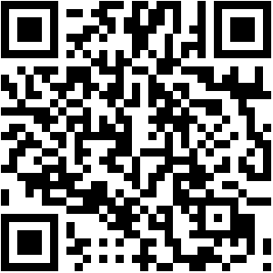
School Counselor Monthly Newsletter
To be added to the listserv, scan the QR code:
Program standards (S/MCs) emphasize learning goals focused on key knowledge and skills.
Technical Skills Assessment (TSA) provide a numerical description of what students have learned and how well programs perform.

Slide 68
My Future AZ Updates
Over 60,000 users
SSO Options: Clever, Azure
Update to School Registration Options (Student Assignment Capabilities, LEA/County Level Reporting)
Scope and Sequence Information for Educators
New, Grade Specific Content for Healthcare Industry and Career Exploration
Parent/Guardian Career Exploration Enhancements
One Page Student Report Printout
About Us Page with Consolidated External Messaging and Information
Program standards (S/MCs) emphasize learning goals focused on key knowledge and skills.
Technical Skills Assessment (TSA) provide a numerical description of what students have learned and how well programs perform.

Slide 69
ECAP Updates
Over 60,000 users
SSO Options: Clever, Azure
Update to School Registration Options (Student Assignment Capabilities, LEA/County Level Reporting)
Scope and Sequence Information for Educators
New, Grade Specific Content for Healthcare Industry and Career Exploration
Parent/Guardian Career Exploration Enhancements
One Page Student Report Printout
About Us Page with Consolidated External Messaging and Information
Due Date: April 30, 2024
Plans must be uploaded in EMAC (ADEConnect)
More information:
www.azed.gov/ecap

Slide 70
Emily Brown
School Counselor Director
602-542-5353
Emily.Brown@azed.gov
Megan Victory
Program Project Specialist
602-542-5076
Megan.Victory@azed.gov
www.azed.gov/cte/counselors

Slide 71
Check for understanding
True or False: ADE sends out a monthly newsletter with school counselor resources?
What month are ECAPs due?
POSTSECONDARY
CAR III and IV will open in October and will be due in December. There are no technical updates. Please keep any eye out for an announcement this Fall.
Notes:
1. True or false: ADE sends out a monthly newsletter with school counselor resources? TRUE 3. What month are ECAPs due? April

Slide 72
Career and Technical Student Organizations

Slide 73
CTSO Membership
Program standards (S/MCs) emphasize learning goals focused on key knowledge and skills.
Technical Skills Assessment (TSA) provide a numerical description of what students have learned and how well programs perform.
Breakdown sheet with each CTSO is on the ADE website and in your packets
FBLA – Dues paid to State
FCCLA – Dues paid to Nationals
FFA – Dues paid to State
HOSA – Dues paid to Nationals
SkillsUSA – Dues paid to Nationals

Slide 74
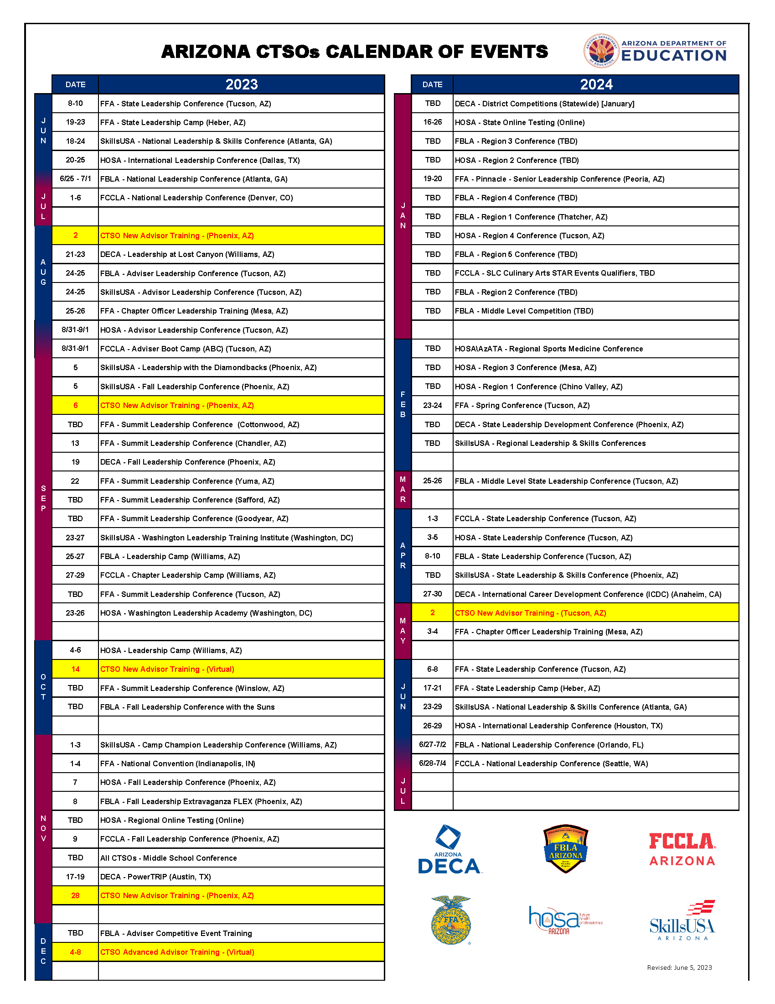
Calendar of Events
Program standards (S/MCs) emphasize learning goals focused on key knowledge and skills.
Technical Skills Assessment (TSA) provide a numerical description of what students have learned and how well programs perform.
Calendar of events is on the ADE website and in your packets.
TBDs will be updated when they become known.

Slide 75
New Advisor Training
Program standards (S/MCs) emphasize learning goals focused on key knowledge and skills.
Technical Skills Assessment (TSA) provide a numerical description of what students have learned and how well programs perform.
FREE
Wednesday, September 6, 2023
8:00 – 3:30 @ ADE North Campus
Saturday, October 14, 2023
8:00 – 3:30 Virtual
Tuesday, November 28, 2023
8:00 – 3:30 @ ADE North Campus
Thursday, May 2, 2024
8:00 – 3:30 @ Pima County JTED
Sign up: https://tinyurl.com/CTSONewAdvisorTraining

Slide 76
Advanced Advisor Training
Program standards (S/MCs) emphasize learning goals focused on key knowledge and skills.
Technical Skills Assessment (TSA) provide a numerical description of what students have learned and how well programs perform.
FREE
Monday – Friday, December 4 – 8
4:00 – 6:00 PM Virtual
Sign up: https://tinyurl.com/CTSOAdvancedAdvisorTraining

Slide 77
Advisor Leadership Conferences
Program standards (S/MCs) emphasize learning goals focused on key knowledge and skills.
Technical Skills Assessment (TSA) provide a numerical description of what students have learned and how well programs perform.
FBLA & Skills USA
August 24-25, 2023
Westin La Paloma
FCCLA & HOSA August 31 – September 1, 2023
Westin La Paloma
PLEASE encourage advisors to participate!

Slide 78
Monthly Mailings
Program standards (S/MCs) emphasize learning goals focused on key knowledge and skills.
Technical Skills Assessment (TSA) provide a numerical description of what students have learned and how well programs perform.
Each CTSO will deliver one monthly newsletter. Use the link below to sign up to receive them:
https://www.cognitoforms.com/ArizonaFCCLA/CTSOEmailDistributionOptInForm

Slide 79
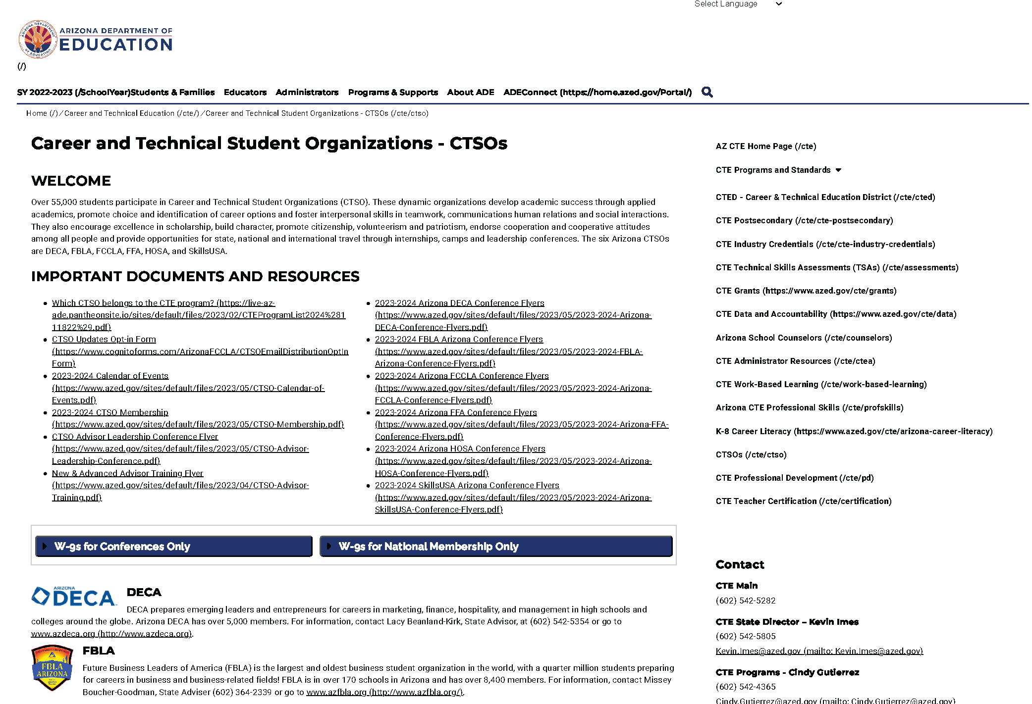
CTSO Website
Program standards (S/MCs) emphasize learning goals focused on key knowledge and skills.
Technical Skills Assessment (TSA) provide a numerical description of what students have learned and how well programs perform.

Slide 80
CTSO Recap
Program standards (S/MCs) emphasize learning goals focused on key knowledge and skills.
Technical Skills Assessment (TSA) provide a numerical description of what students have learned and how well programs perform.
55,000+ 2022-2023 Membership
6 SLCs with over 10,800 students/advisors
2300+ students/advisors and
192 top 10 finishers at National Leadership Conference

Slide 81
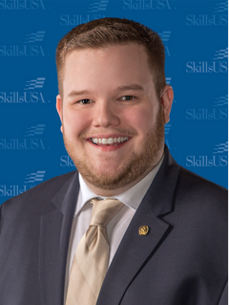
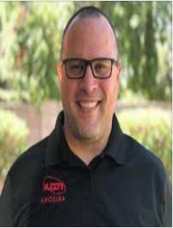
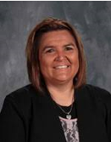
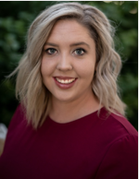
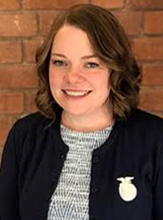
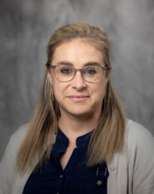
Daniel Kelly
SkillsUSA State Advisor
602-542-5565
Daniel.Kelly@azed.gov
Andrew Kuntz
FCCLA State Adviser
602-542-3040
Andrew.Kuntz@azed.gov
Allison Ashford
Program Project Specialist
602-542-5963
Allison.Ashford@azed.gov
Alvin Todd
Program Project Specialist
602-542-5853
Alvin.Todd@azed.gov
Missey Boucher-Goodman
FBLA State Adviser
602-364-2339
Missey.Boucher-Goodman@azed.gov
Lacy Beanland-Kirk
DECA State Advisor
602-542-5354
Lacy.Beanland-Kirk@azed.gov
Julie Ellis
Director, CTSOs
602-542-5350
Julie.Ellis@azed.gov
Bethany Matos
FFA State Advisor
602-542-5564
Bethany.Matos@azed.gov
Sandra Oligny
HOSA State Advisor
602-542-5770
Sandra.Oligny@azed.gov
www.azed.gov/cte/counselors

Slide 82
Check for understanding
What 2 CTSOs have memberships going to the State rather than their Nationals?
What would be the best course to send my New Advisors to?
POSTSECONDARY
CAR III and IV will open in October and will be due in December. There are no technical updates. Please keep any eye out for an announcement this Fall.
Notes:
1. What 2 CTSOs have membership going to the State rather than their Nationals? (FBLA and FFA)
2 – What would be the best course to send my New Advisors too? (New Advisor Training held in the months of July-November). Flyer will be in the packet.

Slide 83
Partner:
Arizona Occupational Administrators Council
ACTEAZ Summer
Conference
July 2023

Slide 84
AOAC - Arizona Occupational Administrators Council
Organization represents the administrators of Arizona's community colleges who are in charge of occupational education.
Promote and advance occupational education in Arizona's Community Colleges by sharing professional knowledge and best practices.
Establish a common view regarding the unique challenges and issues that arise in the administration of occupational education.
Promote collaborations between colleges, CTED, high schools, universities, businesses, government, industry, and other occupational-oriented organizations and agencies.

Slide 85
AOAC - Arizona Occupational Administrators Council
Officers
President: Reetika Dhawan, Arizona Western College
Past President: Jennifer Kaufman, Maricopa Community Colleges
Vice President: Jason Gee, Mohave Community College
Treasurer: Kimberly Faust, Maricopa Community Colleges
Secretary: Karyn Van Why, Arizona Western College

Slide 86
CTE Administrators Meeting
ACTEAZ Summer Conference
July 2023

