Slide 1
AASBO Meeting Update
ADE School Finance
5/10/2023
Notes:
This is a title page – please do not use for bulleted content

Slide 2
Agenda
FY 2023 Updates
Payment Updates
Statewide Recalculation
Vehicle Inventory Report
FY 2024 Updates
FY 2024 Payment Schedule
New Budget System

Slide 3
FY 2023 Updates
ADE SCHOOL FINANCE
SECTION 1
Notes:
This is a title page – please do not use for bulleted content

Slide 4
FRPL Group B Weight
Funding for the new FRPL Group B weight has been calculated manually for FY 2023.
Initial adjustment amounts and corresponding calculations have been published on the School Finance website (3/13 Hot Topic).
Adjustment amounts were based on Average Daily Membership (ADM) from 1/15/2023 and student need data from early March
Amounts will be updated at the end of the year to reflect final student data.

Slide 5
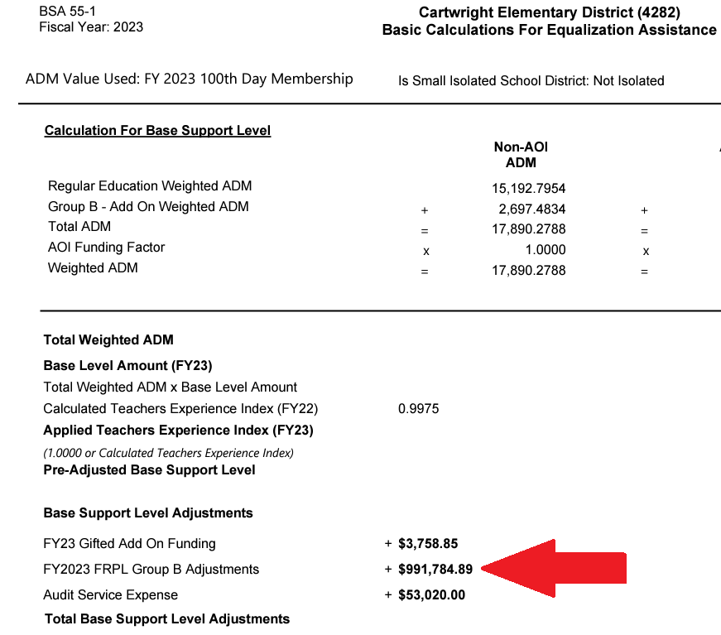
FRPL Group B Weight
Funding appears as an adjustment to the Base Support Level in the BSA55 report

Slide 6
FRPL Group B Weight
The adjustment calculation is detailed in the Excel file attached to the Hot Topic

Slide 7
Prop 123 Add-on Payment
The second half of the $75 million additional funding provided by Proposition 123 will be distributed this week.
Allocated based on the same ADM used for the April Classroom Site Fund payment

Slide 8
Results-Based Funding
The final 40% of Results-Based Funding awards will be paid next week.
Award amounts will be updated to reflect any changes in Average Daily Membership but awarded schools will not change.

Slide 9
Instructional Improvement Fund
The final Instructional Improvement Fund payment will be made at the end of June
We expect to return to two payments per year in FY 2024

Slide 10
FY 2023 Statewide Recalculation
The final student data capture for FY 2023 will be on 7/15
The final payment calculation for FY 2023 will be completed in late July
Any FY 2023 overpayments or underpayments from statewide recalculation will be applied as adjustments to FY 2024 payments.

Slide 11
Vehicle Inventory Report
It is now possible to submit vehicle inventory data and the submission window will close on 7/15/2023
Vehicle inventory data must be submitted in order for FY 2024 Transportation Support Level to be calculated properly
Please review the instructions attached to the Hot Topic published on 5/1 for more information

Slide 12
FY 2024 Updates
ADE SCHOOL FINANCE
SECTION 2
Notes:
This is a title page – please do not use for bulleted content

Slide 13
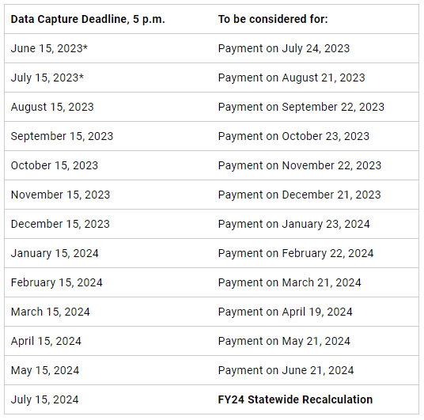
FY 2024 Payment Schedule

Slide 14
New Budget System
School Finance will begin using a new system to accept budget and financial report file submissions in FY 2024
The new system will replace Common Logon for everything accept retrieving prior-year files
The new system is scheduled to be available beginning on 6/15 to accept file submissions

Slide 15
New Budget System
It is a good idea to verify that the assigned entity administrator in ADEConnect is correct.
Access to the new system will need to be granted by the assigned ADE Connect entity administrator after the system is live.
The 4/18 Hot Topic on our website explains how to identify your entity administrator and how to grant permission to access the new system

Slide 16
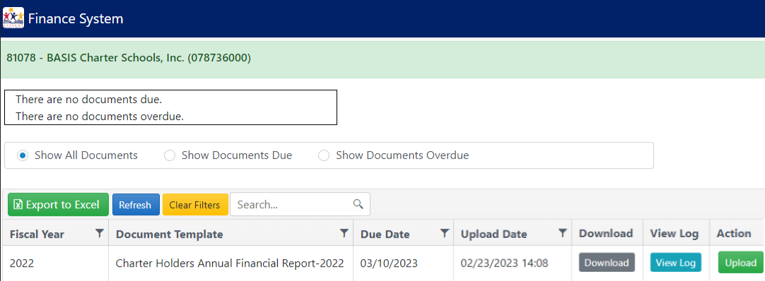
New Budget System

Slide 17
New School Finance DAS
Please welcome Tim McCain as the new Deputy Associate Superintendent for School Finance
Tim joined School Finance as a Budget Analyst and was most recently the Director of Operations Support

Slide 18
Charlie Martin, Deputy Associate Superintendent Charlie.Martin@AZED.gov (602) 542-8026
Thank You
Notes:
This is a title page – please do not use for bulleted content

