Slide 1
Private School Portions ESEA Consolidated Grant Application
Arizona Department of Education
Academic Achievement Unit
Tiffiany Morse - Ombudsman

Slide 2
Objective:
Participants will be able to complete all sections of the ESEA Consolidated grant application pertaining to private school equitable services.
Notes:
Participants will be able to complete all sections of the ESEA Consolidated grant application pertaining to private school equitable services.

Slide 3
Guidance, Training, Resources:
https://www.azed.gov/titlei/privateschools
All public LEAs are required to have procedures in place to locate and provide services to students, staff, and families attending private schools.
Charter schools do not have boundaries. Therefore, they are exempt from providing Title I-A, II-A, and IV-A equitable services.
Notes:
On the screen, you will see our equitable service web address
LEAs are highly recommended to bookmark the ES webpage and check it often for updated resources which are revised and added often
Equitable services is not part of the school choice movement
Federal funds are drawn from census data
Students and families attending private schools helped draw the Federal funds that support schools and the community
Federal funds must pass through the public entity

Slide 4
Title I-A, II-A, IV-A
Notes:
The first two pages in the application that pertain to private schools are applicable to Title I-A, II-A, and IV-A

Slide 5
Private Schools Administration Page
From the Sections page, locate Private Schools and select Administration
List each private school that is in the area and consulted within the last five years
Add new private schools
Verify/change each school’s status
Confirms grants eligibility
Remove a private school by unchecking the box beneath the Open column
Notes:
The first page the LEA must complete that applies to all funds is the Private School Administration page –
This page is often skipped or forgotten, but is important for the rest of the grant application
Locate the private school administration page by navigating to Sections
Find the Private School Section and click Administration
To complete this page, first list each private school that is in the area and/or any private school that the LEA has consulted with in the last five years
Be sure to add any new private schools that may potentially participate
The section to add schools is found at the top of this page
Next to each private school, verify or change their status to reflect if their address is within the LEA’s boundary or outside of the LEA’s boundary
The school’s status is what confirms which grants that school is eligible for ongoing consultation
This year, LEAs may remove a private school from their Administration page
Do this by unchecking the box beneath the Open column

Slide 6
Title I Related Documents
NIP for each school listed on the Private School Administration page
Completed and if applicable, evidence attached
No Response – evidence of three good faith attempts
Separate the NIPs into categories
In-District/not participating
In-District/participating
Out of District/not participating
Out of District/participating
Upload
Notes:
The next page that is completed for all funds is Title I Related Documents
First, verify you have a complete Notice of Intent to Participate for each school listed on the Private School Administration page
Verify each NIP has been completed with all signatures, and if applicable has evidence attached
If the private school did not respond, – evidence of the LEA’s three good faith attempts must be attached to that school’s NIP
Separate the NIPs into categories
In-District/not participating
In-District/participating
Out of District/not participating
Out of District/participating
Upload all NIPs next to the fillable form in the Document/Link column
All NIPs may be uploaded together, they do not have to be individually uploaded

Slide 7
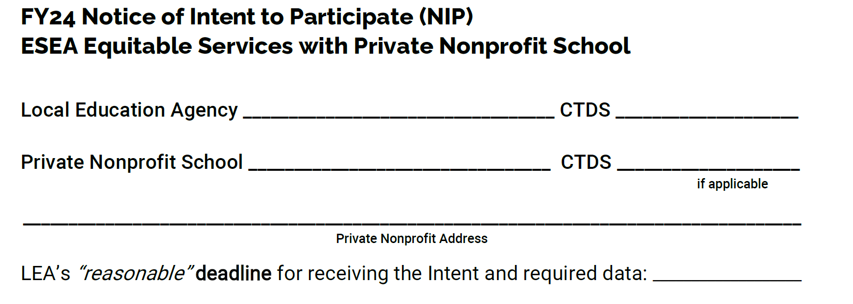
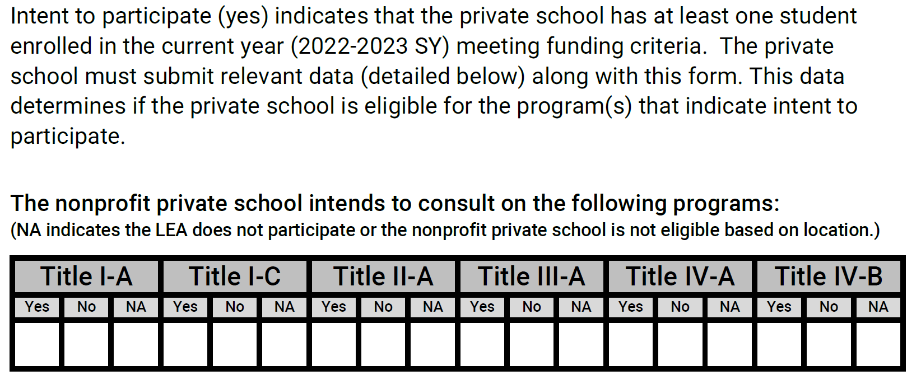
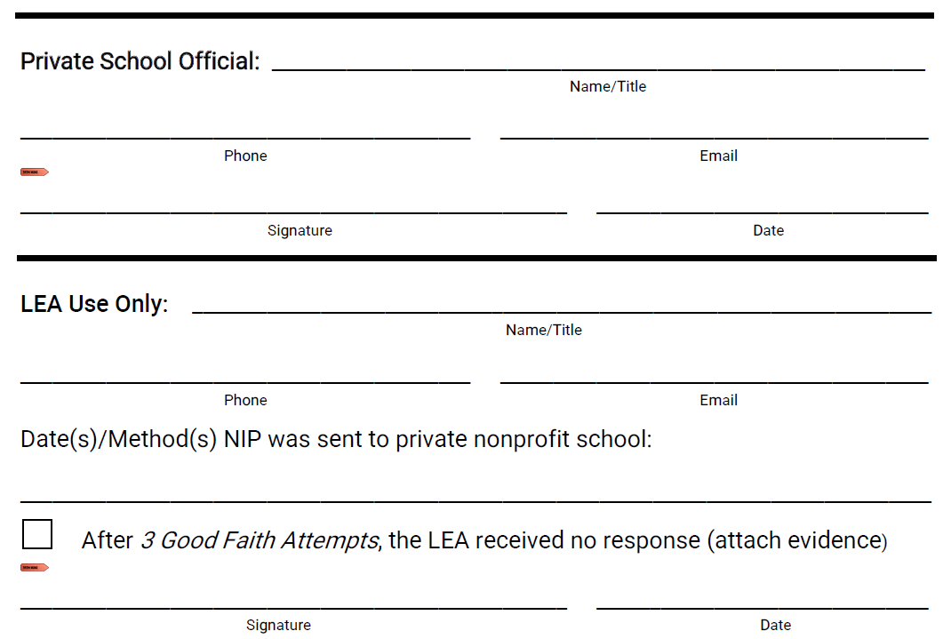
Notes:
Here are some sections of the Notice of Intent to Participate
It is important that LEAs begin providing deadlines for private schools for all requests
This will assist both parties with any breakdown in communication – people move on, forget, get busy, and don’t check back
This causes interrupted services and ultimately large amounts of carryover
LEAs must provide three opportunities for private schools to respond
The section in the turquoise box, is for LEAs that have no private schools
Each box must be checked and then the form must be signed by the LEA
Next is the portion that the private school completes and submits supporting data
LEAs may not prefill NA on this document if they receive funds and plan to transfer
Doing so would be evidence that the LEA violated the law which requires consultation prior to making any decisions that may impact any potential participant
Both parties must sign, and the LEA must document how they contacted the private school for each attempt
The bottom portion provides instructions to add evidence of three good faith attempts if the LEA receives no response
No response evidence may include emails, phone logs, or certified mail receipts
A certified mail receipt is the recommended method for all third attempt deadlines

Slide 8
Title I-A
Notes:
The next few pages pertain to Title I-A only

Slide 9
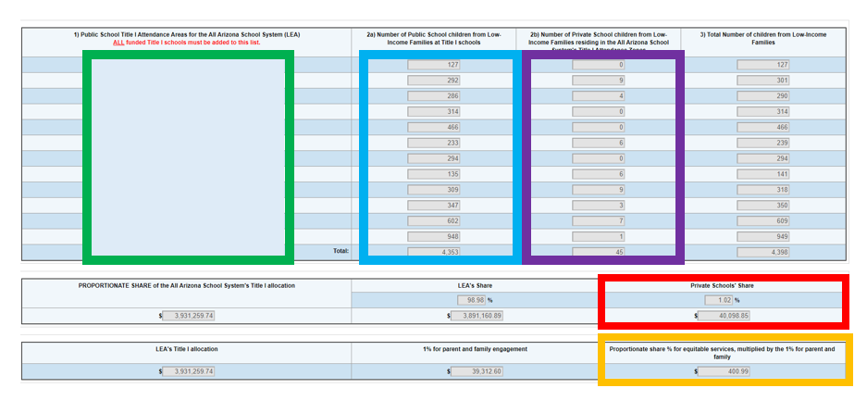
Add every Title I funded school (School Eligibility page)
Low-income data will auto populate from the School Eligibility
Add the total number of students living in that Title I school’s boundary who attend a participating private school and who qualify based on income
Column 3 auto-fills
The minimum private school share and family engagement amounts calculate below
Private School Proportionate Amount Page
Notes:
Next, complete the Title I Proportionate Amount page
This page will calculate the minimum amount that the LEA must provide for private school equitable services
In the first column, add every Title I funded school
This must align to the School Eligibility page
Low-income data will auto populate from the School Eligibility page in the second column
In column 2b, add the total number of students living in that Title I school’s boundary who attend a participating private school and who qualify based on income
Column 3 auto-fills once column 2b is completed
The minimum private school share and family engagement amounts calculate below
These amounts auto-fill on the Set Aside page

Slide 10
Set Aside Page
The total from the Proportionate Amount page prefills in 3 and 3c on the left
Complete all applicable cells on the right
3a – optional Administrative Costs - overseeing private school service, transportation costs, postage for certified letters
3b - optional Indirect Cost – amount may NOT be more than the LEA’s approved indirect cost rate times the minimum amount to allocate
3c – only LEAs with $500,000.00 or more are required to set aside the minimum amount for family engagement
3d – optional professional development- only for private school teachers of eligible Title I students (not school-wide)
3e – required instructional services to be divided among eligible participating private schools
Add all cells on the right - 3a + 3b + 3c + 3d + 3e = Minimum amount to allocate/prefilled amount
Notes:
Next, navigate to the Title I Set Aside page
Check that the total from the Proportionate Amount page matches the minimum amounts prefilled in 3 and 3c on the left
Next, the LEA will fill in all applicable cells on the right
3a is optional and reserved for private school Administrative Costs
these costs must be necessary and reasonable
the amount may NOT be more than what is set aside in 3e for students and must be less than proportional
costs may include overseeing private school services, transportation costs, or postage for certified letters
3b is also optional and is for private school Indirect Cost –
The amount may NOT be more than the LEA’s approved indirect cost rate times the minimum amount to allocate
SA 3b will be labeled in the budget narrative in section 6910
SA 2 + SA 3b = max indirect cost amount also the Line-Item Total for 6910
3c is for private school family engagement
This amount is only required for LEAs that receive $500,000.00 or more
If the LEA is required to set aside a minimum amount in SA 8, then they are required to do the same in 3c
3d is optional and reserved for private school professional development
After consultation, the LEA may determine if a portion of funds will be used for Title I professional development
3d may only be used for private school teachers of eligible Title I students, not school-wide or all staff
3e is the required set aside for instructional services
The amount the LEA puts in 3e is divided among all participating private schools
The last task on this page is to add all cells on the right and make sure that the sum equals the minimum amount that is prefilled on the left

Slide 11
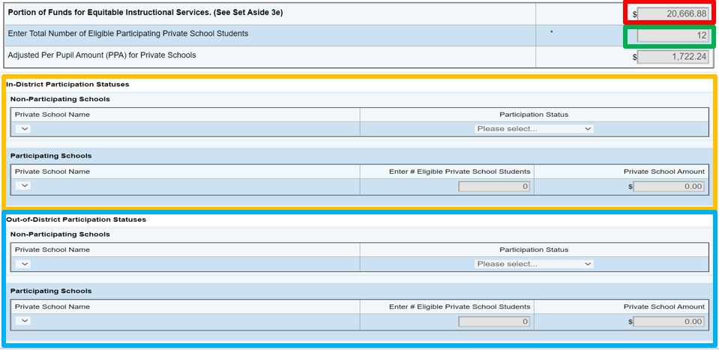
Title I-A Eligible Private School Service Page
The Portion of Funds for Equitable Instructional Services = 3e from the SA page
Enter the Number of Eligible Participating Private School Students
Match the Total on the Private School Proportionate Amount page
Select In-District Participation Status or Out-of-District Participation Status y
Select the reason for all non-participating schools
Enter the total number of eligible students attending each participating private school
Add the private school’s eligible student counts = the Number of Eligible Participating Private School Students
Allocations will auto calculate
Every school listed on the Private School Administration page
Participation status matches each NIP
Notes:
The last page for Title I other than the budget narrative is the Eligible Private School Service page
Verify that the Portion of Funds for Equitable Instructional Services total matches 3e from the SA page
Next, enter the Number of Eligible Participating Private School Students in the second row
The total must match the total on the Private School Proportionate Amount page
Use the drop-down arrows to add each school that is listed on the Private School Administration page
In-District Participation Status schools have addresses within the LEA's boundary
Out-of-District Participation Status schools have addresses outside the LEA’s boundary
For all non-participating schools, use the drop-down arrow to select the reason
Enter the total number of eligible students attending each participating private school
Add each of the private school’s eligible student counts; verify the summed total = the Number of Eligible Participating Private School Students in the second row/Private School Proportionate Amount page total
Each participating private school allocation will auto calculate
Verify that each school listed on the Private School Administration page is listed
Verify each school’s participation status matches what is written on their NIP
Enter each private school’s allocation on the LEA’s contributory budget spreadsheet

Slide 12
Title II-A
Notes:
Title II-A only has one page to complete other than the budget narrative

Slide 13
Title II-A Eligible Private School Service Page
Enter any Optional Administrative Costs
Overseeing private school service, postage costs for certified letters
Enter any Optional Indirect Cost – LEA’s approved indirect cost rate
Number of students auto fills
Add the Total Number of Private School Enrollment = the sum enrollment for all participating private schools
Check Yes to confirm consultations have occurred or been attempted
Enter ONLY In-District schools listed on the Private School Administration page
Select the reason for all non-participating schools
Enter the total enrollment for each participating private school
Allocations will auto calculate
Every school listed on the Private School Administration page
Participation status matches each NIP
Notes:
The Title II Eligible Private School Service page is the page that will determine each participating private school’s allocation
Enter any Optional Administrative Costs – must be necessary and reasonable
Amount may NOT be more than what is allocated for participants and must be less than proportional
Costs may include overseeing private school service or postage for certified letters
Enter any Optional Indirect Cost - this amount may NOT be more than the LEA’s approved indirect cost rate
Private school indirect cost must be labeled as Private School Indirect Cost in 6910 of the budget narrative
LEA Indirect Cost + PS Indirect Cost = max indirect cost/Line-Item Total for 6910
The number of students in the LEA auto populates from the Title I School Eligibility page
Add the Total Number of Private School Enrollment which = the sum of the total enrollment for all participating private schools
Check Yes to confirm consultations have occurred or been attempted
The rest is completed the same as Title I
Use the drop-down arrows to add ONLY In-District schools that are listed on the Private School Administration page
For all non-participating schools, use the drop-down arrow to select the reason
Enter the total enrollment for each participating private school
The private school allocation will auto calculate
Verify that each school listed on the Private School Administration page with an In-District Status is listed
Verify each school’s participation status matches what is written on their NIP
Add each private school’s allocation to the LEA’s contributory budget spreadsheet

Slide 14
Title IV-A
Notes:
The next few pages pertain to the Title IV-A grant

Slide 15
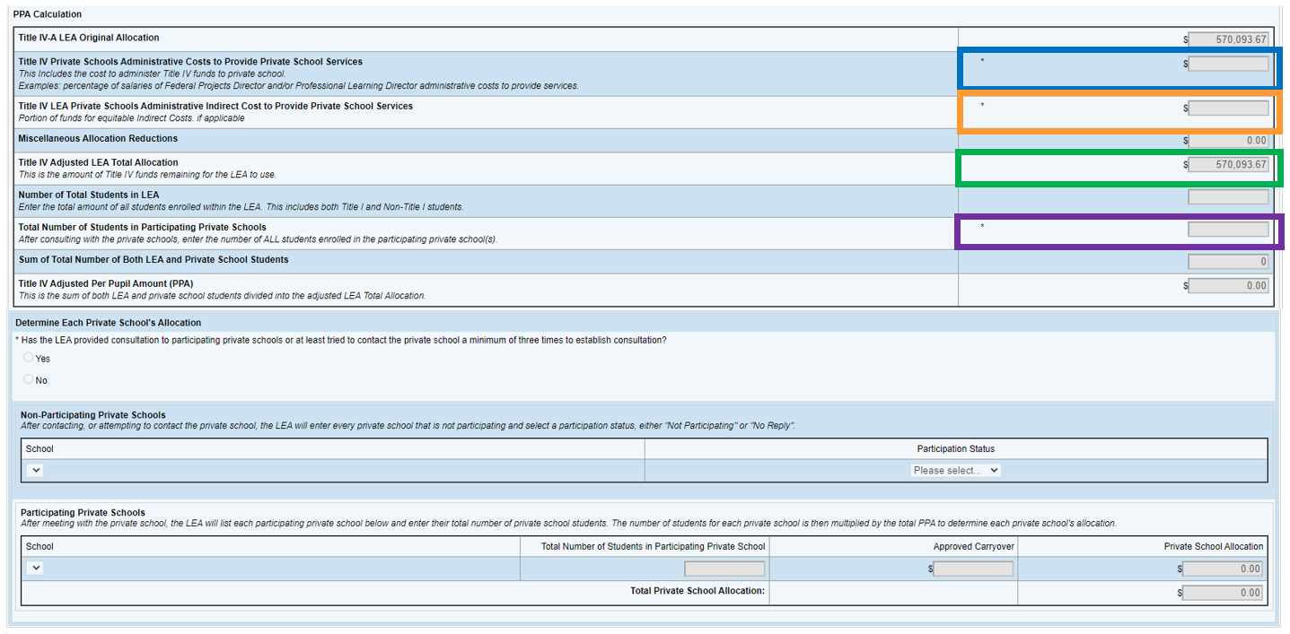
Title IV-A Eligible Private School Service Page
Enter any Optional Administrative Costs
2% cap of the Title IV Adjusted LEA Total Allocation for administrative costs
Overseeing private school service, postage costs for certified letters
Enter any Optional Indirect Cost – LEA’s approved indirect cost rate
Number of students auto fills
Add the Total Number of Private School Enrollment = the sum enrollment for all participating private schools
Check Yes to confirm consultations have occurred or been attempted
Enter ONLY In-District schools listed on the Private School Administration page
Select the reason for all non-participating schools
Enter the total enrollment for each participating private school
Allocations will auto calculate
Every school listed on the Private School Administration page
Participation status matches each NIP
Notes:
The Title IV-A Eligible Private School Service page is almost identical to the Title II-A Eligible Private School Service page
First, enter any Optional Administrative Costs – must be necessary and reasonable
TIV-A has a 2% cap of the Title IV Adjusted LEA Total Allocation for administrative costs
Overseeing private school service or postage for certified letters
Next, enter any Optional Indirect Cost – this amount may NOT be more than the LEA’s approved indirect cost rate
Just like Title I and II, this must be labeled as Private School Indirect Cost in 6910 of the budget narrative
LEA Indirect Cost + PS Indirect Cost = max indirect cost/Line-Item Total in 6910
The number of students in the LEA auto populates from the Title I School Eligibility page
Add the Total Number of Private School Enrollment which = the sum of the total enrollment for all participating private schools
Check Yes to confirm consultations have occurred or been attempted
Use the drop-down arrows to add ONLY In-District schools that are listed on the Private School Administration page
For all non-participating schools, use the drop-down arrow to select the reason
Enter the total enrollment for each participating private school
The private school allocation will auto calculate
Verify that each school listed on the Private School Administration page with an In-District Status is listed
Verify each school’s participation status matches what is written on their NIP
Add each private school’s allocation to the LEA’s contributory budget spreadsheet

Slide 16
Equitable service activities must be detailed under the appropriate program type
Based on ongoing consultations
Program Narrative Questions
Notes:
Next, complete the Title IV Program Narrative Questions page
Equitable service activities must be detailed under the appropriate program type
Sections pertaining to private schools should be discussed and determined as part of the ongoing consultations

Slide 17
Separate activities by program type
20-20 rule
LEA’s budget as a whole
Title IV-A Allocation Worksheet
Notes:
The last page other than the budget narrative in Title IV is the Allocation Worksheet
Equitable service activities must be separated by program type
Private school portions do not need to adhere to the 20-20 rule separately
Their activities will be included in the LEA’s budget as a whole

Slide 18
Title I-A, II-A, IV-A Budget Narratives
All activities must be clearly labeled
Title I – Set Aside 3a, Set Aside 3b
Title I – 3c, 3d, and 3e add private school’s name
Title II – private school name
Title IV – private school name + program type
Brief description of the service/activity
Service provider
Title I –supplies alone are not allowed
Title I – targeted/not be school-wide
cost/student x the number of licenses for eligible students
Budget narrative totals must = Eligible Private School Service page
Notes:
The budget narratives are the basically the same in each grant
All activities must be clearly labeled
Title I – label Set Aside 3a and Set Aside 3b as is
Title I – label Set Asides 3c, 3d, and 3e with the letter, number and the private school’s name
Title II – label with private school’s name
Title IV – label with the private school’s name + Well Rounded, Safe & Healthy, and/or Technology
All activities must include a brief description of the service or activity
All activities must include the service provider
Title I – supplies may not be purchased without being tied to instruction (supplies alone are not allowed)
Title I – programs must be targeted for eligible students and may not be school-wide
May not purchase programs school-wide – must be broken out by cost/student and may only fund the number of licenses for eligible participating students who have an academic need
Budget narrative totals must = amounts listed for each private school on the respective Eligible Private School Service pages

Slide 19
Title I, II, IV LEA Integrated Action Plan
LIAP
Align with budget narratives
Private School program tag
Appropriate funding tag(s)
Title IV-A - appropriate program type tag(s)
May be combined
Notes:
Equitable service funds are all district level funds
Therefore, all activities for private school equitable services must have action steps in the LIAP
Descriptions must align with the budget narratives
Must include the Private School program tag
Must include the appropriate funding tag
Title IV-A action steps must also include the appropriate program type tag
which includes well rounded, safe and healthy, and/or technology
All activities may be combined in one or two action steps if all the above components are present

Slide 20
Guidance, Training, Resources:
https://www.azed.gov/titlei/privateschools
Tiffiany Morse tiffiany.morse@azed.gov
602-542-7466
Notes:
Reminder to please bookmark the equitable services webpage and check it often
Use links rather than printing hardcopies to ensure you are using the most current revision
Please reach out any time!
All feedback is ALWAYS welcome!

