Slide 1
Friday focus: Test irregularities
This webinar will be recorded and posted on the ADE Assessments webpage at https://www.azed.gov/assessment.
Please enter your First and Last Name in the Chat for tracking purposes for the live event.
We will also be capturing the chat questions. ADE will compile and create a FAQ list which will then be posted on our website. The FAQ will only include those questions that are relevant to the webinar topic. ADE will follow up with any other questions via e-mail.

Slide 2
Friday Focus webinar #8
Reducing Test Irregularities

Slide 3
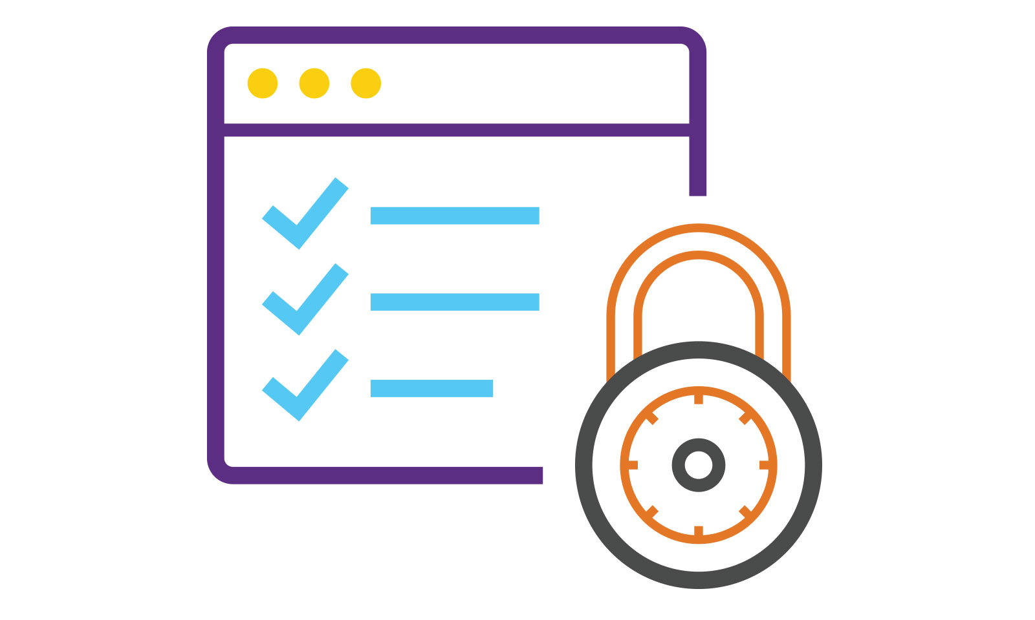
Overview
Test Security
Standardized Assessments
Did You Know…..
2021-2022 Test Irregularities
This Photo by Unknown Author is licensed under CC BY-SA

Slide 4
Standardized Assessments
Examples of Standardized Assessments: NAEP, AASA, MSAA
The tests are administered in the same or similar manner as possible
Training for all District Test Coordinators or for All Test Administrators
Longitudinal Data and Trends
This is why the data from the Pandemic has been scrutinized and flagged with cautions and why ADE tried to have reasonable flexibilities without going so far that the data or results could not be interpreted in the same ways

Slide 5
Test Security
Important component of Statewide Assessments
This is why we track Test Irregularities
Item Level – costly
Test Level - costly (Accountability)
Personally Identifiable Information
Only send us SSID numbers
Technology is “locked down”
Applications (external programs) running when TestNav launches

Slide 6
Kinds of Test Irregularities
Will most likely not be invalidated:
Started test but technology prohibited reentering test to complete during same day
Leaving motivational posters up in classroom
Students do math worksheet after completing the reading unit
Will be invalidated:
Cheating by adults or students
Students using cell phone or having cell phone out
Providing a non-allowable accommodation
Reading the Reading Test (passages)
Taking photo or tik-toks during test administration
All need to be documented but some will result in an invalidation of a test or tests
We appreciate the seriousness our District Test Coordinators take in reporting and investigating
We get reports from DTCs, parents (whose children went home and shared what happened)
We investigate any and all reports to ADE- including anonymous reports

Slide 7
How to avoid test irregularities
Ensure
Participation in The Test Security & Ethics module is to be completed by all staff (including for ACT and ACT Aspire as well as AASA and AzSCI)
Participation in The Test Administration Responsibilities module is to be completed by all staff for AASA and AzSCI
Have a plan to monitor during test administration

Slide 8
Process for Reporting Test Irregularities
Monitor test administrations
Keep materials under lock and key
Test tickets
Cell phones (for students and adults)
Contact ADE Assessment Email Inboxes
Specific to the test/program (e.g., Test Irregularity for AzSCI- email the AzSCI inbox, Test Irregularity for ACT or ACT Aspire email Testing Inbox)
Submit in PAN
For AASA and AZSCI and ACT Aspire. ADE will follow up with next steps
Submit in PAN for ACT for online testing and paper irregularity report form for paper testing
See Test Coordinator Manual Spr 23 pages 14-16 of document

Slide 9
Data from Test Irregularities AASA
1001: Connectivity issues. Specific error message from Pearson
1009: Unable to download test content
1021: Pearson server connectivity lost
Frozen TestNav: The test itself froze and student was unable to take test
Kicked Out: Student was kicked out of TestNav. Test needed to be Resumed
Lag: Students experienced extended wait times
Timed Out: TestNav working too long caused a time out of the session
UNK Comp Issue: Computer experienced an issue preventing testing. Site related
UNK Error Msg: TestNav had an error but error code was not reported. TestNav related

Slide 10
Data from Test Irregularities AzSCI
1001: Connectivity issues. Specific error message from Pearson
1009: Unable to download test content
1021: Pearson server connectivity lost
Frozen TestNav: The test itself froze and student was unable to take test
Kicked Out: Student was kicked out of TestNav. Test needed to be Resumed
Lag: Students experienced extended wait times
Timed Out: TestNav working too long caused a time out of the session
UNK Comp Issue: Computer experienced an issue preventing testing. Site related
UNK Error Msg: TestNav had an error but error code was not reported. TestNav related

Slide 11
Test Irregularities AASA- Invalidations
There were 1,196 Do not Report/Invalidated Tests for ELA and Mathematics in Grades 3-8
There were 119 Do not Report/Invalidated Tests for Science in Grades 5, 8 and 11
There were 1,447 Do not Report/Invalidated Tests for ACT Aspire in Grade 9
There were 144 Do not Report/Invalidated Tests for ACT in Grade 11
Examples: Going to lunch in middle of test, cell phones/electronics, posters, or materials displayed in classrooms, use of calculator in non calculator section.

Slide 12
Questions?

Slide 13
THANK YOU!
For questions, please contact us at:
Testing@azed.gov

