Slide 1
Notes:
Narration: Welcome to the Alternate English Language Proficiency Assessment, known as the Alt ELPA. The Alt ELPA is an English language proficiency assessment created by the Collaborative for the Alternate Assessment of English Language Proficiency (CAAELP). The assessment was designed specifically for English learners with the most significant cognitive disabilities who do not participate in general assessments. The Alt ELPA measures students' progress toward the attainment of English language proficiency in four language domains (listening, reading, speaking, and writing). The purpose of the assessment is to meet requirements for reporting student achievement of English language proficiency under the Every Student Succeeds Act (ESSA). Test results also identify students in need of English language services and allow schools and teachers to appropriately support the students’ English language needs.

Slide 2
Alternate English Language Proficiency Assessment (Alt ELPA)
Pre-Administration Tasks
© 2022 Iowa Department of Education. Contact CRESST at UCLA for permission to use this work.
Notes:
Narrator: In this video you will learn about the 6 important pre-administration tasks of the Alt ELPA assessment. The Alt ELPA is administered online to students using the Cambium Online Assessment System. Prior to administering any items, the Test Administrator must complete several pre-administration tasks that are also thoroughly described in the online self-paced Test Administrator training.

Slide 3
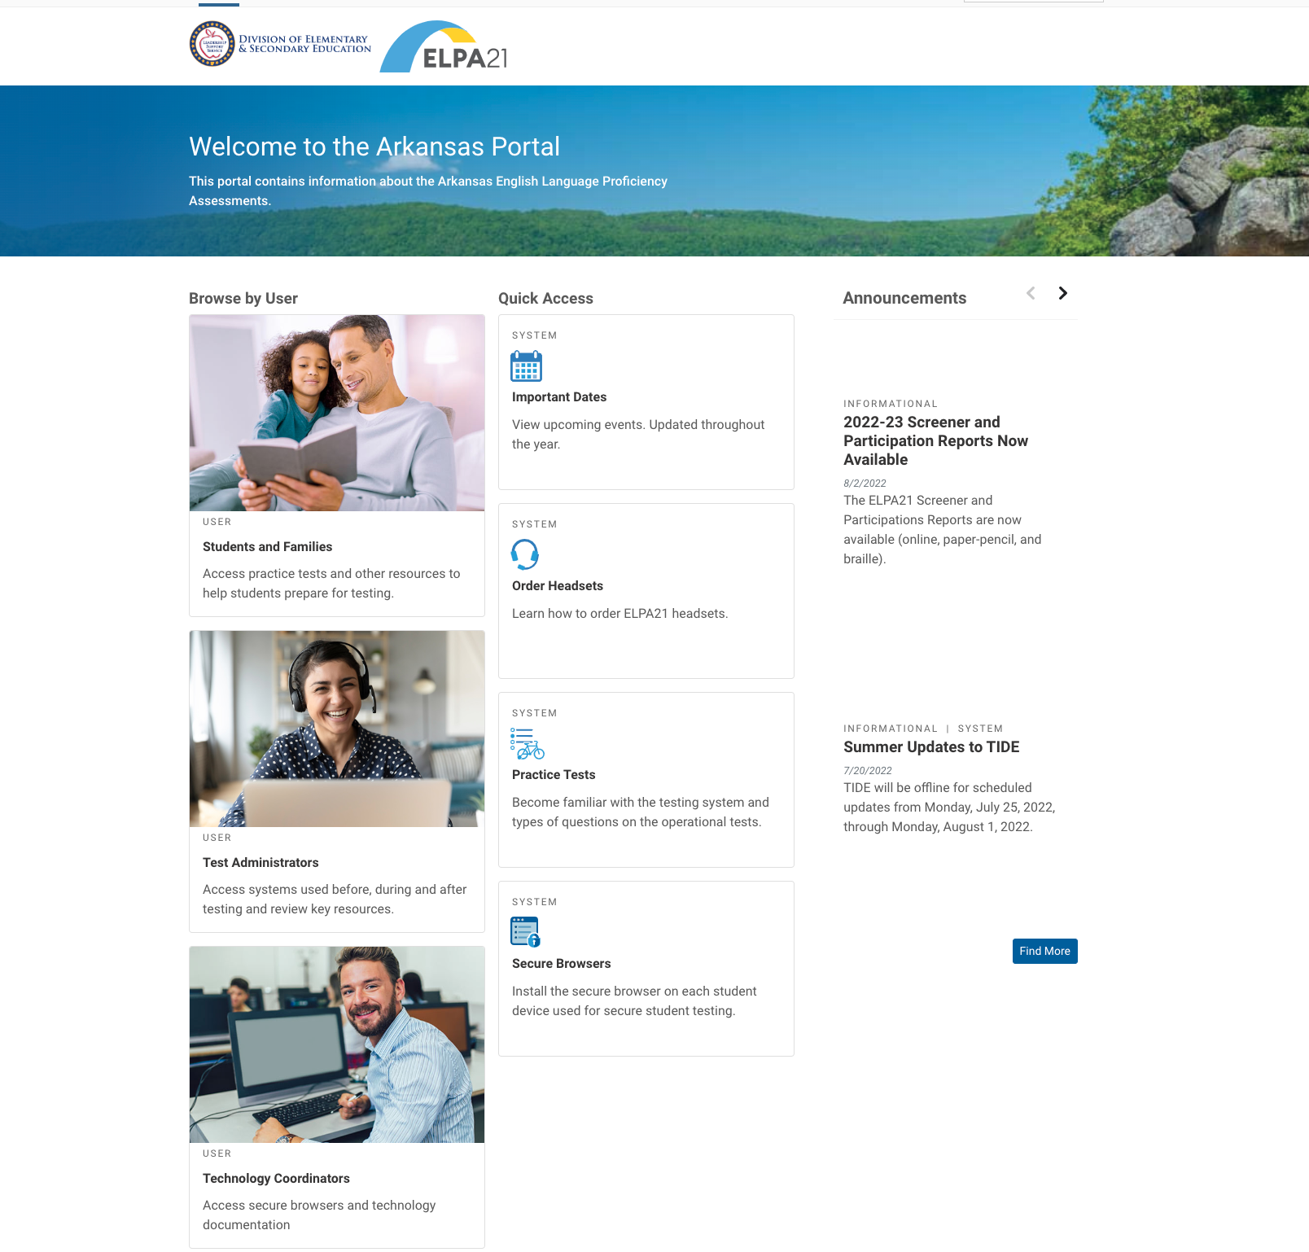
The Alt ELPA Online Assessment System Home Page
© 2022 Iowa Department of Education.
Contact CRESST at UCLA for permission to use this work.
Notes:
Narrator: Here is a screenshot of the Online Assessment System home page that includes all the information related to the Alt ELPA. Each state's home page has three sections of important information for students and families, Test Administrators, and Technology Coordinators. This slide shows a screenshot of the Arkansas portal. Each state has their own portal that aligns with their state’s testing needs and regulations. Throughout this presentation we will provide examples of the Arkansas testing portal. Refer to the speaker notes for links to all the states’ testing portals.
Resources:
Link to the Arkansas testing portal: https://ar.portal.cambiumast.com/
Link to the Arizona testing portal: https://az.portal.cambiumast.com/
Link to the Connecticut testing portal: https://ct.portal.cambiumast.com/
Link to the Iowa testing portal: https://iowaelpa21.portal.cambiumast.com/
Link to the Louisiana testing portal: https://la.portal.cambiumast.com/
Link to the Nebraska testing portal: https://ne.portal.cambiumast.com/
Link to the Ohio testing portal: https://oh-oelpa.portal.cambiumast.com/
Link to the Oregon testing portal: https://osasportal.org/
Link to the West Virginia testing portal: https://wv.portal.cambiumast.com/index.html

Slide 4
Six Pre-Administration Tasks
Notes:
Narrator: Now we will describe the six important Alt ELPA pre-administration tasks. Online administration is considered the standard administration for the Alt ELPA assessment.

Slide 5
Pre-Administration Tasks
Six pre-administration tasks that every Test Administrator must complete prior to administering the Alt ELPA Operational Field test:
Complete the online self-paced LMS Test Administrator or the Test Coordinator training
Review the Alt ELPA Test Administration Manual (TAM)
Review the Alt ELPA Accessibility and Accommodations Manual
Review the Cambium Test Administrator User Guide
Review the Cambium Assistive Technology Manual
Review the Test Administrator Directions and Scoring Rubrics Booklet process
Notes:
Narrator: Here is the list of the six pre-administration tasks. We will go through each individually.
(pause 5 secs)

Slide 7
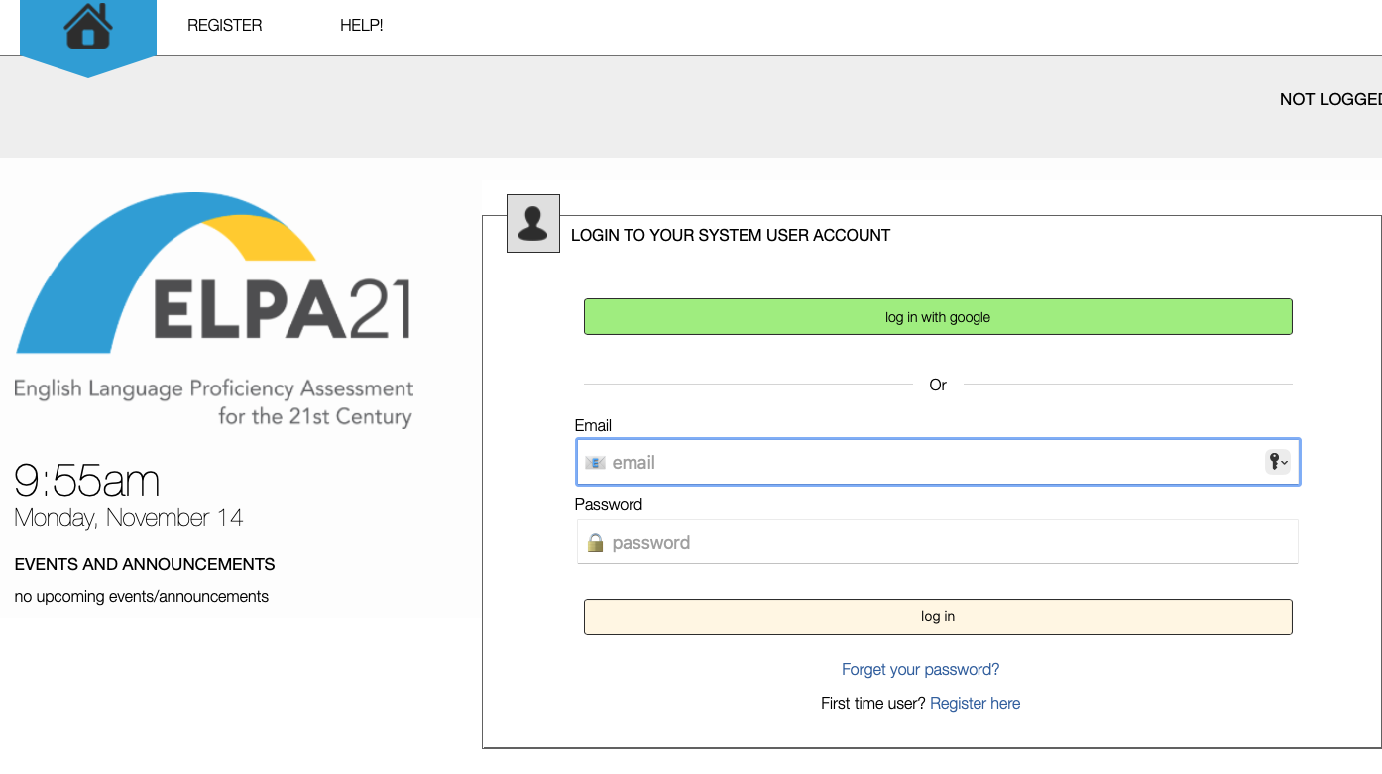
1. Complete the online self-paced LMS Test Administrator and Test Coordinator Training
Located on the ELPA21 training platform
Free to access
Test Administrator module: approx. 90 mins to complete
Test Coordinator module: approx. 60 mins to complete
Stop and return anytime
Notes:
Narrator: Test Administrators and Test Coordinators are highly encouraged to complete the online self-paced training modules. Refer to the speaker notes for a link to the ELPA21 Test Administrator Training System and links to documents describing how to login to the ELPA21 Training System. The Alt ELPA Test Administrator Manual also describes how to access the training site in the section “User Support”.
Resources:
Link to ELPA21Test Administrator Training System, Test Administrator/Technology Coordinator module: https://training.elpa21.org/index_login.php
Links to the directions on how to access the LMS modules.
Link to directions on how to login to the ELPA21 Training System using non-Google sign-in: https://ucla.box.com/s/x1soc02sgalrqhuekgtrpud0t7eal12k
Link to directions on how to login to the ELPA21 Training System using Google sign-in: https://ucla.box.com/s/8mot6164ozwsiqksqbpa3simxtr8371x

Slide 8
2. Review the Alt ELPA Test Administration Manual
State-specific
Located in each state’s testing portal under “Resources”
Not secure—download or print
Recycle when done
Notes:
Narrator: Test Administrators should review all the information described in the Test Administration Manual to ensure they have the necessary knowledge and training to appropriately administer the assessment for the student. The Alt ELPA Test Administration Manual is state-specific and can be found on each state’s testing portal.

Slide 9
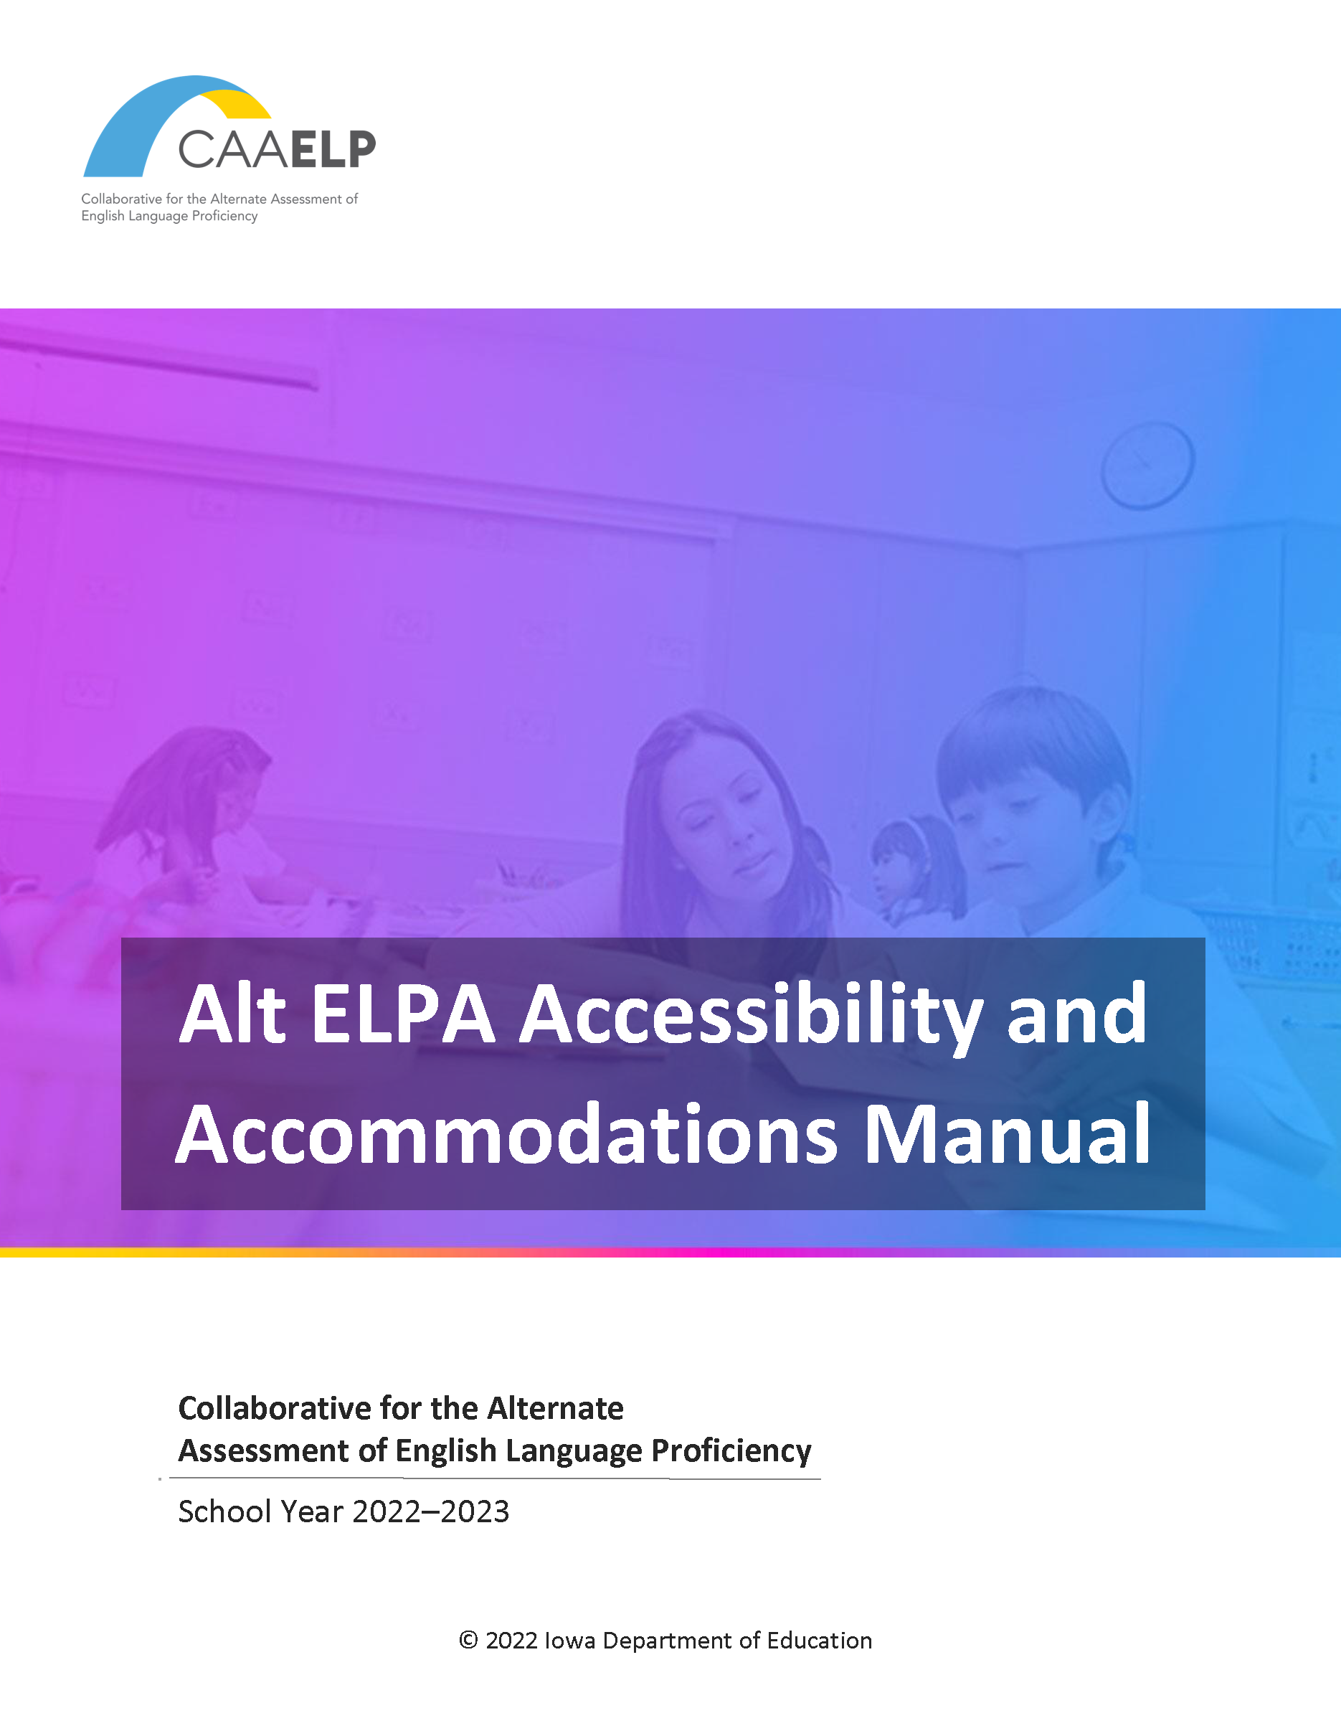
3. Review the Alt ELPA Accessibility & Accommodations Manual
State-specific
Located in each state’s testing portal under “Resources”
Not secure—download or print
Recycle when done
Notes:
Narrator: This manual describes the Alt ELPA Universal Features, Designated Supports and Accommodations. These supports should be based on the individual needs of your student, used routinely during instruction, and documented in the student’s IEP. Some features are embedded in the Alt ELPA online assessment system and others are provided by the Test Administrator. The test administrators should customize the student’s test settings according to their unique testing needs. The Alt ELPA Test Administration Manual can be found on each state’s testing portal.
Resources:
AR AA Manual: https://ar.portal.cambiumast.com/resources/test-administrators/alt-elpa-accessibility-and-accommodations-manual

Slide 10
Complete the Personal Needs Profile Planning Tool
Located in the Alt ELPA Accessibility and Accommodations Manual
Appendix E
Not secure—print one per student
Destroy when done per state policies
Notes:
Narrator: Here you are seeing the Personal Needs Profile Planning Tool form. Test Administrators are encouraged to print out one form for each student that will be tested. This form is used to list all the supports and accommodations that the student needs during the assessment. Since the test should be administered by someone the student is familiar with, that individual will know what accommodations, accessibility features, and extra support the student requires. The Personal Needs Profile Planning form is included in the Alt ELPA Accessibility and Accommodations Manual which is available on each state’s online testing portal.
Resources:
AR Accessibility and Accommodations Manual: https://ar.portal.cambiumast.com/resources/test-administrators/alt-elpa-accessibility-and-accommodations-manual

Slide 11
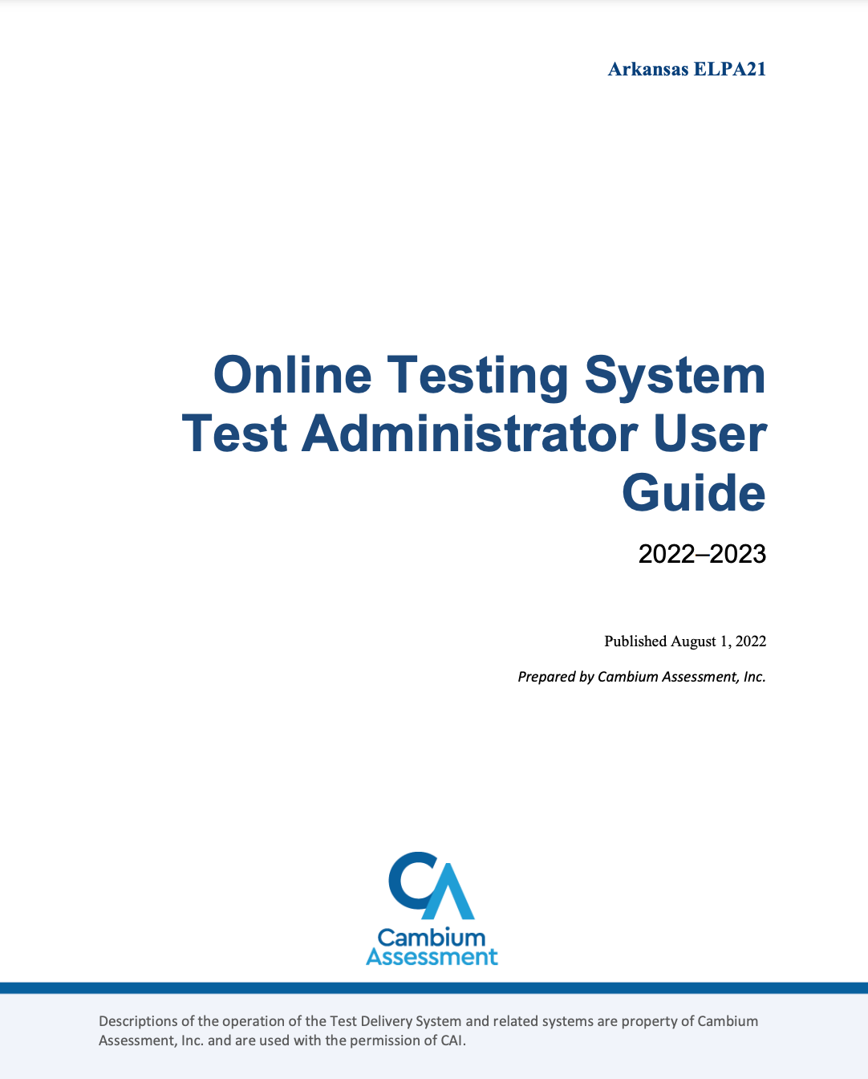
4. Review the Cambium Test Administrator User Guide
Located in each state’s testing portal under “Resources”
Not secure—download or print
Recycle when done
Notes:
Narrator: This slide shows the Cambium Test Administrator User Guide. The Cambium Test Administrator User Guide describes information such as how Test Administrators proctor test sessions in the Test Administrator Site and how students sign into the student testing site and complete tasks. The Cambium Test Administrator User Guide can be found in each participating state’s online testing portal. Here we have an example of the Arkansas Cambium Test Administrator User Guide. Refer to the speaker notes for a link to the Arkansas Cambium Test Administrator User Guide.
Resources:
AR Portal: https://ar.portal.cambiumast.com/resources/test-administrators/arkansas-elpa21-ta-user-guide
(same user guide for ELPA21 and Alt ELPA!)

Slide 12
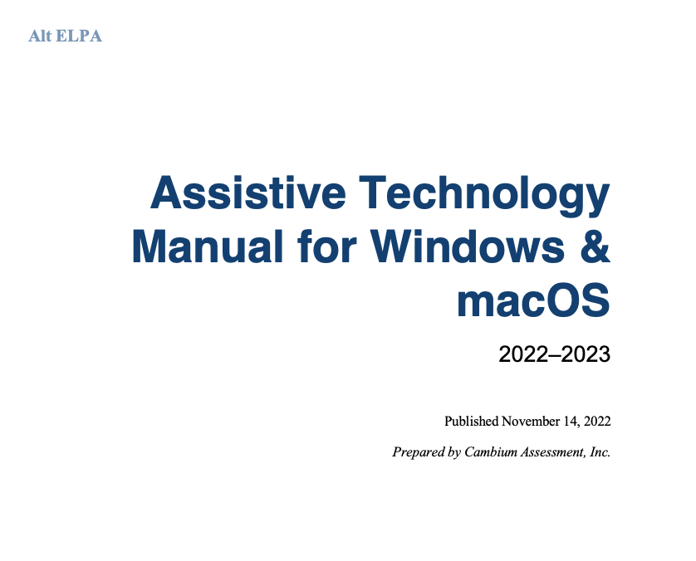
5. Review the Assistive Technology Manual
Located in each state’s testing portal under “Resources”
Not secure—download or print
Recycle when done
Notes:
Narrator: This slide shows the Assistive Technology Manual which specifically geared towards Test Coordinators. This manual is available on each state portal under the ”Resources" tab. "This manual provides an overview of the embedded and non-embedded assistive technology tools that can be used to help students with accessibility needs, complete Alt ELPA online tests in the Test Delivery System (TDS). It includes lists of supported devices and applications for each type of assistive technology that students may need, as well as setup instructions for the assistive technologies that require additional configuration in order to work with the online Test Delivery System.
Resources:
Iowa’s testing portal: https://iowaelpa21.portal.cambiumast.com/resources/technical-information/alt-elpa-assistive-technology-manual

Slide 13
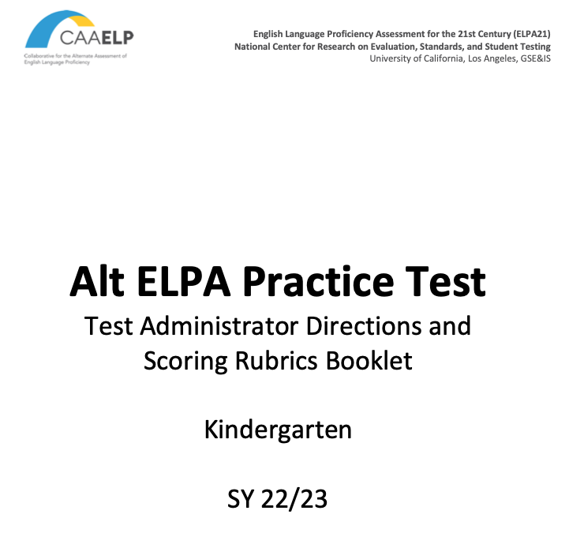
6. Test Administrator Directions and Scoring Rubrics Booklets
Two sets of Test Administrator Directions and Scoring Rubrics Booklets
A. For the Alt ELPA Practice Tests:
Located in each state’s testing portal under “Resources”
Not state-specific
One per grade/grade band
Not secure—downloadable
Recycle when done
Notes:
Narrator: Every Alt ELPA test question has item specific test administer directions which are located in the grade-specific Test Administrator Directions and Scoring Rubrics Booklets. Those item-specific directions do not display online for the student. For the practice test these booklets can be found in the state testing portal. The Alt ELPA requires that the Test Administrator has an additional electronic device available while practicing with the student. The grade-specific booklet has to be displayed on the Test Administrators’ screen, while assisting the student through the practice test.
Resources:
AR Portal practice test- test administer directions booklets: https://ar.portal.cambiumast.com/resources/test-administrators/alt-elpa-pt-test-administrator-directions

Slide 14
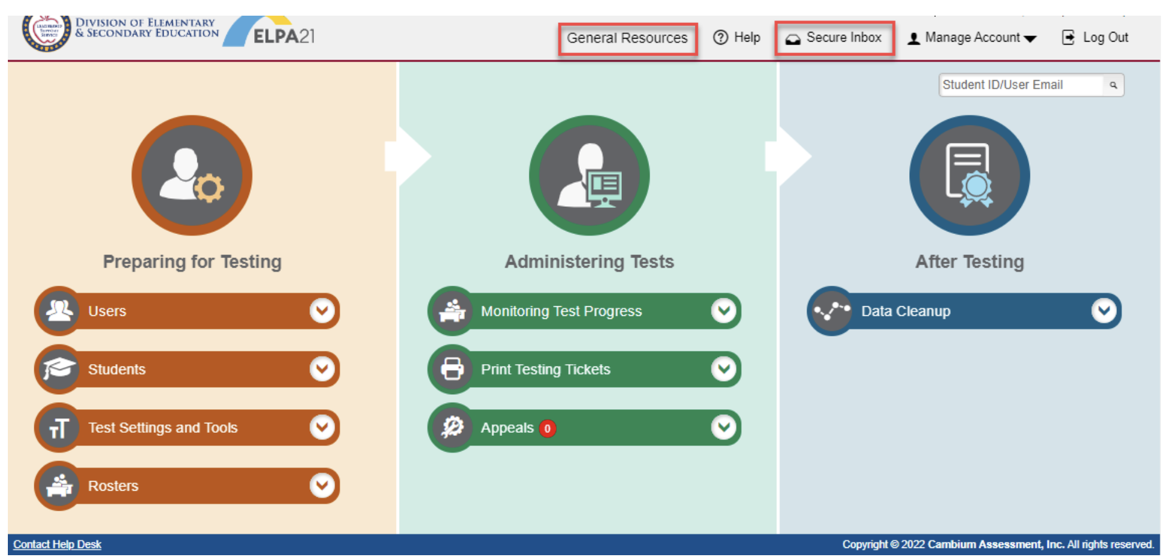
6. Test Administrator Directions and Scoring Rubrics Booklets
SECURE
B. For the Alt ELPA Operational Field Test:
ONLY accessible through the secure Cambium TIDE portal
Not state-specific
Four booklets per grade/grade band (one per domain: listening, reading, writing, and speaking)
Highly secure
Downloadable for testing (immediately delete off computer when testing is done and empty computer trash)
Notes:
Narrator: Again, every Alt ELPA test question has item-specific test administer directions which are located in the Test Administrator Directions and Scoring Rubrics Booklets. These item-specific directions do not display online for the student. For the operational field test, these booklets can be found in the Test Information Distribution Engine (TIDE) system only. Once the live test has been started for the student, a message will appear on the student’s screen indicating which test version the student has been assigned: A, B, C, or D. The Test Administrators’ must then proceed to login into their TIDE account, search under “General Resources” or under “Secure Inbox”, depending on the state, and locate the correct Test Administrator Directions and Scoring Rubrics Booklet. This process of locating the correct Test Administrator Directions and Scoring Rubrics Booklet has to be repeated for each domain test. The Alt ELPA requires that the Test Administrator has an additional electronic device available while testing the student. The booklet has to be displayed on the Test Administrator’s electronic device, while assisting the student through the operational field test. Each booklet contains instructions in the front pages, explaining how to use the booklet.

Slide 15
Thank you!
Visit our Website: altelpa.org
Notes:
Narrator: Thank you for watching this video about the Alt ELPA pre-administration tasks. We appreciate your time and dedication to your students. In case of any test administration questions, please contact your state's testing coordinator. You may find your state's testing coordinator's contact information on your ELPA21 online testing portal.
To find out more about the Alt ELPA project, please visit our website at https://altelpa.org or email us at info@altelpa.org.
Resources: Link to each state portal
Link to the Arkansas testing portal: https://ar.portal.cambiumast.com/
Link to the Arizona testing portal: https://az.portal.cambiumast.com/
Link to the Connecticut testing portal: https://ct.portal.cambiumast.com/
Link to the Iowa testing portal: https://iowaelpa21.portal.cambiumast.com/
Link to the Louisiana testing portal: https://la.portal.cambiumast.com/
Link to the Nebraska testing portal: https://ne.portal.cambiumast.com/
Link to the Ohio testing portal: https://oh-oelpa.portal.cambiumast.com/
Link to the Oregon testing portal: https://osasportal.org/
Link to the West Virginia testing portal: https://wv.portal.cambiumast.com/index.html

