Slide 1
GPEMC Meeting Update
ADE School Finance
10/28/2022
Notes:
This is a title page – please do not use for bulleted content

Slide 2
Agenda
FY 2023 ADM
Group B Weights
Aggregate Expenditure Limit
Annual Financial Reports
Use of data in new School Financial Transparency Portal
Other Updates

Slide 3
Average Daily Membership Update
ADE SCHOOL FINANCE
SECTION 1
Notes:
This is a title page – please do not use for bulleted content

Slide 4
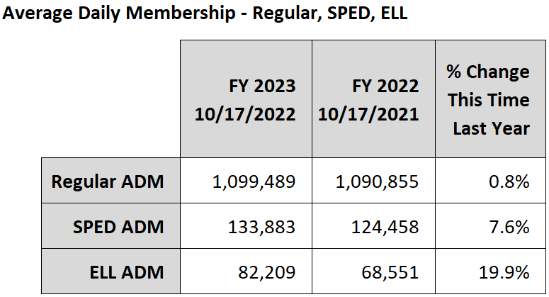
ADM Update

Slide 5
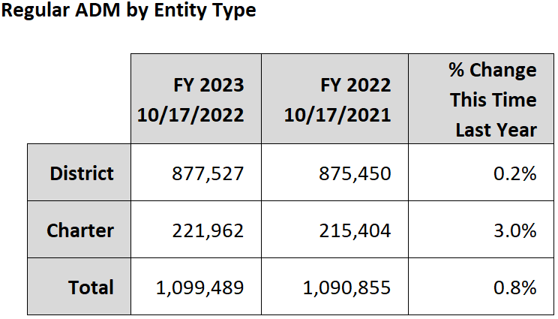
ADM Update

Slide 6
Group B Weights
ADE SCHOOL FINANCE
SECTION 2
Notes:
This is a title page – please do not use for bulleted content

Slide 7
Gifted Group B Weight
Group B weight funding for gifted students will be calculated manually for FY 2023
Same process as for FY 2022
Funding will appear as an adjustment to the base support level in BSA 55 Reports
Calculation will be published on the School Finance website
GIFT11 report shows students reported with a qualifying need; ADM15 report shows ADM generated by students

Slide 8
FRPL Group B Weight
Funding for this weight will be calculated manually for FY 2023
Similar process to Gifted
FRPL weight is 0.018, which is about $86 per eligible student
The SUPP72 report in AzEDS shows students for which a qualifying need has been reported; ADM15 report shows ADM generated by students

Slide 9
Results-Based Funding
ADE SCHOOL FINANCE
SECTION 3
Notes:
This is a title page – please do not use for bulleted content

Slide 10
Results-Based Funding
FY 2023 awards will be based on FY 2021 assessment results and poverty measures
Current-year student counts for charters; prior-year for districts
Based on the percentage of students passing FY 2021 state assessments
Payments will be made in November and May

Slide 11
Results-Based Funding
$400 per student count
Top 13% of 60%+ FRL schools
$225 per student count
Top 27% of 60%+ FRL schools
Top 13% of all schools

Slide 12
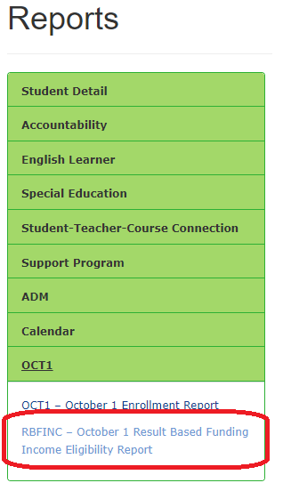
Results-Based Funding - RBFINC Report
New student-level report in AzEDS details the calculation of % eligible for free or reduced-price lunch
RBFINC report can be accessed from the October 1 menu

Slide 13
Aggregate Expenditure Limit
ADE SCHOOL FINANCE
SECTION 4
Notes:
This is a title page – please do not use for bulleted content

Slide 14
Aggregate Expenditure Limit
Article 9, Section 21 of the Arizona Constitution defines the expenditure limitation for school districts
The Economic Estimates Commission calculates the limit
School Finance calculates statewide expenditures subject to the limit
If budgeted expenditures exceed the limit, legislature may approve or school districts are required to reduce budgets

Slide 15
School Finance Calculation
BUDG-AGD reports extract certain values from budget files submitted by school districts based on the definition of expenditures subject to the limit
Expenditures in most school district funds are excluded
Several specific items within otherwise included funds are also excluded
Adjustments are made for items that are not possible to separate from district budgets
Individual district numbers roll up to the statewide calculation

Slide 16
FY 2023 BUDG-AGD Reports
BUDG-AGD reports showing the FY 2023 calculation for each district will be published on Tuesday (11/1)
Reports will list at risk budgeted expenditures for each district
Legislature may approve expenditures in excess of the limit by March 1st
If the Legislature fails to authorize excess expenditures, districts will be notified of required reductions by March 5th

Slide 17
Annual Financial Reports
ADE SCHOOL FINANCE
SECTION 5
Notes:
This is a title page – please do not use for bulleted content

Slide 18
Annual Financial Reports / Financial Data
Deadline to submit Annual Financial Reports was 10/15
It is possible to correct errors through the prior-year data correction process (ARS 15-915) or by simply uploading new files (if no change to actual expenditures or state aid)
Data from the AFR will be used in the new School Financial Transparency Portal being developed by the Arizona Department of Administration
Additionally, certain data will still appear in School Report Cards and has been requested for use in third-party websites

Slide 19
School Financial Transparency Portal
ARS 15-747 requires the Arizona Department of Administration to develop a school financial transparency portal and specifies requirements
Requirements were largely moved from School Reports Cards by Laws 2021, Chapter 404
School Report Cards will now include a link to the new portal
ARS 15-747 requires ADE to provide data and financial information to ADOA and the contractor for the portal

Slide 20
School Financial Transparency Portal
ADE has supported development of the portal by providing access to download AFR files and data extracts from school finance payment and budget systems
ADE has provided feedback on implementation
Our strongest suggestion was that all data/calculations be transparent to districts/charters
ADOA is conducting outreach to districts, charters and other stakeholders

Slide 21
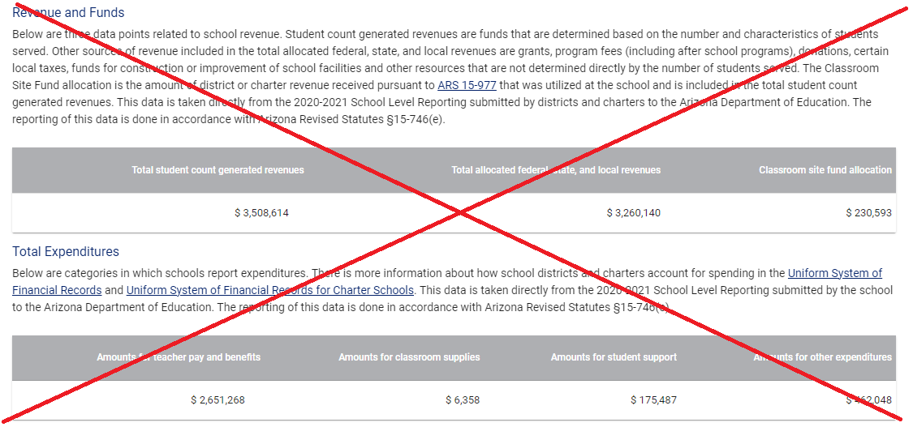
Changes to School Report Cards
Data points that moved to the new portal will be removed and replaced by a link to the portal

Slide 22
Changes to School Report Cards
Per pupil spending from federal and state/local funds will remain

Slide 23
Other Updates
ADE SCHOOL FINANCE
SECTION 6
Notes:
This is a title page – please do not use for bulleted content

Slide 24
Other Updates
BUDG25 reports for FY 2023 are now available
Compares district’s current-year budget to ADE calculations
BUDG25 letters notifying of required revisions will be published soon
BUDG75 reports will be published in the next two weeks
Compares prior-year budget/AFR to ADE calculations
Once the BUDG75 has been published, certain values in the current-year BUDG25 will begin to display data from the AFR

Slide 25
Other Updates
Submission reports are available on School Finance website
School District Employee Report (SDER) data is now published at schoolfinancereports.azed.gov
SDER 96 – Teacher Experience Index (TEI)
Revisions are possible February 1st through March 1st
School District Employee Report Manual and Training Video
https://www.azed.gov/finance/instruction-manuals
https://www.azed.gov/finance/training-videos

Slide 26
Other Updates
SFOB Attending Average Daily Membership Report
New report added to the School Finance website after the published data capture date each month
Public copy of the school-level student counts provided to the School Facilities Oversight Board (SFOB)
Created based on feedback from GPEMC and discussions with SFOB in the spring

Slide 27
Charlie Martin, Deputy Associate Superintendent Charlie.Martin@AZED.gov (602) 542-8026
Thank You

