Slide 1
Friday focus: azella tests aligned to the 2019 elp standards
This webinar will be recorded and posted on the ADE Assessments webpage at https://www.azed.gov/assessment.
Please enter your First and Last Name in the Chat for tracking purposes for the live event.
We will also be capturing the chat questions. ADE will compile and create a FAQ list which will then be posted on our website. The FAQ will only include those questions that are relevant to the webinar topic. ADE will follow up with any other questions via e-mail.
Notes:
Please be sure to enter your first and last name in the chat for tracking purposes for this live event.

Slide 2
Friday Focus webinar #6
AZElla tests aligned to the 2019 English language proficiency standards
Notes:
Thank you for joining us today. This webinar of the Assessments series is dedicated to the new AZELLA Tests. My name is Gabriela Finn and I am the Director of English Language Assessments and oversee the development of the AZELLA tests.
Most of the information that I will presenting today was included in the breakout session that we presented at the Assessments Conference in September, but we wanted to make sure that those who didn’t attend the Conference would receive this important information. We understand that you are anxious to learn and ask questions about the new AZELLA Tests that will be administer during the Spring 2023 Reassessment test window. There is a lot of information to cover today, but we will try to leave time at the end of the presentation to answer as many questions as possible. Please enter your questions into the chat. We will create and post a Frequently Asked Questions document and if your question is not answered today, we will respond to it in the FAQ.

Slide 3
Friday focus: azella tests aligned to the 2019 elps
The purpose of this webinar is to provide an overview of the new Arizona's English Language Proficiency (ELP) Assessment, AZELLA, aligned to the Arizona 2019 ELP Standards.
During this presentation, we will highlight the new test design, new item types, new Sample Tests, and the new Writing and Speaking rubrics.
Notes:
During today’s webinar we will provide an overview of the AZELLA aligned to the 2019 English Language Proficiency Standards and highlight the test design, new item types, the Sample Tests, and new Speaking and Writing rubrics.

Slide 4
Friday focus: azella tests aligned to the 2019 elps
New AZELLA Tests Timeline
Grade Configuration and Modes of Administration
Test Design by Grade
Test Units
New Item Types
Domains Assessed
How to Use the New AZELLA Sample Tests
Notes:
These are the specific topics we will discuss today, which include a timeline of the new test, the grade configuration aligned to the 2019 ELP Standards along with the modes of administration for each grade or grade brand, the test units and domains assessed in each unit, as well as the item types. Finally, we will briefly discuss the use of the new AZELLA Sample Test to help students be better prepared for the new test.

Slide 5
AZELLA aligned to the 2019 ELP Standards Timeline
2022–2023
SY 2022-2023 Placement Test –no changes
Spring 2023
Spring 2023 Reassessment
New AZELLA
2023–2024
SY 2023-2024 New Placement test
May - June 2023*
Standard Setting
July - August 2023*
Spring 2023 AZELLA Electronic Reports to Districts & Paper Reports to Districts
Fall 2023
Performance Level Descriptors, Item Specifications, and Scoring Rubrics are posted
*Exact dates TBD
Notes:
As you probably know, for the current school year, there are no changes to the Placement Test.
The first administration of the new AZELLA tests will take place during the Spring 2023 Reassessment administration. The Spring 2023 Reassessment test window opens on January 30 and closes on March 17, 2023.
Standard Setting Activities that include committees of Arizona educators are projected for late May and early June, but exact dates are still being determined.
The electronic and paper reports will be available later than usual due to Standard Setting, which only is done after a statewide test aligned to new standards is administered for the first time. ADE will communicate the exact dates to districts as soon as they become available.
Item specifications, PLDs, and Scoring Rubrics will be posted in the fall of 2023.
Finally, the new AZELLA Placement tests for Grades 1 – 12 will be administered starting in the fall of school year 2023 – 2024.

Slide 6
Grade Configuration and Modes of Administration
New AZELLA Tests
Notes:
Because AZELLA is a standards-based assessment, it must adhere and reflect the grade configuration of the 2019 ELP Standards.

Slide 7
Grade(s) | Mode of Administration
Kindergarten | Paper and Pencil Unit 5 (Speaking) administered on the phone
Grade 1 | Paper and Pencil Unit 5 (Speaking) administered on the phone
Grades 2 – 3 | Units 1,2,3, and 5 online Unit 4 (Extended Writing) on paper
Grades 4 – 5 | 100% online
Grades 6 – 8 | 100% online
Grades 9 – 12 | 100% online
Notes:
As you can see in this table, Kindergarten and Grade 1 will continue to have a paper-and-pencil administration. Unit 5, which is the Speaking test, will be administered on the phone using a Lithocode.
Grades 2 – 3 is an online administration in TestNav for Units 1, 2, 3, and 5. Unit 4 of the test, which is the Extended writing portion, will be administered on paper and the Extended Writing Student Test Books will be shipped back to Pearson as scorable documents for scoring.
Grades 4 – 5, 6 – 8, and 9 – 12 are administered 100% online.
We will go into more detail in the next slides when we talk about the test design by grade.

Slide 8
Test design by Grade
New AZELLA Tests
Test Units
Domains Assessed
Item Types
Notes:
In this section of the presentation, we will talk about the test units and the domains assessed in each unit of the test by grade or grade band, as well as the item types in each test unit.

Slide 9
Kindergarten and Grade 1
Test Unit | Administration | Item Types and Domains
Unit 1 Listening | Group | Listening: multiple-choice questions
Unit 2 Interactive | Group | Reading and Writing multiple-choice questions Short-answer Writing items
Unit 3 KG -Reading Grade 1 -Interactive | Group | KG: Reading multiple-choice questions Grade 1: Reading and Writing multiple-choice questions
Unit 4 Writing | Group | Writing: short and constructed-response items
Unit 5 Speaking | Individual | Speaking items Oral Reading (KG)/Oral Reading Fluency (G1)
Notes:
Like the current AZELLA, Unit 1 of the test is the Listening test. Unit 1 requires the use of an audio CD or electronic audio file and all the question in this unit are multiple-choice questions.
We call Unit 2 of the test an “interactive” unit because it includes more than one domain. There are Reading and Writing questions, with the Reading being multiple-choice and the Writing multiple-choice and short answers. We will show you an example of a short-answer Writing item in a moment.
Unit 3 contains Reading questions only for Kindergarten, and Reading and Writing multiple-choice questions for Grade 1.
Unit 4 is a Writing-only test unit and includes short and constructed responses. We will also take a look at a sample of a constructed-response Writing item for Grade 1 momentarily.
Unit 5 of the test is the Speaking test, and it is the only unit that requires an individual administration, just like the current AZELLA. In addition to the Speaking items, Unit 5 includes an Oral Reading item in Kindergarten and an Oral Reading Fluency item in Grade 1.

Slide 10
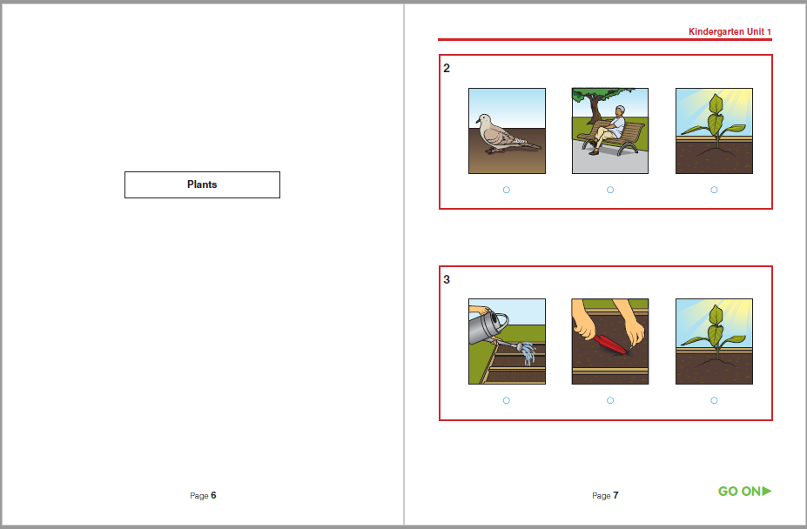
Kindergarten and Grade 1
New Listening Item Types
NOTE: This item type is included in all Grade K – 12 tests.
Listening Sets
Short informational or narrative passages with more than one multiple-choice question.
For Kindergarten and Grade 1, the title of the Listening passage that appears on the left-hand side of the spread indicates this is a Listening Set. The title is there mostly for the Test Administrator’s reference.
Students will listen to the passage again with new question of the set.
Notes:
On this slide, we have an image of two Listening items from the new Kindergarten Sample Test. We will not spend too much time on each of the samples of the new item types, but we will be sure to post the slides for your reference. A new item type for all grade levels is the Listening sets. Students will listen to a passage and the same passage will be used to ask more than one question.

Slide 11
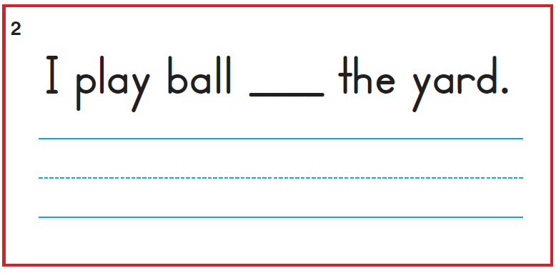
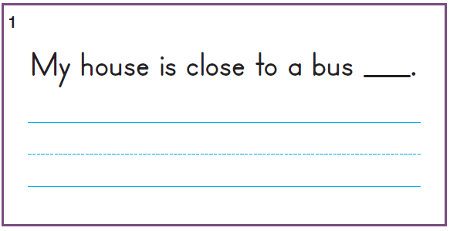
Kindergarten and Grade 1
New Writing Item Types
Writing -short answer
SAY Look at the sentence. It is missing a word. I will read the complete sentence to you. Then, you will write the missing word on the line.
Now listen to the sentence: I play ball in the yard.
Listen again: I play ball in the yard.
Write the missing word on the line.
Kindergarten
Grade 1
Notes:
These are samples of the short-answer Writing items. We included the scripted directions from the Teacher’s Edition. Similar scripted directions will be included in the Test Administration Directions, or TAD, that the Test Administrator will read to the students. It is worth mentioning that students need sufficient practice and direction, so they understand that they need to write the missing word on the blue line provided under the sentence. If the student writes the missing word in the blank, the response will still be scored, but there might not be sufficient space given that young students’ handwriting tends to be larger in size. It is also important to impress upon students that they must write their words inside the box. During the Stand Alone Field Test, we noticed that some students copied the entire sentence, and that is acceptable provided that they include the missing word, but again, space can become an issue.

Slide 12
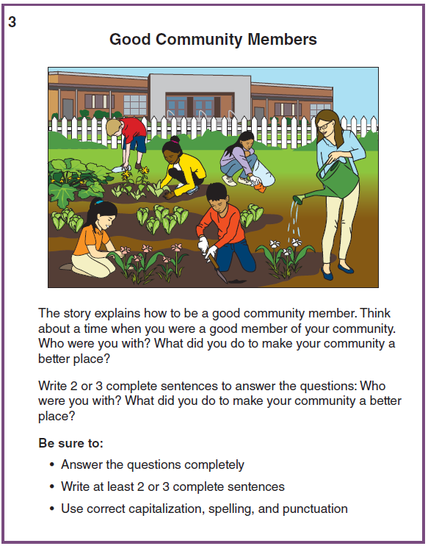
Grade 1
Writing Constructed Response
A Listening passage is presented to students. After listening to the passage, the students will be asked 2 or 3 questions. Students will then write a short response to those questions. The questions are connected to the topic of the passage.
The purpose of the Listening passage is to stimulate the students’ imagination or get some ideas to write about. Students are NOT expected to summarize or detail the information from the passage, but their response must be related to the topic.
NOTE: this item type is also included in the Grades 2 – 3 test.
Notes:
For the Grade 1 Writing items that ask the student to construct a response, the Test Administrator will play an audio recording that includes a Listening passage. After listening to the passage, the students will be asked 2 or 3 questions that have a connection to topic of the passage. Students will then write a short response to those questions. It is important to clarify that the purpose of the Listening passage is to stimulate the students’ imagination, get them thinking about a topic, and provide some useful vocabulary or ideas that they can use in their writing. There is no expectation for the students to recall details or summarize the passage or story. However, the student response must be related to the topic. The example on the screen is about good community members. The Listening passage explains what good community members are and provides examples of actions and situations in which good community members participate. Then the students are asked about their own experiences. The expectation is that students write 2 – 3 sentences to answer the questions. Again, this was taken from the Sample Test and the Grade 1 Digital Kit includes the audio recording. Please note that this item type is also included in Unit 4 of the Grades 2 – 3 test, extended writing.

Slide 13
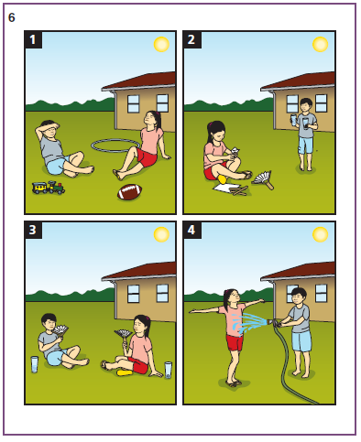
Kindergarten and Grade 1
New Speaking Item Types
Four-picture narrative
Speaking item
The prompt includes a short sentence-starter for the story.
NOTE: This Speaking item type is included in all grade K – 12 tests.
Alan and Ariana were playing outside, but it got too hot.
Notes:
A new Speaking item type is the four-picture narrative. Students are presented with four pictures and provided a short sentence starter for the story. If the student can’t remember the names of the characters, that is OK, they can come up with their own. This item type is included in Unit 5 in all the grades and grade bands.

Slide 14
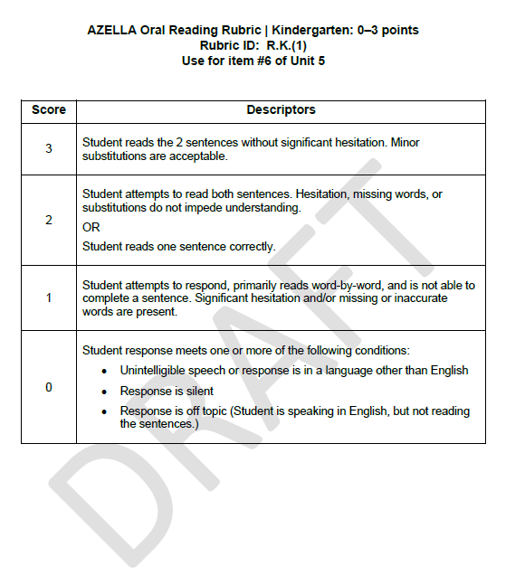
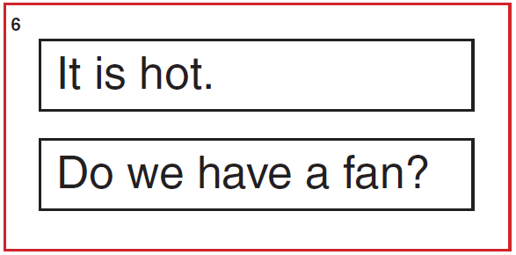
Kindergarten
New Reading Fluency Item
Notes:
The Kindergarten Reading Fluency item includes two short sentences with high-frequency and CVC words. You can see the draft of the scoring rubric for this item type. The drafts of the Writing and Speaking rubrics for the new AZELLA tests are included in the Teacher’s Editions (similar to the TADs) of the new Sample Tests.

Slide 15
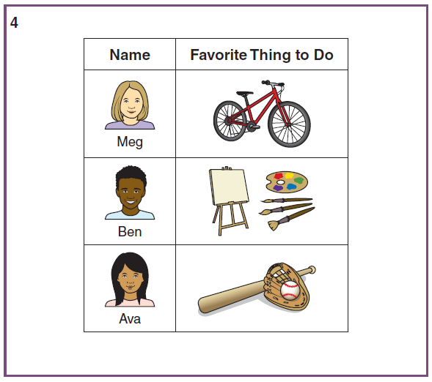
Grade 1 Speaking
Short Presentation
Look at the chart. [pause] The chart has information about three children—Meg, Ben, and Ava—and their favorite things to do. [pause] Imagine that you will give a presentation, or talk about the chart, to your class.
When you are ready, use the information from the chart to talk about it to your class. [pause] Be sure to say as much as you can and speak using complete sentences.
NOTE: this item type is included in the Grades 1 – 12 tests.
Notes:
Another new Speaking item type for Grades 1 – 12 is the presentation item. You will see samples of the presentation items for other grades in the next slides. The rubric for this item type is included in the Teacher’s Edition as well.

Slide 16
Grades 2 – 3
New AZELLA Tests
Administration
New Item Types
Notes:
Moving on to Grades 2 – 3, we will talk about the mode of administration of the test units and new item types.

Slide 17
Grades 2 – 3
Test Unit | Administration | Item Types and Domains
Unit 1 Listening | Group Online | Listening multiple-choice questions
Unit 2 Interactive | Group Online | Reading and Writing multiple-choice questions
Unit 3 Interactive | Group Online | Reading and Writing multiple-choice questions
Unit 4 Writing | Group Paper | Extended Writing –responses are entered into the Extended Writing Student Test Book
Unit 5 Speaking | Small Group Online | Speaking, Listening, and Oral Reading Fluency items
Notes:
Units 1, 2, and 3 of the test for Grades 2 – 3 are group administration online in a small or large group setting. Unit 1 is the Listening test, Units 2 and 3 include Reading and Writing items, all multiple-choice.
Unit 4 is administered on paper using an audio recording as we explained before, as well as the Extended Writing Student Test Book.
Unit 5 requires a small group administration (approximately 6 students in a regular size classroom). We will talk about Unit 5, the Speaking test, in more detail in a minute.

Slide 18
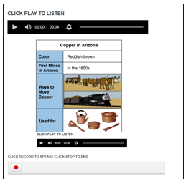
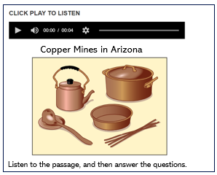
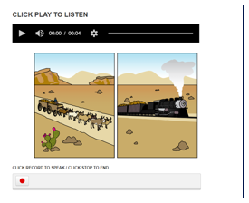
Grades 2 – 3
Unit 5
Themed Item Sets
In Unit 5 (Speaking), students will listen to a passage and respond to a couple of multiple-choice Listening questions. Then, they will respond to a Speaking question related to the same topic. Finally, they will use the information on a chart to craft a very short oral presentation.
NOTE: this thematic approach is included in Unit 5 of grades 2 – 12
Notes:
Starting at Grades 2 – 3, Unit 5 of the test includes what we call “themed sets.” Students will listen to a passage and respond to a couple of multiple-choice Listening questions. Then, they will respond to a Speaking question related to the same topic. Finally, they will use the information on a chart to craft a very short oral presentation.

Slide 19
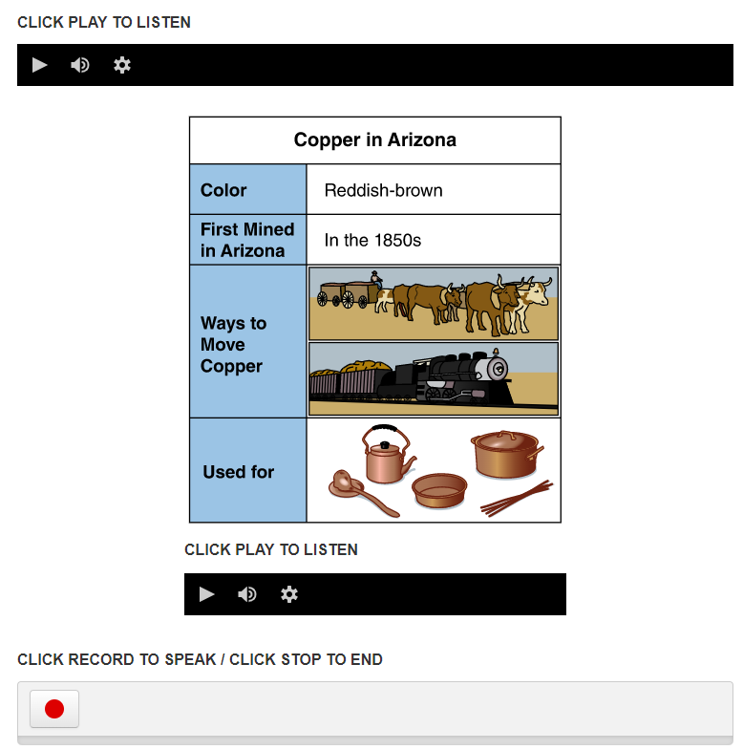
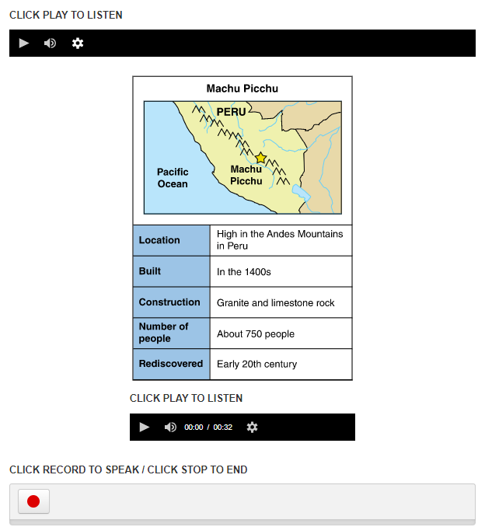
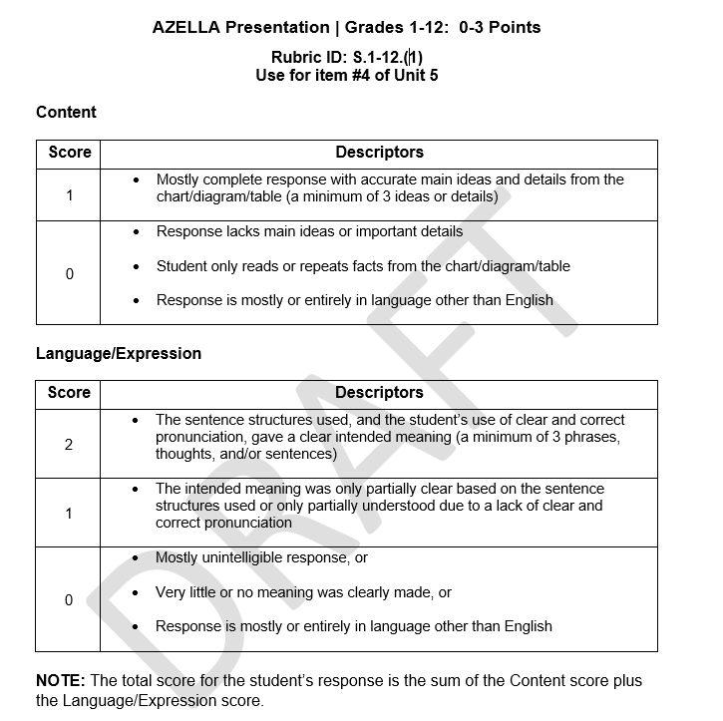
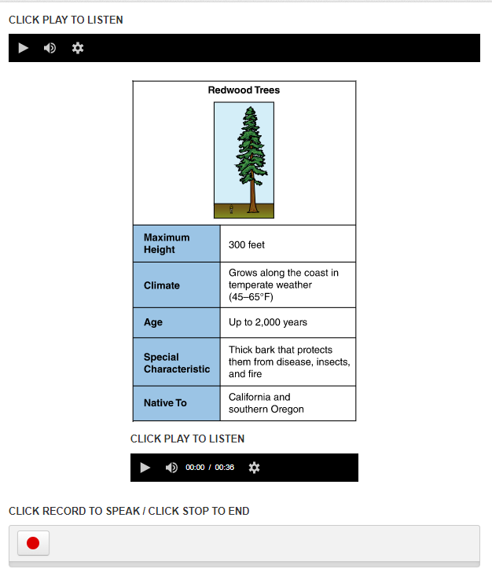
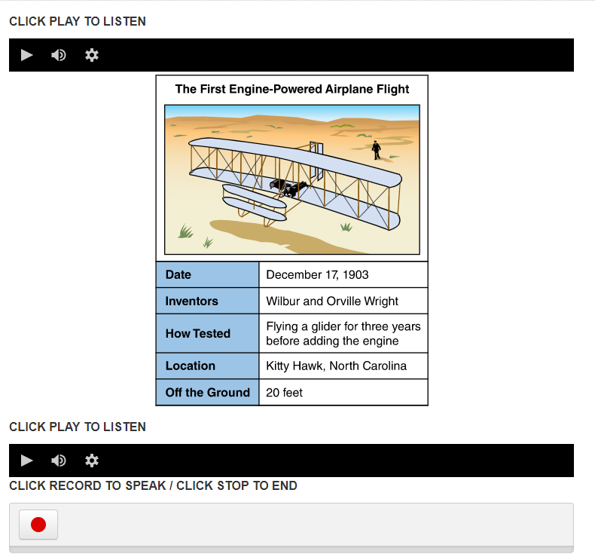
Presentation Items
Notes:
As we mentioned earlier, we wanted to provide examples of Presentations items for Grades 2 – 3, 4 – 5, 6 – 8, and 9 – 12. For the upper grades, the tables might be rich in information that the student will use to craft their short presentation. Therefore, an accessibility recording is included under the table. The content of the table is read to students. Students can write an outline or even a short script for their short presentation. When they are ready, they press the “Record” button and record their answer.

Slide 20
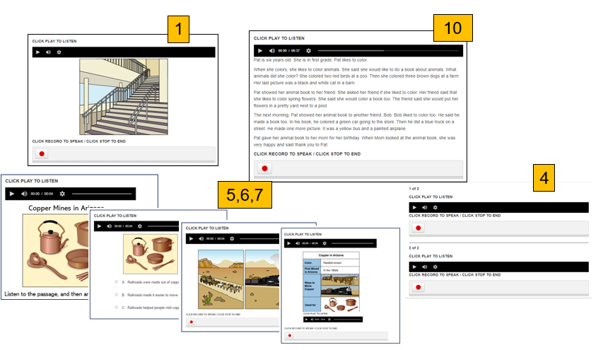
Grades 2 – 3 Unit 5 Sample Test Administration
Required for Spring 2023 Reassessment
The Test Administrator will conduct a small-group administration of identified Unit 5 items to monitor students, answer their questions, and ensure that each student is ready to take Unit 5 of the test independently. If a student does not engage with the test confidently, an individual administration with the Test Administrator navigating the test will be required for that student.
The Test Administrator will initial the Testing Log attesting to each student’s ability to play the question or prompt and record their responses without issue.
Required practice questions: Question #1, Question #4, Questions #5 – #7, and Question #10
Notes:
For Grades 2 – 3 only, the administration of the Speaking Sample Test is required so the Test Administrator can verify that the students, specially second graders, are capable of taking Unit 5 of the test independently in a small group setting. The details of the Speaking Practice Protocol for Grades 2 – 3 will be included in the Grades 2 – 3 Training Module and the Test Administration Directions manual.

Slide 21
Grades 4 –12
New AZELLA Tests
Administration
Domains Assessed
Sections within Units

Slide 22
Grades 4 – 12
Test Unit | Administration | Domains Assessed | Two or more sections within the Test Unit
Unit 1 | Group Online | Listening | No
Unit 2 | Group Online | Reading and Writing multiple-choice | Yes
Unit 3 | Group Online | Reading and Writing multiple-choice, and Extended Writing | Yes
Unit 4 | Group Online | Reading and Writing multiple-choice, and Extended Writing | Yes
Unit 5 | Small Group Online | Speaking and Listening [and ORF for Grades 4– 5 only] online | No
Notes:
The table on the slide shows which domains are assessed in each of the test units of the Grades 4 – 5, 6 – 8, and 9 – 12. It is important to mention that Units 2, 3, and 4 may have more than one section. In other words, these test units might have section breaks. An example of when a section break is needed is when the Reading passage appears with the Extended Writing item. If that is the case, the Reading passage includes the text-to-speech feature. There will be a section break after the Reading questions and before the extended writing questions. Once a section is submitted, students cannot go back and change their responses. Again, this will be explained in detail in the TAD. The new Sample Tests include section breaks so students can become familiar with them.

Slide 23
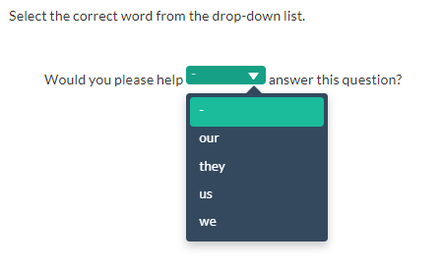
Technology- Enhanced Items Grades 4 – 12
Notes:
There are two types of technology-enhanced items: dropdown menu, and drag-and-drop. These item types are also represented in the new Sample Tests.

Slide 24
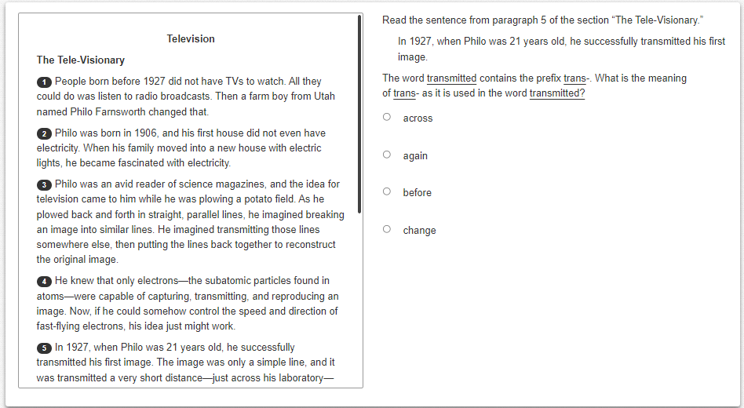
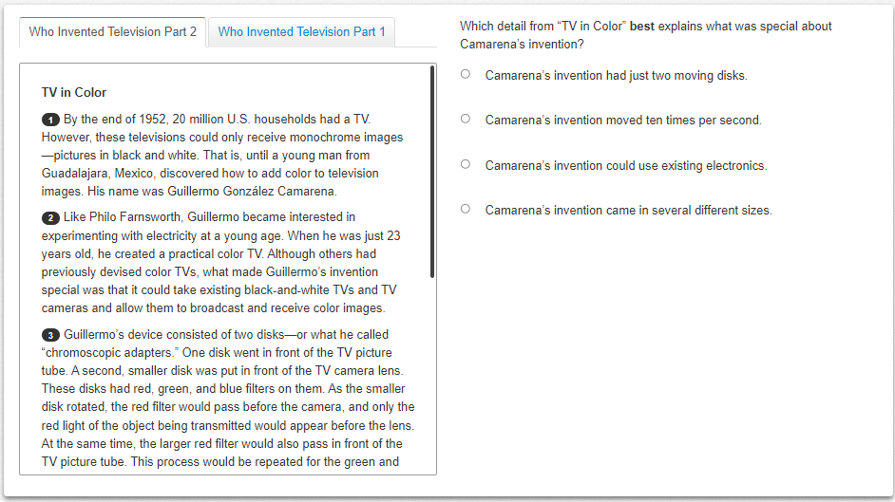
Reading Passages Titles vs. Sections
Students might only see one section of the passage first but later there may be tabs.
Notes:
Some of the Reading passages will have two sections. Students should be given enough opportunity to practice with the Sample Test to feel comfortable navigating the tabs. If the question is about a section of the passage, it will default to the specific section or tab. If the question is about the two sections, it will default to the first section. The terms, “Part” and “Section” are used interchangeably .

Slide 25
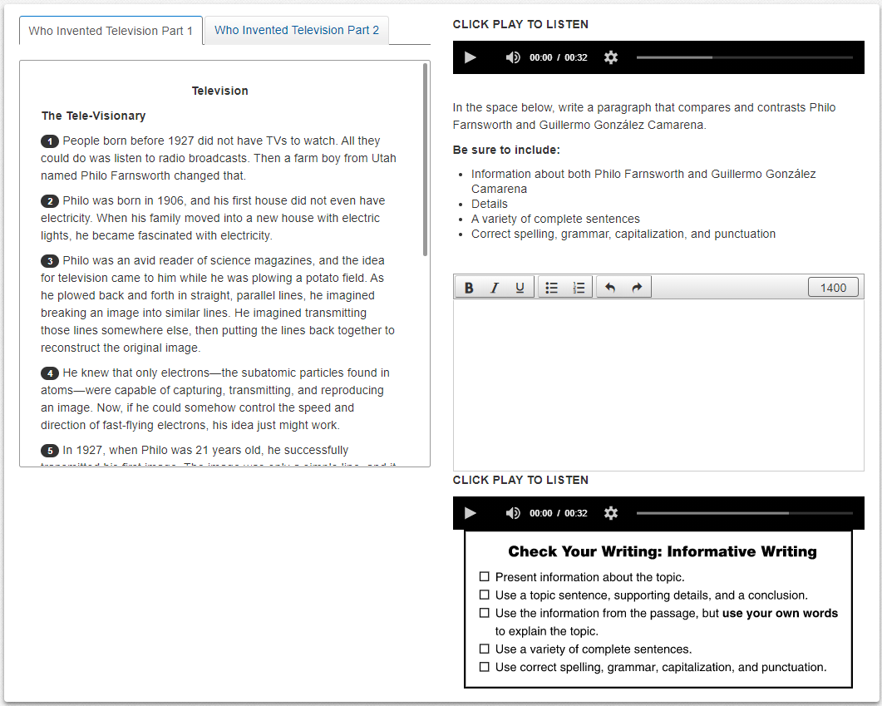
Units 3 and 4 Grades 4 – 12 Precautions and Recommendations
Extended Writing Prompt Grades 4 – 12 :
Students will need to scroll not only for the Reading passage, but also under the text box to be able to see the checkbox and play the audio.
Notes:
This is a sample of an Extended Writing item that includes the Reading passage and the text-to-speech feature. Students may listen to the entire passage, one of the two sections, or a specific paragraph using the text-to-speech feature.

Slide 26
Spring 2023 AZELLA Reassessment Estimated Test Administration Times in Minutes | Spring 2023 AZELLA Reassessment Estimated Test Administration Times in Minutes
 | Grade(s) | Unit 1 | Unit 2 | Unit 3 | Unit 4 | Unit 5
 | Kindergarten | 30 – 35 | 40 – 45 | 20 – 30 | 20 – 30 | 25
 | Grade 1 | 30 – 35 | 45 – 50 | 45 | 45 | 20 – 25
 | Grades 2 – 3 | 30 – 35 | 45 – 50 | 45 – 50 | 45 – 50 | 25 – 30
 | Grades 4 – 5 | 20 – 30 | 45 – 50 | 45 – 50 | 45 – 50 | 25 – 30
 | Grades 6 – 8 | 20 – 30 | 45 – 50 | 45 – 50 | 45 – 50 | 25 – 30
 | Grades 9 – 12 | 20 – 30 | 45 – 50 | 45 – 50 | 45 – 50 | 25 – 30
DRAFT
Notes:
This is a draft of the estimated administration times for each of the units of the test for each of the grades and grade bands. Please keep in mind that AZELLA is not a timed test, and that sufficient time should be allowed to students to complete their test units.

Slide 27
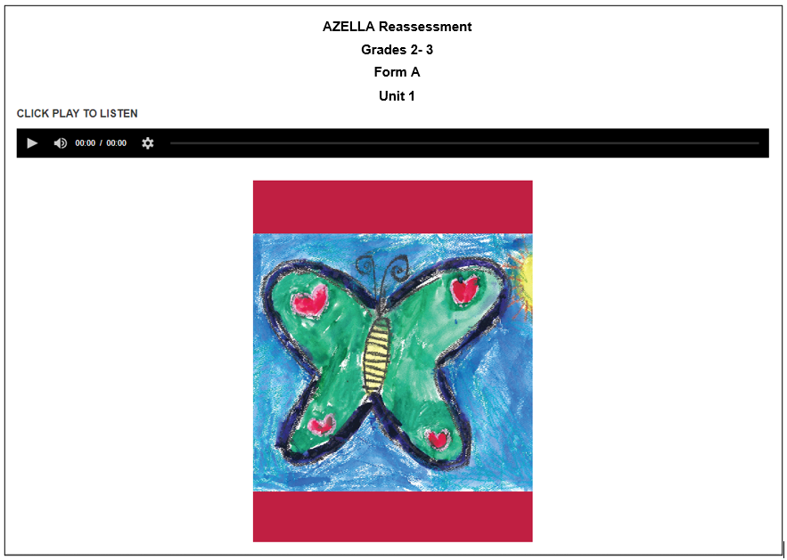
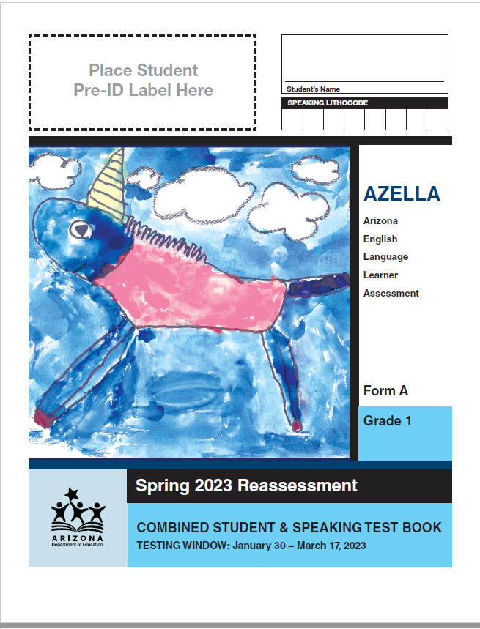
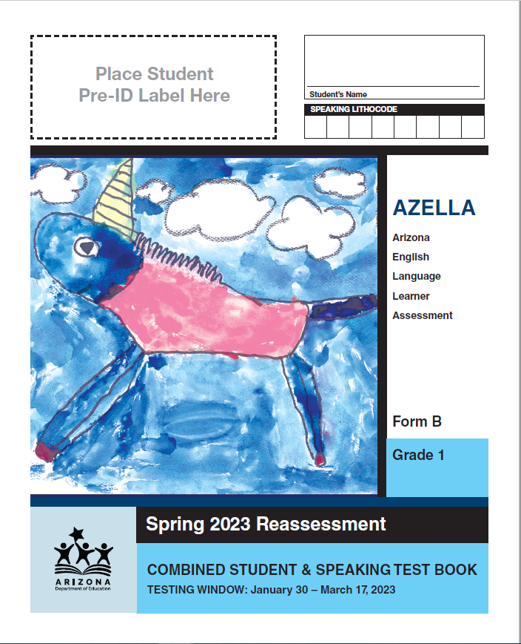
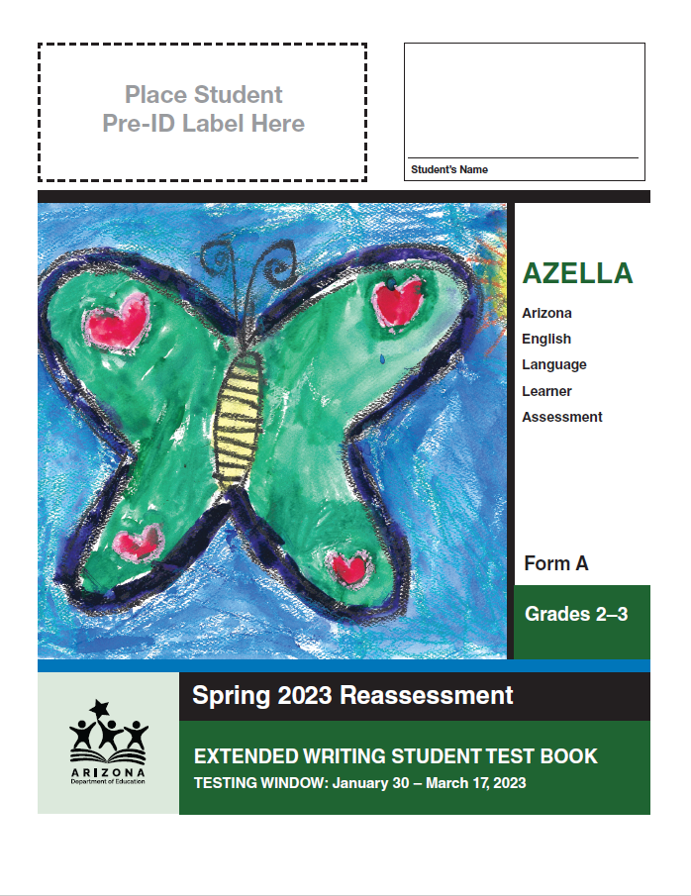
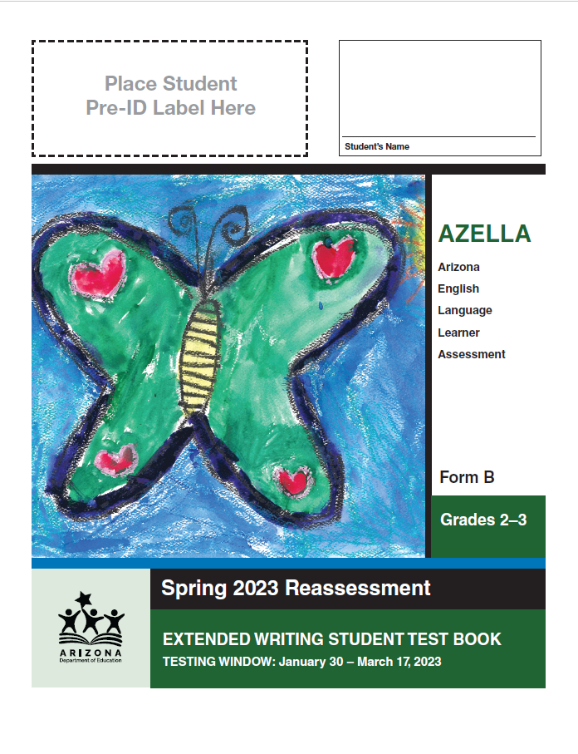
Two test forms –Form A and Form B
for Grades 1 - 12
Notes:
There will be two test forms, Form A and Form B, for Grades 1 – 12 for the Spring 2023 Reassessment.
No action on the part of the school or district is necessary for grades 4 – 12 because the student’s credentials or testing ticket will automatically take them to the correct form of the test.
For Grade 1 and Grades 2 – 3, test forms will be assigned by school and paper materials will be packaged and shipped by school. As you can see, the Student Test Books and TADs of Grade 1 and Grades 2 – 3 ER STB and TAD will have the same student art on the cover, except for the form designation. It is critical to verify that the correct form of the STB and TAD is used.
The Welcome screens of the online test units of the Grades 2 – 3 test will include the test form only as an additional way to check that there is no mismatch between the Extended Writing STB and the online form. More information will be provided in the DTC and STC Spring Reassessment test module. Please be aware that if a student takes one form of the online test units and a different form of the ER Writing, that student cannot receive an overall proficiency level.

Slide 28
How to Use the New AZELLA Sample Tests
New AZELLA Tests

Slide 29
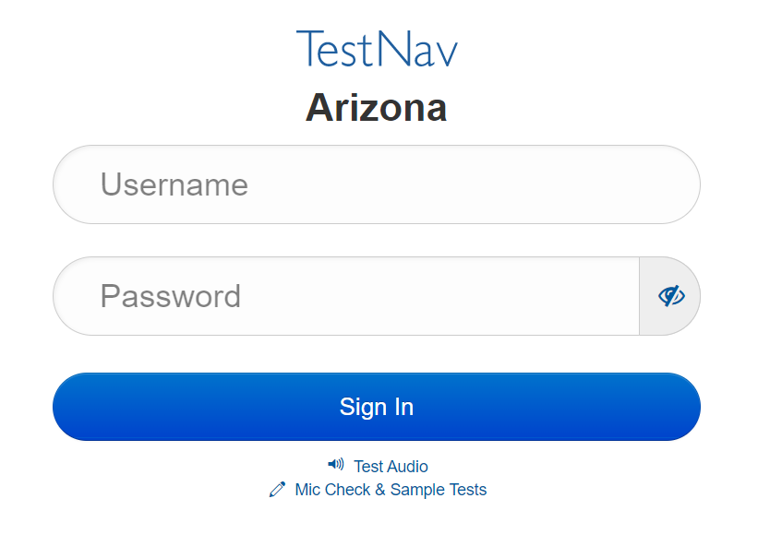
Digital Kits and Online Sample Tests
Paper-and-pencil grades:
In PearsonAccess^{next} >> Support >> Documentation
Kindergarten
Student Test Book
Unit 1 (Listening) Audio File
Teacher’s Edition
Grade 1
Student Test Book
Unit 1 and Unit 4 Audio Files
Teacher’s Edition
Grades 2 – 3 (Hybrid)
Extended Writing Student Test Book
Unit 4 (Extended Writing) Audio File
Teacher’s Edition
Online grades:
Grades 2 – 3: Units 1, 2, 3, and 5
Grades 4 – 12: Units 1 – 5
https://az.testnav.com/client/index.html
Notes:
In this slide, and for you reference, we have included the components of the digital kits by grade and where you can find the new AZELLa Sample Tests.

Slide 30
The New AZELLA Sample Tests help you give your students an opportunity to:
practice following directions, finding page numbers, locating item numbers, and learning how to correctly bubble responses
simulate the actual test environment
assist students to feel comfortable when taking the actual AZELLA
become familiar with the test design and item types (especially new item types)
allow students to demonstrate their true English language proficiency when they take the test by removing construct-irrelevant constraints (e.g., online navigation)
simplify, paraphrase, or explain directions and samples
familiarize students with the expectations for open-ended questions (i.e., Writing and Speaking rubrics)
Notes:
This is our last slide, and we have listed here the opportunities teachers and EL students can derive from practicing with the new AZELLA Sample Tests.

Slide 31
Friday focus: azella tests aligned to the 2019 elps
QUESTIONS?
Notes:
Any questions for AZELLA?

Slide 32
Gabriela Finn English Language Assessments Director AZELLA Inbox azella@azed.gov

