Slide 1
Friday focus: AzSCI Performance Level Descriptors
This webinar will be recorded and posted on the ADE Assessments webpage at https://www.azed.gov/assessment.
Please enter your First and Last Name in the Chat for tracking purposes for the live event.
We will also be capturing the chat questions. ADE will compile and create a FAQ list which will then be posted on our website. The FAQ will only include those questions that are relevant to the webinar topic. ADE will follow up with any other questions via e-mail.

Slide 2
Friday Focus webinar #7
AzSCI Performance Level Descriptors

Slide 3
Overview
AzSCI Background
Performance Level Descriptors
Resources and Supports
Item Specification Document
Practice Test

Slide 4
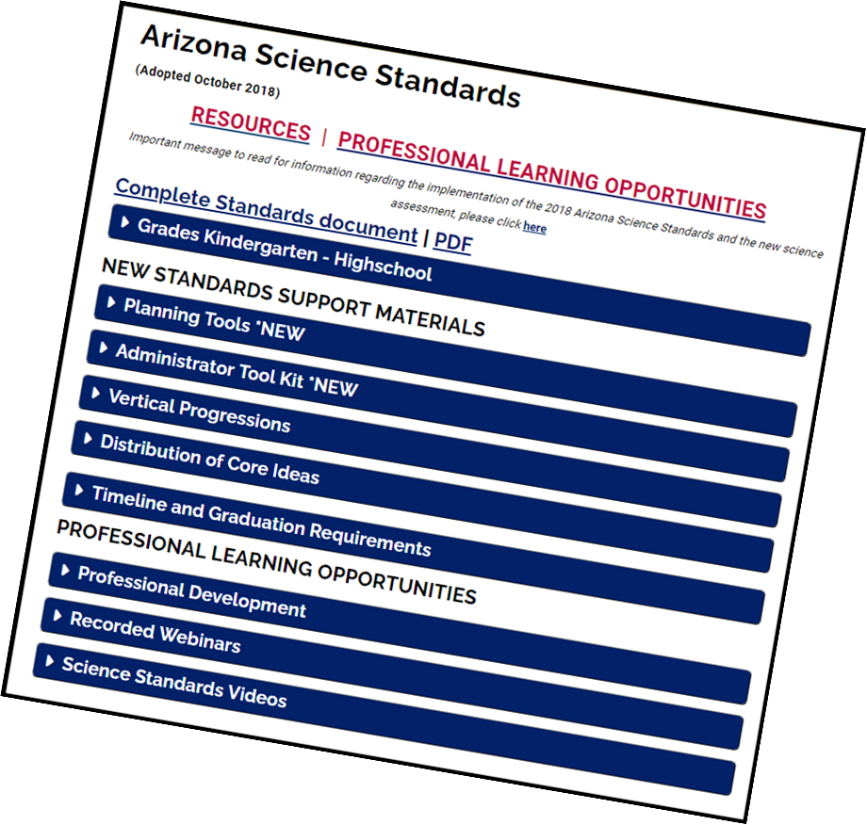
Background
AzSCI is administered online in Grades 5, 8, and 11 in grade bands
Grades 3-5, Grades 6-8 and Grades 9-11
The test is designed to be aligned to the Arizona Science Standards Core Ideas, Science and Engineering Practices (SEPs) and Cross-Cutting Concepts (CCCs)
AzSCI Prototype (2020), Field Test (2021) and the first operational assessment in 2022. Performance Levels were set through a Standard Setting in June of 2022
AzSCI currently contributes to bonus point for participation for State Accountability

Slide 5
Earth and Space Standard

Slide 6
Performance level descriptors

Slide 7
Performance Level Descriptors
The Performance Level Descriptors (PLDs) are a series of statements that describe the level of knowledge and skills required at each performance level on the new assessment. PLDs serve a variety of purposes. They provide specific information about what each level means and indicate the progression of student knowledge, skill, and ability across the performance levels. PLDs provide detail on the spectrum, or range, of performance within each performance level. They define the processes, strategies, and knowledge students need in order to correctly answer test items.

Slide 8
Proficiency levels

Slide 9
Performance Level Descriptor-Core Idea

Slide 10
Performance Level Descriptor-Core Idea

Slide 11
Performance Level Descriptor-Core Idea

Slide 12
PLD - Science and engineering practices

Slide 13
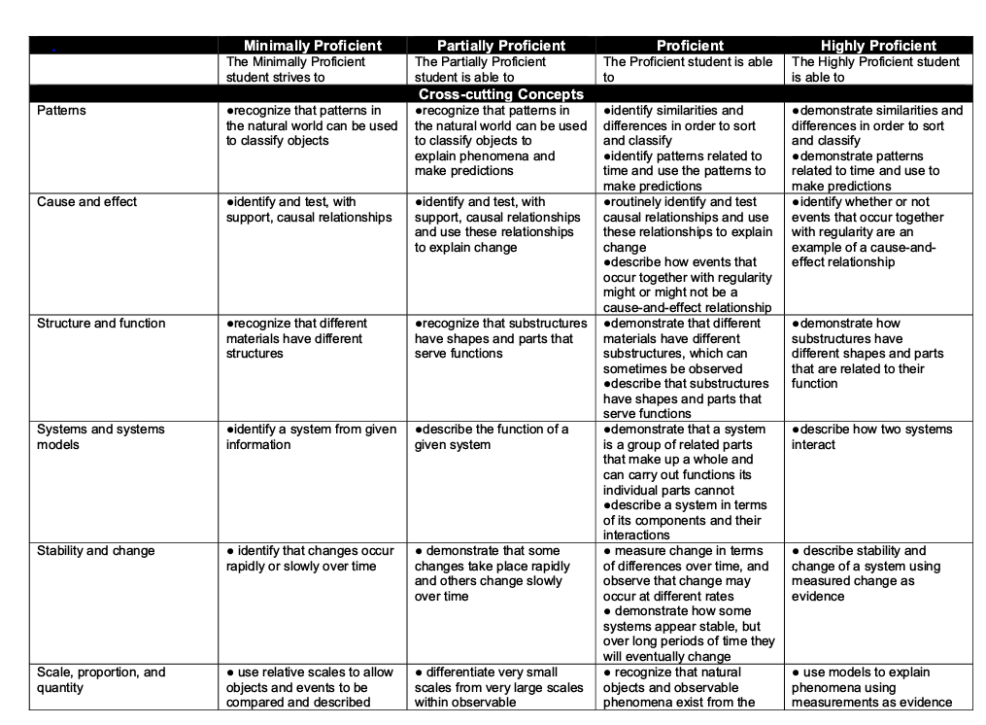
PLD - Crosscutting Concepts

Slide 14
Questions?

Slide 15
Resources and Supports

Slide 16
Tools for Teachers and Students
State Standards
All Subjects
Quick Links - Formative Assessments Resources
http://www.azed.gov/standards-practices/
AzSCI Assessment Resources to support instruction
Item Specifications
Item Types
Sample Test
AzSCI Scoring guides
AzSCI Exhibits
https://www.azed.gov/assessment/sci

Slide 17
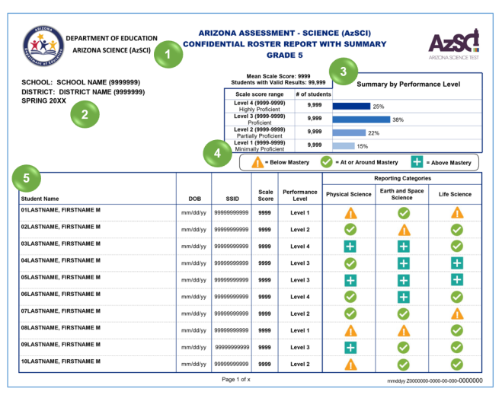
Tying it Together
Utilizing Data Reports to flag or bring attention to one of the reporting categories
Examining existing lessons to ensure the lesson is targeting different levels
Work with curriculum coaches
Roster Report with Summary allows an at-a-glance view of school and grade.

Slide 18
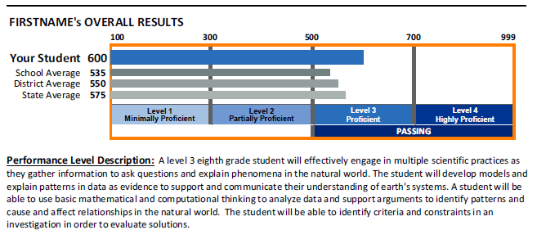
For Individual Students

Slide 19
Where to Find these resources
https://www.azed.gov/assessment

Slide 20
AZSCI Educator Resources
https://www.azed.gov/assessment/resources

Slide 21
Questions?

Slide 22
SAMPLE TESTS and Scoring guides

Slide 23
AzSCI Sample test
Purpose:
To help students, teachers, and parents become familiar with the content, item types, and the tools in online test administration.
Help students become comfortable with TestNav and reduce any anxiety they might have while taking a high-stakes test online.
What is it not used for?
They DO NOT include an item for each of the aligned Arizona Academic Standards and DO NOT provide scores for students.
They should NOT be used to evaluate a student’s proficiency level.
When?
Students should take the TestNav Tutorial and Sample Test prior to taking the Spring 2023 AzSCI tests.

Slide 24
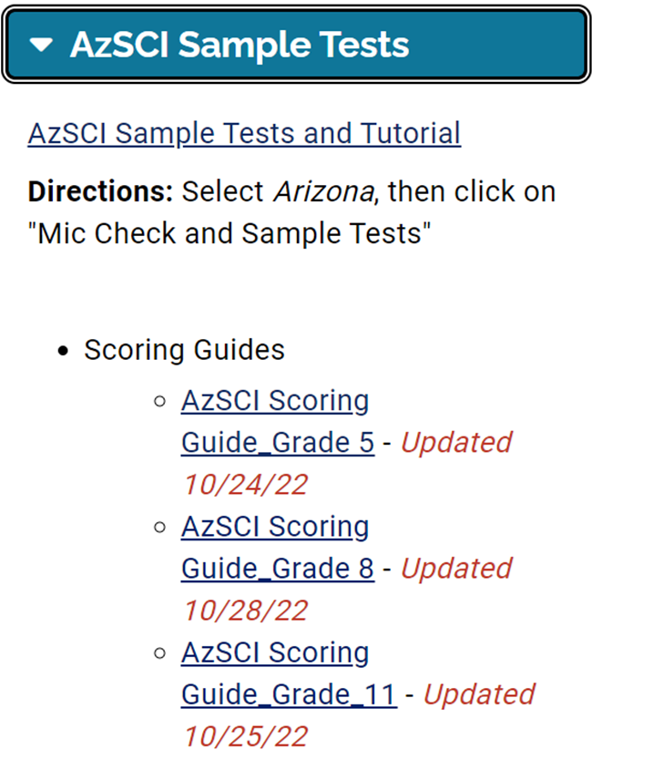
AzSCI Sample Test
AzSCI Sample Tests
Tutorials
Scoring Guides
The items included in the AzSCI Sample Test Scoring Guides provide details about the items and item types, student response types, correct responses, and related scoring considerations for items.
Static presentation of student response field (when appropriate)
Answer key or scoring rubric

Slide 25
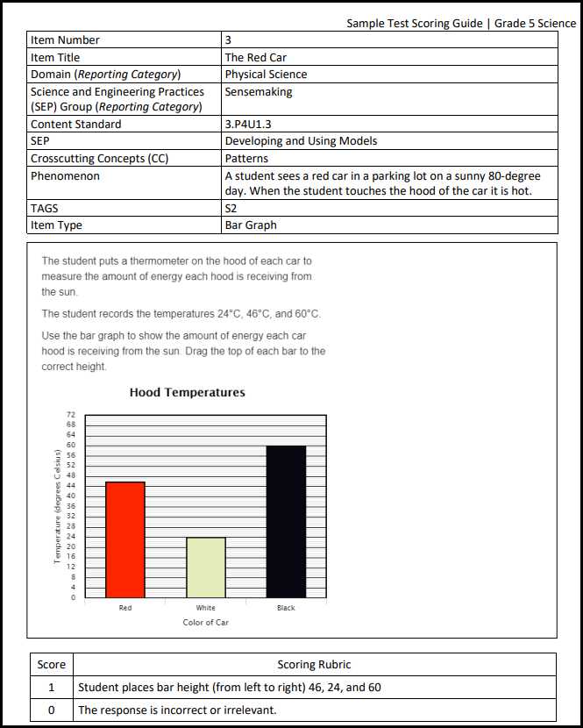
AzSCI Scoring Guides
Scoring Guides
Item Details
Response
Scoring

Slide 26
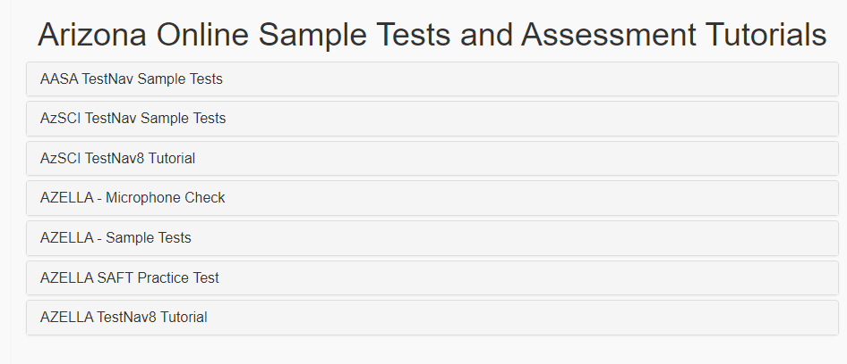
How to get into the Sample Tests

Slide 27
TestNav Tools (What and how students see them)

Slide 28
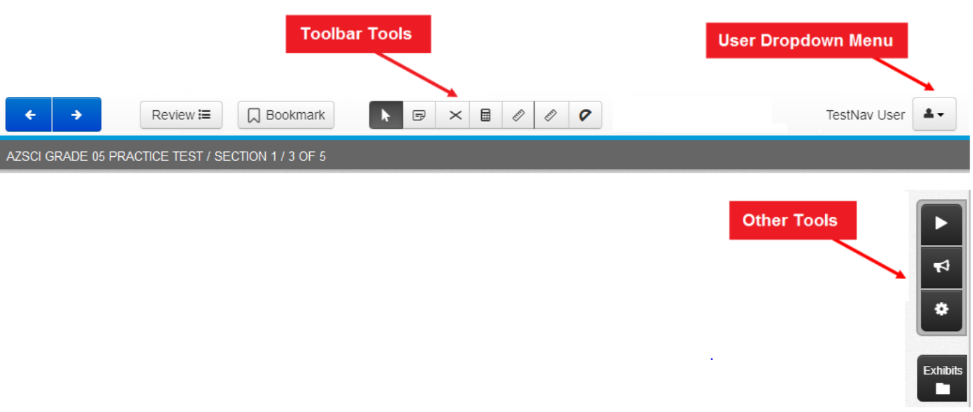
AzSCI Test Toolbar

Slide 29
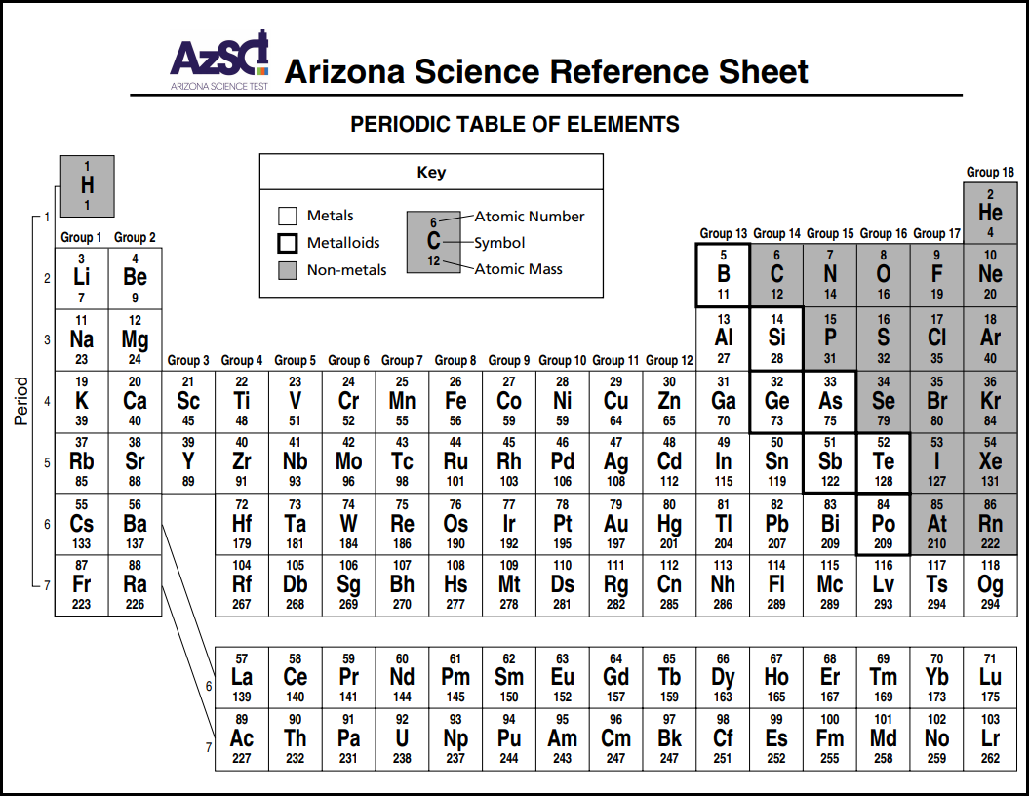
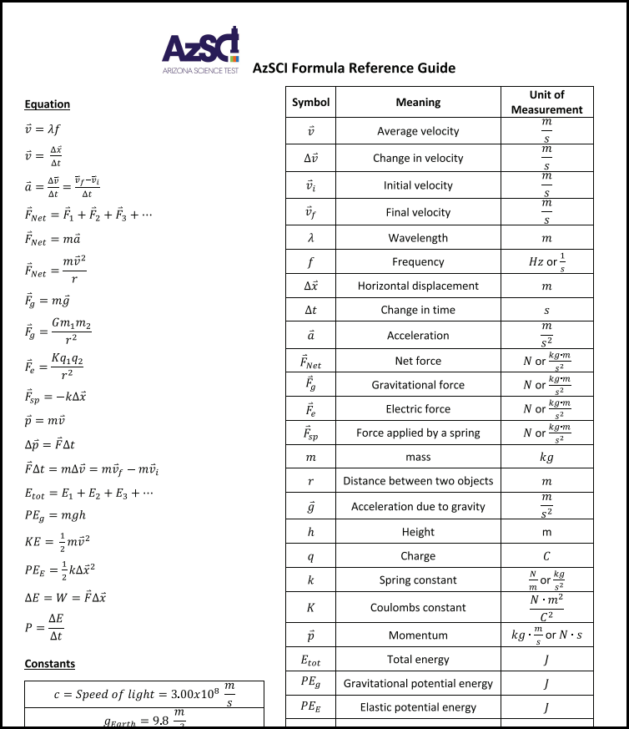
AzSCI Exhibits
Exhibits
Grade 8: Periodic Table of Elements
Grade 11: Periodic Table and Formula Reference Guide
Notes:
There are exhibits available for the 8th and 11th grade tests. The Periodic Table of Elements is available for 8th grade students and 11th grade students have the Periodic Table and a Formula Reference Guide.

Slide 30
Questions?

Slide 31
Educator Committees

Slide 32
Assessment Committee
We are inviting content area teachers, teachers of students with disabilities, teachers of EL students, and instructional coaches/administrators to provide their perspective on the items and standards set on Arizona's statewide assessments. If you are interested in serving on an Assessment Educator Committee, please complete our Committee Application found at:
https://www.azed.gov/assessment/assessment-educator-committee-application

Slide 33
Educator Committees
Share this with your teachers
Help us recruit teachers for these committees!
EDUCATOR REVIEW COMMITTEE:
A committee of Arizona Teachers review items for content, grade-level appropriateness, and bias. All approved items are moved forward to field testing.
DATA REVIEW COMMITTEE:
A committee of Arizona Teachers review Field test items data to ensure they perform appropriately.
We are also looking for Community Members (i.e., parents, grandparents, retired educators, businesses) for the Community Review Committees

Slide 34
Questions?

Slide 35
THANK YOU!
For questions, please contact us at:
AzSCI@azed.gov

