Slide 1
Accessibility & Assessments
SABIHA Klepk
Accommodations and Accessibility specialist

Slide 2
agenda
Tiered Approach to Accessibility
Accommodations Request Process
Special Paper Version (SPV) Requests
ACT Accommodations
Best Practices
Testing Supports
Important Dates
Resources
Questions

Slide 3
Tiered Approach to Accessibility

Slide 4
Three tiers of accessibility

Slide 5
TIER 1: Universal test administration conditions (Utac)
Vary between subjects and assessments
Example: Simplified Scripted Test Administration Directions are permitted on AASA and AzSCI but are not permissible on AZELLA
Found in each assessment’s accommodations manual
Available to every student
Do not require an Accommodations Request
Examples: Small group administration, Familiar Test Administrator, Testing in a separate location on campus, Glasses, Magnification Hearing Assistive Technology (If use of Bluetooth is required, please contact ADE)

Slide 6
TIER 2: Universal tools
Available to all students taking the ELA, Mathematics, Science, and AZELLA Computer-Based Tests (CBT)
Availability of tools cannot be turned off
Tools vary between subjects and assessments
Do not require an Accommodations Request
Examples: Change Background and Foreground Color, Magnifier, Answer Masking

Slide 7
Tier 3: Accommodations
Provisions made in how a student accesses the test and/or demonstrates learning that do not alter the validity of the test, construct, score interpretation, reliability, or security of the test.
Accommodations remove barriers to test taking while maintaining the rigor of the assessment

Slide 8
Accommodations Request Process

Slide 9
Submit requests to ADE for:
AASA (Grades 3-8)
AzSCI (Grades 5,8,11)
AZELLA Placement and Reassessment (Grades K-12)
ACT Aspire (Grade 9)

Slide 10
Achievement Assessments
Separate request forms for SPV (Special Paper Version), Braille, Paper, Large Print and Additional Accommodations Request
Request is valid for the entire school year
If IEP/504 is updated after approval, please submit updated documentation via the pertinent Request Form
Select applicable assessments in the SPV or Additional Accommodations Request Form
Example: For Grade 5 student, select AASA and AzSCI
Requests for American Sign Language (ASL) should be submitted as an Additional Accommodations Request

Slide 11
AZELLA
Placement
Reassessment
One Request Form for Special Paper Version (SPV) and Additional Accommodations
Valid for the entire school year
If SPV or Accommodation is approved for Placement, approval also applies to Reassessment
If IEP/504 is updated after approval, please submit updated documentation via the Request Form

Slide 12
ACT Aspire
Grade 9 Only
Aspire Accessibility Guide
Submit Requests to ADE for: Special Paper Version (SPV), Speech-to-text (Requires Paper Administration)
Speech-to-text is only available on ACT Aspire
Request deadline: February 24
A request for Extended Time is not needed for ACT Aspire
Students eligible for Alternate Assessments should not be administered ACT Aspire

Slide 13
Alternate Assessments
Do not require Additional Accommodations Requests
Exception: EL students eligible for Alt ELPA who have not been administered or do not have a current AZELLA Placement test.
All EL students must be administered the AZELLA Placement
Once identified as English learners with the AZELLA Placement Test, students eligible for Alternate Assessments participate in Alt ELPA in the Spring

Slide 14
ADE Accommodations Request Process
Review student’s IEP/504
If student requires Assessment Accommodations, review Universal Test Administration Conditions and Universal Tools
If your student’s needs are not met by Universal Conditions and Universal Tools, then please submit an Additional Accommodations Request
Current IEP/504 must be included

Slide 15
Submission of Additional Accommodations Request
1. The District Test Coordinator (DTC) or staff member submits the corresponding Request Form. All submissions are completed on a secure server.
2. Please wait to test the student until ADE provides a decision. Testing the student prior to ADE’s decision will result in a Test Irregularity.
3. ADE will review and provide a decision on the request. In some instances, ADE may require additional information. If requested, please submit additional information in a timely manner.

Slide 16
Reminders
Protect student data
Fill out the request in its entirety
Attach all pertinent and current documentation (e.g., IEP sections, 504 Plan)
Ensure request is being submitted for the correct student
An assessment accommodation cannot be provided unless the student uses the accommodation routinely during instruction.
The DTC submitting the request will receive an automated email stating the request was submitted.

Slide 17
Request tips
Decision based on information provided
Use Additional Information section on request form to include information not captured in the IEP or 504 Plan
Accommodations differ between assessments. Accommodations selected should be applicable to assessments student participates in.
Example: MSAA Accommodations should not be selected for students participating in AASA and AzSCI

Slide 18
Common Occurrences in 2021-2022 School year
Requests submitted for Universal Test Conditions
Accommodation not used in Instruction
Insufficient Information
Missing SSID
Late Requests
Misinterpretation of allowable accommodations
Assessment Accommodations not included in IEP/504 for ELs in K-2

Slide 19
Special Paper Version (SPV) Requests

Slide 20
AZELLA SPV and Other Accommodated Forms
Paper
Braille available for Reassessment (K-12)
Large Print
American Sign Language (ASL)
Submit request via AZELLA Accommodations Form

Slide 21
AASA , AzSCI, and ACT Aspire SPV
Paper
Large Print
Braille
Submit Request via Achievement’s SPV Request Form
If student is in a grade where multiple assessments are administered, only 1 request required

Slide 22
ACT Accommodations

Slide 23
ACT Accommodations Process
Requests submitted directly to ACT through the Test Accessibility and Accommodations System (TAA)
Test Administration Coordinator (TAC) ensures Consent to Release Information to ACT form is signed and kept on file.
TAC initiates and submits requests
Provide additional documentation when requested
ACT Accommodations Webinar: November 2, 2022

Slide 24
Best Practices

Slide 25
Best Practices for Accommodations Requests
Submit early
Current documentation
Review Accessibility Manuals
Reach out for support with unique situations

Slide 26
Accessibility Tips
Use sample tests to familiarize students with accessibility features
Encourage students to experiment with accessibility tools prior to an actual assessment
Prior to assessment administration, review each student's accommodations and adjust as needed
Incorporate Assistive Technology (i.e., adaptive mouse, adaptive keyboard, amplification) as permitted by the assessment
Submit requests for additional accommodations not listed in test administration manuals before the testing window opens

Slide 27
Testing Supports

Slide 28
Testing Supports in TestNav
Sample Tests provide students an opportunity to familiarize themselves with Universal Tools and Accessibility Features prior to the assessment
TestNav Tutorials provide information on how to navigate the test

Slide 29
Sample Tests and Tutorials
AASA, AzSCI and AZELLA Sample Tests and Tutorials may be accessed from home.testnav.com
Select Arizona from the options
You will be taken to a TestNav Arizona login screen
Username and password are not required
Click on Mic Check & Sample Tests
Select Sample Test or Tutorial of interest

Slide 30
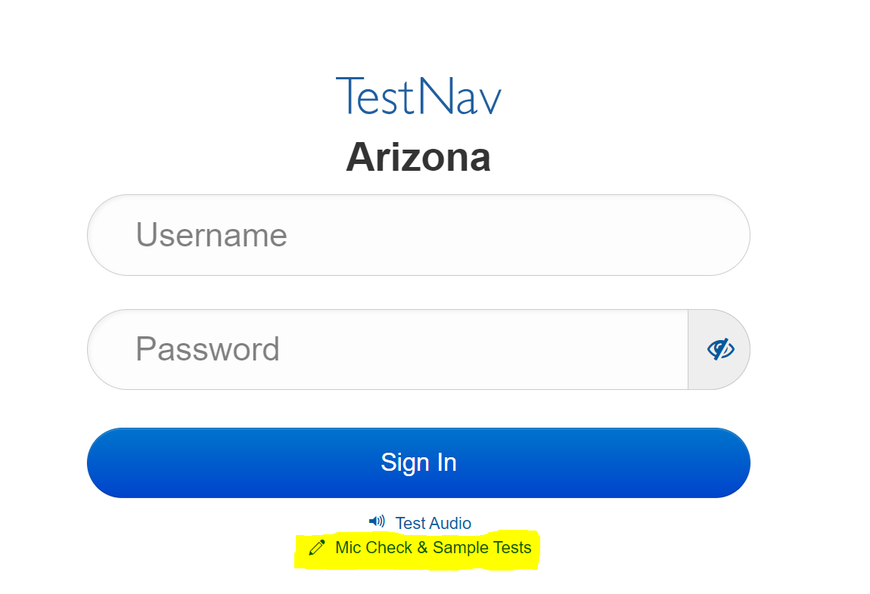
Sample Test Login Screen

Slide 31
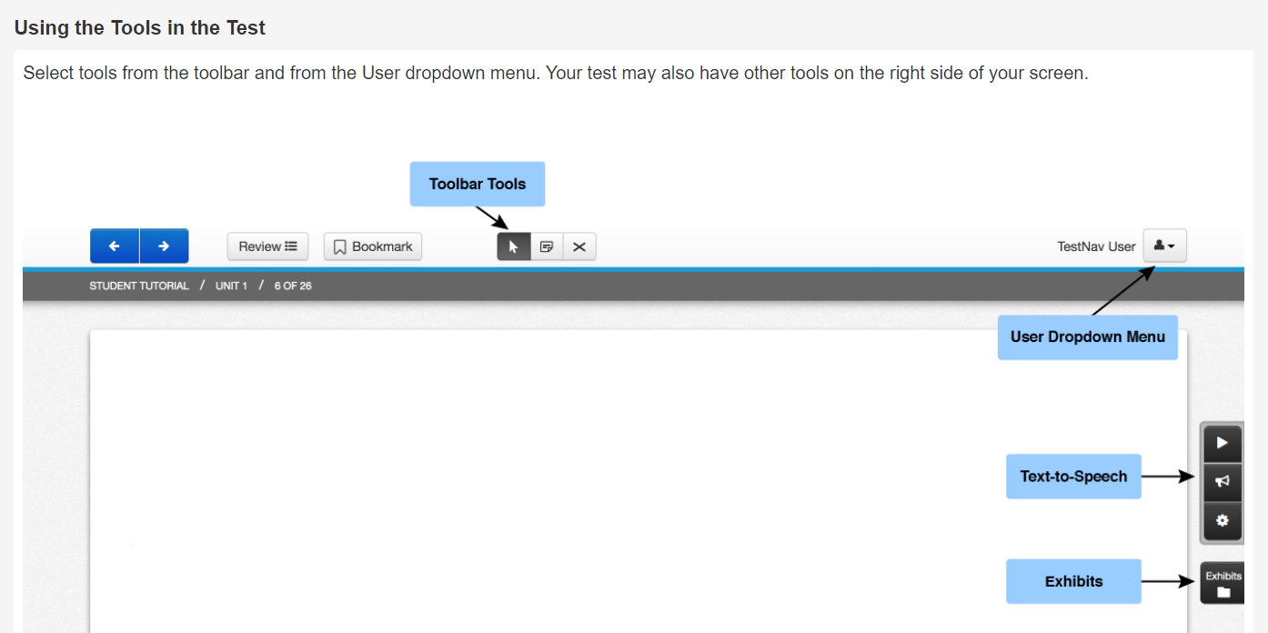
Sample Toolbar

Slide 32
Toolbar tools

Slide 33
Accessibility Tools in user dropdown menu
Change background and foreground color
Magnifier
Line Reader Mask
Answer Masking

Slide 34
Keyboard Navigation shortcuts
Many item types within TestNav can be interacted with using a keyboard. Keyboard navigation to supported item types uses basic keyboard commands.
Action | Keyboard Shortcut
Move forward | Tab
Move backwards | Shift and Tab
Select buttons | Enter or Spacebar
Navigate and select radio buttons | Arrow up or arrow down
Select and deselect boxes | Spacebar

Slide 35
Personal Needs Profile (pnp)
Select Universal Tools for students prior to testing session in ${PearsonAccess}^{next}$
Student can still enable available features independently in the testing environment
PNP available for every student

Slide 36
Important Dates

Slide 37
School Year 2022-2023
Achievement (AASA, AzSCI, ACT Aspire) Accommodations Request Window Open Now and Closes February 24, 2023
ACT: Open Now and Closes January 27, 2023
AZELLA: Open Now
MSAA and Alt ELPA: Do not require Accommodation Requests

Slide 38
Resources

Slide 39
Accessibility Resources
ADE Assessment Homepage
ADE Assessment Accessibility
ACT Arizona
ACT Test Accessibility and Accommodations (TAA) User Guide
ADE Assistive Technology
Council of Chief State School Officers (CCSSO) Accessibility Manual

Slide 40
Questions?

Slide 41
Thank you!
For questions, please contact us at:
Testing@azed.gov
Azella@azed.gov

