Slide 1
Friday focus: Things to know as a new dtc
This webinar will be recorded and posted on the ADE Assessments webpage at https://www.azed.gov/assessment.
Please enter your First and Last Name in the Chat for tracking purposes for the live event.
We will also be capturing the chat questions. ADE will compile and create a FAQ list which will then be posted on our website. The FAQ will only include those questions that are relevant to the webinar topic. ADE will follow up with any other questions via e-mail.

Slide 2
Friday Focus webinar #3
Things to know as a new district test coordinator

Slide 3
Friday focus: Things to know as a new dtc
The purpose of this webinar is to guide new District Test Coordinators on topics related to State Testing.
Throughout this webinar we will provide you with valuable resources and helpful links for testing related materials.

Slide 4
Friday focus: Things to know as a new dtc
Welcome from the ADE ASSESSMENTS TEAM
General Assessment Information
Achievement Assessments
Alternate Assessments
AZELLA Assessments
Questions

Slide 5

Welcome from ADE state Test coordinators

Slide 6

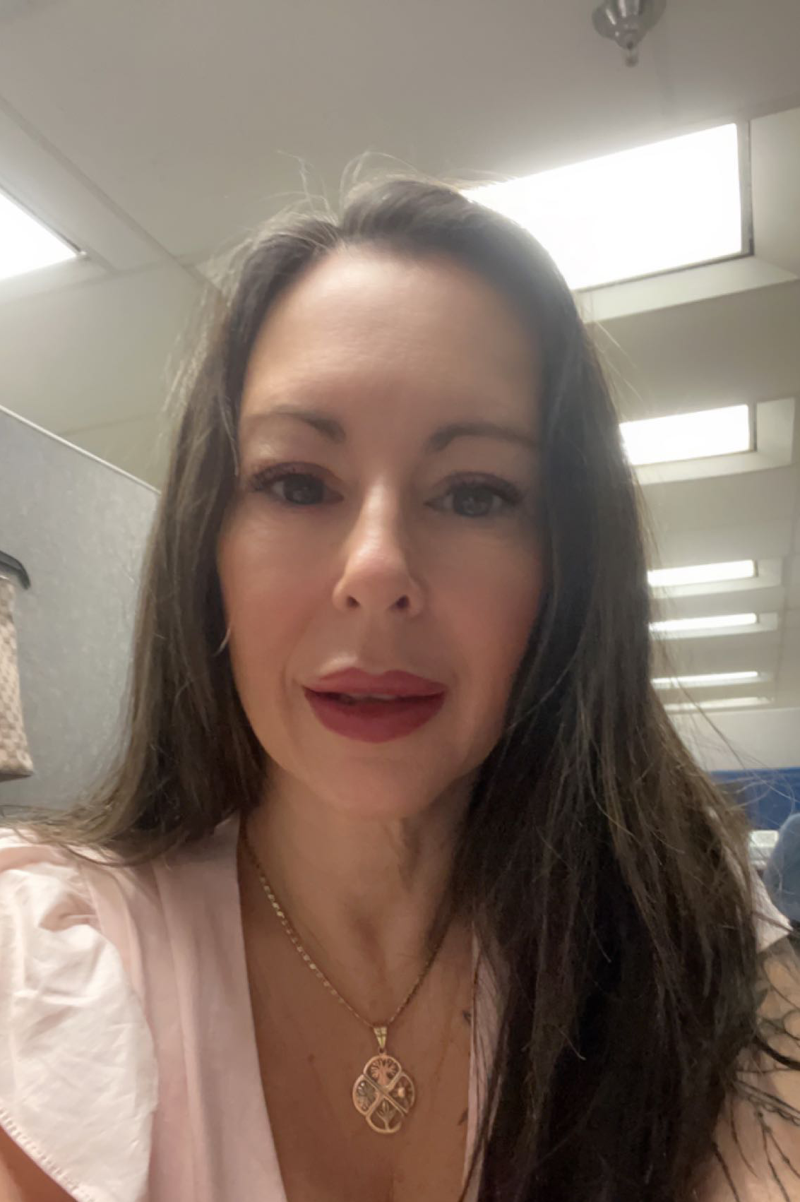
Friday focus: Things to know as a new dtc
ACHIVEMENT State test coordinator
ACHIVEMENT State test coordinator
Candis Middlebrook
Rose Alvarez

Slide 7
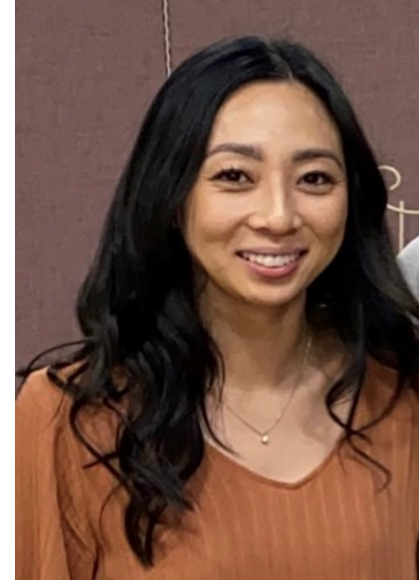
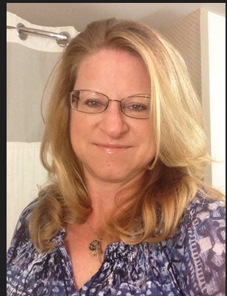
Friday focus: Things to know as a new dtc
Alternate assessment coordinator
Azella state test
coordinator
Sarah Han
Brenda Vanderwerp

Slide 8
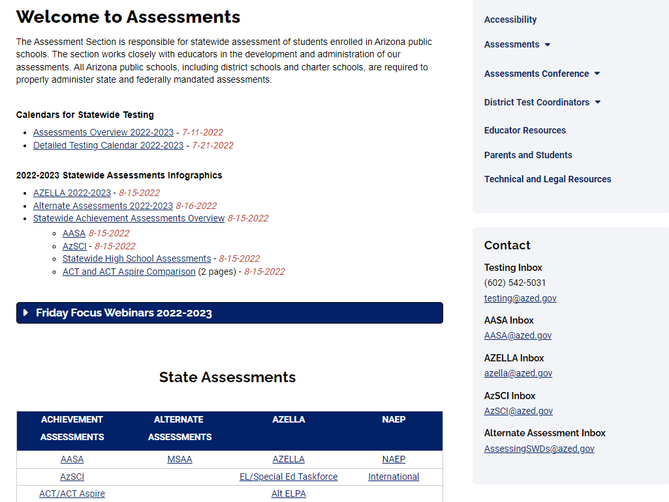
Friday focus: Things to know as a new dtc
ASSESSMENTS
https://www.azed.gov/assessment

Slide 9
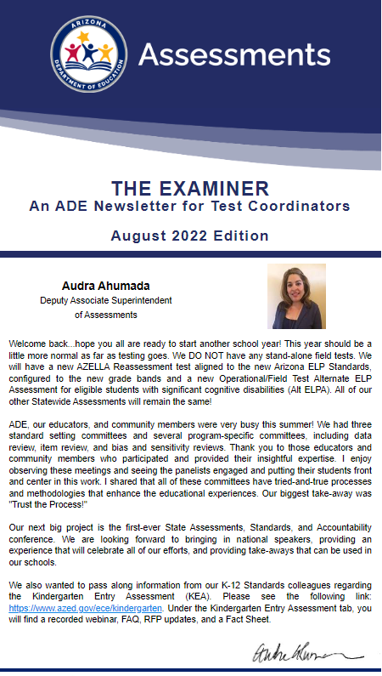
Friday focus: Things to know as a new dtc
The Examiner
https://www.azed.gov/assessment/examiner
The Examiner newsletter is sent to DTCs quarterly on the 1st of August, November, February and May. This newsletter provides essential information for DTCs regarding all state testing related topics.

Slide 10
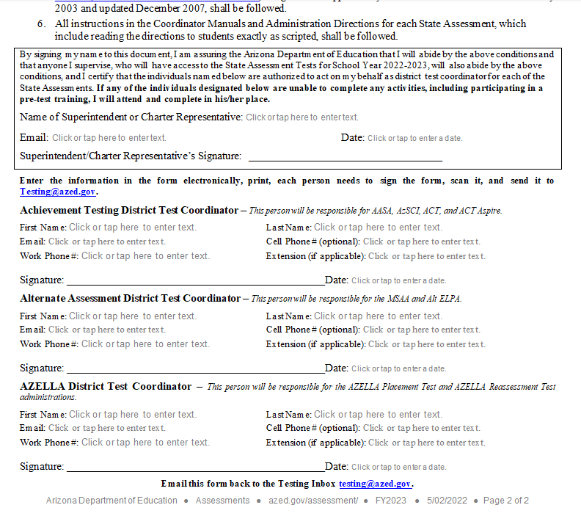
Friday focus: Things to know as a new dtc
GETTING STARTED: IMPORTANT FIRST STEP
The first step you must take as a DTC is to fill out the DTC Test Security Agreement and return the signed agreement to: testing@azed.gov
2022-2023 Assessment Test Coordinator and Security Agreement
If there is a change to the DTC at your district, a new agreement must be signed and submitted as directed above.
Please note that this agreement must be signed by Superintendent/Charter Representative

Slide 11
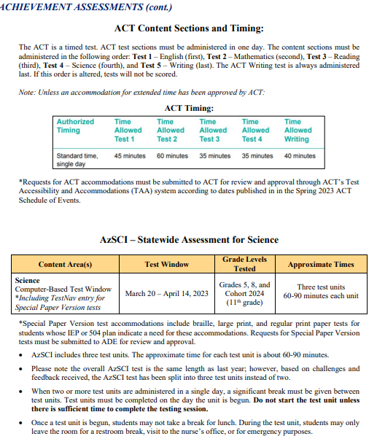
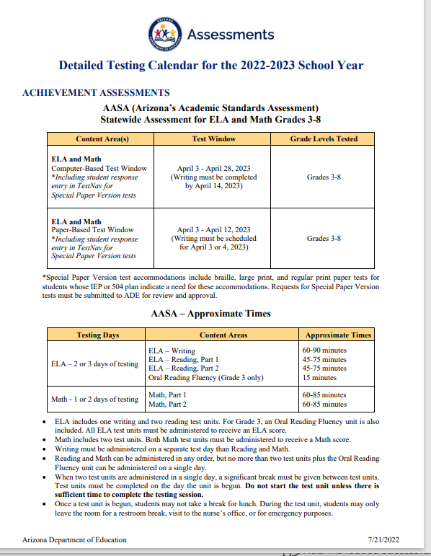
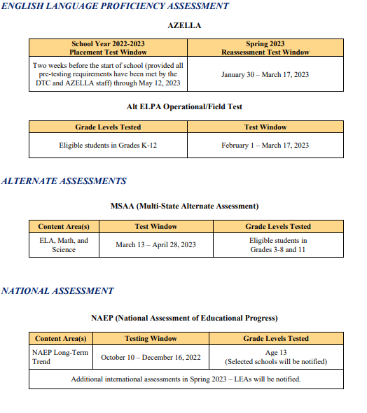
Friday focus: Things to know as a new dtc
2022-2023 Detailed Testing Calendar

Slide 12
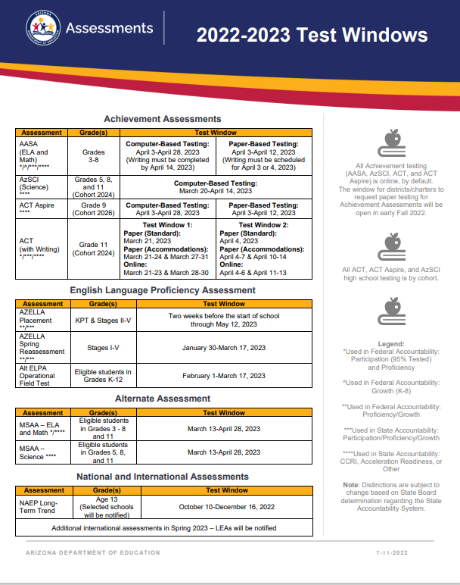
Friday focus: Things to know as a new dtc
2022-2023 Test Windows
https://www.azed.gov/sites/default/files/2022/05/Assessments%20Overview%202022-2023.pdf

Slide 13
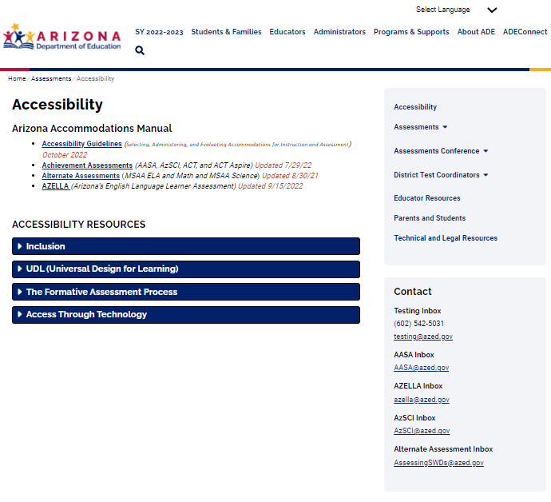
Friday focus: Things to know as a new dtc
ACCESSIBILITY
https://www.azed.gov/assessment/accessibility

Slide 14

Friday focus: Things to know as a new dtc
ADE will upload ALL students to PearsonAccess^{next} (the test registration platform), including students who are eligible for Alternate Assessment.
Students who will take MSAA and Alt ELPA (the Alternate Assessments) will also be uploaded to the Alternate Assessment testing platforms.

Slide 15
Achievement assessments
AASA, Azsci, act aspire, act

Slide 16
Friday focus: Things to know as a new dtc
Aasa: Statewide assessment for ELA and math
azSci: statewide assessment for science
Who to test:
Grades 3-8
Testing Window:
Computer-Based: April 3-April 28, 2023
Paper-Based: April 3-April 12, 2023
Who to test:
Grades 5, 8, and Cohort 2024 (11th grade)
Testing Window:
March 20-April 14, 2023

Slide 17
Friday focus: Things to know as a new dtc
ACT ASPIRE:
STATEWIDE HIGH SCHOOL ASSESSMENT
Grade 9 (Cohort 2026)
Testing Window:
Computer-Based: April 3-28, 2023
Paper-Based: April 3-April 12, 2023

Slide 18
Friday focus: Things to know as a new dtc
Act: statewide high school assessment
Grade 11 (cohort 2024)
Testing Window 1:
Paper (Standard Administration):
March 21, 2023
Paper (Accommodations Administration):
March 21-24 and March 27-31, 2023
Online Administration:
March 21-23 and March 28-30, 2023
Testing Window 2:
Paper (Standard Administration):
April 4, 2023
Paper (Accommodations Administration):
April 4-7 and April 10-14, 2023
Online Administration:
April 4-6 and April 11-13, 2023

Slide 19
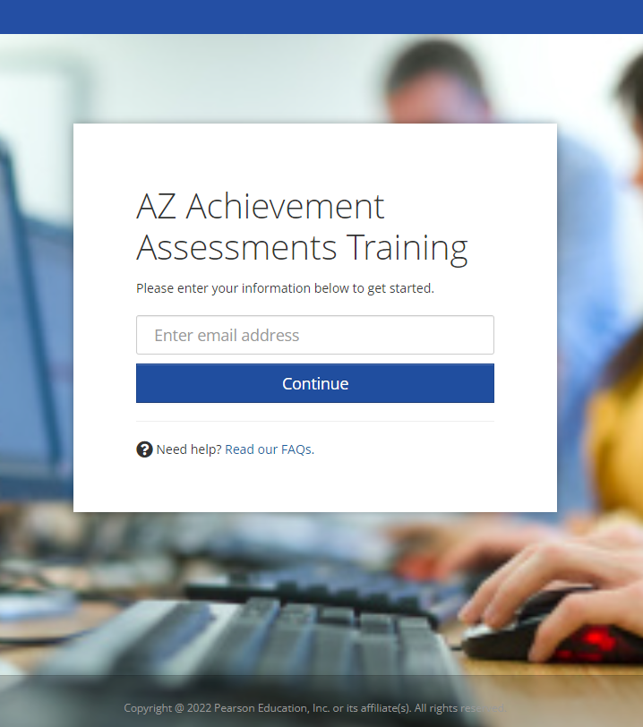
Friday focus: Things to know as a new dtc
Trainings
Coming Winter 2022-2023

Slide 20
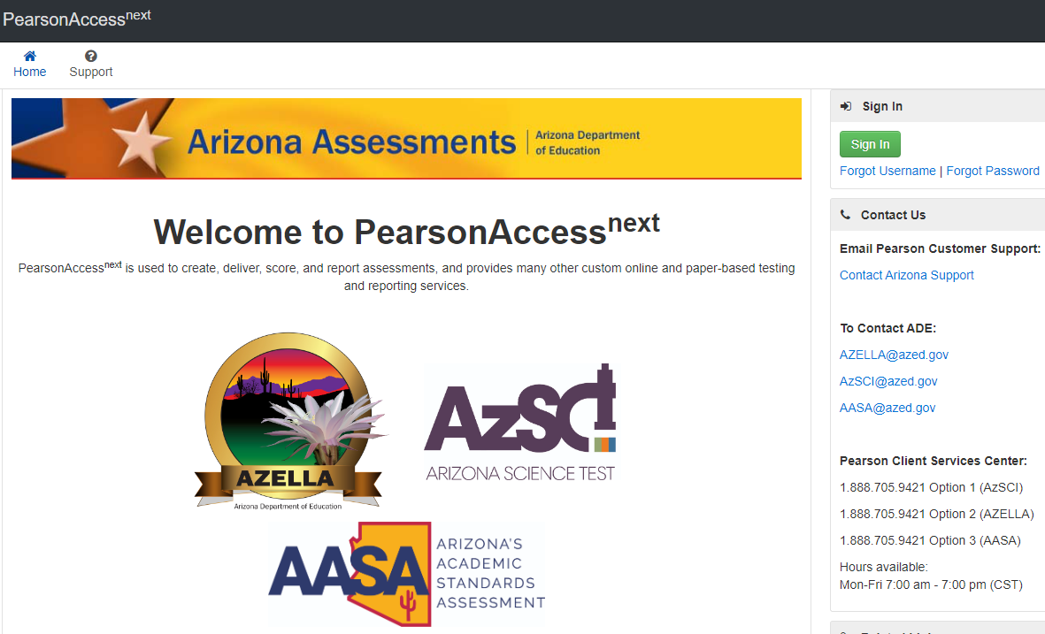
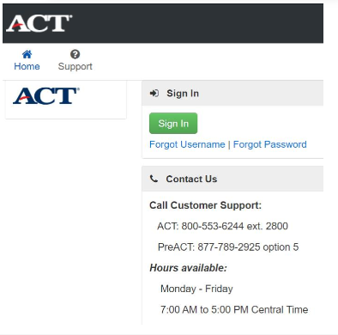
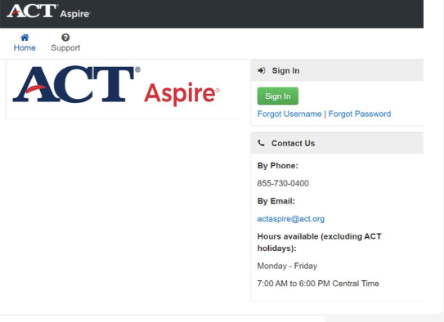
Friday focus: Things to know as a new dtc
Testing Platforms: PearsonAccess^{next} (PAN)
Administrative Tasks
AASA and AZSCI:
az.pearsonaccessnext.com
ACT ASPIRE:
aspire.act.org
ACT:
testadmin.act.org

Slide 21
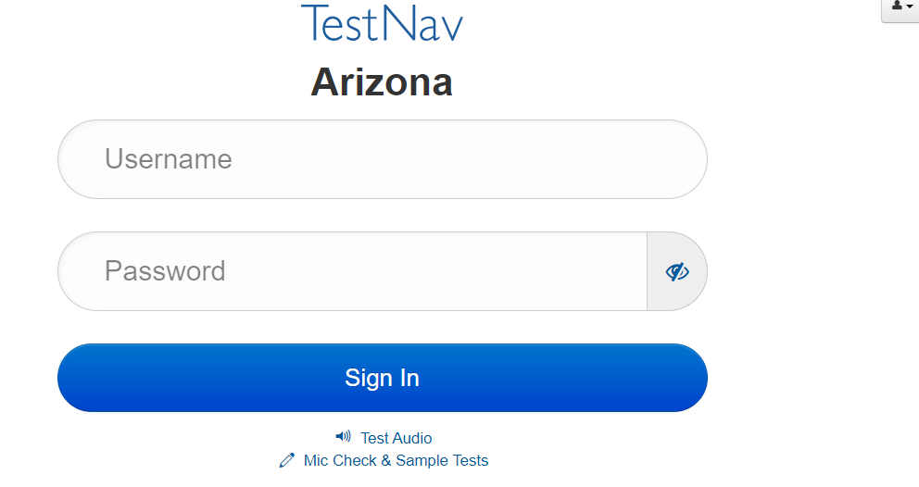
Friday focus: Things to know as a new dtc
Testing Platforms:
Operational and Sample Tests:
TestNav APP
Sample Tests:
az.testnav.com

Slide 22
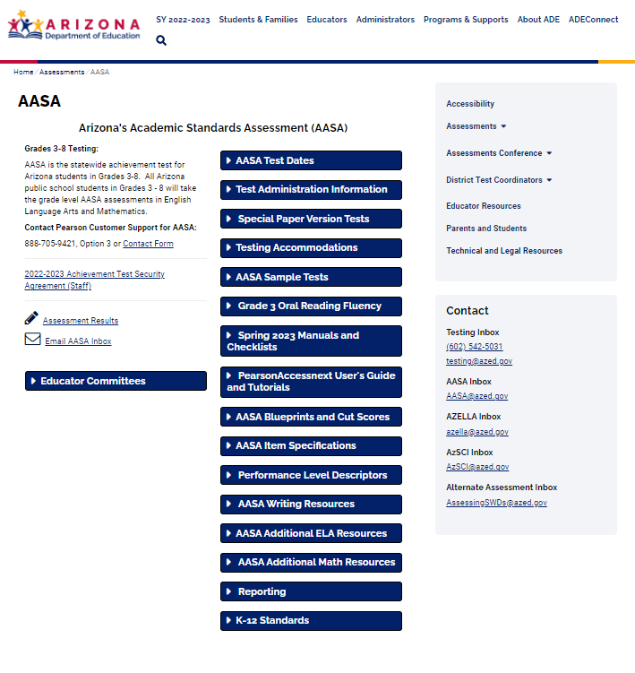
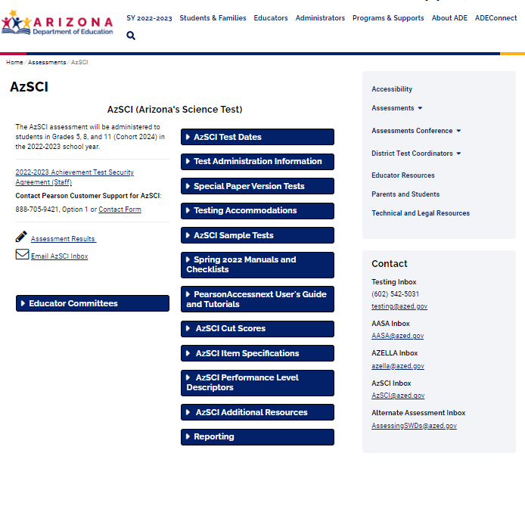
Friday focus: Things to know as a new dtc
IMPORTANT RESOURCES AND WEBPAGES
AASA
AzSCI

Slide 23
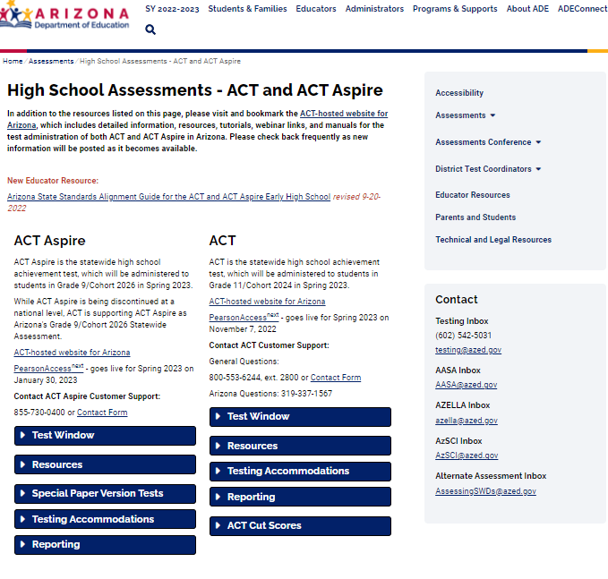
Friday focus: Things to know as a new dtc
IMPORTANT RESOURCES/WEBPAGES
ACT AND ACT ASPIRE

Slide 24
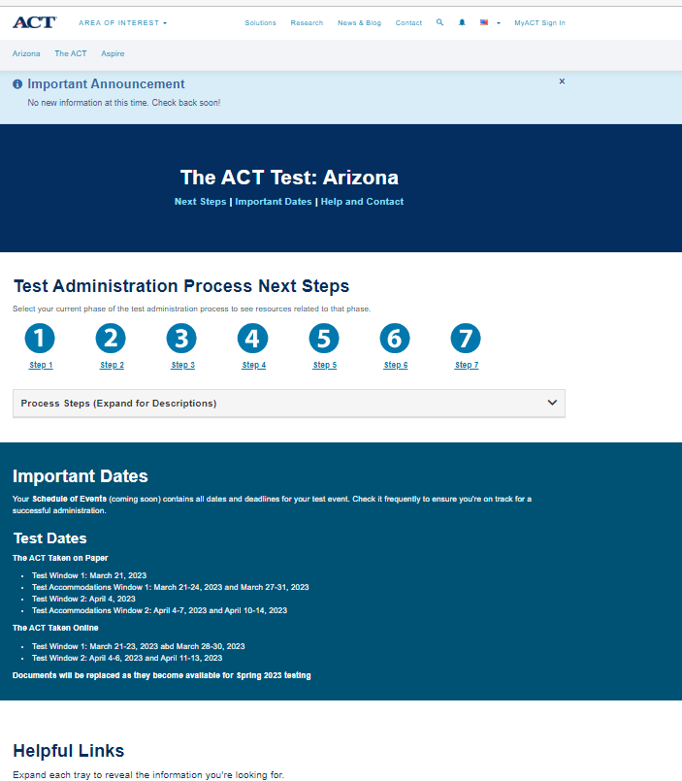
Friday focus: Things to know as a new dtc
ACT Hosted Website for Arizona
This is an ACT hosted website and here you can access a variety of resources to assist you with these assessments. There are a series of steps that take you to the resources related to the phase of test administration that you are currently working in.

Slide 25
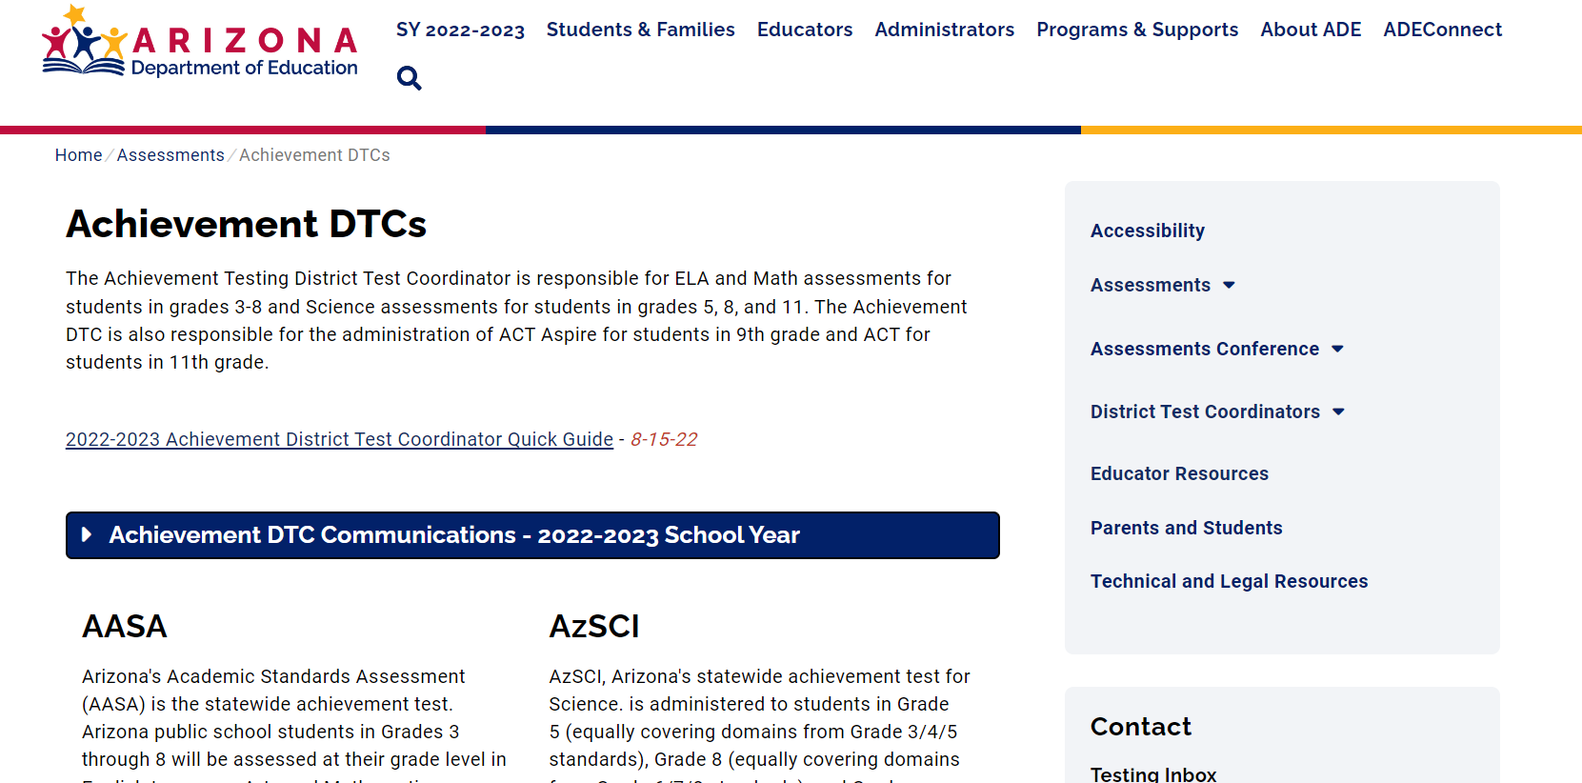
Friday focus: Things to know as a new dtc
Achievement DTCs
DTC Communications: These are sent regularly throughout the school year and will increase in frequency as we approach the testing windows. As communications are sent to DTCs, they will also be published on the Achievement DTC page of our website under the “Achievement DTC Communications – 2022-2023 School Year” dropdown.

Slide 26
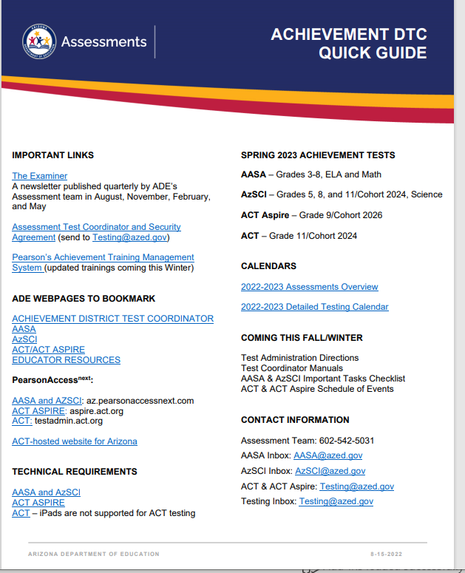
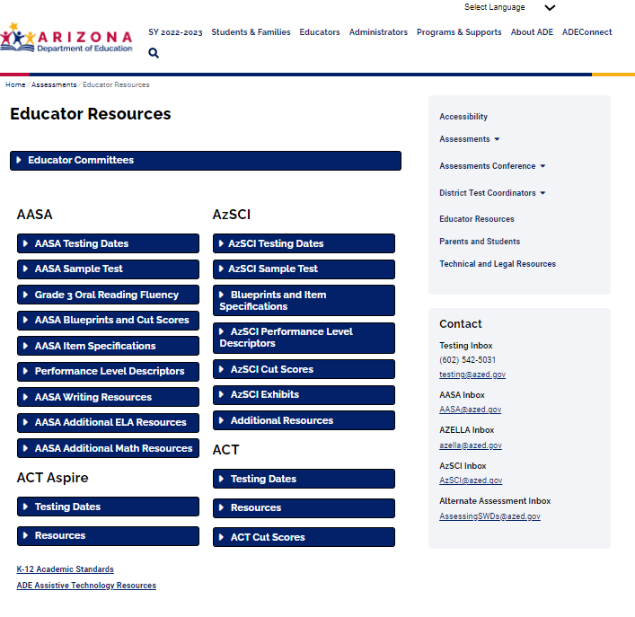
Friday focus: Things to know as a new dtc
IMPORTANT RESOURCES AND WEBPAGES
EDUCATOR RESOURCES
ACHIEVEMENT DTC QUICK GUIDE

Slide 27
Friday focus: Things to know as a new dtc
Resources Coming Soon
DTC Important Tasks Checklists for AASA and AzSCI
Schedule of Events for ACT and ACT Aspire

Slide 28
Friday focus: Things to know as a new dtc
ACHIEVEMENT ASSESSMENT QUESTIONS

Slide 29
Alternate assessments
Msaa and alt elpa

Slide 30
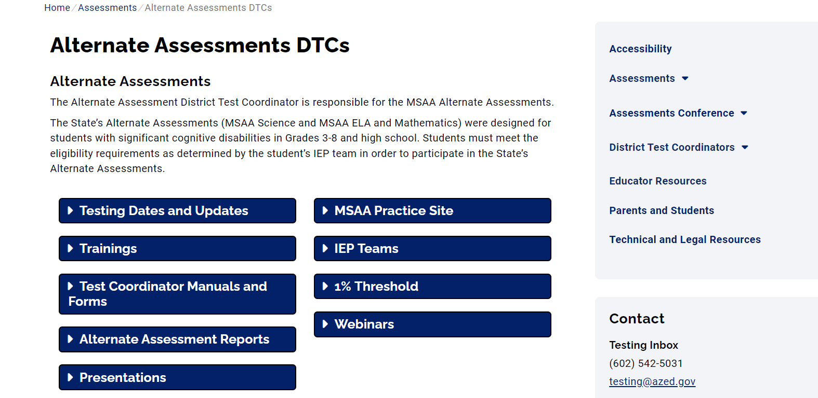
Friday focus: Things to know as a new dtc
ALTERNATE ASSESSMENTS
https://www.azed.gov/assessment/alternate-assessments-dtcs

Slide 31
Friday focus: Things to know as a new dtc
ALTERNATE ASSESSMENTS
What are alternate assessments?
Alternate assessments are designed for students with the most significant cognitive disabilities. Eligibility is determined by the IEP team annually following specific eligibility criteria.
The Alt ELPA is administered to English learners with the most significant cognitive disabilities in Grades K-12.
The Multi-State Alternate Assessment (MSAA) is administered to eligible students in Grades 3-8 and 11 in the areas of ELA, Mathematics and Science.

Slide 32
Friday focus: Things to know as a new dtc
Testing Windows:
Alt ELPA: February 1 – March 17, 2023
MSAA: March 13 – April 28, 2023

Slide 33
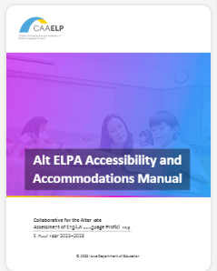
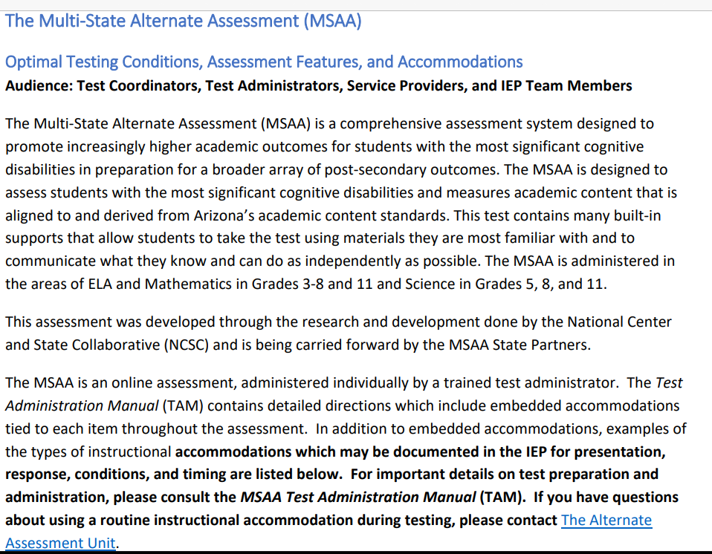
Friday focus: Things to know as a new dtc
Test administration:
One on one administration
Allows many accessibility features and accommodations to meet communication modes.
Alt ELPA Accommodations Manual MSAA Accommodations Manual

Slide 34
Friday focus: Things to know as a new dtc
All communication is e-mailed to Alternate Assessment Test Coordinators. Notifications are posted on the:
Alternate Assessment DTC webpage.
Refer to the Alternate Assessment District Test Coordinator Handbook for dates and instructions for all alternate assessment activities.

Slide 35
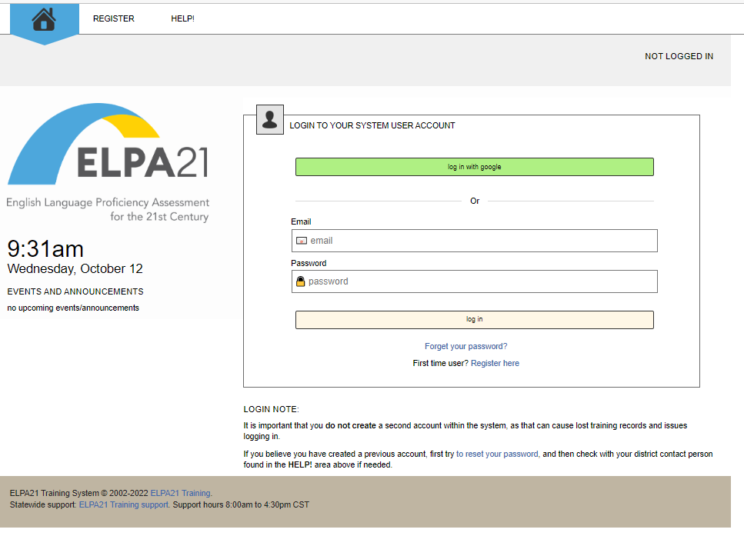
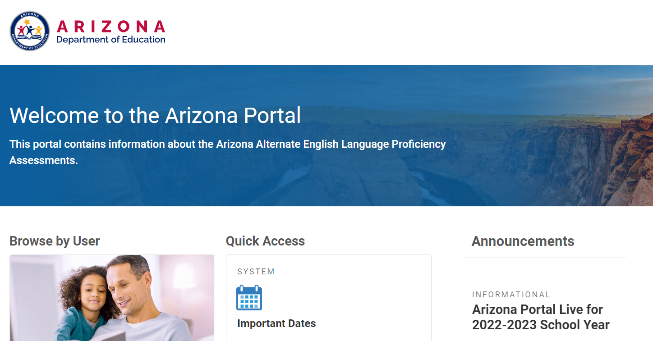
Friday focus: Things to know as a new dtc
Alt ELPA Training Platform – LMS
Alt ELPA Sample Items and
Test Administration Platform –
Cambium Portal

Slide 36
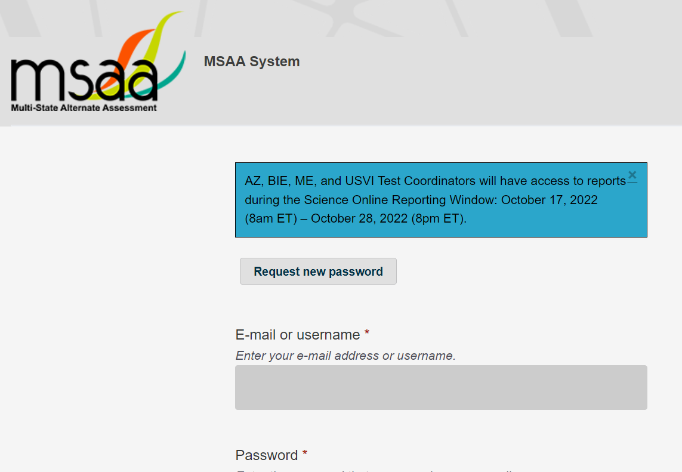
Friday focus: Things to know as a new dtc
MSAA Training and Test Administration Platform – MSAA Portal

Slide 37
Friday focus: Things to know as a new dtc
ALTERNATE ASSESSMENTS
QUESTIONS

Slide 38
Azella assessments
Placement and reassessment

Slide 39
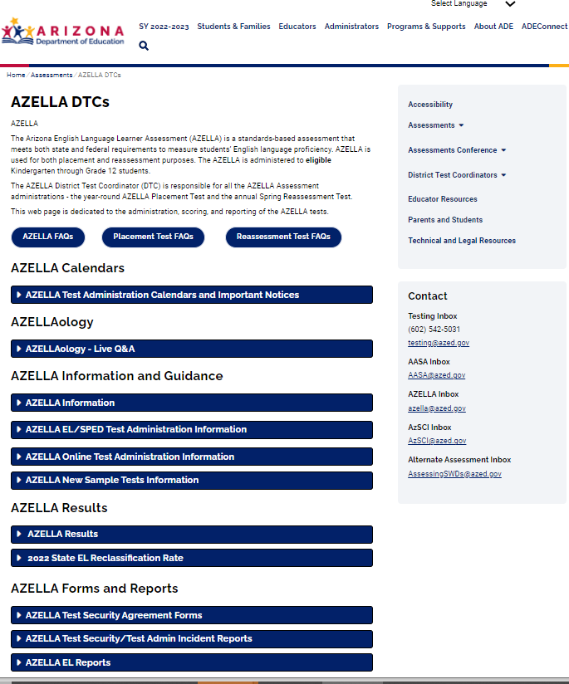
Friday focus: Things to know as a new dtc
AZELLA ASSESSMENTS
https://www.azed.gov/assessment/azella-dtcs

Slide 40
Friday focus: Things to know as a new dtc
What is AZELLA?
The Arizona English Language Learner Assessment (AZELLA) is:
a standards-based assessment that meets both state and federal requirements to measure students’ English language proficiency
used for both placement and reassessment purposes
AZELLA assesses the four domains of the language: Listening, Reading, Writing, and Speaking.

Slide 41
Friday focus: Things to know as a new dtc
Who to test?
Upon first enrollment in an Arizona school, if any of the three questions on the Home Language Survey (HLS) form is answered with any language other than English or American Sign Language (ASL), the student must be administered an AZELLA Placement Test. The three questions are as follows:
1. What language do people speak in the home most of the time?
2. What language does the student speak most of the time?
3. What language did the student first speak or understand?
The Spring Reassessment Test is administered to all English learners until they obtain an Overall Level of Proficiency of Proficient.

Slide 42
Friday focus: Things to know as a new dtc
AZELLA TEST windows
Placement Test Window:
As early as two weeks before the first day of school, provided all the pre-testing requirements have been met.
Test administration closes 5/12/2023
Spring 2023 Reassessment Test Window:
January 31, 2023 – March 17/2023
AZELLA Test Administration Calendars for School Year 2022 – 2023

Slide 43
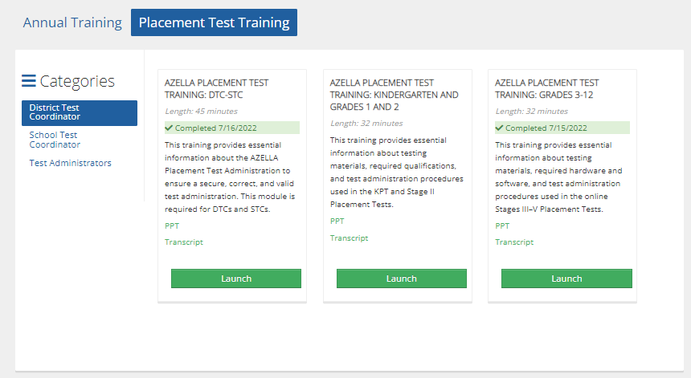
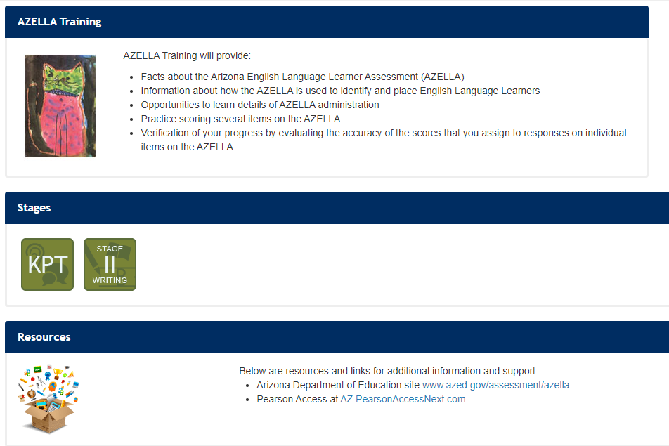
Friday focus: Things to know as a new dtc
AZELLA Training Platforms
Arizona Training Management System (ATMS) https://az.tms.pearson.com
Annual, Placement, and Reassessment training modules by category
Understand Scoring*
https://azella.scoring.pearsonassessments.com/understandscoring/
Kindergarten Placement Test –Test Administrator Qualification
Stage II Writing Scorer Qualification
*Only for districts that serve KG – Grade 2 students for the Placement Test Administration.

Slide 44
Friday focus: Things to know as a new dtc
AZELLA Communications:
The AZELLA Communiqué sent to AZELLA District Test Coordinators:
Welcome DTC Email –all the basic information for training, calendars, and much more!
Regular Communications –updates and reminders

Slide 45
Friday focus: Things to know as a new dtc
Virtual Office hours –AZELLAology (not required, but suggested for new DTCs)
On scheduled Tuesdays to ask questions and learn about specific topics.
The link to the AZELLAology and schedule can be found at:
https://www.azed.gov/assessment/azella-dtcs

Slide 46
Friday focus: Things to know as a new dtc
AZELLA FAQs
AZELLA Placement Test FAQs
AZELLA Reassessment Test FAQs

Slide 47
Friday focus: Things to know as a new dtc
AZELLA QUESTIONS

Slide 48
Friday focus: Things to know as a new dtc
Achievement assessment contacts
ACT and ACT Aspire
testing@azed.gov
AASA Inbox
AASA@azed.gov
AzSCI Inbox
AzSCI@azed.gov
AZELLA Inbox
azella@azed.gov
Alternate Assessment Inbox
AssessingSWDs@azed.gov
Assessment Team:
(602) 542-5031
testing@azed.gov

Slide 49

Friday focus: Things to know as a new dtc
QUESTIONS?

