Slide 1
ACT and ACT Aspire: Interpreting Reports
Assessments Friday Focus Webinar Series#2
Dr. Anju Kuriakose
Director of Psychometrics
Arizona Department of Education

Slide 2
Welcome to Webinar #2: ACT and ACT ASpire – Interpreting reports
This is the second webinar session in this series for the 2022-2023 school year
This webinar will be recorded and posted on the ADE Assessments webpage. ​https://www.azed.gov/assessment.
Please enter your First and Last Name in the Chat for tracking purposes for the live event.​
​
We will also be capturing the chat questions. If there are questions that were frequently asked or need further clarification, ADE will compile and create an FAQ which will then be posted on our website. The FAQ will only include those questions that are relevant to the webinar topic. ADE will follow up with any other questions via email.

Slide 3
Welcome and Overview
  This session will highlight how you can use some of the information contained in the ACT and ACT Aspire reports.
  We will briefly introduce the webpage that has a lot more information.
  We will go over the student reports and interpret the results.
  We will answer some frequently asked questions.

Slide 4
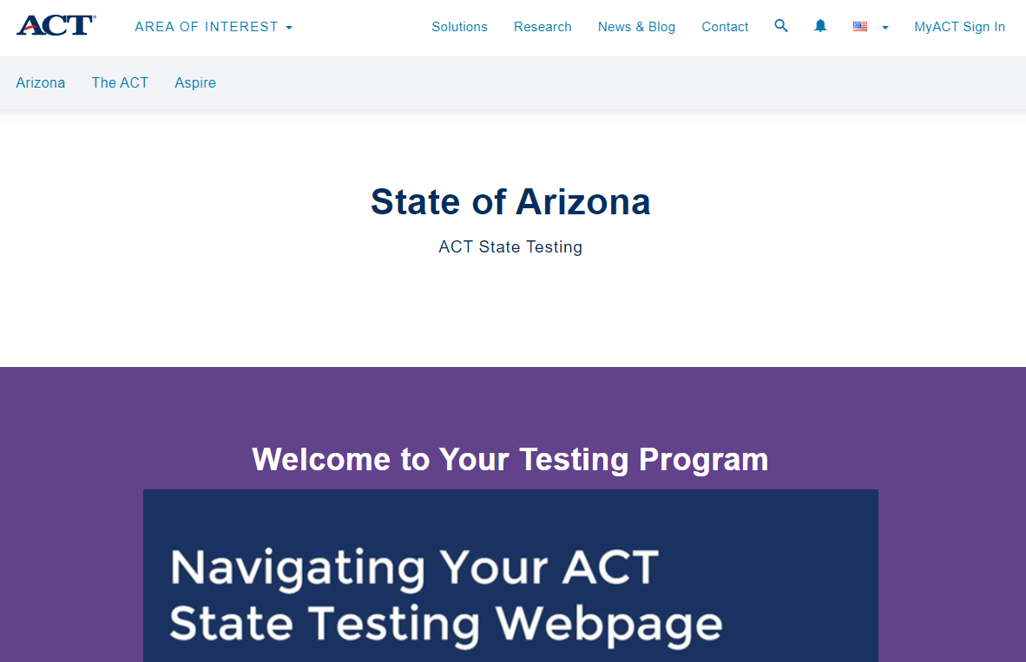
ACT Site
ACT Arizona site has all the information and much more.
https://www.act.org/content/act/en/products-and-services/state-and-district-solutions/arizona.html

Slide 5
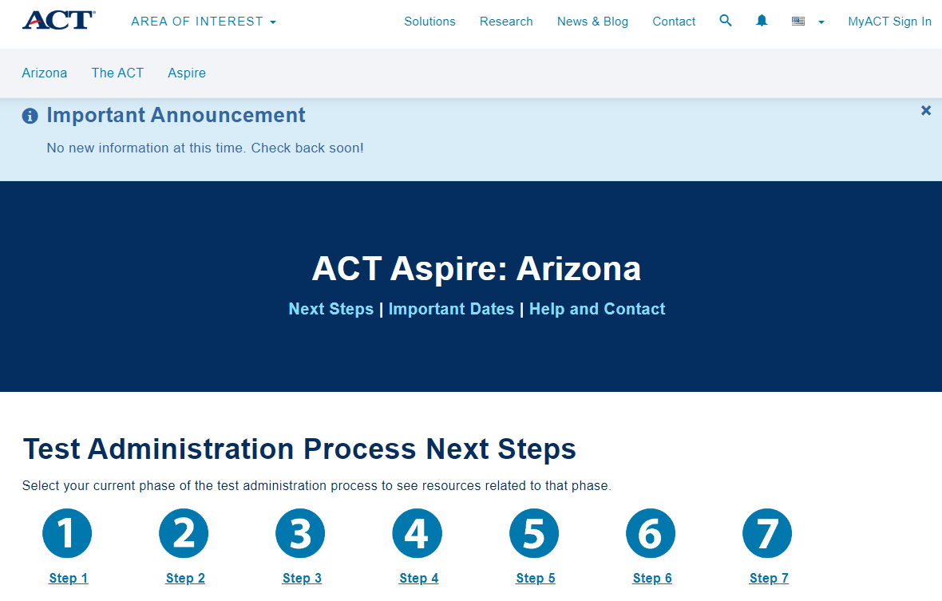
Seven StepS – ACT and aCT ASPIRE

Slide 6
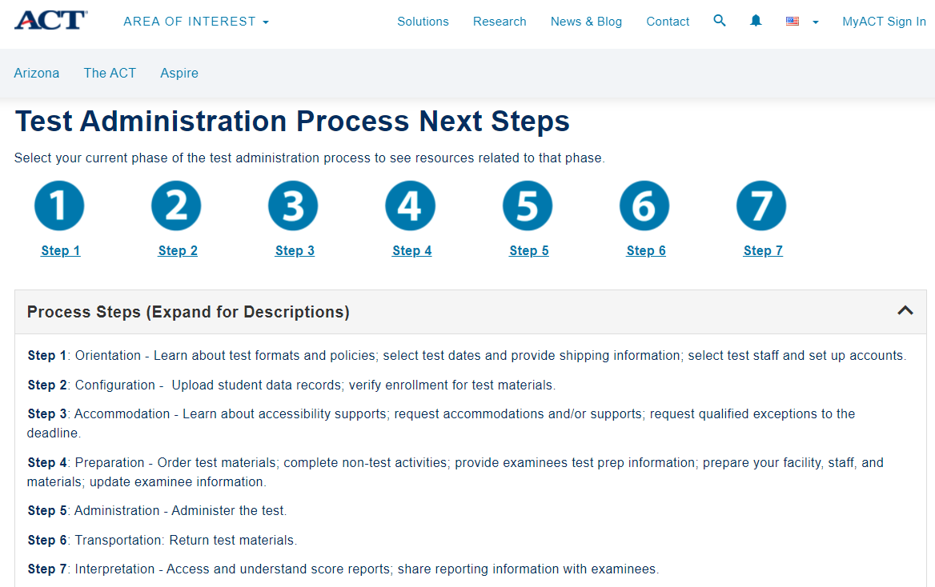
ACT and ACT Aspire

Slide 7
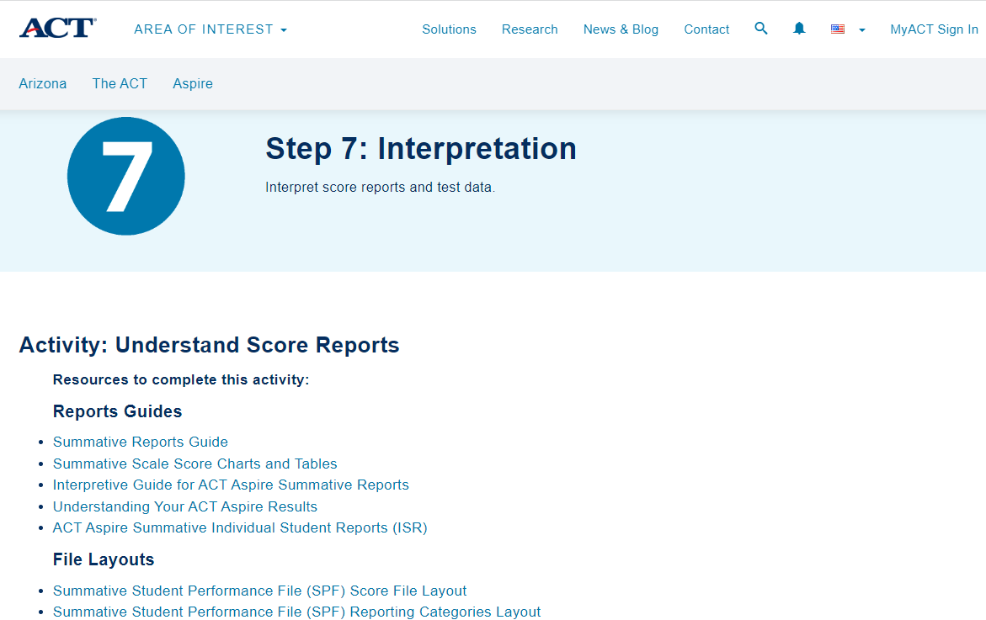
DATA InterPretation

Slide 8
ACT Aspire
Measures student progress towards college and career readiness.
  English
  Reading
  Mathematics
  Science
  Writing
The scores from each subject are measured against ACT Readiness Benchmarks.
Identifies whether students are on target to meet the ACT Readiness Benchmarks when they take the test in grade 11.

Slide 9
ACT Aspire scores
ELA scaled score – English, reading, and writing
STEM scaled score – Math and Science combined
Progress with text complexity
  Identifies whether students are making enough progress with reading complex texts to be ready for college and career
Composite score – English, Math, Reading, and Science
Predicted Scores
  Pre-ACT and ACT
Percentile Ranks
Readiness levels

Slide 10
ACT ASPIre – ReadINess Levels
Readiness levels also reported in four levels
Exceeding
  Substantially above the benchmark and have the highest chance to be college and career ready
Ready
  Students have met the Benchmark indicator and on target for 50% or higher likelihood of college readiness
Close
  Scored below the target but close to the ready category
In need of support
  Scored substantially below the readiness indicator

Slide 11
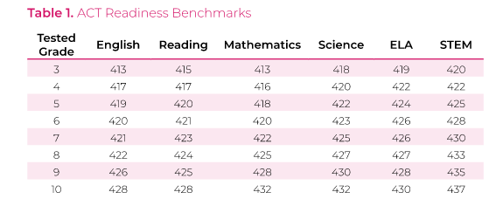
ACT Aspire Readiness Benchmarks by grade
The table shows data for all grades and subjects. Students who score at or above these benchmarks are on target for college readiness when they take the ACT test in grade 11.
The readiness benchmarks are on the score reports.
No readiness benchmarks for writing.

Slide 12
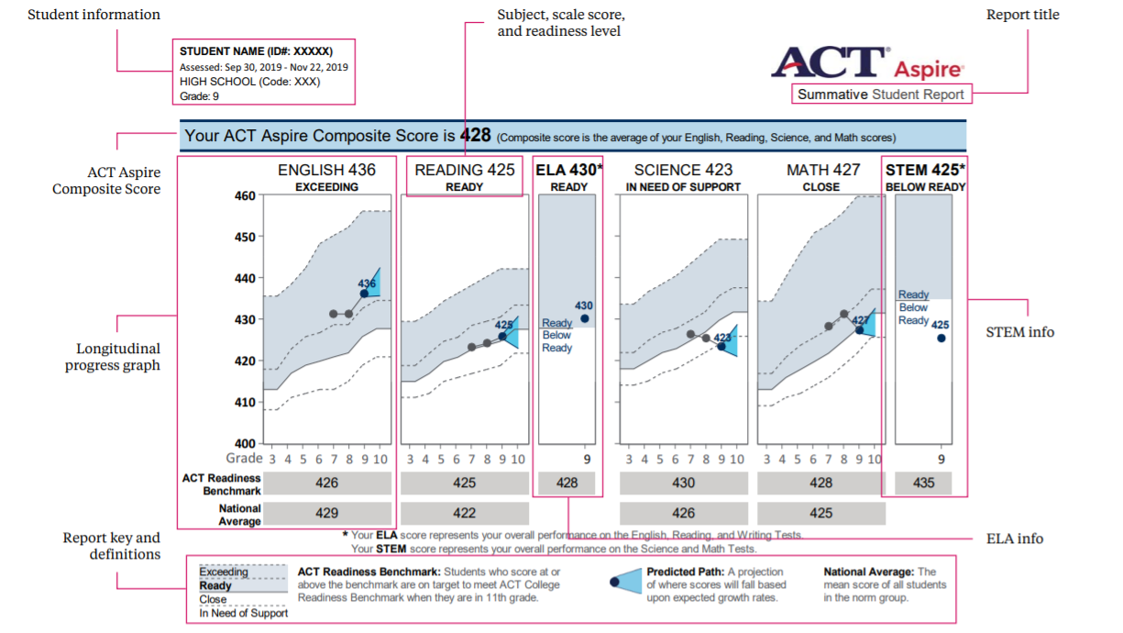
ACT Aspire – INDIVIDUAL Student Report

Slide 13
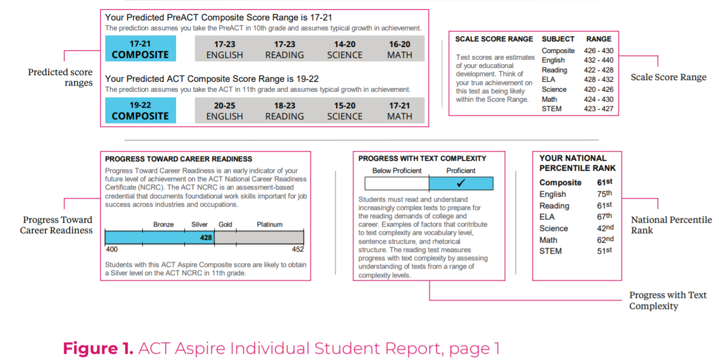
ACT Aspire – Summative Student Report
ACT Aspire – INDIVIDUAL Student Report

Slide 14
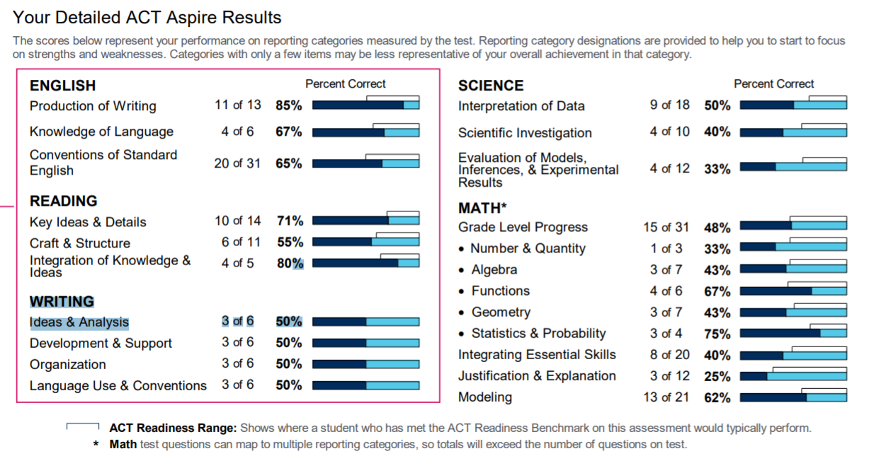
Aspire ISR-Reporting Categories

Slide 15
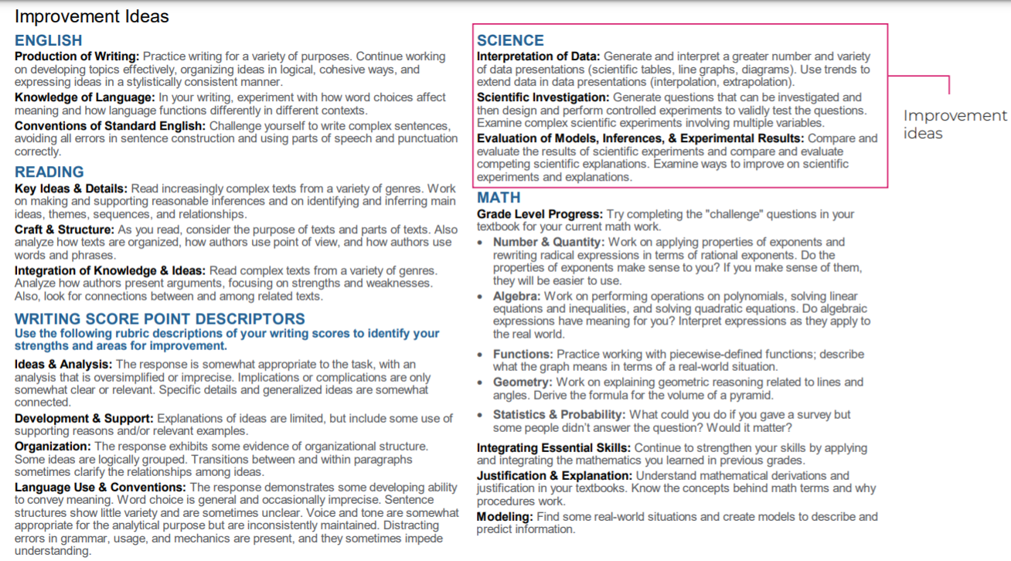
ASPIRE –ISR Details

Slide 16
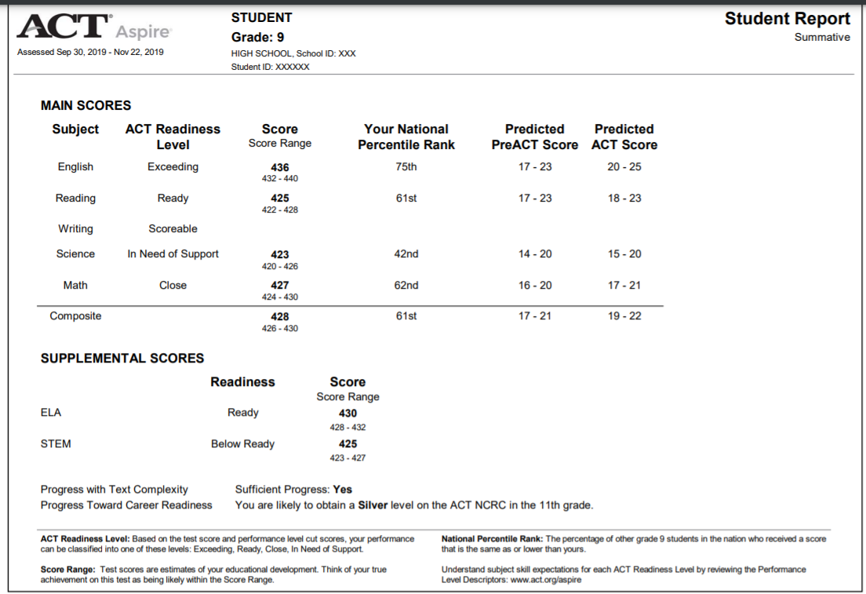
ACT Aspire ISR – 1 page

Slide 17
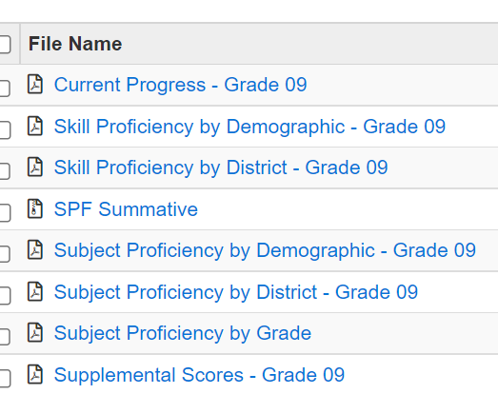
ASPIRE REpORTS

Slide 18

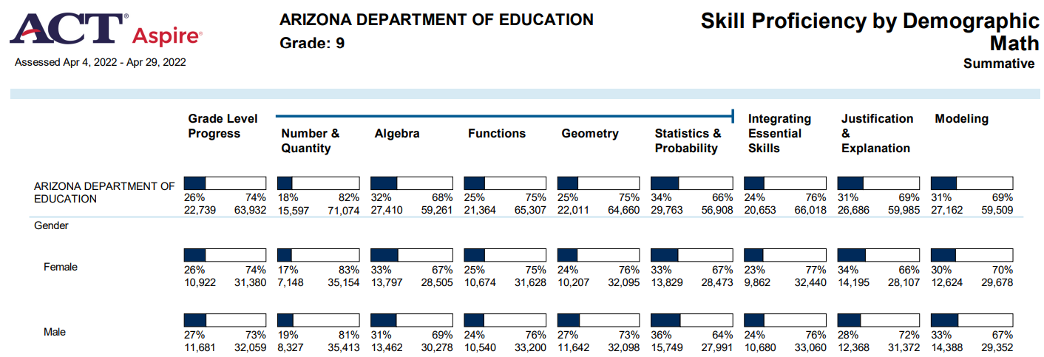
Skill Proficiency by DemOgraphic Math - exaMPle

Slide 19

ASPIRE 2022 – Subject ProfIciency by GRADE

Slide 20
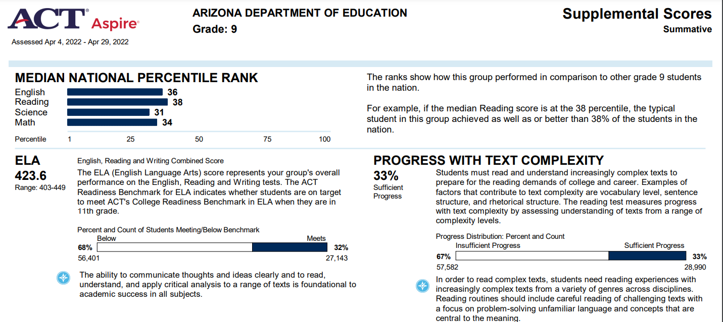
ASPIRE Reports – Supplemental Scores Summative

Slide 21
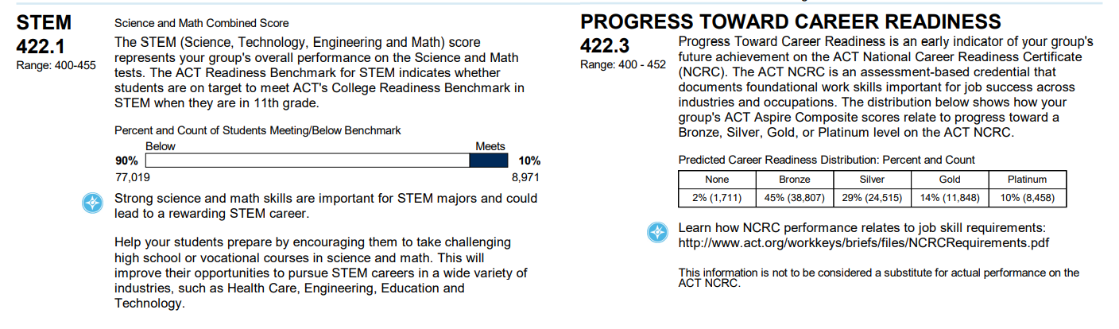
ASPIRE Reports – Supplemental Scores Summative

Slide 22
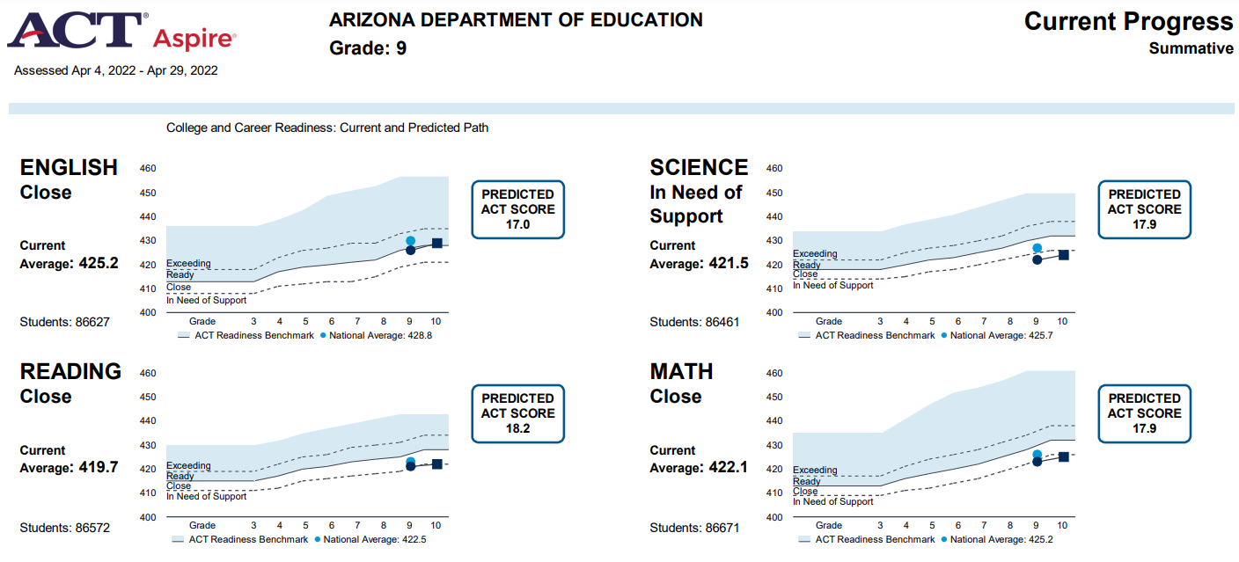
Current Progress summative

Slide 23
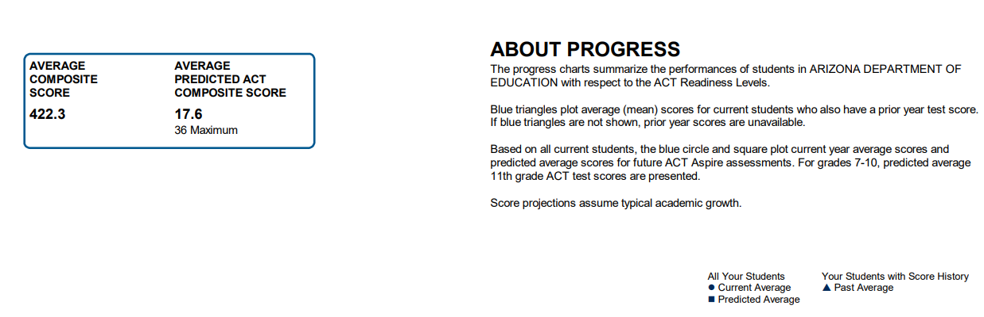
Current Progress Summative

Slide 24
ACT ReadINESS BeNcHMARKS
  The Benchmarks are scores on the ACT subject-area tests that represent the level of achievement required for students.
    To have a 50% chance of obtaining a B or higher or about a 75% chance of obtaining a C or higher in corresponding credit-bearing first-year college courses.
  These college courses include English composition, college algebra, introductory social science courses, and biology.
  Based on a sample of 214 institutions and more than 230,000 students from across the United States, the Benchmarks are median course placement values for these institutions and as such represent a typical set of expectations.

Slide 25
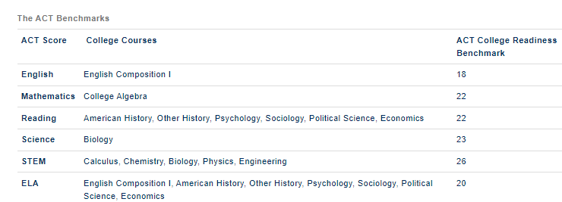
ACT BeNCHMARKS

Slide 26
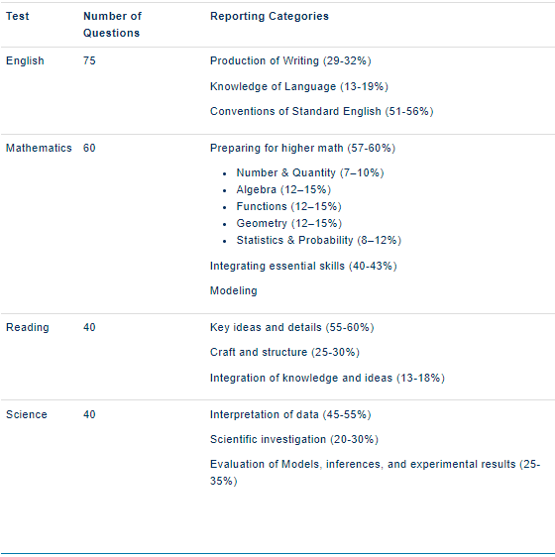
ACT Reporting CATEGORIES

Slide 27
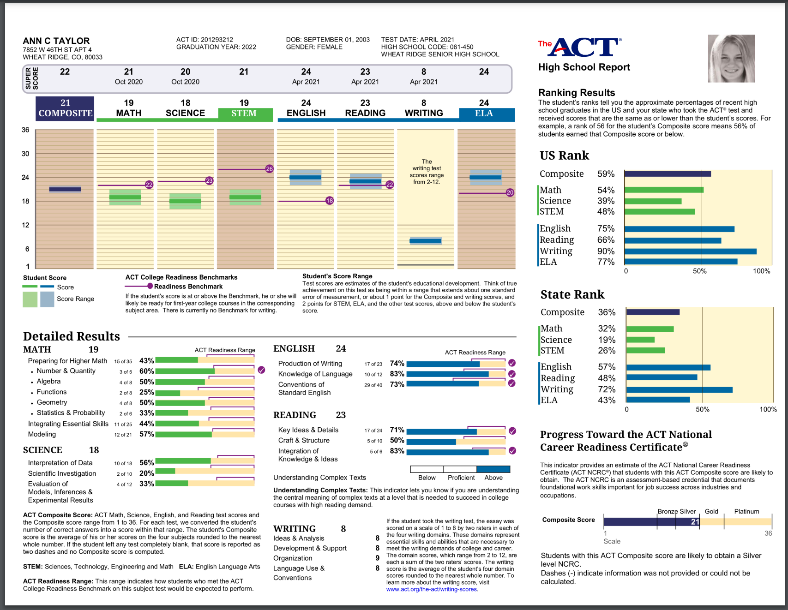
ACT – Individual Student Report

Slide 28
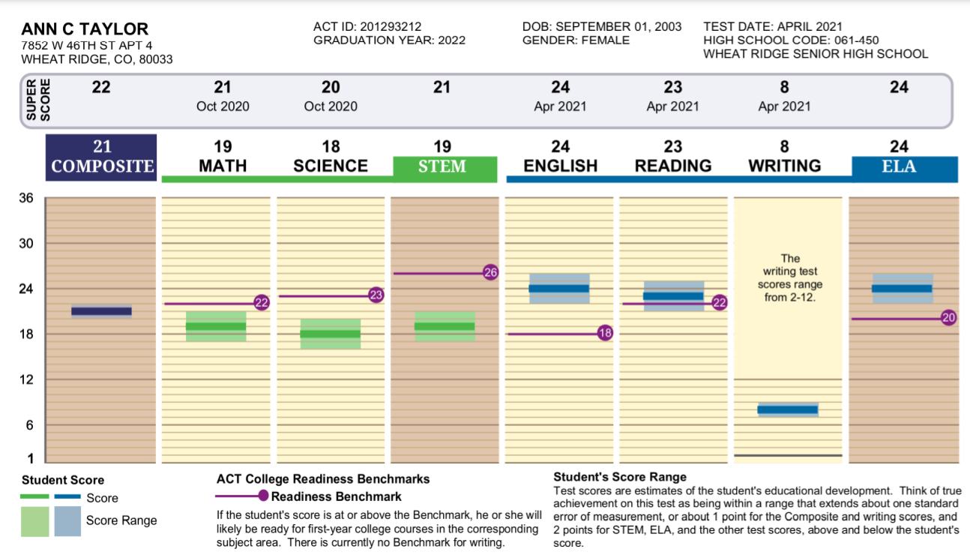
ACT - Scores

Slide 29
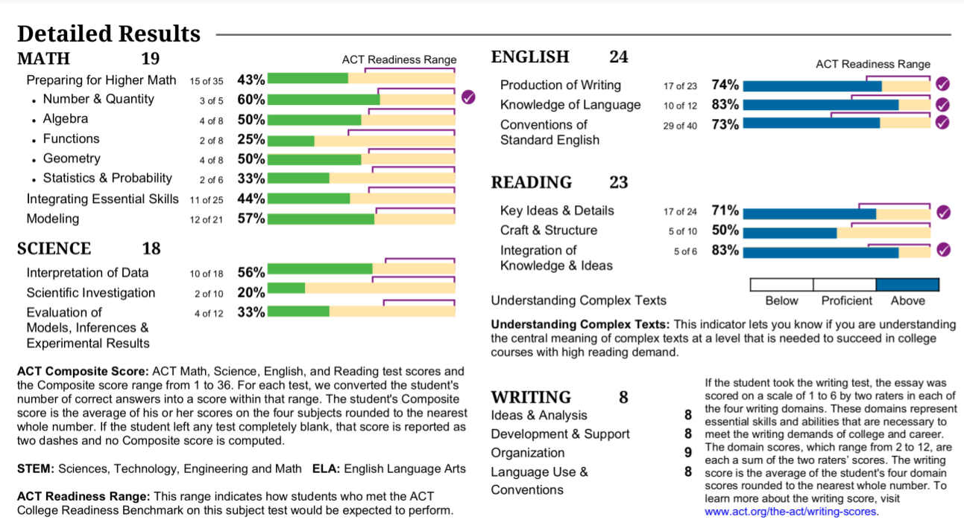
ACT – Detailed Results

Slide 30
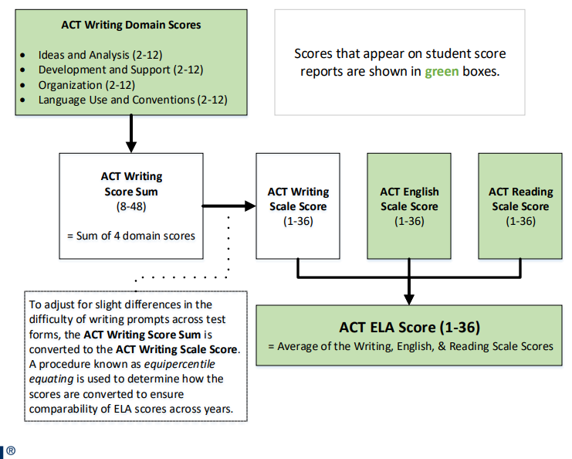
ELA ScOre on The ACT

Slide 31
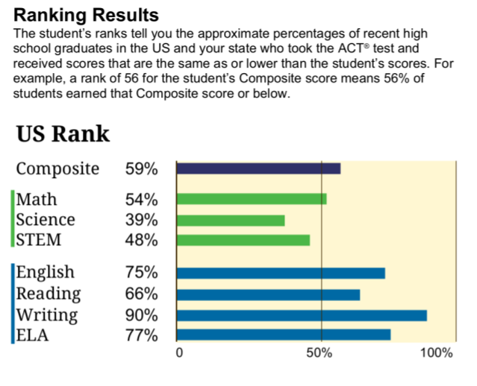
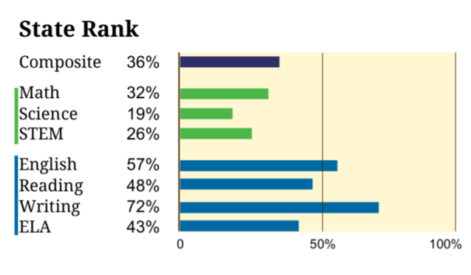
ACT HS Report - Rankings

Slide 32
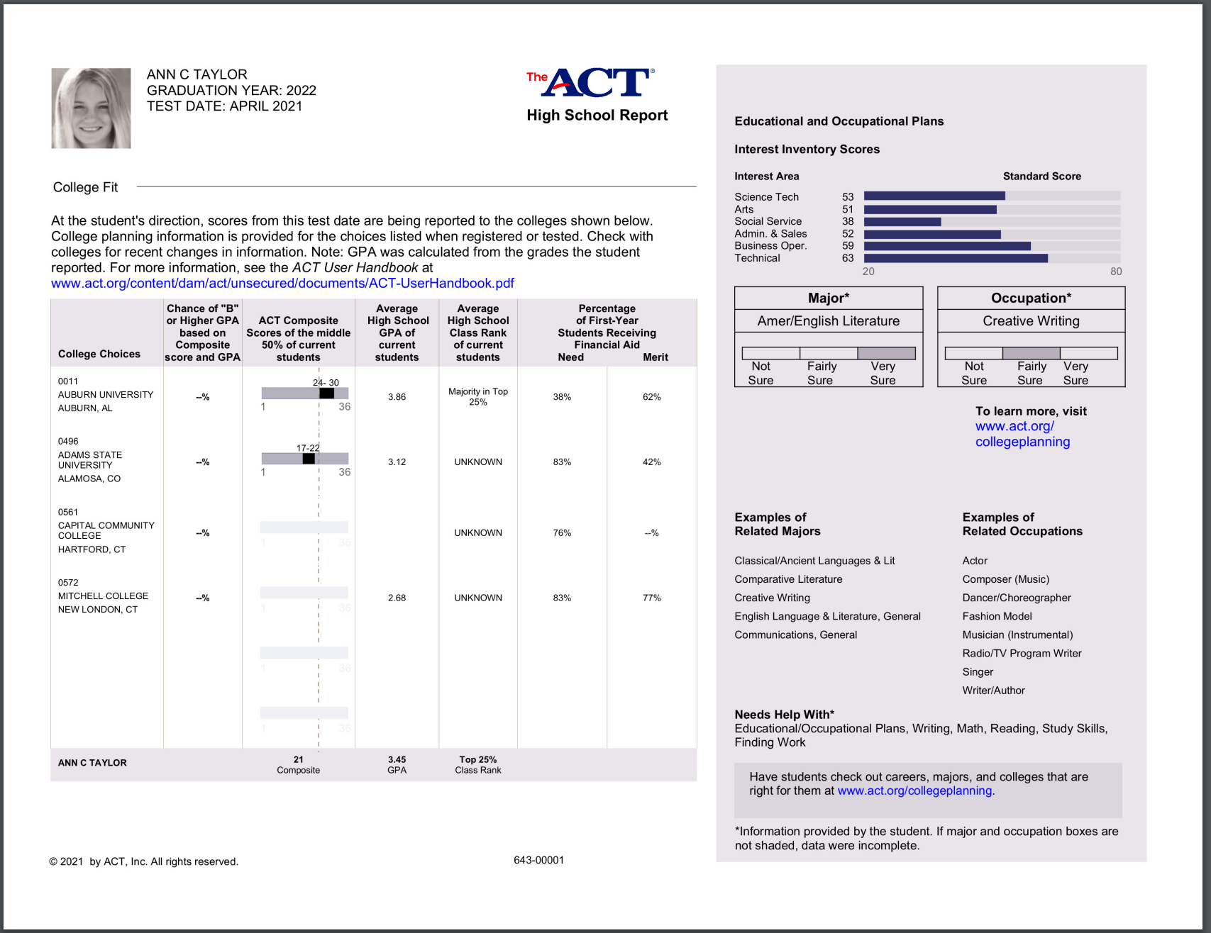
ACT – Individual Student Report (ISR)

Slide 33
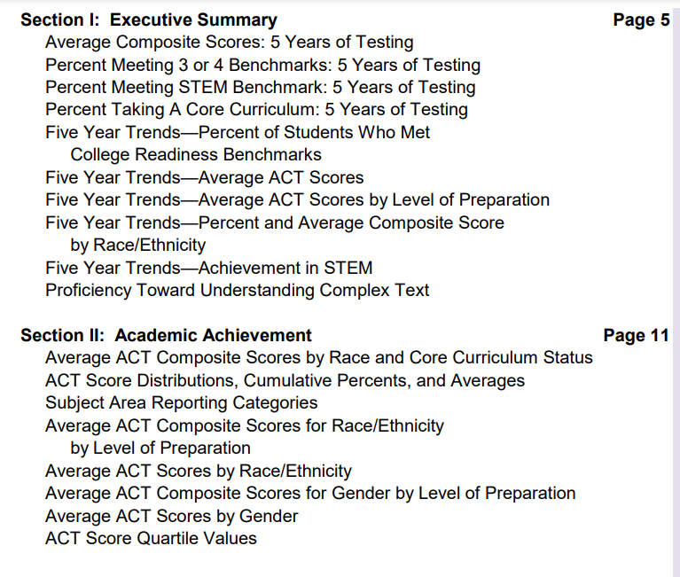
ACT List of DATA ELEMENTS Available

Slide 34
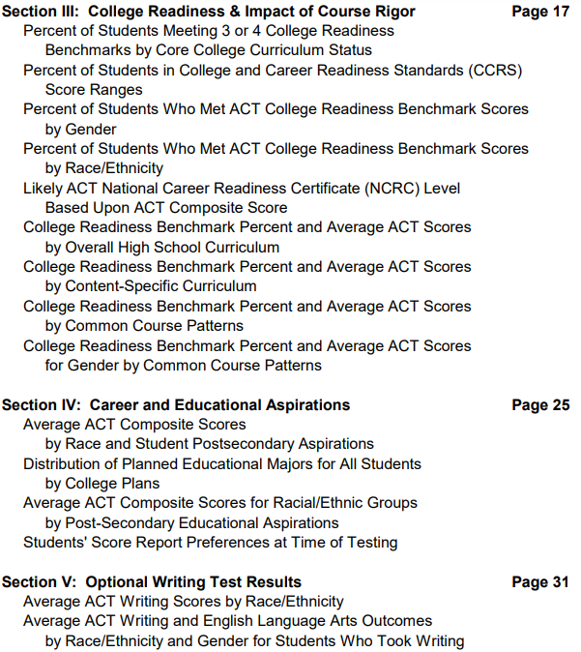
ACT LIST of data ELEMENTS AVAILABLE

Slide 35
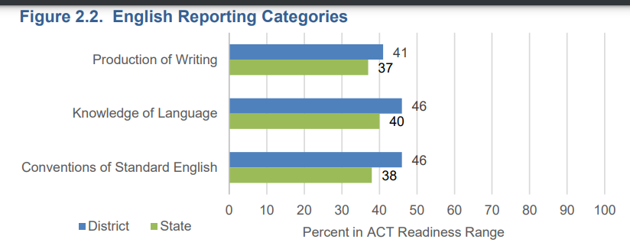
ACT Profile Report in PAN

Slide 36
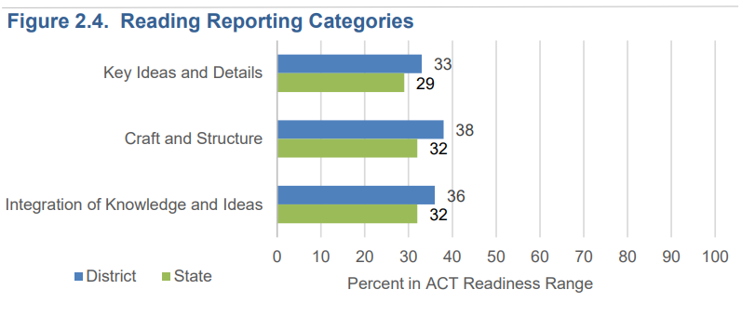
ACT Profile Report in PAN

Slide 37
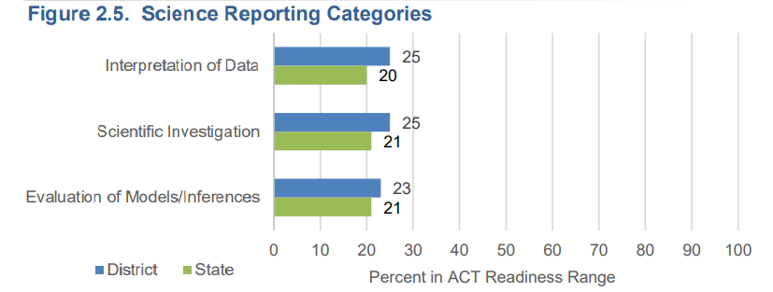
ACT Profile Report in PAN

Slide 38
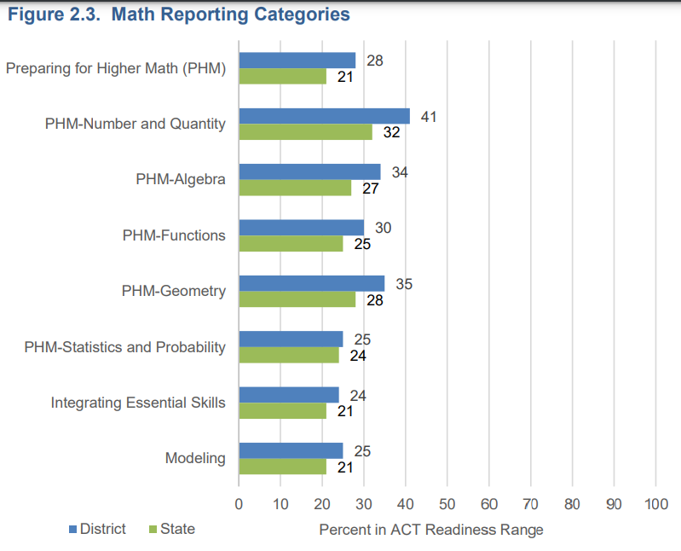
ACT Profile Report in PAN

Slide 39
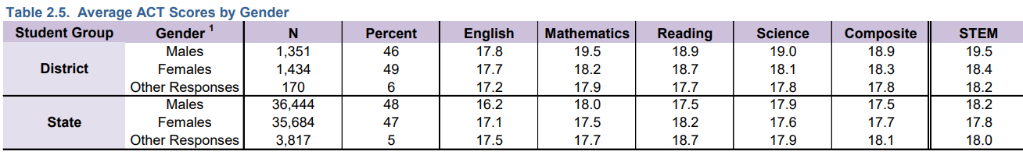
ACT AGGREGATE DATA

Slide 40
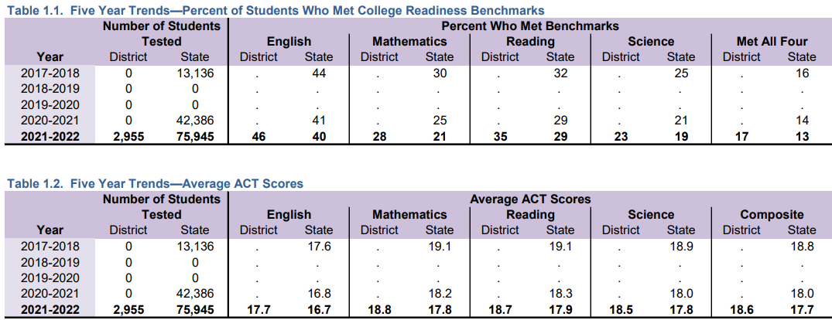
aCT – Profile Report Summary

Slide 41
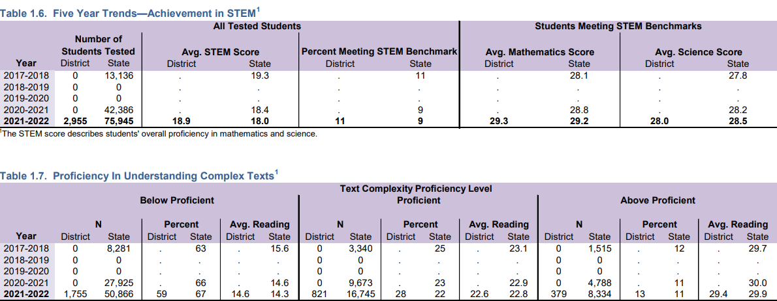
aCT Profile Report Summary

Slide 42
ACT DETAILS
What is the plan for AzSCI after Spring of 2022?
  ADE will continue to utilize AzSCI as the statewide assessment for Grades 5, 8, and 11.
How were ACT cut scores determined?
They were determined by a standard setting process with educators.

Slide 43
ACT DATA ACCESS CHAnge
Spring 2023 data
    Districts will need to access their data in ACT’s online reporting system at success.act.org rather than in PAN.
    The data will no longer be located in both places.

Slide 44
Frequently Asked Questions for ACT and ACT Aspire
Does Arizona have cut scores for ACT Aspire? No.
Will this be added?
  Not at this time. Per State Board, State Accountability is utilizing ACT Aspire for participation only. LEAs can use the information contained in the ACT Aspire Report for instructional decision-making.
ACT Aspire is being discontinued by ACT. What does this mean for Arizona?
  ACT Aspire will be utilized by ADE under this contract.
Will Arizona transition to administering Pre-ACT?
  Pre-ACT does not have a writing component; therefore, it cannot be used by ADE.

Slide 45
Frequently Asked Questions for ACT and ACT Aspire
When will ACT and Aspire PearsonAccess^{next} sites go live for Spring 2023?
  ACT – will go live on November 7, 2022
  ACT Aspire – will go live on January 30, 2023
When will DTCs begin receiving ACT emails?
  ACT communications to Test Coordinators are scheduled to begin on October 31, 2022.

Slide 46
Test Windows and Other INformation
Important dates for ACT and ACT ASPIRE are on our webpage.
  https://www.azed.gov/assessment/high-school-assessments-act-and-act-aspire
Schedule of Events for each – Coming Soon
Other resources
Communicated through The Examiner

Slide 47
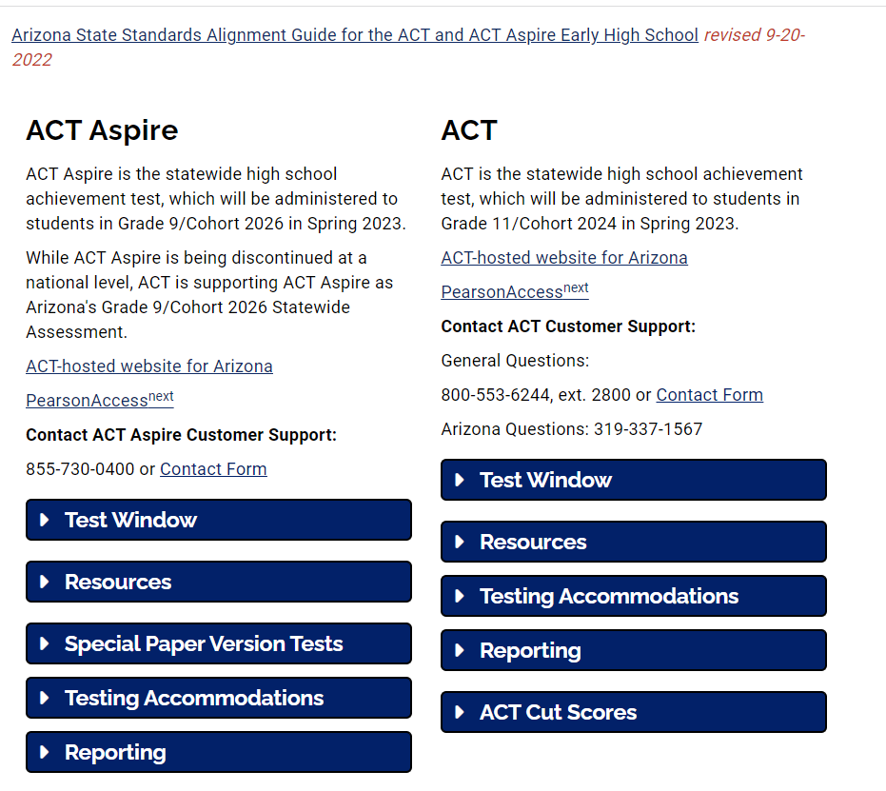
ACT ASPIRE and ACT Information

Slide 48

Questions
This Photo by Unknown Author is licensed under CC BY-SA

Slide 49

Thank you!
For questions, please contact us at:
Testing@azed.gov
This Photo by Unknown Author is licensed under CC BY-NC-ND

