Slide 1
Friday Focus Webinar #1
The State of Assessments and Accountability – an Overview for the 2022-2023 School Year
Audra Ahumada, Deputy Associate Supt. Of Assessment

Slide 2
Welcome to Webinar #1: The State of Assessments and Accountability – An Overview for the 2022-2023 School Year
This webinar will be recorded and posted on the ADE Assessments webpage.​
Please enter your First and Last Name in the Chat for tracking purposes for the live event.​
​
We will also be capturing the chat questions. If there are questions that were frequently asked or need further clarification, ADE will compile and create an FAQ which will then be posted on our website. The FAQ will only include those questions that are relevant to the webinar topic. ADE will follow up with any other questions via email.

Slide 3
Welcome and Overview
This is the first webinar session in this series for the 2022-2023 school year
These will be recorded and posted on the Assessments Webpage: https://www.azed.gov/assessment
This session will highlight any updates to statewide testing for the 2022-2023 school year.

Slide 4
By the Numbers
Tests administered:
AASA – 1,269,000 tests (ELA and Math)
ACT – 77,000 students
ACT Aspire – Over 400,000 tests (content areas completed)
AzSCI – 245,000 tests
MSAA – 5,500 students
AZELLA –98,000 students K-12
*Statewide Data Released September 7, 2022 (See Accountability Webpage)

Slide 5
Collaborative for the Alternate Assessment of English Language Proficiency

Slide 6
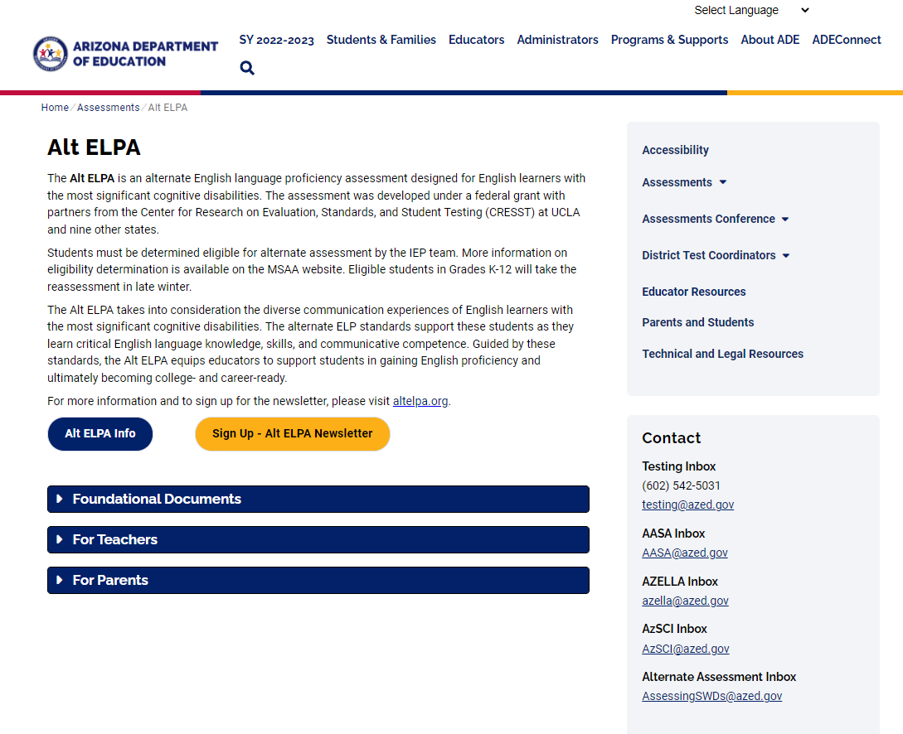
New Alternate English Language Proficiency Assessment (AltELPA)
Identified English Learners with significant cognitive disabilities
Student must have participated in AZELLA Placement test prior to administration of AltELPA
Eligibility Criteria: https://www.azed.gov/sites/default/files/2020/10/Alternate%20Assessment%20Eligibility_May%202022.pdf
Operational/FT will be administered online in the Spring, one on one with a familiar test administrator

Slide 7
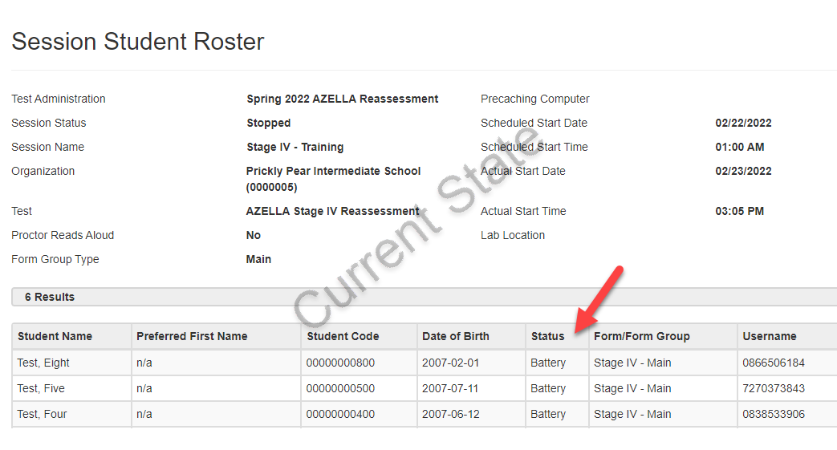
Enhancements to PAN/TEstNAV – Session Student Roster
Improved Session Student Roster Report
Starting in Spring 2023, the Session Student Roster Report will show a detailed status by test unit, rather than the overall test status.

Slide 8
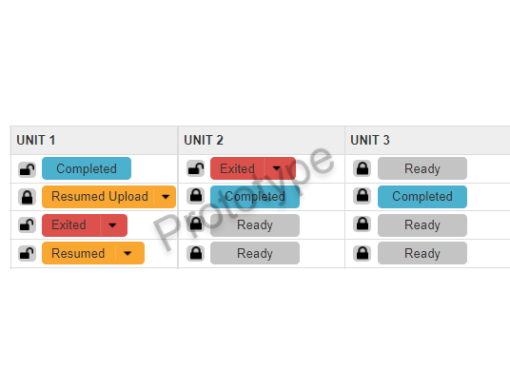
Enhancements to PAN/TEstNAV – Filter mass Lock/Unlock
Improved Session Management with Mass Lock/Unlock function with filters
Use filters to find students and lock/unlock test units with fewer clicks.
One-click unlock function allows users to lock units and unlock desired unit in one step
Using Lock/Unlock button will not force user to the top of the page

Slide 9
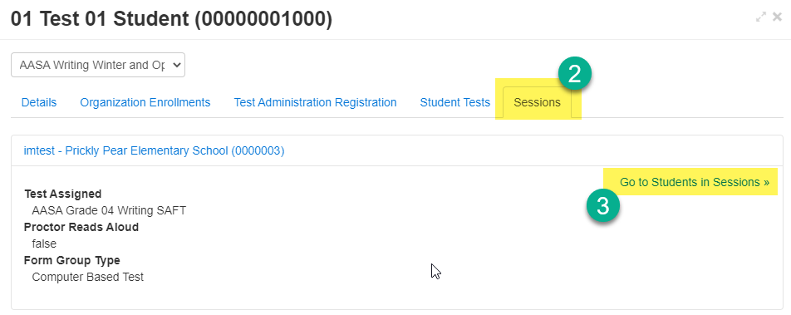
Enhancements to PAN/TEstNAV - SessIoNS
Get to the Students in Sessions Screen to view a Student’s Test in fewer clicks.
Find your student, click the INFO icon
Click on the sessions tab
Click Go to Students in Sessions

Slide 10
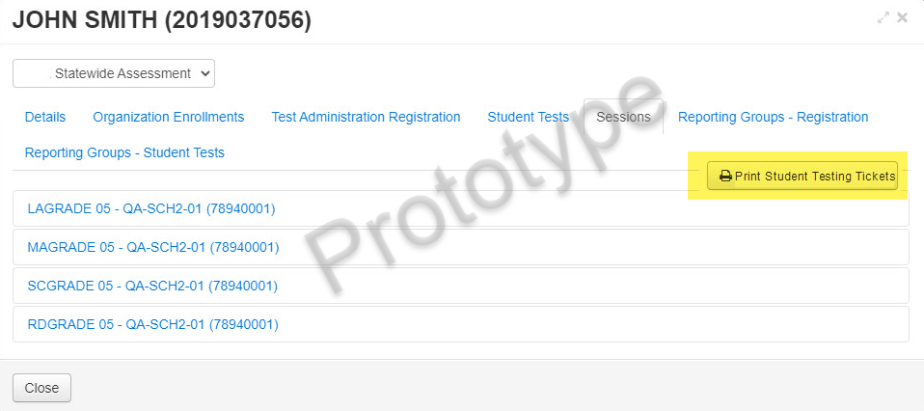
Enhancements to PAN/TEstNAV – Testing Tickets
Testing Tickets improvement
Quickly print all testing tickets across sessions for a student from the student information page

Slide 11
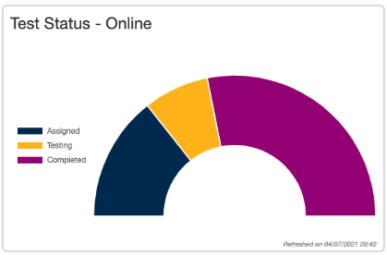
Enhancements to PAN/TEstNAV – testing Status Dashboards
New Dashboards provide a quick view of testing status to monitor testing progress
*Use dashboards to monitor Test Sessions, Student Test Status by Unit and Overall Test Status.
*For use on AASA and AzSCI only

Slide 12
Reporting Portals
AASA- New dynamic reporting portal coming
AzSCI- No changes
ACT- changes (email from ACT Sept 2022)
AZELLA- No changes
MSAA- No changes

Slide 13
Assessment Infographics
https://www.azed.gov/assessment

Slide 14
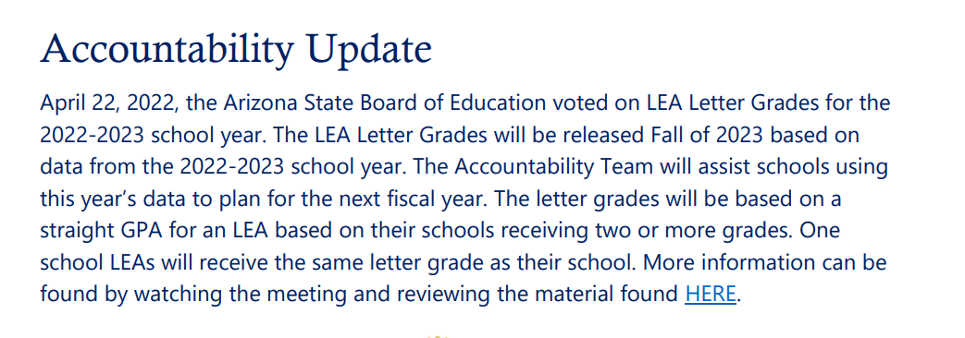
Accountability
State Board will be releasing School A-F Letter Grades the 2021-2022 school year in the Fall
LEA and School Letter Grades were not released for the 2020 or 2021 school years
The Grader Newsletter provided an update to LEA/District Letter Grades

Slide 15
Accountability Newsletter: The Grader
Please email Achieve@azed.gov if you would like to be added to our distribution list and receive notifications of when The Grader is released.

Slide 16
Assessment Webinar Series - Posted
All Assessment Webinars will be posted on the ADE Website- Assessment Page:
PowerPoint Presentation
Recording
Frequently Asked Questions
https://www.azed.gov/assessment

Slide 17
Questions
This Photo by Unknown Author is licensed under CC BY-SA

Slide 18
THANK YOU
For questions, please contact us at:
Testing@azed.gov
This Photo by Unknown Author is licensed under CC BY-SA-NC

