Slide 1
CTE ADMINISTRATORS MEETING February 3, 2022
Vision:
Develop Arizona’s competitive workforce through the power of Career and Technical Education.
Mission:
Career and Technical Education will engage Arizona learners in relevant experiences leading to purposeful and economically viable careers.

Slide 2
Agenda
Welcome and ADE Updates– Clarkdale/Cottonwood Rooms
Grants, CLNA Panel
Updates: ACOVA – Postsecondary
Program Monitoring, Industry Credentials
Updates: ACTEAZ – Premier Program Series – AZ CTE Curriculum Consortium
Fall Assessment, TSA Meetings, New Tutorials and Assessment Website, APS SEL
Break
CTSOs
Updates: Project Change
Accountability and Fiscal
School Counselor Update
Reminders and Closing

Slide 3
CTE ADMINISTRATORS MEETING February 3, 2022
Happy CTE Month!

Slide 4
Happy CTE Month!
Please let your teachers know we at ADE appreciate all they have done in these challenging years to keep their programs rolling. Their students need them now more than ever!
Thank you, CTE Administrators, for the efforts you make daily to keep your programs on the forefront!
Notes:
Happy CTE Month!
It is hard to believe that 2022 is here already and soon I will be celebrating my 5th year at ADE! Where did the time go?
We have had many challenges in the past 5 years, but as consummate CTE educators we rise to the occasion and meet those challenges head on while continuing to provide quality CTE programs for our students! That in itself must be celebrated!
This spring the new Career Clusters Framework will be introduced.

Slide 5
US Presidential Scholars CTE AZ Nominees 2021-2022
Garrett Comes Red Mountain HS Mesa
Ayra Kacir Desert Mountain HS Scottsdale
Salil Naik Mountain Ridge HS Deer Valley
Aleena Nielson Vista Grande HS Casa Grande
Lydia Pastore Red Mountain HS Mesa

Slide 6
Welcome and Updates
Arizona Career Readiness Credential: Andy Ridley, Workforce Program Manager

Slide 7
Arizona Career Readiness Program

Slide 8
Office of Economic Opportunity and
Arizona Commerce Authority
2015-2020 Research (across all sectors)
Question: What do young new-hires LACK?
#1 Real world skills
#2 Professionalism
#3 Motivation
#5 Communication Skills
#6 Collaboration (Teamwork)

Slide 9
The Arizona Career Readiness Credential (ACRC)
A Certification of Foundational Academic Skills and Professional Skills
Applied Mathematics | Communicating Effectively
Reading for Information | Conveying Professionalism
Applied Data and Graphics | Critical Thinking/Problem Solving
 | Collaboration (Teamwork)

Slide 10
ACRC Program Contact Information
ACRC.AZ.gov
Andy Ridley, OEO Workforce Program Manager
andrew.ridley@oeo.az.gov
602-694-0575

Slide 11
CTE Teacher Certification

Slide 12
The Why - 2017 Changes and their impact
Removed and disallowed provisional certificates
Allowed for non-disciplinary suspensions of certificates for unmet deficiency timelines
Created alternate paths to meet exam requirements but did not eliminate the exam requirement overall
Notes:
The above changes took place in 2017.

Slide 13
Allowable Deficiencies
Allowable deficiencies must be corrected by the due date identified on the certificate(s). If the deficiency is not corrected by the due date, the Arizona Educator Certificate will be placed on a non-disciplinary suspension until the deficiency has been corrected.
Once corrected the end date will be extended to its original end date at the time it was issued.
To determine the exact deficiency for the certificate, please refer to the certificate, or log into the AzEDCert Portal and under Educator Certificates:
Once the requirement for the deficiency has been met the applicant will need to apply to remove the deficiency. Applicants may now apply online at AzEDCert Portal, or by completing the Application to Remove a Deficiency and mail it to the address on the form along with a $20 (check or money order).
An updated certificate will be issued to the applicant by mail.
Notes:
An allowable deficiency is a requirement that the applicant does not have, but the ADE is able to issue the certificate.

Slide 14
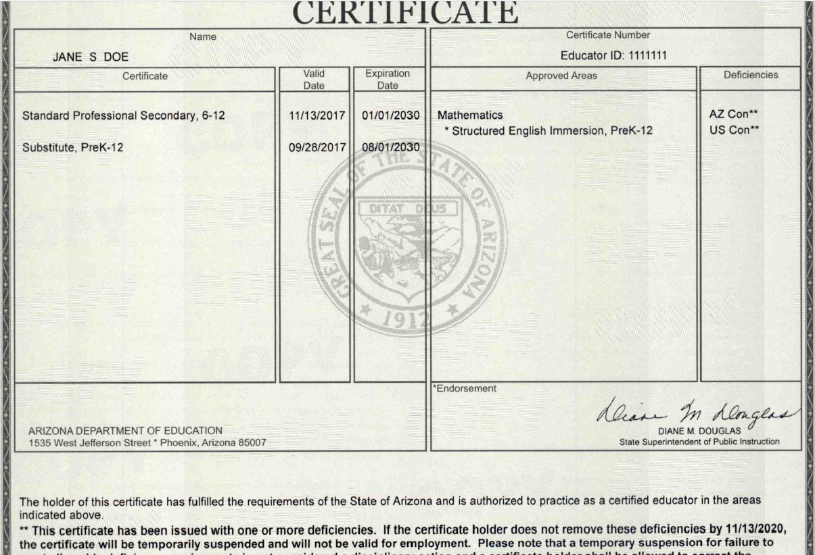
Approved Area
Endorsement
How to read an Arizona Certificate
Deficiencies
Deficiency Due Date
Notes:
IF the deficiency is not removed within the 3 years, the certificate is placed on non-disciplinary suspension and then once met, the certificate is extended out to the original end date.
Extensions are not provided; Board rule does not provide for this. Exception.
The deficiency removal webpage has links that address all deficiencies and how to meet and remove them.

Slide 15
Allowable Deficiencies
All deficiencies for CTE certificates are 3-years
AZ/US Constitution
Professional Knowledge Exam – Secondary Ed
15-Semester Hours
Visit the Certification website for additional information:
https://www.azed.gov/educator-certification/educator-certification-deficiency-removal
Notes:
The next few slides discuss each of these in more detail.

Slide 16
AZ/US Constitution
Pass the exam: "Constitutions of the United States and Arizona" (AZ033) and request that the results be submitted to the Arizona Department of Education. Information may be found on the Testing Information page. OR
Take the appropriate course(s) through an accredited institution. Upon completion of the course, request that the university/college submit official transcripts to the Certification email inbox at certification@azed.gov

Slide 17
Professional Knowledge Exam – Secondary Ed
CTE Certificate holders may take the exam or meet one of the exam waivers.
Option A: Take and pass the NES or AEPA Assessment of Professional Knowledge: Secondary exam. Please visit Testing Information for additional information.
Exam Waiver Options:
Option B: Submit an official score report documenting the applicant passed a substantially similar Professional Knowledge Secondary examination from another state or agency. Please visit Testing Information for a list of out-of-state equivalent exams.
Option C: Hold a valid, comparable certificate from the National Board for Professional Teaching Standards. Submit a photocopy of the certificate.
Option D: Three years of full-time teaching experience in any state, including Arizona, in grades 6-12. Submit a Verification of Teaching Experience form signed and completed by the District Superintendent or Personnel/HR Director to verify teaching experience. Teaching experience in a foreign school or substitute teaching does not meet this requirement. The HR Department must submit the form to certification@azed.gov.

Slide 18
Semester Hours
Up to fifteen (15) semester hours of courses in professional knowledge in:
career and technical education, to include any of the following areas: principles/philosophy of career and technical education; developmentally appropriate instructional delivery, facilitation, and methodologies; instructional technology; instructional design, and lesson planning to include modifications and accommodations, assessing, monitoring, and reporting progress; the learning environment to include classroom management; teaching students with exceptionalities; or professional responsibility and ethical conduct.
Fifteen semester hours may be obtained through Board or Department-CTE-approved professional development. Fifteen clock hours of approved professional development equals one semester hour.
Follow the link for more information: CTE Professional Development

Slide 19
Keeping Track of Deficiencies
Request a copy of the certificate from the certificate holder or from your HR.
Work with your HR Department to obtain a list of CTE holders and deficiencies.
Deficiencies are identified on the certificate along with the due date.
Each applicant is provided an evaluation that identifies how the applicant qualified and identifies any deficiencies with the due date.

Slide 20
CTE ADMINISTRATORS MEETING February 3, 2022
Perkins V and State Priority Grants

Slide 21
Grant Specialist Team
Shelley Baudean – Grants Program Specialist
Audrey Dieken – Grants Program Specialist
Don Dolin – Grants Program Specialist
Mark McManus – Grants Program Specialists
John Jones – OCR Special Populations Program Specialist
Mary M. Medina – CTE Grants Supervisor

Slide 22
CTE Grants Important Dates
FY2022
CTE Federal Perkins SDLP Performance Measures Improvement
plans due date: March 1, 2022
CTE State Priority Grant end date: June 2022
FY2023
CTE Federal Perkins Grant application opens: March 1, 2022
with a due date of May 2, 2022
CTE State Priority Grant application opens: March 1, 2022
with a due date of May 2, 2022
CTE Statewide and Innovative Grant applications open:
March 1, 2022 with a due date of May 2, 2022

Slide 23
CTE Grants Important Dates - Continued
Funding year for CTE Federal Perkins Grant: July 1, 2022 –
September 2023
Funding year for CTE State Priority Grant: July 1, 2022 – June
2023
Funding year for CTE State Leadership and CTE Innovative
Programs Grants: July 1, 2022 – September 30, 2023
General Statement of Assurances (GSA) & Self Assessment
due to GME by March 1, 2022
Indirect Cost Request due to GME by February 1, 2022 in to
receive the FY2023 rate by March 1, 2022

Slide 24
FY2023 - Perkins V Biennial Year
The Comprehensive Learning Needs Assessment (CLNA) must
be completed on a biennial basis with a review of the progress
every other year (2nd Year) of the biennial cycle.
The CLNA review must be completed prior to the completion of
the Perkins grant application and must be uploaded to the
Related Documents section of the grant application before
review and approval of the grant application.

Slide 25
Preparation Materials for CLNA Leadership Progress Review Meeting
Last year’s CLNA
Evidence / data for review / documentation
Program of Study (POS) review summaries
Objective pages from the FY2022 grant application
Planning budget for FY2023
Program of Study (POS) accomplishments
List of goals / targets not met (why)

Slide 26
Example of CLNA Review Responses

Slide 27
Example of CLNA Review Responses

Slide 28
Reminders
CLNA goals / objectives must align to the Perkins V grant
application
**Audrey Dieken is doing a presentation:
Writing Objectives Like a Pro @ 2:00 pm in the Arizona Room
CLNA review must be completed & uploaded prior to the
review and approval of the Perkins V grant application
Coherent sequences for CTE programs offered must be in
place prior to the Perkins V grant review / approval.
CTE programs offered must be listed in the FFATA & GSA
Verification section of the grant application.

Slide 29
Contact Information
Shelley Baudean John Jones
Grant Program Specialist OCR Special Populations Program Specialist
shelley.baudean@azed.gov john.jones@azed.gov
602-542-5323 970-216-6740
Audrey Dieken Mark McManus
Grant Program Specialist Grant Program Specialist
audrey.dieken@azed.gov mark.mcmanus@azed.gov
602-350-5064 602-542-8744
Don Dolin Mary Medina
Grant Program Specialist CTE Grants Supervisor
don.dolin@azed.gov mary.m.medina@azed.gov
602-518-6526 505-426-6681

Slide 31
AOAC – Arizona OCCUPATIONAL ADMINISTRATORS cOUNCIL
Representing Arizona Community Colleges’ Occupational | CTE | Workforce Programs
Development and delivery of Occupational | CTE Programs and Courses
Cultivating partnerships with business, industry, education and workforce agencies to inform program needs
Workforce and CTE funding including Perkins, Prop 301 (sales tax) STEM formula funding and private funding
Foster research (Ex: LMI) leading to improvements in occupational education

Slide 32
AOAC – Arizona OCCUPATIONAL ADMINISTRATORS cOUNCIL
Current initiatives:
CTE Teacher shortage – Feb. 4 AOAC | College HR CTE Innovative Recruitment & Retention Strategy Session
Working to Improve CTE/Community College shared program monitoring process and Regional In-Demand Programs list for CTED 4th year funding
Development of Bachelor’s Degree Programs https://www.maricopa.edu/bachelors-degrees

Slide 33
The Arizona Occupational Administrators Council Recognizes Dr. Janice Lawhorn for her many years of service and leadership Janice - You represent the Heart and Soul of CTE in AZ!

Slide 34
CTE Program Services Updates Cindy Gutierrez, Director, CTE Program Services
Monitoring updates
Monitoring Training for SY22-23
Industry Credentials
Notes:
New for SY22-23
New Application process
New Credential removal process
New Incentive Fund Programs

Slide 35
Monitoring Document Update
Overview of changes SY22-23
Minor Clarification of a few indicators on Monitoring Document and guide
2d. CTE teachers have access to resources and support to implement all elements of a high-quality program. high quality – High-quality means meeting 90-100% of all quality indicators for a CTE program
5d. program form "tangible support" change to “Financial or Technical Support”
8a. Type of work-based learning program courses is work-based learning provided in changed to Course information or curriculum indicating where WBL occurs in the program provided
New!! CTED Community College Monitoring Guide
Updates will be on the CTE Website at
https://www.azed.gov/cte/programs
Notes:
We have some clarifications on our monitoring document and guide to better help explain the indicators. Those are
2d CTE teachers have access to resources and support to implement all elements of a high-quality program. high quality – High-quality means meeting 90-100% of all quality indicators for a CTE program
5d. program form "tangible support" change to “Financial or Technical Support”
The program services team ahs also worked to develop a CTED community college guide for specific CTED program. All resources are on our website

Slide 36
Monitor Training – SY22 -23
Required Districts:
Colorado City USD
Phoenix UHSD
MICTED and Satellite Districts
STEDY and Satellite Districts
VACTE and Satellite Districts
WAVE and Satellite Districts
Next trainings for Cohort 22-23 only:
April-May via MS Teams each CTED and satellites
Step by step for JotForms district link
Notes:
We held a training yesterday for the 22-23 cohort districts being monitored as well as invited those for 23-24 to get an idea of the process. we are planning smaller groups meeting to give greater attention to starting the submissions for the 22-23 SY.

Slide 37
Industry Credentials and Application process
NEW SBE approved for SY22-23
DANB Coronal Polish Certification
Google Data Analytics Certificate
Google IT Support Certificate
Google Project Management Certificate
Google User Experience (UX) Design
Smart Automation Certification Alliance (SACA) Certified Industry Associate
CAMT-Certificate for Apartment Maintenance Technicians
Mining and Health Administration (MSHA) Part 48
Trane Tech One
List available on CTE webpage https://www.azed.gov/cte/cte-industry-credentials
Notes:
WE had nine new credentials approved by the state board of education to add to the industry credentials list beginning in SY22-23. The new credentials will also be available on our website

Slide 38
Incentive fund programs SY 2022-2023
The only added program is
15.0612.00 Energy and Industrial Technology – LOP
All other programs remain the same.
Added districts who are approved for LOPs
Community Health Care Worker - Pima JTED
Physical Therapy Assistant - CAVIT
Masonry - American Leadership Academy
sUAS Drones - CAVIT, West-MEC
Marine, Power and Extreme Sport - West-MEC
The graphic of Incentive programs is available in your packet and on the CTE Webpage at
https://www.azed.gov/cte/cte-industry-credentials
Notes:
For school year 2223 we only had one new program added to the industry incentive fund list and that is the energy and industrial technology program which is an LLP we did update districts who are approved for LOP’s that qualify for the incentive fund. the additions are permitted under community health care worker Cabot under physical therapy assistant American leadership Academy under masonry Cabot and West meck under drones and West MEC under marine power in extreme sports

Slide 39
Industry Credentials NEW Application process
opens: March 1, 2021
closes: new date MAY 31, 2021, 5 pm
Application changes:
Only accepted from an LEA with industry input,
no third-party credentialling agency applications accepted
Added “Please Include at least three (3) current job openings in Arizona where this credential is listed as a preference or requirement for hiring”
New
All submissions will be through the JotForms link, which will be on the CTE Website, https://www.azed.gov/cte/cte-industry-credentials
Notes:
We have several changes to the credential application process. First the closing date is now May 31st each year. Application changes:
We will Only accept applications from an LEA with industry input,
no third-party credentialling agency applications accepted
WE Added “Please Include at least three (3) current job openings in Arizona where this credential is listed as a preference or requirement for hiring”
We are beginning a new submission process that will track each application as it is submitted, the person submitting will receive an automated email that their application was received and in process. The new process will be through a jot forms link to upload the application.

Slide 40
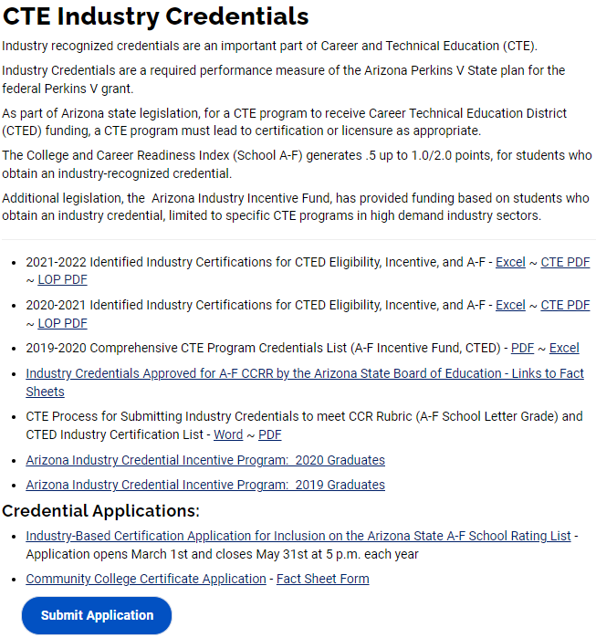
Notes:
On our industry credentials page under credential applications in Delhi a would either select the industry based certification application or the Community College certificate application he would then download that application and fill it out completely once filled out you would go to our website and click submit application so I've draw arrows to each application and the submit button.

Slide 41
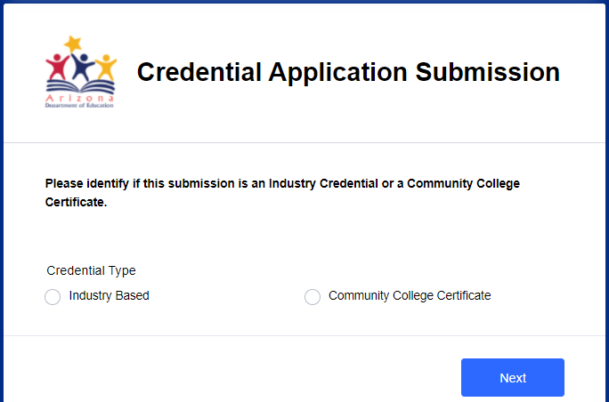
Notes:
Once you click on that submit button the application submission page will come up you select which credential type click next

Slide 42
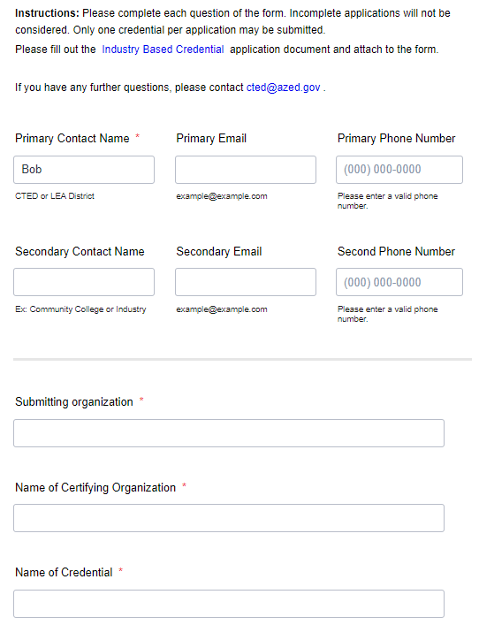
Notes:
instructions page will come up where you would fill out all the required information this is for tracking submissions and the auto reply once submitted

Slide 43
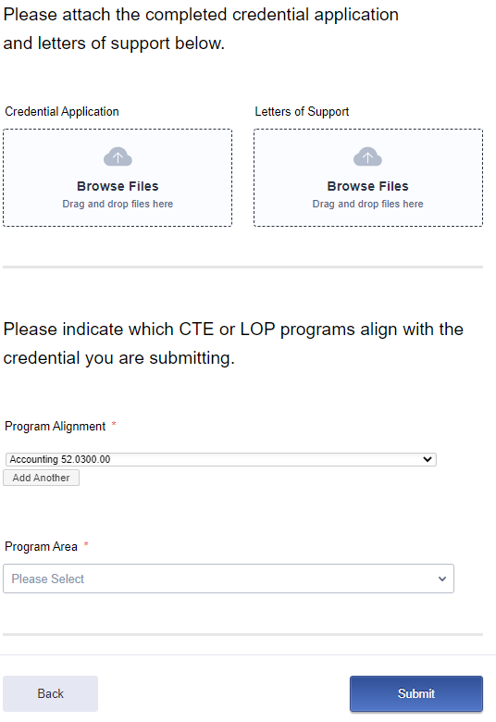
Notes:
Then you will either browse your files and upload or drag and drop your application into the job form submission . Select which program or programs this credential would be for, select the appropriate program area and submit.

Slide 44
Industry Credentials NEW Credential REMOVAL process
Arizona Department of Education (ADE)
Career and Technical Education (CTE) policy regarding Industry-recognized Credentials
to be enacted beginning in school year 2022-2023
With ADE CTE now collecting documentation in the CTE Data Portal on students who have attained an industry recognized credential, ADE CTE will implement the following:
To effectively manage the industry-recognized credentials, ADE CTE will sunset/remove any credential that does not have data indicating a student in the state has attempted that credential in the past four (4) years.
The effect of the policy will be to condense the current 627 credentials on our list by eliminating those that have no data indicating a student in the state has attempted that credential in the past four (4) years and will showcase the credentials that our students can attain and have produced data indicating a student in the state has attained that credential in the past four (4) years. This will ease the burden of CTE Teachers who may have more credentials listed under one program than are realistically manageable for an individual instructor to offer during the course of a CTE program.
Notes:
A new policy and process to remove industry credentials has been approved by the AZ CTE Quality Commission on January 31, 2022. This will affect 66 credentials that are currently on our list.

Slide 45
Industry Credentials for REMOVAL SY22-23
Credentials that will be removed, having no data indicating attempts statewide from 2021 and prior years, please see list in your packet
Academic Certificate: Child & Family Professional Development (CTED/Rio Salado College only)
Agricultural Biotechnology Certification
Agricultural Technician Certification
American Hotel and Lodging Institution
Animal Care Training
ArcGIS Certified Desktop Entry Certification
Arizona Certified Nursery Professional (ACNP)
ASQ scale score 550
Associate Certification: Mill Design and Toolpaths
Autodesk Certified User (ACU) – 3Ds Max
AZDOT – CDL
Beginning Jewelry Sales
Beginning to Teach Certificate
Center for Energy Workforce Development (CEWD) Energy Industry Fundamentals Certificate
Certified Apprentice Drafter – High School
Certified Drafter – Advanced High School
Certified Environmental Professional in Training
Certified Expert Technical Artist – Rigging and Animation
Certified Front Desk Representative (CFDR)
Certified Fundamentals Pastry Cook (CFPC)
Certified Logistics Technician (CLT)
Certified Restaurant Server
Certified Technology Specialist (MCTS)
CPR/First Aid
Desktop Pro (Word, Excel, PowerPoint, Access, Computer Basics)
Feature Cam
Federal Aviation Administration (FAA) – Private Ground Written
Federal Aviation Administration (FAA) – Control Tower Operator
Federal Aviation Administration (FAA) – Ground Instruction Basic
Federal Aviation Administration (FAA) – Ground School
Federal Aviation Administration (FAA) – Powerplant Mechanic
Forklift Operations
HAAS Certification: CNC Tool Setter
International Society of Automation (ISA) – Certified Automation Professional
IPC and the Wiring Harness Manufacturer’s Association (WHMA) J-STD-001 Certification
IPC Association Connecting Electronics Industries – Hand Soldering
Machining Manufacturing Skill Standards Council (MSSC) – Certified Production Technician (CPT)
Machining Manufacturing Skill Standards Council (MSSC) – Green Production Certification
Manufacturing Skill Standards Council (MSSC)
Mastercam Associate
Mechatronics
Microsoft Certified Solutions Associate (MCSA)
National Career Readiness Certificate (NCRC) Level 1
National Center for Construction Education and Research (NCCER) – Cabinetmaking
National Center for Construction Education and Research (NCCER) – Carpentry – Level 1
National Center for Construction Education and Research (NCCER) – Carpentry – Level 2
National Center for Construction Education and Research (NCCER) – Electrical – Level 1
National Center for Construction Education and Research (NCCER) – Electronics Systems Technician (EST) – Level 1
National Center for Construction Education and Research (NCCER) – Electronics Systems Technician (EST) – Level 2
National Center for Construction Education and Research (NCCER) – Industrial Maintenance Mechanic – Level 2
National Center for Construction Education and Research (NCCER) – Mechanic – Level 1
National Center for Construction Education and Research (NCCER) – Millwright
National Center for Construction Education and Research (NCCER) – Plumbing – Level 1
National Institute for Metalworking Skills (NIMS)
National Institute for Metalworking Skills (NIMS) – EDM Plunge
National Institute for Metalworking Skills (NIMS) – EDM Wire
National Institute for Metalworking Skills (NIMS) – Level 1
National Institute for Metalworking Skills (NIMS) – Machining Level II – Grinding Skills II
National Institute for Metalworking Skills (NIMS) – Machining Level II – Manual Milling
National Institute for Metalworking Skills (NIMS) – Turning I
National Occupational Competency Testing Institute (NOCTI) – FANUC Certified Robot Operator 1
National Occupational Competency Testing Institute (NOCTI) – FANUC Certified Robot Operator 2
National Occupational Competency Testing Institute (NOCTI) – FANUC Certified Robot Technician 1
National Occupational Competency Testing Institute (NOCTI) – FANUC Certified Robot Technician 2
Woodwork Career Alliance Passport – Blue Credential
Woodwork Career Alliance Passport – Green Credential
Notes:
Sam Irvin will be sharing with you the process used to determine the list of credentials that will be removed.

Slide 46
CTE Month is Here! February 2022
Governor’s Proclamation
ACTEAZ Website
www.acteaz.org “CTE Month”

Slide 47
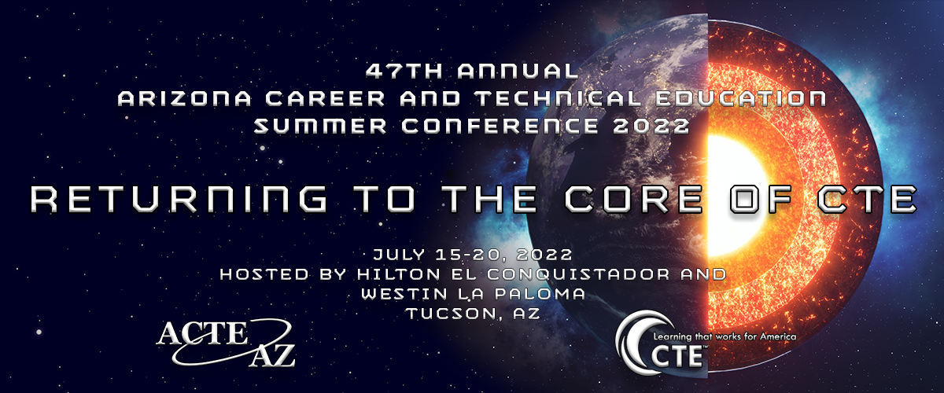
ACTE Summer Conference
Hotel Room Rates - $100.00 plus taxes and fees.

Slide 48
ACTEAZ Awards and Scholarships
Don’t forget to nominate the great educators you know. Applications are online. Go to www.acteaz.org
Deadline: March 18, 2022
Don’t forget to let your students know Scholarship Applications are online.
Go to www.acteaz.org
Deadline: March 18, 2022

Slide 49
Want More Information?
Rahsaan Bartet, ACTEAZ President
rahsaanbartet@acteaz.org
Pam Ferguson, ACTEAZ Executive Director pamferguson@acteaz.org
Shelly York, ACTEAZ Asst. Executive Director shellyyork@acteaz.org
Alec Damiano, Technology
alecdamiano@acteaz.org

Slide 50
PREMIER SERIES

Slide 51
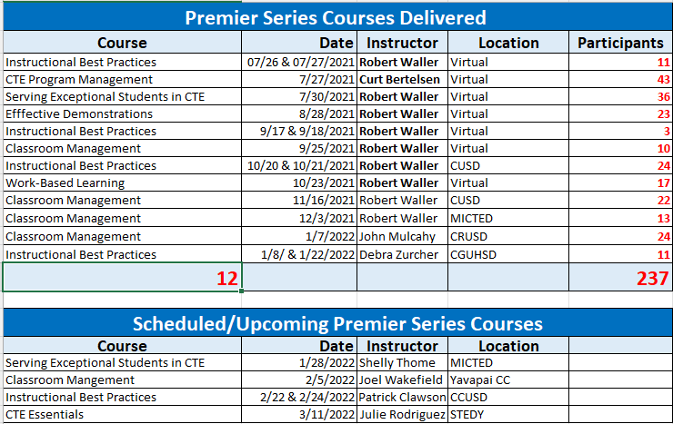
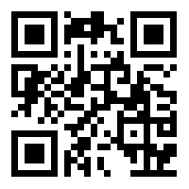
Premier Series
FY 2021-2022 as of January 26, 2022

Slide 52
Arizona
CTE Teacher
Recruitment

Slide 53
CTE Curriculum Connection
#haveyoucheckedtheconnection
New Resources
Announced via Discussion Forum
Links in email
Join your program groups
Training and Support - Next School Year
Please reach out for a training session
Notes:
Welcome you to visit the CTE Curriculum Connection site for new resources
New resources are announced via discussion forum of the program group
An Automatic email goes out to the program group the resource is posted in.
Live links in the email back to new resource
Please join your district/schools program group to stay up to date with your teachers and receive resource announcements.
This year over 500 teachers have been trained and counting.

Slide 54
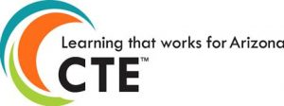
Upcoming Events
Blueprint & Instructional Framework
Virtual Events (Asynchronous and Synchronous)
During Non-contract hours
Eligible for Project Payment
Summer Programs
Automotive Technologies
Business Operations
Emergency Medical Services
Electronic Technologies
Finance
Fire Service
Hospitality Management
Interior Design and Merchandising
Laboratory Assisting
Nominate Today:
https://bit.ly/ConsortiumBlueprintEvent22
Notes:
We have upcoming Blueprint and Instructional Framework events for the noted programs. This will take place during first week of June this Summer.
Thank you to those that have already nominated your teachers. There is still time to Nominate today using the bitly link.
When Kathy Bowersocks sends out the CTEA presentation via email the bitly link will be live.

Slide 55
Meeting Dates
Future Quarterly Meetings
February 9, 2022 - In Person - West-MEC
April 20, 2022 - In Person - Chandler Innovation Center
Reach us: support@ctecaz.org
Follow on Social Media:
Notes:
Our upcoming meeting dates are February 9 in West-Mec and April 20 in Chandler - in - person
Please reach out if you have any questions or if you’d like to schedule training

Slide 56
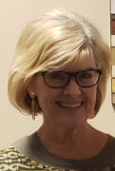
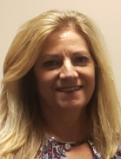
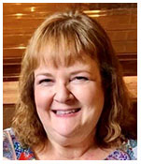
Standards-Assessment-Career Development Team
JUDY Balogh CATHY Reed JULIE Shumate SUSAN Farretta JET Wilson Dight
judy.balogh@azed.gov cathy.reed@azed.gov julie.shumate@azed.gov Susan.Farretta@azed.gov Jet.Wilson.@azed.gov
602-542-4155 602.364.0103 602.542.5044 602-542-5540 602.542.2968

Slide 57
Spring 2022 Schedule for Technical Skills Assessments (TSAs)

Slide 58
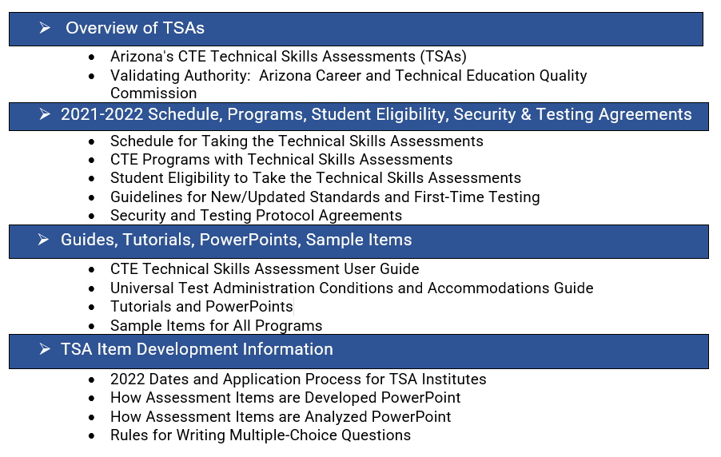
CTE Technical Skills Assessments (TSAs) Webpage
(https://www.azed.gov/cte/assessments)

Slide 59
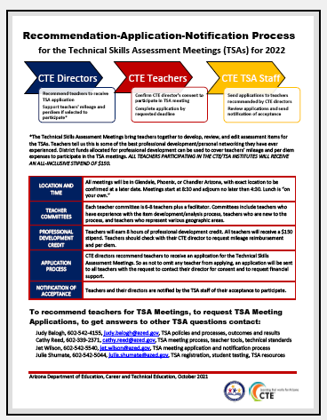

Slide 60
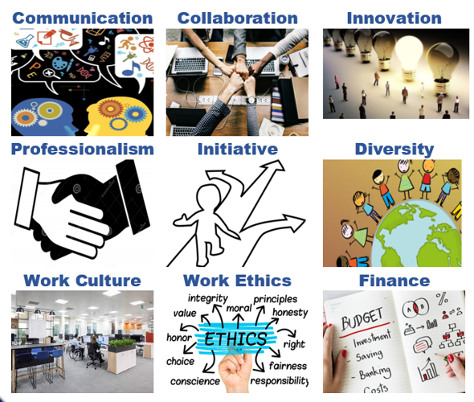
Arizona Professional Skills and SEL Crosswalk
Career & Technical Education and School Safety & Social Wellness
Notes:
Recently I had the opportunity to work with the School Safety and Social Wellness staff at ADE to develop a crosswalk between the Arizona Professional Skills and the Social and Emotional Learning Competencies

Slide 61
Some Key Definitions
Crosswalk analysis: a way to connect similar or disparate content for the purpose of showing relevancy in learning outcomes.
Crosswalk committee: individuals interested in discovering connections in teaching and learning
Crosswalk documentation: a side-by-side display showing the integration of the APS standards and SEL competencies

Slide 62
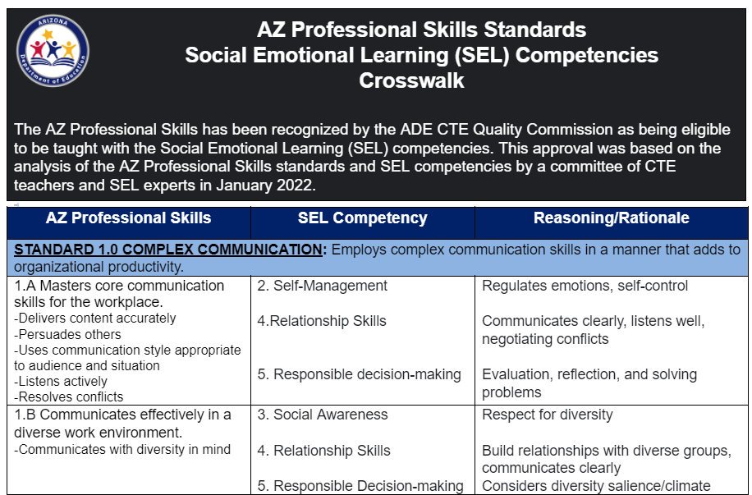
APS and SEL Crosswalk
Notes:
Describe the document

Slide 63
APS and SEL Crosswalk
Why Important:
Teaching SEL in context with technical skills is an approach to learning that focuses on motivating and challenging students to connect what they learn with the world they live in.
Exposing students to tools to develop their identity, make decisions with efficacy, and work together all starts with a stable self-image.
This collaborative effort serves to ensure that today’s workforce needs can be met through the successful completion of a CTE program
Next Steps:
Add teaching strategies and lesson ideas to crosswalk
Link crosswalk to CTE and SEL websites for access to all teachers
Interdisciplinary Session at Summer Conference
Crosswalk SEL competencies to K-8 Literacy Standards

Slide 64
Questions?
JUDY BALOGH SUSAN FARRETTA
Judy.Balogh@azed.gov Susan.Farretta@azed.gov
602-542-4155 602-542-5540

Slide 65
CTSOs

Slide 66
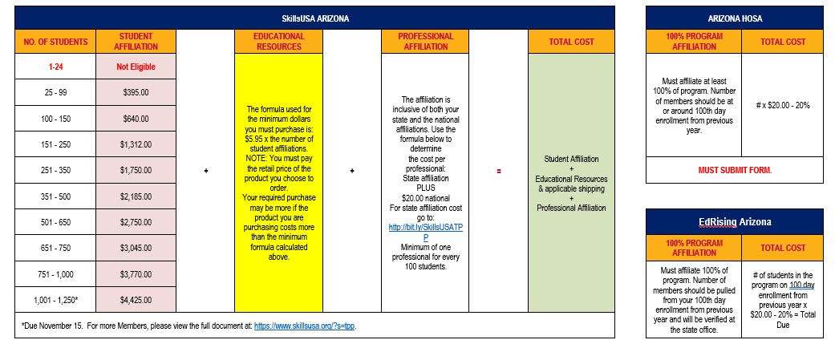
CTSO Membership

Slide 67
Canceling In person Regionals
The why?
Rising COVID numbers within the schools
Lack of judges/judges canceling
Advisors asking for extensions for their registration or testing, due to students being out with COVID.
Advisor wanting to cancel their registration, due to students canceling
Lack of substitutes and bus drivers in the schools
All CTSO not being able to get out of our State Leadership Conference Contracts
We knew that almost all of these competitive events did not have to be pre-qualifiers, to attend the State Leadership Conference

Slide 68
State Leadership Conferences
February 25-27
March 28-30
March 27-30
April 5-9
April 4-6
April 19-20
May 9-11

Slide 69
WE NEED JUDGES
DECA
Dates: February 25-27
Location: Arizona Grand Resort & Spa
Link: https://bit.ly/AZDECA-SCDCJudges
EDRISING: 2022 EDRISING STATE LEADERSHIP CONFERENCE
Dates: March 28-30, 2022
Location: El Conquistador
Link: https://edrisingarizona.wufoo.com/forms/z9iu8v0150j5yj/
FBLA: 2022 FBLA STATE LEADERSHIP CONFERENCE
Dates: April 4-6, 2022
Location: Westin La Paloma
Link: https://fblaarizona.wufoo.com/forms/w17p2hh60txoy8r/
FCCLA: 2022 FCCLA STATE LEADERSHIP CONFERENCE
Dates: March 28-30, 2022
Location: Westin La Paloma, Tucson, AZ
Link: https://www.cognitoforms.com/ArizonaFCCLA/_2022EvaluatorsJudgesSignUp
FFA: FFA STATE LEADERSHIP CONFERENCE
Dates: June 9-11, 2022
Location: Westin La Paloma & the University of Arizona
HOSA: 2022 HOSA STATE LEADERSHIP CONFERENCE
Dates: March 30, 2022- April 1, 2022
Location: Westin La Paloma
Link: https://www.azhosa.org/judge
SKILLSUSA: 2022 SKILLSUSA’S CHAMPIONSHIPS
Date: April 19-20, 2022
Location: Phoenix, Convention Center

Slide 70
New Advisor Training Dates
Saturday July 16th (summer conference)
Saturday October 1st (virtual)
Friday August 5th
(at ADE)
Wednesday November 30th (at ADE)
Tuesday September 13th (at ADE)
Advanced Advisor Training
December 5th-9th 4pm-6pm (virtual)

Slide 71
THANK YOU
STATE ADVISORS!
Robert Waller
Dixie Harvey
Missey Goodman
Andy Kuntz
Bethany Matos
Elizabeth Carnesi
Daniel Kelly

Slide 72
Questions, Concerns, Comments
Julie Ellis
Email
Julie.Ellis@azed.gov
Work
602-542-5350
Cell
520-465-3655
Thank You!

Slide 73
Project CHANGE
Increase gender nontraditional CTE enrollment
Promote safe and healthy schools
Recruitment + Retention of Nontraditional students
Gender, CTE, and Nontraditional Career Success
Stop Sexual Harassment
Stop Cyberbullying + Promote Positive Digital Citizenship
tylerlepeau@email.arizona.edu
timwernette@msn.com

Slide 74
Project CHANGE
We are happy to present in person again! Along with in-person presentations, we are also offering Project CHANGE presentations in these online and/or video formats:
Live online sessions on Zoom or Google Meet (works best with groups of about 10-40 participants).
Pre-recorded video presentations along with optional interactive Google slide activity.
Presentations and workshops are provided at no cost.
Educator presentations provide professional development hours.
Presentations run approximately an hour to accommodate a typical class period (shorter for pre-recorded video).

Slide 75
CTE ADMINISTRATORS MEETING February 3, 2022
Accountability & CTE Data Portal

Slide 76
FY 2022 CTE Data Portal Timeline
Date | Event/Deadline
October 15, 2021 | FALL term enrollment “capture” date NOT a DUE DATE
February 15, 2022 | SPRING term enrollment “capture” date NOT a DUE DATE
June 15, 2022 | DUE DATE #1: Enrollment & Placement Survey closes temporarily. Preliminary funding is calculated. Participants/Concentrators are generated by the system.
July 1, 2022 | Enrollment & Placement Survey data collection resumes.
July 31, 2022 | DUE DATE #2: FY 2022 CTE Data Portal data collection (+ 2021 Placement Survey) ends. *Except Credentials.
August/September 2022 | Final funding is calculated. Performance measures are calculated. Reports are made available in CTE Data Portal. Participants/Concentrators are re-generated by the system.
June 30, 2023 | FY 2022 Credentials data collection ends.
Dates subject to change. Changes will be promptly communicated.

Slide 77
Announcements
FY 2021 Perkins performance measures results for Arizona
Performance Measure | Numerator | Denominator | Actual Level Of Performance | Reporting Year SDLP | Met SDLP | Met 90% of SDLP
Secondary
1S1 Graduation Rate | 23626 | 24856 | 95.05% | 92.25% | Yes | Yes
2S1 Reading | 11657 | 23727 | 49.13% | 24.5% | Yes | Yes
2S2 Math | 10830 | 22471 | 48.2% | 28.25% | Yes | Yes
2S3 Science | 8880 | 21036 | 42.21% | 20.25% | Yes | Yes
3S1 Placement | 17891 | 25763 | 69.44% | 76.25% | No | Yes
4S1 Nontraditional | 8704 | 30738 | 28.32% | 33.25% | No | No
5S1 Industry Credentials | 4605 | 5199 | 88.57% | 33.25% | Yes | Yes
5S4 Technical Skills Assessment | 9654 | 12190 | 79.2% | 70.25% | Yes | Yes
Postsecondary
1P1 Postsecondary Placement | 4955 | 10409 | 47.6% | 35.25% | Yes | Yes
2P1 Credential | 10571 | 18761 | 56.35% | 45.25% | Yes | Yes
3P1 Nontraditional | 5253 | 22471 | 23.38% | 22.25% | Yes | Yes

Slide 78
Announcements
1. FY 2020-2021 Perkins performance measures reports are now available in the CTE Data Portal.
Please be sure to switch the fiscal year to “2021” when viewing these 4 reports.
- Performance Measures Results by District
- Performance Measures Results by District by Program
- Performance Measures Results by School
- Performance Measures Results by School by Program
Data has been loaded into GME.
Performance Improvement plans due by March 1, 2022, for measures not meeting 90% SDLP.

Slide 79
Announcements
2. CTE-participating districts that are members of CTEDs can now view their CTED coherent sequence and enrollment summary report.
Accessible through the “Reports” module in CTE Data Portal.
You can see Coherent Sequence for each of your CTED’s campuses, not only those to which you send students.
You can see Enrollment Summary data for each of your CTED’s campuses, not only your articulated students.

Slide 80
Credential Removal Process
FY 2022 credentials with no activity in four prior years have been removed from list for FY 2023 and beyond.
Removal Process documentation and list of credentials to be removed is in packets.
All FY 2022 credentials with no activity (any attempt) in 2018 – 2022 have been identified for removal for FY 2023.
Any credential added to list in current (FY 2022) or any of the three prior (FY 2019 – 2021) fiscal years will be kept on the list, even if no attempts exist.

Slide 81
Funding Formula Revision
CTE State Priority Grant Allocation Formula Revision
State Priority grant is based on Enrollment (75%) and Related Placements (25%).
Enrollment-based portion of formula has been revised.
Revised formula will be applied to FY 2021-2022 enrollment data for the FY 2022-2023 grant.
All grade levels (09 – 12) will now be eligible for funding.
Courses must still be eligible for funding to be included in calculation.
Articulated courses will still be funded if eligible.

Slide 82
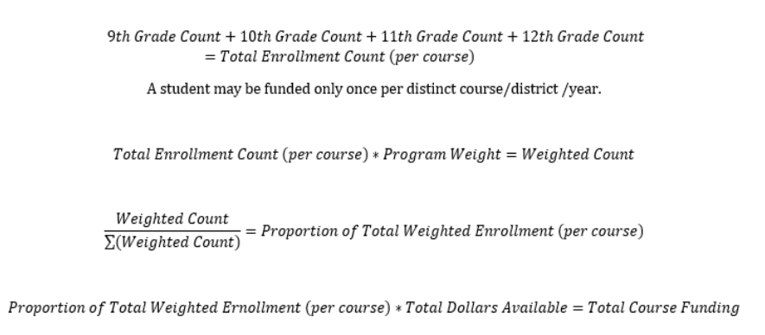
Funding Calculation Revision Detail

Slide 83
Funding Calculation Revision Detail
Formula ignores length of class period, number of weeks, block scheduling, etc.
Example:
Student A is enrolled in Agriscience I in both the Fall and Spring semesters. District reports enrollment in both terms.
Student B is enrolled in Agriscience I in the Fall term in a block schedule; student is not enrolled in any Agriscience courses in the Spring term. District reports the Fall term enrollment only.
Both student A and Student B generate the same amount of funding.

Slide 84
Funding Calculation Revision Detail
Funding is by headcount by course and is across entire district.
CTE Data Portal system captures enrollment by Term, Period, and class title, so multiple records may exist for the same student in a CTE course.
Formula reduces all enrollment to a simple headcount of students for each course within the District (including articulated courses).
Students in different courses within the same program will be funded for both courses.
Students that transfer schools within the district but remain enrolled in the same course at both schools will be funded only once for that course.
Students that transfer schools outside of the district but remain enrolled in the same course at both schools will be funded for both districts.

Slide 85
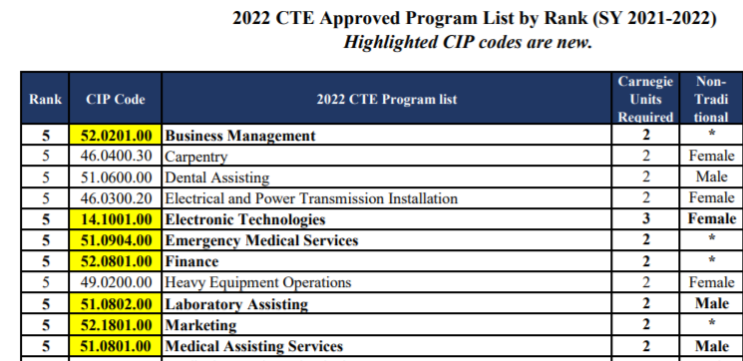
Funding Calculation Revision Detail
Program weights are based on rankings which are based on labor market information.
You can find FY 2022 program weights ranks on the CTE Programs website (look for Approved Programs List):
Rank | Weight
5 | 1.1
4 | 1.0
3 | 0.9
2 | 0.8
1 | 0.7

Slide 86
Funding Calculation Revision Detail
Weighted Count and Sum of Weighted Count
For each eligible course, the weighted headcount is divided by the sum of the weighted count for all eligible courses statewide (all districts).
This is the course’s proportion of the total weighted count (all courses) for the state.
Your district’s share of the weighted count of students is equal to your district’s share of the total funding available.

Slide 87
Funding Related Reports
The following reports will be discontinued starting FY 2022:
VOCI 51-1 Funded School Course Detail/Non-Funded School Course Detail
VOCI 51-2 Funded District Course Detail/Non-Funded District Course Detail
The following new reports have been created starting FY 2022:
District Enrollment Funding Report
Courses Ineligible for Funding Report
Enrollment Headcount Report (not tied to funding)
The following funding reports will remain for FY 2022:
VOCI 17-1 Improper Teacher Certification Report
VOCI 62-1 Funding Summary Report
Related Placement Funding Report
Records Not Added (to check enrollment uploads)

Slide 88
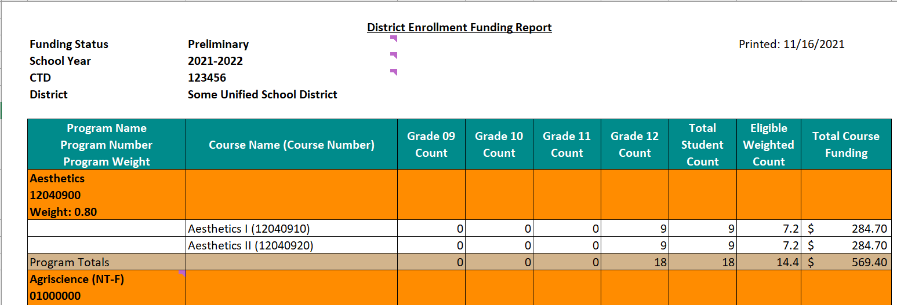
New Funding Reports
District Enrollment Funding Report

Slide 89
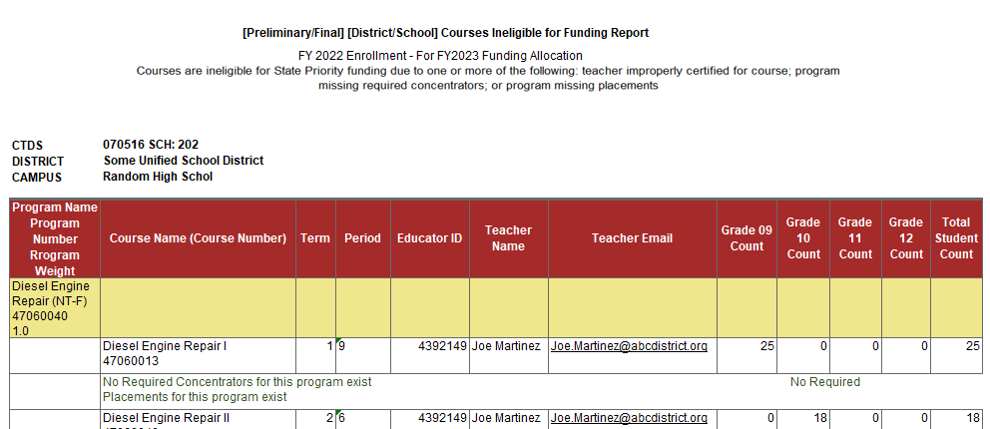
New Funding Reports
Courses Ineligible for Funding Report

Slide 90
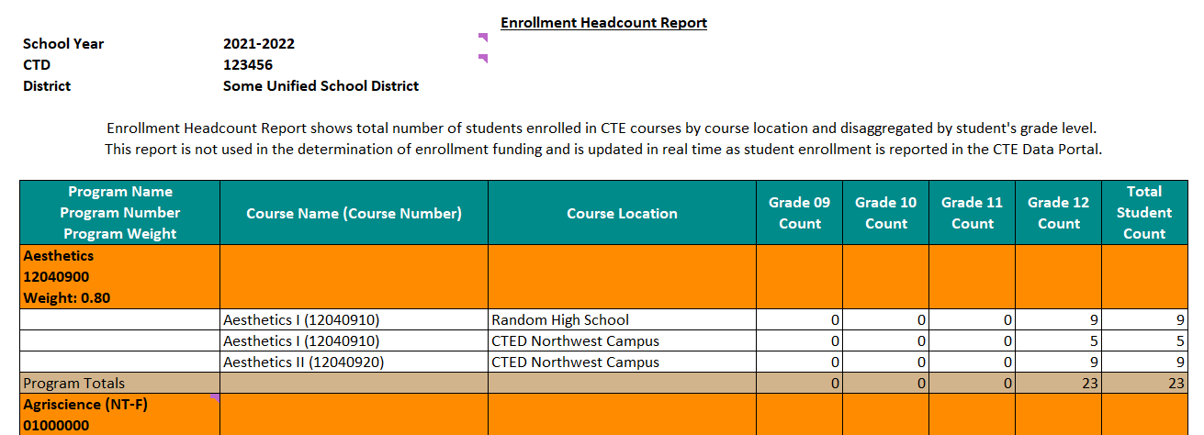
New Enrollment Headcount Report
Enrollment Headcount Report
NOT related to funding – shows total number of students enrolled in your programs (by course and course location).

Slide 91
FY 2022 Data Collection
FY 2022 Coherent Sequence and Enrollment modules are open for District users.
What should Districts be doing now?
Review your coherent sequence and ensure that it is up to date.
Add, delete, or modify programs to ensure that the entire coherent sequence is accurate.
Work with your District SIS staff to get a list of all students enrolled in CTE courses on October 15, 2021 & February 15th, 2022.
Try to get all the information on the enrollment templates.
This will make your data upload easier.
Templates are available here: www.azed.gov/cte/cte-enrollment.
Create your enrollment upload templates.
Once credit is awarded at or near the end of the term, record those credits on the template and upload into the CTE Data Portal.

Slide 92
FY 2022 Data Collection
What should Districts be doing next?
Work with your CTED central office (if you are a member district/satellite campus of a CTED) to ensure that your data is congruent with theirs.
Review your Placement Survey list in the CTE Data Portal (2021 graduates).
Conduct placement surveys and record responses in the CTE Data Portal. Due: June 15, 2022
Record any industry credentials earned by students. Student must have an enrollment record in the system before you can record a related credential. Due: June 30, 2023

Slide 93
Districts and CTEDs Working Together
Career and Technical Education Districts are now reporting student-level data in the CTE Data Portal.
Reporting responsibilities of districts/charters has not changed.
Districts must continue to report articulated enrollment for courses taught at CTED locations. Your CTED central office will report the same students.*
Districts should use the Articulated and Postsecondary Articulated enrollment templates. Districts should not use the CTED Central Campus template (reserved for CTED central offices).
Use the “CTED/District Enrollment Discrepancy Report” to review data with your CTED. Report shows any students reported by one entity that have not been reported by the other.
* Member districts of EVIT will continue to not report articulated enrollment.

Slide 94
CTED/School Enrollment Discrepancy Report
Dark Blue Area
Shows all criteria that must match between CTED and District upload to be considered a “match”: - Program - Course - Course Location - Term - Teacher
Yellow & Light Blue Area
Shows school and CTED campus that reported the students in the report.
White Area
Shows all students that have been reported in the course/term/teacher at the location shown in the dark blue area. Shows student SUID, name, and credits earned.
Look for the “Y” in the Match column.

Slide 95
Contact Information
Tammie Chavez Tammie.Chavez@azed.gov 602-542-3839 | Donna Kerwin Donna.Kerwin@azed.gov 602-542-7881
Samuel Irvin Samuel.Irvin@azed.gov 602-364-1946 | Janet Silao Janet.Silao@azed.gov 602-542-5485
www.azed.gov/cte/cte-data-portal-information

Slide 96
CTE ADMINISTRATORS MEETING February 3, 2022
Fiscal Updates

Slide 97
Announcements
FY 22 Final Allocations March
FY 23 Preliminary Allocations March
Industry Credential Narrative

Slide 98
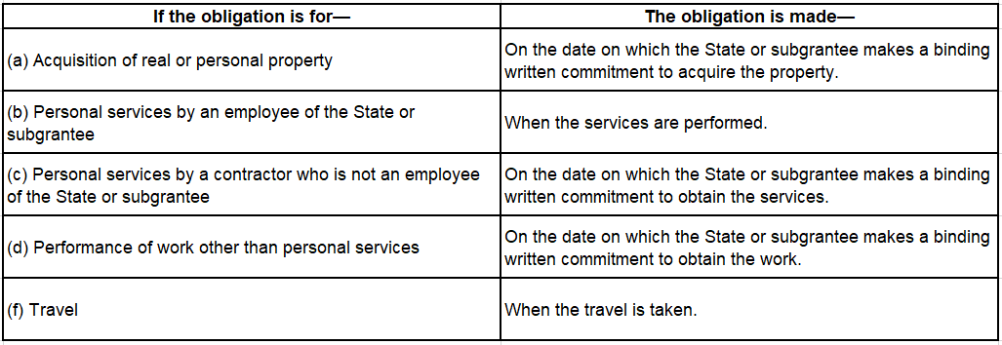
Obligations
***If reimbursed by ADE before payment to the Vendor, you are subject to the interest requirements in UGG (2 CFR Part 200.449) ***

Slide 99
Perkins Calculation
What data do we use???
Estimated number of school age children in poverty by district (US Census Bureau)
ADM Data; due to lack of census information for LEA’s without geographical boundaries (Charter schools/BIE recipients)
ADM Data is retrieved from the Annual Report of the Arizona Superintendent of Public Instruction, Part II

Slide 100
Operational Procedures
Enter data into allocation workbook
Countywide allocations are created for Charter and BIE schools based on ADM
A list of Union and Unified Districts is created with their adjusted census count data and ADM
BIE and charter schools are added along with their ADM data
Census data is extended to the BIE and charter schools based on a county multiplier
The reallocated census counts by school district are entered
Allocation is calculated

Slide 101
Continued…..
30% allocated to LEA’s in proportion to the number of individuals aged 5-17, inclusive, who reside in the school district served by such LEA.
70% allocated to such LEA’s in proportion to the number of individuals aged 5-17, inclusive, who reside in the school district served by such LEA and are from families below the poverty level

Slide 102
Bobby Neves Bobby.Neves@azed.gov 602-542-5137

Slide 103
National School Counseling Week
https://www.schoolcounselor.org/Events-Professional-Development/Events/National-School-Counseling-Week

Slide 104
School Counselors’ Institute
June 6-7, 2022
JW Marriott Starr Pass Resort & Spa – Tucson
Hatching Results
Two Tracks – Beginning & Intermediate – K-5/6-12 focus
$450
Registration is open https://www.azed.gov/tilcsciconferences/sci
Conference agenda and schedule coming soon!

Slide 105
CTE Summer Conference
Hilton El Conquistador
By Request – Sessions on Saturday, Sunday, Monday, Tuesday
Want to present? – Come see me
School Counselor Luncheon – Monday, July 18th

Slide 106
PD & Collaboration Project
PD –New CAP Classes – Free online PD
https://educationforwardarizona.org/innovate/student-supports/azcan/college-access-professional-cap-training/
Guidance for Student Support Services – Collaboration with ADE
AzSCA – Arizona School Counselors Association
AASP – Arizona Association of School Psychologists
SNOA – School Nurses of Arizona
SSWAAZ – School Social Work Association of Arizona

Slide 107
CTE/ESS Project
CTE Recruitment and Retention for Inclusion of Students with Disabilities: Innovative Strategies from a Panel of Your Peers
Webinar
Wednesday, March 30th from 2:30 – 3:30
Looking for panelists – Come see me!
Session at summer conference wrapping up what we have learned this year with a best strategies document and guidance

Slide 108
www.myfutureaz.com
wwww.azed.gov/ecap

Slide 109
Congratulations – AzSCA Award Winners

Slide 110
Contact Information
Amanda Nolasco
School Counselor Specialist
Arizona Department of Education
amanda.nolasco@azed.gov
602.543.5353

Slide 111
Next CTE Administrators Meeting Summer Conference
July 17, 2022
Tucson

