Slide 1
AZELLA Updates
HOPE Conference
December 2021
Brenda Vanderwerp
AZELLA State Test Coordinator

Slide 2
Good Morning

Slide 3
December 2021
Closing Tasks

Slide 4
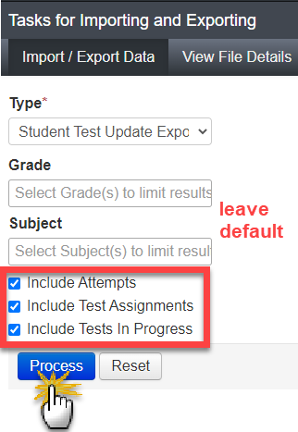
Student Test Update Export Report (PAN)
There is a report in PAN available that can and should be used for all AZELLA test administrations to keep up with the status of student tests.
The Student Test Update Export provides the status of students’ telephone and online test units.
It does not provide the status of paper tests (SAFT and Reassessment) that are returned to Pearson for scanning and scoring during an active test administration.
URGENT To-Do Task

Slide 5
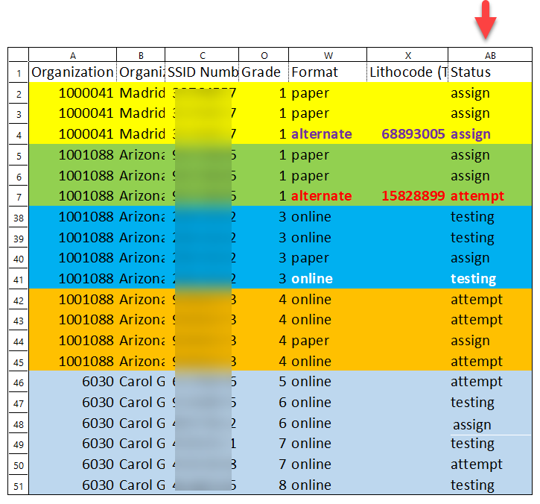
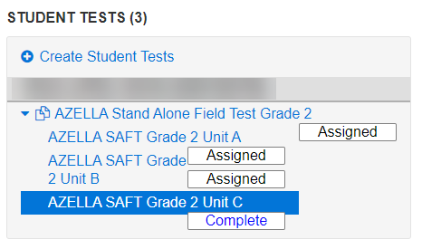
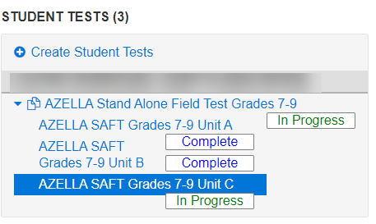
Reading the Student Test Update Export File
ASSIGN = Assigned and Not Started OR it is a PAPER TEST
ATTEMPT = COMPLETE
TESTING = “In Progress” or Ready/Exited/Resumed but NOT FINISHED
Filter the report by Format to show only “alternate” and “online” for the SAFT and Reassessment test administrations

Slide 6
Fall 2021 AZELLA SAFT: CLOSING – LAST DAY Friday, December 10, 2021
Order additional return shipping labels and boxes today if you need them.
Verify all eligible students have completed the test
Check for Work Requests that have been submitted
Check for students in the TRANSFER Session → these students must be moved into a regular test session so they can be tested
Use the Student Test Update Export file from PAN
Look for “Testing” (Grades 3-12)
Look for “Assign” for Grades 1-2 Unit C (Speaking Test)

Slide 7
Fall 2021 AZELLA SAFT Return Materials CLOSING – LAST DAY Friday, December 17, 2021
Utilize the Test Coordinator Manual (TCM) to pack ALL the SAFT materials that you received
Use “Pearson” boxes
Call UPS to schedule the pick-up or you can drop the boxes off at a UPS Store 1.800.823.7459
KEEP ALL TRACKING NUMBERS!
SCORABLE items
Aqua blue Pearson label
Scorable UPS label
Used student test books
Blue – SAFT Header Sheet (bubbled-in)
School Header Sheet
Paper Bands
NONSCORABLE items
Green Pearson label
Nonscorable UPS label
Unused student test books and answer documents
Unused Pre-ID Labels
CDs
TADs
Return Inventory Sheet
Test Coordinator Manual (last thing to go into the box)
URGENT To-Do Task

Slide 8
Packing the SAFT SCORABLE Boxes
Refer to the TEST COORDINATOR MANUAL for explicit directions!
Every banded stack of test books must include a blue bubbled-in scannable header sheet
Multiple grade levels may be placed in the same box
– each grade (by school) must have their own blue bubbled-in header sheet on top of the grade level stack of test books
Multiple schools may be placed in the same box
– must include one School Header Sheet per school at the top of each box (this is not the bubbled-in sheet)
When more than one school is in a Scorable box of materials, the Blue Pearson label must have all schools written on it or place one blue label per school on the box.
All schools must be accounted for when scanning and scoring the Scorable student test books

Slide 9
Header Sheet v. School Header List
You can enter whatever name you want on the backside of the blue bubble-in Header Sheet. The name that is bubbled-in needs to match what is included on the School Header Sheet for that stack of student test books. For the AZELLA SAFT, this can be a more generic name.
The Pearson warehouse worker who opens the box will be verifying that these match to account for the Scorable student test books and who they belong to.
For the Reassessment Test, the same task must be completed; however, the names need to be more specific because this is how student tests will be identified in groups on the electronic group reports and rosters.

Slide 10
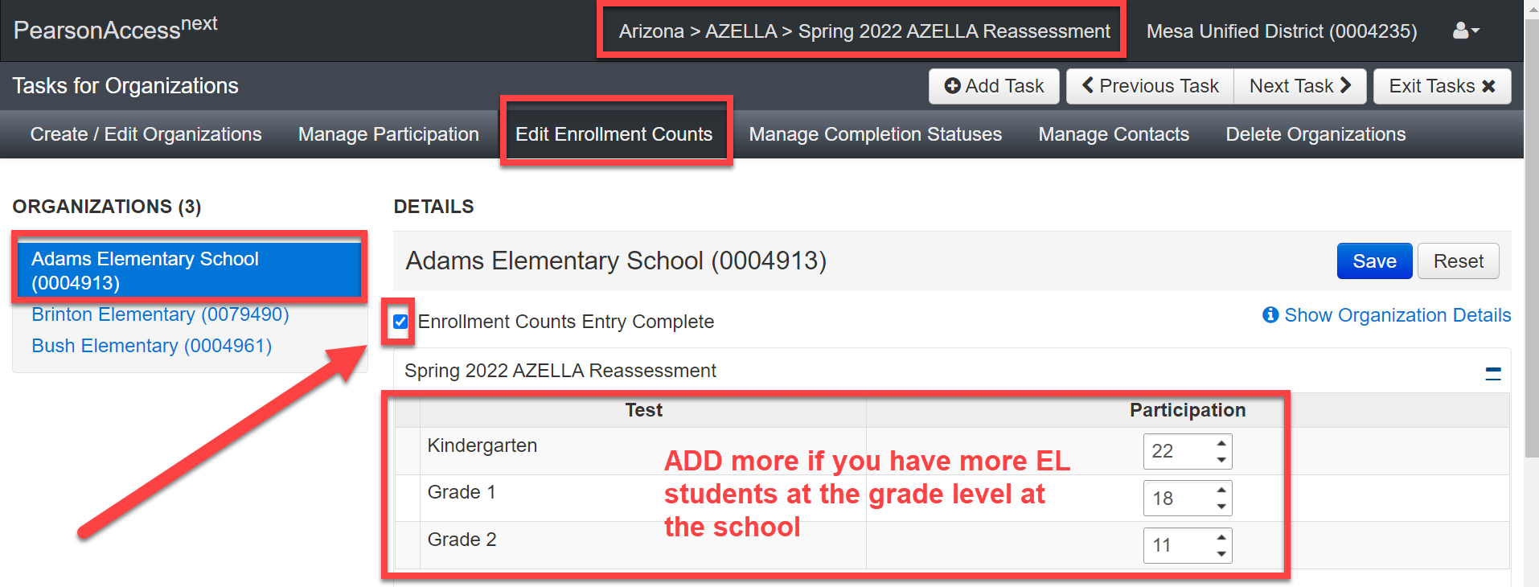
Spring 2022 KG–Grade 2 Participation Counts CLOSING – LAST DAY Friday, December 10, 2021
All districts with schools that serve Kindergarten, Grade 1 and Grade 2 students must complete the Spring 2022 Reassessment Participation Counts and verify shipping address in PAN
LIMITED access to the Reassessment Test administration in PAN to complete tasks
These headcounts provide the automatic initial shipment of Reassessment materials
If you don’t complete your counts you will have to order your own materials AFTER Jan. 21
Participation Counts is NOT connected to Pre-ID Labels
URGENT To-Do Task

Slide 11
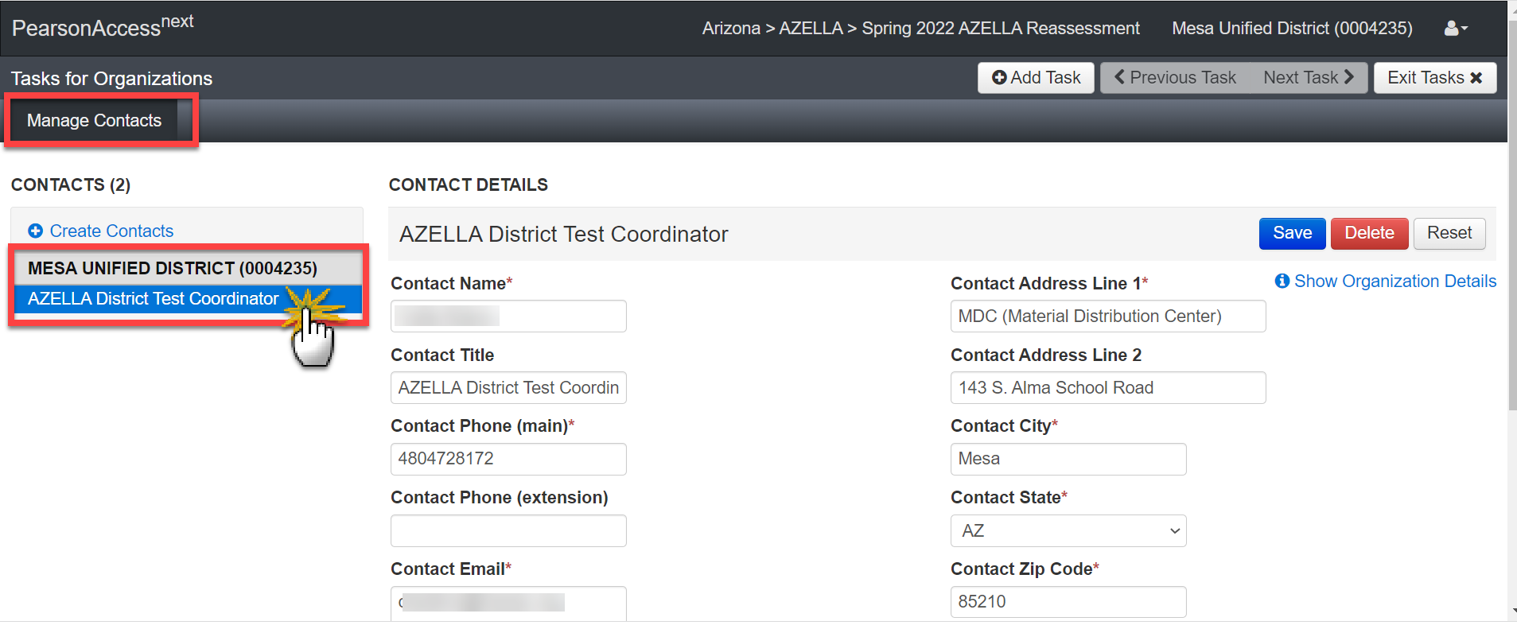
Verify Shipping Address in PAN
Spring 2022 AZELLA Reassessment Test Administration in PAN
Verify the shipping address that Pearson has in PAN for your district(s)
Information from one test administration in PAN does NOT transfer to another administration
Send an email to AZELLA@azed.gov with the following information if it needs to be updated:
District Name
Entity Number
Correct Address
Correct Phone Number
Correct DTC email address
URGENT To-Do Task

Slide 12
Download Your EL73 Reports
Download and review your EL73 Reports today.
Students identified as EL Group 8 must be administered the AZELLA Placement Test now and before December 17, 2021
Also, students with the red font message on their EL70 Report must be administered the Placement Test
Students who are eligible for the Placement Test must be administered the KPT or their appropriate Stage Placement Test within the first 2 weeks of their school enrollment.
Eligible Kindergarten students who have not been administered the KPT by now, must be administered the test by December 17
Districts are out of compliance if this testing is not completed.
URGENT To-Do Task

Slide 13
2021 – 2022 AZELLA Placement Test
Administration of the AZELLA Placement Test continues, non-stop, through May 13, 2022
When you receive a new-to-AZ student during the Spring Reassessment Test window who requires a Placement Test, you must administer the Placement Test, NOT the Spring Reassessment Test

Slide 14
Preparing School Registrars for Student Data Extraction for Reassessment
Make a PLAN of ACTION with school registrars now!
Information is used by Pearson to:
Pre-register K-12 EL students for the Spring 2022 Reassessment Test
Print K-2 Pre-ID Labels for student test books
Student ENROLLMENTS and WITHDRAWALS must be synchronized with AzEDS
EL Program Transactions must be synchronized with AzEDS
Less work for you after January 21
Mon. Jan. 3
Tues. Jan. 4
Wed. Jan. 5
Thur. Jan. 6
Fri. Jan. 7
Enroll, Withdrawal, and EL Program Transactions SYNCHRONIZE DATA
Enroll, Withdrawal, and EL Program Transactions SYNCHRONIZE DATA
Enroll, Withdrawal, and EL Program Transactions SYNCHRONIZE DATA
ADE extracts student data
SAVE YOUR EL73 REPORT
ADE sends to Pearson
URGENT To-Do Task

Slide 15
January 2022
AZELLA Tasks

Slide 16
Reassessment Test Training Modules
Reassessment modules available in the ATMS - Friday, January 14 (keep watch, they may be active earlier)
Annual modules (if not already completed)
Reassessment modules
DTC-STC module
K-2 module
DTCs with schools that serve K-2
STCs at school that serve K-2
TAs administering Stages I and II tests
3-12 module
DTCs with schools that serve 3-12
STCs at school that serve 3-12
TAs administering Stages III, IV, and V tests
Reassessment PAN accounts
DTC PAN accounts will be enabled for the Spring Reassessment administration on or after January 21, 2022, and ONLY after training modules have been completed
DTCs must prepare and present a Reassessment training module to all AZELLA staff based on district and school AZELLA procedures, protocols, and test security and ethics.
Your training presentation must be made available to ADE upon request.

Slide 17
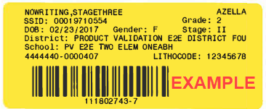
SPR22 Reassessment Paper Test Materials January 18 – 21, 2022
Initial shipment of Reassessment paper test materials to arrive at districts - - ONLY if the Participation Counts are completed by Dec. 10!
If you completed the counts and don’t receive your initial shipment by Monday, January 24, contact the AZELLA Team
KEEP ALL BOXES
(Pearson boxes will be used to return all Reassessment materials and used to return KPT materials in late May)
Inventory all materials prior to distributing to schools
K-2 yellow Pre-ID Labels will arrive during same window as a separate shipment – only students who were extracted by ADE on January 6 should expect to have a Pre-ID Label
– in other words, NOT ALL K-2 students will receive a label, but they must still be tested
Review Pre-ID Labels before they are used on student test books
DO NOT USE IF ANY STUDENT, SCHOOL, DISTRICT, & GRADE LEVEL INFORMATION IS INCORRECT

Slide 18
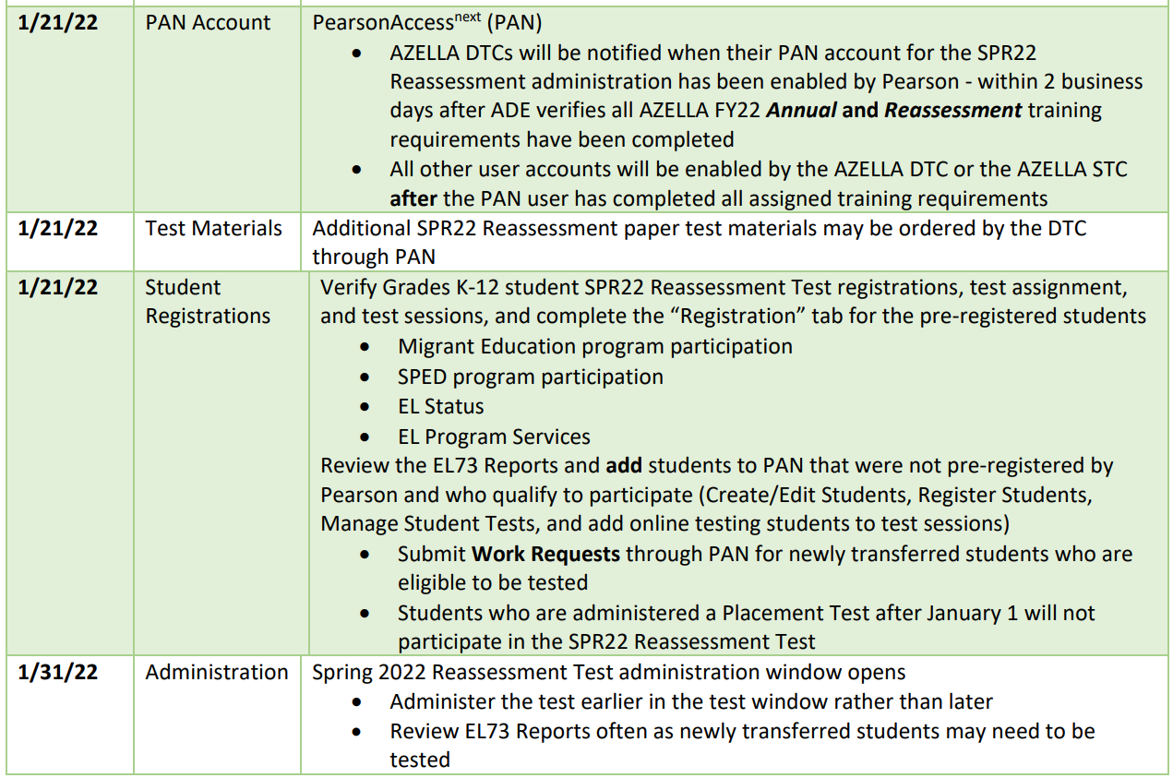
Reassessment Tasks On and After January 21, 2022

Slide 19
Spring 2022 Reassessment Test Window January 31 – March 18, 2022
7-week test window
Plan NOW and
START TESTING EARLY
Do not wait until the last 2 weeks to start testing!
Grades KG – 12 students with an EL need must be tested
Pay attention to the training modules (download the PPT and Transcripts from the ATMS for quick reference)
Read and use the Test Coordinator Manual
Utilize the PAN User’s Guide

Slide 20
Quick Comments – Reassessment Test
Test is same format as prior years and as Stages II-V Placement- meaning 5 test units (is NOT like the SAFT) - there are NOT any Seal Codes
Grades KG–2 = paper & telephone test
All new Lithocode requests (for aborted and interrupted Speaking Tests) must be submitted through PAN > Support > Support Requests
Grades 3 – 12 = all online test units
Stages I and II TADs are paper only; additional copies can be ordered through PAN; do NOT photocopy these TADs
Stage III and IV-V TADs are ONLY available to download from PAN and the ATMS
Students who are not pre-registered by Pearson must be registered by the DTC and STC for the test

Slide 21
Duplicate SSIDs
When you discover that your student has more than one SSID number or your student is sharing an SSID with another student, the district must submit a request to School Finance to merge or split the SSID.
The Assessments Unit is not able to do anything about SSID numbers or student demographics.
Merge/Split SSID requests are submitted through the Help Desk ticketing system (http://helpdeskexternal.azed.gov/)
Please follow these directions for submitting a ticket to School Finance requesting help with SSIDs. Open helpdesk.azed.gov on your web browser
In the upper right area of your screen, click on the Request a Service button
Click on the School Finance icon
Use the School Finance “Account Analyst Support Request” template.
From there, select the Subcategory “Split/Merge” and the appropriate Item (Data Merge – Student, Data Split – Student, or Other)
Please be sure to add “student waiting to be administered the AZELLA state test” in your request (This will move the request through faster)
Submit the request to merge SSIDs
For information on how to submit a Help Desk request, visit the Help Desk Quick Guide: https://www.azed.gov/finance/helpdesk-quick-guide
(The AZELLA Team suggests you start with the Help Desk Quick Guide if you have never submitted a request.)

Slide 22
AZELLAology is a FREE live question-and-answer video call where the AZELLA Team will share information, news, guidance, mini-tutorials, provide answers to your AZELLAology topic related questions, and share a few laughs. AZELLAology is not required.
This is an open invitation for our AZELLA District Test Coordinators. Each live video call will be through the Microsoft Teams application. We will answer as many of your session topic-specific questions as possible during this hour. These AZELLAology video calls are informal, and they will not be recorded.
AZELLAology
Quick Survey
https://azed.surveymonkey.com/r/P5Q83NK
Tuesday
Mornings
8:00-9:00AM

Slide 23
Thank you!
The AZELLA Team is wishing you a wonderful and relaxing holiday season.
Please be sure to attend our next AZELLA presentation tomorrow, right here – same time – same place – and get a sneak peak at the new AZELLA Sample Tests for the 2023 administration.
Brenda Vanderwerp will be out of the office December 15, 20 – 24, and 29 – 31
ADE is closed December 24 and December 31

