Slide 1
AASA Writing Test Prompts, Rubrics and Testing Times

Slide 2
Arizona State Standards
All instruction and assessment begins with the state STANDARDS
Notes:
All items on the state assessments must directly assess one or more of the academic standards, so the Assessment Section refers teachers and coaches to the State Standards whenever there are questions about how a standard should be taught.

Slide 3
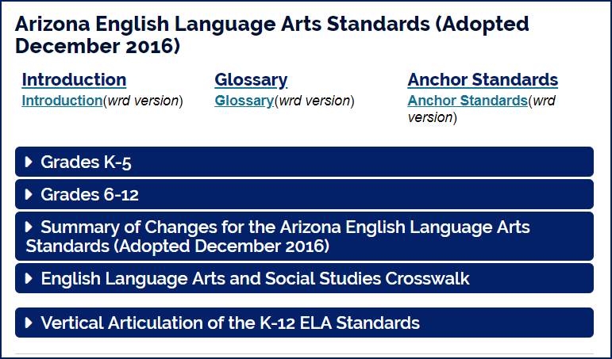
Instructing with Standards
Arizona Standards include Informational Writing, Argumentative Writing, and Narrative Writing.
Instruction should include all writing purposes.
Classroom and benchmark assessments should also include all purposes of writing.
http://www.azed.gov/standards-practices/k-12standards/english-language-arts-standards/
Notes:
Classroom instruction should include lessons that thoroughly address all standards. The state assessment samples the standards each year. For the Writing portion of AASA, we are limited by time in what we can assess.

Slide 4
Writing Standards Assessed on AASA
Write arguments to support claims with clear reasons and relevant evidence.
Write informative/explanatory texts to examine a topic and convey ideas, concepts, and information through the selection, organization, and analysis of relevant content.
Write routinely over extended time frames (time for research, reflection, and revision) and shorter time frames (a single sitting or a day or two) for a range of discipline‐specific tasks, purposes, and audiences.
Notes:
The writing session of AASA measures many of the writing standards – produce clear and coherent writing (Standard 4), gather relevant information from print and digital sources (Standard 8), draw evidence from informational texts to support analysis, reflection, and research (Standard 9) – but also requires writing over a single setting of 90 minutes (Standard 10).

Slide 5
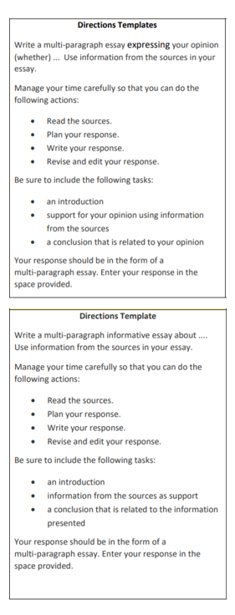
AASA Writing Prompt
Students read and/or listen to the passages.
Planning a response can include student-generated graphic organizers, highlighting text, note-taking, etc. A rough draft is not a requirement.
Time management is required for this writing type, so we recommend that teachers set a time limit for Evidence-Based Writing assignments in the classroom.
https://www.azed.gov/assessment/resources
Notes:
Item Specifications provide the directions template for the writing prompts. You can find these on the Educators page of the ADE Assessment website. You want students to work productively on the task, both in the classroom and during the state assessment. If you have a student who is no longer working during the state assessment, you may direct the student to finish up and then submit his or her work.

Slide 6
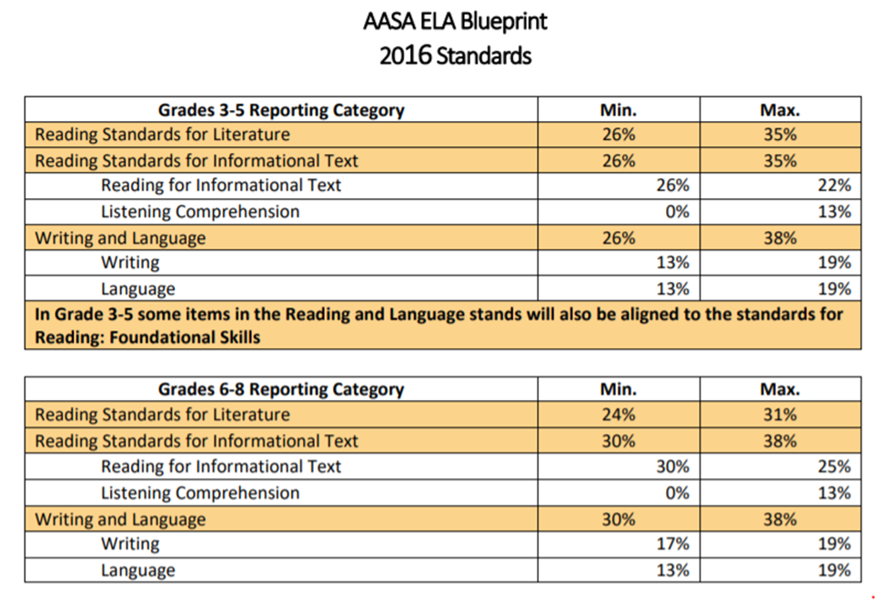
ELA Blueprint
The Writing session of the test requires the longest amount of time expended by students but accounts for less than 20% of the entire ELA assessment.
Use the Writing rubrics and guides to help students understand how they can maximize their points for the Writing portion of the assessment.
Notes:
Writing is an important skill and should be a regular part of your instruction. While only Evidence-Based Writing is assessed at the state level, it is still important to teach other Writing formats and the entire Writing Process.

Slide 7
AASA Rubric
Purpose, Focus, and Organization
The response is fully sustained and consistently focused within the purpose, audience, and task; and it has a clear controlling idea and effective organizational structure creating coherence and completeness.
Evidence and Elaboration
The response provides thorough and convincing support, citing evidence for the controlling idea or main idea that includes the effective use of sources, facts, and details.
Notes:
The AASA rubric focuses on two main indicators for writing – Purpose, Focus, and Organization and Evidence and Elaboration. There is no requirement on the number of paragraphs in the essay; while many students provide four to five paragraphs, many three-paragraph essays have also received the highest score rating. It is the quality of the response along with support for the main idea that determines the rating the essay receives.

Slide 8
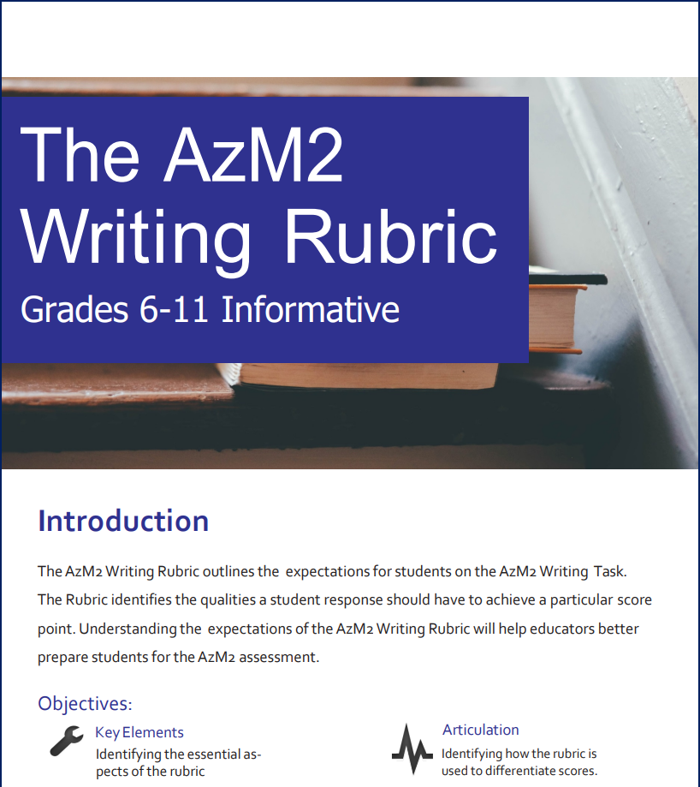
AASA Writing Rubric Guides
AASA Writing Rubric Guides: New Annotated Writing Samples and AASA Writing Rubric Guides will be available Fall 2022. These AzM2 documents can still be utilized for the 2021-2022 school year.
http://www.azed.gov/assessment/resources/
Notes:
These guides can help you and your students to understand how the responses are scored. These are the only two guides, but the same general principles apply to all grade levels.

Slide 9
Key Elements
In the Writing Rubric Guide, you will find the Key Elements that are used for scoring.
Notes:
The Key Elements are helpful in planning instruction for your students. They also highlight the expectations for each score point.

Slide 10
Frequently Asked Questions
Copy Match (CM)
Students who receive a CM rating did not include enough of their own thoughts for the response to be scored.
Students are encouraged to use evidence from the passages in their response but must also elaborate on these ideas. At least 30% of the response should be the student’s own words.
Notes:
Occasionally a student will receive a Student Report that indicates that the Writing Response could not be scored. When teachers and administrators look at the school or district data file, they will see codes that indicate the reason for the response to not be scored. Sometimes a response is not written in English, doesn’t include enough words, or is off-topic. In most cases, the reason indicates a CM, for Copy Match. This means that the student predominantly used the text from the passages but did not elaborate with their own thoughts. At least 30% of the response should be original text that the student generates for the response to be scored.

Slide 11
Frequently Asked Questions
Citations
Showing Evidence
Since the format of the citations are not mentioned in the standards, AASA does not require a specific format.
Students may use any format such as APA, MLA, Chicago, or informal citations such as referencing the passage and paragraph number.
Students may show evidence in their response by using any format such as:
Quotes
Paraphrasing
Textual evidence
Notes:
We frequently get asked if there is a specific format for citations or how students should show evidence in their writing for AASA. Since the State Standards do not specify a particular format, the rubric for AASA responses does not require a particular method. We recommend that students use what is appropriate and required by teachers at their grade levels. The same is true for how students use evidence to support their claims – there is not a required way to include evidence, so we accept all methods on the Writing response.

Slide 12
Managing Time for Classroom Assignments and State Assessment
Identify the Writing Purpose and Read and/or Listen to Passages Closely
Highlight or Take Notes of Key Ideas
Plan A Response
Organize the Information
Gather Evidence
Graphic Organizer
20-40 minutes
Write/Type Response
Proofread
20-30 minutes
30-40 minutes
Notes:
When teaching the writing process, having longer time periods may be advantageous. In fact, the writing process encourages time for reflection. In Evidence-Based Writing, though, the amount of time spent should be a class period for reading/writing. These are general suggestions for planning your instruction; depending on the topic, the length of the passages, and the needs of students, these may be modified. Students should always look at the prompt to identify the purpose for reading and writing. As the student reads or listens to the passages, he or she should highlight text or jot key ideas. This should take approximately 30-40 minutes of time.
For the second part of the assignment, students should begin to plan their response. This is the time to review any highlighted text or notes and add details to these. Students do not need to copy text; some ideas include mapping, outlining, or charting to reduce the amount of text a student writes in this phase. Students should then organize the order of information they want to present. Depending on how long the passages were, the amount of information, and how closely the student read the passages, this phase can take anywhere from 20-40 minutes.
Finally, the student writes or types the response in the appropriate place (test booklet, text box, class notebook, etc.). Students then proofread and finalize their work before submitting the assignment. This phase typically takes 20-30 minutes to complete.
Writing is an on-demand quick write meant to mimic a classroom assignment. For more information about on-demand writing and scoring for quick, see the AASA Writing Resources on the AASA webpage.

Slide 13
Testing Times
AASA ELA | ADE Recommended Time
Writing | 60 - 90 minutes
Part 1 | 45 - 75 minutes
Part 2 | 45 - 75 minutes
ORF (Grade 3 only) | 15- 20 minutes
The testing time for AASA should mirror what students experience in the classroom regularly.
This average includes student with disabilities and EL students.
Notes:
Let’s look at the average time it takes students to complete the ELA AASA test. We want the state assessment to mirror what occurs in the classroom, so each session has a recommended time period that reflects the time in a classroom that may be spent reading/writing. While some students may need an additional half hour or so, students who are no longer productively working may be reminded to finish working and to submit their work.
We recognize that there are times a test is begun in the morning and there needs to be a period of time when a student is not engaged in the test. This flexibility for school schedules should not be interpreted for students to work more than the suggested times. With the type of writing expected during testing, there is no evidence that taking longer than the suggested time results in higher scores.
Schools should schedule Writing sessions early enough in the morning to not interfere with students’ lunch time or early enough in the afternoon, so it doesn’t interfere with the end of the school day.

Slide 14
Thank You!
For questions, please contact us at:
Testing@azed.gov

