Slide 1
CTE Data Portal
for Career and Technical Education Districts
Arizona Department of Education
Career and Technical Education
FY 2021-2022

Slide 2
Topics/Agenda
Introduction
CTE Data Collection timeline
Logging into the CTE Data Portal
The Technical
Home Page
Contacts
Coherent Sequence
Enrollment
Participant/Concentrator records
Roles and Responsibilities

Slide 3
CTE Accountability Team
Janet Silao Education Program Specialist Janet.Silao@azed.gov 602-542-5485
Tammie Chavez Program Project Specialist Tammie.Chavez@azed.gov 602-542-3839
Donna Kerwin CTE Business Analyst Donna.Kerwin@azed.gov 602-542-7881
Samuel Irvin CTE Accountability Lead Samuel.Irvin@azed.gov 602-364-1946
Bobby Neves Director of Fiscal, Grants, & Accountability Bobby.Neves@azed.gov 602-542-5137

Slide 4
Introduction
Career and Technical Education Districts will begin an expanded role in reporting data to ADE-CTE through the CTE Data Portal website.
This expanded role will include:
Creating a coherent sequence for each CTED site
Reporting student-level enrollment for each CTED site
Reporting student credential attainment data for each CTED site
Conducting and recording a placement survey for all eligible concentrators at each CTED site
Working with member districts/satellite campuses to ensure that consistent, quality data is submitted by the member districts/satellite campuses.

Slide 5
Notes for Presentation
CTEDs will report data for all central – owned, central – leased, and community college campuses within the CTED. CTEDs will not report data for satellite campuses. Throughout this presentation (and other training materials), these will commonly be referred to as “central campuses” or “central sites”.
However, for students that are attending a CTED central campus from a satellite campus, both the CTED and the student’s satellite campus will report the student (CTED as nonarticulated, satellite as articulated). This duplication will be used to verify the accuracy of the data submitted by both entities.
The screens/examples shown in this presentation do not include any sensitive student information. Real CTED names/locations are used, but no sensitive information is displayed.

Slide 6
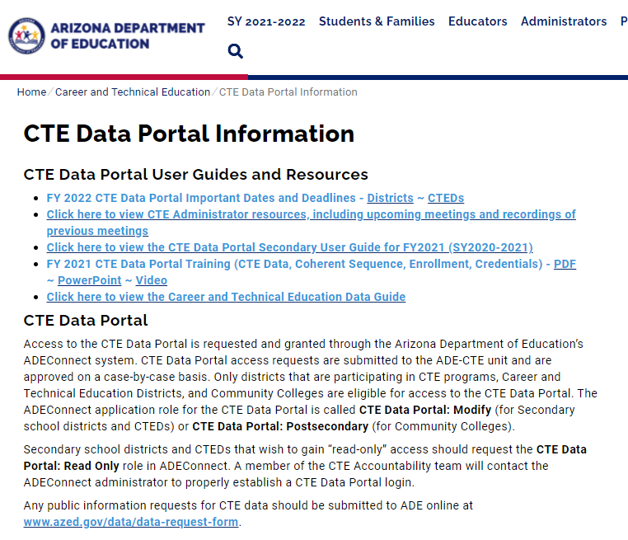
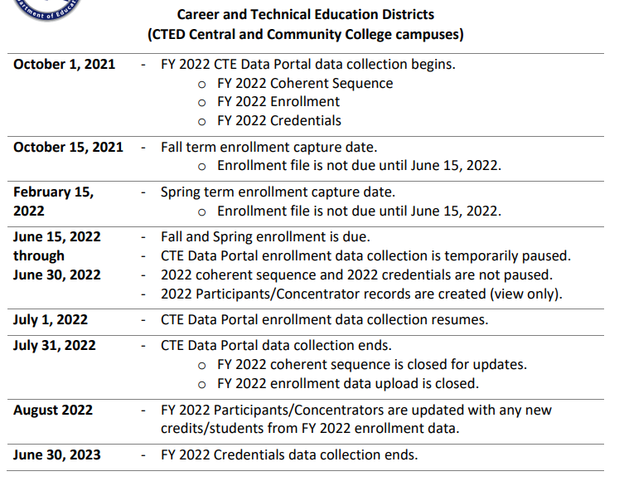
CTE Data Portal Timeline
Find most up-to-date timeline on CTE website and on CTE Data Portal Homepage.
Notes:
CTE data is reported to ADE on an annual cycle that roughly aligns with the fiscal year. The general timeframe runs from October 1st through late Summer of the following year for each fiscal year. Starting on or near October 1st, the CTE Data Portal will begin to accept updates to the coherent sequence, student enrollment reporting, student credential data, and placement surveys for the prior year.
ADE-CTE publishes calendars/deadlines on the CTE website and on the CTE Data Portal homepage. Please refer to these resources for specific deadline dates: https://www.azed.gov/cte/cte-data-portal-information.

Slide 7
CTE Data Portal Timeline - Deadlines
Important Deadline – June 15, 2022
Important Deadline – July 31, 2022

Slide 8
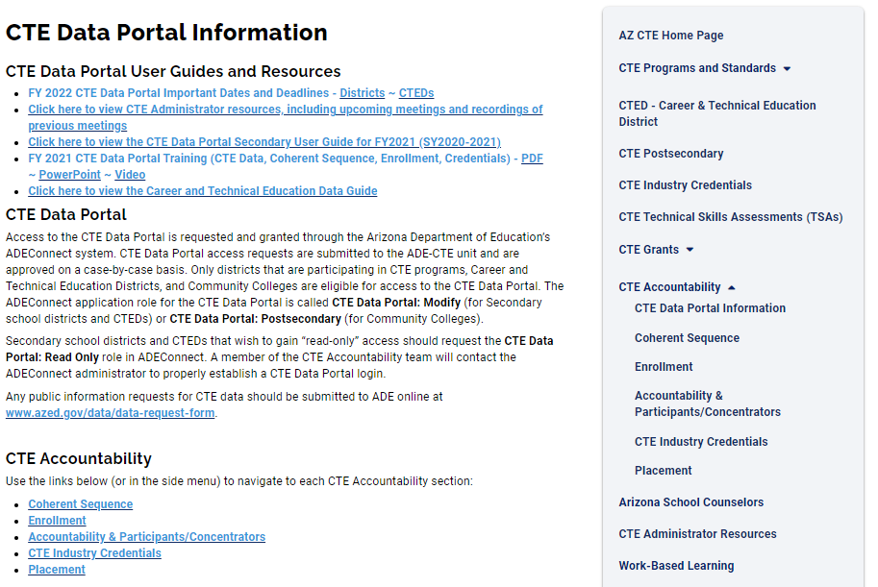
CTE website is a great resource
CTE Data Portal user guide
Data and Accountability handbook
CTE Data Portal upload templates
Information on Industry Credentials
Placement Survey handbook
Placement Survey form
and more…

Slide 9
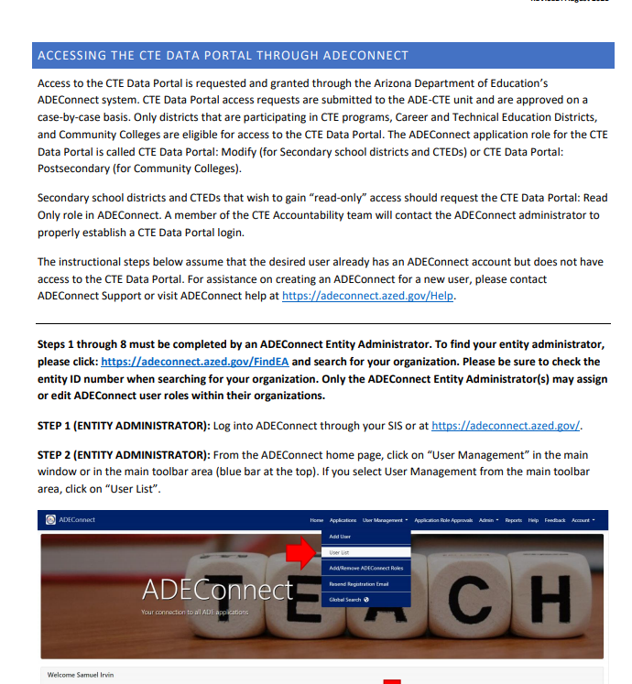
Logging into the CTE Data Portal
CTEDs will continue to log into the CTE Data Portal through ADEConnect.
Help on setting up CTE Data Portal in ADEConnect (for new users):
https://www.azed.gov/sites/default/files/2021/08/Accessing-the-CTE-Data-Portal-through-ADEConnect.pdf

Slide 10
CTED Statement of Assurance
1
2

Slide 11
Contacts

Slide 12
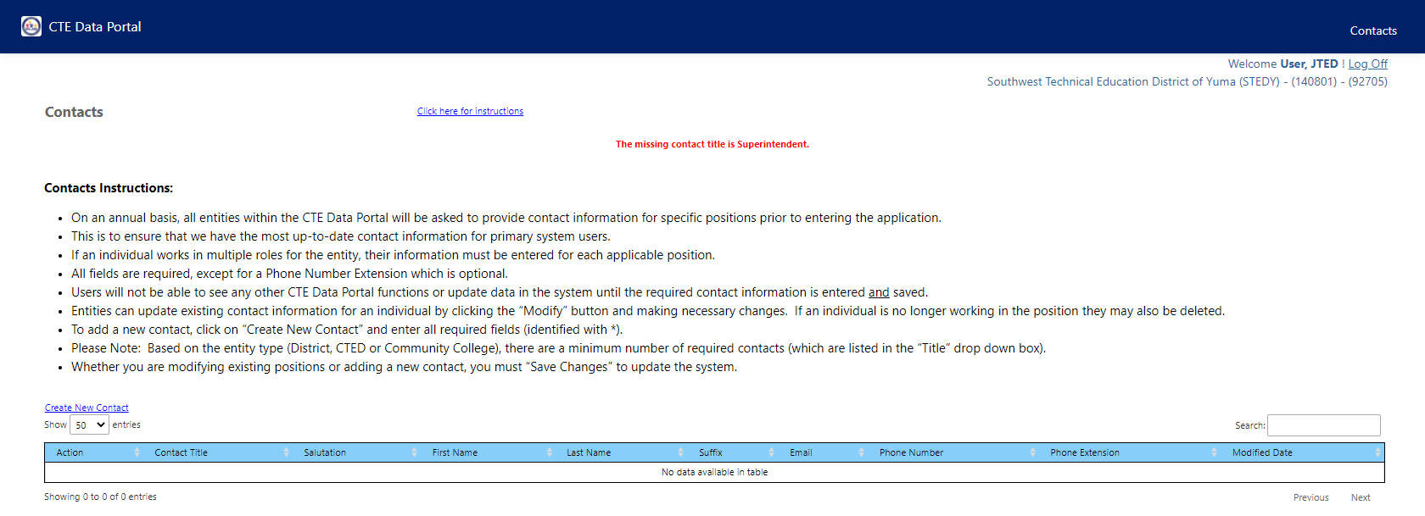
Contacts
Contacts are required for key positions.
This page has not changed from prior years for CTED users.
The system is “locked” until all required contacts are provided.

Slide 13
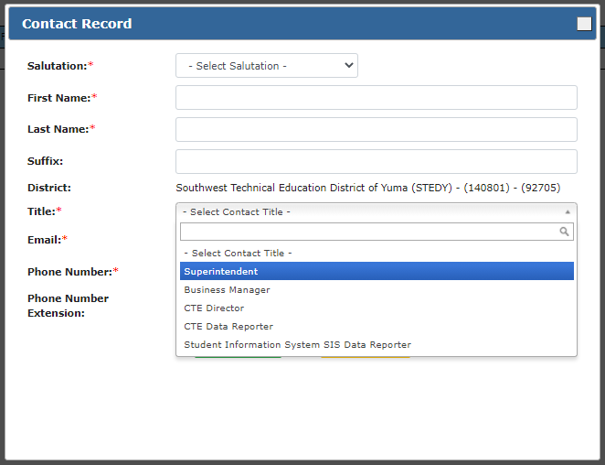
Contacts
Complete form for each required contact type.
Notes:
The required contact types are superintendent, business manager, CTE director, and CTE data reporter. The same individual may be listed for more than one role and more than one individual may be listed for the same role. Any missing required contact types will be displayed on the main contacts screen.

Slide 14
Once all required contacts are entered, system is “unlocked”.
Notes:
Once all contacts are added in, you can access the rest of the system. If at any point your contact information changes throughout the year, please be sure to change it in this page.

Slide 15
Home Page
All new menu options!
Watch for announcements from CTE.
Keep an eye on upcoming deadlines for data reports.

Slide 16
Coherent Sequence

Slide 17
Coherent Sequence
CTEDs will need to create a coherent sequence of courses for all CTE program at each central site:
- Central (Owned)
- Central (Leased)
- Community College
CTE Data Portal lists these sites within each CTED.
CTEDs are not responsible for creating a coherent sequence for any satellite campus. Satellite campuses will continue to maintain their own coherent sequence.
All courses will be considered “nonarticulated”, even those at community colleges. This is intentional – it allows for the system to check enrollment in AzEDS and bring in some data for the student (name, grade, demographics, etc.).

Slide 18
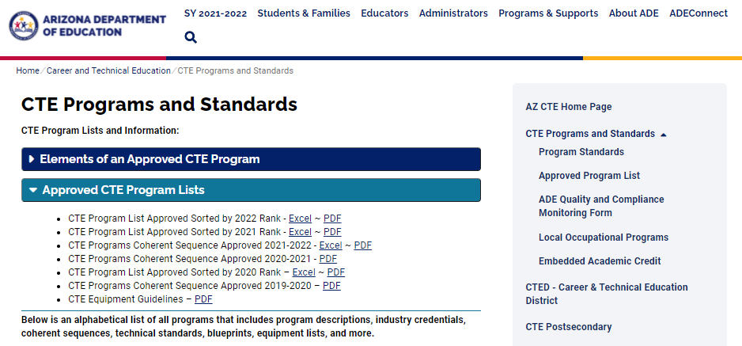
Coherent Sequence
CTE Programs website has full coherent sequence by year:
1
2
Notes:
Available as both PDF and Excel.

Slide 19
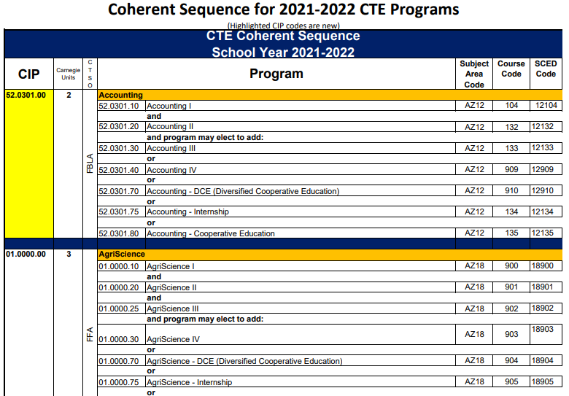
Coherent Sequence
Program Number
Use the program and course numbers from the coherent sequence for your CTE Data Portal uploads (without periods).
Course Number

Slide 20
Coherent Sequence - LOP
If your CTED has been approved for a Local Occupational Program (LOP), that LOP will appear in the program dropdown when you click “Create New Program”.
LOP application is on CTE website: https://www.azed.gov/cte/programs.
(look for “Local Occupational Programs” menu, then “Proposed LOP Request Form link. Deadline is December 15th of each year.)
Please contact CTE Accountability if there is an approved LOP that is not appearing in your Programs list.

Slide 21
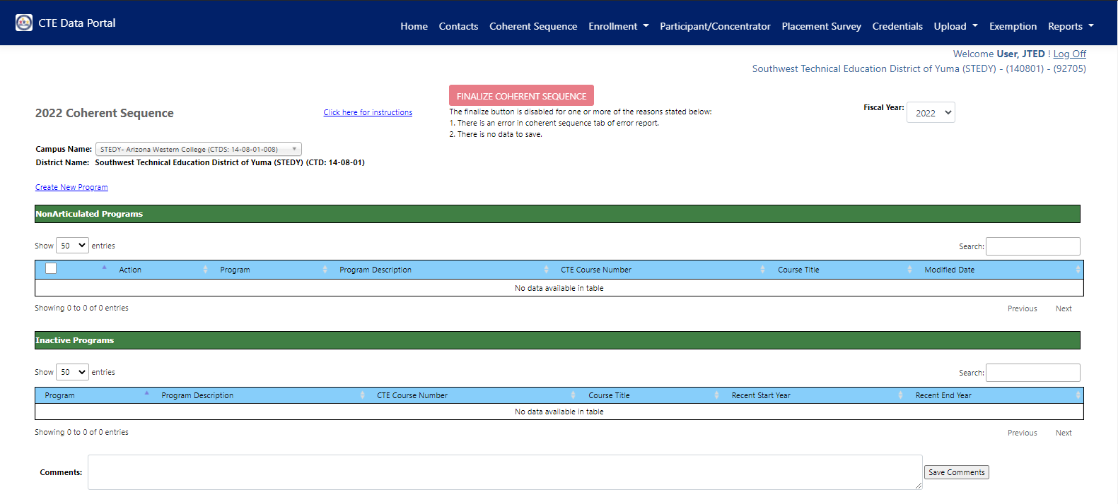
Coherent Sequence
Notes:
Coherent Sequence landing page. Will be blank the first time logging in but will be “rolled forward” each year thereafter. The coherent sequence for CTEDs is very similar to the coherent sequence for your member districts but contains only two sections – nonarticulated and inactive. CTEDs central campuses will not have any articulated enrollment. For courses that are taught at a community college, those community college “sites” will be listed in your school dropdown (like STEDY – Arizona Western College). This is because students that are attending STEDY (but at the community college site) are still enrolled at STEDY, so are recorded as nonarticulated. There is also a comment field where you may leave comments for ADE-CTE regarding your coherent sequence, if applicable.

Slide 22
Coherent Sequence
Notes:
Use the campus name selector to switch between campuses within your CTED. A coherent sequence must be created for each campus. The coherent sequence for each campus should contain the programs taught at that campus.

Slide 23
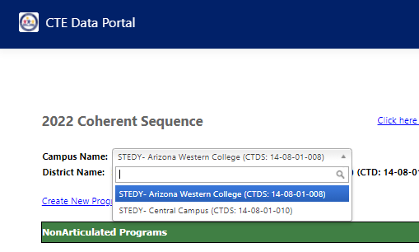
Coherent Sequence
Select a CTED central campus
Includes all central or community college campuses
Notes:
Close up of the select a campus dropdown. It will contain all central owned, central leased, and community college-based CTED campuses. It will not show any satellite campuses. CTED central offices are not required to create or manage the coherent sequence for satellite districts as the CTE-participating member district has that responsibility. Please inform CTE Accountability if there are any concerns with the campuses listed, including missing or any new campuses.

Slide 24
Coherent Sequence
Notes:
To add a program to the coherent sequence, click on the “Create new Program” link in the top left.

Slide 25
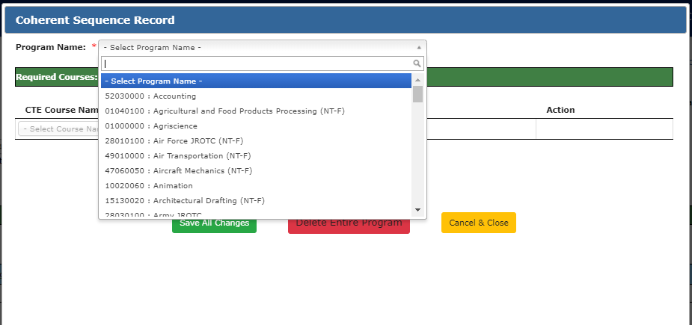
Coherent Sequence
Notes:
Once you click that link, the “Coherent Sequence Record” popup box will appear. Select a program from the “Program name” dropdown. This dropdown includes all approved CTE programs plus any local occupational programs for which your CTED has been approved.

Slide 26
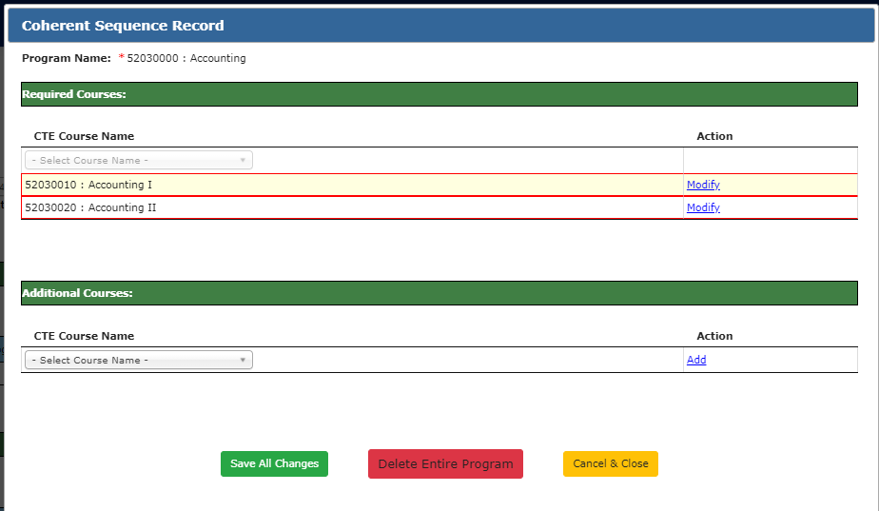
Coherent Sequence
Notes:
Once you select a program name, the program’s required courses are added to the “Required courses section” and are highlighted in red.

Slide 27
Coherent Sequence
Red outline indicates course is not added!
1
Notes:
The red highlight means that the course is not added yet and you must do something to add it. To add the course, click on “Modify”.

Slide 28
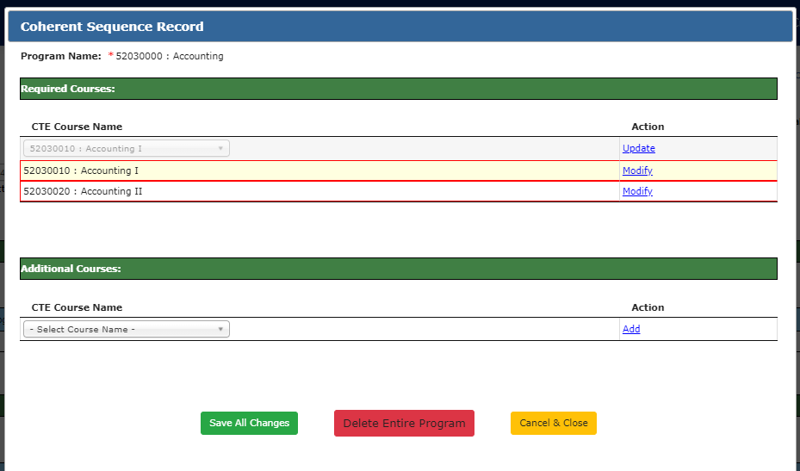
Coherent Sequence
Course moves to the top of the table.
2
Notes:
The course will move to the top of the table. Click on “Update” to add the course.

Slide 29
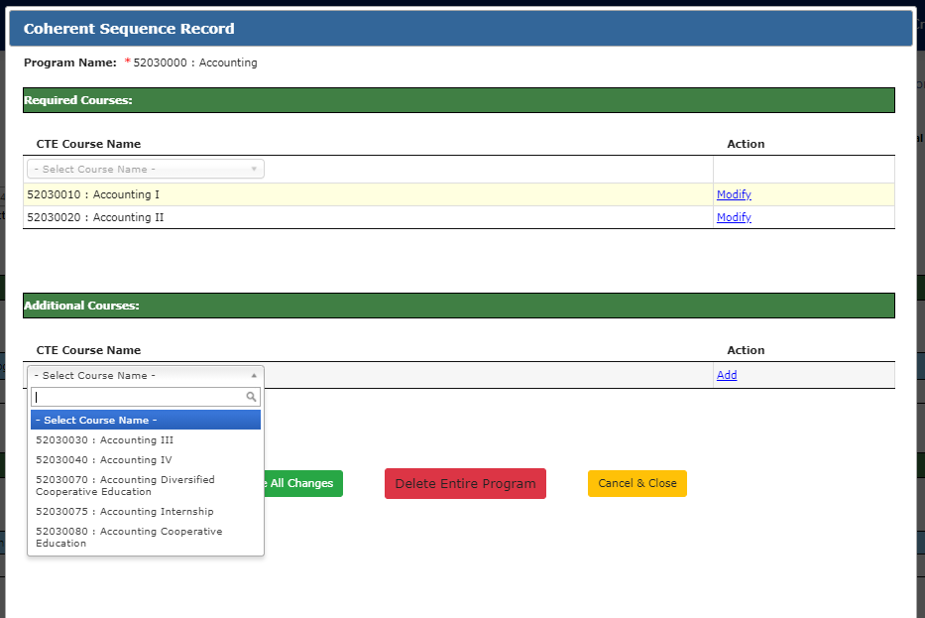
Coherent Sequence
Red outline is removed once course is successfully modified.
1
2
Notes:
The course will move to the top of the table. Click on “Update” to add the course. Do this for all required courses – some programs have 2 and some have 3 required courses. At this point, you may also add additional courses. To add an additional course, select the course you with to add from the CTE Course Name dropdown in the Additional Courses section. Once you select a course, click “Add” to add the course.

Slide 30
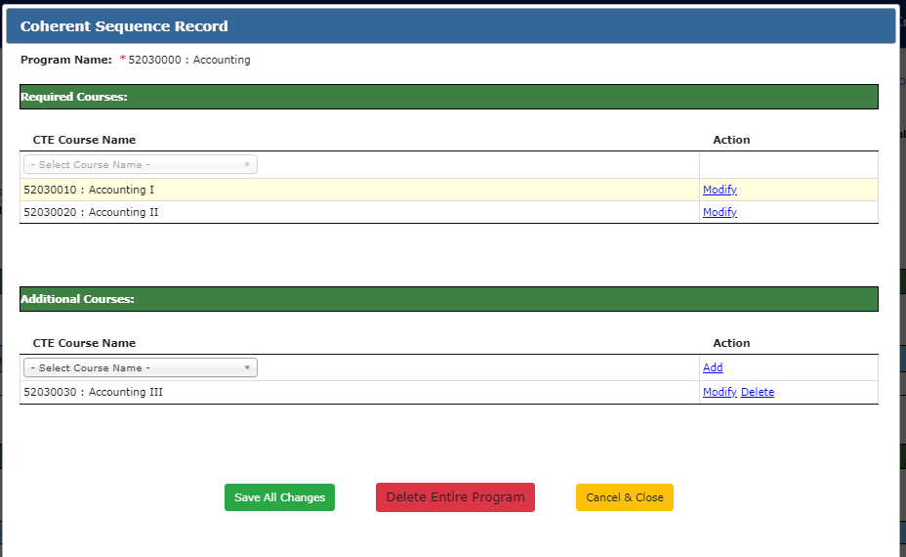
Coherent Sequence
If you click Cancel, no courses will be added.
Notes:
The course will move to the top of the table. Click on “Update” to add the course. Do this for all required courses – some programs have 2 and some have 3 required courses. At this point, you may also add additional courses. To add an additional course, select the course you with to add from the CTE Course Name dropdown in the Additional Courses section. Once you select a course, click “Add” to add the course.
When all courses are added, click on the green Save All Changes button to add the courses to the coherent sequence. You may also cancel and start over, but no course will be added.

Slide 31
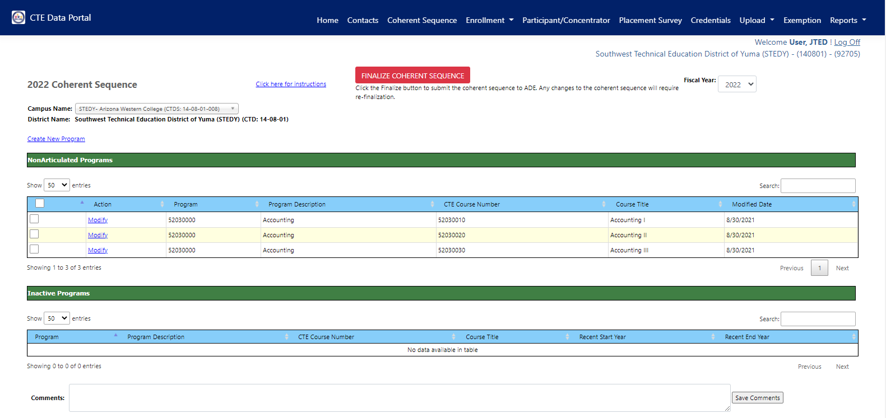
Coherent Sequence
All three Accounting courses were added.
Notes:
When you click Save, the coherent sequence popup box will close, and the courses will be added.
Courses may be added to the coherent sequence only once at each campus, even if multiple instances of the course are taught (such as multiple class periods of the same class or different class names, but the same CTE course being taught. The distinction between multiple classes is made when the enrollment data is provided, not on the coherent sequence. So, for example, if STEDY – Arizona Western College (the selected school in this image) has 10 accounting I classes, Accounting I is still only added to the coherent sequence at this site the one time.

Slide 32
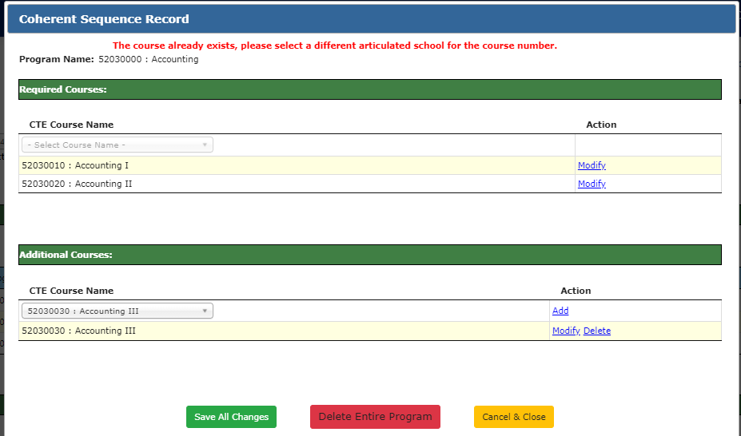
Coherent Sequence
Error Message
If you attempt to add a course more than once, you will see an error message.

Slide 33
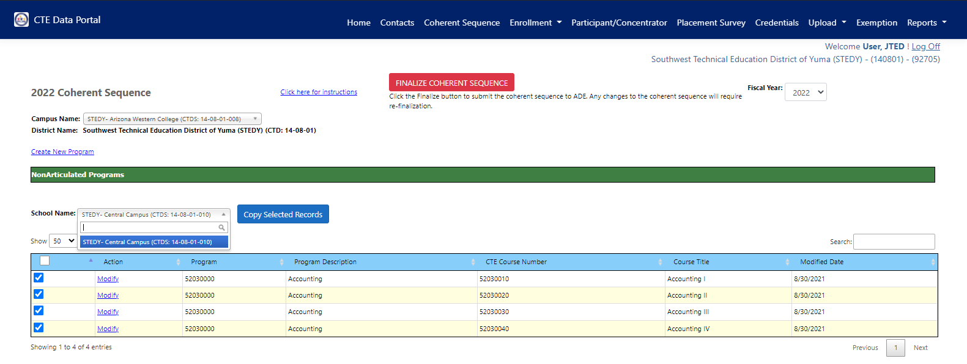
Coherent Sequence
Copy Feature
Select at least one row to activate copy feature.
Notes:
A coherent sequence must be created for each site/campus for the programs that are taught at that campus. As a convenience, there is a “Copy” feature that will allow you to copy courses/programs between campuses all at once, so if more than one program offers the “Accounting” program, you can simply select the courses and copy them to the other campus, rather than creating a new program at each. To use the copy feature, select the checkbox to the left of each course that you wish to copy. Once you select at least one course, the “Copy Selected Records” button will appear with a dropdown listing your other sites. Select the site you wish to copy to, and then click the blue button.

Slide 34
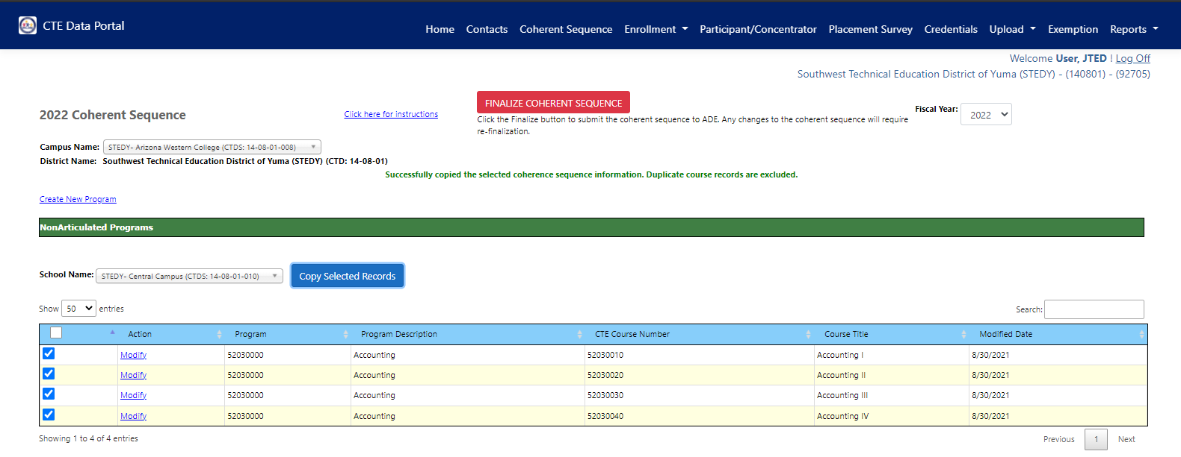
Coherent Sequence
Success message when courses are copied.
Notes:
A green success message will appear when the courses are copied. Notice that any duplicate courses are excluded (meaning that the destination site already had those).

Slide 35
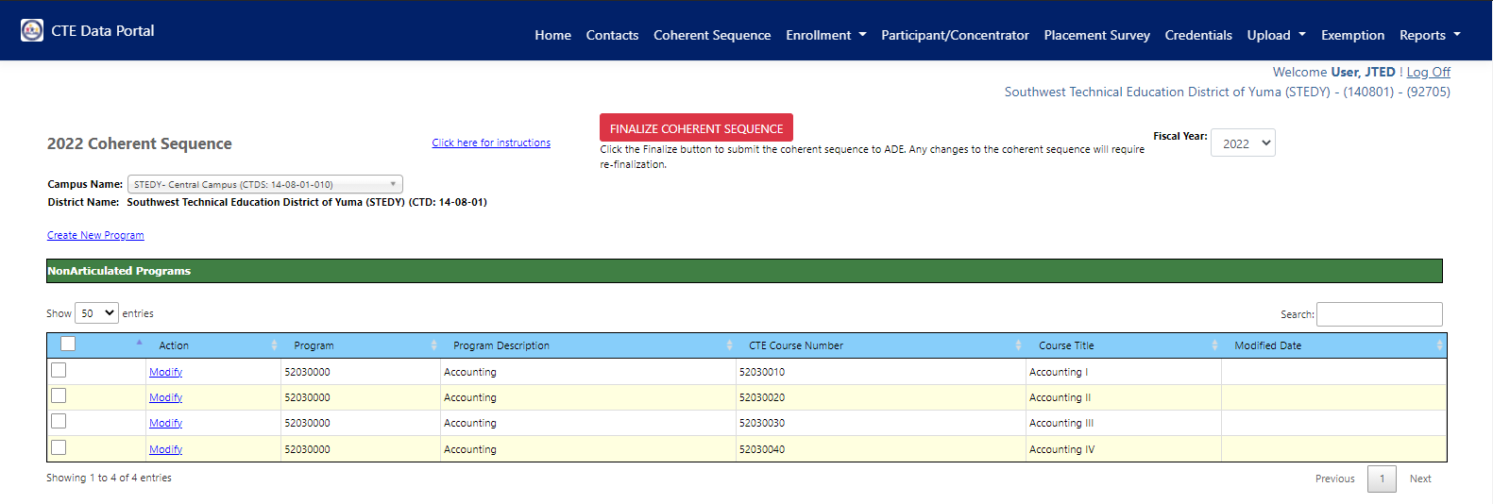
Coherent Sequence
Verify that courses were copied.
Notes:
Once you copy courses, it is a good idea to switch to the destination school and verify that the courses were copied OK. Notice that we’ve switched to STEDY – Central Campus as the courses were copied from another site into this one.

Slide 36
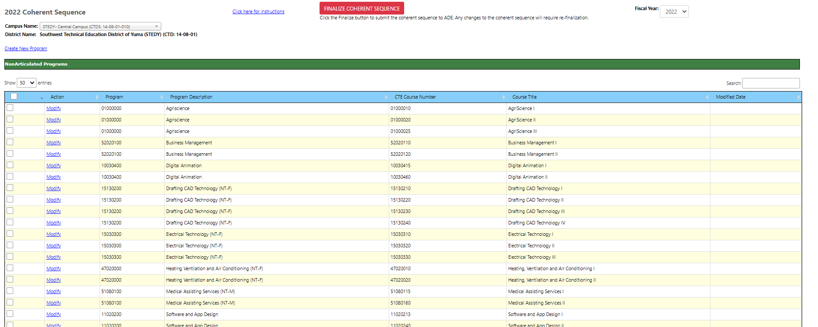
Complete Coherent Sequence
Complete coherent sequence for this campus.
Click “Finalize”.

Slide 37
Working with Member Districts
Member districts will continue to report articulated enrollment for courses taught at a CTED central/community college campus.
Member districts’ coherent sequence must match CTED coherent sequence to successfully report their articulated enrollment.
The following elements must match:
- Program number/CIP
- Course number/CIP
- District articulated location (CTDS) = CTED location (CTDS)

Slide 38
Coherent Sequence at Yuma High School (member of STEDY)
Exercise: this won’t work as expected. Why?
“Az Western College”
CTDS number is
14-06-01-001.
Coherent Sequence at STEDY – Arizona Western College
STEDY – Arizona Western College (CTDS: 14-08-01-008)
Notes:
It is very important that you work with your member districts to ensure that coherent sequences are correct. For any member district’s articulated courses taught at a CTED central/community college campus, the district must have the correct articulated location listed on the coherent sequence (and it must have the corresponding record at the CTED!) This is especially evident for CTED/Community College campuses since the system contains both the actual community college AND the CTED’s community college option – if the course is articulated at a CTED, but the course is actually taught at the community college, districts must select the CTED college option!
Be careful here – the articulated location is not technically incorrect as is (in the first image), but the record will not be considered a match unless the articulated location matches the CTED location (where the CTED reports the same student).

Slide 39
Coherent Sequence at Yuma High School (member of STEDY)
Coherent Sequence at STEDY – Arizona Western College
Locations don’t match!
Articulated location at Yuma HS (Student’s SOR with articulated enrollment) must match CTED’s Central Campus.

Slide 40
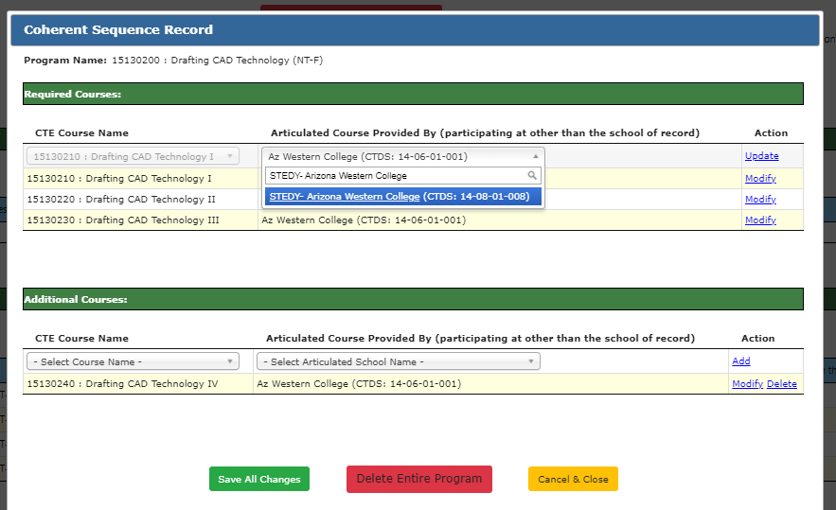
Yuma HS must update coherent sequence to the correct location.
Instructions for District
From coherent sequence landing page, click “Modify” next to any course in the program.
From the popup box, click “Modify” to the right of each course. It will move to the top of the table.
In the “Articulated Course” dropdown, select the correct location. Type the name of the CTED central campus as it appears for the CTED.
Do this for each articulated course that needs to be updated.
Click “Save All Changes”.
This name/CTDS must match CTED campus.

Slide 41
Coherent Sequence at Yuma High School (member of STEDY)
Course Locations match!
Now the coherent sequences match between the two locations.
Coherent Sequence at STEDY – Arizona Western College

Slide 42
Enrollment Reporting

Slide 43
Enrollment
All enrollment data is at the student level.
All enrollment data is uploaded into the CTE Data Portal on an Excel template.
- Get the template here → https://www.azed.gov/cte/cte-enrollment
(look for “2022 Enrollment CTED Central Campus Template”)
All enrollment data is split by term (Fall and Spring semesters) and is a “snapshot” of specific days (plus credits earned at the end of the term):
- Fall term enrollment: October 15, 2021
- Spring term enrollment: February 15, 2022
Your member districts/satellite campuses will be doing the same (for their articulated enrollment), so getting an accurate list of students from your SIS for those specific dates is critical!

Slide 44
Enrollment - Credit
Enrollment is entered by Term, so be sure that the credit is accurate for the term.
If a student is enrolled all year, they will be uploaded twice (two rows on the template) – one for the Fall term (0.5 credits) and one for the Spring term (0.5 credits) (given that the course results in 1 credit).
Credit is used to determine CTE concentrators – a student must complete at least two courses within the coherent sequence (and earn at least one credit in each) to be a concentrator). Internship, cooperative education, and diversified cooperative education courses are not considered when determining concentrator status.
It is critical that credits are input during the enrollment data collection phase to ensure that the student’s credit history is accurate. Credits cannot be entered after this phase is complete!

Slide 45
A note about the Enrollment template
The CTE Data Portal is sensitive!
Please always use the most up-to-date template when uploading your enrollment (download from website).
Please do not alter the template, such as adding or removing columns, reordering columns, or adding/removing tabs.
Template must have all 16 columns in the correct order.
Please refrain from using special characters in the template (stick to the allowed characters on the “Instructions” tab).
Multiple programs/courses, terms, students can be on the same template.

Slide 46
Who to report?
Report all students enrolled in CTE courses at your CTED sites.
Enrollment template has column for “Student Type” which will allow you to identify the student’s relationship with another school, if there is one.
Student Type values:
1 – CTE participating public/charter school
2 – Homeschooled (non-ESA recipient)
3 – Non-CTE participating public/charter school
4 – Private school/private charter school
5 – Empowerment Scholarship Account (ESA) recipient
The system will only look for matching records where the student type is 1 and the CTDS for the student’s regular school is provided.

Slide 47
Who to report?
Report students that were enrolled on 10/15 (fall) and 2/15 (spring) of the fiscal year. Students that were not enrolled (withdrew prior to one of those dates or transferred in after one of those dates) should not be counted in that term’s enrollment data.
The CTE Data Portal will restrict how many times a student can be recorded in a specific course, by term. Only one CTED site (out of all CTED sites in the system) may record a student in the same course in the same term.
If term or course number is different, the student may be recorded.
Notes:
Example: A student is enrolled at CTED Site A in an Agriscience program. On 10/1 (before the fall reporting date), this student transfers to another CTED (Site B) and enrolls in Agriscience. CTED Site A should not report this student at all. CTED Site B should report this student in both terms (given that the student remained enrolled at CTED Site B and in Agriscience for the rest of the year).

Slide 48
Duplicative/Identical Records
 | CTED Site A record | CTED Site B record | Allowed?
Student | John Doe (ID: 123) | John Doe (ID: 123) | No, whichever CTED site that attempted to record this student second would be rejected. Where was student enrolled on 10/15?
Term | Fall | Fall
Course | Agriscience I | Agriscience I
 | CTED Site A record | CTED Site B record | Allowed?
Student | Jane Doe (ID: 321) | Jane Doe (ID: 321) | Yes, both CTED sites would be allowed to record these students as shown. Course is different.
Term | Fall | Fall
Course | Agriscience I | Agriscience II
 | CTED Site A record | CTED Site B record | Allowed?
Student | Sammy Student (ID: 456) | Sammy Student (ID: 456) | Yes, both CTED sites would be allowed to record these students as shown. Term is different.
Term | Fall | Spring
Course | Digital Animation I | Digital Animation I
Notes:
Example: A student is enrolled at CTED Site A in an Agriscience program. On 10/1 (before the fall reporting date), this student transfers to another CTED (Site B) and enrolls in Agriscience. CTED Site A should not report this student at all. CTED Site B should report this student in both terms (given that the student remained enrolled at CTED Site B and in Agriscience for the rest of the year).

Slide 49
Teacher Certification
CTED teachers must be appropriately certified for the course.
Postsecondary instructors (without an EIN) will not be validated.
Two places to check required certification by program:
https://www.azed.gov/cte/programs
(look for programs under the Alphabetical headers, then “Program Description/Industry
Credentials/Coherent Sequence/Teacher Certification” document on each program’s page)
https://www.azed.gov/cte/cte-enrollment
(look for “FY 2022 Teacher Certification Requirements” under Additional Resources)
Certification Abbreviations
Abbreviation | Certification Name
SCTA | CTE Agriculture, K-12
SSCTEA
SCTBM | CTE Business and Marketing, K-12
SSCTEBM
SCTET | CTE Education and Training, K-12
SSCTET
SCTF | CTE Family and Consumer Sciences, K-12
SSCTEFCS
SCTHC | CTE Health Careers, K-12
SSCTEHC
SCTIET | CTE Industrial and Emerging Technologies, K-12
SSCTEIET
Notes:
Example: A student is enrolled at CTED Site A in an Agriscience program. On 10/1 (before the fall reporting date), this student transfers to another CTED (Site B) and enrolls in Agriscience. CTED Site A should not report this student at all. CTED Site B should report this student in both terms (given that the student remained enrolled at CTED Site B and in Agriscience for the rest of the year).

Slide 50
Teacher Certification, Continued
Internships
Any CTE certification
Cooperative Education
CTE certification specific to the program + cooperative education endorsement (CEN)
Diversified Cooperative Education
Any CTE certification + cooperative education endorsement (CEN)
Check certification of teachers using Arizona Online Certification Information System (OACIS) or by verifying teacher’s certificate.
OACIS → https://oacis.azed.gov/PublicOACIS/NormalPages/Educators.aspx
Teachers must be certified by May 1st of the fiscal year to be considered appropriately certified.
Notes:
Example: A student is enrolled at CTED Site A in an Agriscience program. On 10/1 (before the fall reporting date), this student transfers to another CTED (Site B) and enrolls in Agriscience. CTED Site A should not report this student at all. CTED Site B should report this student in both terms (given that the student remained enrolled at CTED Site B and in Agriscience for the rest of the year).

Slide 51
Student Information
The CTE Data Portal brings in the following information using the student’s SUID.
Name (first, last)
Gender
Enrollment status AKA “leave code” (at the school)
Grade level
Race/Ethnicity indicators
Special Population indicators
Individuals with a disability
Economically disadvantaged individuals
English Learners
Homeless Individuals
Foster Care
Parent in Active Military Duty
Migrant
Single Parents
This info is used for reporting and research and is seen on most CTE Data Portal reports and pages.
If you see something that is incorrect, please check with whomever in your organization is responsible for AzEDS reporting and/or your member districts SIS reporters.
Notes:
Checks against AzEDS edfi tables for student characteristics.

Slide 52
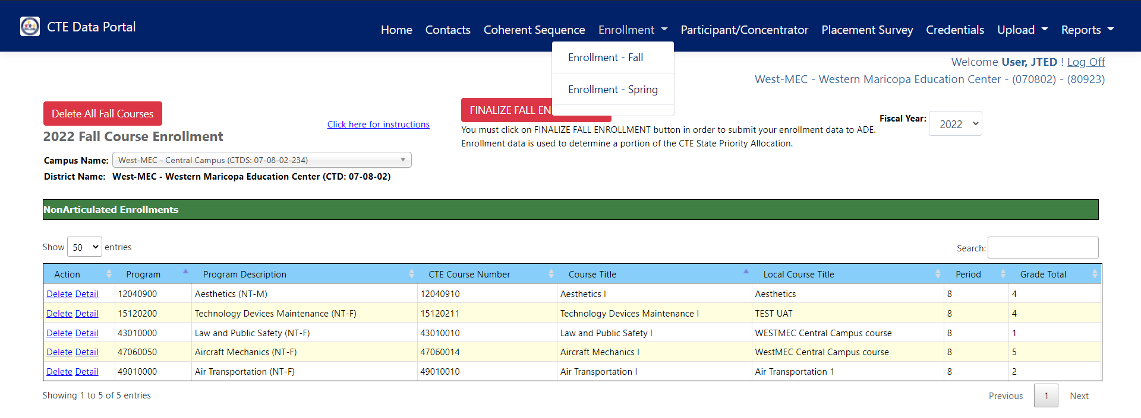
New menu options for Fall and Spring enrollment.

Slide 53
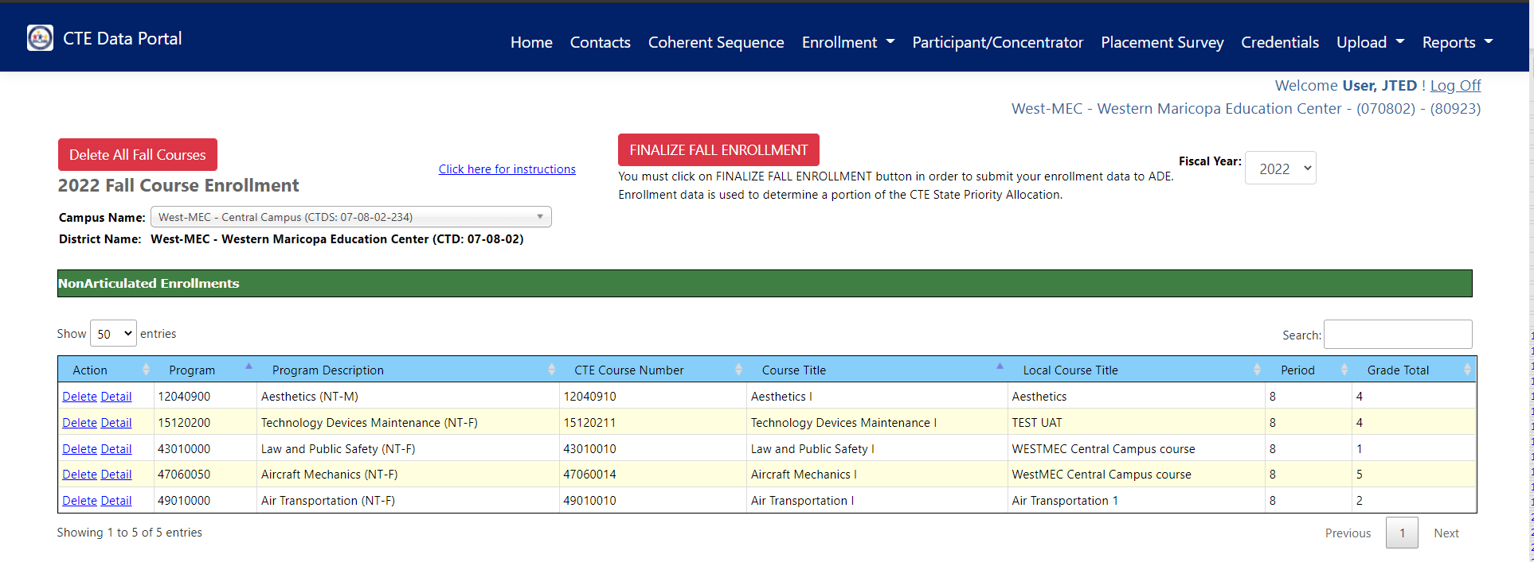
Enrollment Screen – Parts of the Page
A
C
B
D
Notes:
A. On each page, there is a click here for instructions link. Refer to these instructions for step-by-step guidance on completing each data reporting component in the Portal.
B. Enrollment is provided for each campus within your CTED. Look at the list of campuses in the dropdown to see which schools you may be responsible for reporting.
C. You can change the fiscal year to view prior year’s enrollment too – for the first year, you won’t see any prior year’s data.
D. Columns:
Action – will give you links to view or delete each enrollment record.
Program – program number for the record
Program Description – program name for the record
CTE course number – course number for the record
Course Title – Course name for the record
Local Course Title – name distinct to the enrollment record (same name can be used for multiple instances of the same course, such as different class periods)
Period – class period
Grade total – total number of students enrolled in this record
Differences in location, term, Program, course, local title, teacher, and period will create distinct course enrollment records.
Click on “Detail” to view each course enrollment record. Each course enrollment record (row on this screen) contains student enrollment records (rows on the spreadsheets).

Slide 54
Enrollment Upload Template
CTDS: Your CTED central campus CTDS number (no dashes). Excel may drop a leading 0, this is OK.
Term: Fall = 1; Spring = 2
Program Number: 8-digit CTE program number (no periods). Excel may drop a leading 0, this is OK.
Course Number: 8-digit CTE course number (no periods) Excel may drop a leading 0, this is OK.
Local Course Title: Name of course at the CTED, should match for all students in the class

Slide 55
Enrollment Upload Template
Educator ID: AZ-issued Educator ID Number (EIN), not required if postsecondary teacher, will be used to verify teacher certification, if applicable (Community College instructors may not have an EIN)
Teacher First Name: Teacher’s first name
Teacher Last Name: Teacher’s last name
Teacher Email: Teacher’s district/college email

Slide 56
Enrollment Upload Template
Period: Class period, should match for all students in the class
SUID: AZ-issued student unique ID number, will be used to verify enrollment at CTDS in column A
Birthdate: Student’s date of birth, will be used to verify student
Credits Earned: Credit earned by the student in the class, in the term in column B
Student Type: Code value for student, check template instructions for code values
Student’s School of Residence CTDS: CTDS of student’s school of residence, if applicable.
File Type: Type “CTED” for all rows

Slide 57
Enrollment Upload Template
Teacher Identification
The system is programmed to recognize the course location using the CTDS in Column A.
If the CTDS is a CTED central campus (not a community college campus), then a valid EIN is required in Column F and will be used to validate the teacher’s certification.
If the CTDS is a CTED community college campus, then an EIN is not required, and the system will use the name and email provided in Columns G:I.
If CTDS is a CTED central campus (not a community college campus), then system will ignore names typed in columns G:I.
IF CTDS is a CTED community college campus, then system will ignore EIN in column F (and will use teacher name on file with EIN).

Slide 58
Enrollment Upload Template - Complete
This would be a valid file (SUIDs have been removed from example).
File can support different terms, programs, courses, local courses, teachers, periods, and student types.
File cannot support more than one teacher per class, so if two teachers, select only one to include in the upload.
Excel may drop leading zero on CTDS numbers, program and course numbers, or student’s birthdate.
This is ok – please don’t reformat the cell to get the leading zero to stay.
Cells may be formatted (highlighted, bolded, italics, etc.), but for best performance, try removing formatting before uploading.
Pay close attention to birthdates – Excel may convert to numbers, be sure that they are in proper date format.
For cases where student’s SOR does not exist, you can leave the field blank.

Slide 59
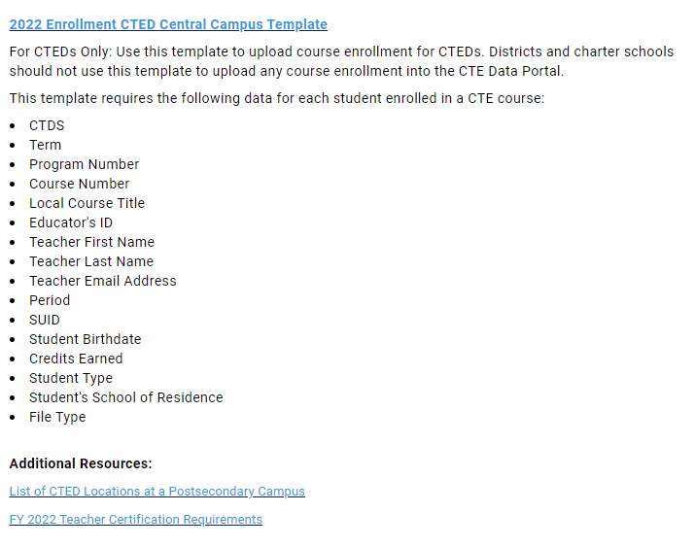
What CTED sites are considered postsecondary/community college?
Get a complete list of “CTED at Postsecondary Site” campuses on the CTE enrollment website:
https://www.azed.gov/cte/cte-enrollment
If one of these location is listed (CTDS in Column A), the course location is considered postsecondary CTED location.
*School Districts will need to use the postsecondary articulated template to upload to these locations!
CTDS | Campus Name
020801012 | CTD - Cochise College
110802009 | CVIT - Central Campus CAC Aravaipa
110802007 | CVIT - Central Campus EAC Gila Pueblo
130802010 | MIJTED - Yavapai College Agribusiness & Technology Center
130802008 | MIJTED - Yavapai College CTEC
130802009 | MIJTED - Yavapai College Prescott Valley
090835217 | NAVIT - Gila Community College
090835215 | NAVIT - Northland Pioneer College LCC
090835214 | NAVIT - Northland Pioneer College PDC
090835213 | NAVIT - Northland Pioneer College SCC
090835218 | NAVIT - Northland Pioneer College SPE
090835216 | NAVIT - Northland Pioneer College STJ
090835212 | NAVIT - Northland Pioneer College WMC
100811216 | PCJTED - Aztec Middle College
100811215 | PCJTED - Aztec Middle College Desert Vista
100811213 | PCJTED - Aztec Middle College East
100811214 | PCJTED - Aztec Middle College North West
100811285 | PCJTED - Central Campus
140801008 | STEDY - Arizona Western College
130801007 | VACTE - Yavapai College Sedona Center
080850007 | WAVE - Arizona Western College
080850008 | WAVE - Mohave Community College
070802285 | West-MEC Estrella Mountain Community College
070802280 | West-MEC Gateway Community College
070802284 | West-MEC Glendale Community College
070802286 | West-MEC Glendale Community College - North
List
Please contact CTE Accountability for any updates to this list.

Slide 60
Enrollment Template Validations/Checks
When the enrollment template is uploaded, the system will validate the following:
File Header | Validation
CTDS (Column A) | Must be a valid CTDS number for one of your CTED central sites, no periods or dashes.
Term (Column B) | Must be a 1 or a 2. 1 is for Fall term and 2 is for Spring term.
Program Number (Column C) | Must be a valid CTE program number and must appear on the site’s coherent sequence (site in Column A).
Course Number (Column D) | Must be a valid CTE course number, must be valid for the program listed in column C, and must be on the site’s coherent sequence (site in column A).
Local Course Title (Column E) | No checks on this field.
Educator ID (Column F) | Must be a valid EIN, must be numbers only. Only checked where applicable.
Teacher First Name (Column G) | Cannot be blank, only checked where applicable.
Teacher Last Name (Column H) | Cannot be blank, only checked where applicable.
Teacher Email (Column I) | Cannot be blank (all cases), must be in valid email format.
Period (Column J) | Cannot be blank
SUID (Column K) | Must be a valid SUID, student must be enrolled in site (site in Column A) in the school year
Student’s Date of Birth (Column L) | Cannot be blank, must match DOB on file in AzEDS for the student in Column K.
Credits Earned (Column M) | Cannot be blank, may be 0.
Student Type (Column N) | Must be a valid student type code (see instructions tab in workbook).
Student’s SOR (Column O) | If student type (Column N) is 1, SOR is required and must be a CTE school.
File Type (Column P) | Should be “CTED” (without quotes) for all rows.

Slide 61
Enrollment Template Validations/Checks
There are a few other validations:
Validation | Description
User must be authorized. | If you try to record data for a school that is not within your organization, you will get an error message that you are not authorized to enter data for the school. The CTDS in column A must appear in your CTE Data Portal Enrollment page school dropdown menu for you to be considered authorized to record data. If you feel there is a school missing, please contact CTE Accountability.
Duplicate Records – Same file | If the file contains a duplicate record within the same file (usually a copy/paste issue), you will see an error message that the record is a duplicate within the same file. Please note that in these cases, neither duplicate record is uploaded!
Duplicate Records – Already Existing enrollment record | If the file contains a record which is an exact match to one that already exists in the CTE Data Portal (on your enrollment pages), you will get an error message that that the record already exists. It will not process, but the existing record will not be changed. Please note that the credit field is not included in this, so if every field except the credit field, matches, the record will still be considered a duplicate to an existing record. If you wish to change an existing record, delete the record from the enrollment pages and re-upload with the corrections.
Duplicate Record – Different CTED | If the file contains a record which is an exact match to one that already exists in the CTE Data Portal at a different CTED site (either within your own CTED or within another CTED’s central sites), you will get an error message that the student is already enrolled in the course at a different site. Students may be enrolled in a course (by term) in a single CTED site. This validation does not compare district and CTED files, only CTED to CTED files.

Slide 62
Uploading the Enrollment Template
Hover over “Upload” and click on “Enrollment”.
Click on “Choose File” to search for your completed template.

Slide 63
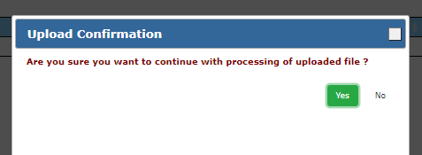
Uploading the Enrollment Template
Once you select a file, click on “Upload”.
Click “Yes” in the confirmation pop up.

Slide 64
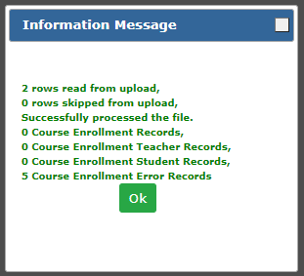
Uploading the Enrollment Template
Information message tells you how many records were processed.
File was processed, but there was an error.
Click “Yes” in the confirmation pop up.

Slide 65
Uploading the Enrollment Template
Review “Records Not Added” report + Error messages to see what went wrong.
Fix these errors in the file and reupload. You may want to delete the file before reuploading.

Slide 66
Uploading the Enrollment Template – Success!
“None out of X” number of records means everything was successful!

Slide 67
Verifying/Reviewing Data with Reports
Enrollment Summary Report
Shows aggregate count of student enrollment records, by program and course, term, and class (local course title, teacher, period). Parameters: by Campus or Program
Disaggregated Student Enrollment Summary Report
Shows a list of the individual student enrollment records broken by program and course, term, and class (local course, teacher, period). Parameters: by Campus
Improper Teacher Certification Report
Shows the certification status of each teacher that is not properly certified to teach the CTE course for which they were recorded as the teacher. Parameters: by Campus
Records Not Added Report
Shows all records that are not added – a combination of all “Records Not Added” reports from the Upload > Enrollment page. Parameters: by Campus

Slide 68
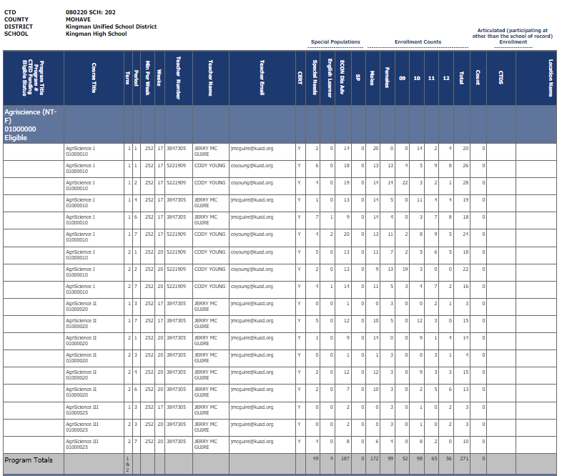
Report Examples
Enrollment Summary Report
Shows aggregate count of student enrollment records, by program and course, term, and class (local course title, teacher, period). Parameters: by Campus or Program
Shows total number of student enrollment records, not students (broken down by term, class).
Program Totals in the grey bar at the bottom of each program section.
Example is from Kingman High School but yours would be for your CTED central campuses.

Slide 69
Report Examples
Disaggregated Student Enrollment Summary Report
Shows a list of the individual student enrollment records broken by program and course, term, and class (local course, teacher, period). Parameters: by Campus
Shows each individual student enrollment record, that student’s demographic information, and any special populations.
Report is very large; it is recommended to view in Excel and not as a PDF.
Example is from Kingman High School but yours would be for your CTED central campuses.

Slide 70
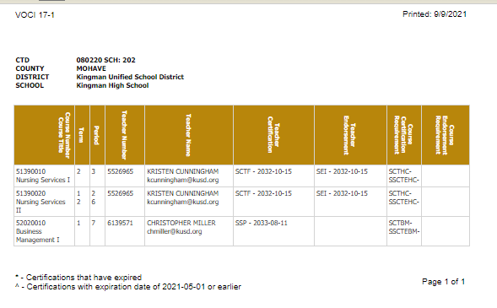
Report Examples
Improper Teacher Certification Report
Shows the certification status of each teacher that is not properly certified to teach the CTE course for which they were recorded as the teacher. Parameters: by Campus
Shows the course info, the teacher info, their current certifications, and the required certifications.
Community college/postsecondary instructors will not appear on this list.
Example is from Kingman High School but yours would be for your CTED central campuses.

Slide 71
Working with Member Districts
Both CTED central offices and satellite campuses will be working in the Portal and will be reporting the same students.
CTED central campus will report as nonarticulated any students that attend the central campus.
Satellite campuses will report as articulated any student that attends the CTED central campus from their satellite campus.
Since data is duplicative, it can be used to verify and match up student records.
It is important that your data match your satellite campus’ data and vice versa.
The processes are the same, except districts will use slightly different templates for reporting data (articulated vs. nonarticulated).

Slide 72
Working with Member Districts to create Enrollment Upload Templates
CTED Enrollment Template
District Articulated Enrollment Template (1 of 2)
To be considered a “matching record”:
CTED CTDS (A) = District Articulated CTDS (J)
Term = Term
Program Number = Program Number
Course Number = Course Number
No matching done on:
Local Course Title
Period
Student Type indicator
Credits Earned*
*Will show on mismatch report
Teacher EIN = Teacher EIN OR
Teacher Last Name = Teacher Last name
SUID = SUID
Birthdate = Birthdate
Notes:
The other district articulated template is very similar but has a field for EIN vs Teacher Names.
The district template shown above is the “Postsecondary Articulated” file that is used by districts for courses taught at CCs or at CTED/CCs. It doesn’t require an EIN.
The other template is the “Articulated” file that is used by districts for all other articulated enrollment, including non-postsecondary CTED central campuses.
In that template (“articulated”), CTED CTDS (column A on CTED file) must equal the articulated CTDS on the district file (column I in the “Articulated Enrollment” district file).

Slide 73
Working with Member Districts – Enrollment Discrepancy Report
The CTE Data Portal contains an “Enrollment Discrepancy” report that shows any “unmatched” enrollment records where a match is expected.
A match is expected when:
A CTED uploads an enrollment record where the student is coming from a high school (and the student’s high school’s CTDS number is provided). The match is expected at the high school as an articulated enrollment record where the articulated location is this CTED.
-OR-
A District high school uploads an enrollment record where the student is attending the course at a CTED. The match is expected at the CTED as a nonarticulated enrollment record where the student’s high school/SOR CTDS is this district high school.

Slide 74
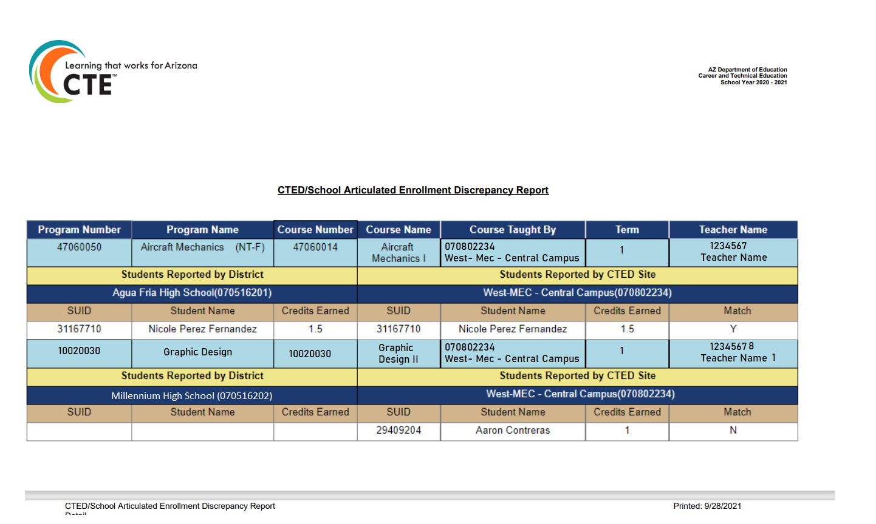
Working with Member Districts – Enrollment Discrepancy Report

Slide 75
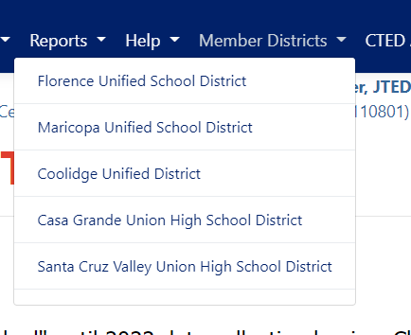
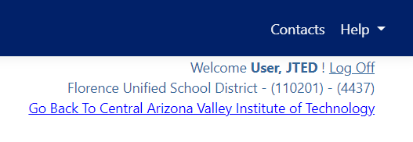
Working with Member Districts – View Member Districts
Navigate to member districts (view only) by selecting a district from the “Member District” menu option.
Go back to CTED by clicking “Go back to…” link in top right corner.

Slide 76
Other Tools Available in Enrollment
Deletion
Delete an individual student enrollment record
Delete an entire course enrollment record
Delete an entire term’s course enrollment records
When to delete? You must delete existing enrollment records and re-upload if you wish to modify the record.
Please note that deleting an enrollment record will also delete any corresponding credentials that have been entered!
Deleting an uploaded file also deletes any record that was on that file.

Slide 77
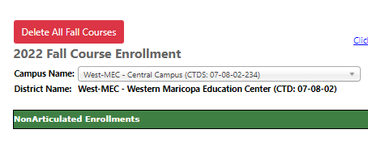
Other Tools Available in Enrollment
Click this button to delete All Fall term course/student enrollment records.
Same option available for Spring.

Slide 78
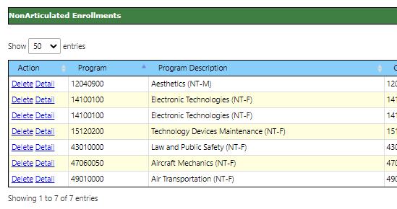
Other Tools Available in Enrollment
Click “Delete” to delete the course enrollment record (row).

Slide 79
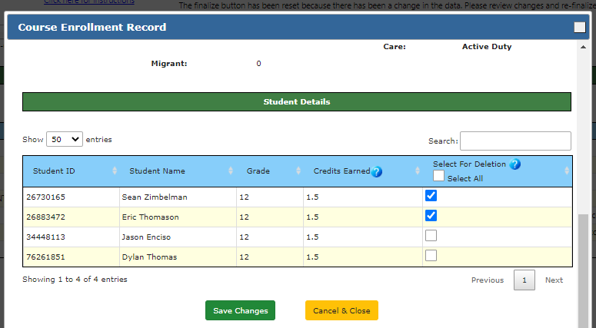
Other Tools Available in Enrollment
Check the box for each student you wish to delete. They will be deleted when you click “Save Changes”.

Slide 80
Credentials

Slide 81
Credentials Reporting
Industry Credentials website:
https://www.azed.gov/cte/cte-industry-credentials
Student must have a current year enrollment record for a credential to be recorded.

Slide 82
Other Tools Available in Enrollment
Schools should report ALL credential attempts, even unsuccessful ones.
Credential data is used in Perkins V performance measure 5S1
Number of CTE concentrators who graduated from high school during the reporting year and earned a recognized credential for their program divided by the number of CTE concentrators who graduated from high school during the reporting year and attempted to earn a recognized credential for their program.
FY 2022 state-determined level of performance for 5S1 is 33.50%.
90% of SDLP is 30.15%.
Your credentials reporting will affect your member districts!

Slide 83
Industry Credential Incentive Program
Credentials in CTE Data Portal are not currently used for Industry Credential Incentive Program.
Credentials in CTE Data Portal will be used for Industry Credential Incentive Program once 4 years of data is gathered.

Slide 84
Recording Credentials
Credentials may be added two ways:
Via the website interface on the Credentials menu page
Click “Add New Credential”
Search for student using SUID – must have existing enrollment
Add credential by filling in the grid
Via template upload
Get template here: https://www.azed.gov/cte/cte-industry-credentials
Template requires a credential code to indicate the credential earned.
Get Credential Code from the same web page.
Credential codes change from year to year – be sure to use most up-to-date list from website.

Slide 85
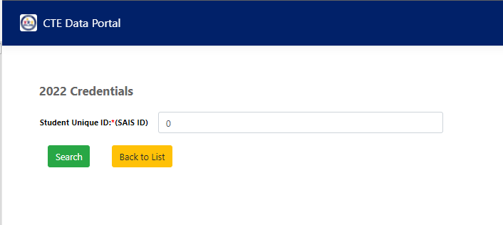
Recording Credentials – Manual Entry
Via the website interface on the Credentials menu page
Click “Add New Credential”
Search for student using SUID – must have existing enrollment

Slide 86
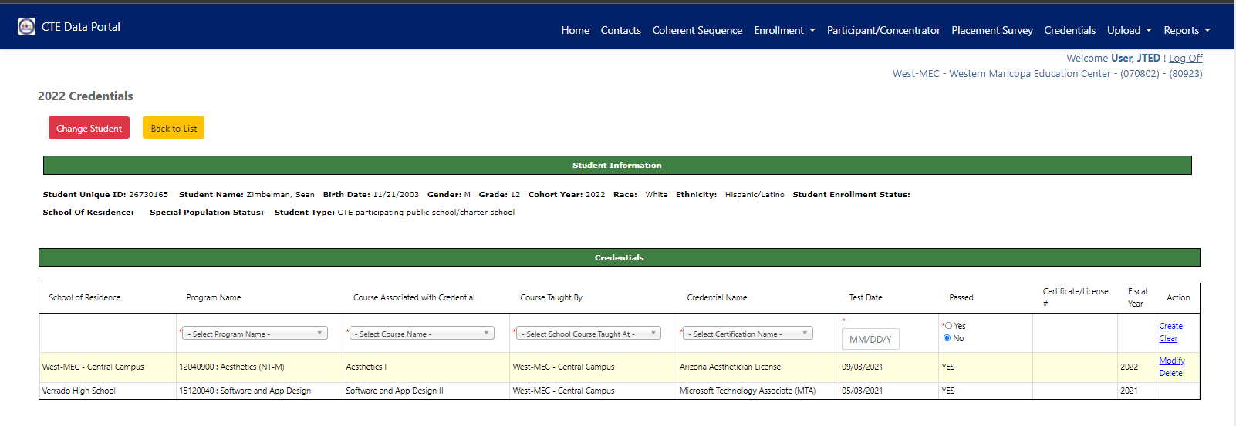
Recording Credentials – Manual Entry
Add credential by filling in top row of table (dropdowns) and click “Create”.
Dropdowns will show the selected student’s enrollment in the same year.
A passing credential may only be recorded once. Non-passing credentials may be recorded more than once.
Click “Modify” to modify the credential record (including any uploaded credentials).

Slide 87
Recording Credentials – Manual Entry
The first column shows who recorded the credential, but both parties can view the credential if matching enrollment exists.
“Course Taught By” column shows the name of the school that taught the student in that course.

Slide 88
Recording Credentials – Upload
Credential will be created at school in Column B (“School of Residence CTDS”)
Program and Course Numbers must match student’s enrollment in the same fiscal year – if no enrollment, credential can’t be added
Course Taught By CTDS is location of course – can be the same as Column B if course was taught at CTED (and credential is being recorded by CTED)
Get Credential Code from website: https://www.azed.gov/cte/cte-industry-credentials

Slide 89
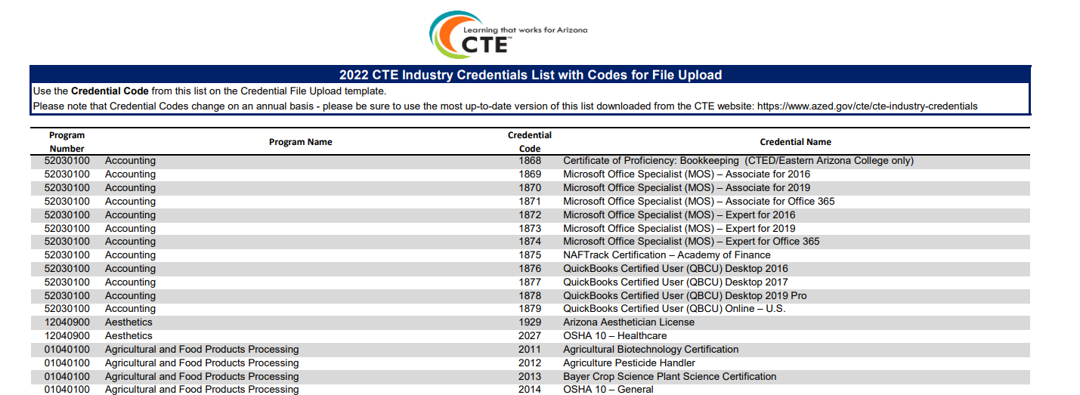
Recording Credentials – Upload
Use the appropriate credential code on the file upload.
Be sure to use the credential in the correct/appropriate program.

Slide 90
Recording Credentials – Upload
In CTE Data Portal, hover over Upload, then click on Credentials.
Click “Browse” to find the complete credential template, then click “Upload”.

Slide 91
Recording Credentials – Upload
See uploaded file.
Click on file name to view file itself.
If any invalid records, review error report in the “Reports” column.

Slide 92
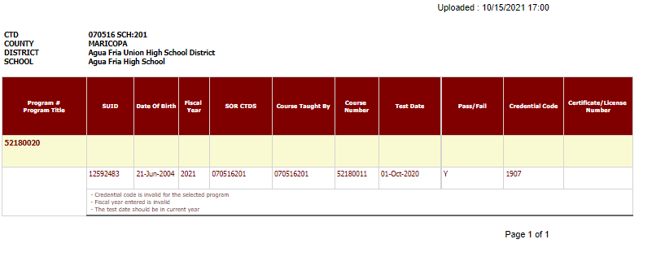
Recording Credentials – Upload Error Report

Slide 93
Participants & Concentrators

Slide 94
Definitions
CTE Participant
A student that completes not less than one course in a CTE program.
Course must be worth at least one credit.
CTE Concentrator
A student that completes not less than two courses within a single CTE program.
Both courses must be worth at least one credit each.
Internships, Co-op, and DCE courses cannot be used.

Slide 95
Participants & Concentrators
The system will create your participant and concentrator records using the credits that the student has earned in the Enrollment.
Credits are aggregated by program and are maintained from year to year and are “rolled forward” each year.
System will bring in “leave code” (AzEDS entry/exit codes) from the student’s school of residence to determine eligibility for Placement Survey.
CTEDs will not have PC records until after June 2022.

Slide 96
Participants & Concentrators Uses
Your member districts rely on PC records for their Perkins V Performance Measures and funding eligibility.
CTEDs are not subject to this requirement.
Participant and Concentrator records will be used to create the CTED Annual Achievement profiles (ARS §15-393.01) data files.
Program Completion
TSA Pass Rate
Graduation Rate
Placement Rates

Slide 97
Participants & Concentrators Uses
Main page contains list of all PC records. Records are kept until student leaves secondary education.
LC: Leave code – AzEDS Exit code from Student’s SOR
LCP: Date that leave code was posted.

Slide 98
Participants & Concentrators Uses
Individual PC record shows credit history, student demographics, and student’s SOR.

Slide 99
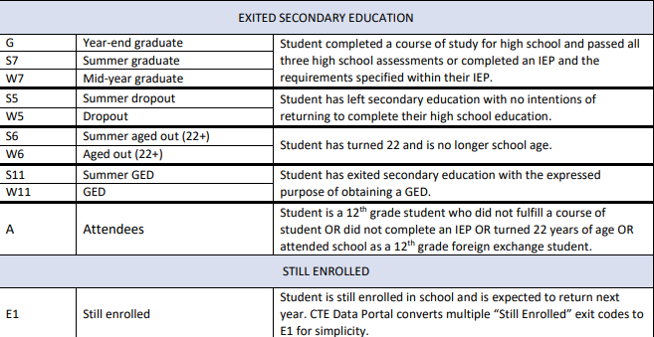
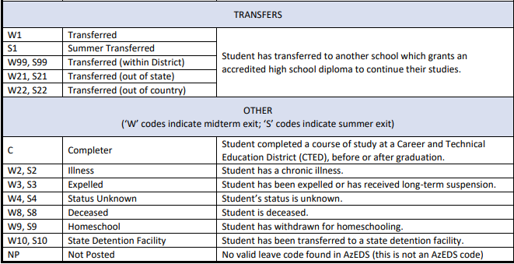
Leave Codes
Leave code will be brought in from student’s school of residence rather than using the CTED leave code.

Slide 100
Questions?

