Slide 1
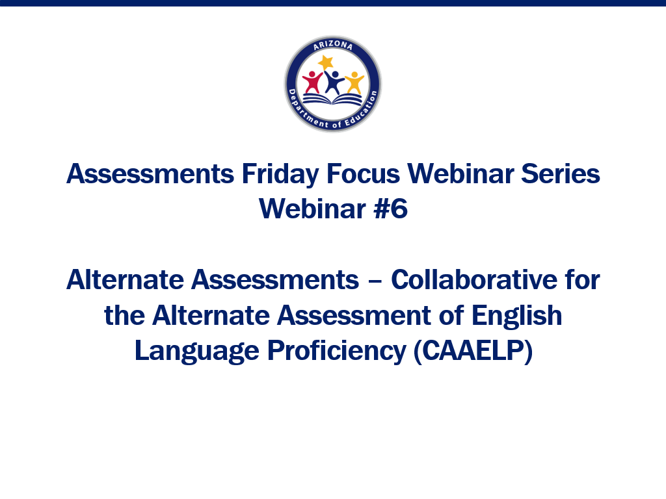

Slide 2
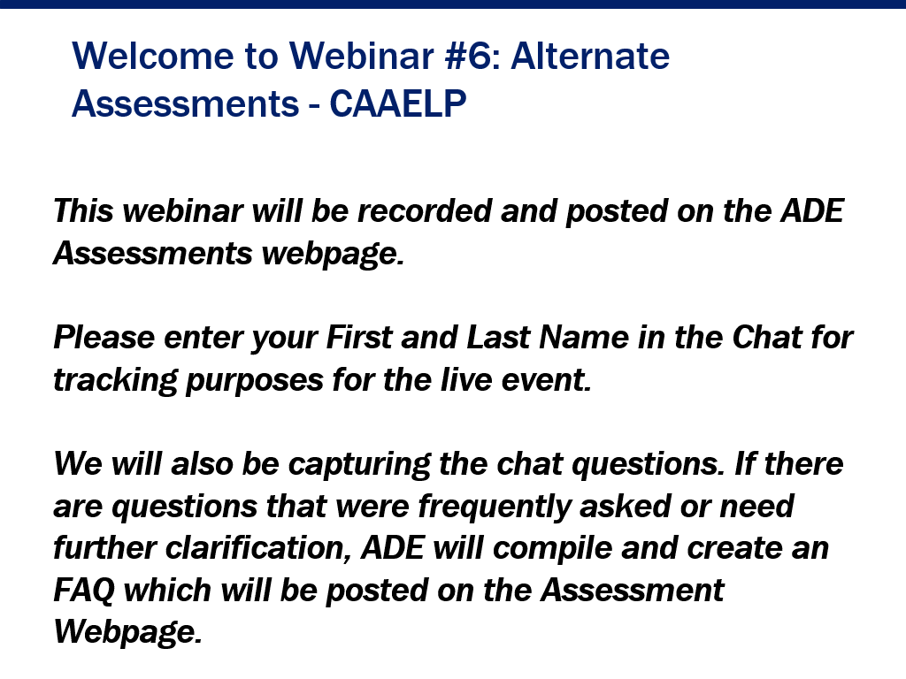

Slide 4
Bethany Spangenberg
Director of Alternate Assessment
Friday Focus Webinar
November 19, 2021
Notes:
Welcome to our Friday Focus Webinar. Today’s topic will be the Collaborative for the Alternate Assessment of English Language Proficiency, or CAAELP, and Alt ELPA, or the Alternate English Language Proficiency Assessment.

Slide 5
Agenda
Project Overview
Upcoming Project Activities
Project Updates
Looking Towards the Operational Assessment
Notes:
During this webinar, I will share with you the project overview, project updates, upcoming project activities, and information on the operational assessment.

Slide 6
Project Overview
Notes:
Let’s start with an overview of the project.

Slide 7
Vision
“The vision is to embrace the language capabilities and full potential of English learners with the most significant cognitive disabilities through a fair and accurate alternate assessment”
Notes:
CAAELP’s vision is to embrace the language capabilities and full potential of English learners with the most significant cognitive disabilities through a fair and accurate alternate assessment.

Slide 8
Project Highlights
Funded in the 2019 CGSA Program by US Department of Education
Awarded $7,767,502 to develop alternate summative assessment for English learners with the most significant cognitive disabilities
Awarded to Iowa, which is partnering with CRESST
Notes:
The project was funded in the 2019 CGSA Program by the US Department of Education. Over $7.7 million was awarded to develop an alternate summative assessment for English learners with the most significant cognitive disabilities. The grant was awarded to Iowa, which is partnering with CRESST on this project.

Slide 9
Project Highlights
Participating states
Iowa Nebraska
Arizona New York
Arkansas Ohio
Connecticut Oregon
Louisiana West Virginia
Period of Performance
October 2019 – September 2023
Notes:
There are 10 states participating in the collaborative. These states vary in size and geographic location. Arizona is excited to be working with these state partners.
The project duration is October 2019 through September 2023. We are about half-way through this project and are on track to have a fully operational and sustainable alternate ELP assessment by Fall 2023.

Slide 10

Notes:
Some of the important tasks are shown in this timeline. We have already drafted foundational documents, finalized the blueprint, started developing items using the item templates, conducted educator feedback, and published the Accessibility and Accommodations Manual. Recruitment for the pilot is underway. We are still accepting more students for the pilot. I’ll share more information on how you can get involved a little later.
After the pilot, we will develop items for the field test and finalize the test administration training and manuals to prepare for the field test in the 2022-2023 school year.
Following the field test, we will prepare for the fully operational assessment to be available starting the 2023-2024 school year.

Slide 11
Project Goals 2019–2023
Goal 1
develop an alternate summative assessment of English language proficiency (Alt ELPA), based on alternate performance expectations for English language development, to be administered to English learners with the most significant cognitive disabilities (ELSCDs)
Goal 2
deliver resonant professional learning about the standards, instruction, and assessment of ELSCDs
Goal 3
develop and launch a sustainable program to maintain the assessment and practices
Notes:
This project has three goals and there is a corresponding team for each goal. The first goal is to develop an alternate summative assessment of English language proficiency, which will be the Alt ELPA, based on alternate performance expectations for English language development, to be administered to English learners with the most significant cognitive disabilities, or ELSCDs.
The second goal is to deliver resonant professional learning about the standards, instruction, and assessment of the ELSCDs. One way we have started to do this in each state was to start a Community of Practice. Presentations and information will be available in an LMS system for additional learners to access soon.
The third goal is to develop and launch a sustainable program to maintain the assessment and practices.

Slide 12
Who Are ELSCDs?
who are not proficient in the English language and have been identified as needing English language development services;
who meet the federal definition of an English learner (ESEA §8101(20));
who meet the state definition for having a most significant cognitive disability; and
whose IEP teams have determined an alternate assessment is appropriate for the student.
Notes:
As we discuss this project, we need to identify who are the students that will be participating. Arizona has not finalized the eligibility criteria yet. We will be following the CAAELP guidance. ELSCDs would be students who are not proficient in the English language and have been identified as needed English language development services, meet the federal definition of an English learner, meet the state criteria for having a most significant cognitive disability, and whose IEP teams have determined eligibility for alternate assessments for the student.

Slide 13
Project Updates
Notes:
Let’s look at some project updates next.

Slide 14
Assessment Design
Finalized
Item specifications for the 6 grade bands
Accessibility & Accommodations Manual
Student access descriptions
Pilot phase 1 (educator feedback on assessment)
Notes:
The test is designed by six grade bands: K, 1, 2-3, 4-5, 6-8, 9-12
We continue to make great progress and have recently completed a couple of key tasks, specifically
Acceptance of the Accessibility and Accommodations Manual for use in the field test and
Completion of our Pilot Phase 1, which involved a series of seven meetings with educators to solicit information and feedback from them about our English learners with the most significant cognitive disabilities and the accessibility, appropriateness, and language processes measured by a set of sample tasks. We are in the process of writing the Pilot Phase 1 report.
Our vendor continues to work on item development.
As I mentioned, we are working on preparations for Phase 2 pilot study. More information on that soon.
And we have continued discussions about the field test's design and implementation.

Slide 15
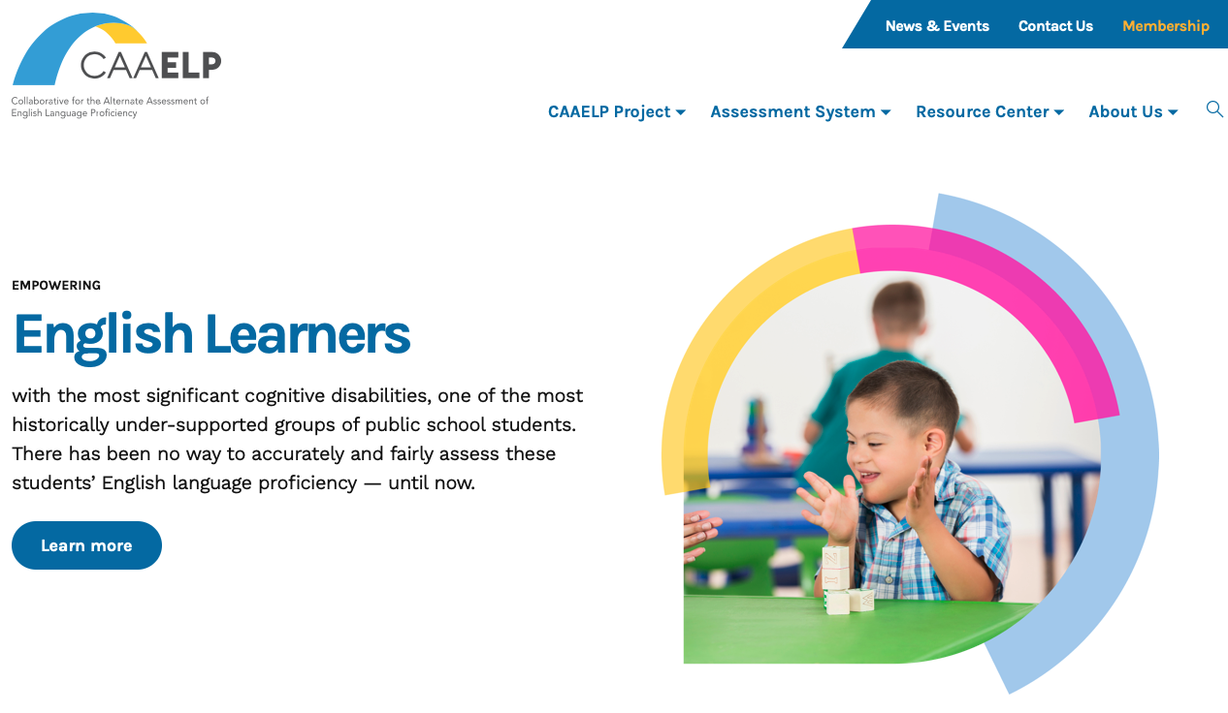
Communities of Practice Professional Learning Modules
LMS Launching soon…
Launching the online Professional Learning modules 1-6 for CoPs
CAAELP Newsletter
Sent the 3rd quarterly CAAELP e-newsletter
CoP/PL Modules Finalized
Professional Learning Modules #1–6 finalized (13 modules total)
Notes:
CAAELP publishes a quarterly newsletter. You can sign up to receive the newsletter on the Alt ELPA website. https://altelpa.org
Professional learning modules 1-6 have been shared with our Community of Practice. There are 7 more modules scheduled during this project.
As I mentioned, the LMS will be available soon. CoP members will have accounts created and we can identify additional users later.

Slide 16
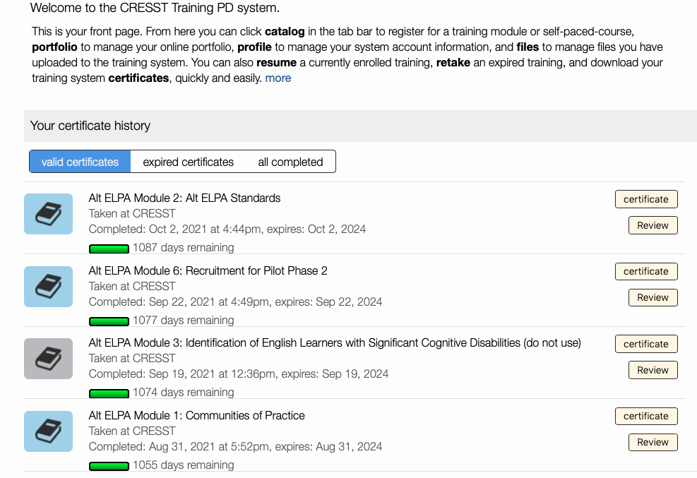
Online Professional Learning Modules
Professional Learning modules for state leads to utilize with their CoP
On Alt ELPA Learning Management System
Self-paced or group-paced
Provides flexibility to come back/relearn
Have similar content
Agenda
Required or referenced documents
Guiding questions for discussion/“Think Abouts”
Notes:
The Professional Learning Modules are designed to meet the needs of educators by providing the option for self-paced or group-paced learning the ability to access previous modules for review, similar content, and consistency in the information presented.

Slide 17

Timeline for Communities of Practice (CoP) Members PL Modules
Goal 2: To deliver resonant professional learning about the standards, instruction, and assessment of English Learners with the most significant cognitive disabilities
2020/2021
2021/2022
2022/2023
Packet # 3 Identification of ELSCDs
Review Test Administrator Training Materials
Review Test
Administrator Training Materials
Packet #1 Establishing CoPs
Packet #9 Preparation for Field Test
Packet #10 Assessment Walk-Thru & Field Test Recruitment
Spring'21
Summer'21
Fall'21
Winter'22
Spring'22
Summer'22
Fall'22
Winter'23
Spring'23
Summer'23
Packet # 4 Recruitment for Educator item Feedback, Item writers, content, bias & sensitivity reviews
Packet #5 Accommodations
Packet #2 Alt ELPA Standards
Packet #6 Recruitment Pilot Test
Packet #7 Assessment Design
Packet #8 Assessment Accessibility & UDL
Packet #12 Informing Student instruction with Assessment Data
Packet #13 Sustaining CoPs
Packet #11
Alt ELPA Test Administration
Test Administrator training & certification
Recruitment for 3 summer events begins
Educator Item writing
Educator Item Feedback
Pilot Test (Item Try-outs)
Operational Field Test
Educator content, bias & sensitivity reviews of FT items
Educator content, bias & sensitivity reviews of sample item
Educators: Standard setting
Post field test reviews
Professional Learning Packets dates are subject to change. REV: 04/29/2021
Notes:
Top row: educator learning, feedback loop, building ground knowledge
Bottom row: peer to peer, actual project steps, working on the actual test
Some events involving educator participation have concluded such as the content, bias, and sensitivity reviews, item writing, and item feedback. There will be additional opportunities for participation in the pilot and work next summer.
All of the events below will need recruited educators/consultants through the CoPs
Feb/March 2022: Cog Labs (pilot phase 2): this event is conducted by CRESST
June 24+25, 2022: Item Content, Bias & Sensitivity Panels of item pool– hosted and conducted by Cognia
Sept 2022: Field test preparation–this event is conducted by CRESST
July 2023: post field test reviews–TBD
August 2023: Standard setting – this event is conducted by CRESST

Slide 18

Communities of Practice
Communities of Practice Updates
8 CoPs set-up: AZ, AR, CT, NE, IA, LA, OH, & OR
Together, conducted 32 Professional Learning sessions, with 157 unique attendees
State recruitment plans summary
2 CoP set-ups in progress (WV & NY)
CoPs actively recruiting for the pilot study
CoP “Office Hours”
Notes:
As I mentioned, Arizona has set up a Community of Practice. We meet monthly. At this time all states have CoPs set up and have started meeting. When there are no new training modules to share, I hold office hours for any member to ask questions, talk with teams, or collaborate across LEAs. CoPs across the project have also met in a joint CoP in September.

Slide 19
Sustainability
Team Focus
Assessment system documentation
Current Focus
✔️Pilot test and operational field test scope and pricing
CAAELP Test Delivery System Requirements
✔️ Finalized the CAAELP Data Handling Manual
✔️Pilot & field test delivery technical specifications
Procurement model
Governance
Data flows
Notes:
All of the work so far is leading us to our third goal of developing a sustainable assessment program. Documentation, procedures, governance, and data have already been addressed and will be carried forward after the project concludes. The pilot and field test will help us identify platform requirements and test administration considerations.

Slide 20
Upcoming - Pilot
Notes:
Let’s look at more details of the phase 2 pilot.

Slide 21
Pilot Study February–March 2022
investigate administration conditions
Purposes of the “on-site” pilot study (cognitive lab/item try-outs) are:
help us best prepare for the operational field test, which is scheduled for February through March 2023
investigate the proposed scoring procedures
understand how the items are functioning
Notes:
As a reminder, phase 1 of the pilot was conducted through educator surveys. That report has not been finalized yet.
This phase of the pilot will occur in February and March 2022. The purpose of this study is to understand how items are functioning, investigate administration considerations, evaluate proposed scoring procedures, and help us prepare for the operational field test in 2023.

Slide 22
Pilot Details
2-3 items per student
60-90 minutes duration
Researcher interacting on zoom
Test administrator (teacher) required
  Training: 60 minutes
Requirements
  Superintendent/principal sign off
  Registration
  Parent permission
Notes:
We are still recruiting for the pilot. As you consider your participation, these are the details you need to know.
Each student in the pilot will view 2-3 items. The test administrator will assist the student by creating a comfortable environment and facilitate the interaction between the items and the researcher. Expected start to finish time is 60-90 minutes including getting the computer set up, orienting the student to the task, and administering the items. And the test administrator will need to complete a 60-minute training prior to administration.
To get set up for the pilot, you will need a permission letter signed by the superintendent or principal. The test administrators will complete a survey to register themselves and their students. And a parent permission form will need to be signed. These forms will be translated into several languages based on languages indicated in the registration.

Slide 23
Looking Towards the Operational Assessment

Slide 24
Looking Towards the Operational Assessment
Items
Accessible assessment items to demonstrate English knowledge and skills
Scoring
Future
Fully sustainable program that is valid, efficacious, feasible, and affordable
Listening, reading, speaking, writing
Accounts for diverse communication experiences
Modality level, domain-level sub scores, and overall proficiency score
Standard setting
Using embedded standard setting process
Notes:
Items - Items reflect consideration of the range of students’ unique communication experiences, application of principles of Universal Design for Learning, and best practices related to item development, accessibility, and accommodations.
Standard setting: embedded Standard Setting approach will be used.
Scoring - we are designing a scoring model that supports reliable, valid, and fair scores. The Alt ELPA will report at the modality level (receptive, productive) with domain-level sub scores (listening, reading, writing, speaking) and an overall proficiency score. The overall proficiency is determined through the pattern and level of performance across the four domains and considers how the language domains interact.
Future – We expect to have a fully sustainable and valid program. We are exploring the possibility of a through-year as well end of year assessment.

Slide 25
Utilization of Alternate English Language Proficiency Standards (Alt ELPS)
ADE is in the process of recommending to the State Board of Education and Superintendent of Public Instruction the utilization of the Council for Chief State School Officers (CCSSO) Alt ELPS.
Held an EL and Special Education Taskforce Meeting to gather feedback on the Alt ELPS.
Public Comment Window (September 22-October 22, 2021)
  Nearly all respondents were in support of the utilization of the Alt ELPS for Arizona.
Link to standards
  https://ucla.app.box.com/s/fd82746xcj3a57dud1rxck399d85bktl
Notes:
As we look ahead to the operational assessment, ADE is in the process of recommending to the State Board of Education and the Superintendent of Public Instruction the utilization of the CCSSO Alternate English Language Proficiency Standards. ADE held an EL and Special Education taskforce meeting to gather feedback on the Alt ELPS. The standards were out for public comment September 22-October 22 and almost all of the feedback was in support of the utilization of these standards for Arizona. The standards will be published on the ADE website after they are brought to the board and the superintendent. You can view the standards on the Alt ELPA website until then.

Slide 26
AltELPA.org
Glossary of terms
Accessibility and Accommodations Manual
Standards
Participation Guidelines
And more!
Notes:
The AltELPA website has a lot of information and resources. Recently published were the glossary to help EL specialists and special education teachers understand terms used in this project. Another recent publication is the Accessibility and Accommodations Manual. Please have your IEP teams read the manual and start considering accessibility and accommodation needs for ELSCDs. Many features and accommodations are different than both AZELLA and MSAA so it will be important for IEP teams to start including this in the IEPs to prepare for the operational field test next school year. As I mentioned the standards are posted to this website. You can also review the participation guidelines, which will be incorporated into Arizona’s eligibility criteria. There is much more information and other resources so feel free to explore AltELPA.org.

Slide 27

Q&A
This Photo by Unknown Author is licensed under CC BY

Slide 28
Notes:
Thank you for joining us today.

