Slide 1
CTE ADMINISTRATORS MEETING November 4, 2021
Vision:
Develop Arizona’s competitive workforce through the power of Career and Technical Education.
Mission:
Career and Technical Education will engage Arizona learners in relevant experiences leading to purposeful and economically viable careers.

Slide 2
Agenda
Welcome and ADE Updates– Clarkdale/Cottonwood Rooms
Grants
Updates: ACOVA – Postsecondary
Program Monitoring, Industry Credentials
Updates: ACTEAZ – Premier Program Series – AZ CTE Curriculum Consortium
Technical Standards Validation and Technical Skills Assessment (TSA) Meetings
CTSO
Break
Updates: Project Change
Accountability and Fiscal
School Counselor Update
Reminders and Closing

Slide 3
Welcome and Updates
ADE Updates:
Dr. Felica Durden, Associate Superintendent
New CTE Staff: Joe Grieco, Construction Science Technologies
Susan Farretta, Career Connections Specialist
Robert Waller, DECA State Advisor
CTE Presidential Scholar applications: 45
CTE Minority Data (handout)

Slide 4
CTED 4th Year Funding
Regional in-demand programs were approved by the Quality Commission on October 20. (in packet)
If a 9th grade student is enrolled in one of the regional in-demand programs their 9th grade year and are in any CTE program on the 40th day of their 11th grade ADM funding will be generated for the CTED.
If a high school graduate is in a regional in-demand program the year after graduation, they will generate ADM for the CTED.

Slide 5
Regions for for CTED 4th year Funding
CTED Workforce Region
CAVIAT Coconino & Yavapai
CAVIT Pinal County
CTD Cochise, Graham & Greenlee
CVIT Apache, Gila, & Navajo
EVIT Maricopa County
GIFT Cochise, Graham, & Greenlee
MICTED Yavapai County
NATIVE Apache, Gila, & Navajo
NAVIT Apache, Gila, & Navajo
Pima County JTED Pima & Santa Cruz Counties
STEDY Yuma County
VACTE Coconino & Yavapai
WAVE Mohave & LaPaz Counties
West-MEC Maricopa County

Slide 6
CTE Forums
October 19: Online CTE Programs
November 15: Rural Work Based Learning Issues

Slide 7
Federal Perkins and State Priority Grants November 4, 2021

Slide 8
Grant Specialist Team
Shelley Baudean – Grants Program Specialist
Audrey Dieken – Grants Program Specialist
Don Dolin – Grants Program Specialist
Mark McManus – Grants Program Specialist
John Jones – OCR Special Populations Program Specialist
Mary Medina – CTE Grants Supervisor

Slide 9
CTE Grant Application Important Dates
FY2021
CTE Federal Perkins Grant Completion Report opened October 1, 2021. Please submit your Completion Report no later than December 30, 2021

Slide 10
Managing Your FY2022 Grants
Ensure you have grant user access role
Purchase of Capital Equipment
Work with your Business Manager to ensure regular submission of reimbursement requests
Focus on FY2022 CLNA & goals/targets
****Spend your allocated funding****

Slide 11
Things That May Affect Your Grants
Ordering equipment / supplies not listed in grant
Procrastination in purchasing = irregularity in reimbursement request submissions
Revisions include limited / vague information in budget narratives
Global Holds prevent your grants / revisions from being approved. Resolve Global Holds with GME as soon as possible.
**Contact GPS for review prior to submission if you are unsure about any of your revisions

Slide 12
Thinking Ahead
Schedule meetings with CLNA Leadership Team in February 2022 to discuss / begin documenting progress relating to this grant year’s CLNA goals / targets as this is year 1 of the biennial cycle
Based on CLNA Leadership Team meeting discussions, begin planning FY2023 Perkins Grant Measurable Objectives to be included in the FY2023 Perkins grant application due May 2022
Start planning your Perkins and State Priority budgets for the FY2023 applications due May 2022

Slide 13
Contact Information
Shelley Baudean John Jones
Grant Program Specialist OCR Special Populations Program Specialist
shelley.baudean@azed.gov john.jones@azed.gov
602-542-5323 970-216-6740
Audrey Dieken Mark McManus
Grant Program Specialist Grant Program Specialist
audrey.dieken@azed.gov mark.mcmanus@azed.gov
602-350-5064 602-542-8744
Don Dolin Mary Medina
Grant Program Specialist CTE Grants Supervisor
don.dolin@azed.gov mary.m.medina@azed.gov
602-518-6526 505-426-6681

Slide 14
Grant Specialist Team
Shelley Baudean – Grants Program Specialist
Audrey Dieken – Grants Program Specialist
Don Dolin – Grants Program Specialist
Mark McManus – Grants Program Specialist
John Jones – OCR Special Populations Program Specialist
Mary Medina – CTE Grants Supervisor

Slide 15
Email Address Change:
Mary Medina
mary.m.medina@azed.gov

Slide 16
ACOVA Updates
ACOVA is the professional association for building community, advocacy, and leadership for Arizona CTE Administrators!
The ACOVA Board is here for YOU!
ACOVA Fall Conference will follow this meeting.

Slide 17
Fall Conference Highlights
Keynote & breakout: Rachel Mann Data Reporting Assistance (byod) Utilizing Community Connections Incorporating Work-based Learning
Navigating the CTE Teacher Certification From the Pandemic Moving Forward Secondary and Post-secondary Partnerships

Slide 18
Networking Social & Scholarship Auction
Thank you for bringing auction items Buy tickets from ACOVA Board Members ACOVA now accepts Venmo!

Slide 19
Postsecondary Update Jennifer Kaufman
AOAC – Arizona OCCUPATIONAL ADMINISTRATORS COUNCIL

Slide 20
AOAC – Arizona OCCUPATIONAL ADMINISTRATORS cOUNCIL
We represent Arizona’s Community Colleges in the areas of:
Development and delivery of Occupational | CTE Programs and Courses
Cultivating partnerships with business, industry, education and workforce agencies to inform program needs
Workforce and CTE funding including Perkins, Prop 301 (sales tax) and STEM formula funding
Foster research (Ex: LMI) leading to improvements in occupational education

Slide 21
AOAC – Arizona OCCUPATIONAL ADMINISTRATORS cOUNCIL
We work in tandem with the AC4 – Arizona Community College Coordinating Council comprised of the Presidents of the 10 AZ public community college districts whose strategic vision for 2030 includes 3 major goals:
Expand access to postsecondary credentials
Increase completion and transfer of associate degrees and certificates
Improve alignment between college programs and workforce needs

Slide 22
AOAC – Arizona OCCUPATIONAL ADMINISTRATORS cOUNCIL
Current areas of interest:
CTE Teacher shortage
Increase the number of short-term, workforce specific, credential training opportunities – including non-credit
Diversity, Equity & Inclusion
Maintain and continue to improve multiple modalities of instruction (in-person, online, hybrid, modular, etc.)

Slide 23
Program Services Updates
Aden Ramirez
Health Science Technologies
Program Specialist
Career and Technical Education Arizona Department of Education

Slide 24
Program Services Team
Program Specialists
Bruce Watkins - Agriculture and Welding
Elena Sobampo - Business and Marketing Education;
Communication Media Technologies
Joe Grieco - Construction Science Technologies
Dixie Harvey – Ed. Professions, Early Childhood Education/EdRising CTSO
Tracy Rexroat - Engineering, Information Technologies,
and Manufacturing
Tracie Carmel - Family and Consumer Sciences
Aden Ramirez - Health Science Technologies
Jason Wojcik - Public Services Careers,
Transportation Technologies
Support Staff
Janai Nesby - Program Project Specialist
Gwen Lamb - Administrative Assistant

Slide 25
Industry Credentials Update
The following Industry Credentials will be submitted to State Board of Education for A-F and AZ Incentive Fund consideration for SY22-23:
Coronal Polishing Certificate
Certified Apartment Maintenance Technician
Google Data Analytics Certificate
Google IT Support Certificate
Google Project Management Certificate
Google UX Design Certificate
Mine Safety and Health Administration Part. 48
Smart Automation Certification Alliance Certified Industry Associate Level 1
Trane Tech 1

Slide 26
Credentials continued
Please Note:
All credential lists available on the CTE Industry Credentials webpage - https://www.azed.gov/cte/cte-industry-credentials
Industry credentials change or are retired often
CTE Directors/Program teachers know your credentials and the providers
Fact Sheets with provider information on CTE Credential webpage
new versions of each credential list are dated in the lower left corner of each page
Contact CTE Program Services if you know of any changes throughout the year

Slide 27
Industry Credential Application Process
Industry credential application process:
opens on March 1st each year
closes on May 31st
Please note the change to the closing date
Submissions:
Made by Districts with input from Industry partners
Statewide or nationally recognized
Vendor submissions will not be considered
Applications available at
https://www.azed.gov/cte/cte-industry-credentials

Slide 28
Local Occupational Programs https://www.azed.gov/cte/programs
Reflects local need
Not on the CTE Approved Program List
Significantly different than any approved CTE Program
Must apply for LOP
Must be approved for a CTED or District in order to add to coherent sequence in Data Portal for the following school year
Reminder, If applying for an LOP, Deadline to submit December 15, 2021, by 5 pm to CTED@azed.gov

Slide 29
CTE Program Monitoring Quality and Compliance, Accountability
ADE CTE – year two of rotation
SY 21-22 = 37 schools, 4 CTEDs
Planning for on-site visits per district approvals
Notable Highlights:
Several northern AZ districts submitting early and with great documentation
On-site visits are happening if district permits
Reminder for current districts:
please submit your district level form promptly in order to receive your program level form and submit by your deadline
If in need of an extension, please email CTELocalPrograms@azed.gov for all requests
Schedule, Guides and Information on CTE webpage - https://www.azed.gov/cte/programs

Slide 30
CTE Program Monitoring For SY22-23
SY 22-23 District notifications:
2nd Announcement today, Nov. 4, 2021
Email notification week of November 15, 2021
Required Training in February at Mid Winter Conference
District only meetings in April-May TBD
District level form link via email May 2022
Districts Scheduled for SY 22-23
Colorado City USD – Perkins only
Phoenix Union HSD - Perkins only
MICTED and all member districts
STEDY and all member districts
WAVE and all member districts

Slide 31
CTE Program Services Professional Development Opportunities
PD Website: https://www.azed.gov/cte/pd
PD Opportunities, Events Calendar by Program Area

Slide 32
Questions

Slide 33
Program Services Team
Program Specialists
Tracie Carmel - Family and Consumer Sciences
Dixie Harvey - Education and Training/Educators Rising CTSO
Aden Ramirez - Health Science Technologies
Tracy Rexroat - Engineering ,Information Technologies,
and Manufacturing
Elena Sobampo - Business and Marketing Education;
Communication Media Technologies
Bruce Watkins - Agriculture and Welding
Jason Wojcik - Public Services Careers,
Transportation Technologies
Joe Greico - Construction Science Technologies
Support Staff
Janai Nesby - Program Project Specialist
Gwen Lamb - Administrative Assistant

Slide 34
CTE Administrators Meeting
November 2021

Slide 35
ACTEAZ Fall Fest
Fall Fest is a virtual conference geared toward
New CTE Teachers!
Sessions will be available for on-demand viewing from October 28 to December 13, 2021. Enjoy all the videos at your convenience. Deadline to register is November 12.
We will be using Whova for this event, so you can still participate in the community boards, virtual hangouts, and more.
Cost will be $25.00, and registration will be available at www.acteaz.org shortly. Attendees will be awarded 10 Professional Development Hours.

Slide 36
Information to Come
Read your e-blasts and check the ACTEAZ.org website for upcoming information on the following:
Midwinter Conference proposal submissions (Due Dec. 6^{th)}
CTE Month Video Contest and Flyers on Website (Video Contest Ends on January 7, 2022. Winners announced February 1, 2022.)
Professional Development Opportunities Calendar
Awards and Scholarship submissions
Summer Conference (July 15 – 20, 2022)

Slide 37
Want More Information?
Rahsaan Bartet, ACTEAZ President
rahsaanbartet@acteaz.org
Pam Ferguson, ACTEAZ Executive Director pamferguson@acteaz.org
Shelly York, ACTEAZ Asst. Executive Director shellyyork@acteaz.org
(623) 826-6399
Premier Series
premierseries@acteaz.org

Slide 39
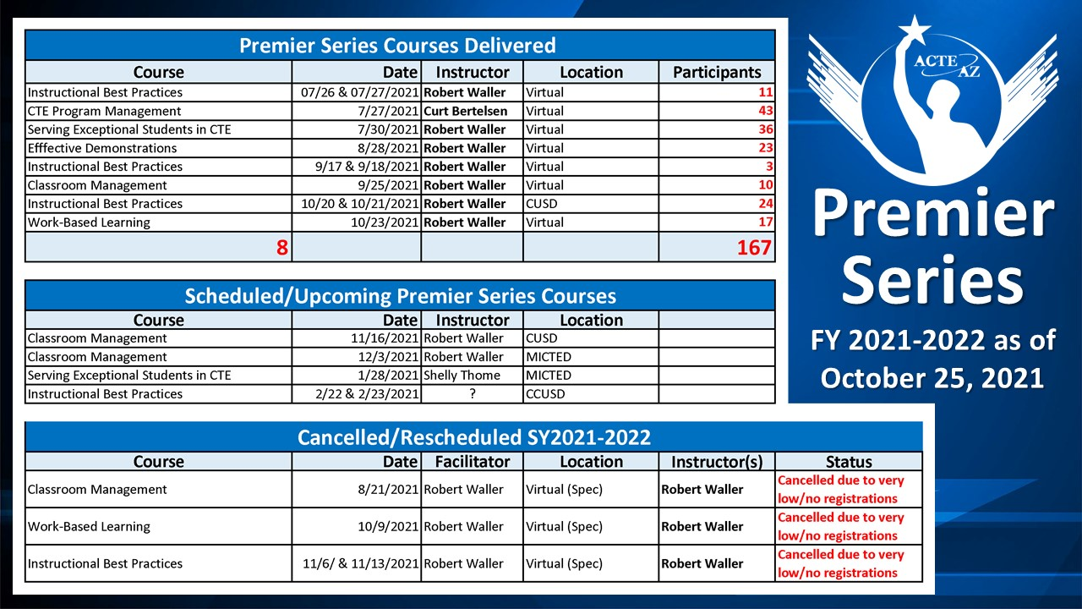

Slide 40
CTE Curriculum Connection
#haveyoucheckedtheconnection
New Resources
Announced via Discussion Forum
Links in email
Training and Support
Please reach out for a training session

Slide 41
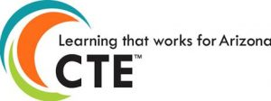
Upcoming Events
Blueprint & Instructional Framework
Virtual Events (Asynchronous and Synchronous)
During Non-contract hours
Eligible for Project Payment
Programs
Accounting
Architectural Drafting
Automotive Collision Repair
Diesel Engine Repair
Electronic Technologies
Interior Design and Merchandising
Mechanical Drafting
Precision Machining
Nominate Today:
https://bit.ly/ConsortiumBlueprintEvent22

Slide 42
Meeting Dates
Future Quarterly Meetings
February 9, 2022 - In Person - West-MEC
April 20, 2022 - In Person - Chandler Innovation Center
Reach us: support@ctecaz.org
Follow on Social Media:

Slide 43
Fall TSAs Are In Process

Slide 44
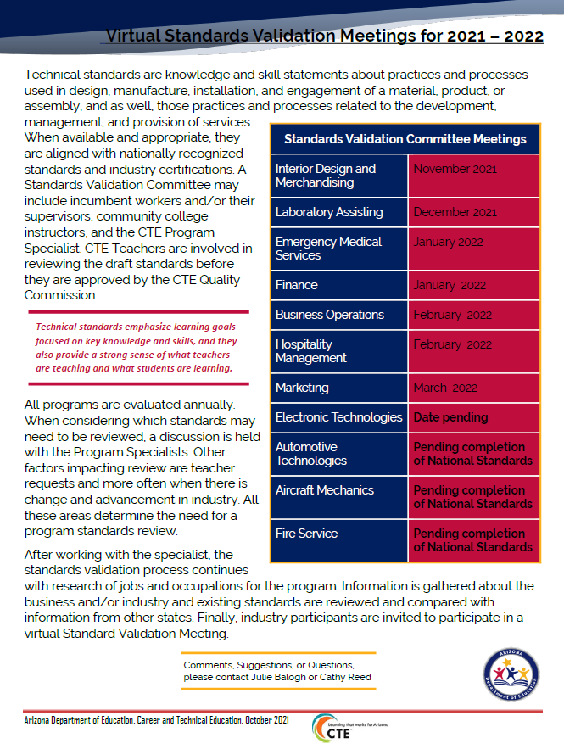
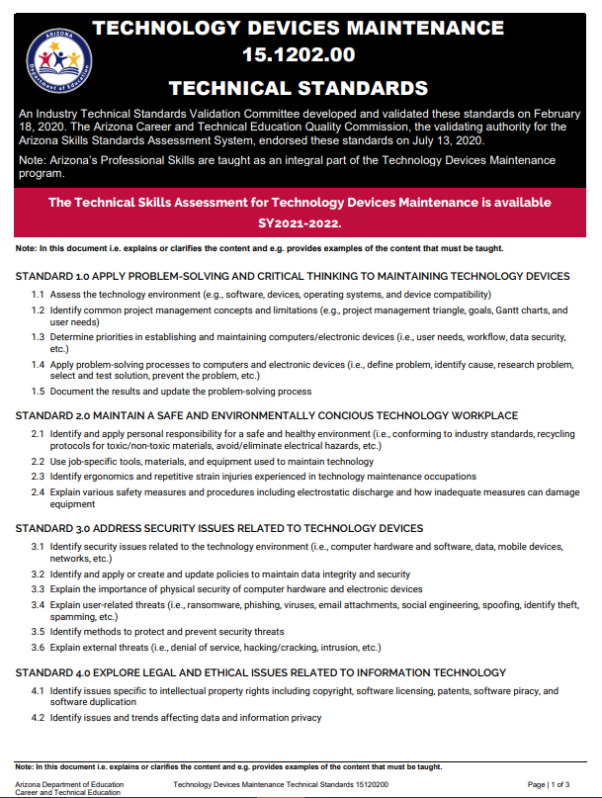
Standards Validation Meetings 2021-2022

Slide 45
2022 CTE / TSA Institutes

Slide 46
Technical Standards Validation and Technical Skills Assessment (TSA) Meetings
Judy Balogh Judy.Balogh@azed.gov
Cathy Reed Cathy.Reed@azed.gov

Slide 47
CTSOs

Slide 48
New DECA State Advisor
Robert Waller

Slide 49
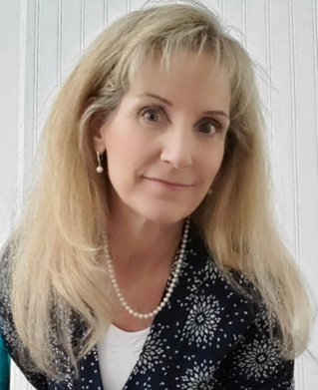
Contact Information Phone: 602-542-5315 Email: Dixie.Harvey@azed.gov
Dixie Harvey

Slide 50
Looking for Judges We will send out links next week for the following events. You can also go onto each CTSO website
DECA
Districts – January
State - February
EDRising
State - March
FBLA
Regionals – Jan/Feb
State - April
FCCLA
State - March
HOSA
Regionals –Jan/Feb
State – March/April
SkillsUSA
Regionals –Jan/Feb
State - April

Slide 51
New Advisor Training
Cost: Free
Taught by: CTSO State Director and State Advisors
Dates:
Saturday December 8th 8:00am-3:30pm – Virtual
Each Participate will spend about 2 hours with their State Advisor
LAST ONE OF THE SCHOOL YEAR
Sign up: https://fblaarizona.wufoo.com/forms/w9y13nl19006cq/

Slide 52
Advanced Advisor Training (mini-sessions)
Cost: FREE
Time: 4:00pm-6:00pm
Dates: December 6th-10th
Monday – “Establishing a Firm Foundation for your CTSO”
Tuesday – “Growing your Program”
Wednesday – “Building a Solid Officer Team”
Thursday – “Successfully Implementing a Program of Work”
Friday – “Running an Effective Meeting” (parli pro)
Sign up: https://fblaarizona.wufoo.com/forms/wh8c7zp1eqclbu/

Slide 53
Skating to the Future Middle Level Leadership Conference $25 per Student/Teacher
SAVE THE DATE:
December 15TH 2021
(Date Changed)

Slide 54
Questions, Concerns, Comments
Julie Ellis
Email
Julie.Ellis@azed.gov
Work
602-542-5350
Cell
520-465-3655
Thank You!

Slide 55
Project CHANGE
Increase gender nontraditional CTE enrollment
Promote safe and healthy schools
Recruitment + Retention of Nontraditional students
Gender, CTE, and Nontraditional Career Success
Stop Sexual Harassment
Stop Cyberbullying + Promote Positive Digital Citizenship
tylerlepeau@email.arizona.edu
timwernette@msn.com

Slide 56
Project CHANGE
We are happy to present in person again! Along with in-person presentations, we are also offering Project CHANGE presentations in these online and/or video formats:
Live online sessions on Zoom or Google Meet (works best with groups of about 10-40 participants).
Pre-recorded video presentations along with optional interactive Google slide activity.
Presentations and workshops are provided at no cost.
Educator presentations provide professional development hours.
Presentations run approximately an hour to accommodate a typical class period (shorter for pre-recorded video).

Slide 57
CTE ADMINISTRATORS MEETING November 4, 2021
Accountability & CTE Data Portal

Slide 58
FY 2022 CTE Data Portal Timeline
Date | Event/Deadline
October 15, 2021 | FALL term enrollment “capture” date
February 15, 2022 | SPRING term enrollment “capture” date
June 15, 2022 | DUE DATE #1: Enrollment & Placement Survey closes temporarily. Preliminary funding is calculated.
July 1, 2022 | Enrollment & Placement Survey data collection resumes.
July 31, 2022 | DUE DATE #2: FY 2022 CTE Data Portal data collection (+ 2021 Placement Survey) ends. *Except Credentials.
August/September 2022 | Final funding is calculated. Performance measures are calculated. Reports are made available in CTE Data Portal.
June 30, 2023 | FY 2022 Credentials data collection ends.

Slide 59
Reminders & Announcements
2021 Perkins performance measures are still being calculated.
There is an issue with some of the data that is pulled from AzEDS that is preventing accurate calculations – ADE IT is working on fixing these issues.
Reminder: FY 2023 State Priority grant allocation (enrollment-based portion) will be calculated using FY 2022 enrollment in grades 09 – 12. Historically, it has used enrollment in only grades 11 – 12.
Minutes per Week and Number of Weeks have also been removed from the calculation.

Slide 60
“Data Capture Date”
Two data “capture” dates in FY 2022.
FALL term: October 15, 2021
SPRING term: February 15, 2022
These replace 40th and 100th day enrollment counts.
Report any student enrolled in your CTE courses on these dates.
Students should be reported if they were enrolled on those dates, regardless of student absences or school breaks.
Contact CTE Accountability if you have special cases, such as students that transferred in from out of state or transferred in after the data capture date but did not earn credit elsewhere.

Slide 61
FY 2022 Data Collection
FY 2022 Coherent Sequence and Enrollment modules are open for District users.
What should Districts be doing now?
Review your coherent sequence and ensure that it is up to date.
Add, delete, or modify programs to ensure that the entire coherent sequence is accurate.
Work with your District SIS staff to get a list of all students enrolled in CTE courses on October 15, 2021.
Try to get all the information on the enrollment templates.
This will make your data upload easier.
Templates are available here: www.azed.gov/cte/cte-enrollment.
Create your enrollment upload templates.
Once credit is awarded at or near the end of the term, record those credits on the template and upload into the CTE Data Portal.

Slide 62
FY 2022 Data Collection
What should Districts be doing next?
Work with your CTED central office (if you are a member district/satellite campus of a CTED) to ensure that your data is congruent with theirs.
Review your Placement Survey list in the CTE Data Portal (2021 graduates).
Conduct placement surveys and record responses in the CTE Data Portal. Due: June 15, 2022
Record any industry credentials earned by students. Student must have an enrollment record in the system before you can record a related credential. Due: June 30, 2023

Slide 63
Districts and CTEDs Working Together
Career and Technical Education Districts are now reporting student-level data in the CTE Data Portal.
Reporting responsibilities of districts/charters has not changed.
Districts must continue to report articulated enrollment for courses taught at CTED locations. Your CTED central office will report the same students.*
Districts should use the Articulated and Postsecondary Articulated enrollment templates. Districts should not use the CTED Central Campus template (reserved for CTED central offices).
Use the “CTED/District Enrollment Discrepancy Report” to review data with your CTED. Report shows any students reported by one entity that have not been reported by the other.
* Member districts of EVIT will continue to not report articulated enrollment.

Slide 64
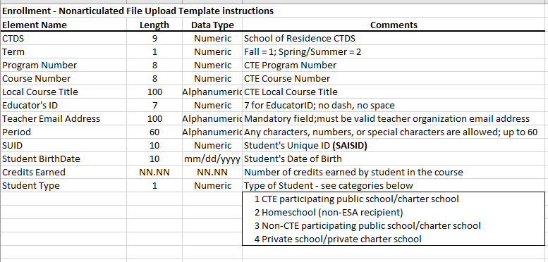
Resources
Enrollment
Use the CTE website to see what you need to report.
https://www.azed.gov/cte/cte-enrollment
Use the templates themselves to see what elements are needed. Most of this may come from your SIS.

Slide 65
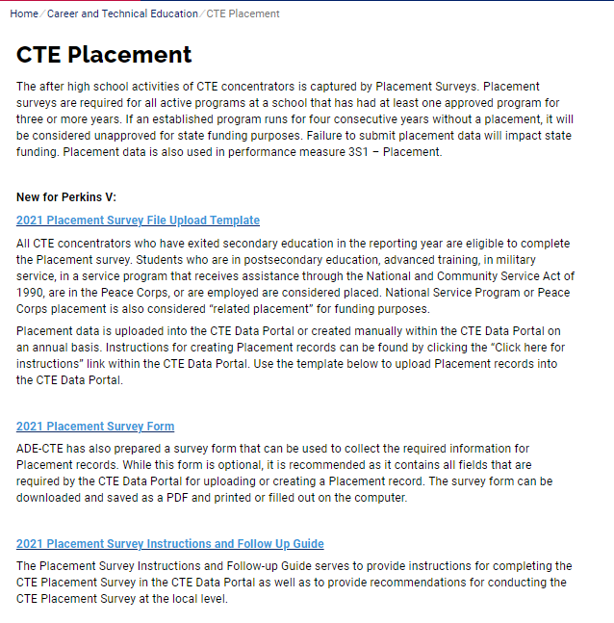
Resources
Placement
Use the CTE website to see what you need to report.
https://www.azed.gov/cte/cte-placement
Use the 2021 Placement Survey upload template, 2021 Placement Survey Form, and 2021 Placement Survey follow-up guide.

Slide 66
Resources
General
Most general information on the CTE Data Portal and CTE Accountability is found on the CTE website under “CTE Data Portal Information”.
https://www.azed.gov/cte/cte-data-portal-information
FY 2022 CTE Data Portal timelines
CTE Data Portal training, including recordings of previous training + printed materials
CTE Data Portal User Guide
CTE Data & Accountability Guidebook
Links to templates
Contact information for CTE Accountability team

Slide 67
Contact Information
Tammie Chavez Tammie.Chavez@azed.gov 602-542-3839 | Donna Kerwin Donna.Kerwin@azed.gov 602-542-7881
Samuel Irvin Samuel.Irvin@azed.gov 602-364-1946 | Janet Silao Janet.Silao@azed.gov 602-542-5485
www.azed.gov/cte/cte-data-portal-information

Slide 68
CTE Fiscal Updates Bobby Neves Director of Fiscal, Grants, & Accountability Bobby.Neves@azed.gov 602-542-5137

Slide 69
Fiscal Updates…
FY22 Final Allocations
Please remember to draw down funds
FY23 CTE State Priority
9th through 12th
Phone Calls
Voicemail

Slide 70
www.myfutureaz.com
Interest Form for Onboarding – complete if you are interested in using the platform and want updates on training opportunities
Hosted trainings in September and October
Districts/charters are using it with students
Educator accounts created by filling out the Educator Account Template and then email it to Amanda
Demo accounts are available
More rollouts at the end of November
Middle School
Four Year Plan
Updated Language

Slide 71
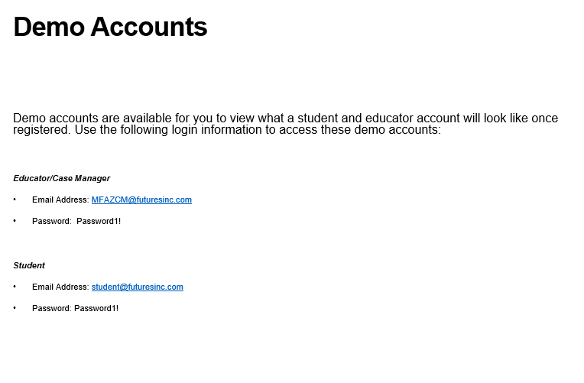

Slide 72
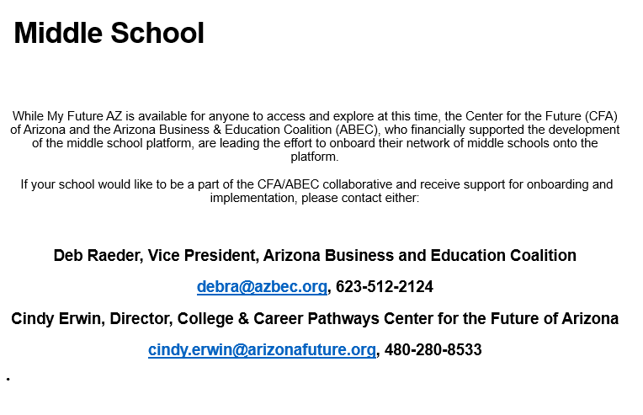

Slide 73
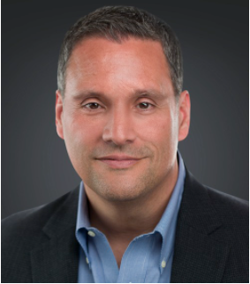
AzSCA Conference
February 6-8, 2022
Sunday 2/6 – Pre-Conference
Monday 2/7 – Full day
Tuesday 2/8 Full day
In Person – We Ko Pa
ADE CTE – sponsoring Mark Perna for keynote address
More info at www.azscaconference.org

Slide 74
NTACT Goal Updates – Aligning & developing training resources to assist LEAs, VR staff, and CTE staff in the recruitment & retention of students with disabilities accessing and participating in CTE programs.
Webinar – CTE Recruitment for Inclusion of Student with Disabilities - access the webinar recording here. Link to webinar and slide deck at www.azed.gov/cte/counselors
Consider sharing your strategies and success stories in the recruitment and retention of students with disabilities accessing and participating in CTE programs. The ADE/ESS Secondary Transition Team is still collecting statewide best practices about recruitment and retention efforts from schools with this survey.
Another webinar is coming in the spring – tentative date is March 20, 2022 from 2:30 – 3:30.
Want to share a best practice? We are looking for presenters and ideas for a guidance document.

Slide 75
Summer conference – what topics do you want to see offered for school counselors? Connect with me and let me know!
School Counseling Resources - https://padlet.com/adeschoolcounseling
Monthly Office Hours – dates and sign up come out in the School Counselor Connection newsletter
School Counselor Connection Newsletter – not getting it? Sign up here to receive the monthly communication from ADE about school counseling

Slide 76
Amanda Nolasco
School Counselor Specialist
Arizona Department of Education
amanda.nolasco@azed.gov
www.azed.gov/cte/ecap
www.azed.gov/cte/counselors
602.542.5353
Sign Up for Counseling Newsletter

Slide 77
Next CTE Administrators Meeting ACTEAz and ACOVA Mid-winter Conference February 3, 2022 Prescott Resort

