Slide 1
Assessments Friday Focus Webinar Series Webinar #2: AZELLA Reassessment Domain Scoring
Audra Ahumada
Deputy Associate Superintendent of Assessment
Arizona Department of Education

Slide 2
Welcome to Webinar #2 AZELLA Reassessment Domain Scoring
This webinar will be recorded and posted on the ADE Assessments webpage.
Please enter your First and Last Name in the Chat for tracking purposes for the live event.
We will also be capturing the chat questions. If there are questions that were frequently asked or need further clarification, ADE will compile and create an FAQ which will be posted on the Assessment Webpage.

Slide 3
Welcome and Overview
Background and History of Exiting Students with Disabilities
AZELLA Domain Scoring
Next Steps for LEAs
General ELP Assessment Updates
SAFT
Alternate ELP Assessment (CAAELP)

Slide 4
Purpose of the AZELLA
Arizona’s English Language Proficiency Assessment is an English Language Acquisition Assessment.
Its purpose is to:
Determine if a child has an English Language need and will need additional services and supports
Measure growth from one point (typically Placement Test) to a second point (typically Reassessment Test)

Slide 5
History and Background of Exiting Students with Disabilities
Arizona allowed IEP teams to utilize the “Sped Withdrawal” for many years (and prior to 2019) to exempt any student with a disability from taking any parts of the AZELLA.
Arizona was notified that we must enter and exit all students the same way
Entrance: Home Language Survey - other than English
Exit: Proficiency on AZELLA
Established EL and Special Education Taskforce

Slide 6
AZELLA: SPED Withdrawal (prior to 2019)
Based on the Addendum to September 23, 2016, Non-Regulatory Guidance and direct guidance from the Office of State Support, Arizona can no longer allow for IEP Teams to remove an EL with disabilities from EL Services.
The ONLY way for an EL with disabilities to be withdrawn from EL Services is for the student to demonstrate English language proficiency on a “valid and reliable ELP Assessment”.

Slide 7
When must a student be exited from EL status for ESEA purposes?
An EL must be exited from EL status for ESEA purposes (i.e., for purposes of Title I and Title III requirements) when the student satisfies the State’s standardized statewide exit procedures.
Because section 3113(b)(2) of the ESEA requires a State to implement statewide exit procedures, a student who meets the exit procedures is no longer an EL for ESEA purposes…

Slide 8
Exit Criteria – Same for all Students
ELs with disabilities will be held to the same standards of performance as non-disabled EL peers
“The ESEA requires that a State provide appropriate accommodations for ELs with disabilities and, if an EL has a disability that precludes assessment in one or more domains of the ELP assessment such that there are no appropriate accommodations for the affected domain, assess the student’s ELP based on the remaining domains in which it is possible to assess the student (34 CFR § 200.6(h)(4)).”
(U.S. Department of Education Update on English Language Proficiency Assessments | National Title I Association)

Slide 9
Individual Education Program Teams
IEP Teams do not have the authority to exempt students from any assessment, including AZELLA.
IEP Teams should not be utilizing electronic IEP programs to exempt students from participating in AZELLA.

Slide 10
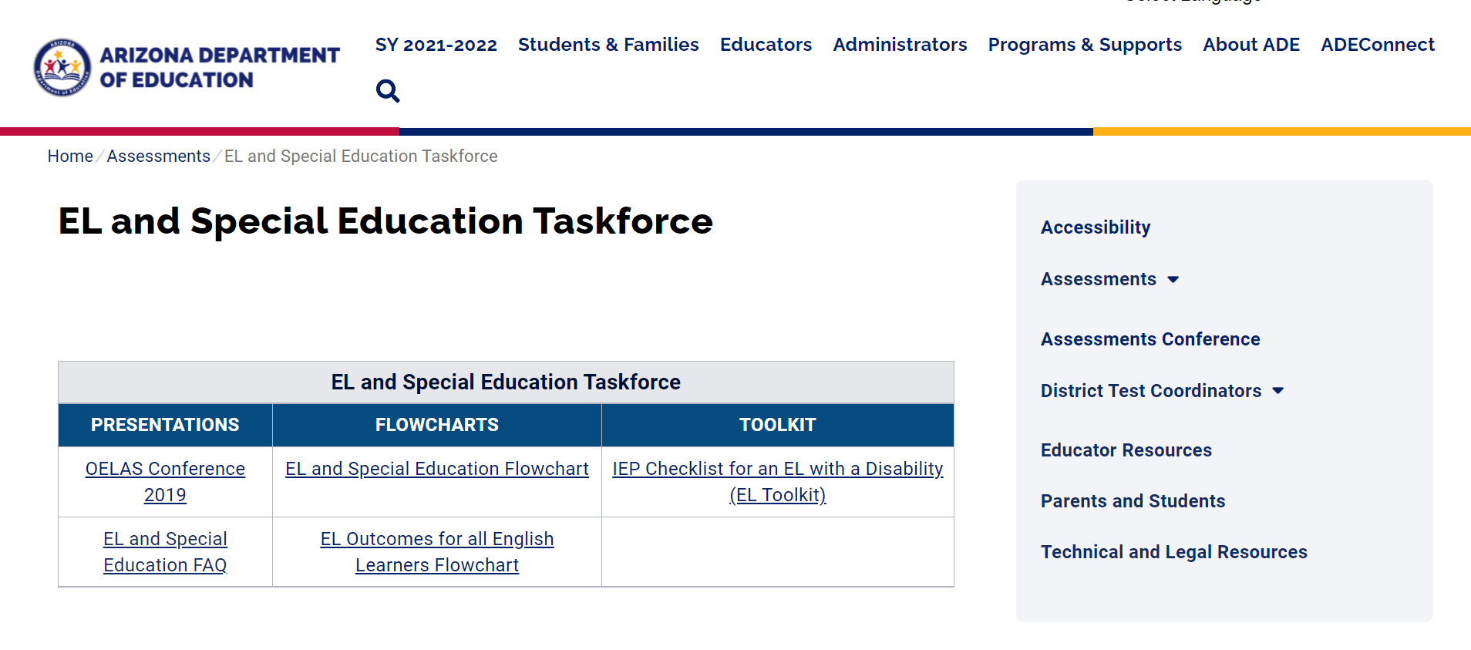
Established EL and Special Education Taskforce
https://www.azed.gov/assessment/taskforce

Slide 11
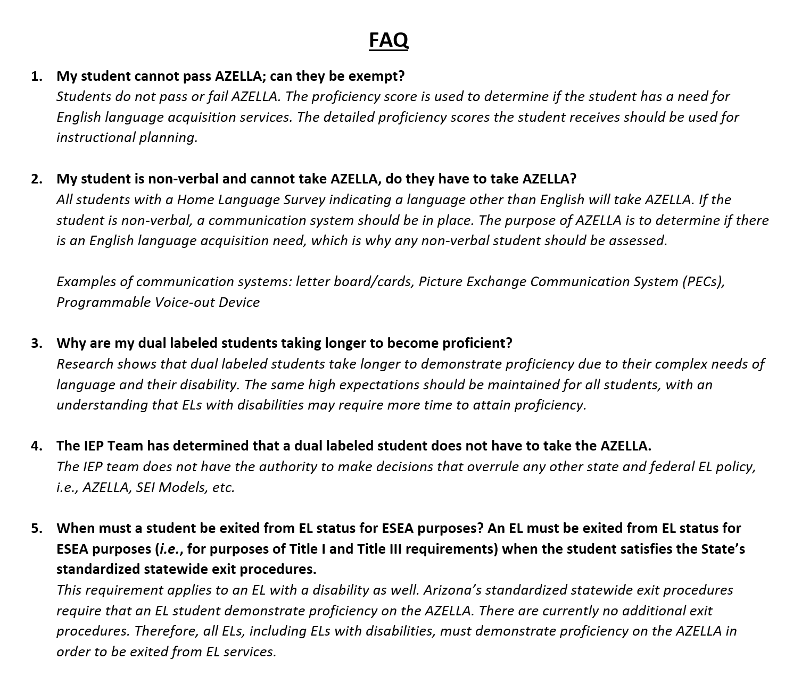
Dual Labeled Students: Frequently Asked Questions

Slide 12
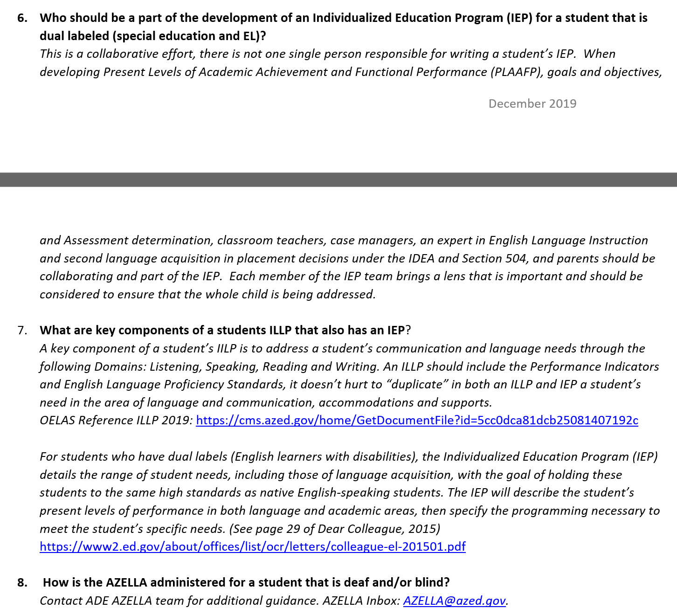
Dual Labeled Students: Frequently Asked Questions Continued

Slide 13
Allowance of Domain Scoring
Under 34 C.F.R. §200.6(h)(4)(ii), if it is determined on an individualized basis that an EL has a disability that precludes assessment in one or more domains of the ELP assessment (speaking, listening, reading and writing), such that there are no appropriate accommodations for the affected domain or domains, an SEA must assess the child’s English language proficiency based on the remaining domains in which it is possible to assess the student.

Slide 14
Allowance of Domain Scoring Continued
A determination that a disability precludes assessment in one or more domains must be made on an individualized basis by the child’s IEP Team, the student’s 504 team or, for students covered under Title II of the ADA, by the team or individual designated by the LEA to make those decisions.

Slide 15
Allowance of Domain Scoring Continued
Under the very rare circumstances when a student’s disability precludes assessment in one or more domains, the student may be exited under the State’s exit procedures based on a score of proficient on the remaining domains in which the student is able to be appropriately assessed.

Slide 16
Domain Scoring : Rare Circumstances
The Department expects that only in very rare circumstances will children need to be assessed in fewer than four domains due to a disability that precludes assessment in a particular domain, and that the vast majority of ELs with disabilities will be able to be assessed in all four domains, with appropriate accommodations as needed, or by taking an alternate ELP assessment for ELs who are students with significant cognitive disabilities.

Slide 17
Utilizing Domain Scoring
ELs with disabilities will be held to the same standards of performance as non-disabled EL peers
“The ESEA requires that a State provide appropriate accommodations for ELs with disabilities and, if an EL has a disability that precludes assessment in one or more domains of the ELP assessment such that there are no appropriate accommodations for the affected domain, assess the student’s ELP based on the remaining domains in which it is possible to assess the student (34 CFR § 200.6(h)(4)).”
(U.S. Department of Education Update on English Language Proficiency Assessments | National Title I Association)

Slide 18
Addressing the Needs of Dual Labeled Students
If a student with an IEP is also an English learner (EL), the IEP should include specific language learning goals for a second language, in addition to special education services and supports.
A well-crafted standards-based IEP for ELs with disabilities should contain goals for teaching and learning the complex academic language needed to learn the content standards.
Incorporating language learning goals into the IEP requires close collaboration between general education, special education, and English as a Second Language or bilingual education teachers.
https://nceo.info/standards_and_accountability/standards_based_iep

Slide 19
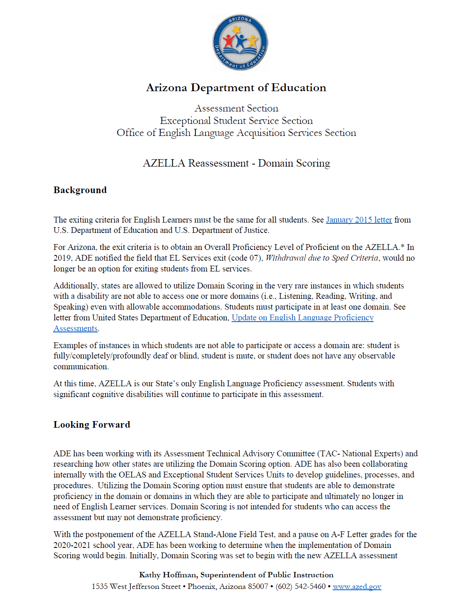
AZELLA Domain Scoring: Communication
Communication to DTCs, EL Coordinators and Special Education Directors is posted on the ADE Assessment’s Webpage: AZELLA DTCs
AZELLA Domain Scoring Letter to Stakeholders: https://www.azed.gov/sites/default/files/2021/07/AZELLA%20Domain%20Scoring%20July%202021.pdf

Slide 20
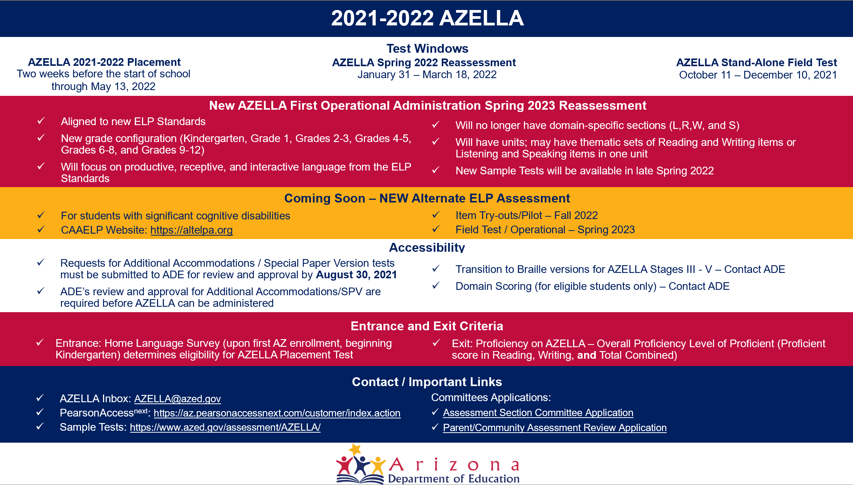
AZELLA Infographic

Slide 21
Planning
Start planning for the
Fall 2021 SAFT
Required Training – September 13
DTC-STC Fall 2021 SAFT
1-2 SAFT
3-4 SAFT
5-12 SAFT
DTC Created Training Module (for all AZELLA staff)
Student Registrations – October 1
Some students will be pre-registered
Other students will require a manual enrollment
2 Test Administrations - concurrent
2021- 2022 Placement Test
Fall 2021 Stand-Alone Field Test
October 11 – December 10, 2021
Don’t wait until the end of the SAFT testing window to start testing!
Be ready to start testing on October 10
Students in Kindergarten will not participate in the AZELLA SAFT
Notes:
Should anyone ask about the “DTC-Created Training Module” this is the training that DTCs need to provide for each AZELLA admin. They select slides from our training and add their district-specific information such as their testing schedule, safe healthy policy and procedures, etc.

Slide 22
Test Administration Times
How long is the test?
Estimated Administration Times
Grade 1; Grade 2
Unit A ~ 12 questions
Unit B ~ 12 questions
Unit C ~ 9 questions
Grade 3; Grade 4
Unit A ~ 15 questions
Unit B ~ 10 questions
Unit C ~ 12 questions
Grades 5 – 12
Unit A ~ 16 questions
Unit B ~ 12 questions
Unit C ~ 12 questions
Grade 1; Grade 2
Unit A -30 minutes
Unit B -30 minutes
Unit C -30 minutes
Grade 3; Grade 4
Unit A -30 minutes
Unit B Part 1 -30 minutes
Unit B Part 2 -20 minutes
Unit C -20 minutes
Grades 5 – 12
Unit A -35 minutes
Unit B -50 minutes
Unit C -20 minutes

Slide 23
AZELLA SAFT Modes of Administration
Grade 1 – paper-and-pencil, Unit C (Speaking) phone administration
Grade 2 – paper-and-pencil, Unit C (Speaking) phone administration
Grades 3, 4 – online, Extended Writing (ER) item paper-and-pencil
Grades 5, 6 – online
Grades 7, 8, 9 – online
Grades 10, 11, 12 – online
Notes:
Slides 11 – 13 have this information in more detail, but of course you don’t need to include those.

Slide 24
Questions
This Photo by Unknown Author is licensed under CC BY-SA

Slide 25
Thank you!
For questions, please contact us at:
AZELLA@azed.gov
This Photo by Unknown Author is licensed under CC BY-NC-ND

