Slide 1

State Tutoring Program
General Information, Tutorials, and Requirements
This information pertains to Tutors

Slide 2




State Tutoring Team
Lauren spenceley
PROGRAM specialist
Laurel cherry
PROGRAM specialist
Ieisha Johnson
EXECTUITVE assistant
Eboney Mckinney
STATE tutoring
coordinator

Slide 3
Introduction
Tutoring is individualized, supplemental, standards-based instruction.
The outcome of tutoring is student academic progress, encompassing measures of both proficiency and academic gain as stated in § A.R.S. 15-241 (K).
Implementation of topics and requirements presented in this PowerPoint are mandatory for an LEA to receive payment from ADE.

Slide 4
Key Program points
General tutoring is not allowed by this grant and, as such, tutoring is centered around specific Arizona academic standards.
Tutoring should not be used as a homework club or drop-in program.
Tutoring is not 1 to 1.
Tutoring should not be on a computer unless there is an approved virtual tutoring plan in place when school buildings are closed.*
Notes:
* If offering a hybrid/virtual model during the 21-22 school year, please indicate on application all possible configurations.

Slide 5
Key Points for Tutors
Responsible for completion of Certificates of Supplemental Instruction (CSI) forms; updated and signed by parent/guardian 3x a year.
Tutoring should be individually focused with no more than five students per group, but not less than three students.
Tutors are responsible for developing the method to demonstrate academic progress on identified standards.

Slide 6
Supplemental State Tutoring
If tutoring is to take place during school hours, it must be during a non-core class. The following classes are considered core classes:
Core Content Areas
American Government | Foreign Language | Physics
Art | General Science | Political Science
Biology | Geography | Reading
Chemistry | Mathematics | Reading Interventions
CTE Classes | Math Interventions | SEI Classroom
Earth & Physical Sciences | Music | Social Studies
Economics | Performing Arts | SPED
English | Physical Education | Visual Arts

Slide 7
Tutor Responsibilities
Complete Tutor Verification Form and provide supporting documentation to principal or administrator for approval.
Complete the State Tutoring Checklist before tutoring begins. Coordinators/site lead will submit to ADE as a single file.
Maintain current and accurate Certificate of Supplemental Instruction (CSI) for each student
  Use data to determine AZ Academic Standards for individual instructional focus.
  Provide evidence of academic progress
  Complete the CSI a minimum of 3 times per year

Slide 8
Tutor Verification Form
The Tutor Verification Form requires teachers and providers to document evidence of content qualifications in the content area(s) of tutoring instruction.
All tutors must complete the form and provide documentation (i.e., transcripts, certificates) to their administrator and be kept at the school sites for documentation (refer to the Accountability Section of the School year 2021-2022 Announcement Letter for more details).
The Tutor Verification form can be found in the Tutor Resource section at http://www.azed.gov/state-tutoring/
The Principal or LEA/Vendor Administrator must sign the Tutor Verification Form indicating eligibility of the tutor.

Slide 9
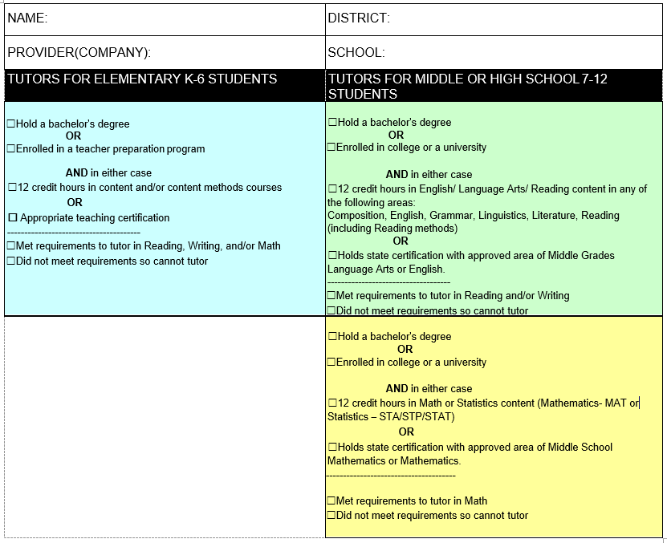
Tutor Verification Form
Please review the eligibility requirements for Tutors as stated on this form.

Slide 10
Tutor Responsibilities (cont.)
Maintain the following records:
  Sign in sheets
  Weekly student and tutor time entry in ADEConnect
  Updated and accurate CSI for each student
Provides planned, targeted instruction that is supplemental to classroom first instruction
Communicate to parents, teacher of record and administration as to status of academic progress including measures of proficiency and growth.

Slide 11
Certificates of Supplemental Instruction (CSI)
The tutor is responsible for filling out all portions of the certificate and obtaining other involved parties’ signature(s). Completed certificates should be kept at the site of tutoring (vendors may keep it with their respective business office).
The certificate is used to initiate an agreement of tutoring between the tutor and student and parent/guardian. Before any tutoring is to take place, it should be filled out completely. The certificate is to be completed 3 times per year with the correct time checked on the form and update targeted standards and academic progress measures.

Slide 12
Certificates of Supplemental Instruction (CSI)
Student Information
  The SSID number, Date of Birth and relevant eligibility checkboxes must be recorded on the document.
Arizona Academic Standards
  Areas to be tutored must be relatable to what the student’s needs are in the areas of math and/or reading, writing, ELA. Specific state standards must be listed. “To improve reading” is not acceptable.
Tutoring Dates
  Should be filled out prior to tutoring beginning and should match what is to be logged on the sign-in sheets. This can be adjusted later to reflect major changes.
Communication
  Indicate how and when tutor will communicate with parents.
Signatures and Contact information
  Tutor sign and date; parent sign and date and provide contact information; Principal to sign if tutoring is during teacher prep time.
  With each new CSI (Sept, Nov/Dec, March), a principal/CEO/administrator signs the previous CSI for an attestation of improvement.

Slide 13
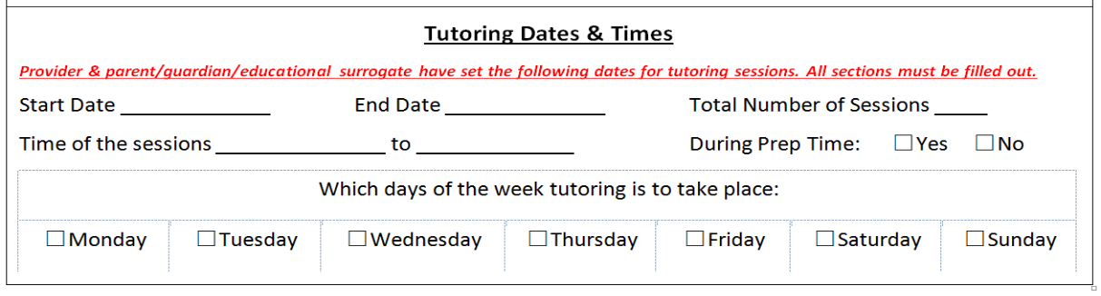
Tutoring Dates and Times
The number of sessions should be predetermined PRIOR to tutoring beginning.
Complete this section on your CSI to clearly communicate to parents/guardians.

Slide 14
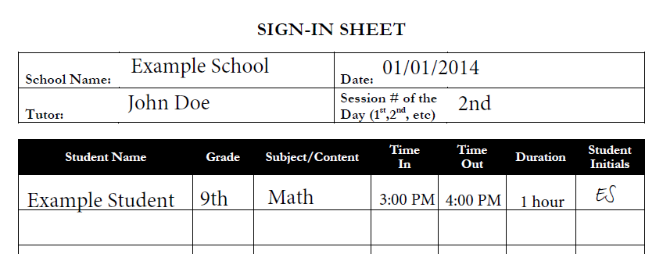
Sign-in Sheets
Supporting documentation which provides ADE records to match with logged tutor hours. All sign-in sheets must be signed or initialed by attending students. Use these to log hours in ADEConnect and turn into your coordinator or administrator.

Slide 15
ADEConnect*
All student and tutor information, including hours, will be entered in ADEConnect.
Usernames and passwords will be determined by the district or LEA administrator.
You must provide your FCC# (fingerprint clearance card number) the first time you log in. If afterwards you still have issues, please contact State Tutoring fund staff.
Communicate with the person/people coordinating the program to ensure that your hours/sessions get logged properly and you do not exceed the allocations for your LEA.
Log your hours WEEKLY! The principal/coordinator should check to ensure this is done.
Notes:
* see ADEConnect tutorial if NEEDED

Slide 16

ADE Connect Link
ADEConnect is located on the main page of the Arizona Department of Education Website: http://www.azed.gov/

Slide 17
Other Requirements
The following documentation should be kept in a single place at the school. These forms will be reviewed during ADE Monitoring of the State Tutoring Program.
Tutor Verification Forms with documentation supporting tutor eligibility
State Tutor Checklist for each tutor
Coordinator Checklist
Certificates of Supplemental Instruction (CSI)
    The appropriate month needs to be checked on each CSI, there will be a minimum of 3 forms completed throughout the year
    Documentation showing evidence of academic progress should be kept with all Certificates
Sign-in sheets signed or initialed by attending students

Slide 18
Completion Survey
Please verify that you have reviewed this presentation by completing the questions contained in the link below:
Required Survey -Verification of Completion
This step is required!!! Please note the date this survey was completed on your Tutor Checklist.

Slide 19

Information and Contacts
All relevant documentation and information can be found at the following web sites:
ADE State tutor website: http://www.azed.gov/state-tutoring/
Email: statetutor@azed.gov
Eboney McKinney
Director of Mathematics and Educational Technology
State Tutoring Coordinator

