Slide 1
Assessments Friday Focus Webinar Series Webinar #1: The State of Assessments and Accountability - An Overview for the 2021-2022 School Year
Audra Ahumada
Deputy Associate Superintendent of Assessment
Arizona Department of Education

Slide 2
Welcome to Webinar #1: The State of Assessments and Accountability – An Overview for the 2021-2022 School Year
This webinar will be recorded and posted on the ADE Assessments webpage.
Please enter your First and Last Name in the Chat for tracking purposes for the live event.
We will also be capturing the chat questions. If there are questions that were frequently asked or need further clarification, ADE will compile and create an FAQ which will be posted on the Assessment Webpage.

Slide 3
Welcome and Overview
ADE Assessments Team will have 6 more webinar sessions in this series for the 2021-2022 school year
These will be recorded and posted on the Assessments Webpage: https://www.azed.gov/assessment
This session will spotlight what is coming! Specifically, as ADE transitions to new Statewide Assessments
Friday Focus Webinar Flyer (includes registration information)

Slide 4
Test Administration by the Numbers (preliminary from portal)
AzM2
Total Tests Completed
ELA: 1,372,007
Math: 909,988
(Grades 3-8)
Percentage Total: 74%
* (results above are for students who tested online)
AzSCI
(Stand-Alone Field Test)
Total Tests Completed:
203,468
(Grades 5, 8, and 11)
Percentage Total: 78%

Slide 5
Test Administration by the Numbers (preliminary from portal)
AZELLA
Total Tests Completed:
80,078
Percentage: 94.2%
Menu of Assessments
ACT
Total Tests Completed:
43,260
SAT
Total Tests Completed:
1,854
Total Reimbursement amount:
$1,778,884
MSAA
Total Tests Completed:
12,334 (ELA, Math and Science)
Percentage Total: 81.5%

Slide 6
Next Steps for the Assessments Section
Continue to join nationwide discussions (CCSSO, USDOE)
Participate in discussions with national experts. The Center for Assessment (national organization) has developed several documents and webinar sessions for States to use as they are thinking through considerations
Support LEAs with communicating 2020-2021 Assessment Results. The toolkits can be found here: https://www.azed.gov/assessment under the LEA Assessments Results Toolkit Tab
https://www.azed.gov/assessment

Slide 7
Thank you!
Thank you for participating in the DTC and TA End of Test Surveys
Thank you for participating in our summer committees
Content and Bias Reviews
Data Reviews
Item Reviews

Slide 8
Characteristics of Summative Assessments
Summative Assessments
Assessments of learning
Near or at the end of a school year
Point in time assessment
Administered under standard conditions
Allowable Tools, Features, and Accommodations
Balanced Assessment Framework link: https://cms.azed.gov/home/GetDocumentFile?id=598093f33217e1170830a006
Notes:
All types of assessments are important and provide important information

Slide 9
Where we are today
Arizona’s Board of Education – 5 Year Assessment Plan
State Board of Education determined that College Board could not be an option on the Menu of Assessments due to their decision to no longer offer the writing essay
Will transition to new assessments this school year
AASA (Grades 3 - 8)
ACT Aspire (Grade 9)
ACT (Grade 11)
AzSCI (Grades 5, 8, and 11)
MSAA Science (Grades 5, 8, and 11)
Stand-Alone Field Tests (All Students must participate)!
AZELLA
AASA Writing
Participating in development of Alternate ELP Assessment
CAAELP

Slide 10
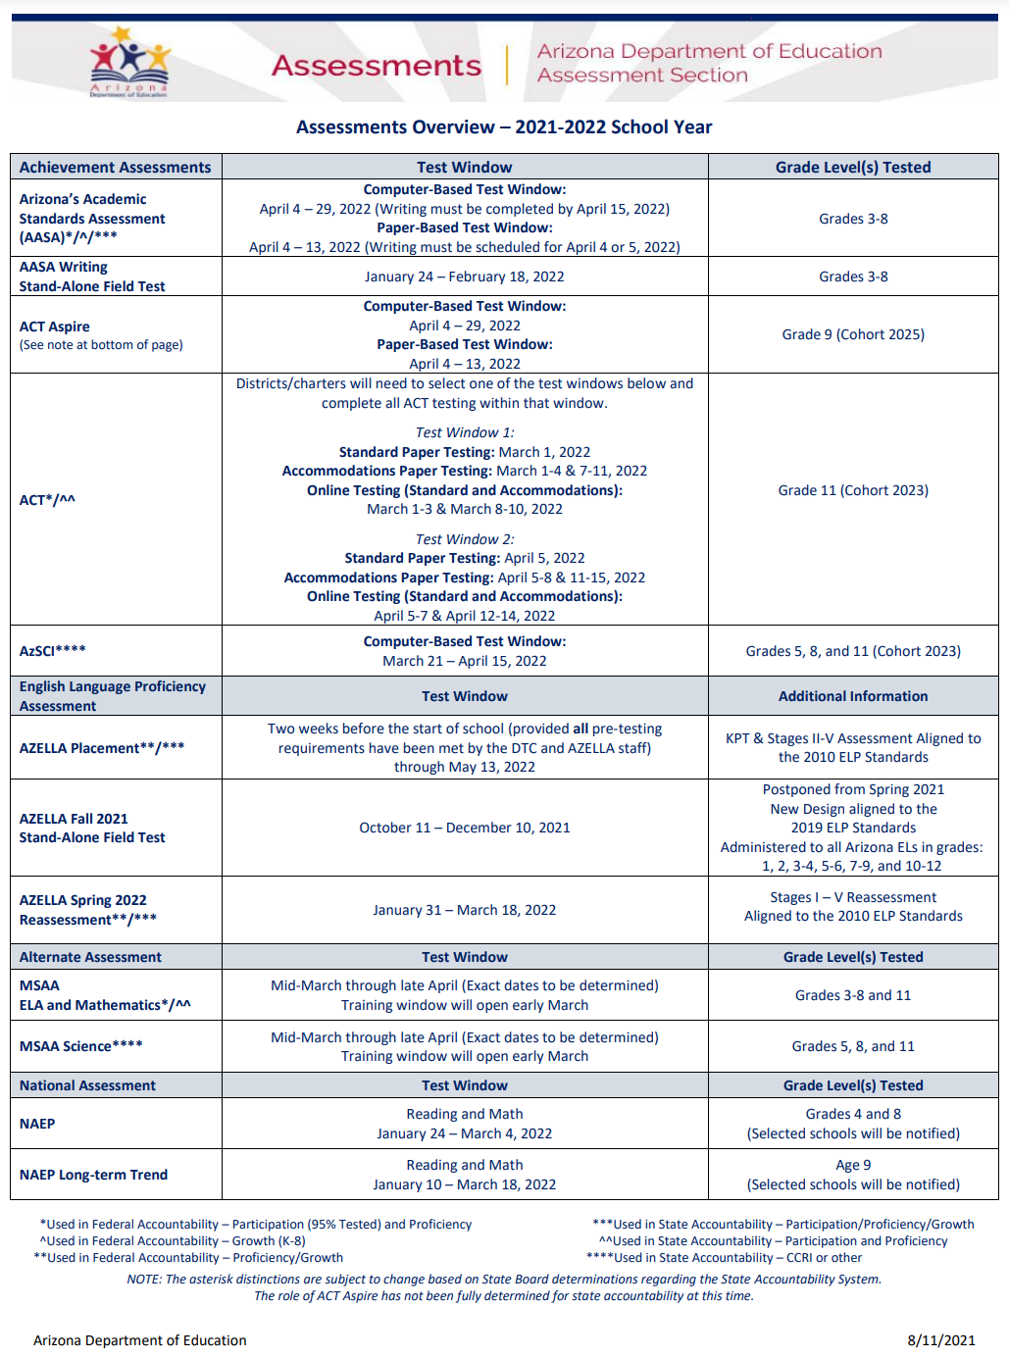
What is on the Horizon . . .
Includes:
Assessments and Requirements
Accountability
Assessment Overview document: https://www.azed.gov/sites/default/files/2021/07/Assessments%20Overview%20-%202021%20and%20Beyond.pdf

Slide 11
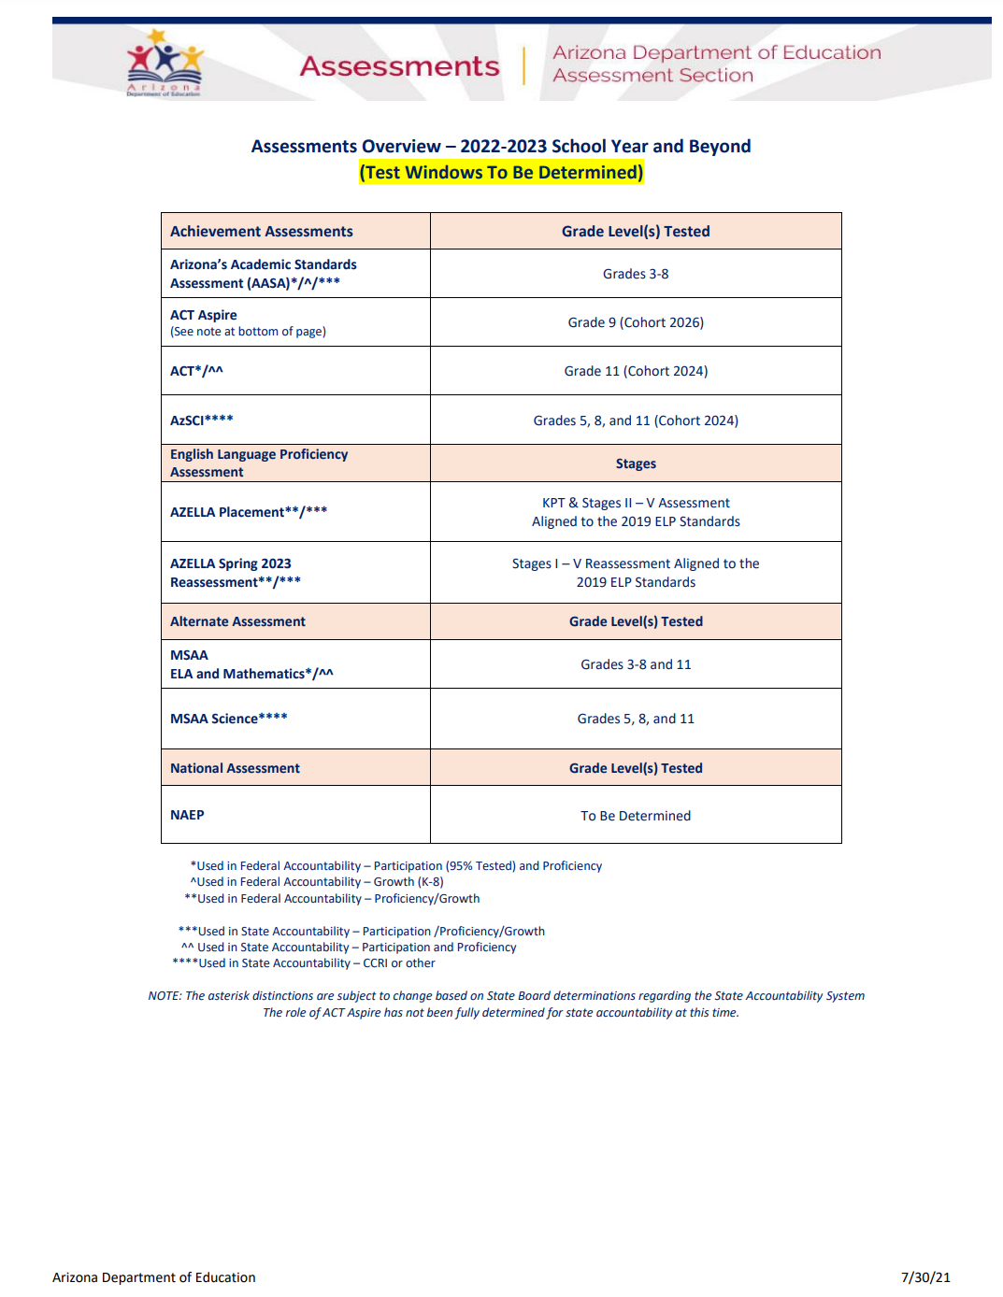
Assessment Overview 2022-2023 School Year

Slide 12
Exciting News AASA’s Logo

Slide 13
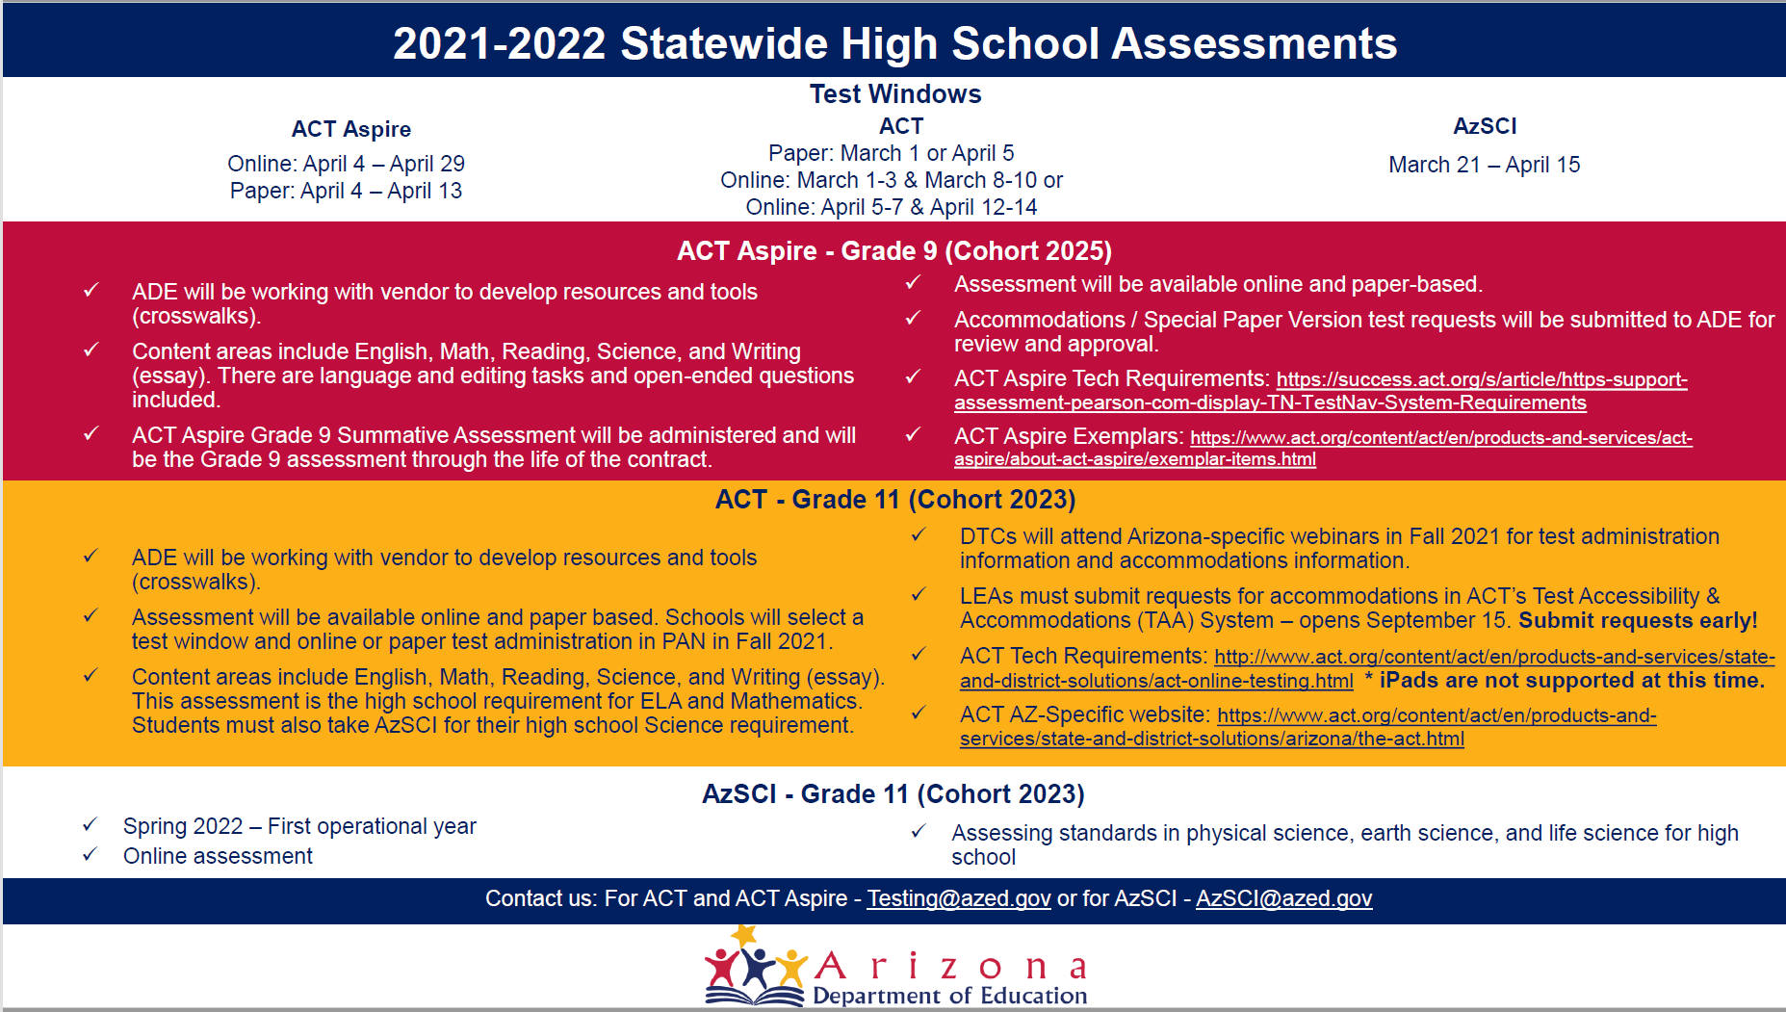
Statewide Achievement Assessment Infographic

Slide 14
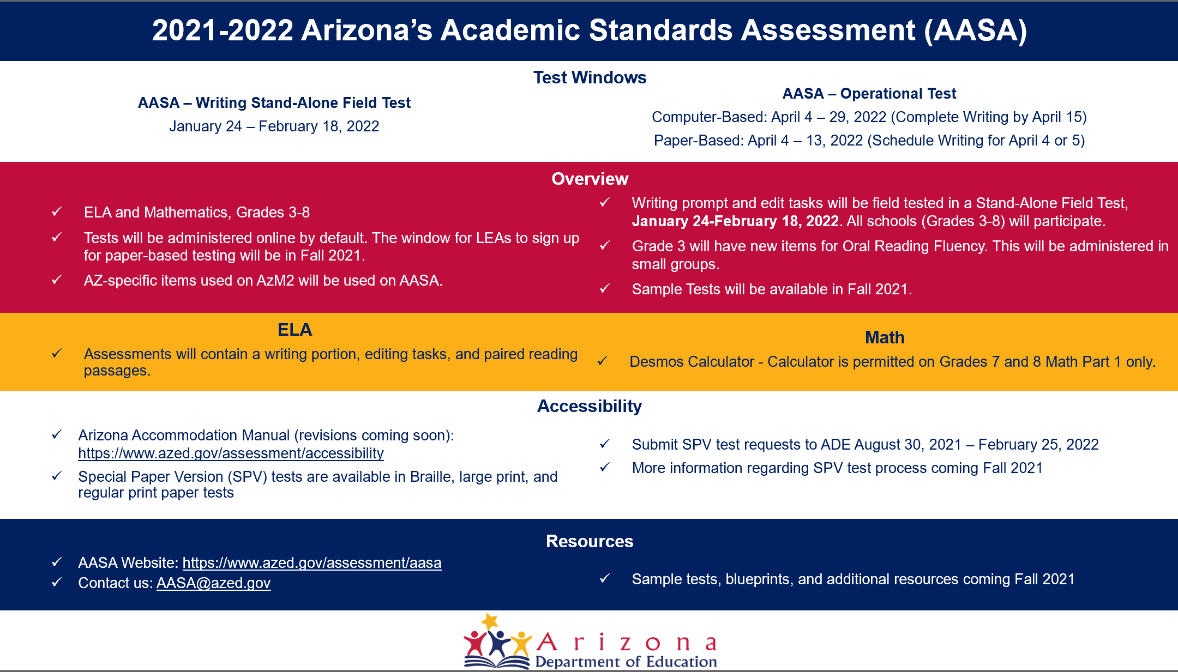
AASA’s Infographic

Slide 15
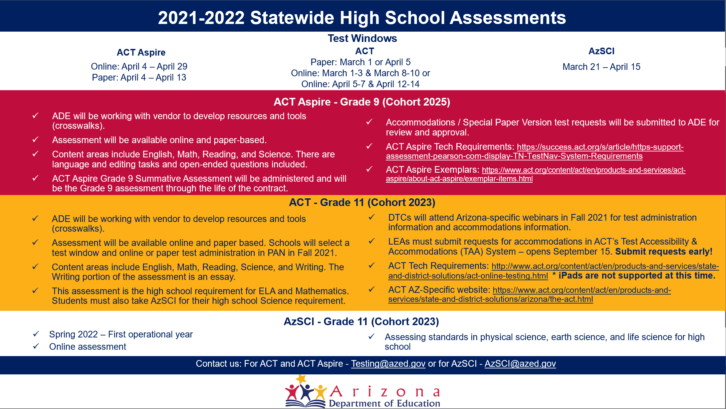
Statewide High School Assessments Infographic

Slide 16
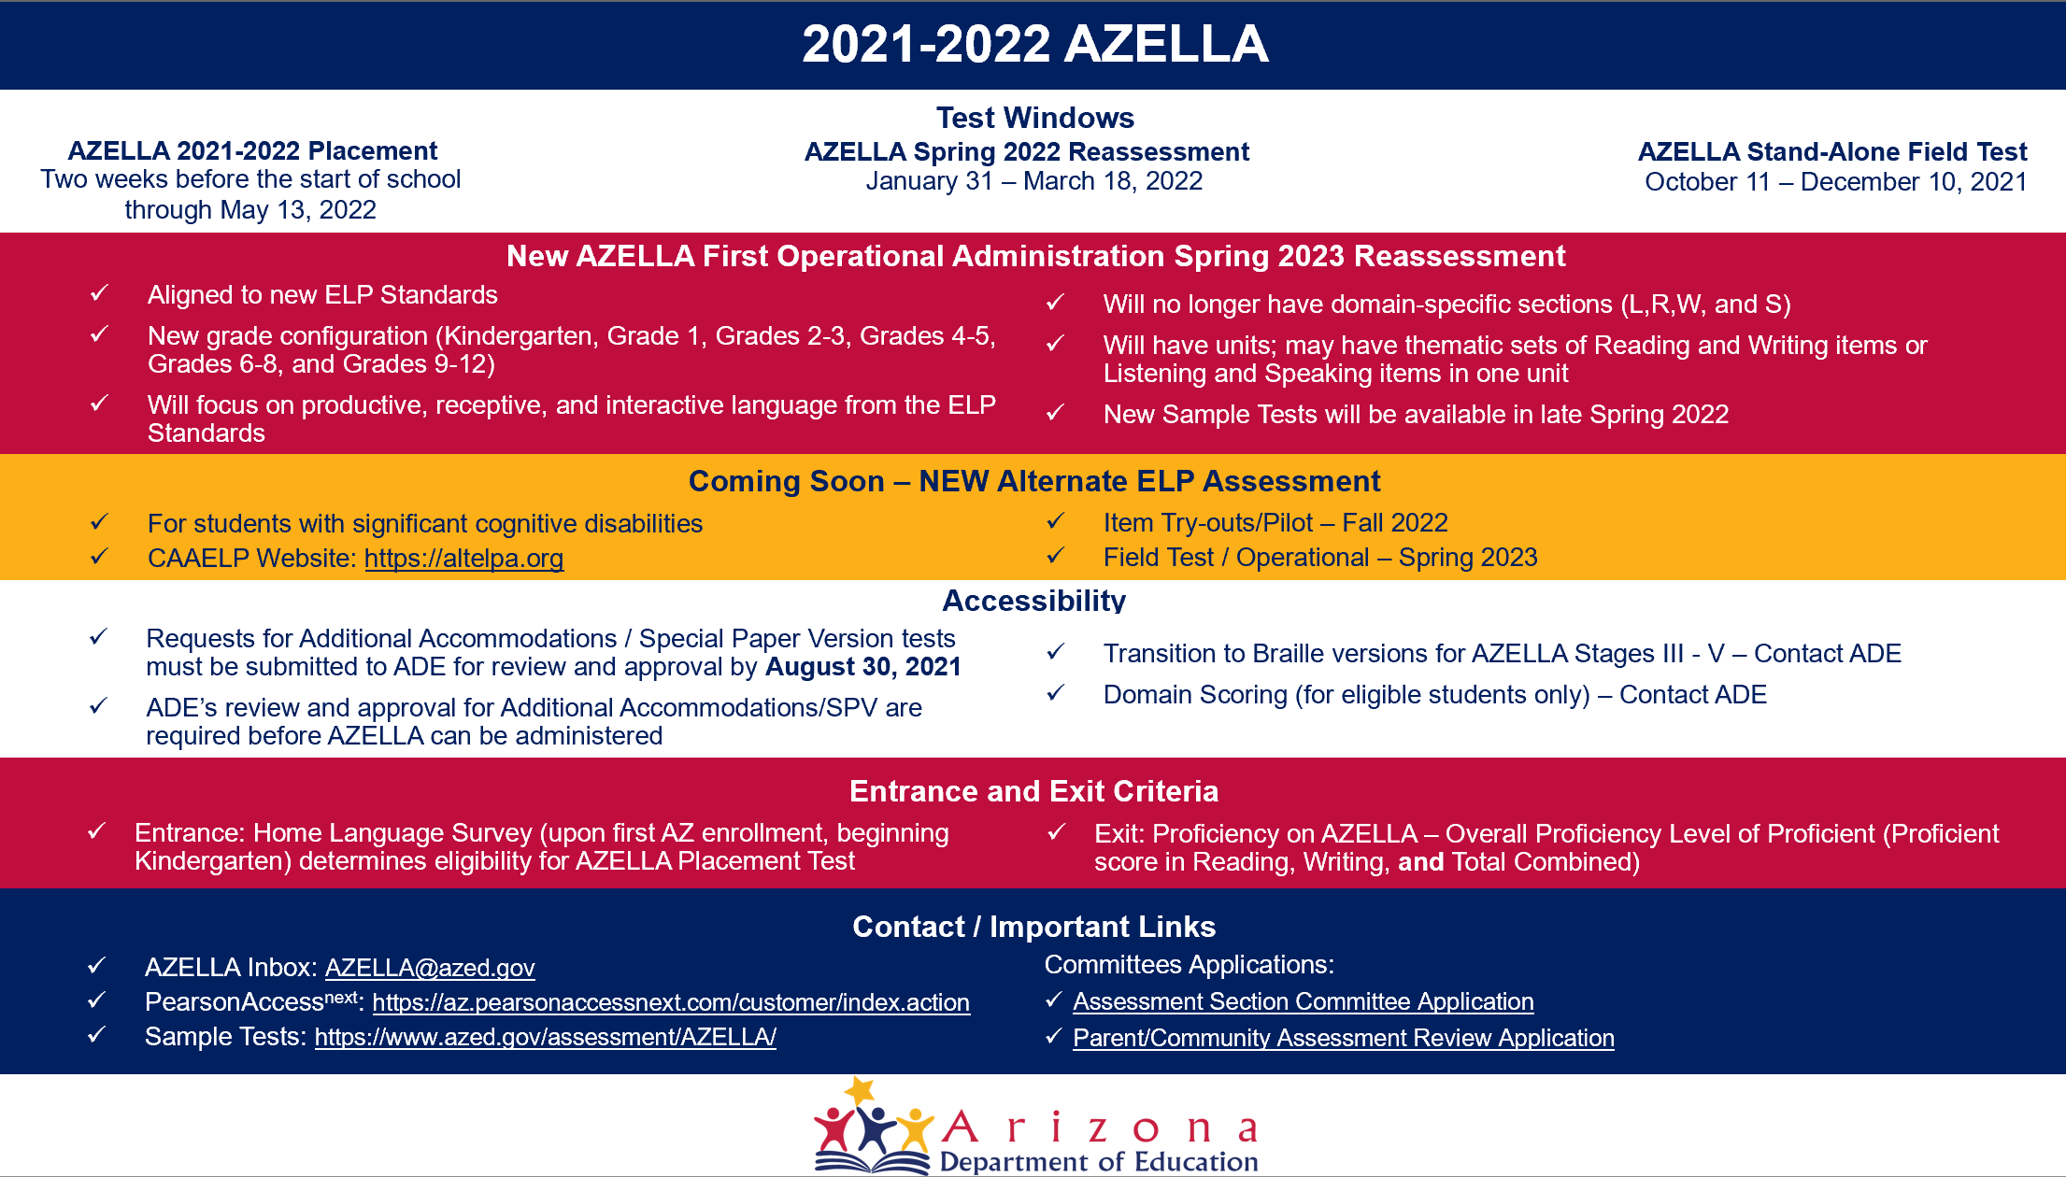
AZELLA Infographic

Slide 17
Alternate Assessment Infographic

Slide 18
Additional Assessment Updates
ADE has shipped results for Statewide Assessments from Spring 2021 test administrations to LEAs
Accountability is working with State Board to produce a report from Spring 2021 test administration
ADE Assessments Team will have 6 more webinar sessions in this series for the 2021-2022 school year
Friday Focus Webinar Flyer (includes registration information)

Slide 19
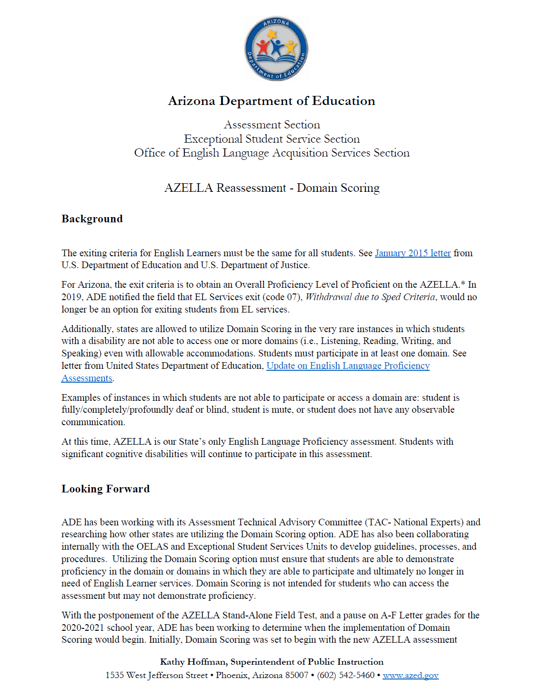
AZELLA Domain Scoring
Communication to DTCs, EL Coordinators and Special Education Directors and is posted on the ADE Assessment’s Webpage: AZELLA DTCs
AZELLA Domain Scoring Letter to Stakeholders: https://www.azed.gov/sites/default/files/2021/07/AZELLA%20Domain%20Scoring%20July%202021.pdf

Slide 20
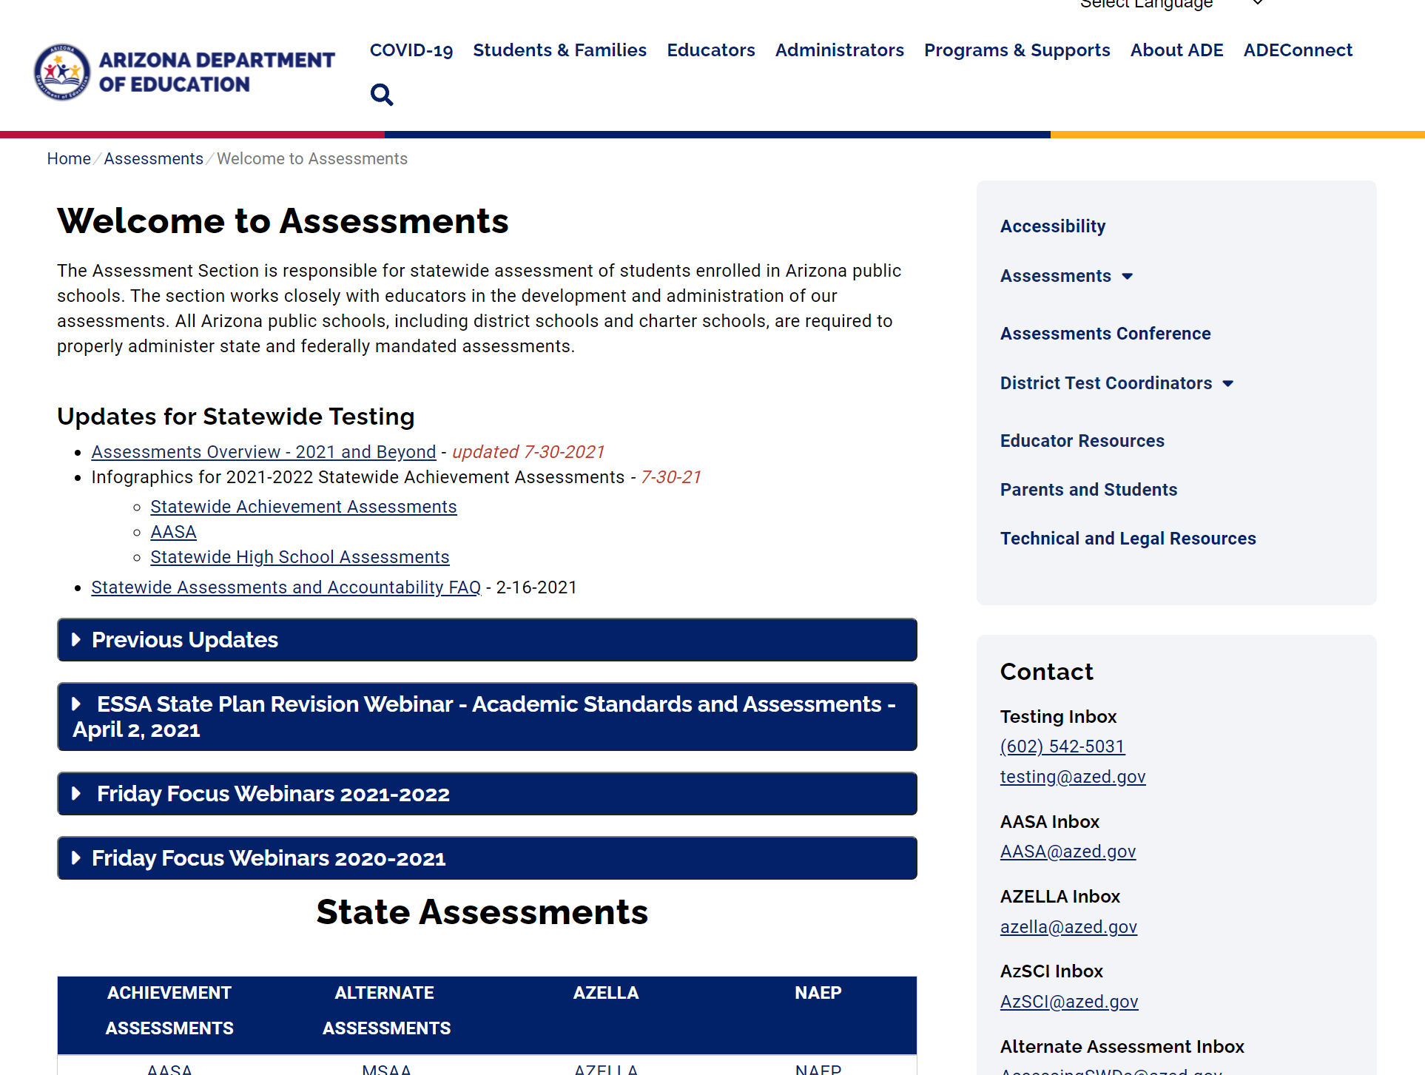
Assessment Webinar Series - Posted
All Assessment Webinars will be posted on the ADE Website - Assessment Page:
PowerPoint Presentation
Recording
https://www.azed.gov/assessment

Slide 21
Assessment’s Quarterly Newsletter for DTCs: The Examiner
The Assessment Quarterly Newsletter is emailed to District Test Coordinators and posted on the Assessment Webpage: https://www.azed.gov/assessment/examiner

Slide 22
State and Federal Accountability
State School Letter Grades (A - F) are mandated by State Law
Paused for 2020-2021
A report to the Governor (per Executive Order) will be available November 2021.
ADE Accountability is working with the State Board of Education (SBE) staff, Helios Education Foundation, Arizona State University, SBE Technical Advisory Groups, The Center for Assessment, and several other education stakeholders both locally and nationally in completing the Governors Executive Order for reporting on the COVID Academic Impact.
Grader Newsletter email: Achieve@azed.gov

Slide 23
Questions
This Photo by Unknown Author is licensed under CC BY-SA

Slide 24
Thank you!
For questions, please contact us at:
Testing@azed.gov
This Photo by Unknown Author is licensed under CC BY-NC-ND

