Slide 1
Educator & School Excellence
Title V-B RLIS:
ESSA State Plan Recommended Revisions
Round II
James Scott, Director of Educator and School Excellence
Educator & School Excellence
Arizona Department of Education
Notes:
Welcome to Round II of Arizona’s proposed revisions to our Statewide Title V-B grant, commonly referred to as the Rural and Low Income Schools grant. My name is James Scott, and I am one of the directors for Educator and School Excellence, and I have led the revision project for V-B. Today we will review the reasons Arizona has elected to revise Title V-B, an overview of the grant purpose, the current state plan, and proposed revisions. For the round 2 session we will also address feedback received in our first public round.

Slide 2
Arizona’s ESSA Plan…
Is the state’s response to the Every Student Succeeds Act (ESSA), the federal law that allows the U.S. Government to support both national and local education goals with grants and other resources
Describes how Arizona identifies schools for support and improvement
Outlines Arizona’s system to make sure every student leaves twelfth grade ready for college or career
Reflects input from a variety of Arizona’s education stakeholders
Was developed in 2016-2017 and received full federal approval in September 2017
Was amended to revise accountability components in 2019; those modifications were approved January 2020
Notes:
Every state is required to develop, revise, and monitor a state plan under the Every Student Succeeds Act, ESSA. The state plan must indicate how the state agency selects schools for support and improvement, how the state supports preparing K-12 students to be college and career ready, receive input from all stakeholders. Our plan was developed in 2016-2017, and has only one prior revision in 2019 regarding accountability components.

Slide 3
Why Revise the Plan?
Superintendent Hoffman has laid out a vision of equity for all students to achieve their full potential
ADE has made key changes that are reflected in the revised plan
Renewed focus on equity
Established an educator recruitment and retention team
Identified current initiatives supported through these federal programs
It has been four years since Arizona began implementing the initial ESSA plan
Notes:
In order to align with the vision of Superintendent Hoffman to provide equity for all students in Arizona, and the plan has not been revised in four years it is now a purposeful time to propose revisions to our state ESSA plan.

Slide 4
RLIS Provides equity
Rural Schools traditionally lack equity in the areas of infrastructure, access to services, and recruitment and retention of qualified educators. The RLIS grant provides additional funding that can be utilized to meet the LEA identified needs through the CNA (Comprehensive Needs Assessment) process. The RLIS grant may be used to meet any of these three needs of equity, and other identified areas. ADE supports LEAs in planning and identifying root causes with micro-trainings, technical assistance, and conferences. The department is also an active participant in the Region 15 Rural School consortium to support LEAs in utilizing ESEA funding, and more specifically RLIS funding to assure equity to all Arizona students.
Notes:
The RLIS grant provides equitable opportunities for students whom attend schools in identified rural areas, and have a higher than average number of families that live in poverty. The RLIS grant supports the school systems with equity by being able to provide for infrastructure, access to services, and the recruitment and retention of highly qualified and appropriately certified educators. The LEA can utilize these additional funds to meet their unique needs identified through the comprehensive needs analysis. The department supports LEAs with technical assistance, needs analysis, and being active participants in groups such as the Region 15 Rural School consortium.

Slide 5
Rural Low Income School Grant Program Guidelines:
An LEA is eligible for the RLIS program if all its schools have locale codes of 32, 33, 41, 42, or 43 and at least 20% of the children the LEA serves are from families below the poverty line.
If an LEA participates in Small Rural School Achievement Grants (SRSA) they may not participate in RLIS simultaneously.
Funds May be utilized as prescribed in Title I-A, Title II-A, Title III, Title IV-A, Title IV-B, and Parent/Family Engagement Activities.

Slide 6
Sample allowable expenses in title v-B (Rlis)
Supplement NOT Supplant Rules apply
Necessary, Reasonable, & Allocable
Timely & Meaningful Private School Consultation required
Social and Emotional Learning and Support
Trauma-Informed Classroom Management
Addictive Behaviors Prevention (tobacco, alcohol, drugs)
Crisis Management
Conflict Resolution
Suicide Prevention/Staff Training
Bullying and Harassment Prevention
Healthy Active Living/Nutrition Education
Improving Academic Achievement
Evidence Based Supplemental Curriculum
Technology Integration/Development/Expansion
Professional Learning and Development
Conferences and Trainings
Instructional Coaching/Educator Support
Summer School/Inter-session/Tutoring
Parent and Community Engagement
Notes:
These are examples of common allowable expense under the RLIS grant. The LEA may identify other needs and work with their program specialist to determine allowability. Please keep in mind though like all federal entitlement grants RLIS adheres to the guidelines of supplement and not supplant, reasonable and necessary, and when applicable the LEA must provide timely and meaningful consultation with private schools.

Slide 7
Today’s purpose
Disseminate proposed changes to the Title IV-B (RLIS) grant under the State of Arizona ESSA Plan

Slide 8
Current state plan overview

Slide 9
Current plan -Purpose
Supports Low Income Rural Schools
Over arching intent is to provide support for academic success

Slide 10
Current-developing, monitoring, evaluating outcomes
LEA develops grant and grant related planning at the local level
ADE monitors compliance and assurances through evaluation of grant application, comprehensive needs assessment, and root cause analysis. Each eligible LEA is assigned a program specialist to support the LEA with technical assistance, monitoring, and professional learning.
ADE evaluates compliance through a six cycle monitoring process, which includes an on-site monitoring visit (cycle 4) to assure compliance and provide technical assistance and support.

Slide 11
Proposed revisions

Slide 12
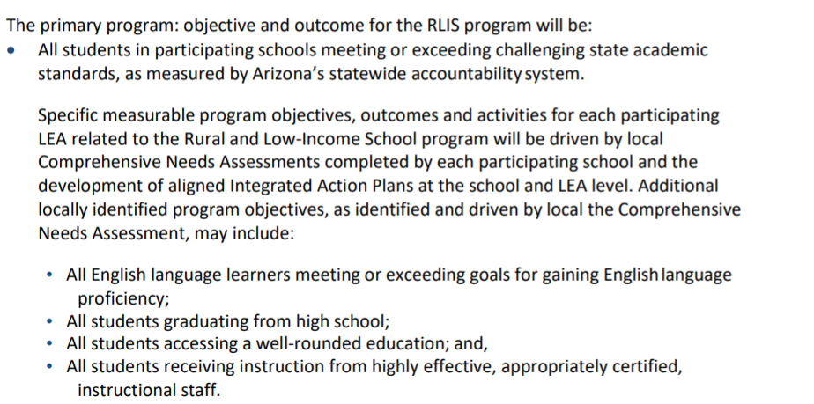
Revision 1: program objective-current

Slide 13
The primary program objective and outcome for the RLIS program will be:
All students in participating schools meeting or exceeding challenging state academic standards, as measured by the Arizona statewide accountability system.
Each LEA will complete the LEA Integrated Action Plan to develop specific measurable program objectives, outcomes, and activities. The Integrated Action Plan is developed by first utilizing key data points to complete the comprehensive needs assessment; conducting a root cause analysis; and then completion of the action plan. Action plans are monitored and adjusted during the fiscal year as part of the continuous improvement process. The LEA will also develop identified program goals as identified by the local comprehensive needs assessment, and may include goals in the following areas:
All English language learners meeting, or exceeding goals for English language proficiency.
All students graduating from high school.
All students having access to a well-rounded education; and,
All students receiving instruction from highly effective, and appropriately certified instructional staff.
Notes:
In this revision the LEA is being asked to specifically develop goals and objectives that are measurable with specific action steps in the LEA integrated action plan. This was always the anticipated expectation of the LEA, and similar to the requirements of other entitlement grants. The clarification of language supports the states intent, and meets the requirements of ESSA.

Slide 14
REVISION 2: TECHNICAL ASSISTANCE-CURRENT

Slide 15
REVISION 2: TECHNICAL ASSISTANCE PROPOSED
Technical assistance, service, and support may be provided by the Arizona Department of Education through a combination of in person services (conferences, workshops, and meetings) and virtual opportunities (webinars, online courses, virtual meetings, telephone conferences, and micro-trainings). Additionally, support at any level may be provided in conjunction with additional partnerships such as Regional Centers, County Educational Service Agencies, post-secondary institutions, and others. We will also continue to develop relationships with external partners to support rural communities such as our quad state partnership for rural schools.
Notes:
The State continues to build relationships with partners and stakeholders. Prior language stated specific partnerships and relationships to support LEAs in rural communities. This language change removes specific entities that have server as stakeholders, and allows for a broader scope of stakeholders to support the state in their efforts in building relationships with key stakeholders.

Slide 16
Opportunity for public comment

Slide 17
Feedback from first public meeting
91% Participants Agreed or Strongly Agreed with supporting the recommended revisions.
There was no positive specific statements regarding the proposed revisions
9% of participants had a disagreement with the revisions, 0% had a strongly disagree.
Concerns regarding the administrative task of completing an Integrated Action Plan for RLIS
Request for ADE to have a list of approved activities and supporting ESEA evidence.
Notes:
In round one 91% of participants agreed or strongly agreed with the Title V-B revisions. In the next few slides will review and address specific concerns and comments that were elevated during our first public round.

Slide 18
Concerns regarding revisions
Concerns requiring administrative time commitment to plan development and needs analysis.
ESEA requires all sub grants, which includes RLIS to have funded programs and services have an education plan with strategies that lead to improvements in the LEAs overall academic achievement.
Approved Activities and Ideas
ADE as a matter of policy does not endorse products and/or vendors.
School Improvement does have a web page committed to evidence-based practices, strategies, and programs that LEAs can utilize as guidance. https://www.azed.gov/improvement/evidence-based-practices
Each LEA has an assigned program specialist which can provide technical assistance and support with LEAs on program development and design.
Notes:
Concern one was the adding of additional administrative task by requiring the LEA to utilized the LEA integrated action plan process. This was always the intent of the department, and a comprehensive needs assessment process is required under ESSA. The intent of this revision is to clarify the language. Each LEA is assigned a designated program specialist which are always able to support the LEA with the development of their integrated action plan.
Another concern was elevated about having approved activities, ideas, and programs to support the LEA. It is the policy of the department to not endorse curriculum, programs, or services. However the LEA can locate research based resources on our school improvement site, link is on the slide. In addition, your assigned program specialist may serve as a support partner in your planning process.

Slide 19
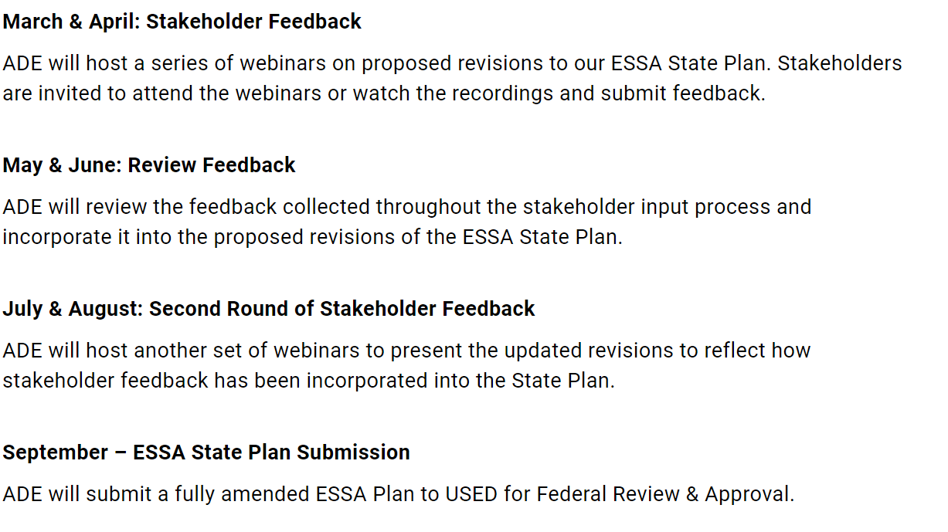
Essa state plan revision timeline
Notes:
We are currently in the third phase, our second round of stakeholder feedback. In a moment you will be given a link to provide feedback. Similar to round one we will utilize this feedback to make any final revisions to the proposed state plan. The next phase in September is to submit the final revisions to the US Department of Education for review and approval.

Slide 20
Essa state plan revision timeline
Notes:
This is the process the state has implemented to disseminate and share the revisions, and gather information from constituents throughout the state. We are currently in the third phase, our second round of feedback. Upon completion of this round the state will utilize feedback to make the final revisions and submit our proposed changes to the US Department of Education for review and approval.

Slide 21
ESSA Survey Request​
Stakeholder Input on Title V, Part B, Subpart 2 (Rural and Low-Income School Program) Section of the Arizona ESSA plan (google.com)
1
2
3
4
5
6
Any questions, please reach out to ESSAInbox@azed.gov
Notes:
You may utilize this link to complete a survey to gather your thoughts, input and any questions for clarification regarding the Title V-B, RLIS revisions being proposed by the State. If you have any questions, or have a specific need you may email us at ESSAInbox@azed.gov
We appreciate your time today and look forward to reviewing your feedback as we begin the final phases of this revision process.

Slide 22
Thank you

