Slide 1
Academic Standards:
Summer 2021 Professional Learning Opportunities

Slide 2

Early Childhood

Slide 3
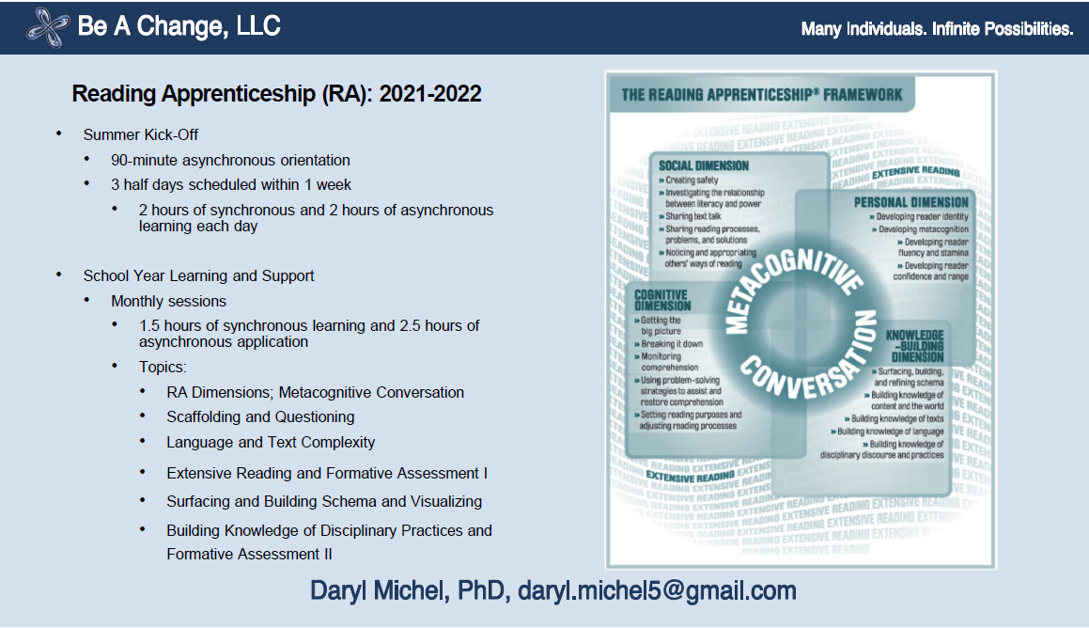
English Language Arts

Slide 4
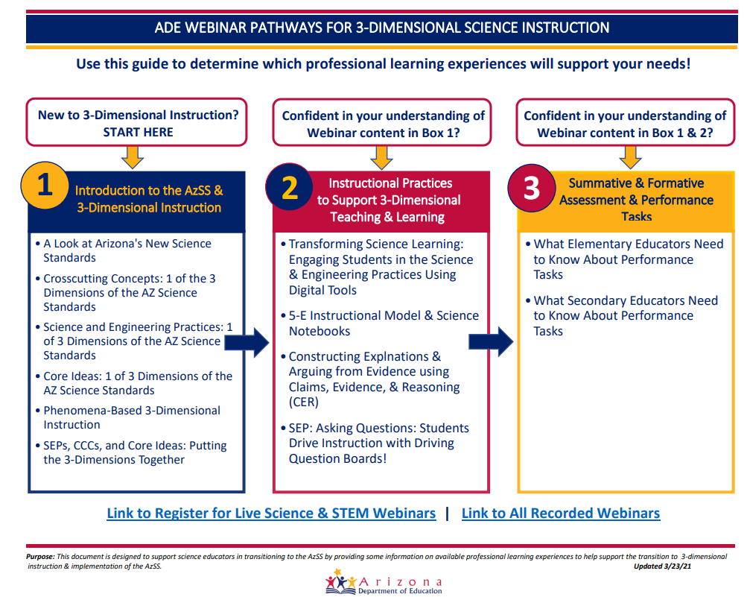
Science

Slide 5

Social Studies

Slide 6

Postsecondary

Slide 7



Math

Slide 8
Academic Standards Team: We Are Here to Help
Area of Focus | Contact | Email
Deputy Associate Superintendent | Sean Ross | Sean.ross@azed.gov
AZ Charter School Program | Mark Francis | Mark.francis@azed.gov
Computer Science | Sarah Sleasman | Sarah.sleasman@azed.gov
Early Childhood | Lori Masseur | Lori.masseur@azed.gov
Educational Technology | Eboney McKinney | Eboney.mckinney@azed.gov
English Language Arts | Amy Boza | Amy.boza@azed.gov
Math | Eboney McKinney | Eboney.mckinney@azed.gov
Postsecondary | Andrea Glenn | Andrea.glenn@azed.gov
Science | Sarah Sleasman | Sarah.sleasman@azed.gov
Social Studies | Tammy Waller | Tammy.waller@azed.gov
World & Native Languages | Tammy Waller | Tammy.waller@azed.gov

