Slide 1
CTE Data Portal Overview
March/April 2021

Slide 2
CTE Data Portal Agenda
We will cover:
CTE Data Cycle – how is your CTE data used in the CTE Data Portal?
Updating Contacts
Creating/Updating a Coherent Sequence
CTE Student Enrollment
Creating Student Credentials
What’s next
Q & A

Slide 3
CTE Data Portal
The CTE Data Portal is...
…Arizona’s CTE data management system.
…used to collect CTE program information, including programs and courses, student-level enrollment, CTE participants/concentrators, post-high school placements, and more.
…used to calculate Perkins V performance measures and (some) funding.
…accessed through ADEConnect (ADE’s online applications portal).
See www.azed.gov/cte/cte-data-portal-information for instructions.

Slide 4
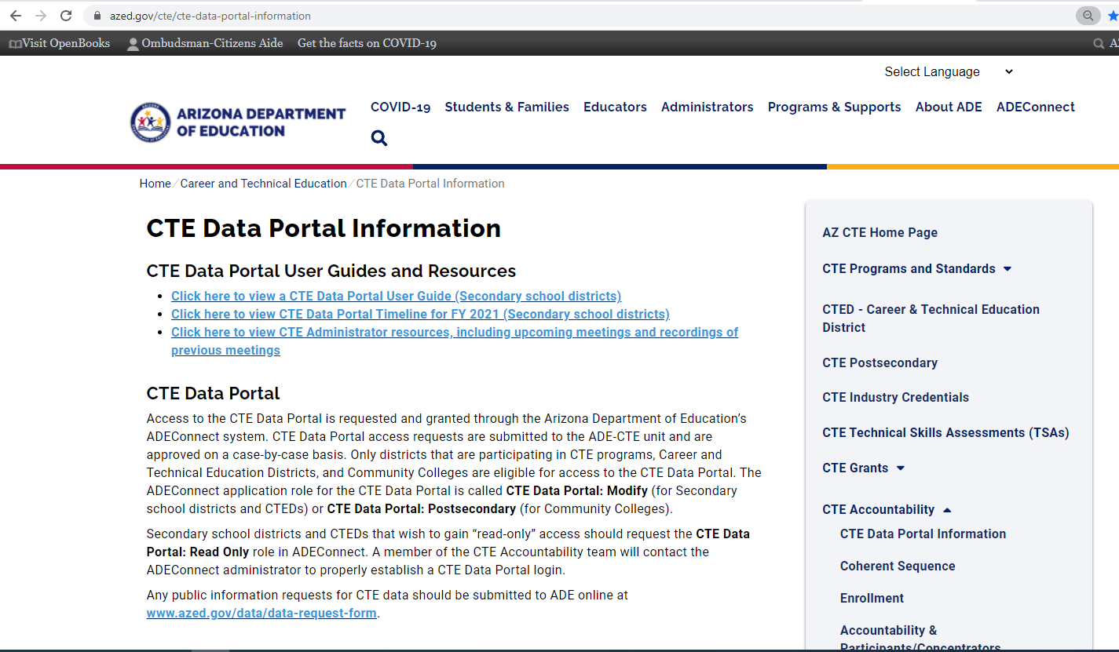
CTE Data Portal
www.azed.gov/cte/cte-data-portal-information

Slide 5
CTE Data Portal
District Actions
System Calculated
●
Industry Recognized Credentials
Performance Measures


❍
Coherent Sequence
Student-Level Enrollment
Participants/ Concentrators *
■
State Priority Funding
Placement Survey
75% Enrollment
25% Related Placements
* Districts can edit credits earned in years prior to FY 2020.

Slide 6
Two-Step process for Enrollment & Participants/Concentrators
Exiting Concentrators eligible for Placement
Enter Enrollment data
Participant Concentrator Records are created
Funding is calculated using current data
Adjust your Enrollment records
Participant Concentrator records are updated
Final Funding is calculated using adjusted data
= Dollar amount used in Grant Allocation

Slide 7
CTE Data Portal
CTE State Priority Grant Funding
25% is based on Related Placements
from prior year’s data, next year’s allocation
75% is based on CTE Course Enrollment
from current year data, next year’s allocation
Performance Measures
1S1 Graduation Rate
2S1, 2S2, 2S3 Academic Proficiency
3S1 Placement
4S1 Nontraditional Enrollment
5S1 Industry Recognized Credential
5S4 Technical Skills Assessment
3S1 – We use placement records from prior year
5S1 – We use Credential data matched to Concentrator records.
5S4 – We bring in TSA attempts and match to Concentrator records.

Slide 8
CTE Data Portal
CTE Data Portal homepage has…
…menu “tabs” for each function.
…recent announcements and due dates.
…links to recent documents.
Notes:
Once accessed through ADEConnect, you see CTE Data Portal home page. Your homepage may look a little different since the contents are updated regularly. The CTE Data Portal’s menu of functions is the “tabs” across the top of the page. These tabs direct you to the various data collection functions of the Portal. The homepage is also updated regularly with announcements and deadlines (at the top of the page), and may sometimes have links to pertinent and helpful documents. The homepage also has a link to the Online Arizona Certification Information System, or OACIS. This is a public website that you can use to find teacher’s educator ID number, or EIN, which is used to validate teacher’s certification when providing CTE course enrollment information. Lastly, one more small tip for you – sometimes the CTE Data Portal will appear “zoomed in” which will cause the menu tabs to stack on top of each other. This may cause some parts of the system to behave strangely, so to “zoom out”, hold down the “Control” key on your keyboard and press the “Minus” key until the menu tabs all appear on one line. Alternatively, you can also hold down the “Control” key and scroll down on your mouse’s scroll wheel.

Slide 9
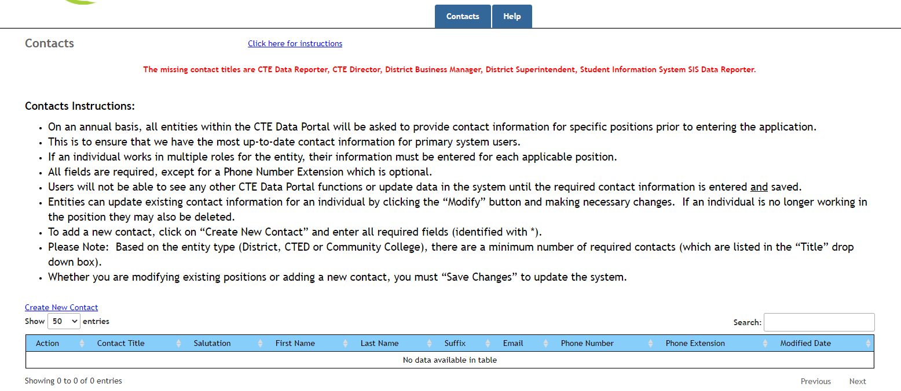
Contacts
Notes:
On an annual basis, the “contacts” tab of the Data Portal is cleared, and new contacts must be entered/provided. All other functions of the data portal are hidden until all required contacts are provided. Required contacts include the CTE Director, CTE Data Reported, District Business Manager, District Superintendent, and District SIS Reporter. The same individual can be entered for as many positions as they hold, and more than one contact can be entered for each position. To add a new contact, click on the “Create New Contact” link at the top left.

Slide 10
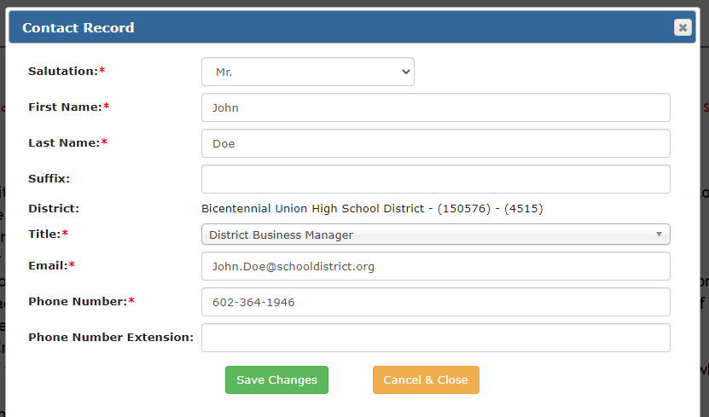
Contacts
Notes:
On an annual basis, the “contacts” tab of the Data Portal is cleared, and new contacts must be entered/provided. All other functions of the data portal are hidden until all required contacts are provided. Required contacts include the CTE Director, CTE Data Reported, District Business Manager, District Superintendent, and District SIS Reporter. The same individual can be entered for as many positions as they hold, and more than one contact can be entered for each position. To add a new contact, click on the “Create New Contact” link at the top left. Fill in each required field indicated with the red asterisk. Select the appropriate title in the dropdown list. Click “save changes” to add the contact to the table.

Slide 11
Contacts
Once all required contacts are entered, the menu tabs appear at the top of the screen.
Remember, contacts will be refreshed on an annual basis.
Notes:
On an annual basis, the “contacts” tab of the Data Portal is cleared, and new contacts must be entered/provided. All other functions of the data portal are hidden until all required contacts are provided. Required contacts include the CTE Director, CTE Data Reported, District Business Manager, District Superintendent, and District SIS Reporter. The same individual can be entered for as many positions as they hold, and more than one contact can be entered for each position. To add a new contact, click on the “Create New Contact” link at the top left. Fill in each required field indicated with the red asterisk. Select the appropriate title in the dropdown list. Click “save changes” to add the contact to the table. Once all contacts are added, the “instructions” disappear, and the CTE Data Portal menu tabs are opened and appear at the top of the screen. You can always click on the “Click here for instructions” link at the top center of the page to review the instructions for this page. The “Create New Contact” link does not disappear, so you can continue to add contacts as needed. You should keep these contacts up-to-date as the CTE staff will use these contacts to share important information with your district. You can delete or modify the contact information at any time, however, if any required contacts are deleted and not replaced, the menu tabs will disappear again until all required contacts are provided. Any data that you’ve provided in other menu tabs will not be affected if the menu tab disappears due to missing contacts.

Slide 12
2021 COHERENT SEQUENCE

Slide 13
Things to Remember….
Must use CIP/CTE Course Numbers
Cannot enter School’s Course Numbers
Must list all required courses even if not offering current school year
Cannot not be uploaded
Existing Coherent Sequence will be rolled over from past school year to current school year
Courses are not brought in from AzEDS – all changes are done within CTE Data Portal
Projected year course to begin no longer needed
Linked to Enrollment

Slide 14
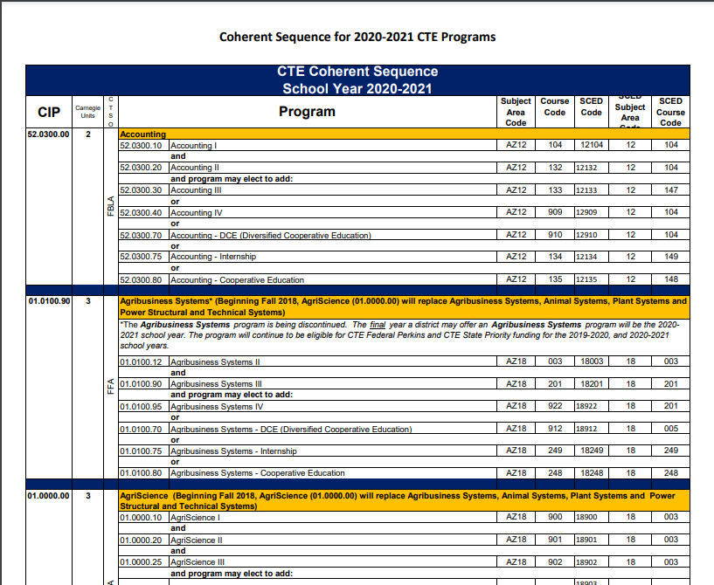
Programs Codes and Titles
https://www.azed.gov/cte/programs

Slide 15
Discontinued Courses
The following programs are being discontinued.
FY/SY 2020-2021 is the final year they may be offered:
•Agribusiness Systems (01.0100.90)
•Animal Systems (01.0100.40)
•Plant Systems (01.0100.30)
•Industrial Electrician (46.0300.30)

Slide 16
Non-Articulated Courses and Articulated Courses
Non-Articulated
CTE programs are offered and taught at the student's school of residence
Articulated
CTE program that is taught somewhere other than the student’s school of residence:
Community College
CTED
Another school

Slide 17
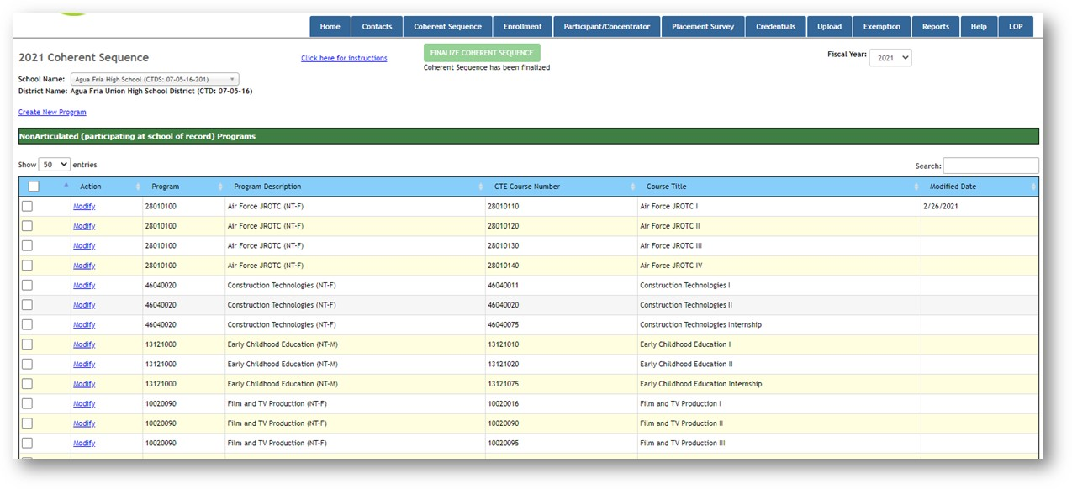
Creating Non-Articulated New Programs/Courses
Click create New Programs

Slide 18
Choose your program

Slide 19
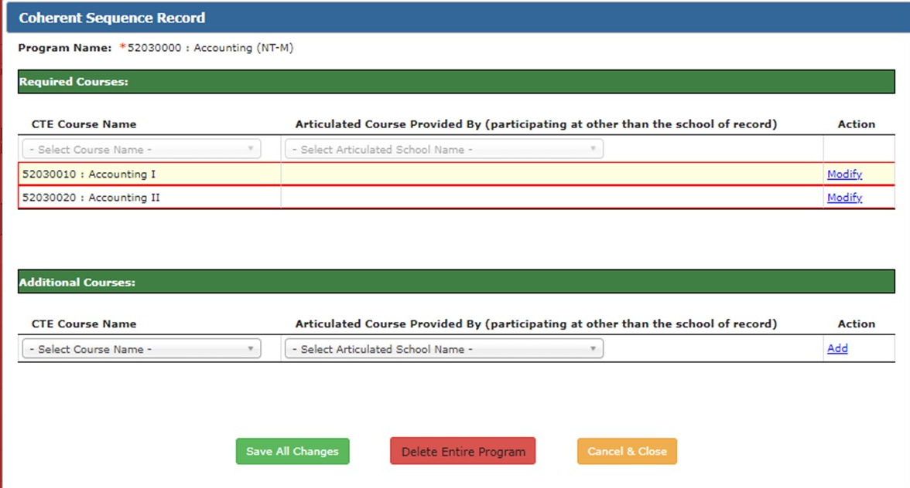
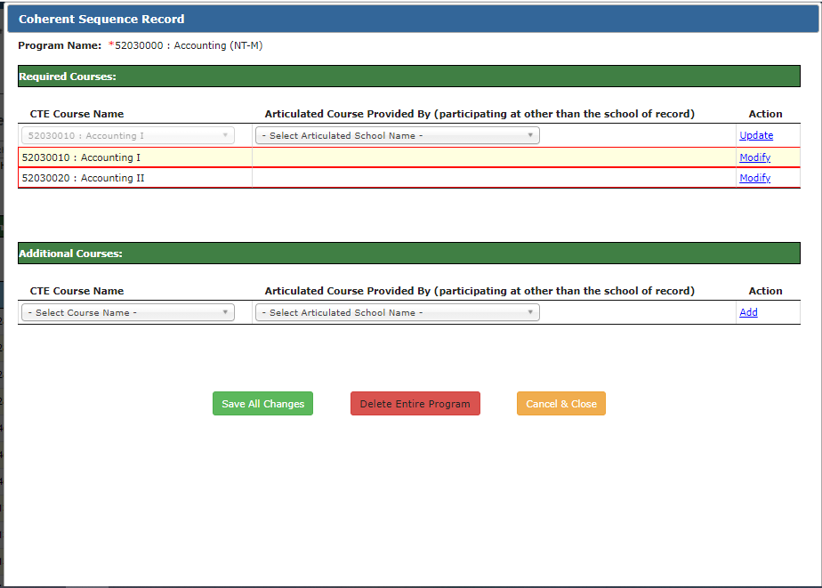
1. Click modify
2. Update each course

Slide 20
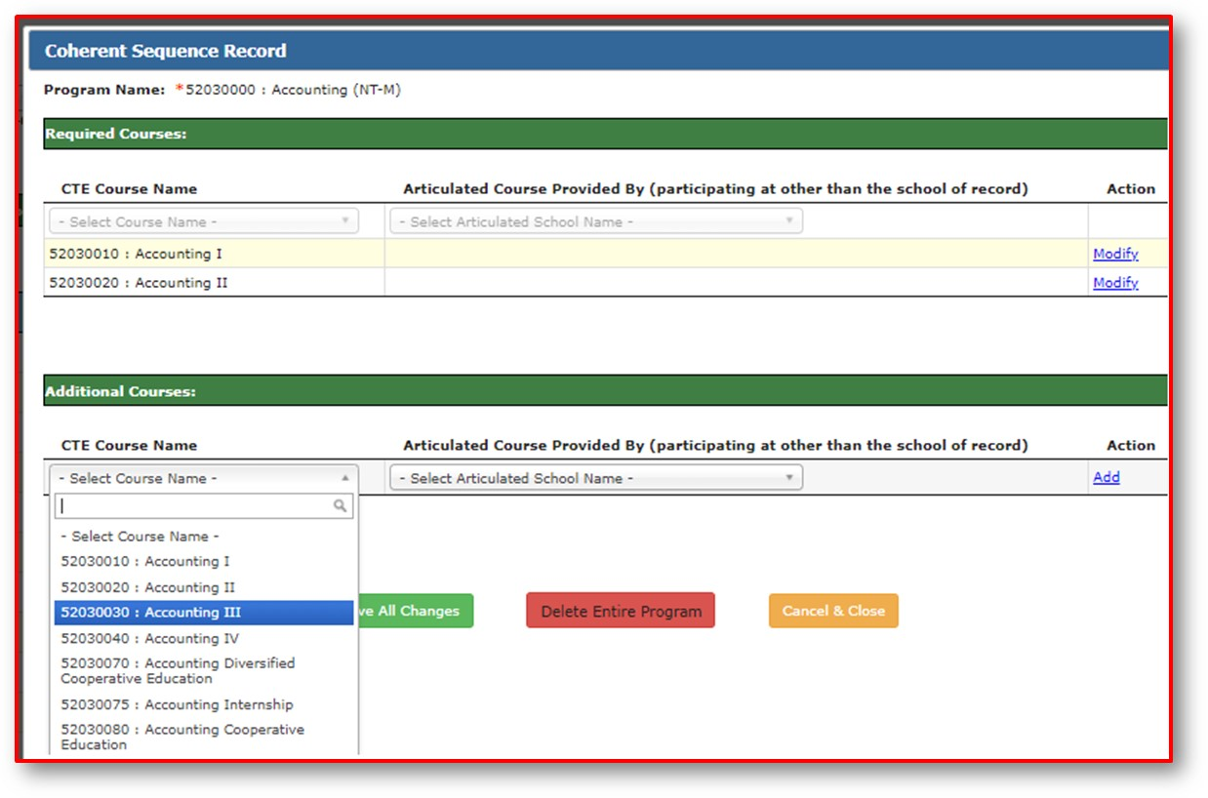
Additional Courses
Select, add, modify, update

Slide 21
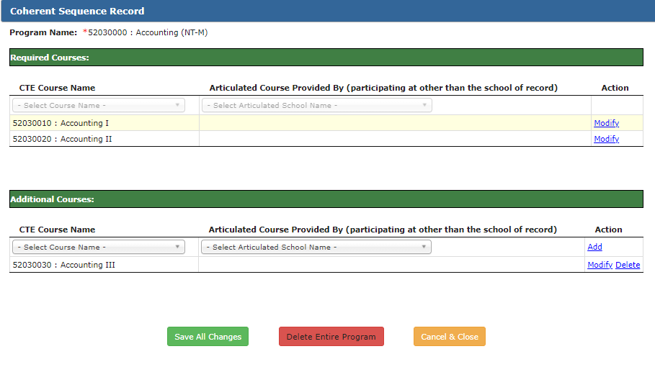
Save all changes
Program and courses added

Slide 22
Creating New Articulated Programs/Courses
1. Select Program
2.Click on modify and select location course is offered
3. Click Update

Slide 23
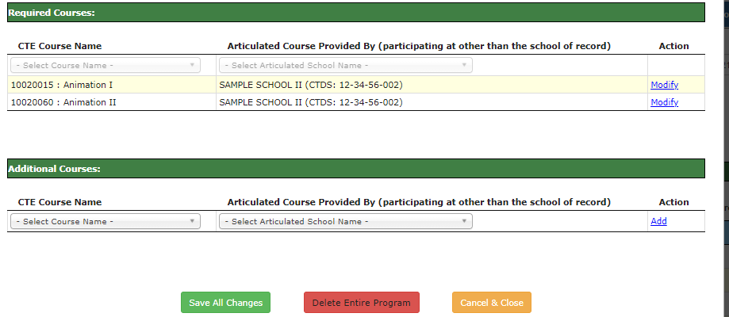
Click to save all changes

Slide 24
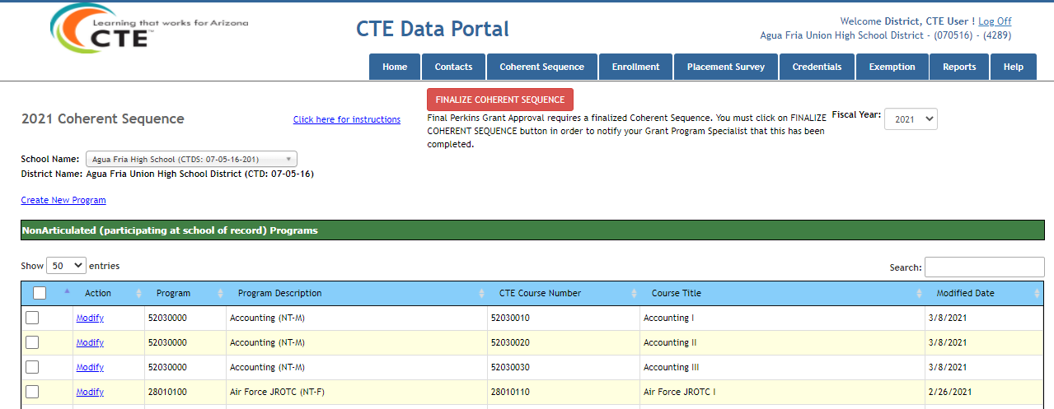
Modifying Existing Coherent Sequence
Click on modify

Slide 25
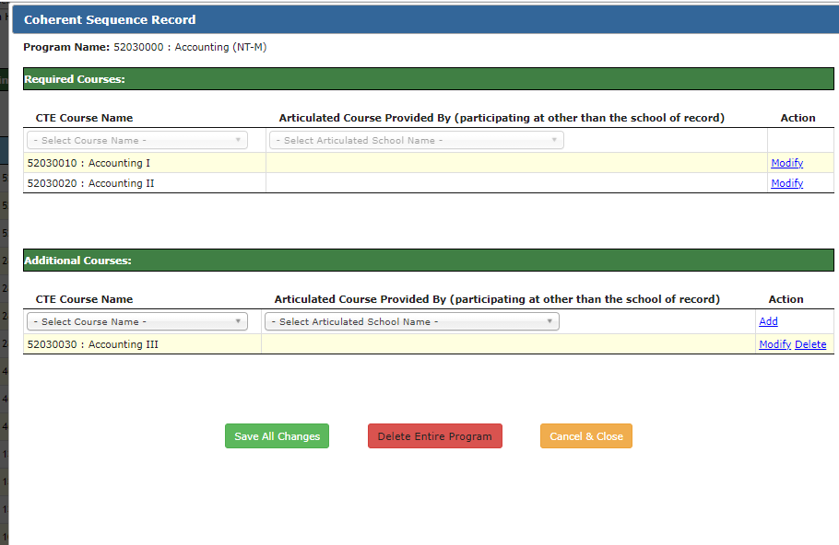
1. Click add, if want to add new course, or modify if want to modify existing course
2. Click update

Slide 26
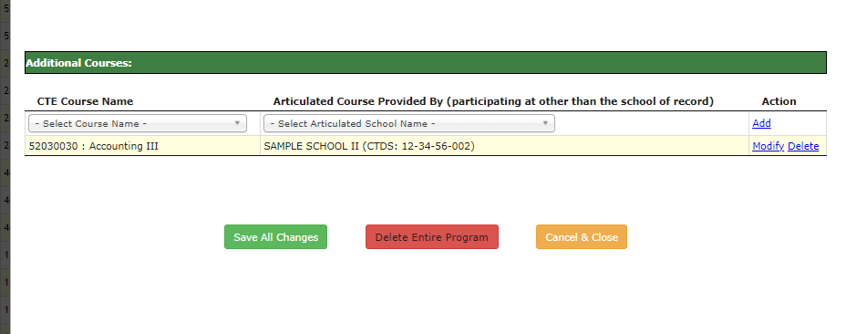
Click Save All Changes
Courses have changed

Slide 27
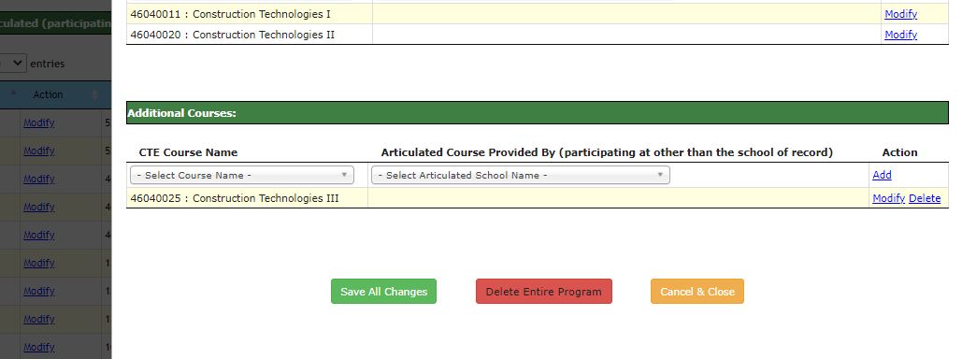
Deleting Additional Courses
Please remember only additional courses can be deleted
Click modify
Click delete

Slide 28
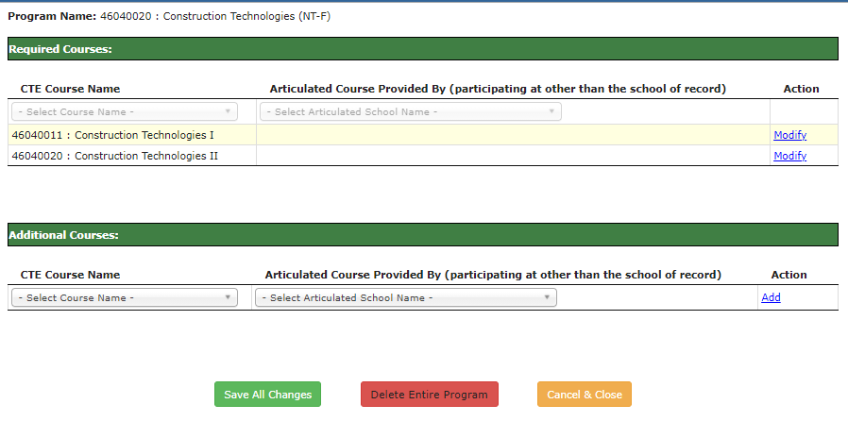
Click ok
Click save all changes

Slide 29
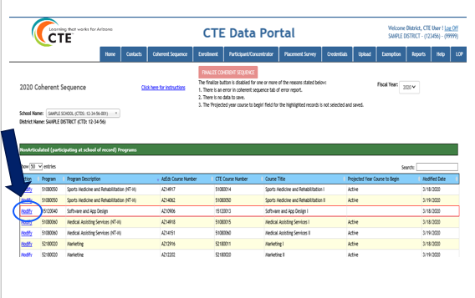
Deleting A Program
Click modify

Slide 30
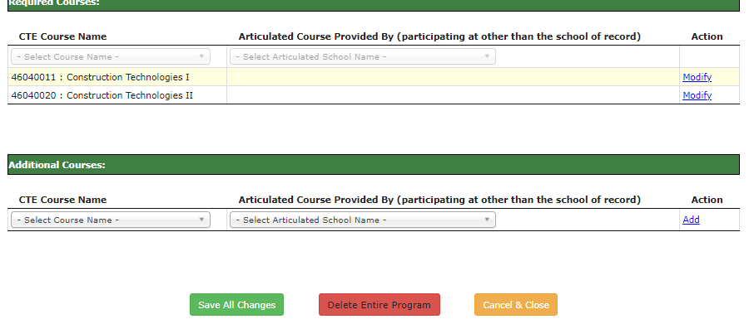
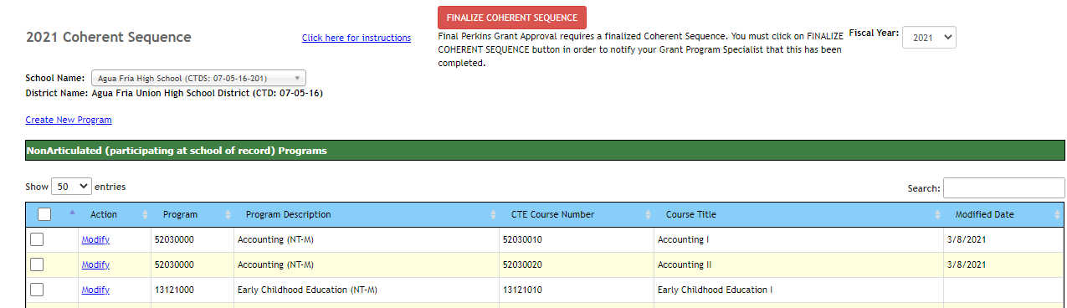
Click Delete Entire program
Program deleted

Slide 31
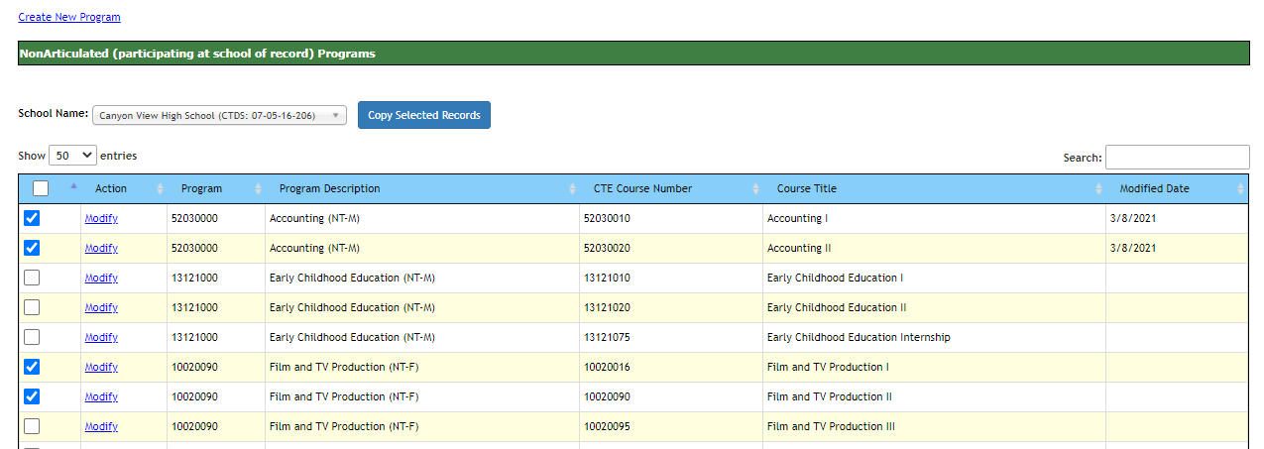
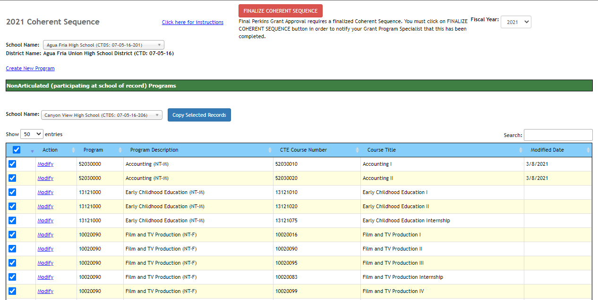
Copying Programs/Courses
3.Select school and click Copy Selected Records
1. Can select individual programs and courses
3. Select school and click Copy Selected Records
2. Or all programs

Slide 32
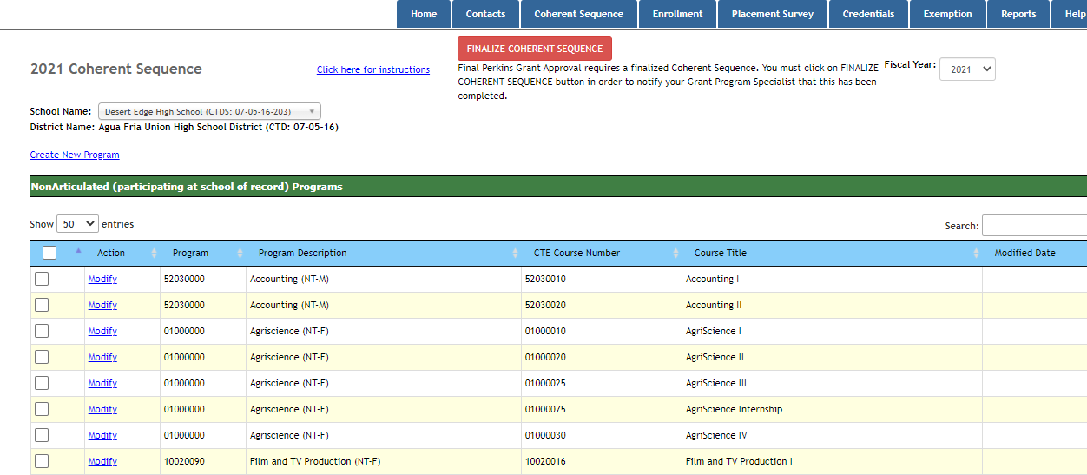
Programs have been added

Slide 33
Finalizing Coherent Sequence
Click Finalize

Slide 34
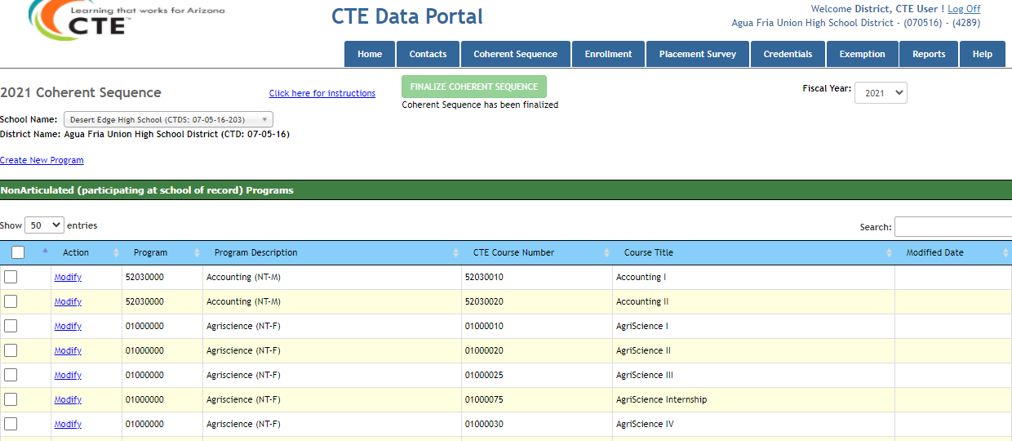
Please remember the finalize button has to clicked for each school
Finalized Coherent Sequence

Slide 35
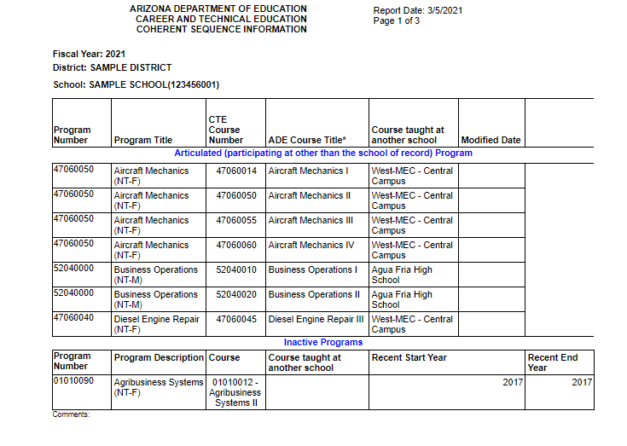
Coherent Sequence Report
Located under Reports Tab of CTE Data Portal

Slide 36
CTE ENROLLMENT DATA REPORTING School Year 2020-2021
By: Janet Silao
janet.silao@azed.gov/ 602-542-5485

Slide 37
BEFORE WE BEGIN, QUICK REMINDERS
CTE Data Portal is now open for FY 2021 Fall/Spring Enrollment reporting
Fall & Spring enrollment data is due June 15
Fall is 40th day/ Spring is 100th day
Enrolment is tied to Coherent Sequence- courses must exist on the school’s coherent sequence to upload enrolment records
METHOD OF SUBMISSION- file upload data submission

Slide 38
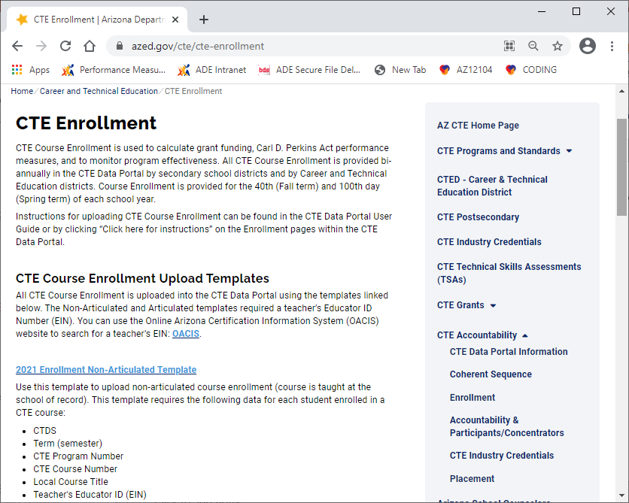
File Upload Data Submission- CREATE YOUR FILE
USE the CTE Data Portal Templates available for download in https://www.azed.gov/cte/cte-enrollment
Complete instructions included in the templates

Slide 39
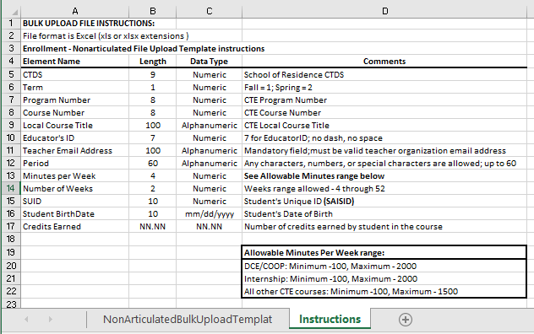
There are 3 templates to choose from:
NON-ARTICULATED COURSE ENROLLMENT- course taught at the school of record
Use Enrollment Non-Articulated Template
Data elements required for non-articulated courses
Teacher educator ID
is required- make sure your teachers are properly certified

Slide 40
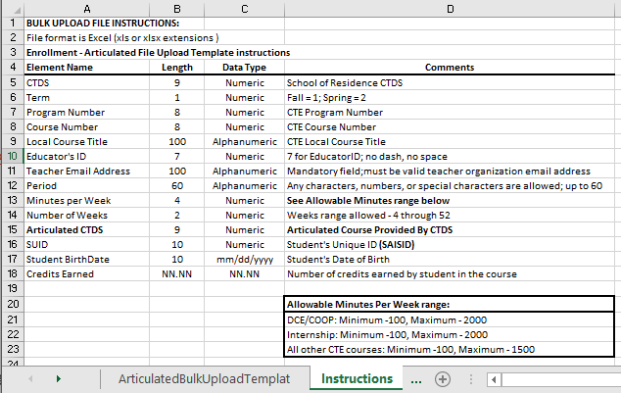
ARTICULATED COURSE ENROLLMENT- course taught at a school other than the school of record
Use Enrollment Articulated Template
Data elements required for articulated courses
Teacher educator ID
is required- get educator ID from CTED
!
DO NOT use this template for a course taught at a Postsecondary institution or for a CTED course at a Postsecondary site (by a community college teacher)

Slide 41
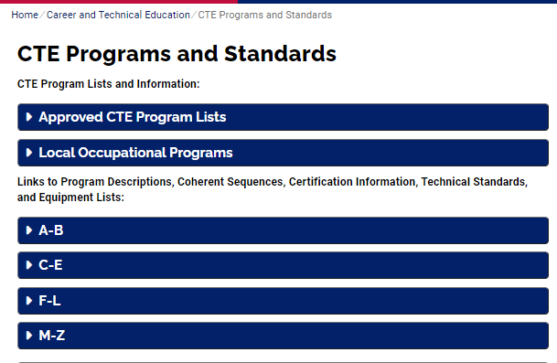
YOUR TEACHER/S MUST BE PROPERLY CERTIFIED
Teachers teaching the program courses must be properly certified by MAY 1, 2021 .
Teacher Certification Requirements for Programs- Use the Course Description/Coherent Sequence/Certification Information as your guide in knowing what certification your teacher needs, https://www.azed.gov/cte/programs/cte/programs/

Slide 42
ADDITIONAL INFORMATION ON TEACHER CERTIFICATION
INTERNSHIP course
Teacher is required to have a valid CTE certificate in any program area; not required to have a Cooperative Education Endorsement (CEN)
COOPERATIVE EDUCATION (COOP) course
Teacher is required to have a valid CTE certificate in the appropriate program with a Cooperative Education Endorsement (CEN)
DIVERSIFIED COOPERATIVE EDUCATION (DCE) course
Teacher is required to have a CTE certificate in any program with a Cooperative Education Endorsement (CEN)

Slide 43
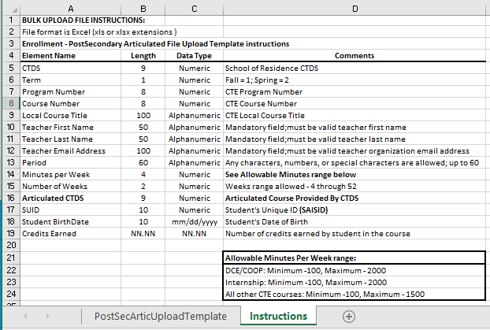
ARTICULATED TO POSTSECONDARY COURSE ENROLLMENT- taught at a postsecondary institution/community college or a CTED course taught at a Postsecondary site by a postsecondary teacher
Use Postsecondary Articulated Template
Data elements required for courses articulated to Postsecondary
Teacher educator ID
not required

Slide 44
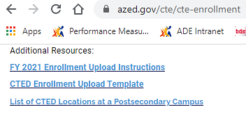
For the list of eligible postsecondary CTED sites, see "Additional Resources"
Site CTDS | CTED at Postsecondary Site Name
020801012 | CTD - Cochise College
110802009 | CVIT - Central Campus CAC Aravaipa
110802007 | CVIT - Central Campus EAC Gila Pueblo
130802010 | MIJTED - Yavapai College Agribusiness & Technology Center
130802008 | MIJTED - Yavapai College CTEC
130802009 | MIJTED - Yavapai College Prescott Valley
090835217 | NAVIT - Gila Community College
090835215 | NAVIT - Northland Pioneer College LCC
090835214 | NAVIT - Northland Pioneer College PDC
090835213 | NAVIT - Northland Pioneer College SCC
090835218 | NAVIT - Northland Pioneer College SPE
090835216 | NAVIT - Northland Pioneer College STJ
090835212 | NAVIT - Northland Pioneer College WMC
100811216 | PCJTED - Aztec Middle College
100811215 | PCJTED - Aztec Middle College Desert Vista
100811213 | PCJTED - Aztec Middle College East
100811214 | PCJTED - Aztec Middle College North West
140801008 | STEDY - Arizona Western College
130801007 | VACTE - Yavapai College Sedona Center
080850007 | WAVE - Arizona Western College
080850008 | WAVE - Mohave Community College
070802285 | West-MEC Estrella Mountain Community College
070802280 | West-MEC Gateway Community College
070802284 | West-MEC Glendale Community College
070802286 | West-MEC Glendale Community College - North

Slide 45
ALWAYS USE the template from the website
to avoid getting errors

Slide 46
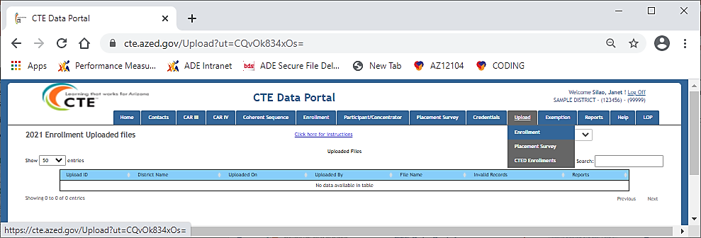
BEGIN ENROLLMENT REPORTING- upload the enrollment file using the CTE Data Portal
Click on Upload, choose Enrollment
Select file to upload, then click Upload
Information Message will pop up saying “Successfully processed the file”

Slide 47
After file upload, you will see the history information:
Date
Email address of the uploader
File Name
Number of valid/invalid records
Reports
Click on the link to open the file you uploaded
Click on Records Not Added link to open the error report
all records uploaded
will be deleted

Slide 48
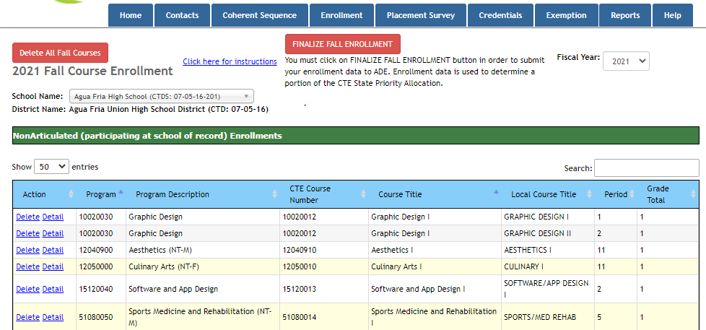
The enrollment records that were successfully uploaded will appear in either Fall or Spring; review and verify them for accuracy
Incorrect record/s can be deleted- Delete All Courses or Single Course delete
Records added

Slide 49
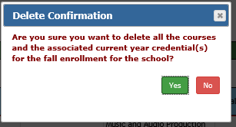
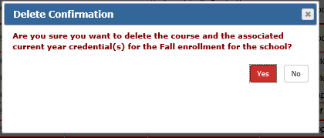
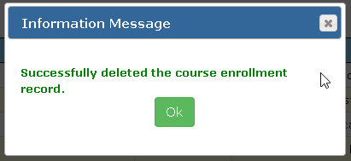
When Delete All Courses or Single Course delete is selected, a delete confirmation message will be
displayed
Deleting a course or courses will delete the associated current year credential(s) and the respective students enrolled for the term
For ALL COURSE DELETION
For SINGLE COURSE DELETION

Slide 50
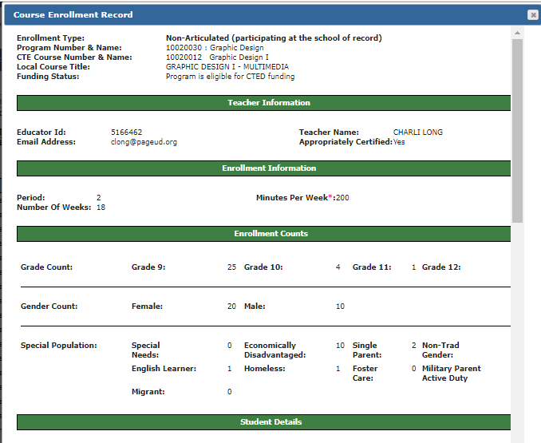
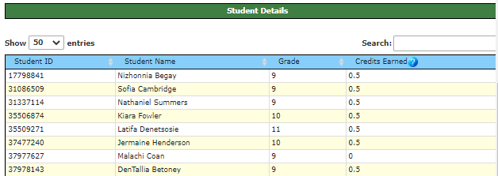
Detail link- click this link to see “Course Enrollment Record
Review student details for accuracy
Make sure to submit the credits earned by each student
7891011
Teacher Name
Teacher@email.com
zero

Slide 51
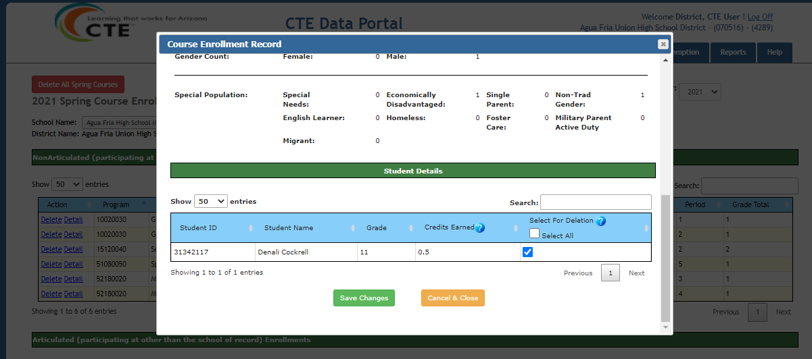
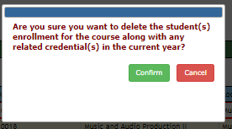
Delete one or more or all students within a single course
Click on Details to open the course enrollment record
Associated current year credential(s) of the selected student/s will be deleted
Will delete ALL students

Slide 52
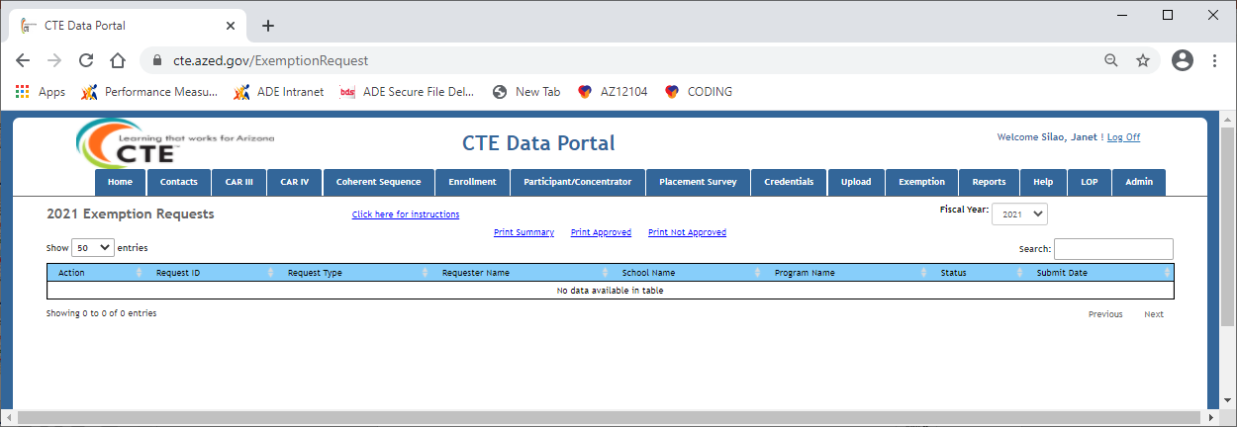
EXEMPTION REQUEST
Submit an exemption request if a requirement will not be in place by the due date
Deadline of submission of exemption request is JUNE 15, 2021
Exemption Request is submitted via CTE Data Portal

Slide 53
Program/s and course/s information can only be added through bulk file upload
You MUST click the “Finalize” button after reviewing your data
All errors must be fixed/corrected and reuploaded for the records to be counted
If the course in not already in the coherent sequence you will get an error for the enrollment bulk upload

Slide 54
Accountability & CTE Data Portal
March 11, 2021
Donna Kerwin
CTE Business Analyst
Donna.Kerwin@azed.gov
(602) 542-7881

Slide 55
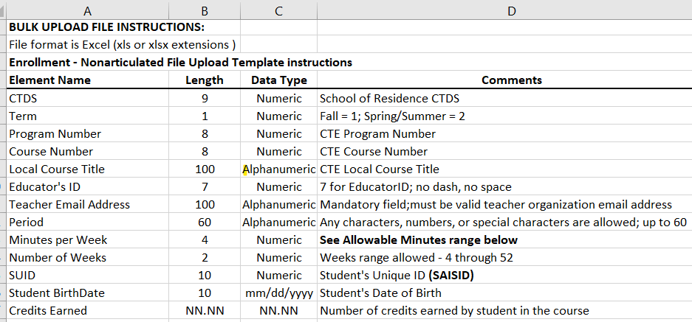
CTE Data Portal – Bulk Upload
2021 Enrollment
CTE Data Portal validates student enrollment in AzEDS:
Student (SUID) must be enrolled (in AzEDS) in the current year in the CTDS (School of Residence CTDS) in the 2021 Enrollment bulk upload file
AzEDS validates using School of Residence CTDS, SUID, DOB
If validation successful, student records will be uploaded and AzEDS student demographics pulled into CTE Data Portal student records
If validation unsuccessful, student record rejects – will appear on upload Error Report and Records Not Added report

Slide 56
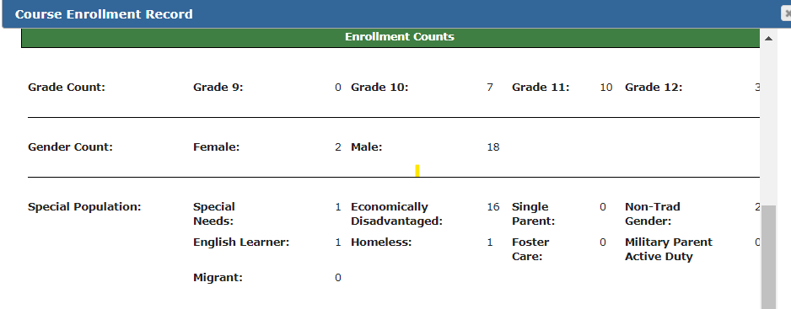
CTE Data Portal – Enrollment Details
AzEDS Student demographic details will appear in Enrollment details:
Grade level
Gender totals
Special Pops totals
Only for valid student Enrollment records successfully uploaded

Slide 57
CTE Data Portal – Participant-Concentrator
CTE IT will generate 2021 Participant-Concentrator student records after 2021 Enrollment closes for the first time

Slide 58
CTE Data Portal – Participant-Concentrator
Current Year Enrollment Credits Earned in a CTE program/courses:
Prior Year Credits Earned in a CTE program:
Used to create 2021 Participant-Concentrator student record

Slide 59
CTE Data Portal – Participant-Concentrator
CTE IT will create the 2021 Participant-Concentrator records for CTE Districts
AzEDS Student demographic details will appear in Participant-Concentrator student details:
Student SUID
Student Name
Student Birth Date
Student Gender
Student Grade Level
Student Cohort Year
Student Race and Ethnicity
Student Enrollment Status (current leave code/exit code)
Student Special Populations status including Single Parent status
Student School of Residence (current school of student)

Slide 60
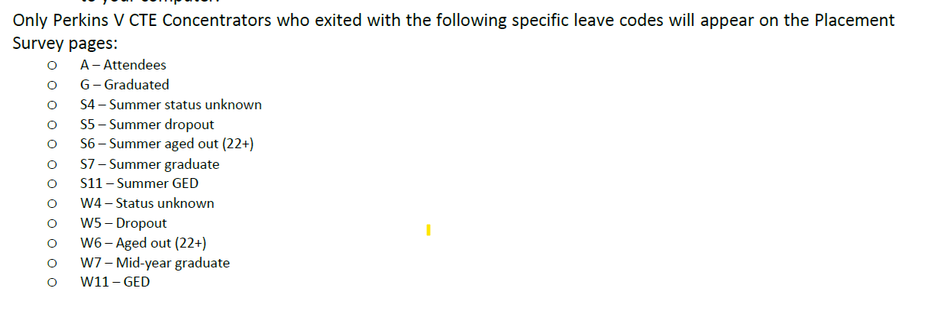
CTE Data Portal – Placement Survey
Placement Survey records are Perkins V Concentrators with specific leave codes/exit codes
Perkins V CTE Concentrator definition:
A student who has completed and passed at least 2 courses worth 1 credit each in a single career and technical education program. Internship, cooperative education, and diversified cooperative education courses are not included in defining a CTE Concentrator.
AzEDS
Leave Codes/Exit Codes
Used in Placement Surveys
AzEDS Student demographic details will appear in Placement Survey student details:
Student SUID
Student Name
Student Gender
Student Enrollment Status (current leave code/exit code)

Slide 61
CTE Data Portal – Credentials
Credentials can only be created for a student with Current Year Enrollment
Click on the Credentials tab to view or add to your district’s student credentials.
If no student credentials exist yet, credentials may only be added for existing Current Year Enrollment student records.
A student credential cannot be created by itself; it must be added (associated with) an existing Current Year Enrollment student record.
Credentials cannot be entered twice for the same student, even if a Credentials can apply to multiple CTE programs.
Credentials are associated with a course in a CTE program.
Both the Course Associated with Credential and Course Taught By must be entered.
Course Taught By is who (LEA) was teaching the course when the student took the Credential.

Slide 62
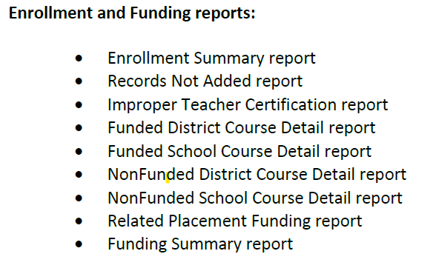
CTE Data Portal – Reports – Enrollment Reports
2021 Enrollment reports available now in the CTE Data Portal/Reports after 2021 Enrollment data successfully uploaded:
Enrollment Summary report - all valid Enrollment records by District/School/Program
Records Not Added report (errors report)
Improper Teacher Certification report (updated nightly)
Student Enrollment Summary report – disaggregated student enrollment details by District/School/Program/Course
All Funding reports for 2021 will be available after 2021 Preliminary State Priority Funding has been run

Slide 63
Questions? Thank you! Donna Kerwin CTE Business Analyst Donna.Kerwin@azed.gov (602) 542-7881

Slide 64
Participant/Concentrators
A CTE Concentrator is a student who has completed at least 2 courses worth at least 1 credit each in an approved CTE program. Internships, Cooperative Education, and Diversified Cooperative Education courses cannot be used to define a concentrator.
A CTE Participant is a student who has completed at least 1 course worth at least 1 credit in an approved CTE program in the reporting year.
Participant/Concentrator records are kept on file until a student graduates or otherwise leaves the school and are updated annually with any new credits the student earns.
A Participant/Concentrator record is the record of the credits a student has earned in a single CTE program, meaning a student can have more than one PC record.
Concentrators are used to determined which students are eligible for post-high school Placements and are used in calculating Performance Measures required by the Perkins Act.
Notes:
Let’s take a closer look at the upload template itself – I have here the “articulated template” from our website.

Slide 65
Credentials
When students attain or attempt to attain an industry recognized credential for their CTE program, enter the attempt and the results of the attempt into the CTE Data Portal.
Credential data is used in Performance Measures reporting (5S1)
2021 Credentials
2021
123456789
John
Doe
Sample High School
2021
987654321
Jane
Doe
Sample High School
2021

Slide 66
Credentials
When students attain or attempt to attain an industry recognized credential for their CTE program, enter the attempt and the results of the attempt into the CTE Data Portal.
Credential data is used in Performance Measures reporting (5S1)
2021 Credentials
2021
123456789
John
Doe
Sample High School
2021
987654321
Jane
Doe
Sample High School
2021
Notes:
Let’s take a closer look at the upload template itself – I have here the “articulated template” from our website.

Slide 67
Credentials
When students attain or attempt to attain an industry recognized credential for their CTE program, enter the attempt and the results of the attempt into the CTE Data Portal.
Credential data is used in Performance Measures reporting (5S1)
2021 Credentials
2021
123456789
John
Doe
Sample High School
2021
987654321
Jane
Doe
Sample High School
2021
Notes:
Let’s take a closer look at the upload template itself – I have here the “articulated template” from our website.

Slide 68
Credentials
2021 Credentials
123456789
Jane Doe
01/01/1900
Sample School
Sample School
Credential details page shows programs in which student is enrolled.
Once a program (and course) is selected, the “Credential Name” populates with approved, industry recognized credentials.
Enter all credential attempts, even if the student didn’t earn the credential. (Use the “Yes” or “No” radio buttons in the “Passed” column to indicate if the attempt was successful).

Slide 69
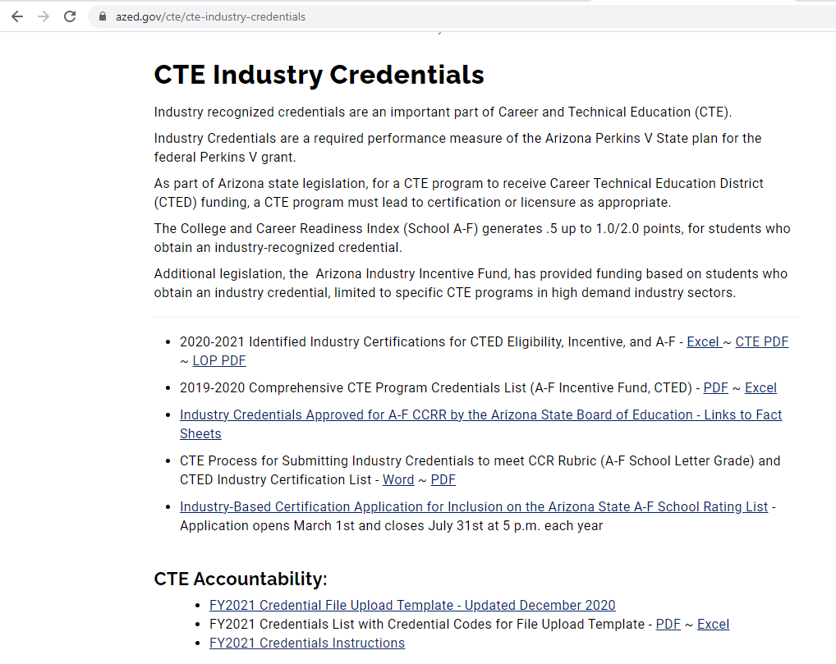
Credentials
www.azed.gov/cte/cte-industry-credentials
Get list of approved credentials by program
Get Credential Upload template
Get list of Credential codes (used with upload template)

Slide 70
Credentials
Always check the website – Credential Codes change from year to year!
Always use the most up-to-date template downloaded from the website.

Slide 71
What’s Next
When | What
March 1 – June 15 | Coherent Sequence, Fall/Spring Enrollment, Exemptions Requests, and Industry Credentials open in CTE Data Portal.
June 15 | 2020 Placement Survey closes
June 16 – July 15 | Participant/Concentrators open in CTE Data Portal
~ July 16 – August 15 | Coherent Sequence, Fall/Spring Enrollment, and 2020 Placement Survey RE-OPEN for corrections/adjustment
August 16 – August 31 | Participants/Concentrators RE-OPEN for corrections/adjustment
September 1 | Final Funding is calculated for Priority grant allocations
September 30 | FY 2021 Credentials closes
This is where we are now.

Slide 72
CTE Accountability Team
Team Member | Email | Phone
Tammie Chavez | Tammie.Chavez@azed.gov | 602-542-3839
Janet Silao | Janet.Silao@azed.gov | 602-542-5485
Donna Kerwin | Donna.Kerwin@azed.gov | 602-542-7881
Samuel Irvin | Samuel.Irvin@azed.gov | 602-364-1946
https://www.azed.gov/cte/cte-data-portal-information
Questions?

